Slide 1
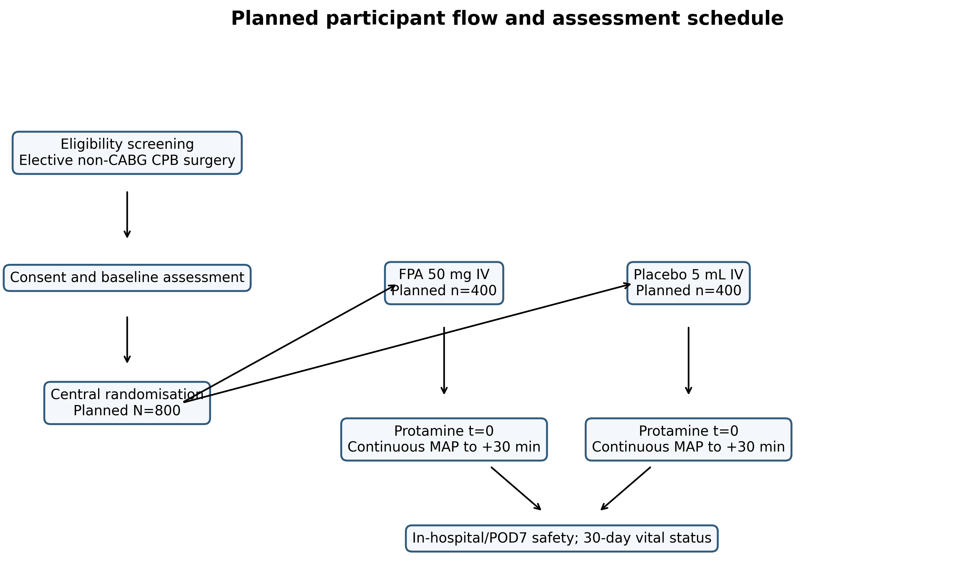
Figure 1. Planned participant flow and assessment schedule
Planned flow for the IF-U-PLEASE II trial. Counts are design targets and do not represent enrolment. CPB, cardiopulmonary bypass; FPA, flurbiprofen axetil; MAP, mean arterial pressure; POD, postoperative day.

Slide 2
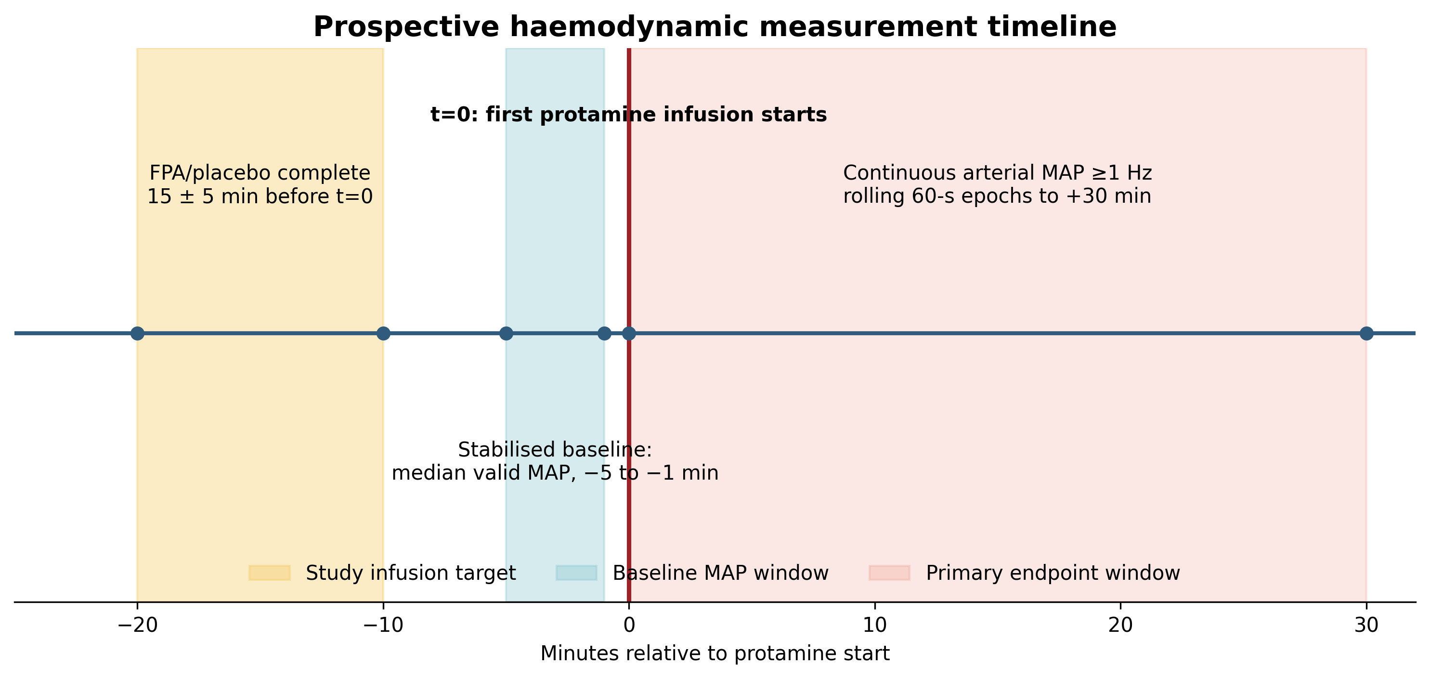
Figure 2. Prospective haemodynamic measurement timeline
Study-drug administration, stabilised baseline, protamine time zero, and the 30-minute primary endpoint window. FPA, flurbiprofen axetil; MAP, mean arterial pressure.

