Slide 1
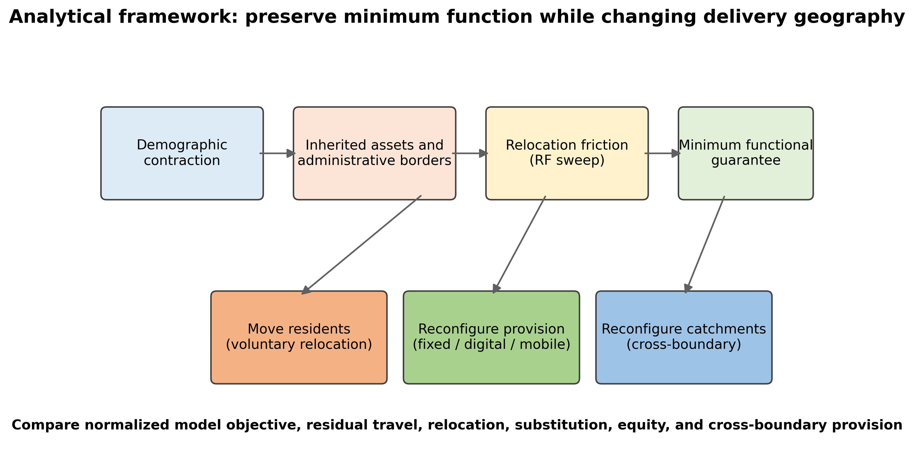
Figure 1. Analytical framework
All labels and source notes are editable; the plotted panel is programmatically generated.

Slide 2
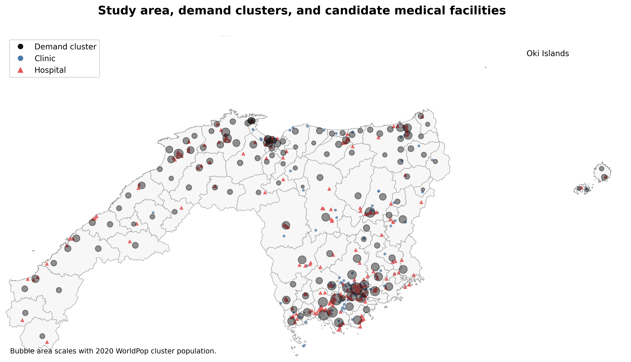
Figure 2. Study area and empirical inputs
All labels and source notes are editable; the plotted panel is programmatically generated.

Slide 3
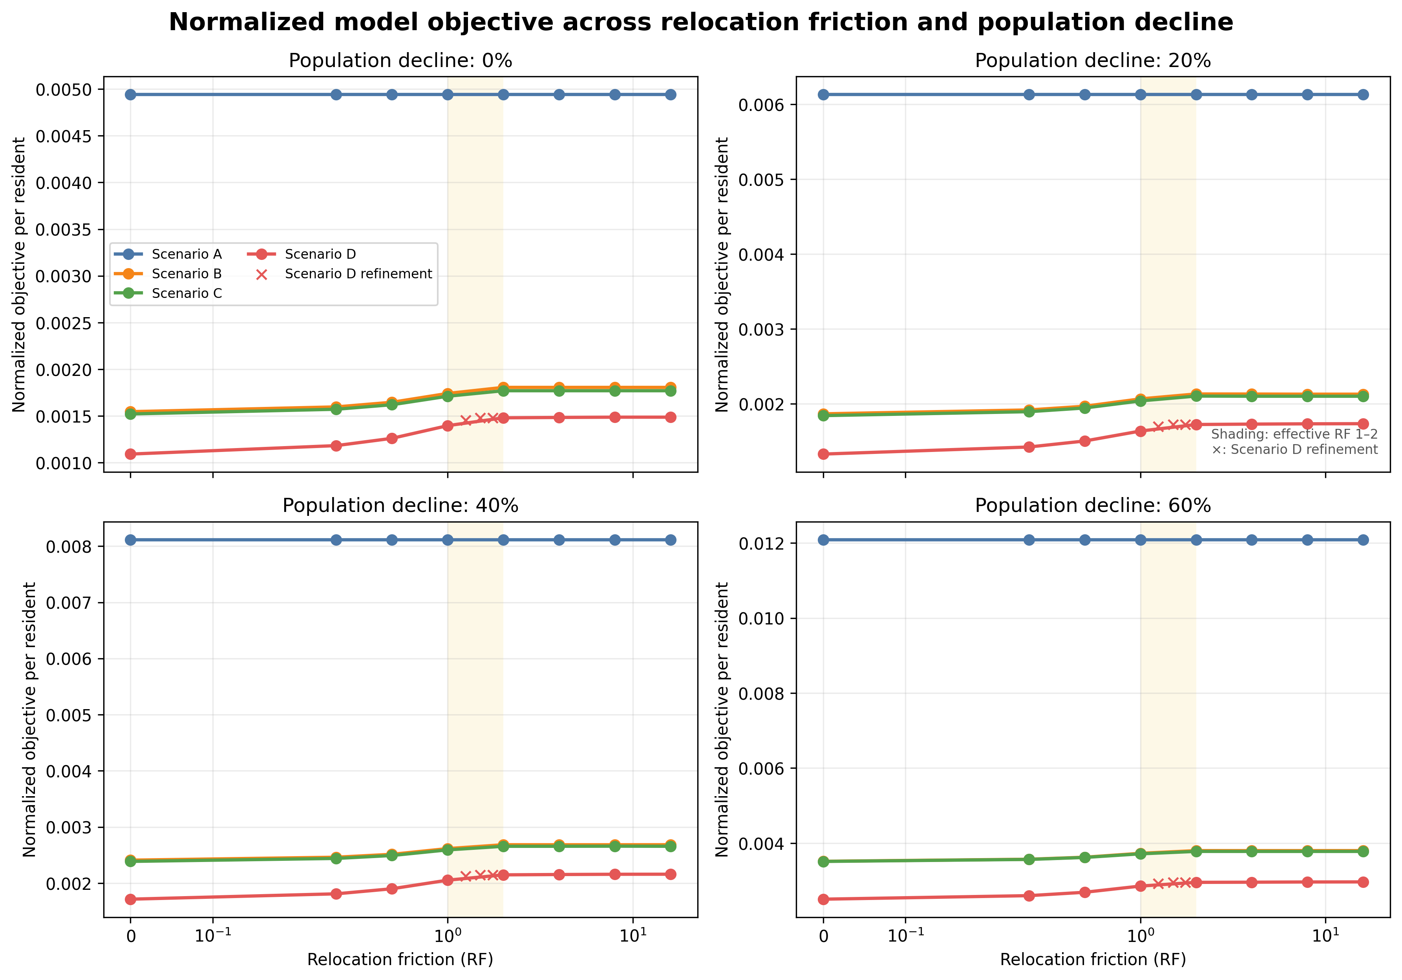
Figure 3. Normalized objective across RF and depopulation
All labels and source notes are editable; the plotted panel is programmatically generated.

Slide 4
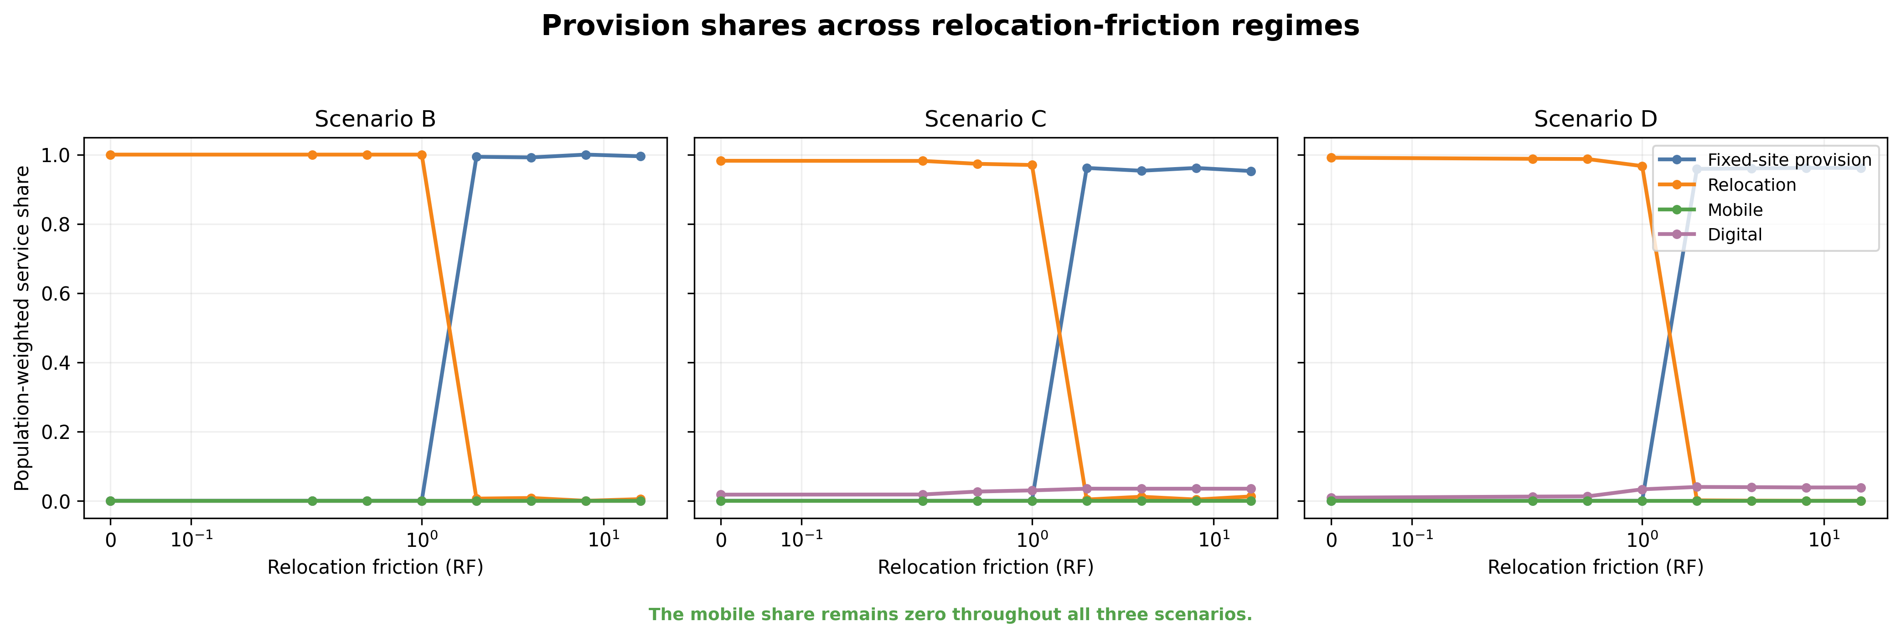
Figure 4. Strategy substitution
All labels and source notes are editable; the plotted panel is programmatically generated.

Slide 5
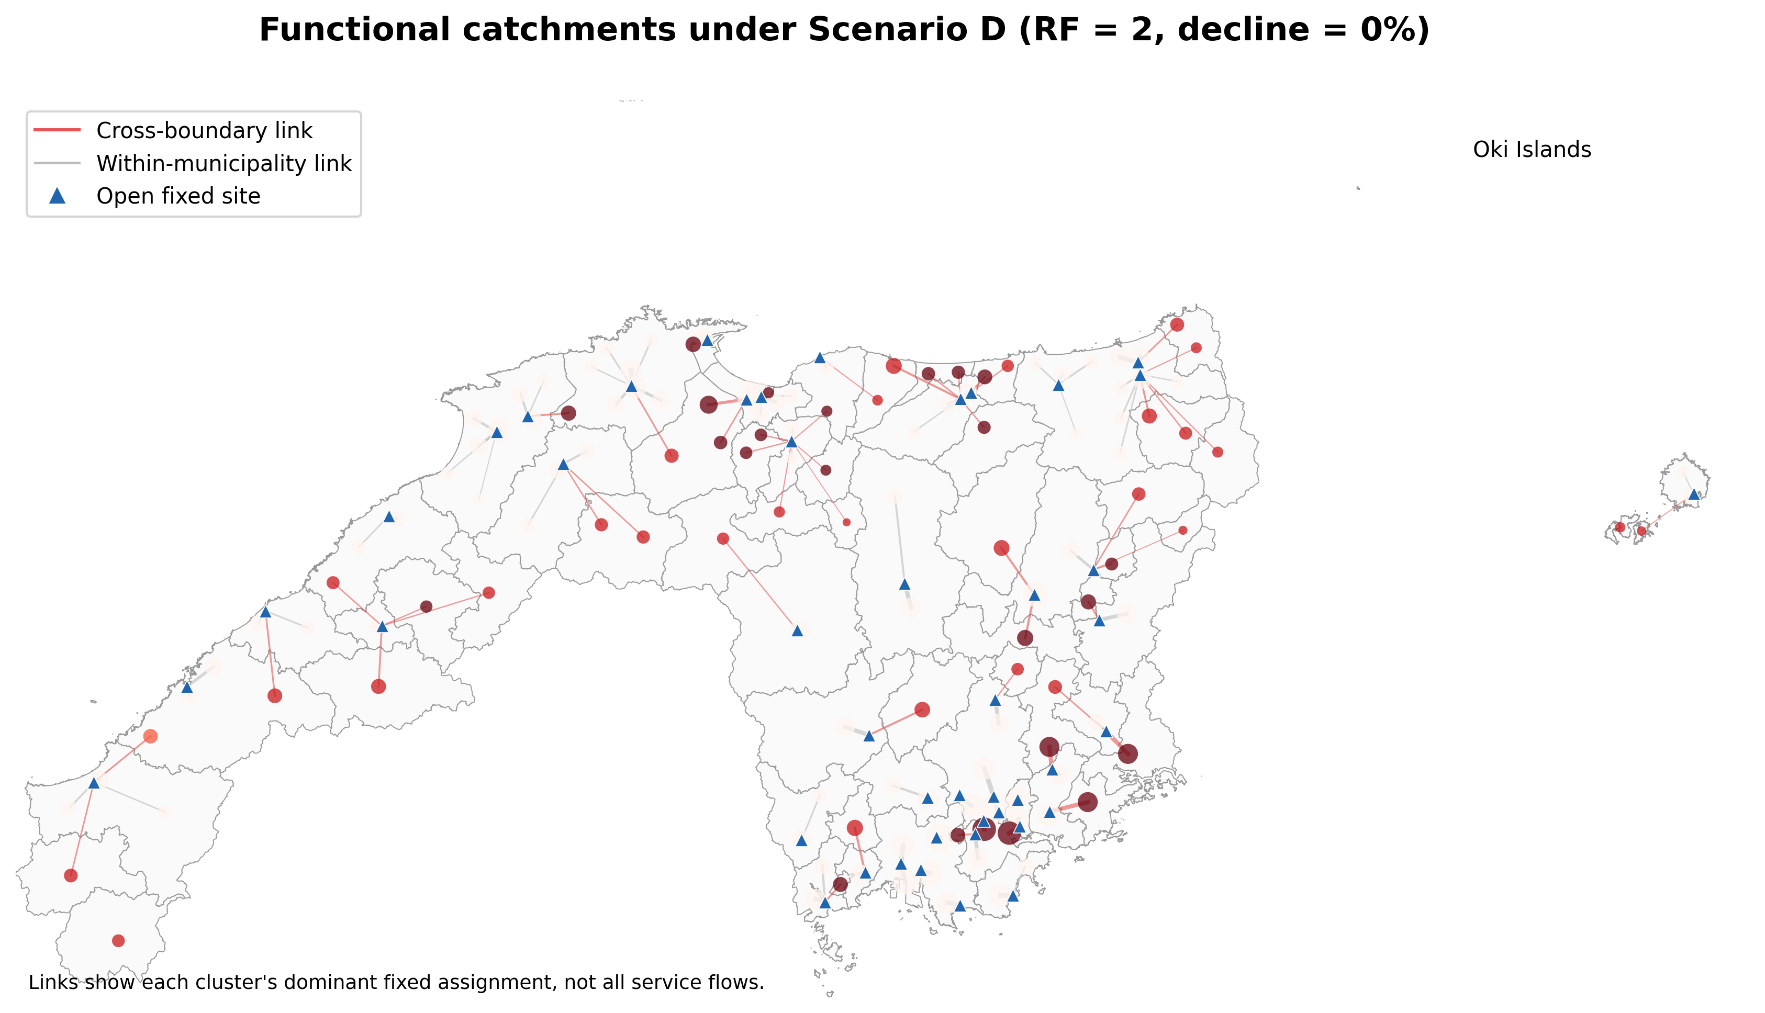
Figure 5. Functional catchments
All labels and source notes are editable; the plotted panel is programmatically generated.

Slide 6
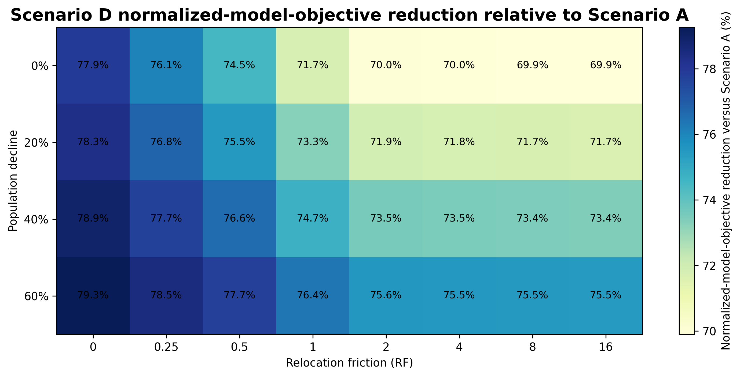
Figure 6. Normalized-objective reduction
All labels and source notes are editable; the plotted panel is programmatically generated.

Slide 7
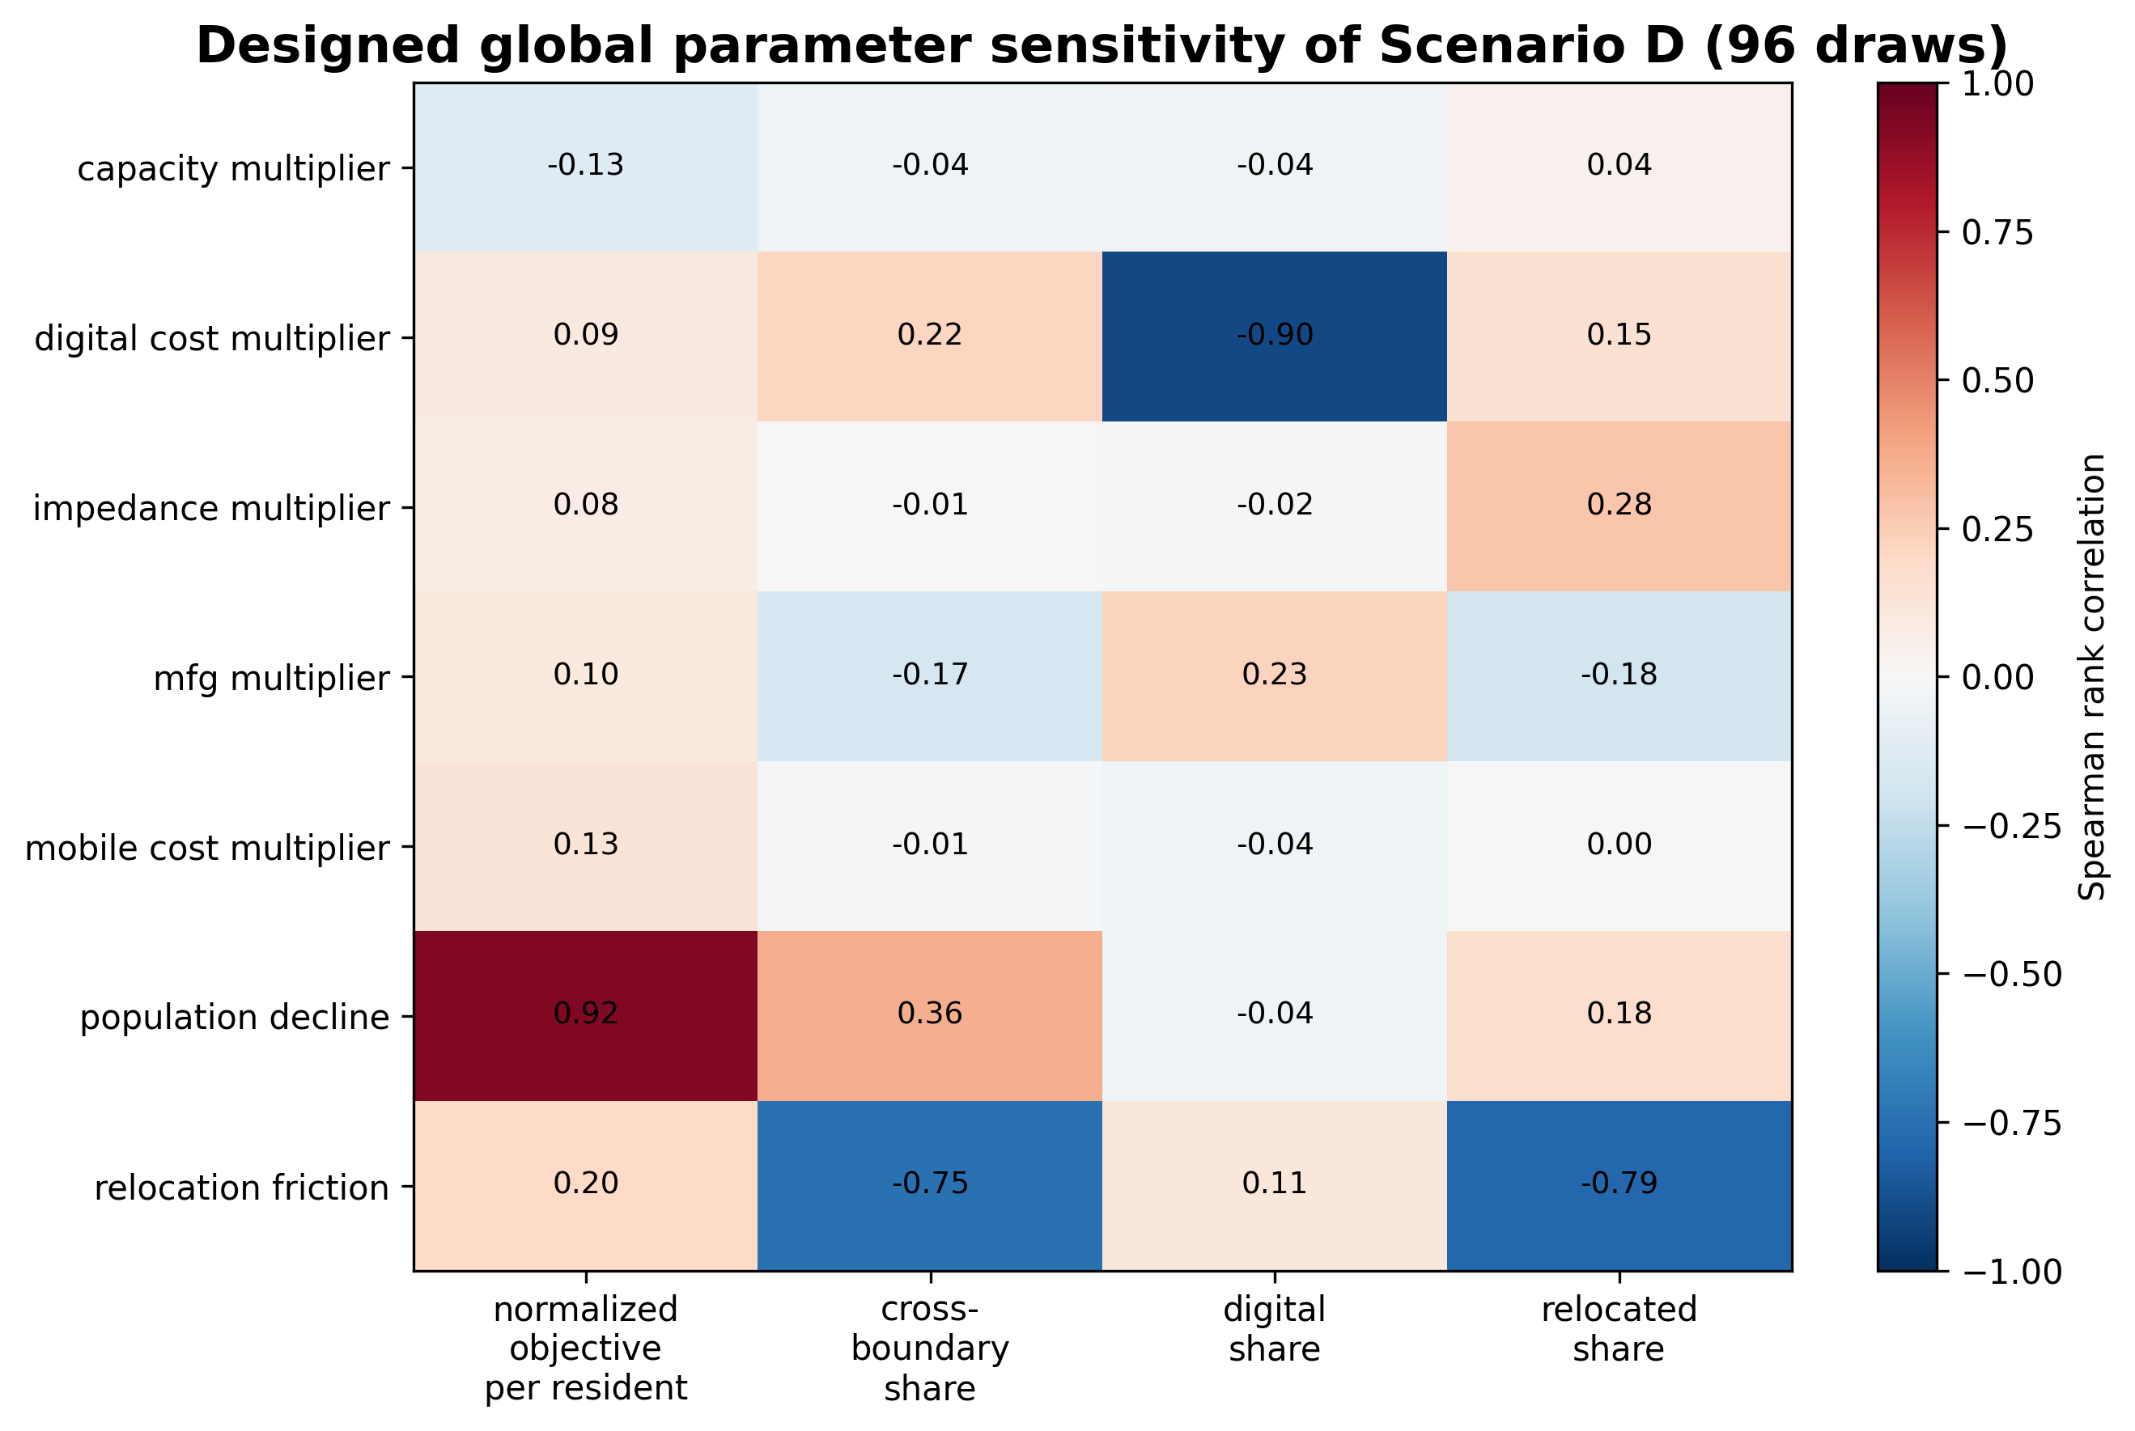
Figure 7. Designed global parameter sensitivity
All labels and source notes are editable; the plotted panel is programmatically generated.

