Slide 1
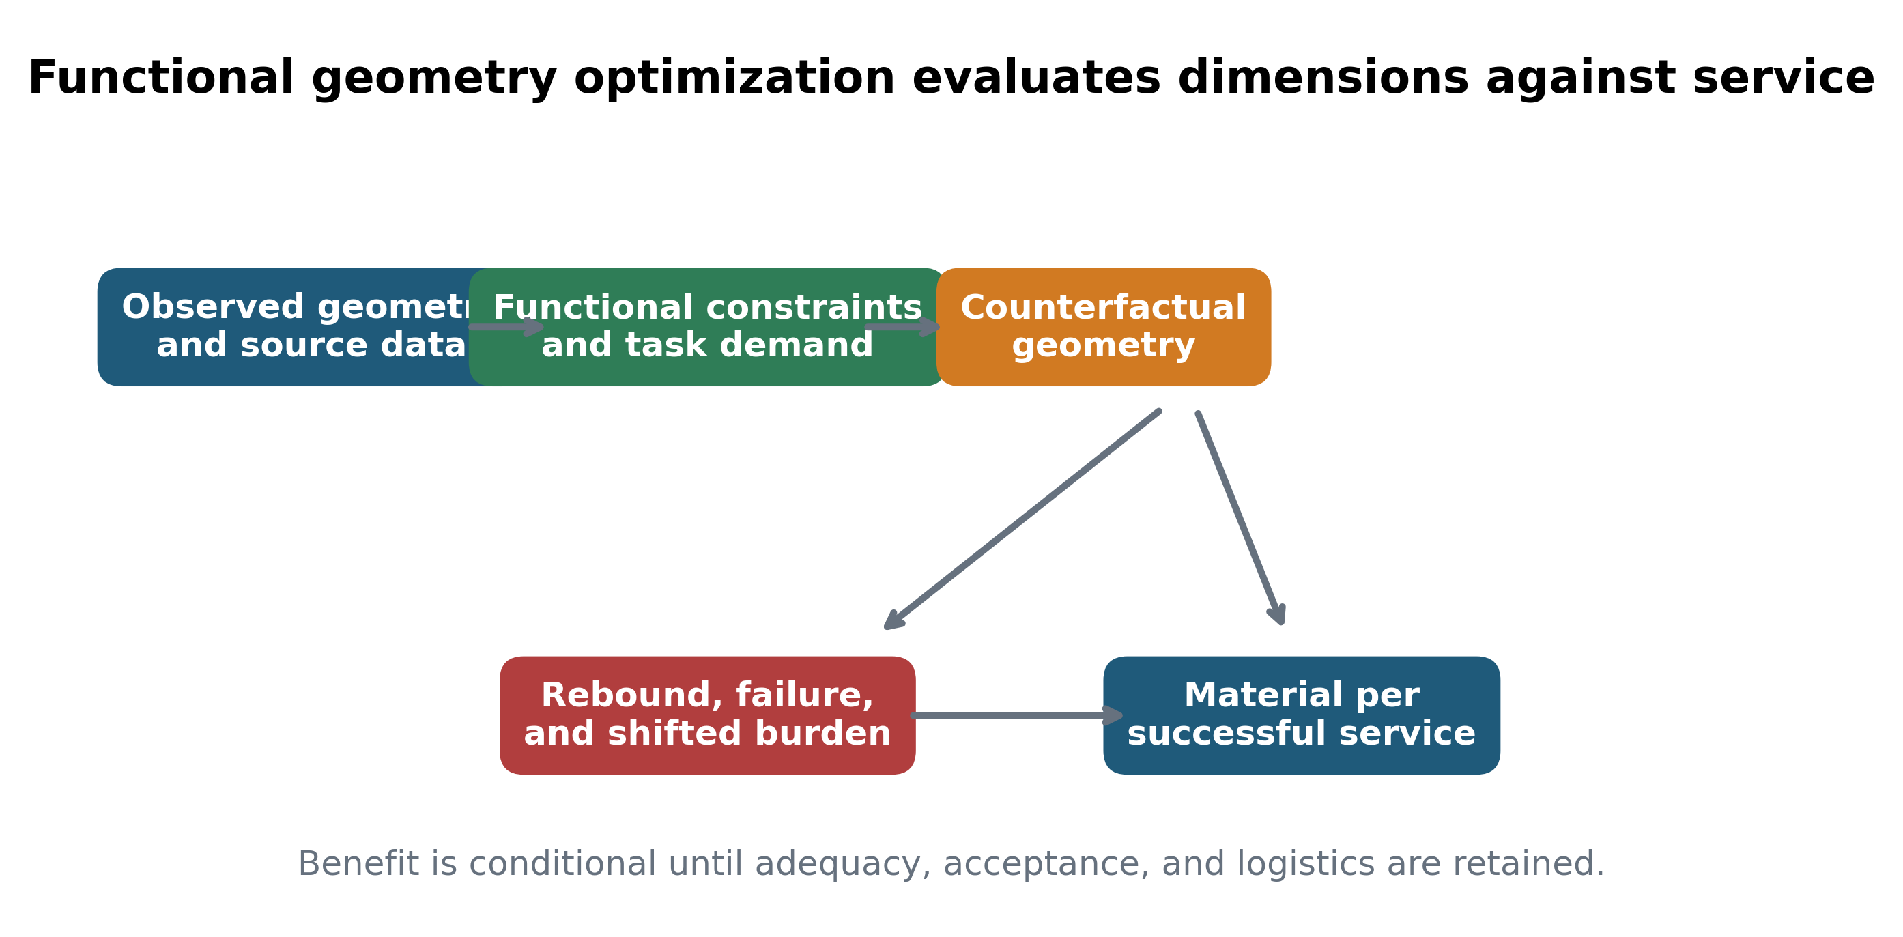
Figure 1
Functional geometry optimization framework. Geometry is evaluated against functional constraints before response, process loss, and shifted burden determine material per successful service.

Slide 2
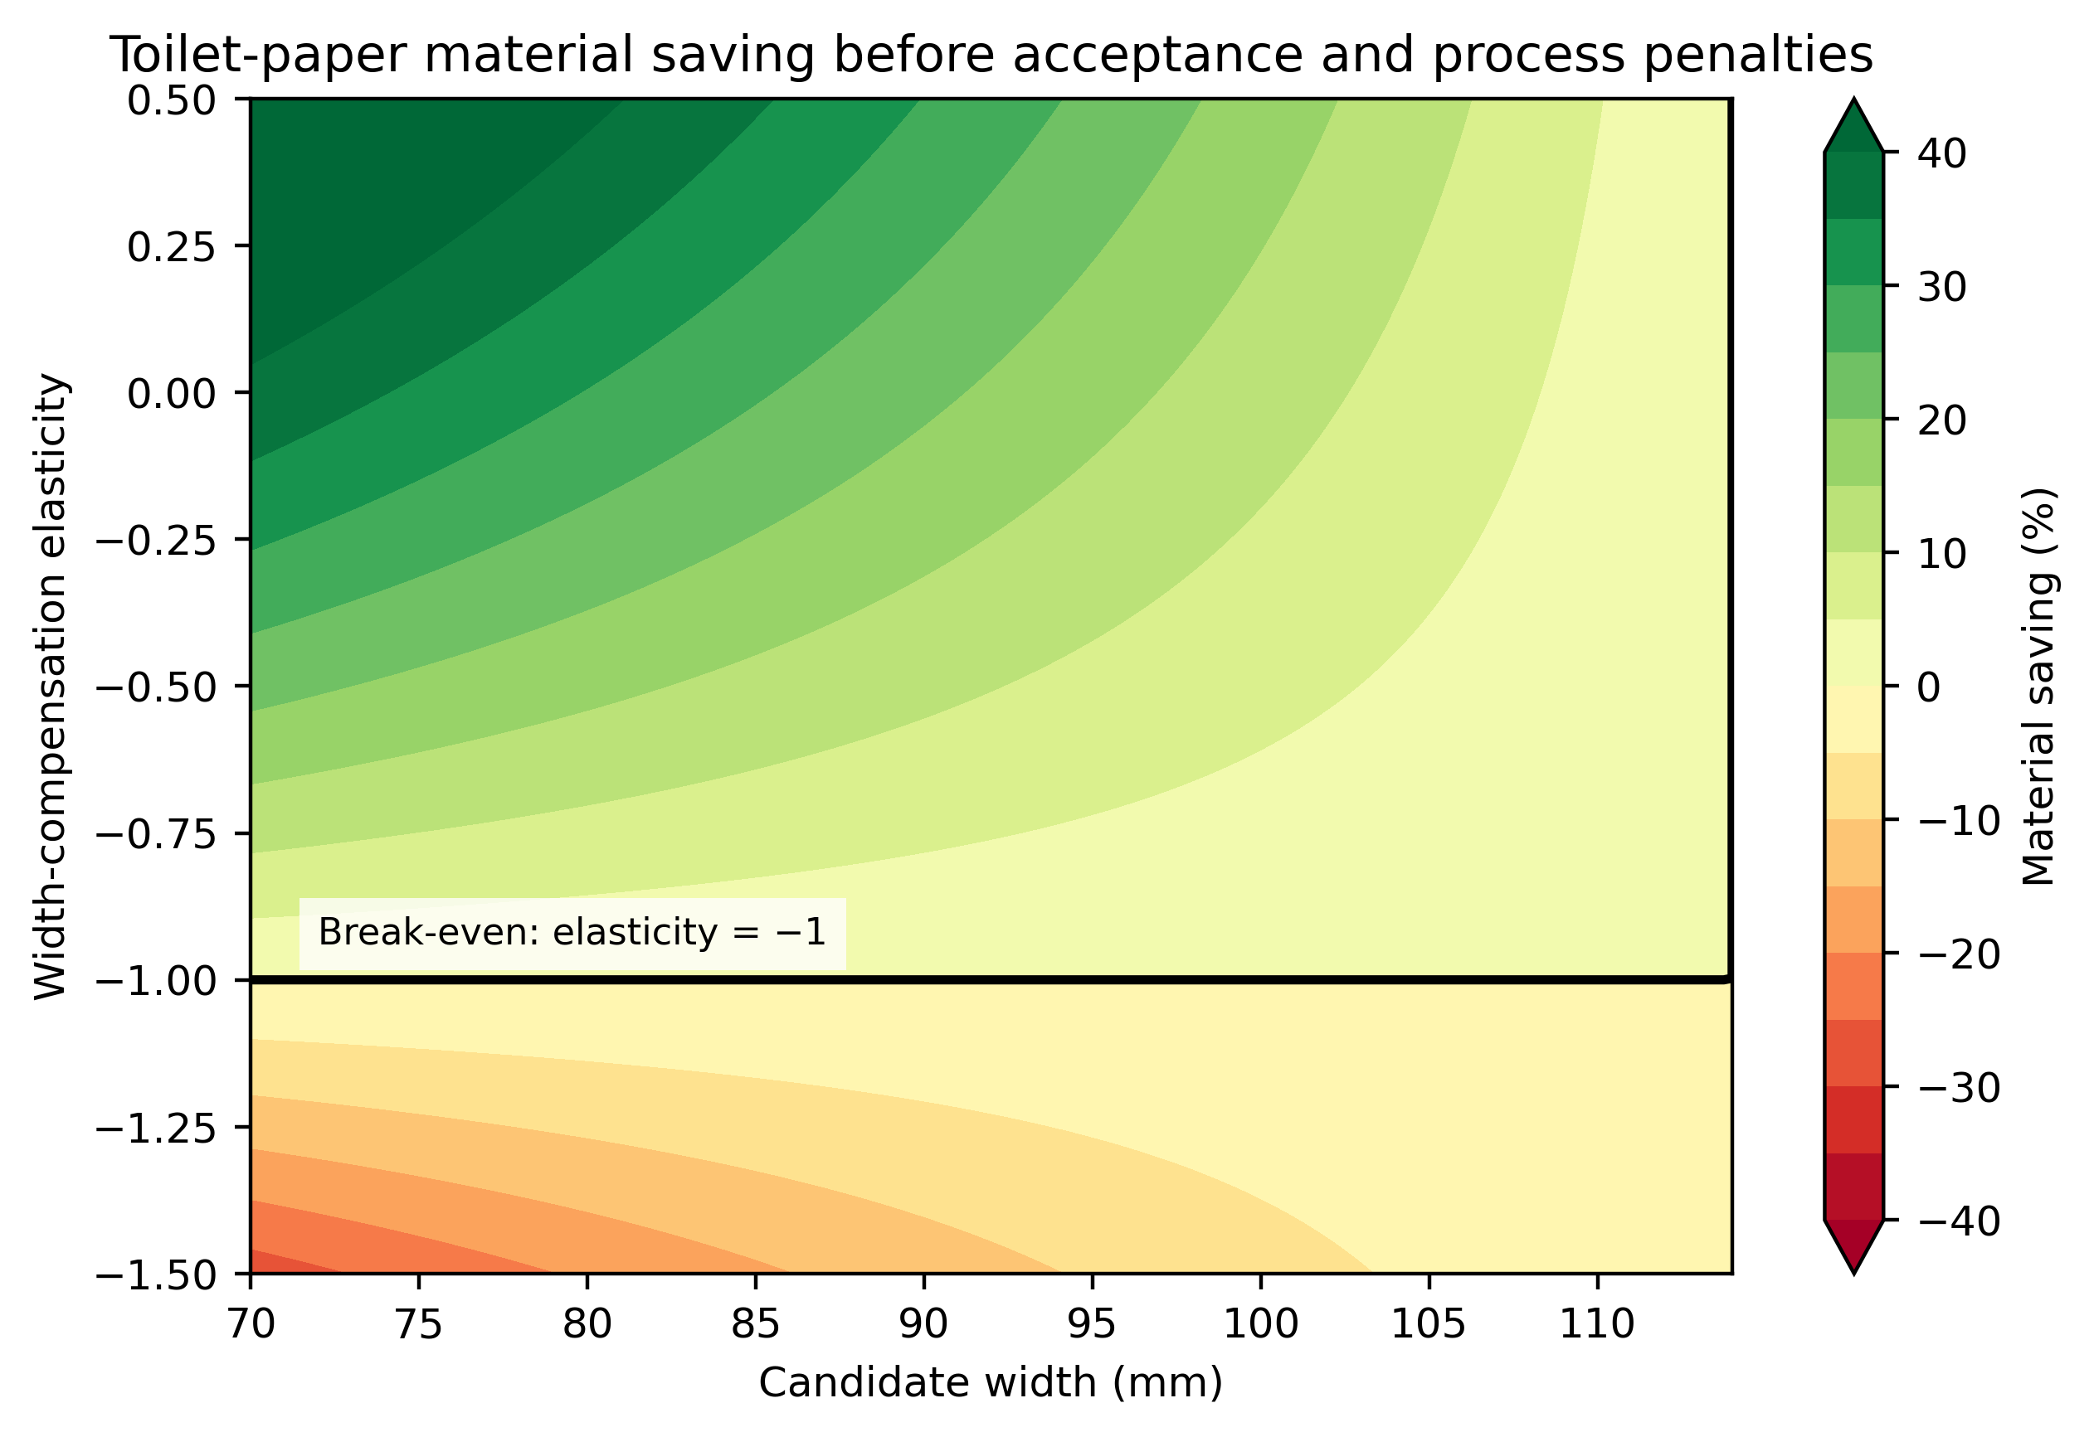
Figure 2
Toilet-paper material-saving surface as a function of candidate width and width-compensation elasticity. The black boundary marks zero saving.

Slide 3
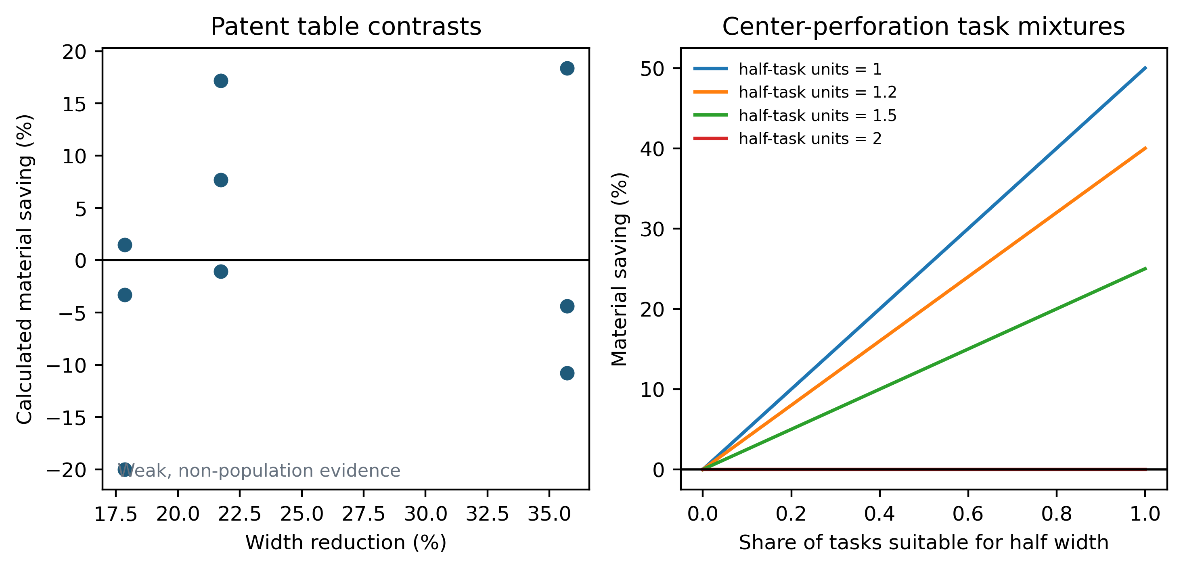
Figure 3
Patent-table width contrasts and hypothetical center-perforation task mixtures. Patent contrasts are weak non-population evidence.

Slide 4
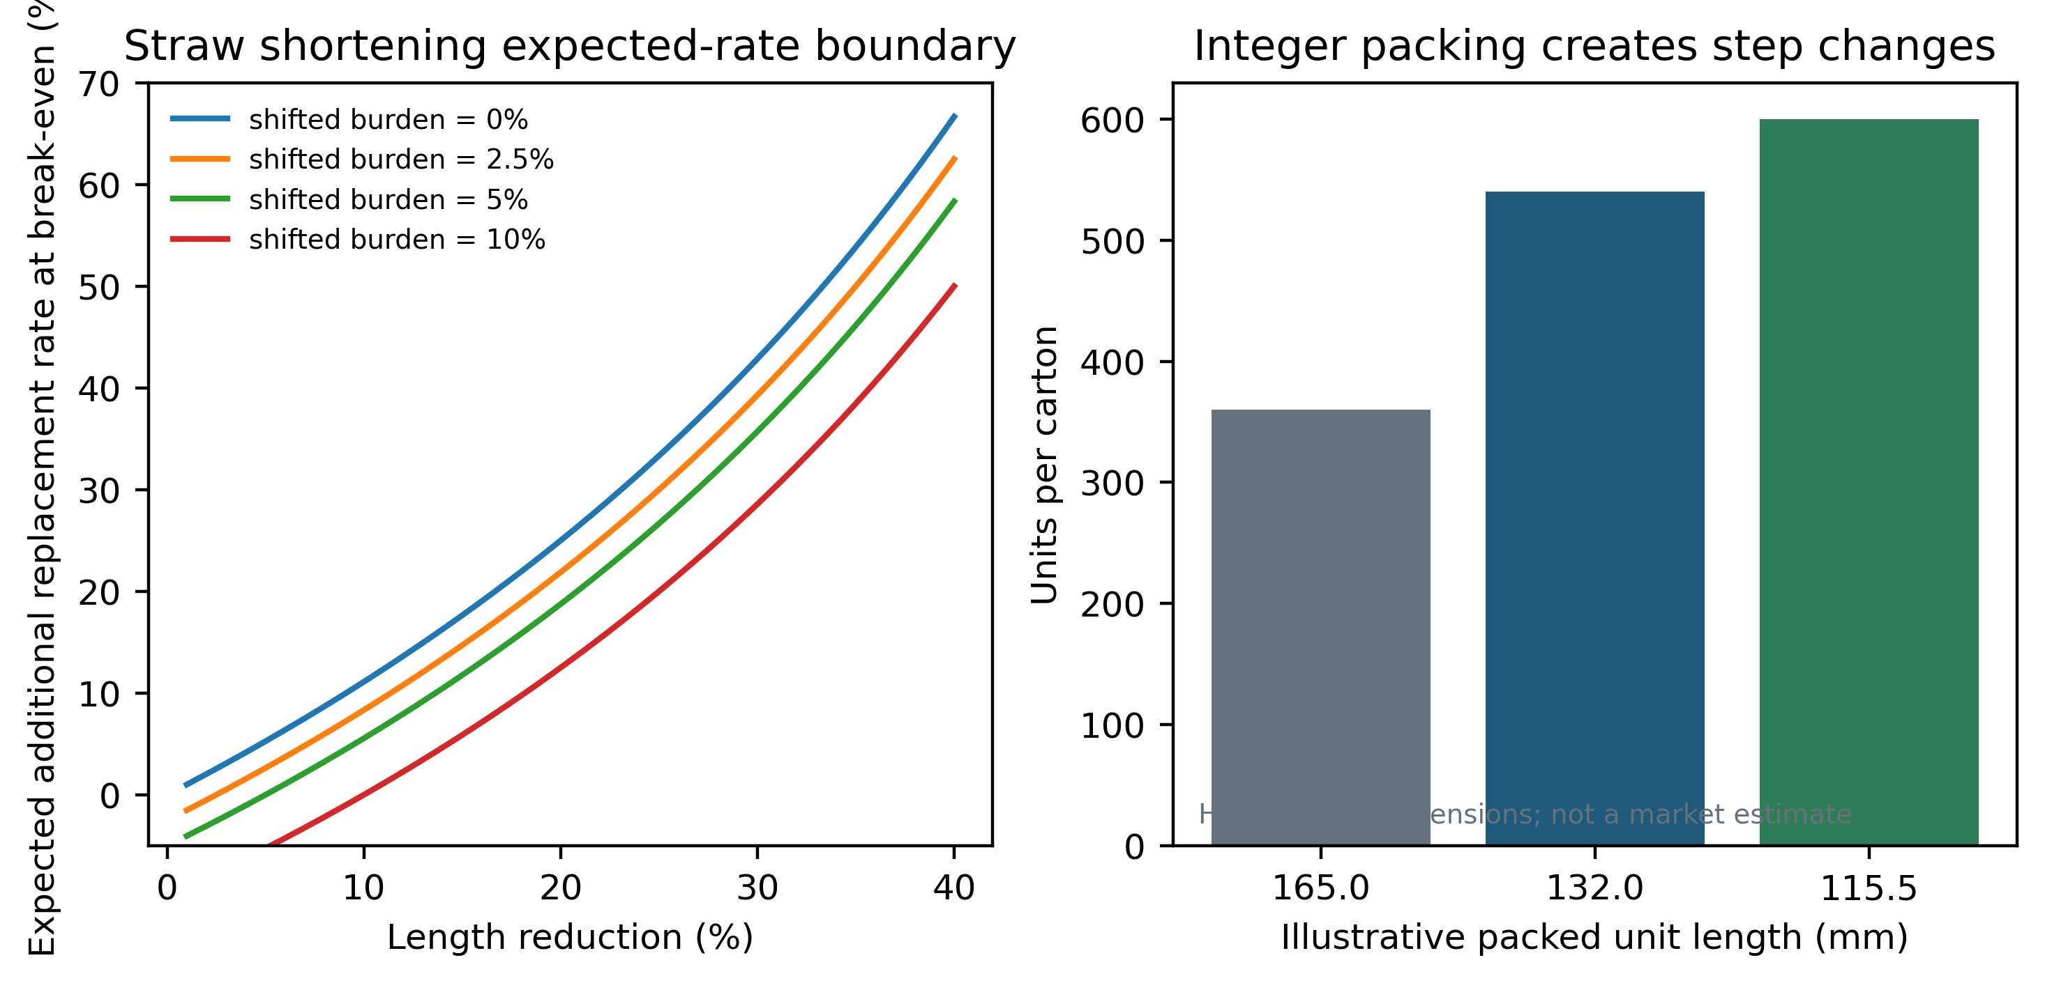
Figure 4
Straw shortening expected-additional-replacement-rate boundary and an illustrative integer-packing example. Packing dimensions are hypothetical.

Slide 5
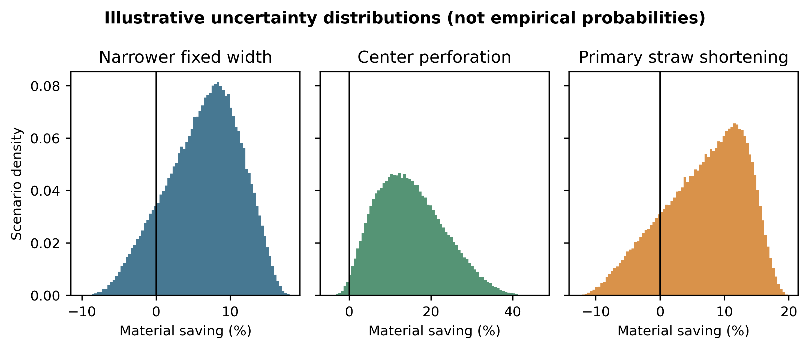
Figure 5
Configured scenario uncertainty distributions. Densities and positive proportions are not empirical probabilities.

