Slide 1
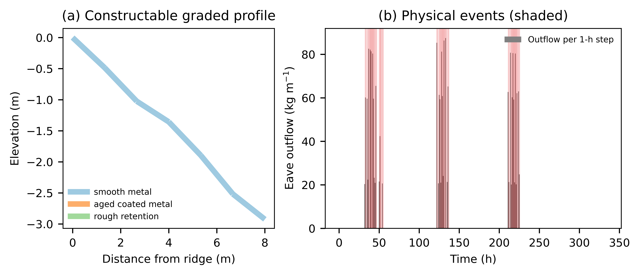
Figure 1
Figure 1. (a) Example constructable graded profile coloured by surface class. (b) Eave outflow per 1-h step in the maritime warming winter with physical events shaded.

Slide 2
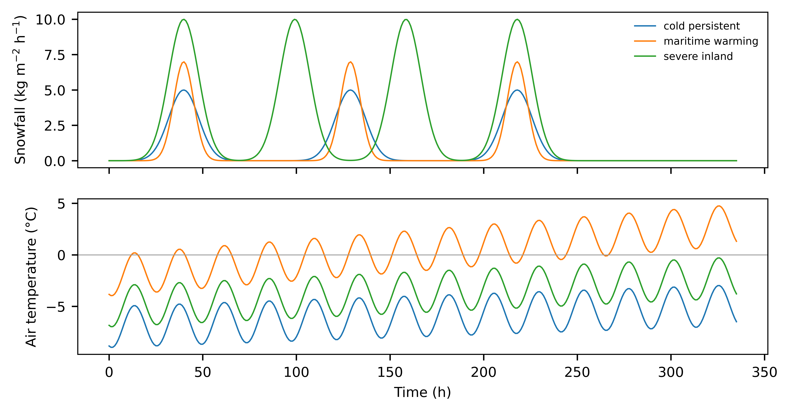
Figure 2
Figure 2. Synthetic forcing: snowfall rate and air temperature for the three winters.

Slide 3
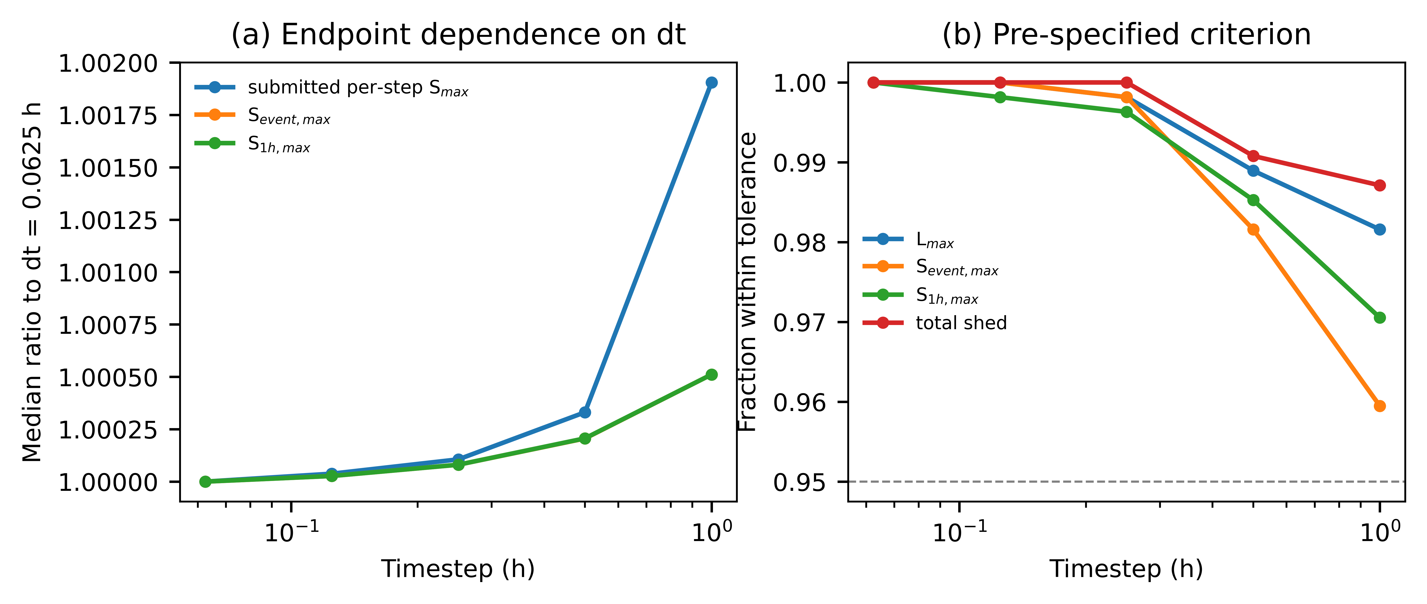
Figure 3
Figure 3. (a) Median ratio of release endpoints to the dt = 0.0625 h reference. (b) Fraction of design-winter pairs within the pre-specified tolerance; dashed line is the 95% criterion.

Slide 4
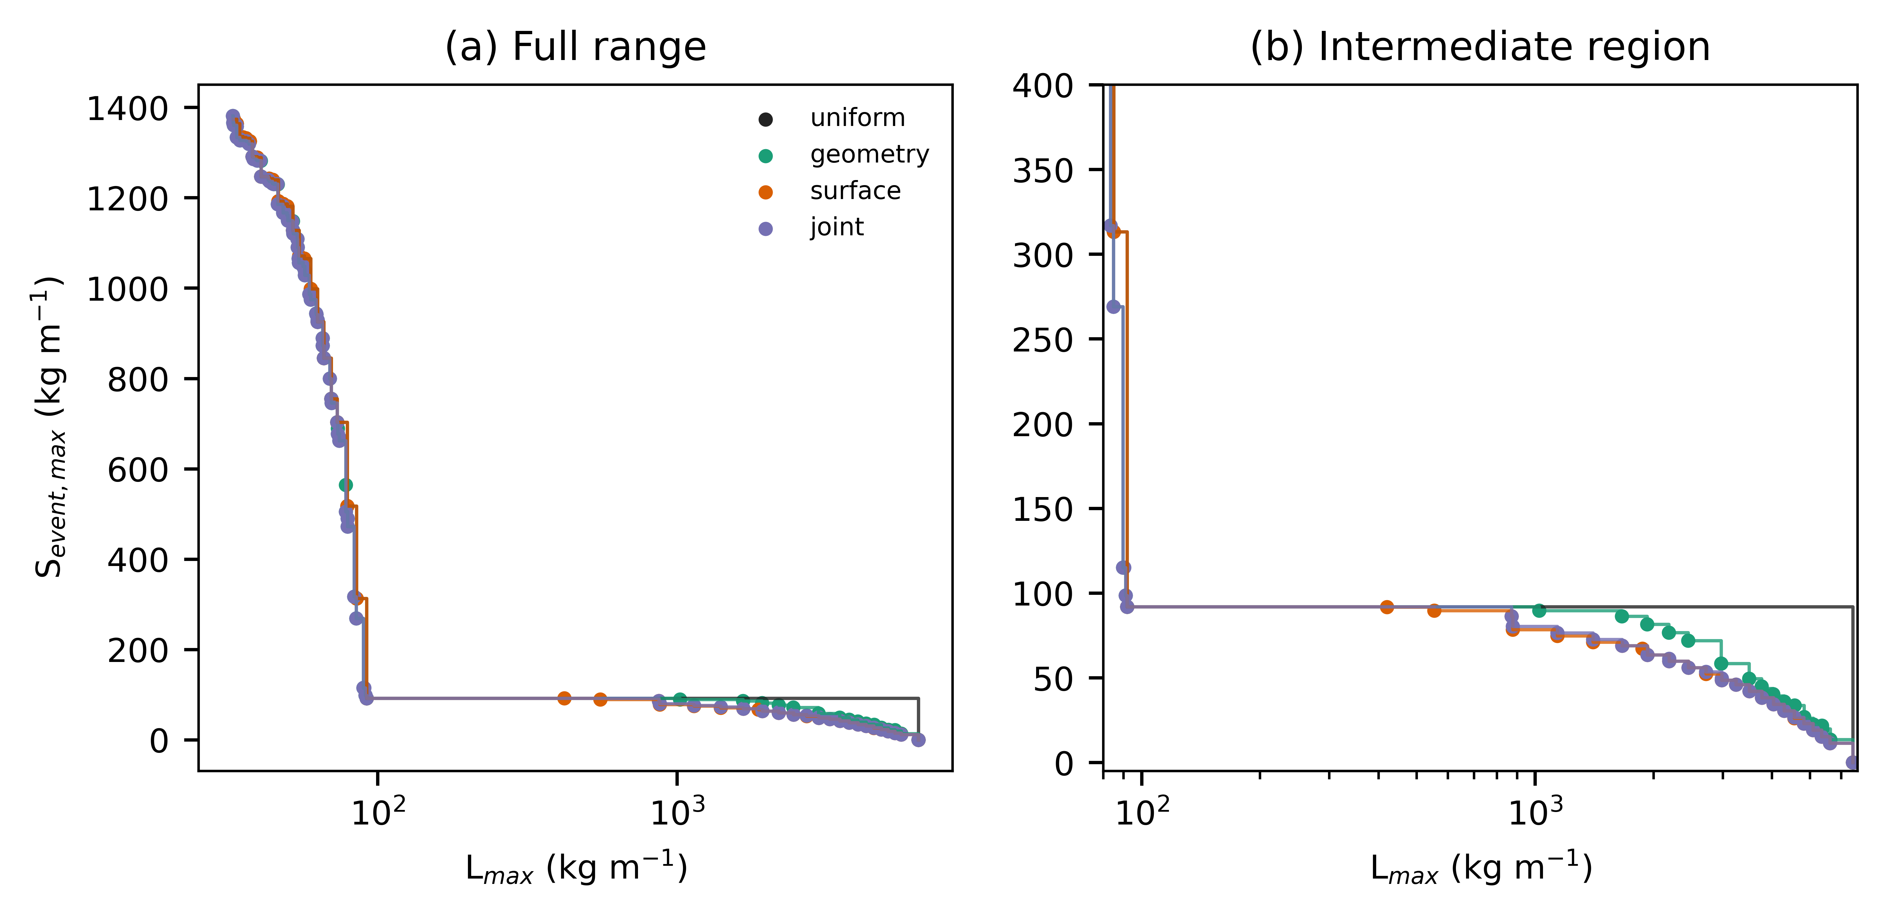
Figure 4
Figure 4. Constructable Pareto fronts for uniform, geometry-only, surface-only and joint sets: (a) full range, (b) intermediate region between the uniform shedding and retention regimes.

Slide 5
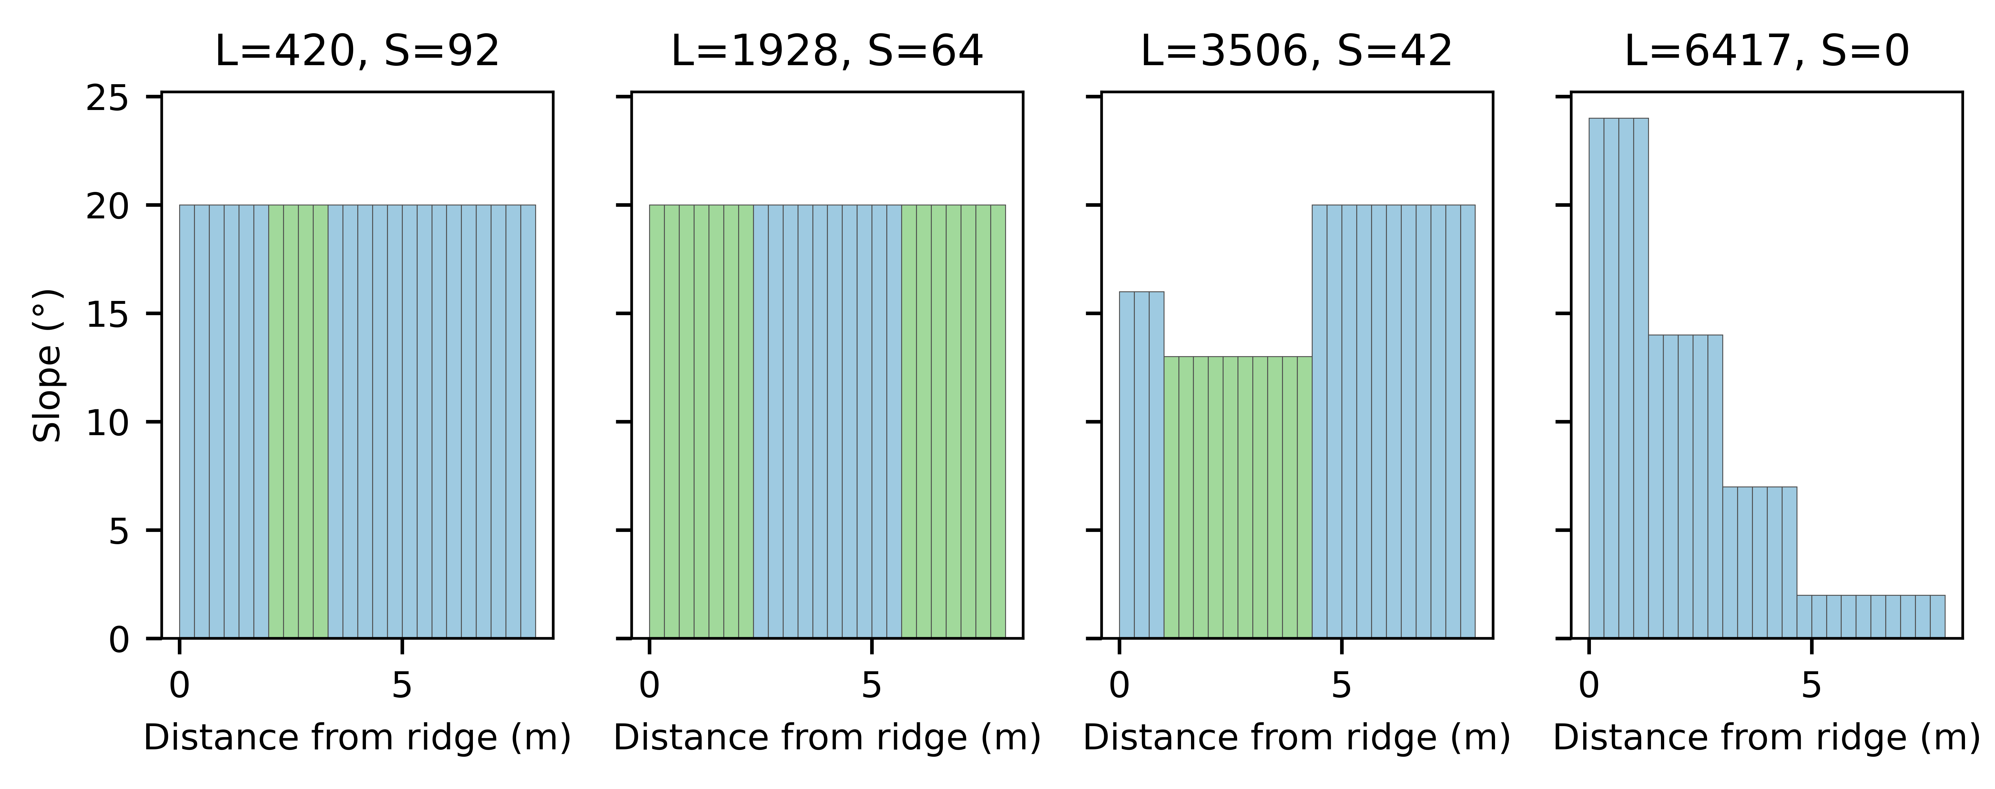
Figure 5
Figure 5. Slope profiles of representative intermediate graded designs; bar colours denote surface class.

Slide 6
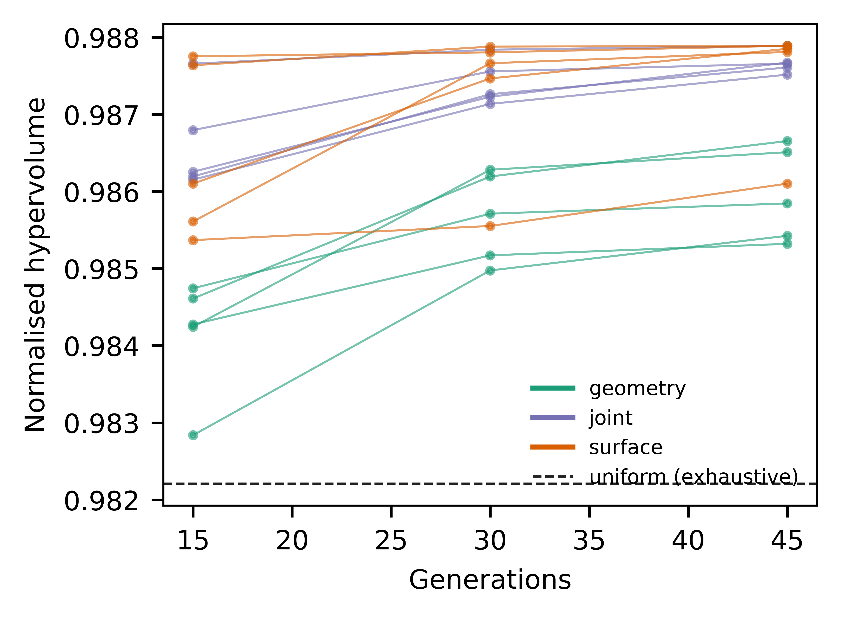
Figure 6
Figure 6. Normalised hypervolume after 15, 30 and 45 generations for each seed; dashed line is the exhaustive uniform set.

Slide 7
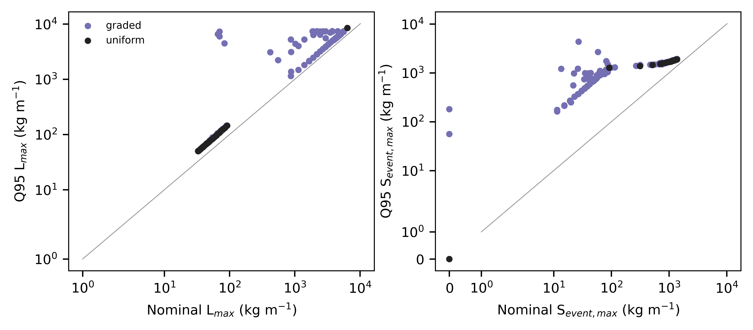
Figure 7
Figure 7. Nominal versus Q95 outcomes under 250 common uncertainty draws for all nondominated designs.

Slide 8
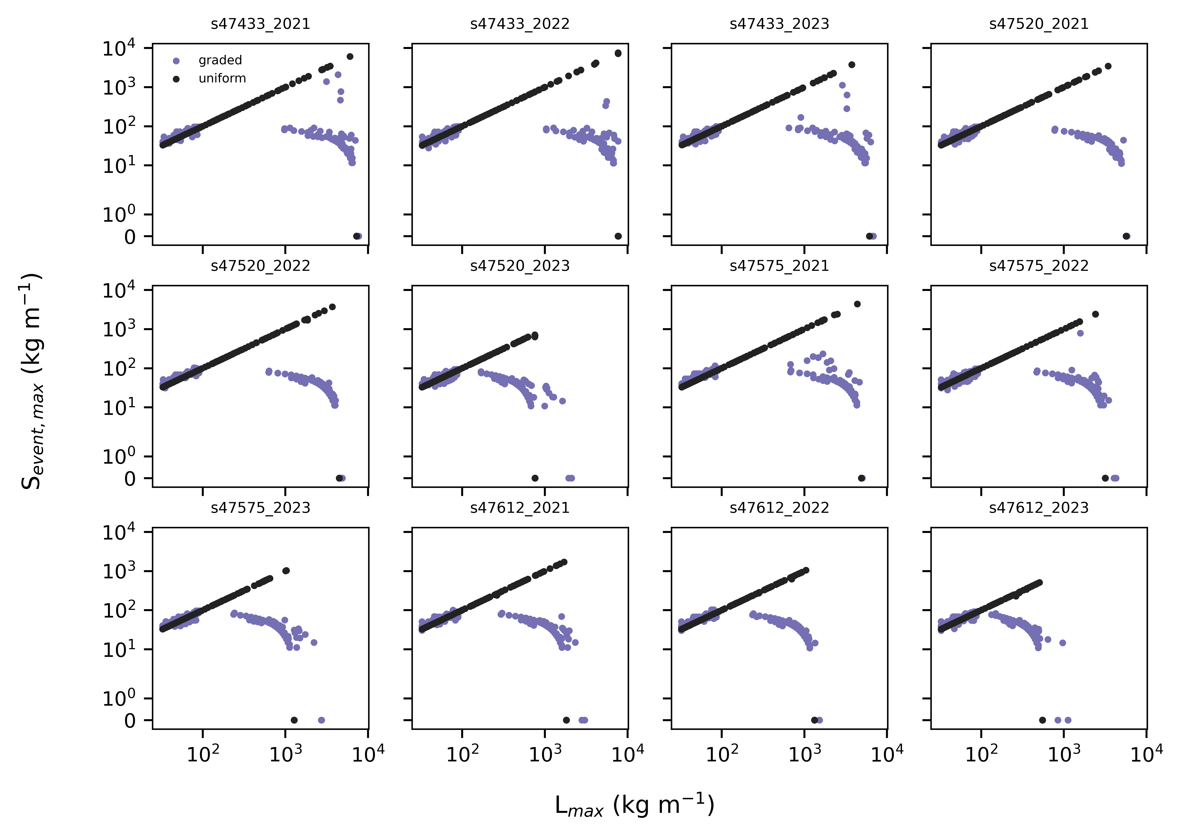
Figure 8
Figure 8. Objective pairs of uniform and nondominated graded designs under observed JMA station-winters (daily totals spread uniformly over 24 h).

