Slide 1
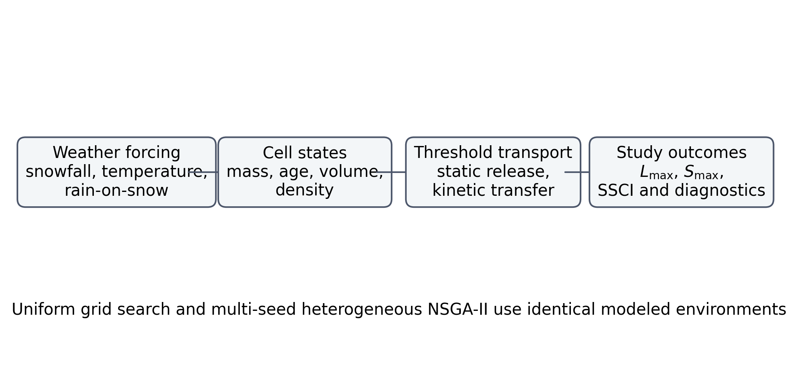
Figure 1
Figure 1. Reduced-order model and comparative optimization workflow.

Slide 2
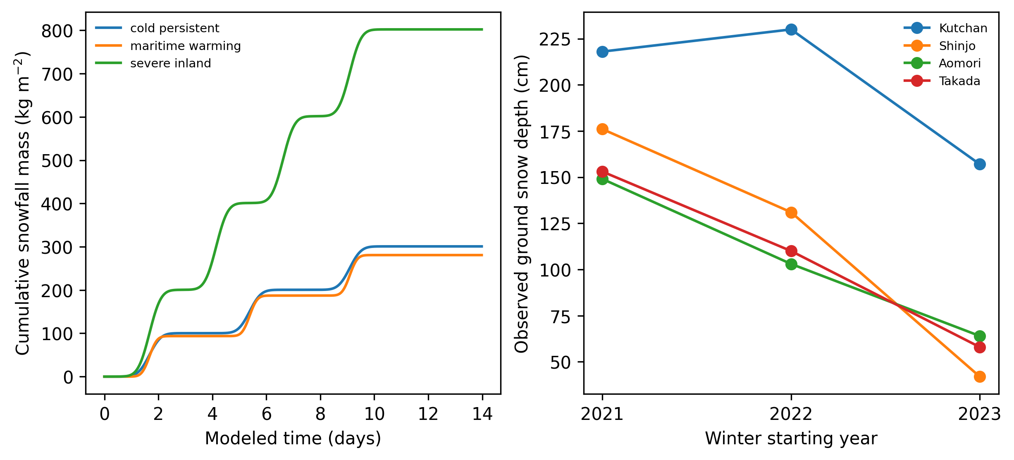
Figure 2
Figure 2. Synthetic snowfall scenarios and JMA ground-snow contexts.

Slide 3
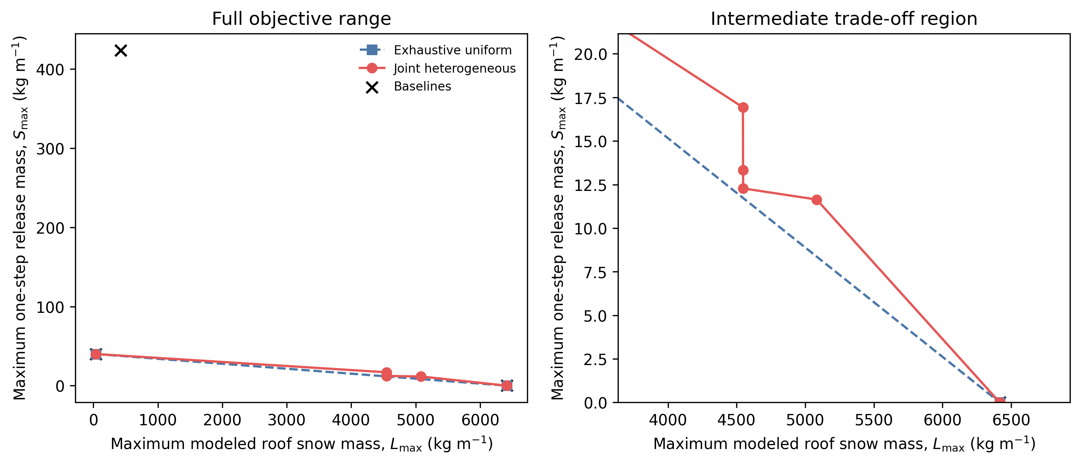
Figure 3
Figure 3. Unique objective pairs for the exhaustive uniform and heuristic joint sets, shown over the full range and the intermediate trade-off region.

Slide 4
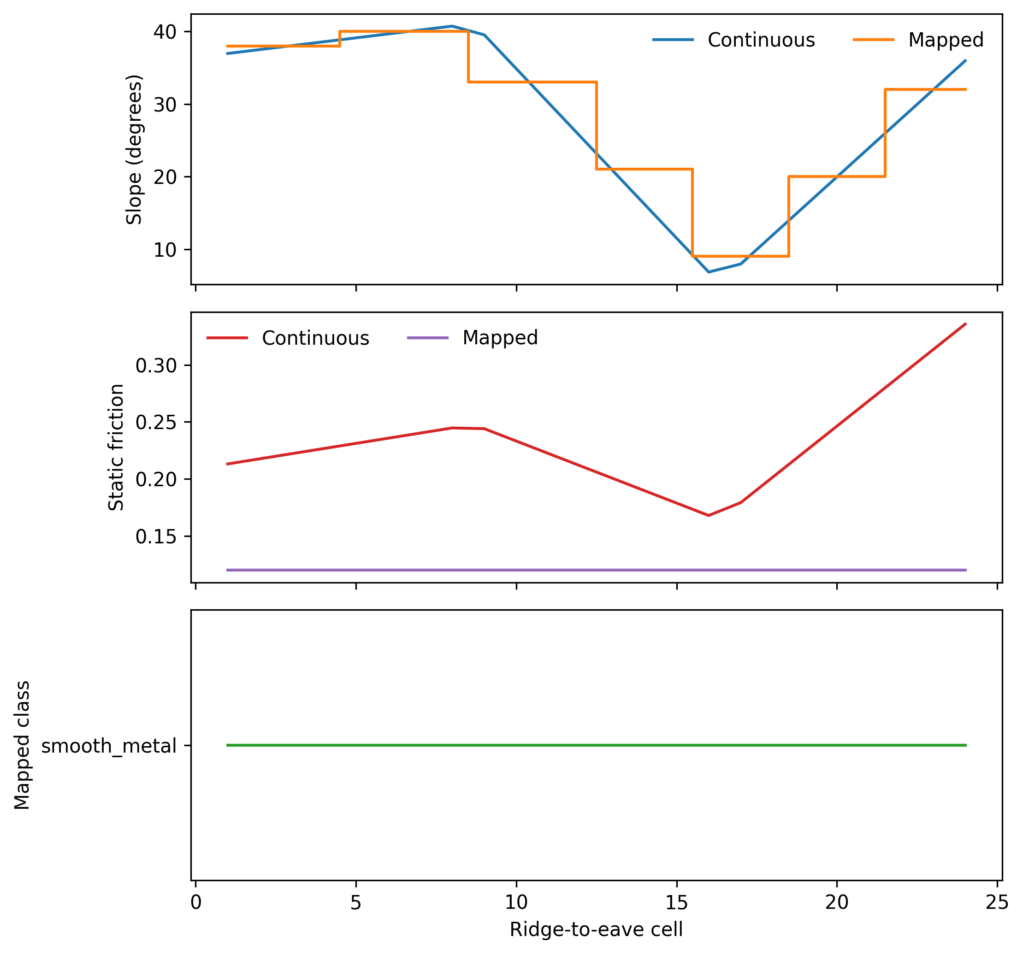
Figure 4
Figure 4. Continuous joint-knee slope and friction profiles compared with the post hoc segmented, generic-class mapping.

Slide 5
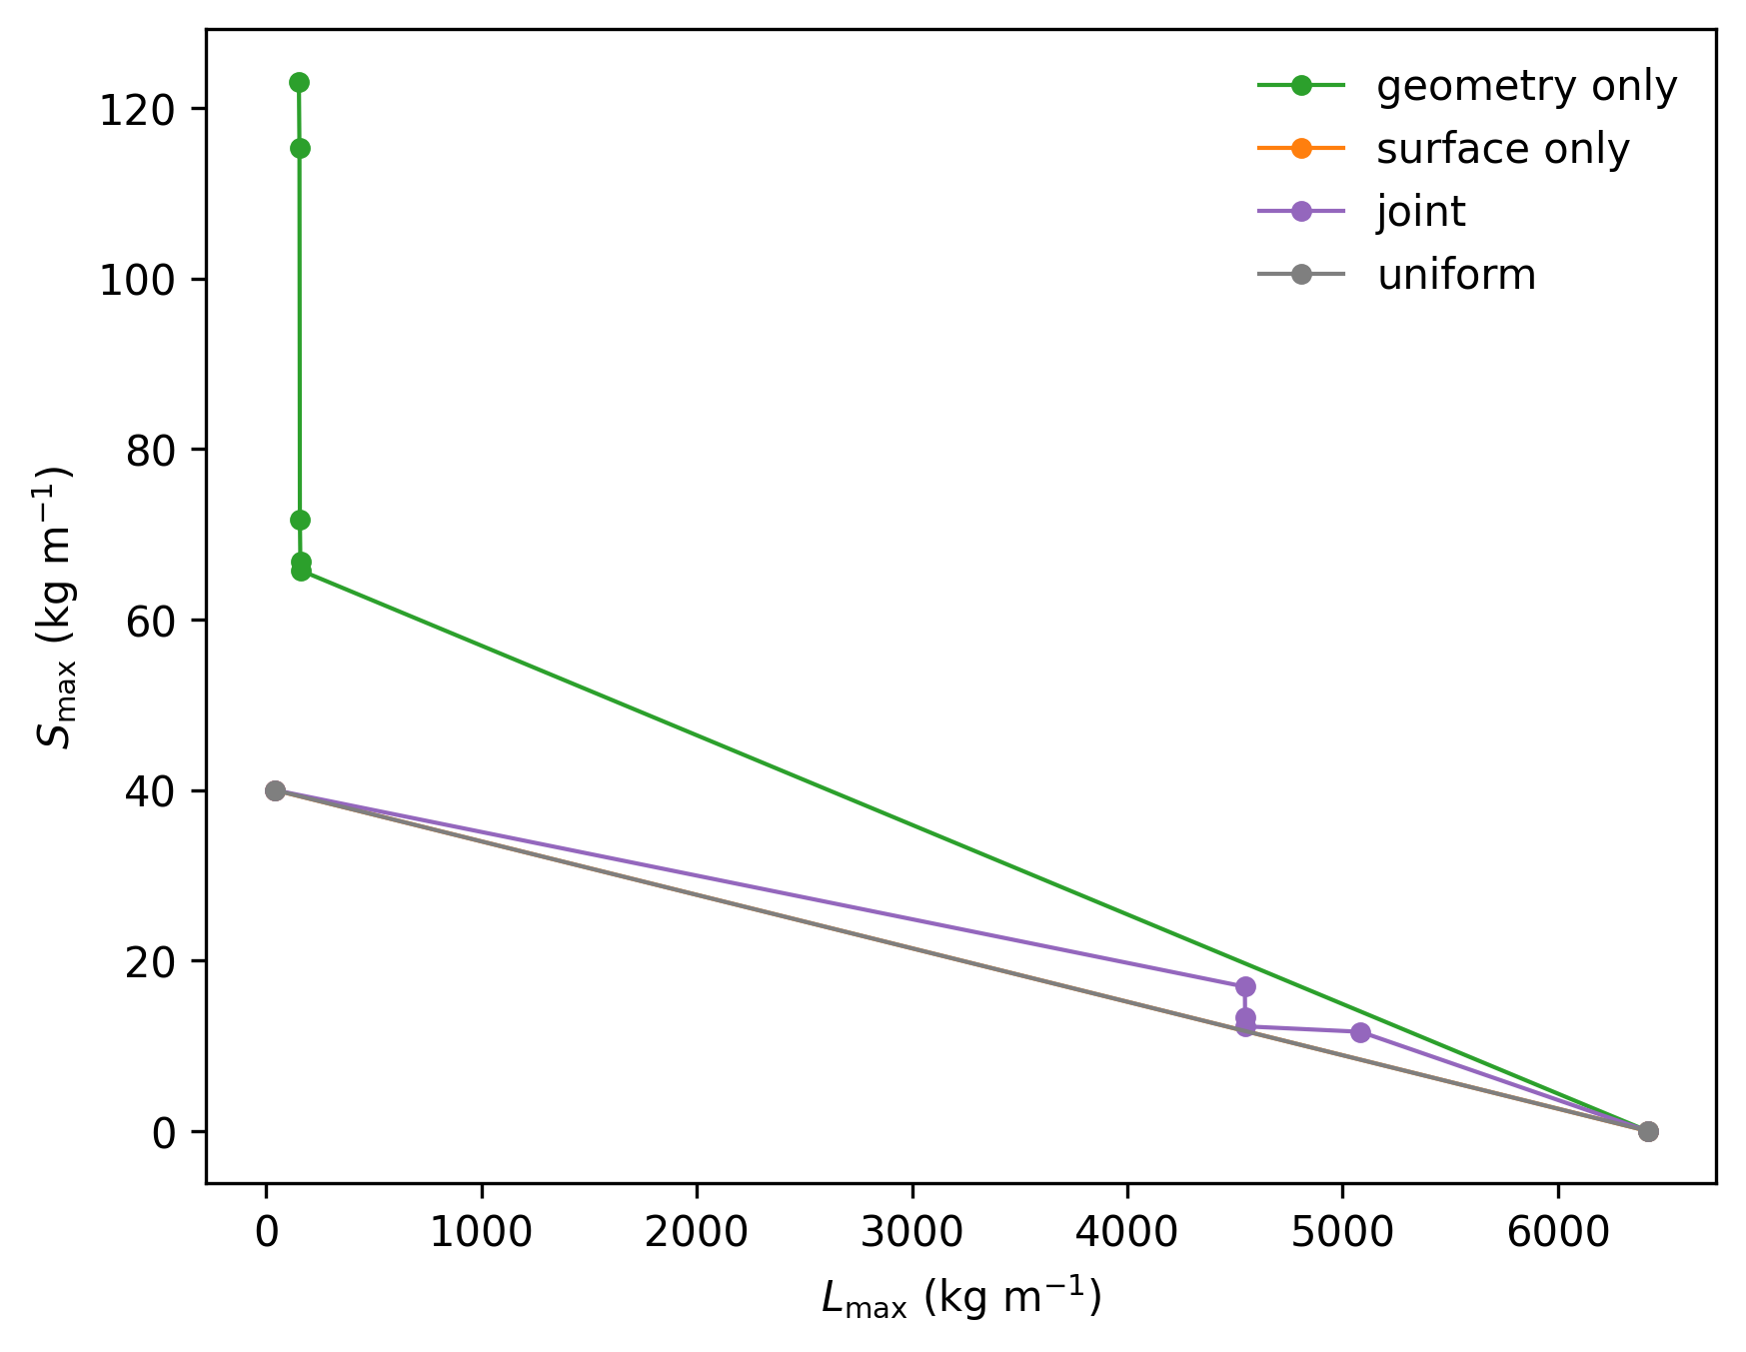
Figure 5
Figure 5. Unique objective pairs for the uniform, geometry-only, surface-only, and joint sets.

Slide 6
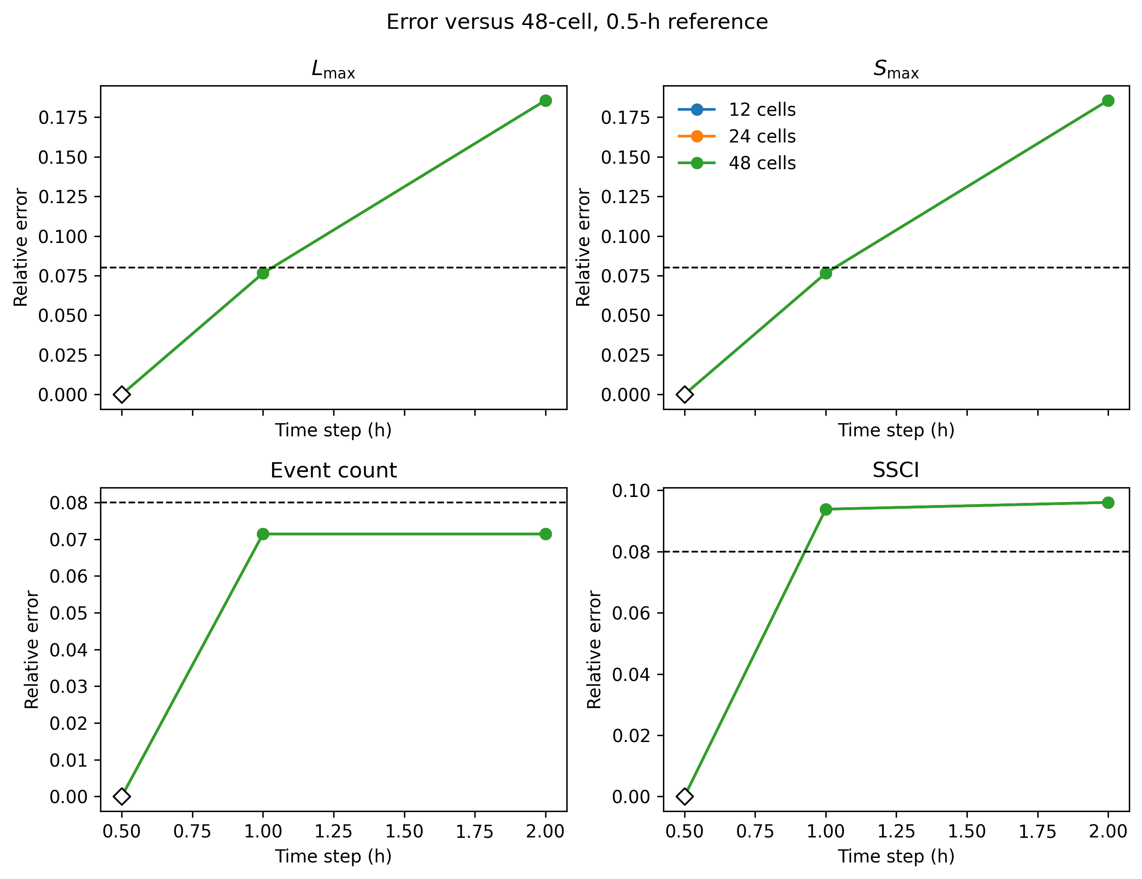
Figure 6
Figure 6. Four-metric numerical convergence relative to the 48-cell, 0.5-h reference; the dashed line is the frozen relative-error tolerance.

Slide 7
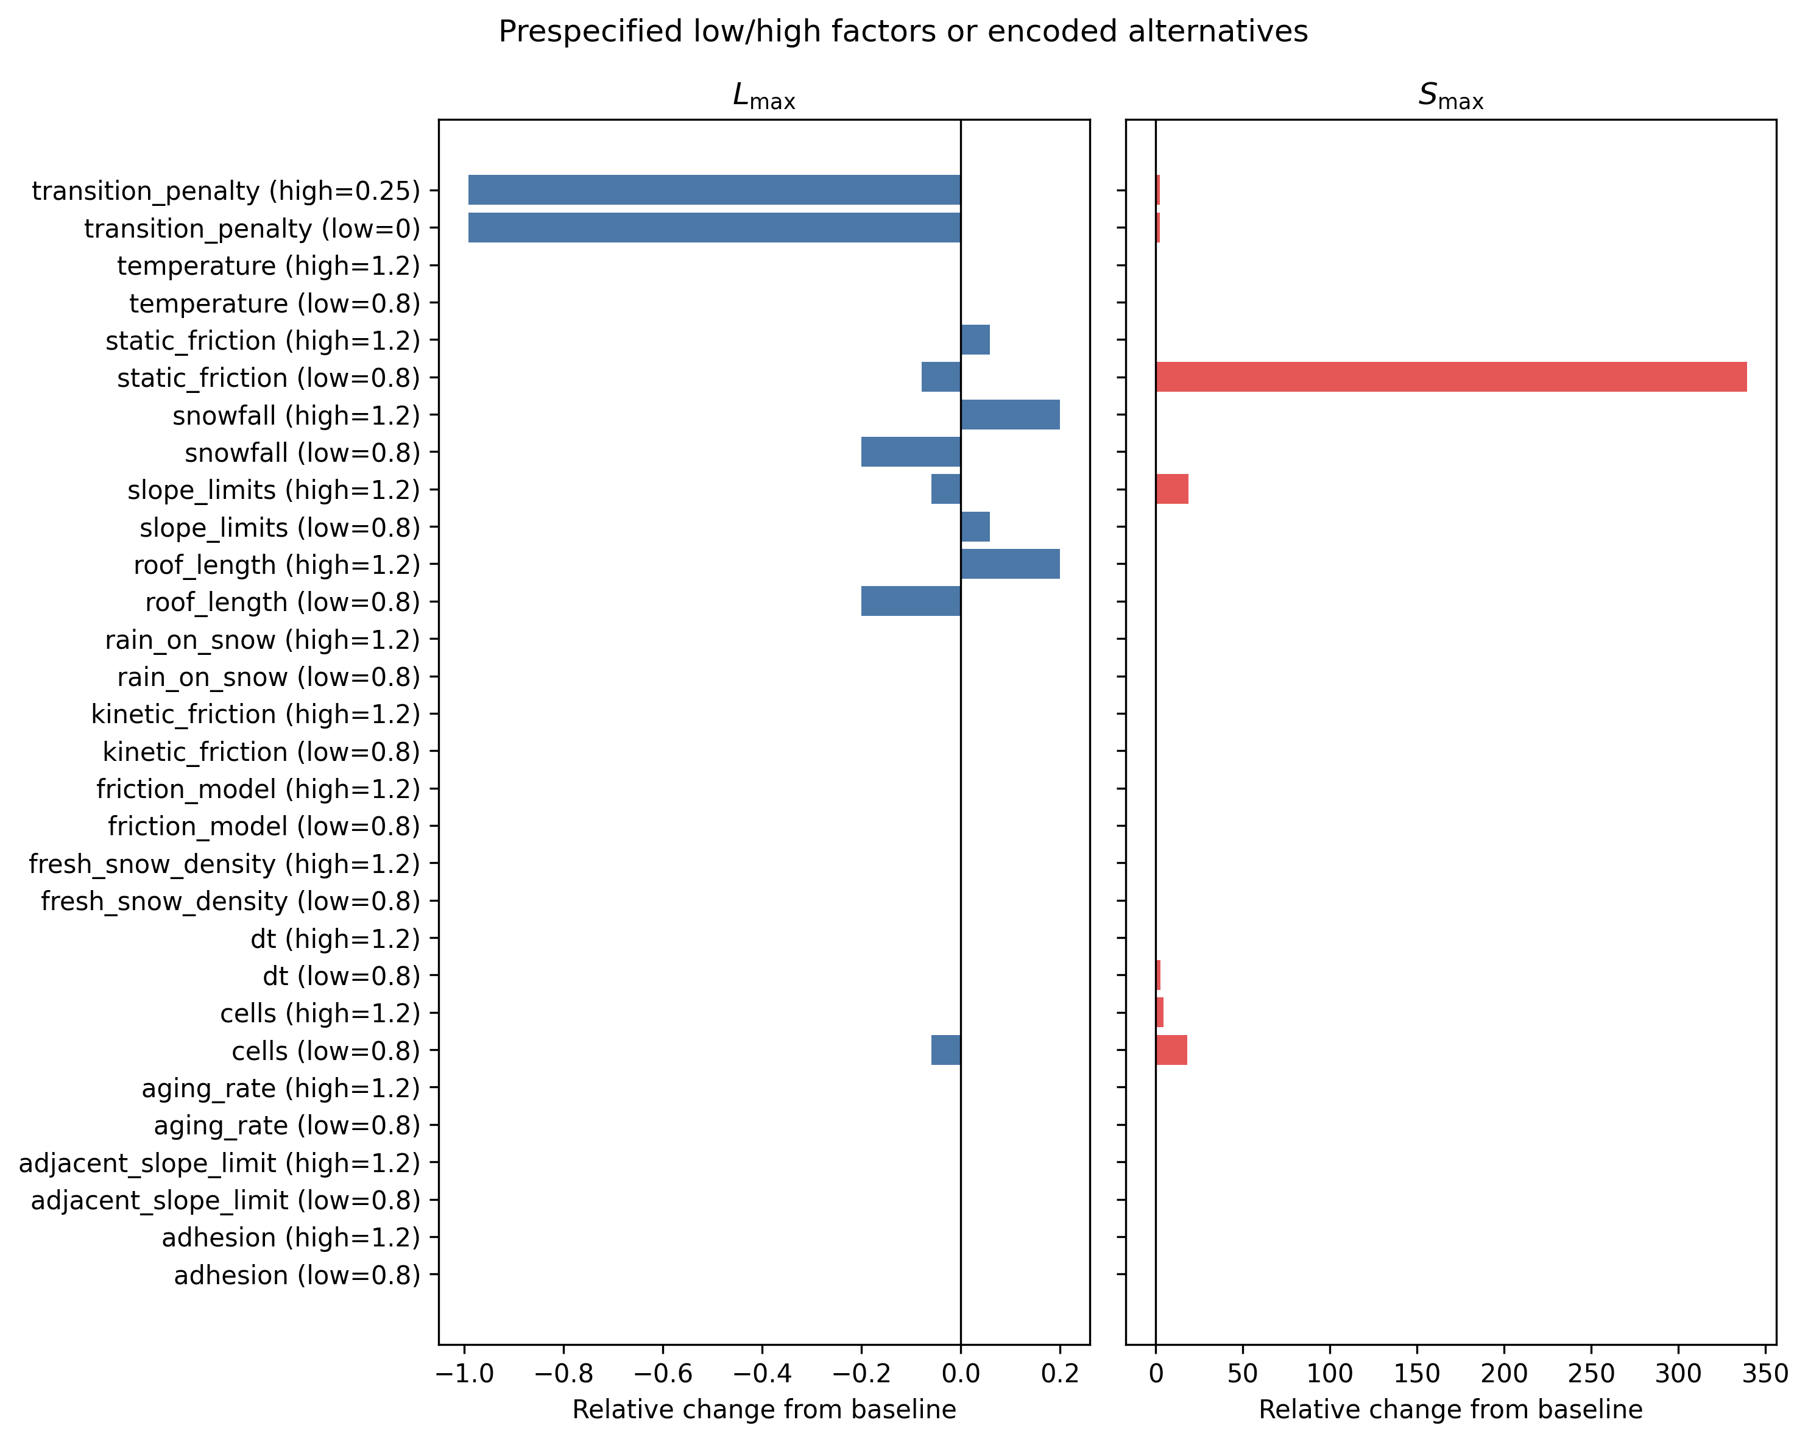
Figure 7
Figure 7. Prespecified one-at-a-time sensitivity. Labels state each low/high factor or encoded alternative; bars are relative changes from baseline.

Slide 8
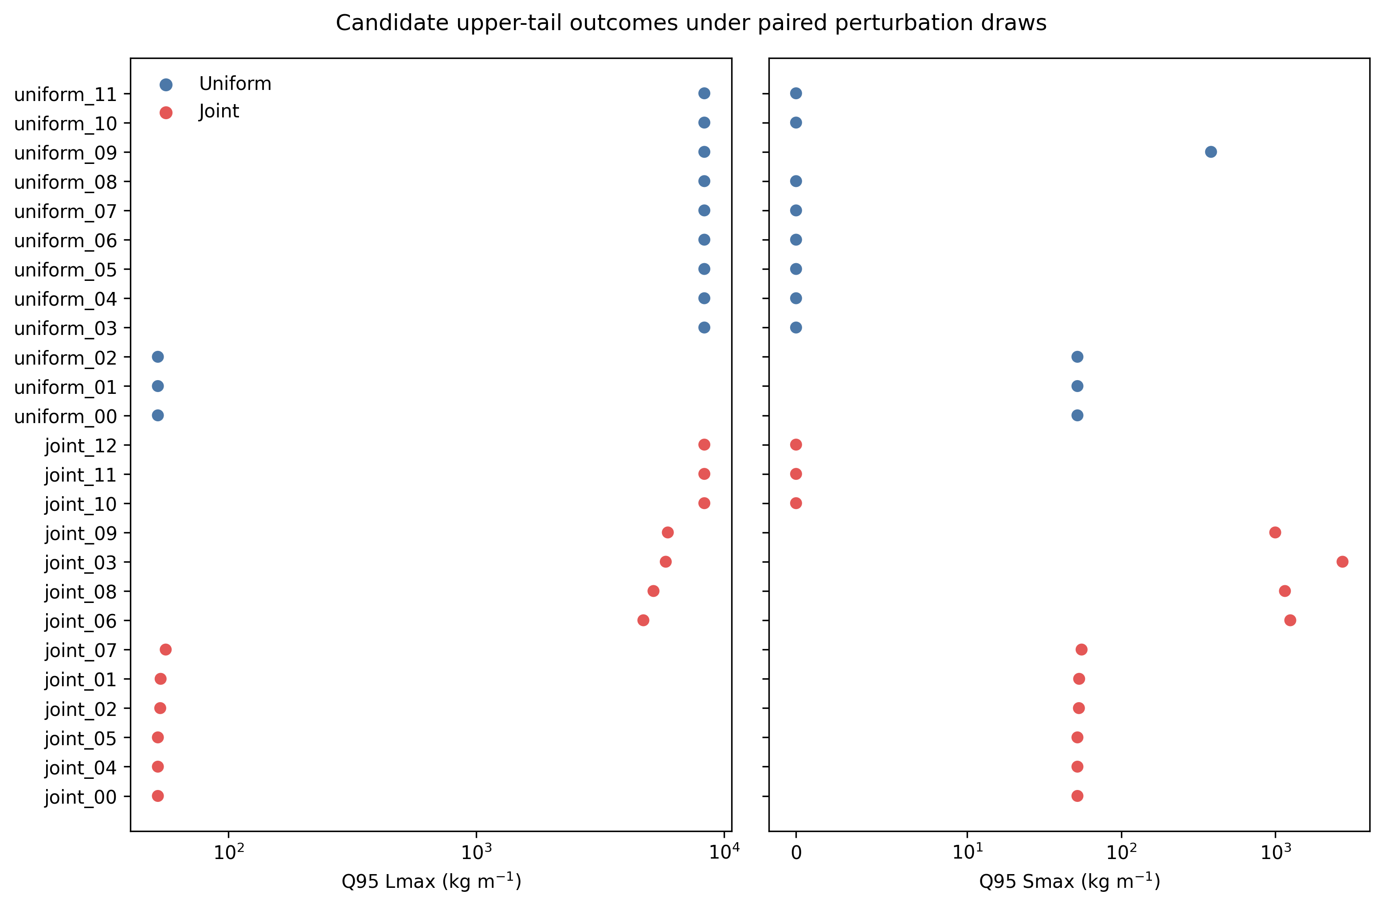
Figure 8
Figure 8. Candidate-specific Q95 retained-mass and release-mass outcomes under 250 paired perturbation draws. Symmetric-log axes include zero outcomes.

Slide 9
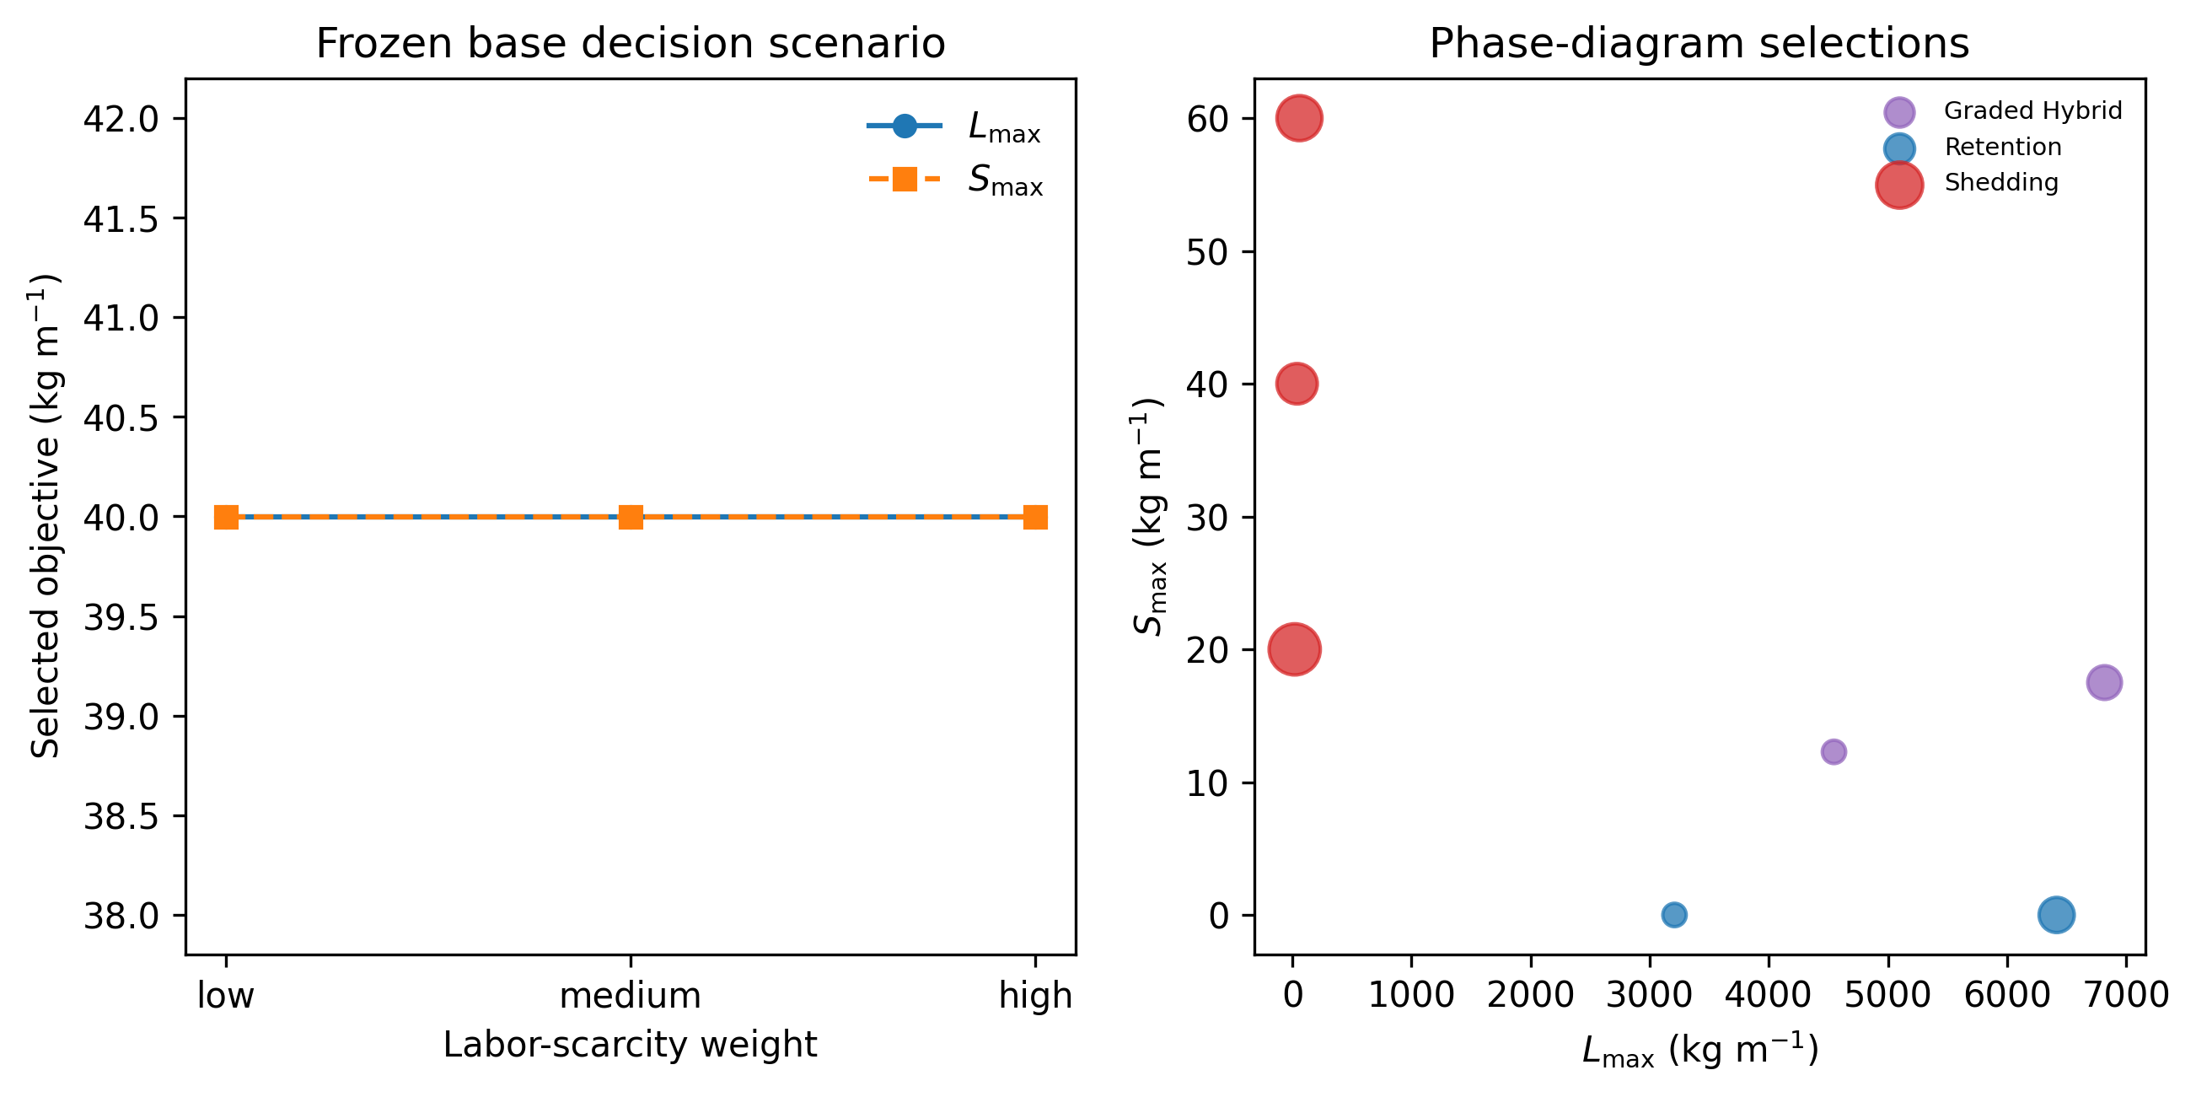
Figure 9
Figure 9. Frozen labor-scarcity selections in the base decision scenario and phase-diagram objective pairs; bubble area reflects selection frequency.

