Slide 1
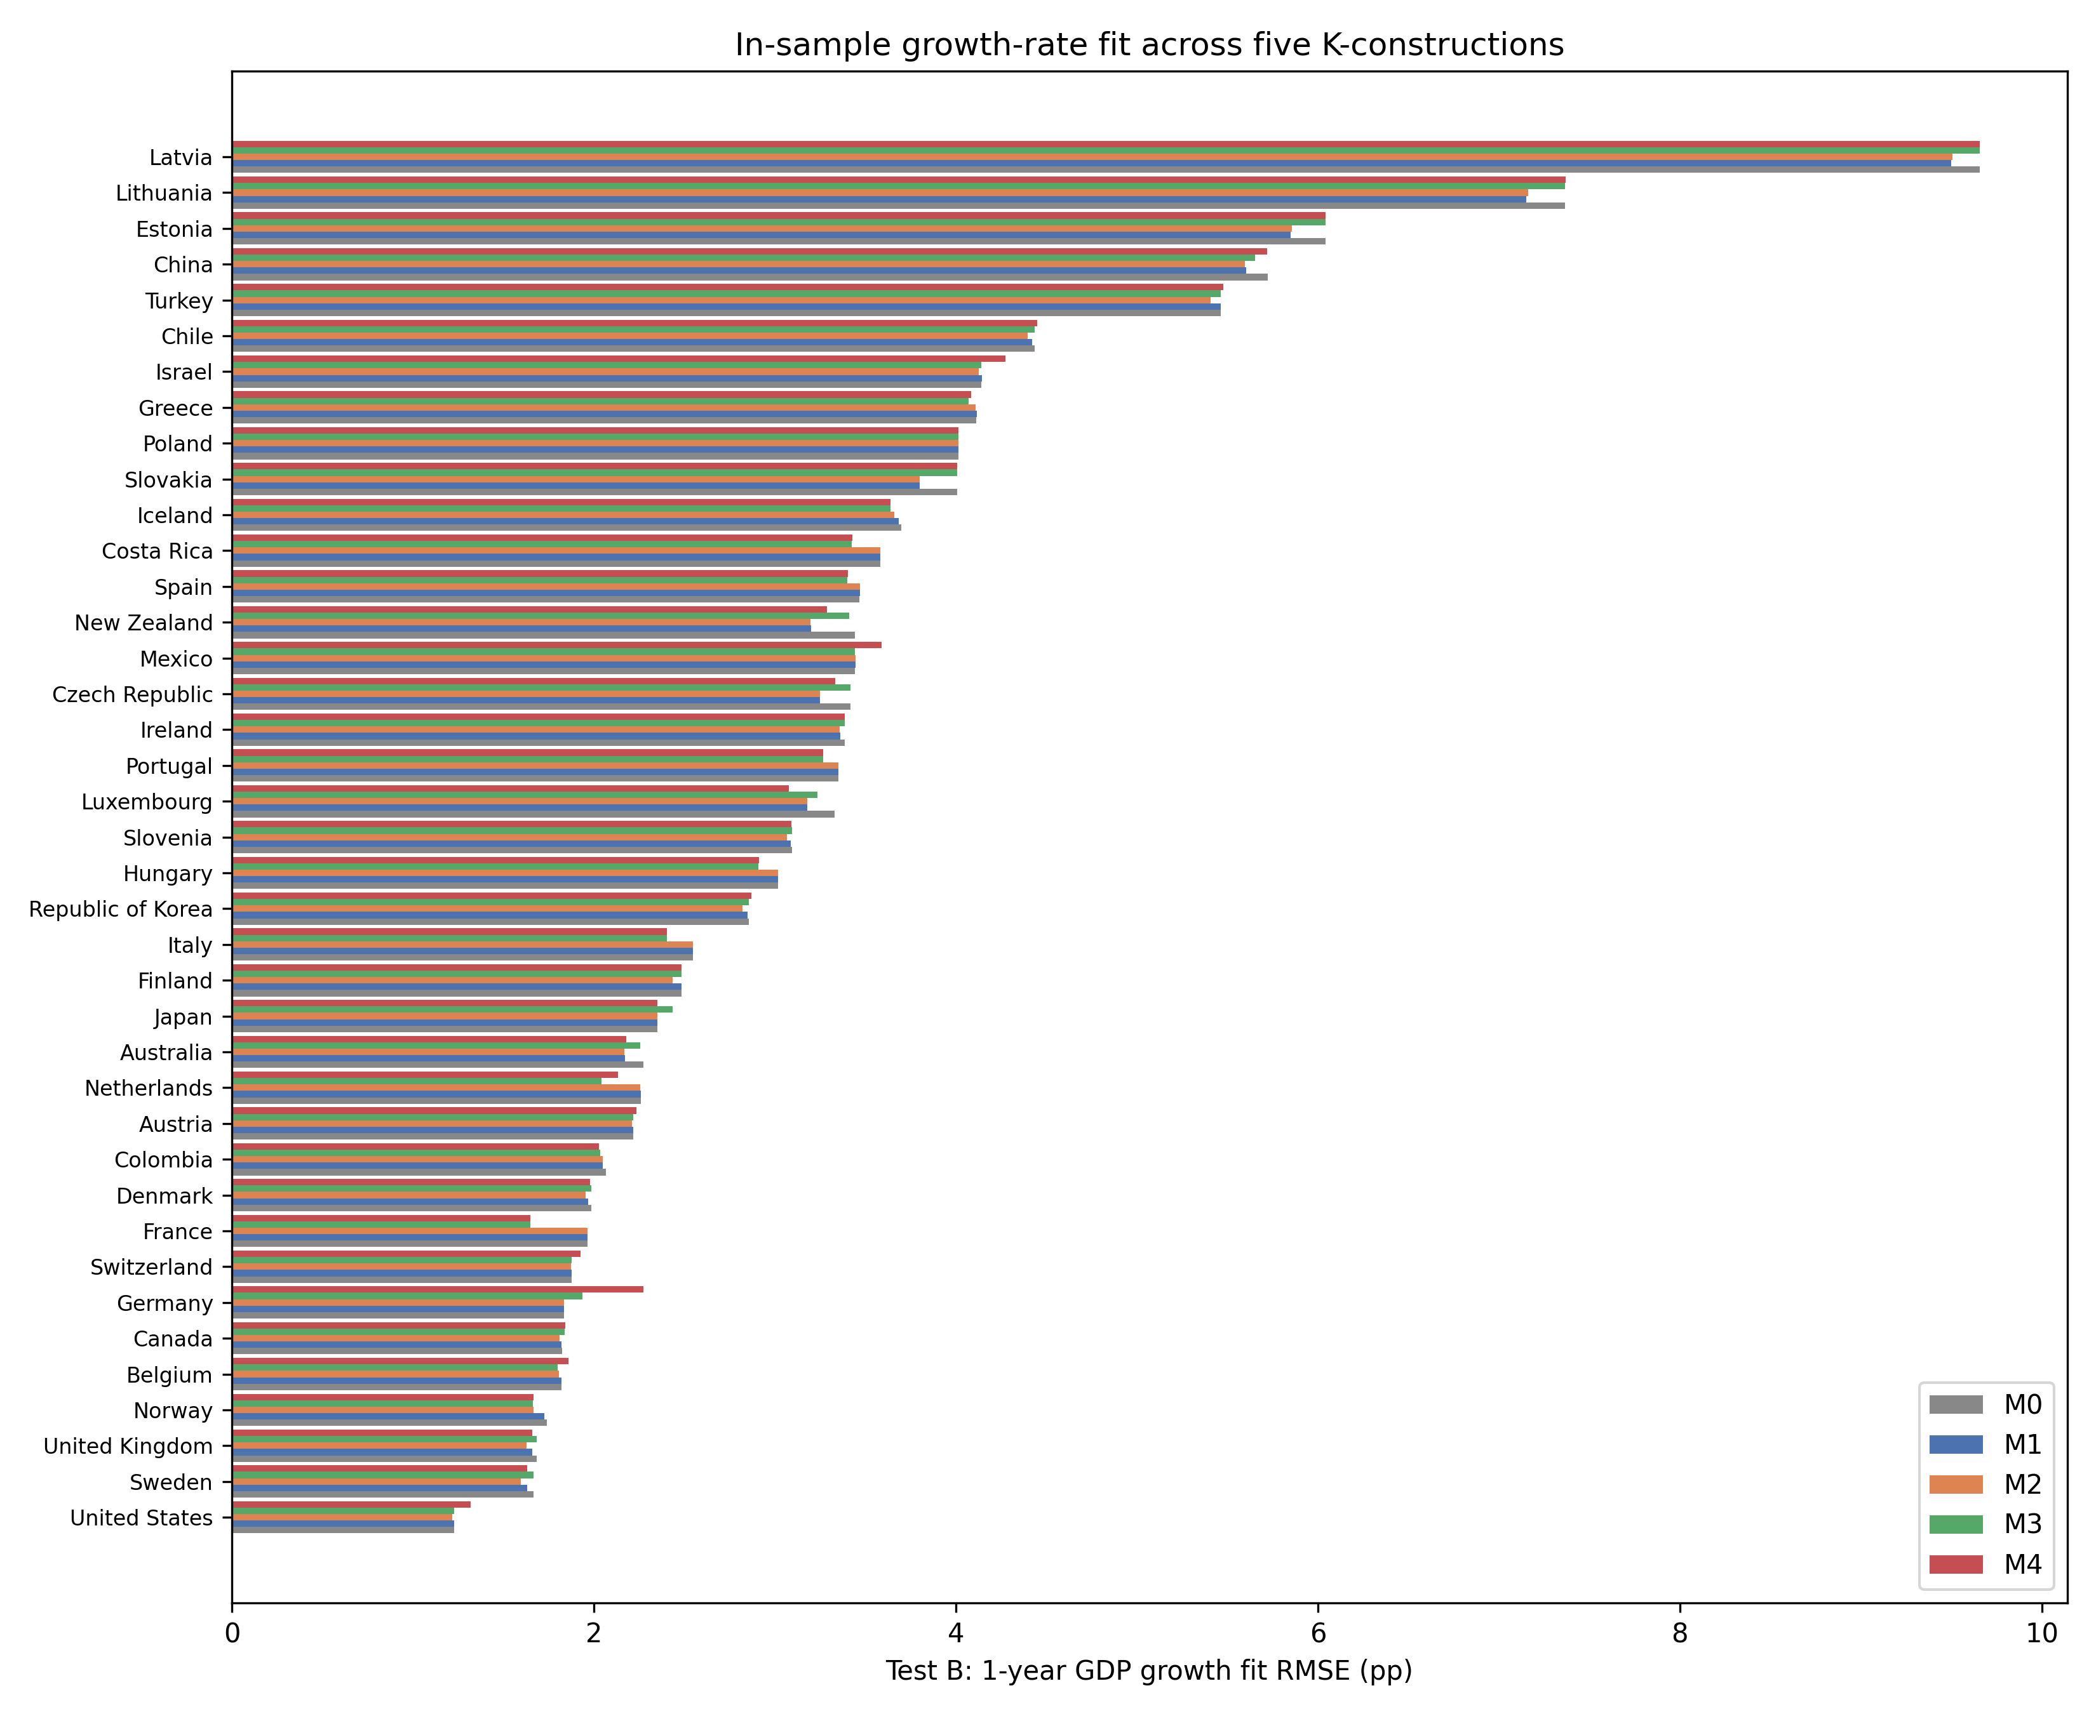
Supplementary Fig. 1. In-sample 1-year GDP growth RMSE across M0–M4 for 39 countries (lower is better).
In-sample 1-year GDP growth RMSE across M0–M4 for 39 countries (lower is better).

Slide 2
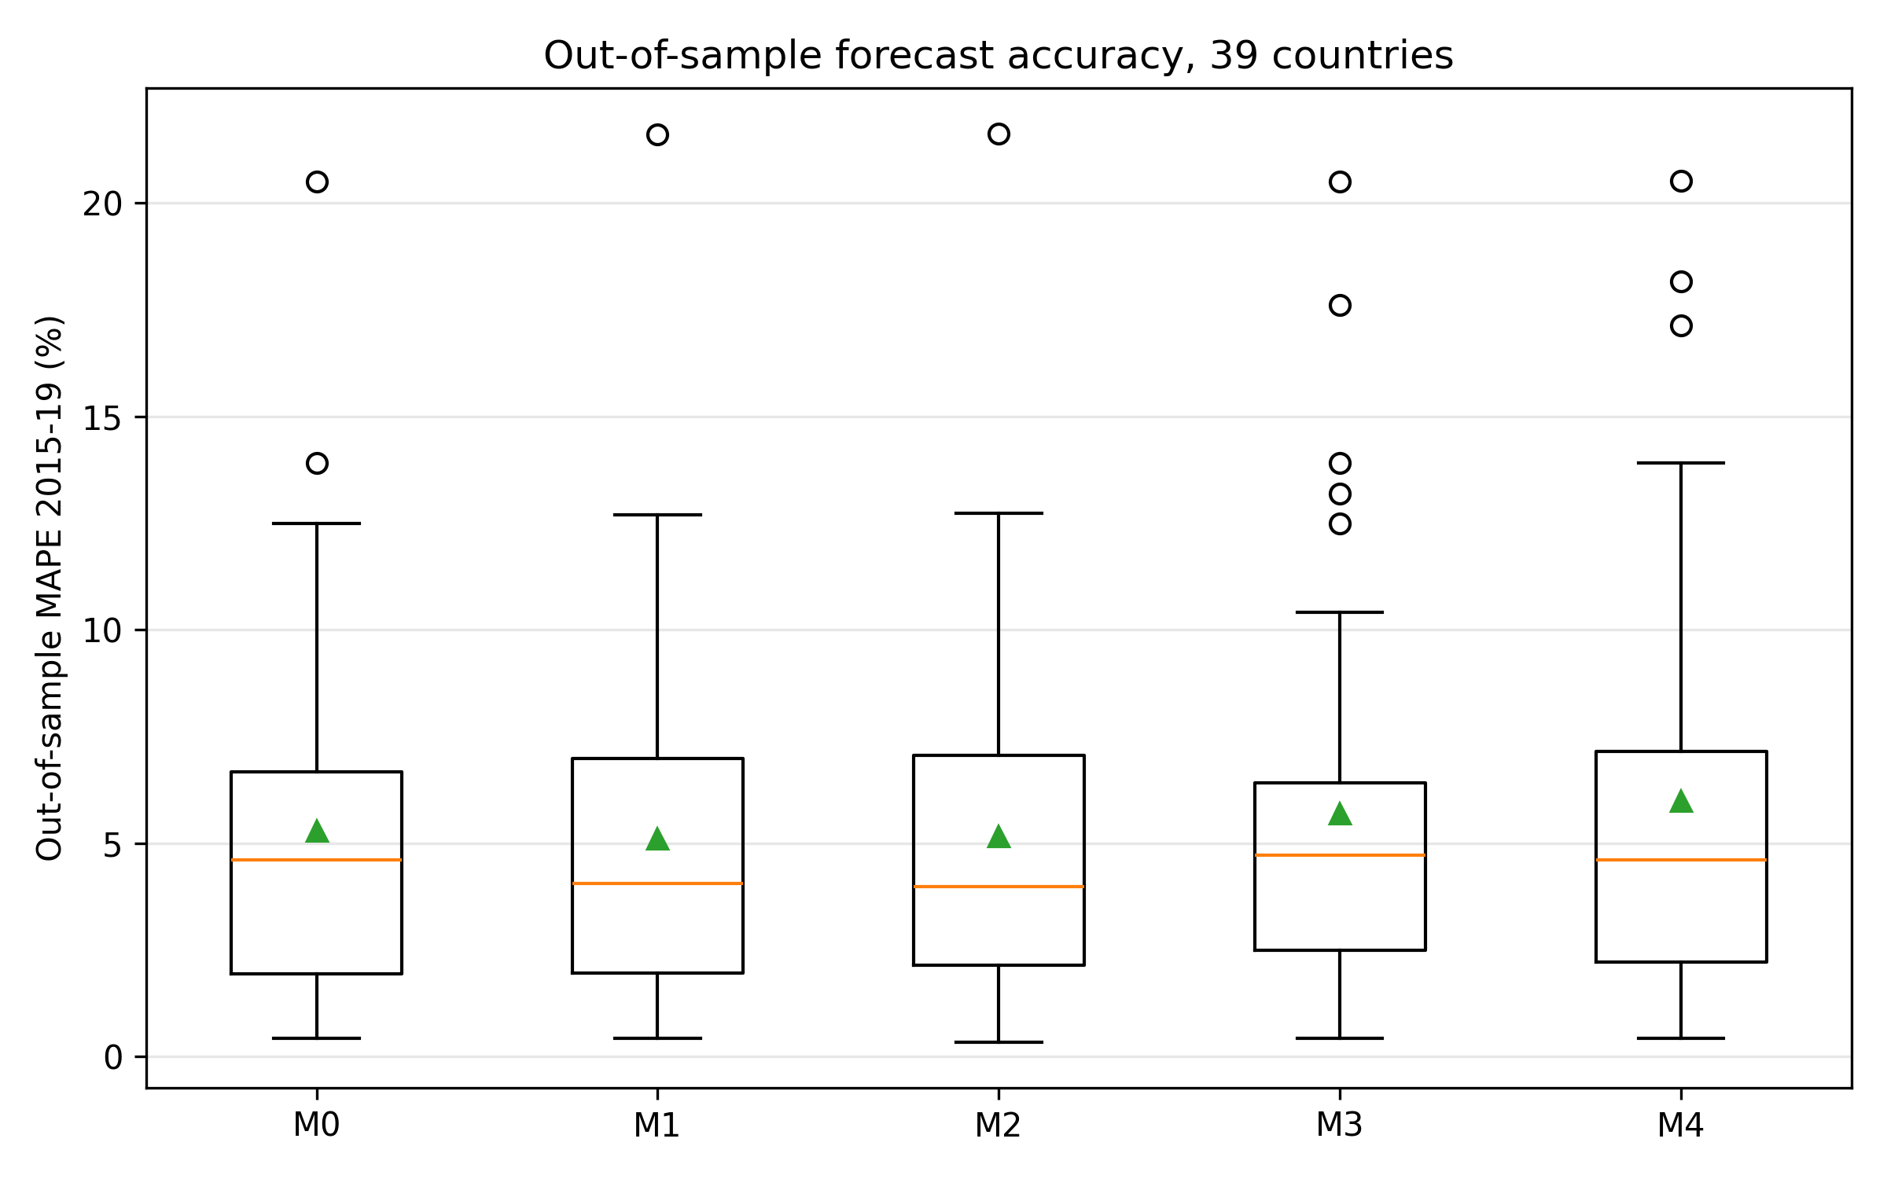
Fig. 1. Out-of-sample MAPE on 2015–19 held-out window; M2 achieves 13% relative improvement vs M0.
Out-of-sample MAPE on 2015–19 held-out window; M2 achieves 13% relative improvement vs M0.

Slide 3
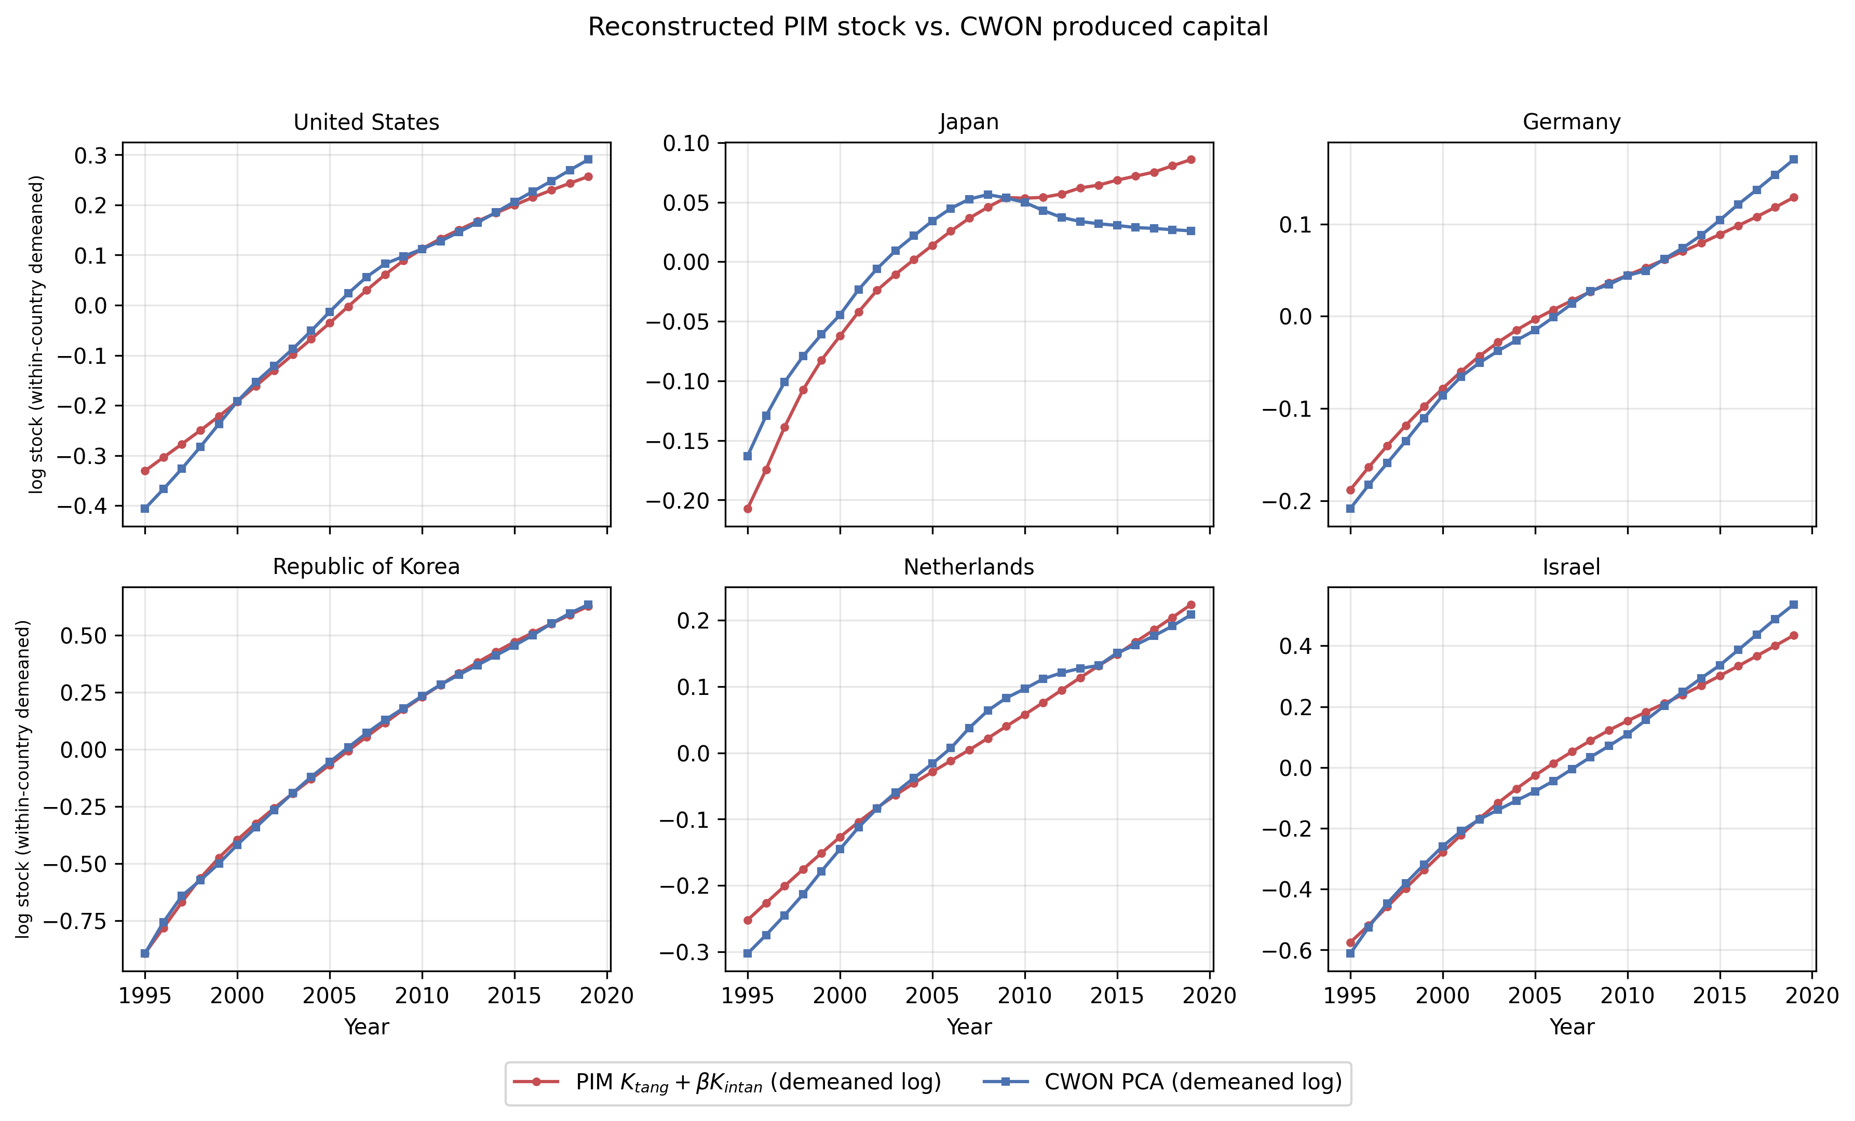
Fig. 2. PIM tangible-plus-intangible stock versus CWON PCA (within-country demeaned log).
PIM tangible-plus-intangible stock versus CWON PCA (within-country demeaned log).

Slide 4
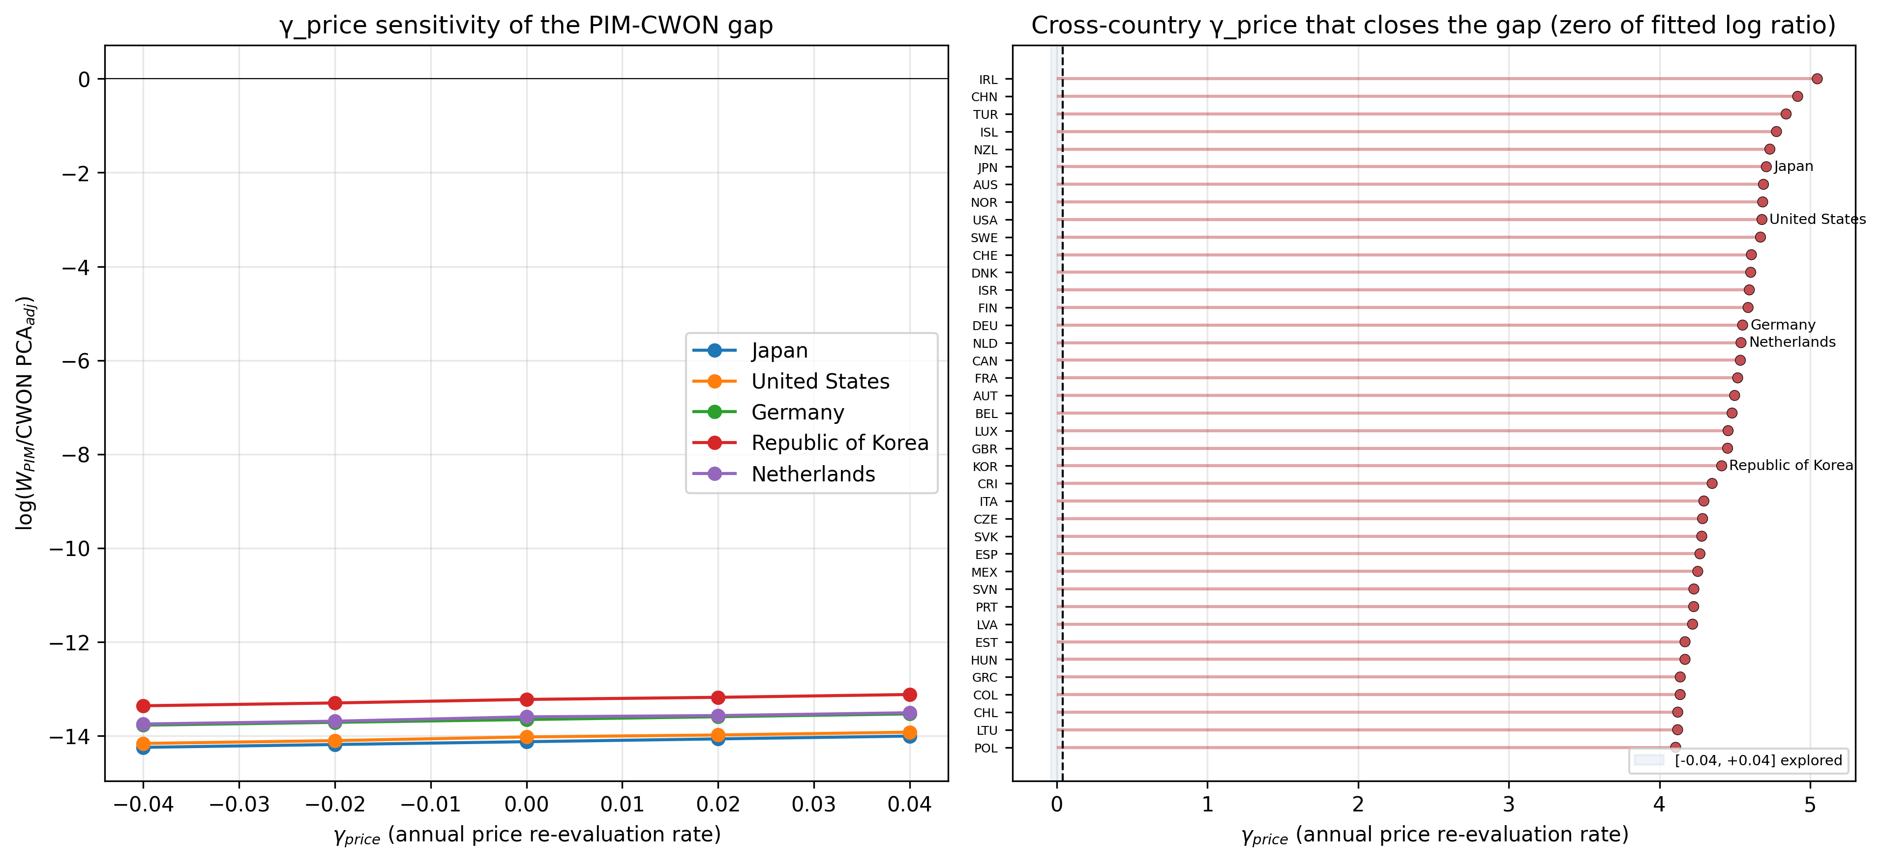
Supplementary Fig. 4. Price-sensitivity of the PIM/CWON log-ratio. Left: selected countries. Right: cross-country zero-crossing γ_price; all roots lie outside the explored [-0.04, +0.04] range.
Price-sensitivity of the PIM/CWON log-ratio. Left: selected countries. Right: cross-country zero-crossing γ_price; all roots lie outside the explored [-0.04, +0.04] range.

Slide 5
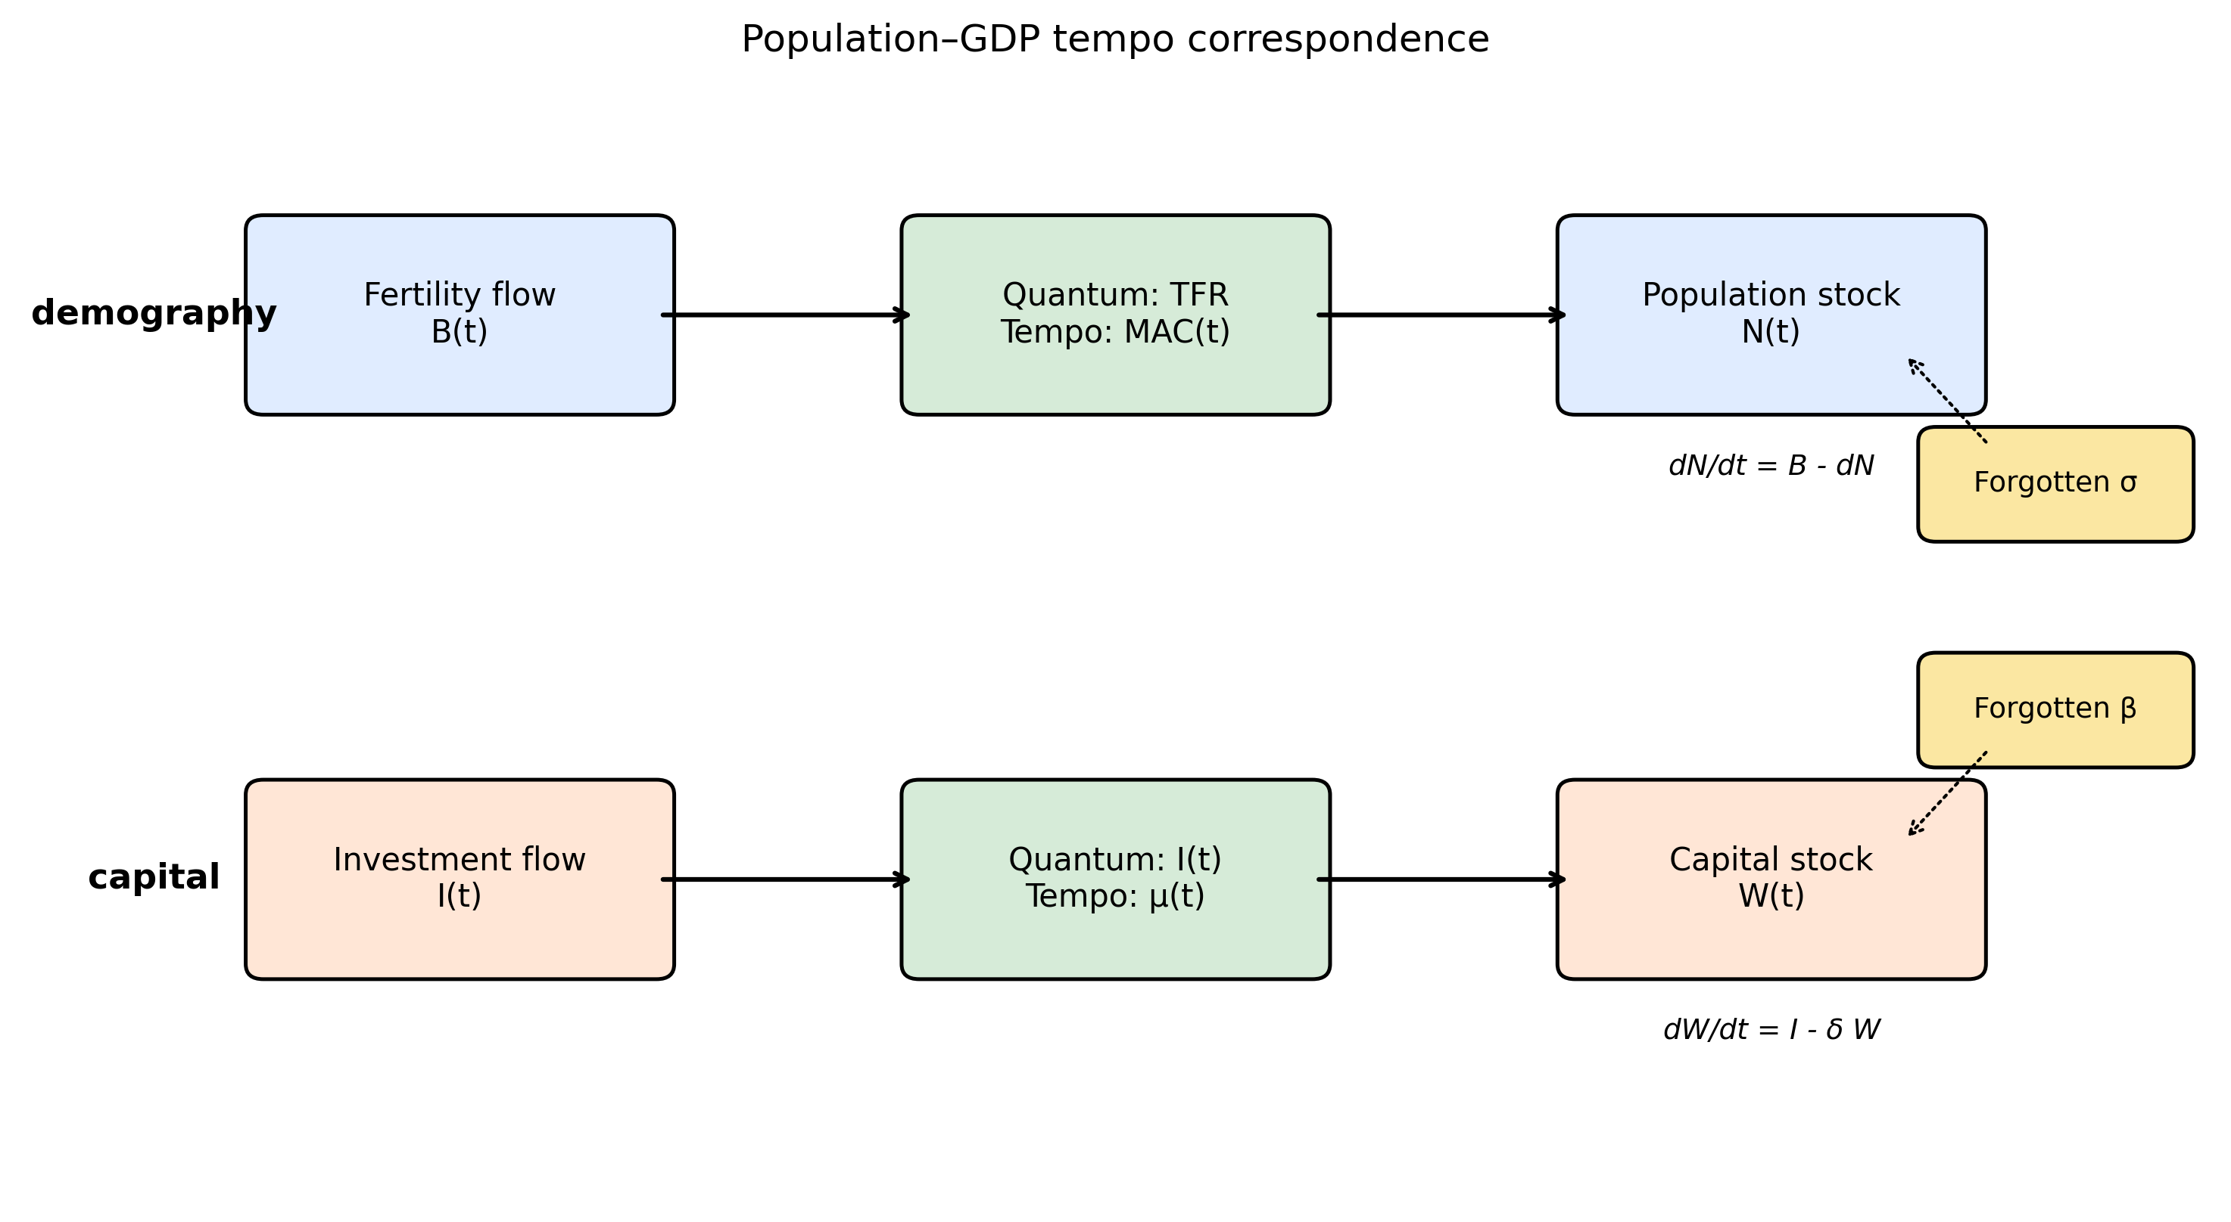
Supplementary Fig. 5. Conceptual diagram of the population-capital tempo correspondence.
Conceptual diagram of the population-capital tempo correspondence.

Slide 6
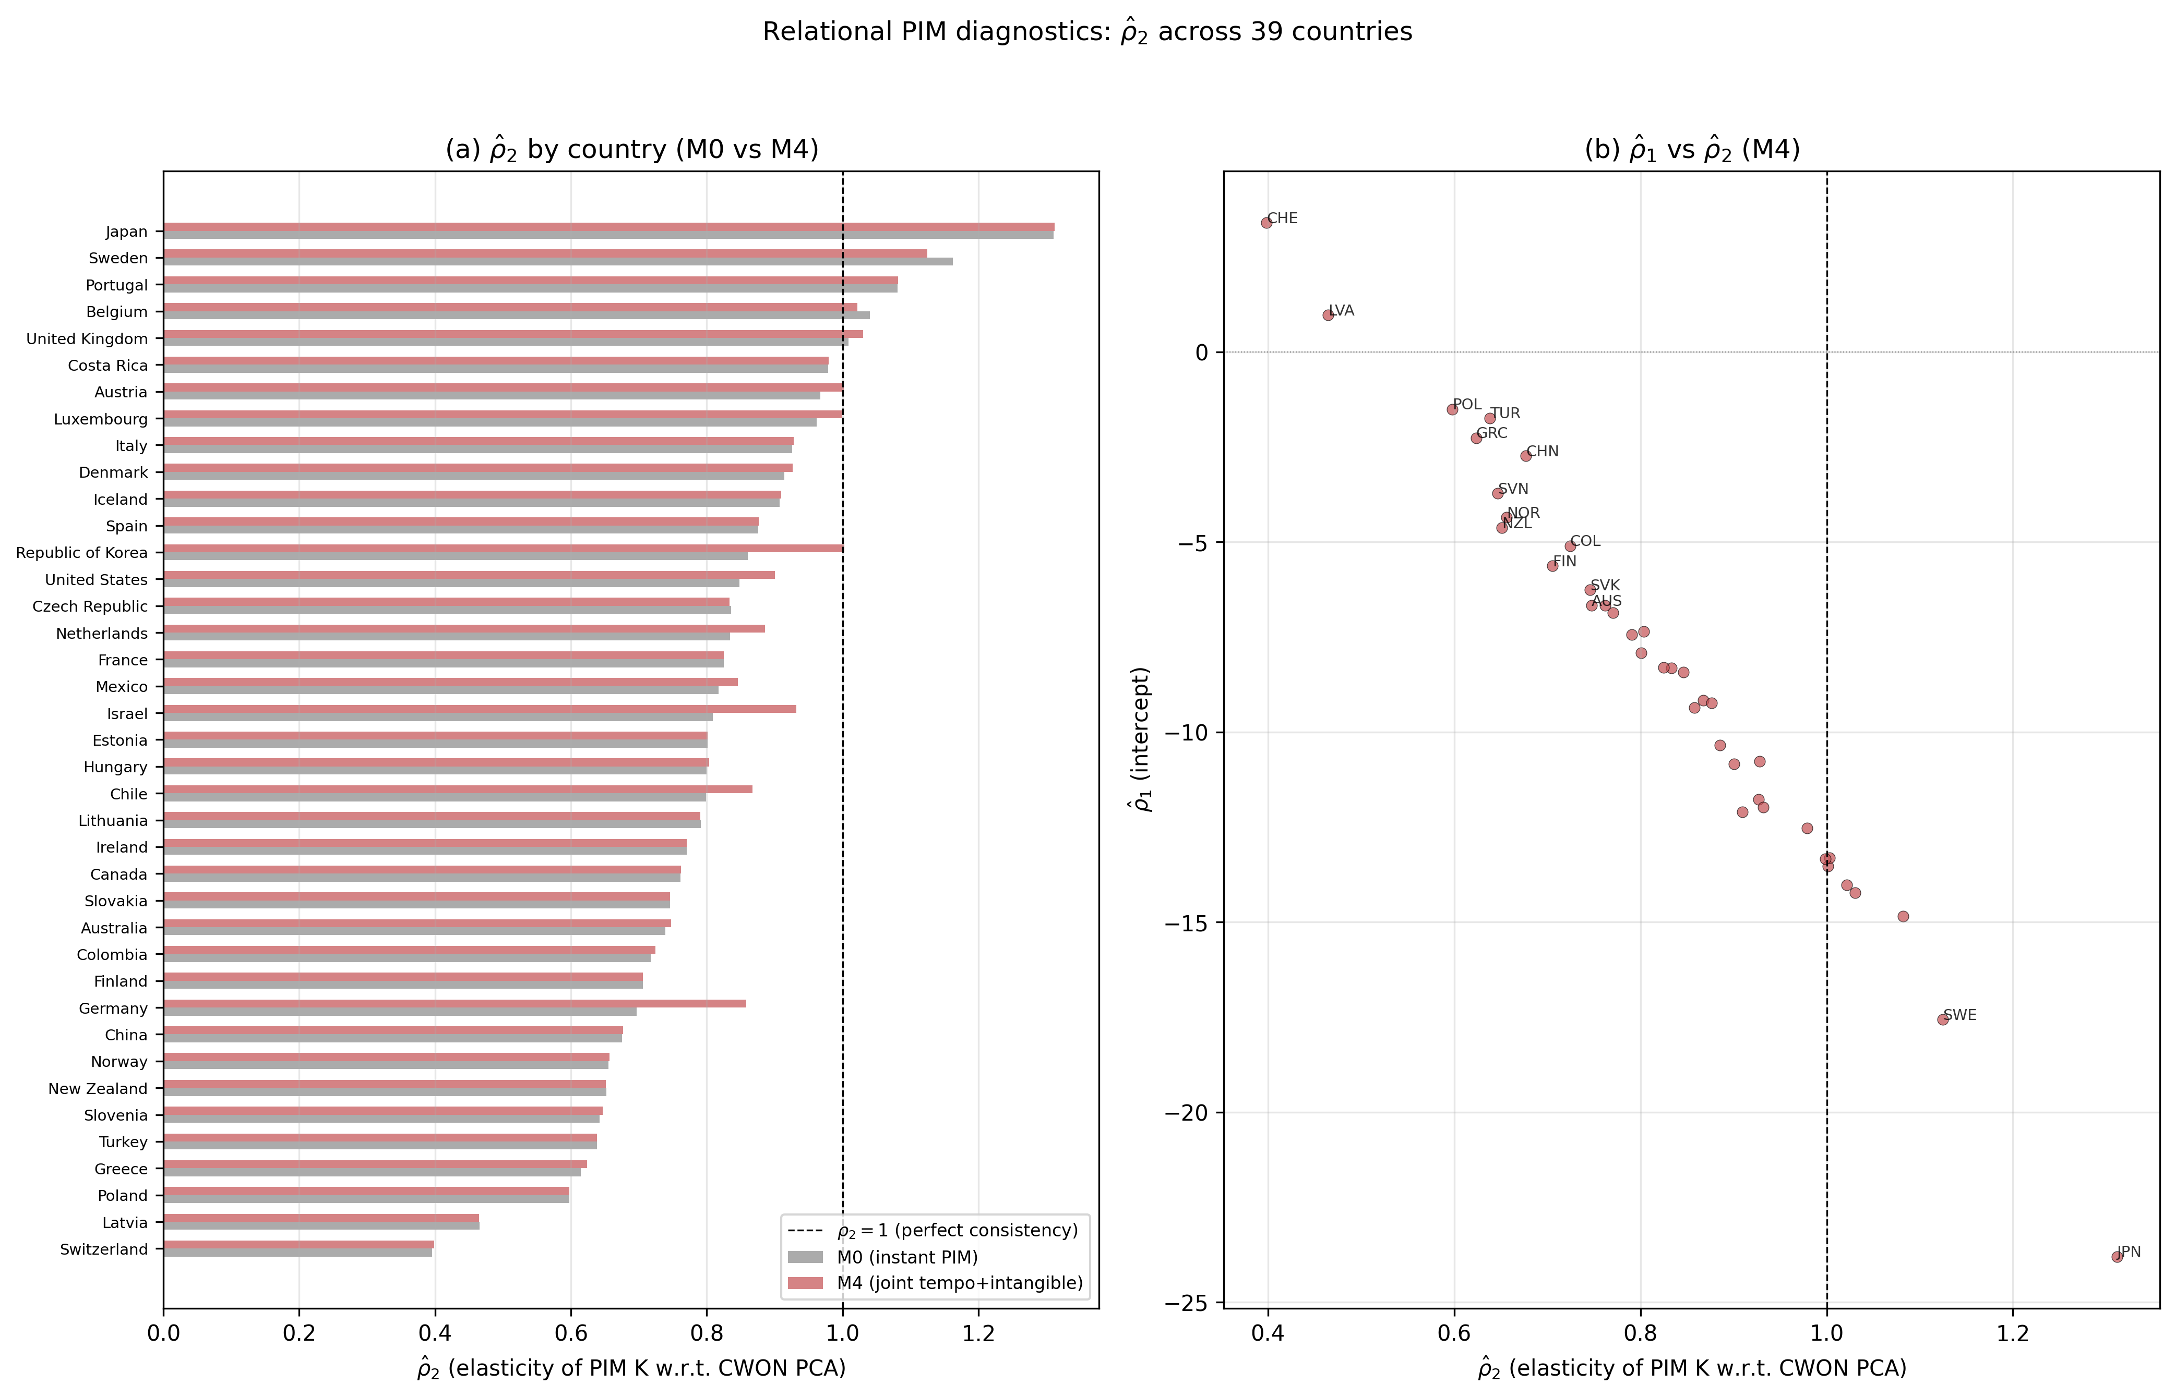
Supplementary Fig. 6. Relational PIM diagnostics: ρ̂₂ across 39 countries under M0 vs M4.
Relational PIM diagnostics: ρ̂₂ across 39 countries under M0 vs M4.

Slide 7
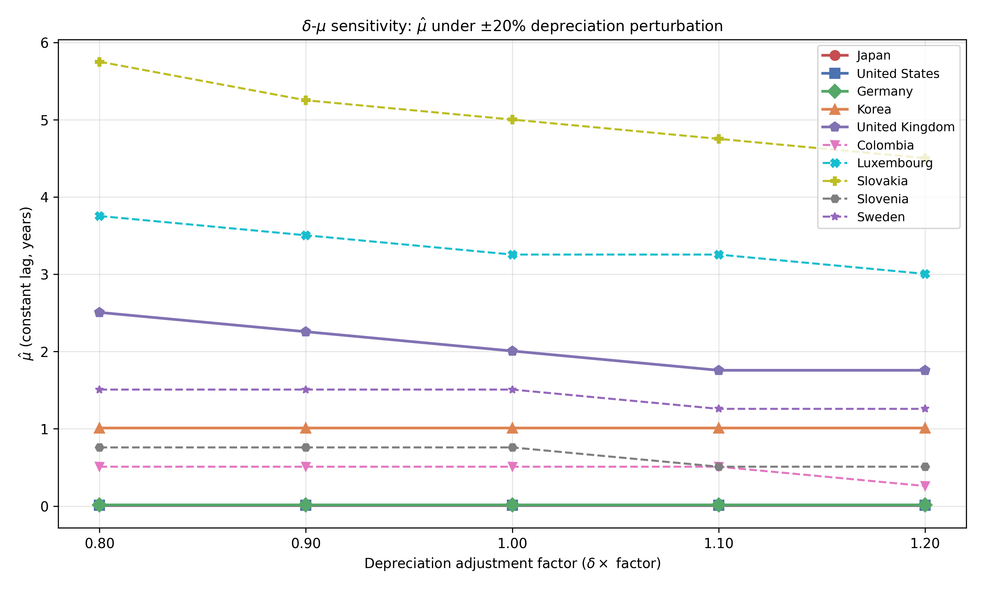
Supplementary Fig. 7. Depreciation–lag sensitivity: estimated μ̂ under ±20% depreciation perturbations.
Depreciation–lag sensitivity: estimated μ̂ under ±20% depreciation perturbations.

Slide 8
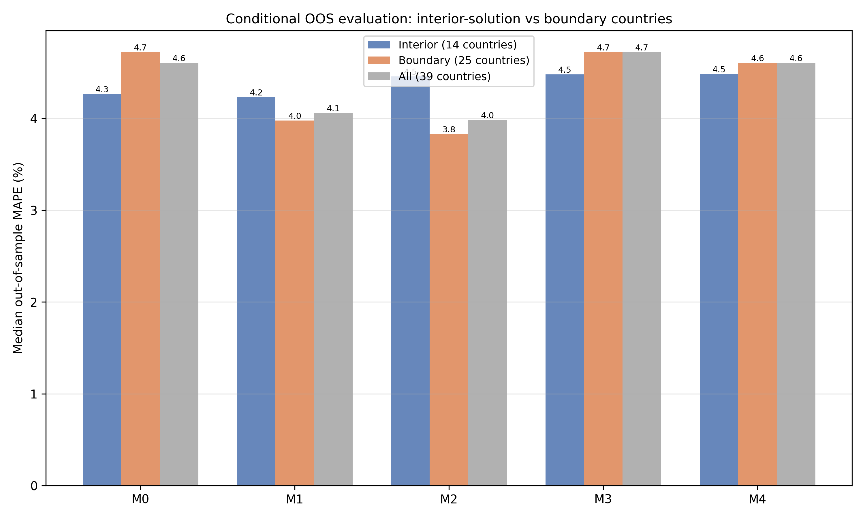
Supplementary Fig. 8. Conditional OOS evaluation: interior-solution vs boundary countries.
Conditional OOS evaluation: interior-solution vs boundary countries.

Slide 9
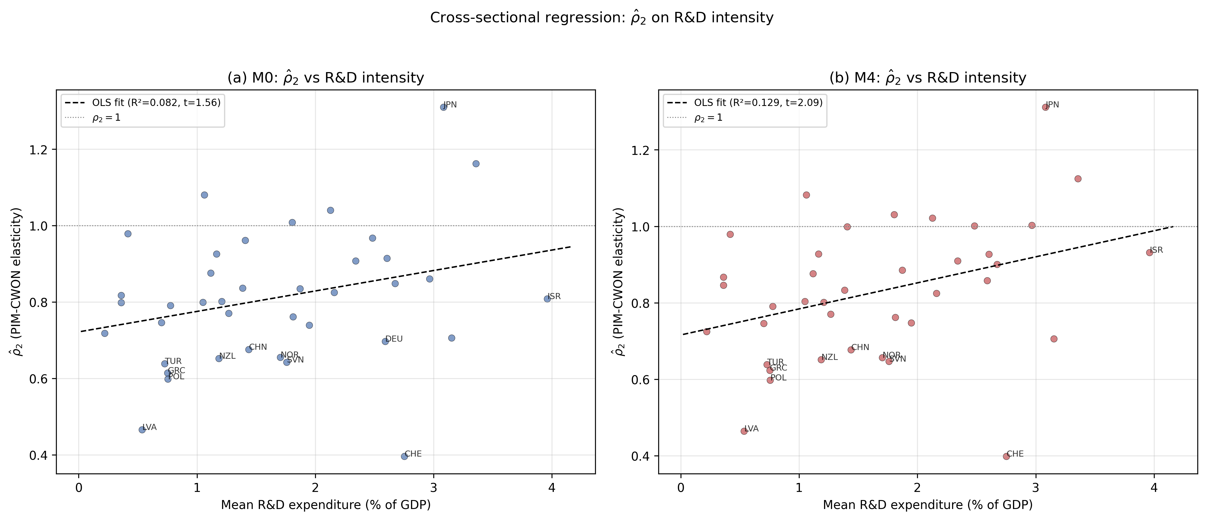
Supplementary Fig. 3. Cross-sectional regression of ρ̂₂ on R&D intensity.
Cross-sectional regression of ρ̂₂ on R&D intensity.

Slide 10
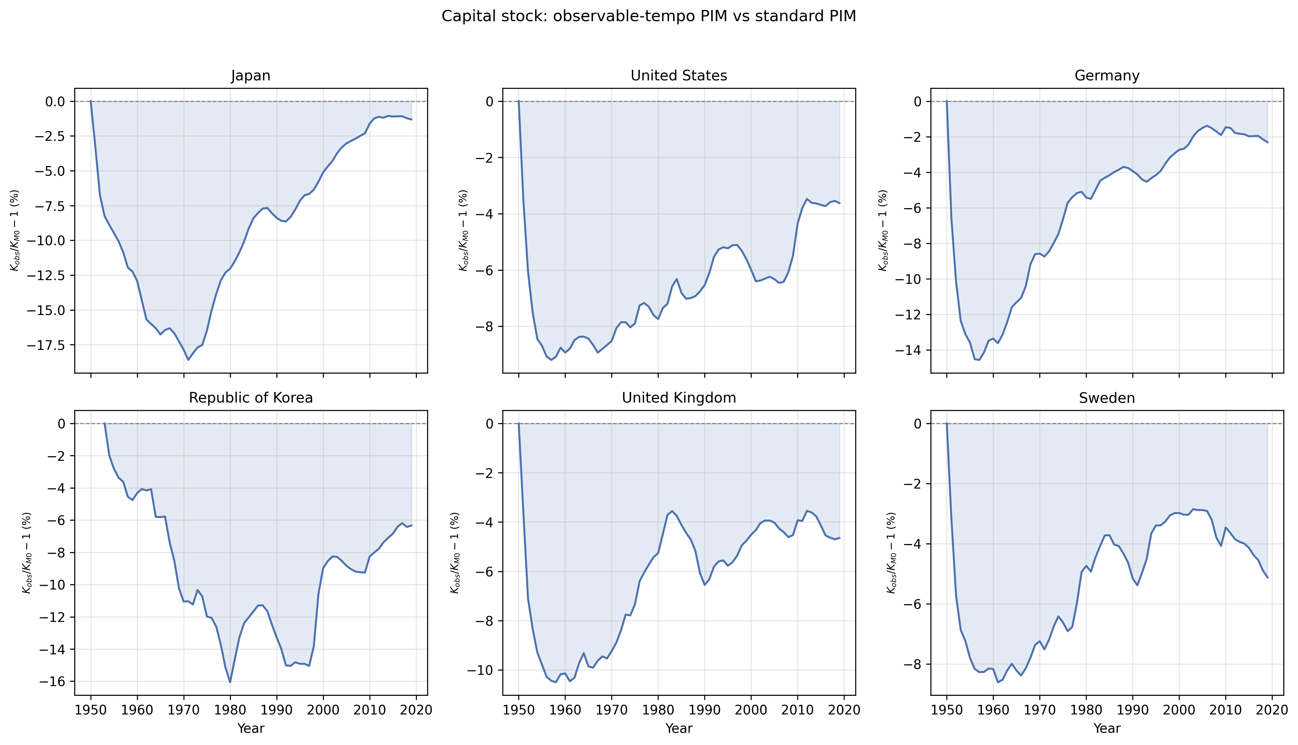
Fig. 3. Capital-stock divergence: observed versus baseline capital stock over time for six representative countries.
Capital-stock divergence: observed versus baseline capital stock over time for six representative countries.

Slide 11
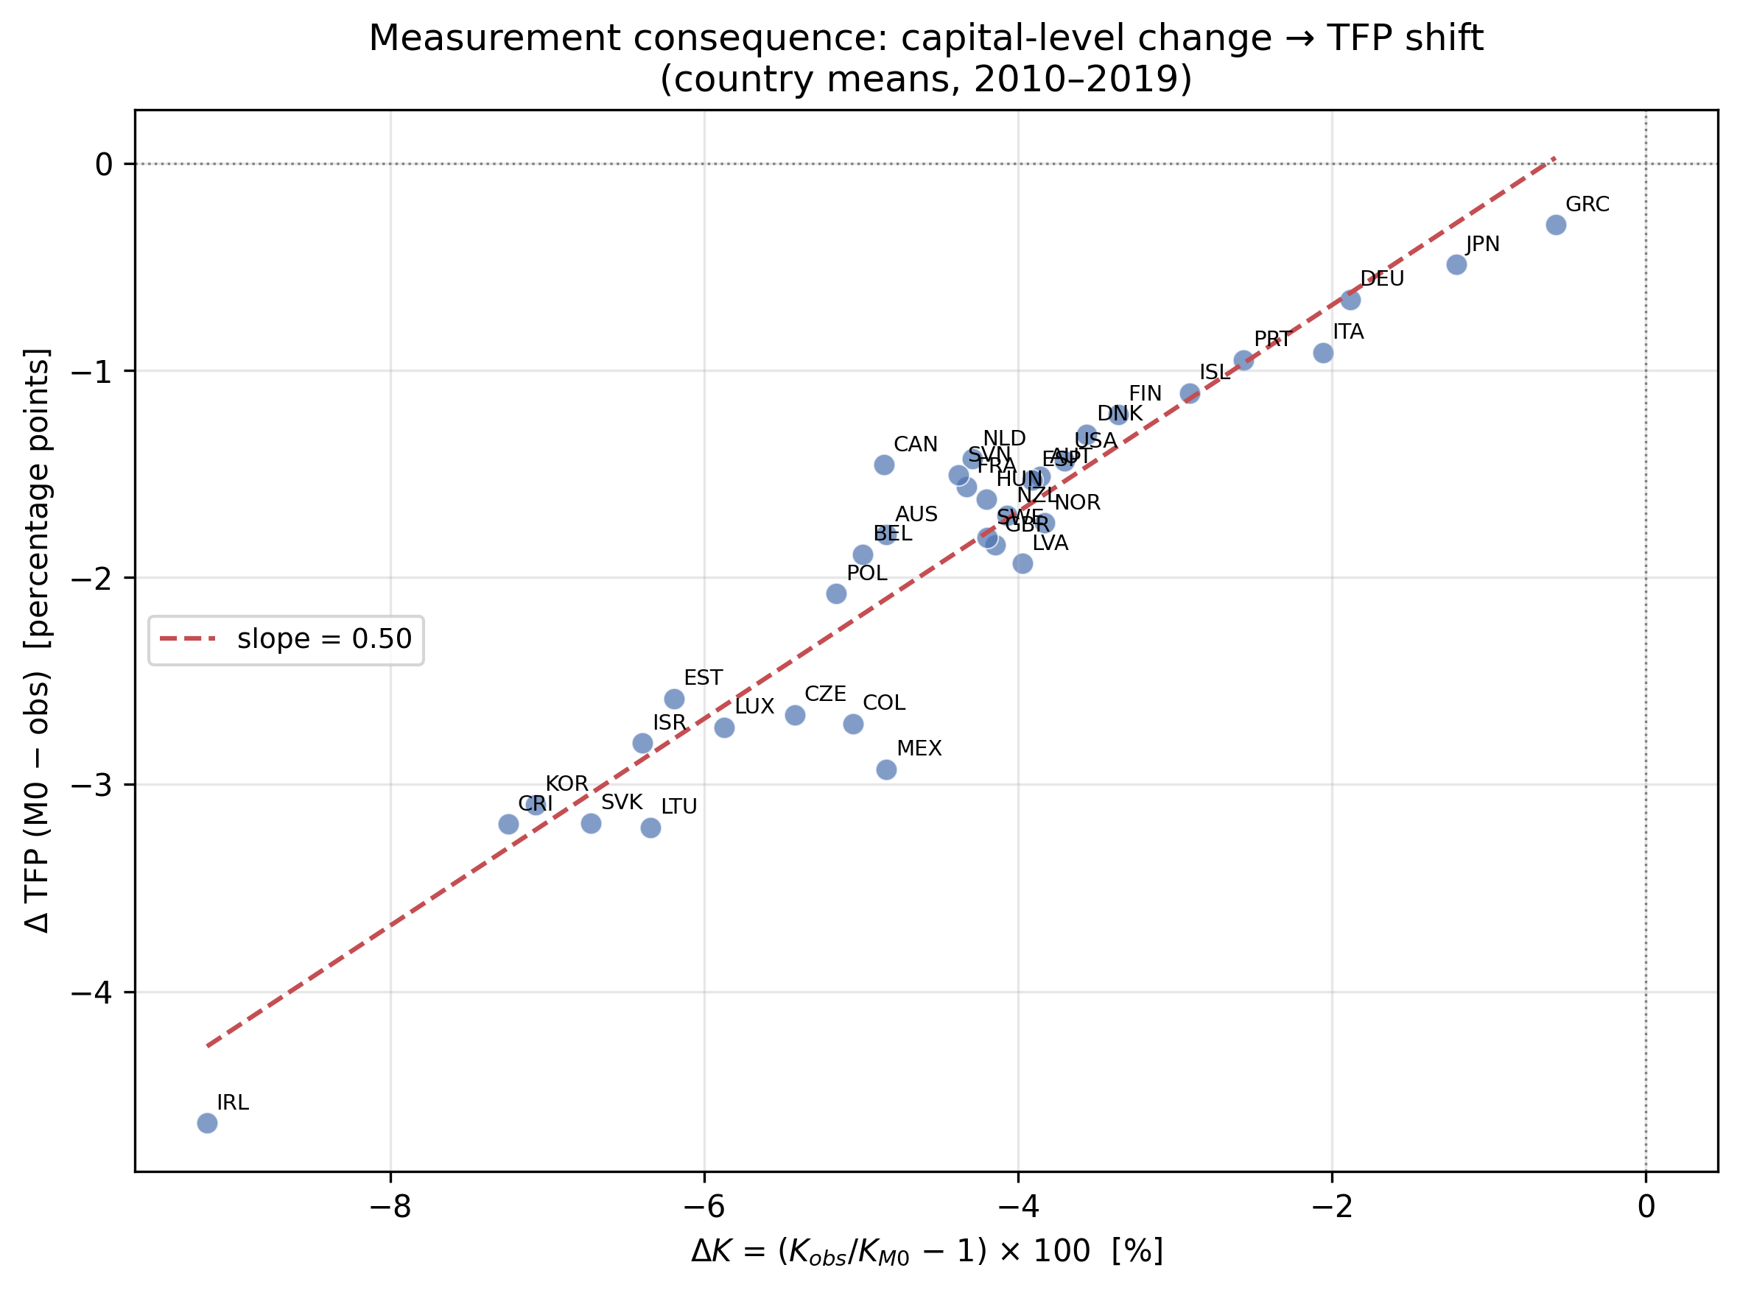
Fig. 4. Measurement consequence: K-level change vs log-level TFP shift (country means, 2010–2019).
Measurement consequence: K-level change vs log-level TFP shift (country means, 2010–2019).

Slide 12
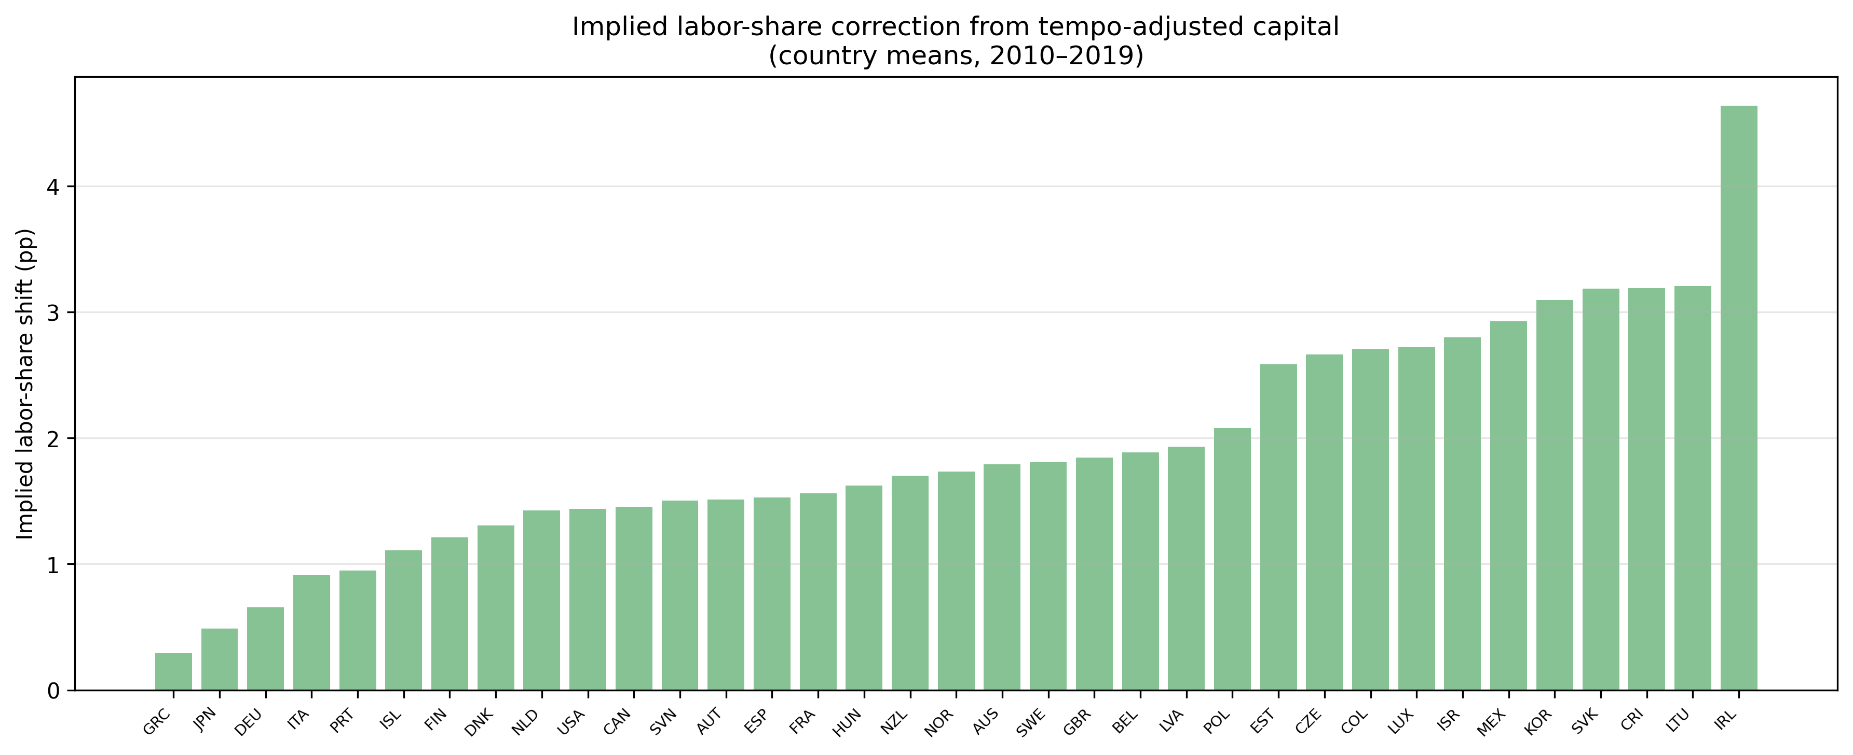
Fig. 5. Implied labour-share correction from tempo-adjusted capital (country means, 2010–2019).
Implied labour-share correction from tempo-adjusted capital (country means, 2010–2019).

Slide 13
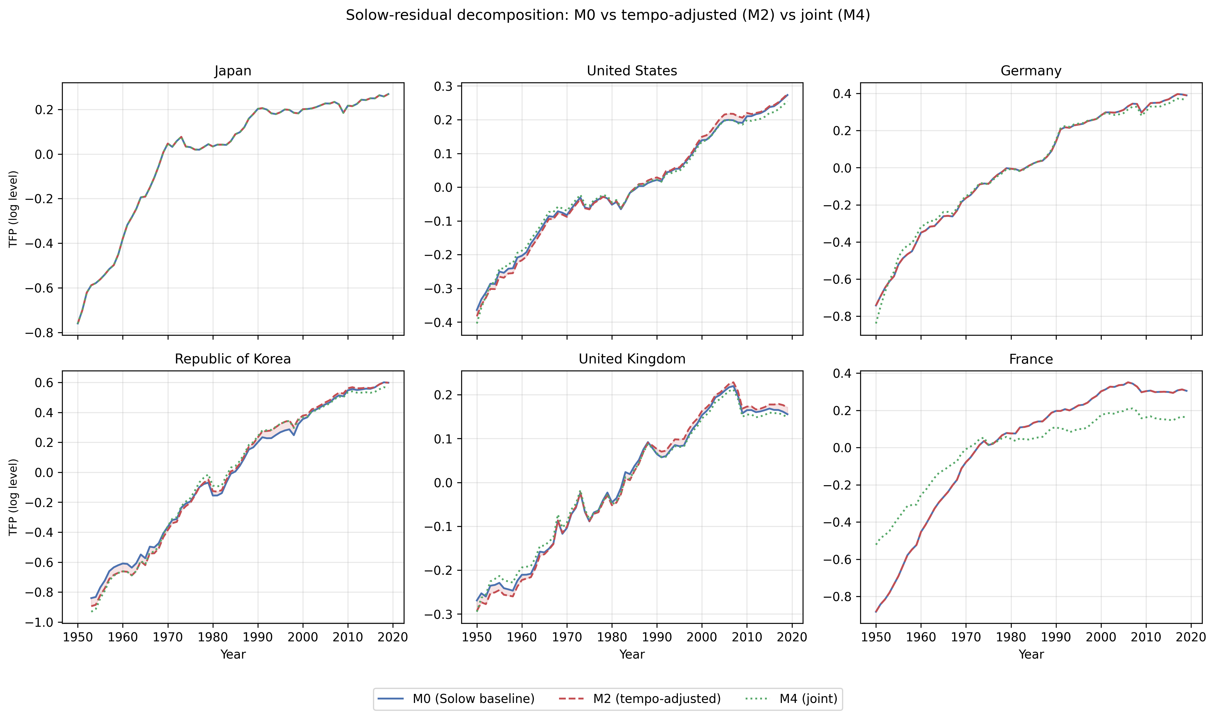
Supplementary Fig. 2. Solow-residual decomposition: M0 vs tempo-adjusted (M2) vs joint (M4) for six representative countries.
Solow-residual decomposition: M0 vs tempo-adjusted (M2) vs joint (M4) for six representative countries.

Slide 14
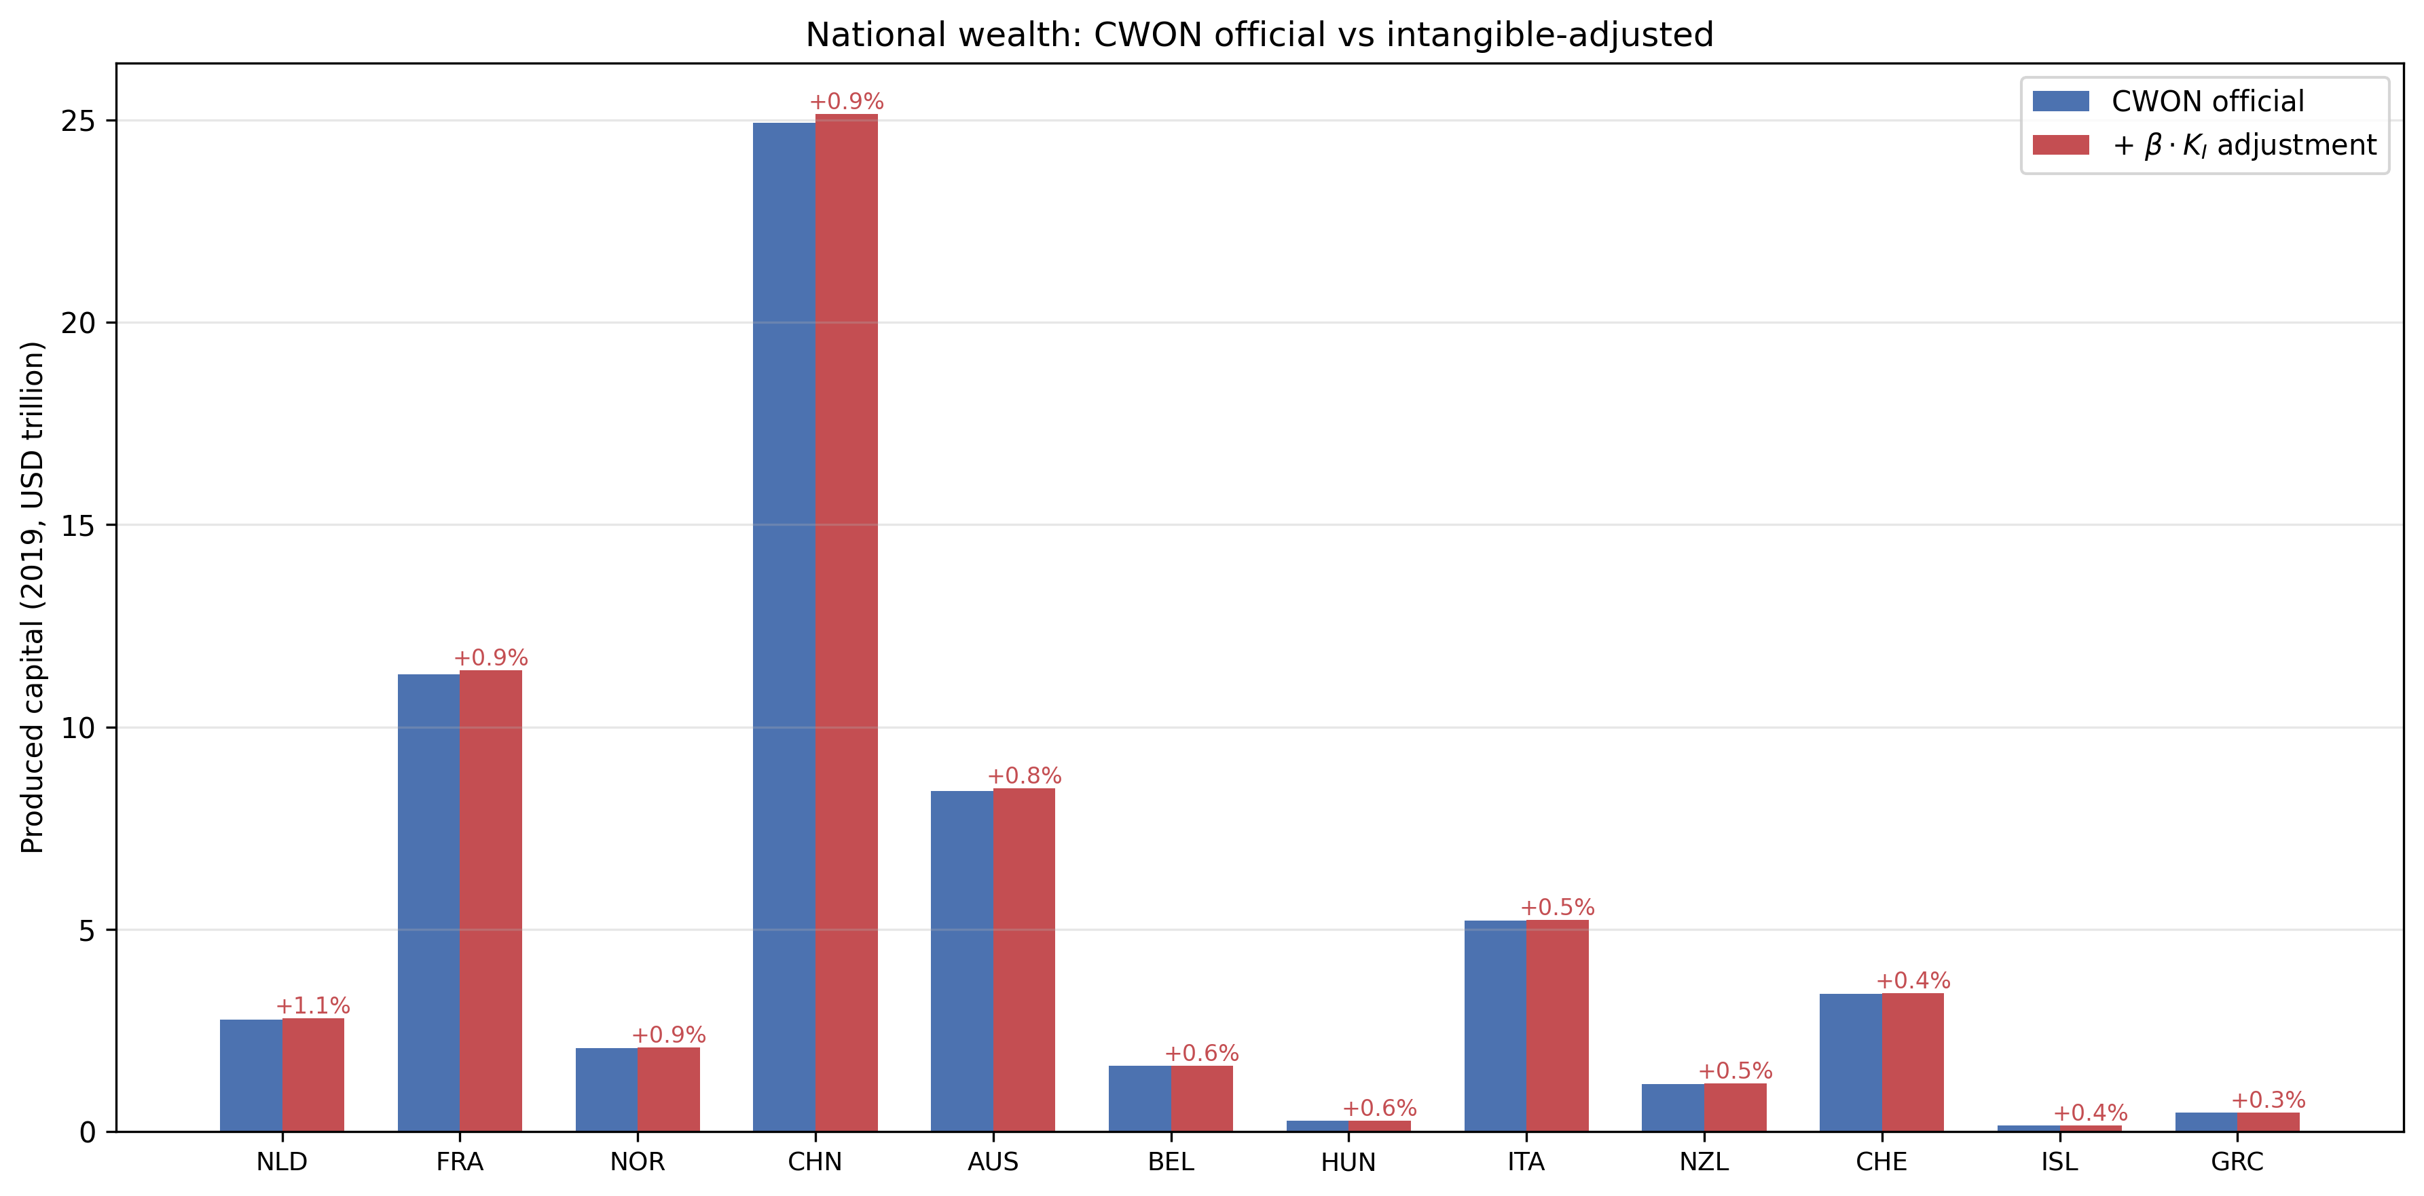
Supplementary Fig. 9. National wealth: CWON official vs intangible-adjusted produced capital (2019).
National wealth: CWON official vs intangible-adjusted produced capital (2019).

Slide 15
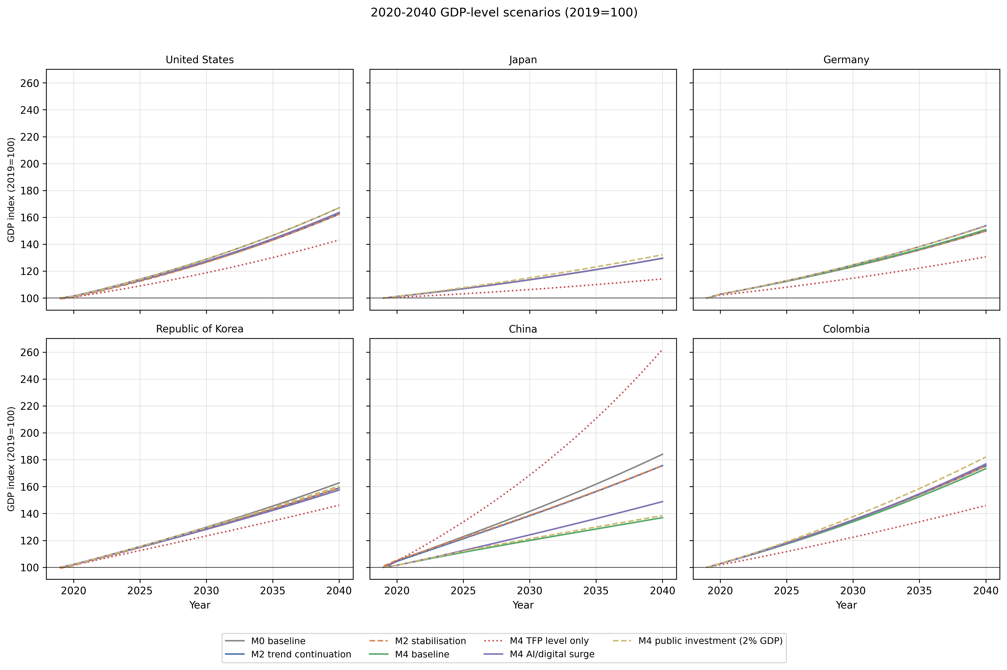
Supplementary Fig. 10. 2020–2040 GDP-level scenarios (2019=100) for selected countries, including M4 baseline, level-only TFP (2019 held fixed), AI surge, and fiscal-stimulus variants.
2020–2040 GDP-level scenarios (2019=100) for selected countries, including M4 baseline, level-only TFP (2019 held fixed), AI surge, and fiscal-stimulus variants.

Slide 16
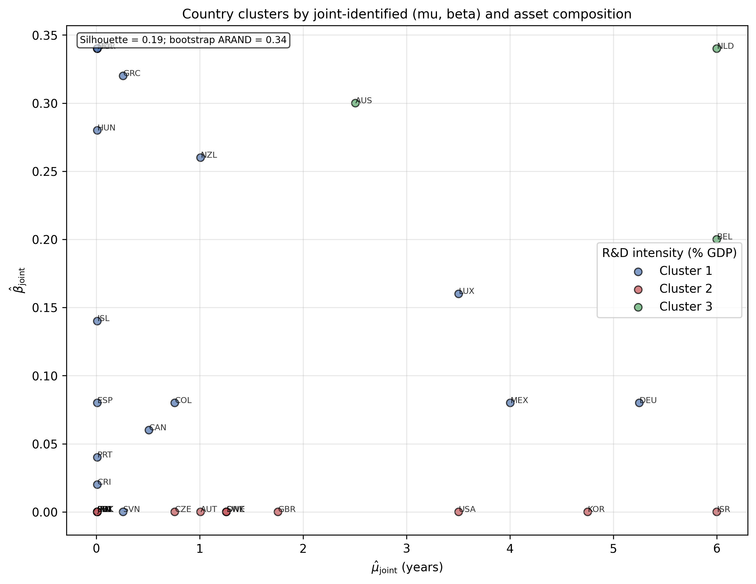
Supplementary Fig. 11. Country clusters by joint-identified (μ̂, β̂) and asset composition; silhouette and bootstrap-stability metrics support the k=3 partition (Table 10b).
Country clusters by joint-identified (μ̂, β̂) and asset composition; silhouette and bootstrap-stability metrics support the k=3 partition (Table 10b).

Slide 17
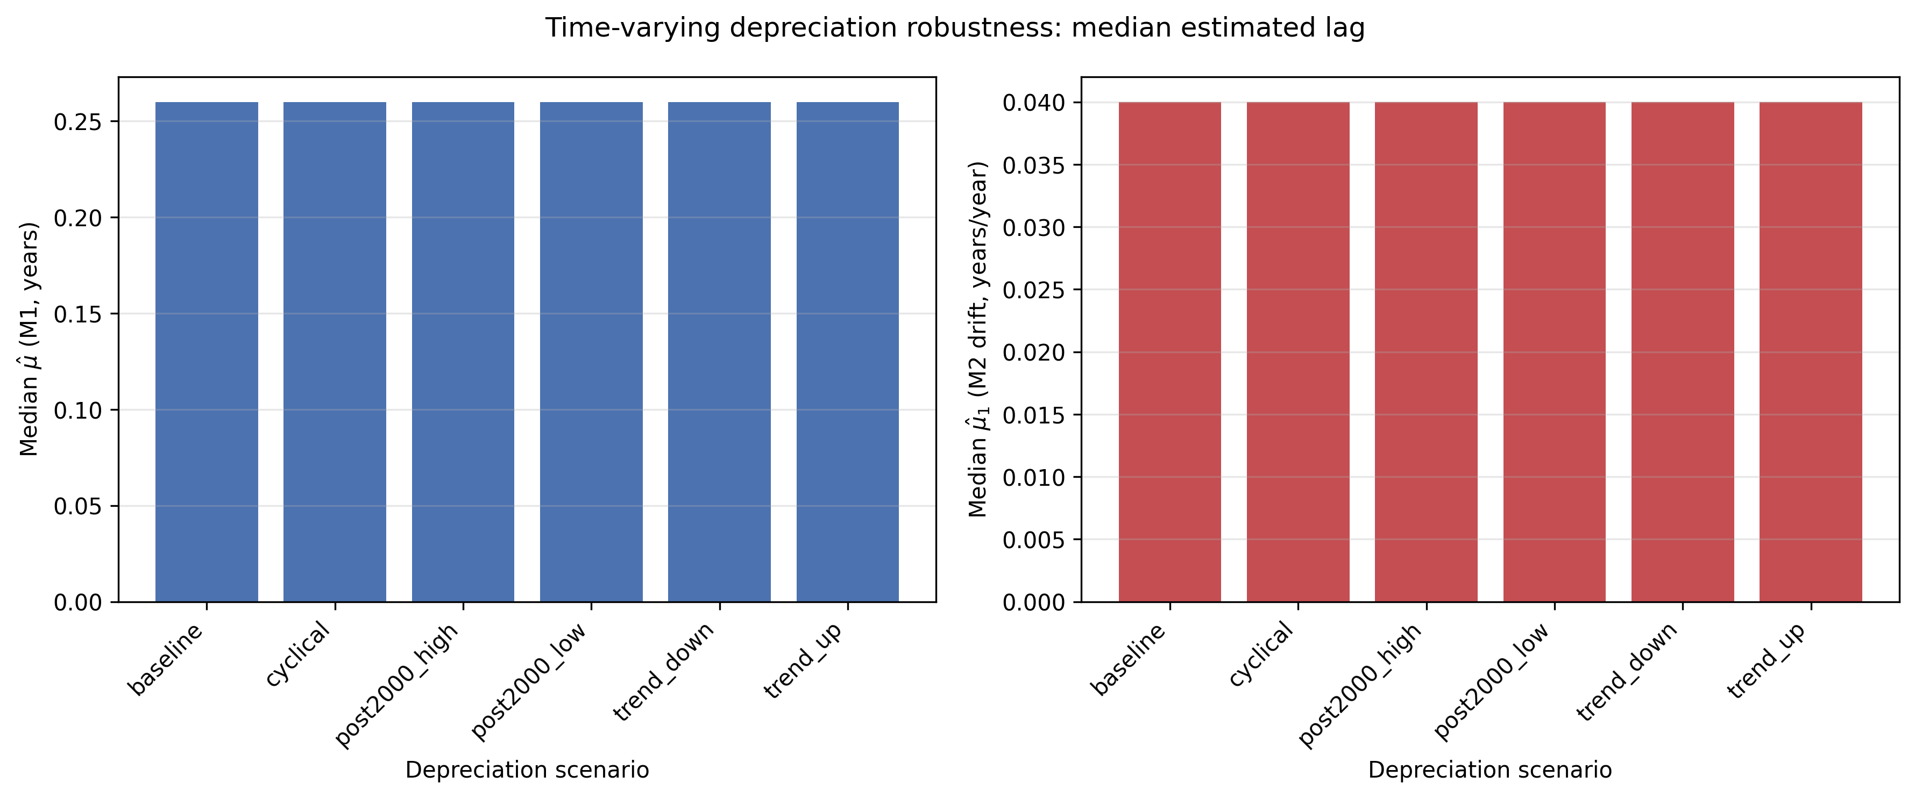
Supplementary Fig. 12. Time-varying depreciation robustness: median estimated lag.
Time-varying depreciation robustness: median estimated lag.

Slide 18
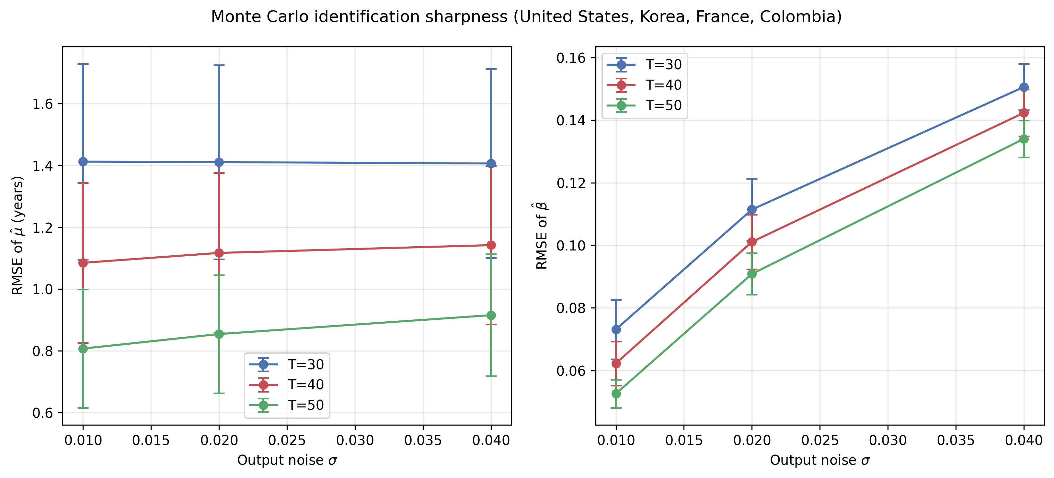
Supplementary Fig. 13. Monte Carlo identification sharpness for four calibrated economies (United States, Republic of Korea, France, Colombia). Error bars show approximate 95 % confidence intervals for the mean RMSE across parameter cells.
Monte Carlo identification sharpness for four calibrated economies (United States, Republic of Korea, France, Colombia). Error bars show approximate 95 % confidence intervals for the mean RMSE across parameter cells.

Slide 19
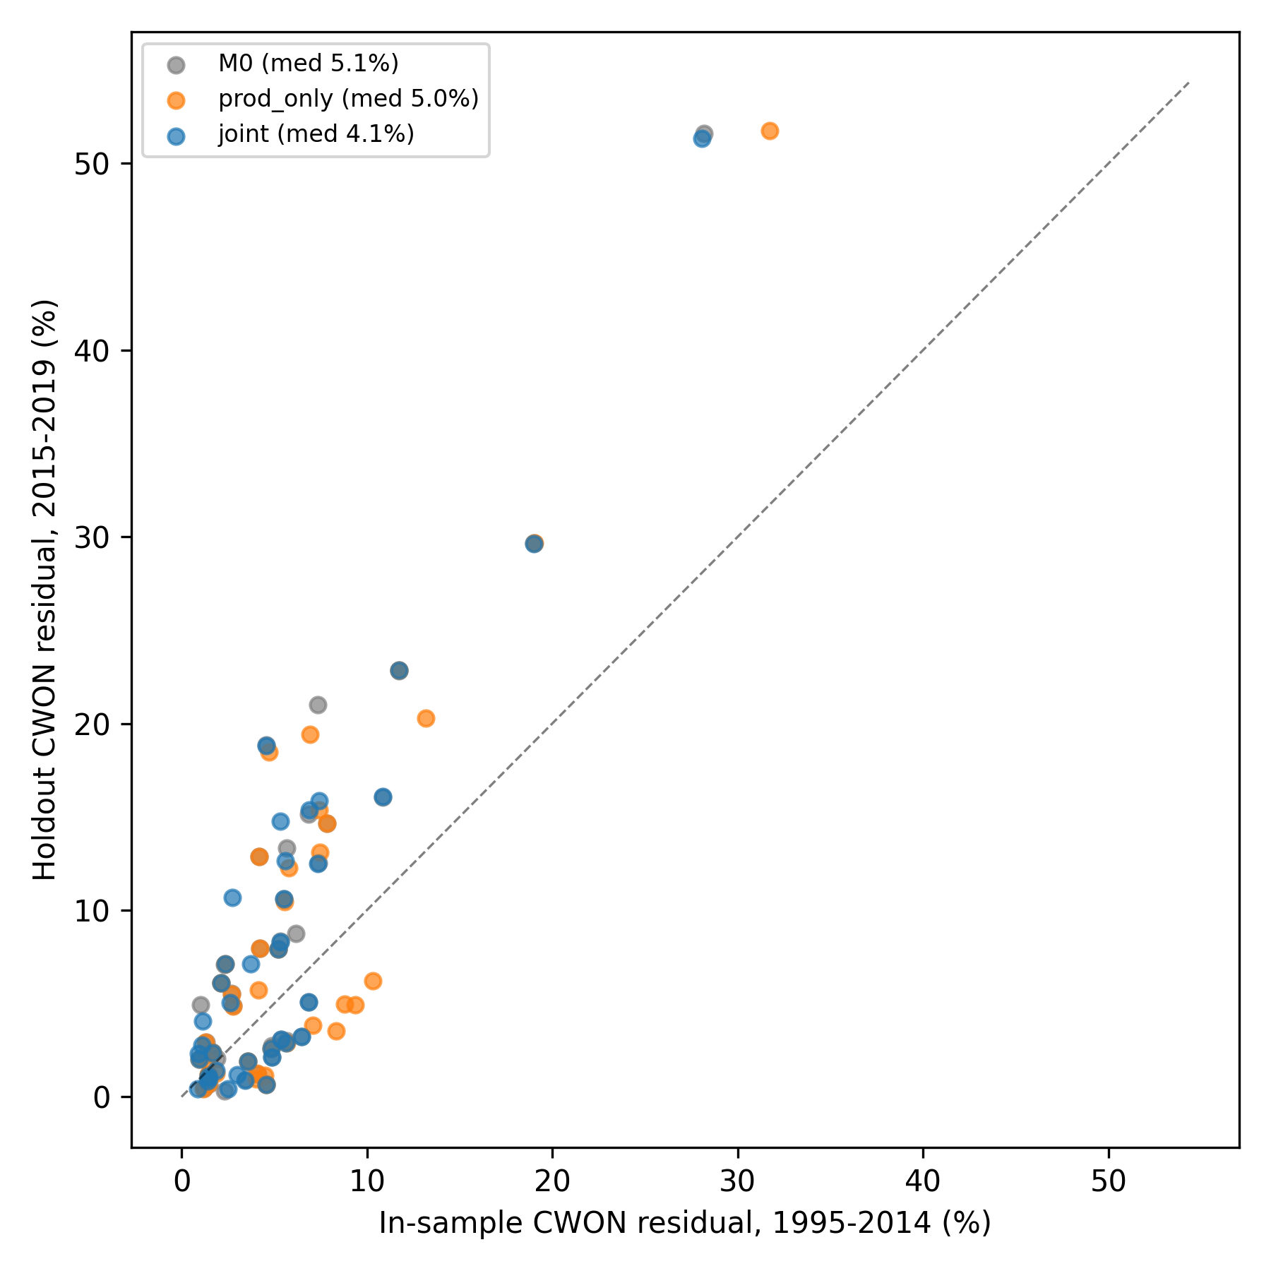
Supplementary Fig. 14. CWON temporal holdout: in-sample (1995–2014) versus held-out (2015–2019) wealth residuals under M0, production-only, and joint identification.
CWON temporal holdout: in-sample (1995–2014) versus held-out (2015–2019) wealth residuals under M0, production-only, and joint identification.

