Slide 1
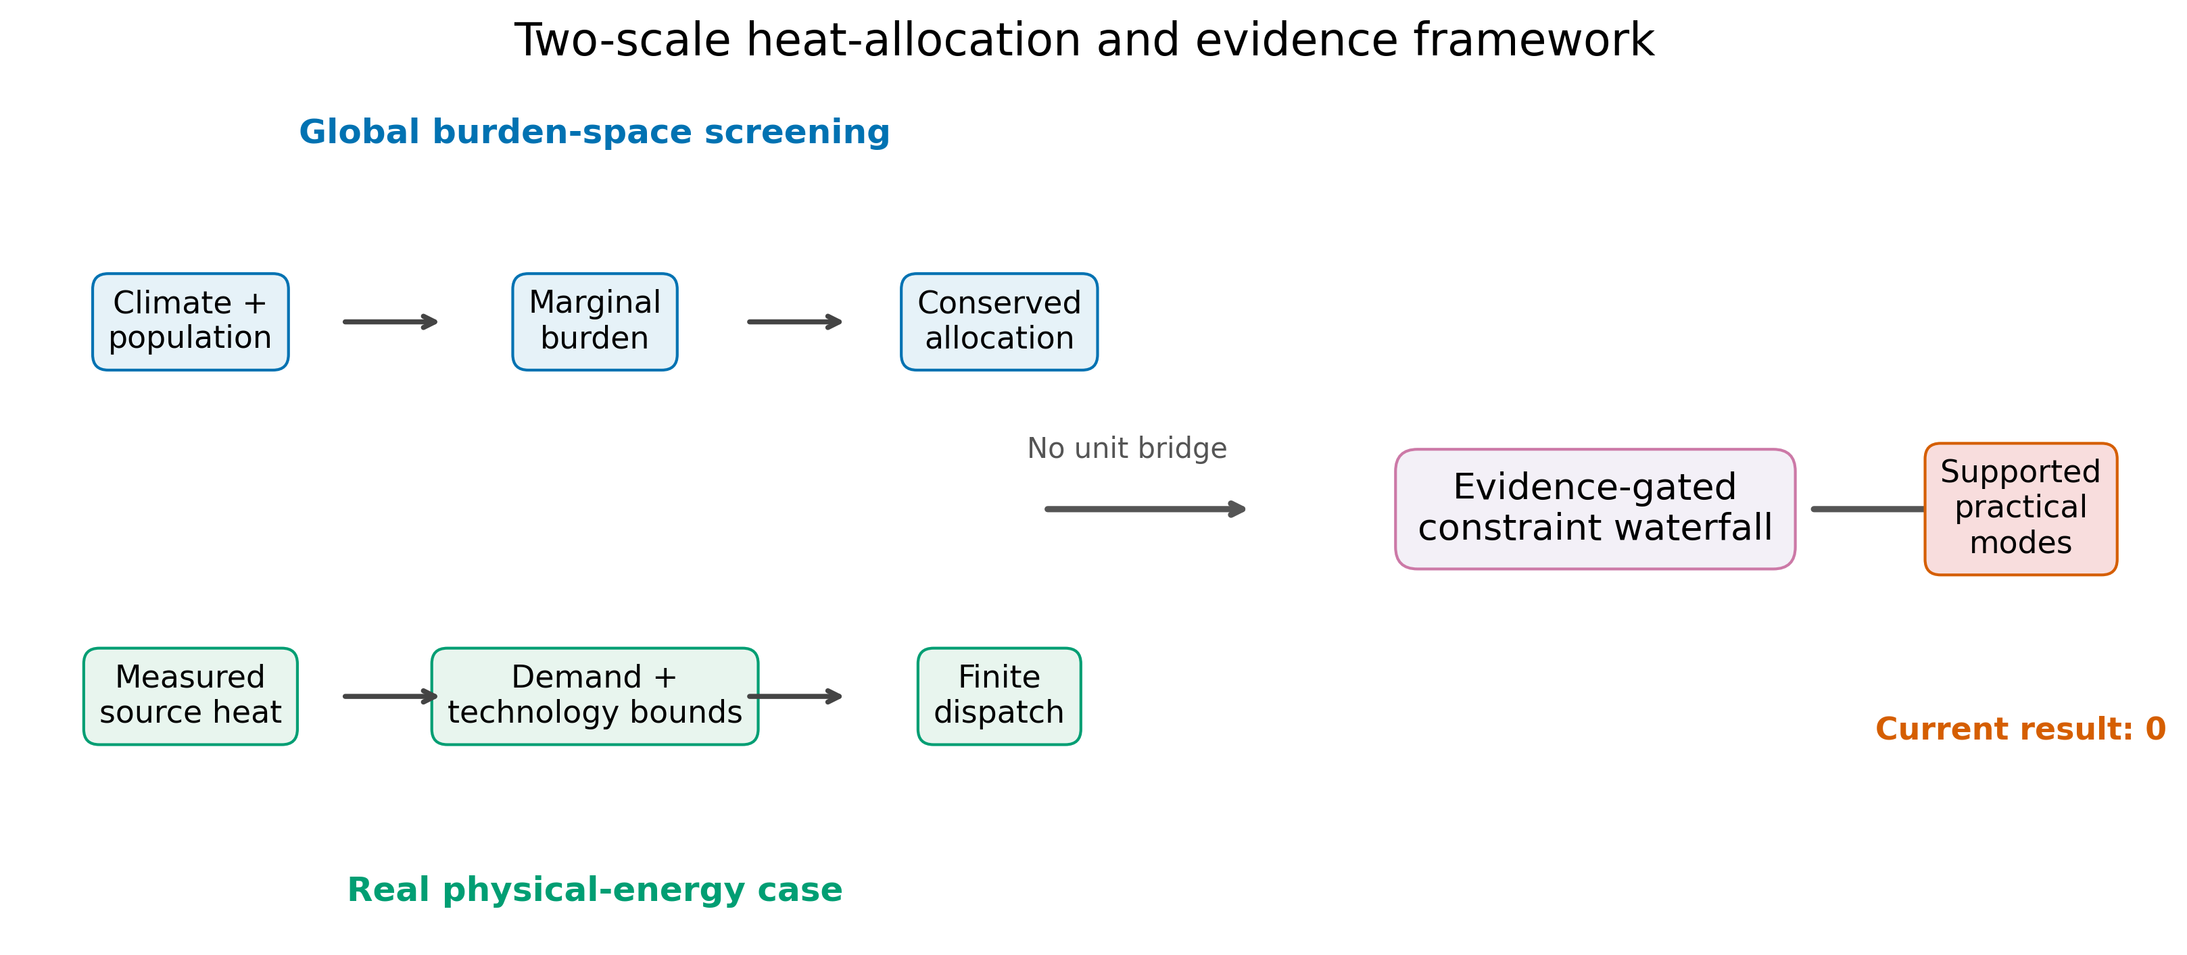
Figure 1
Figure 1. Two-scale heat-allocation and evidence framework. The global burden-space screening branch and the real physical-energy branch enter a common evidence-gated constraint waterfall without an assumed unit conversion.

Slide 2
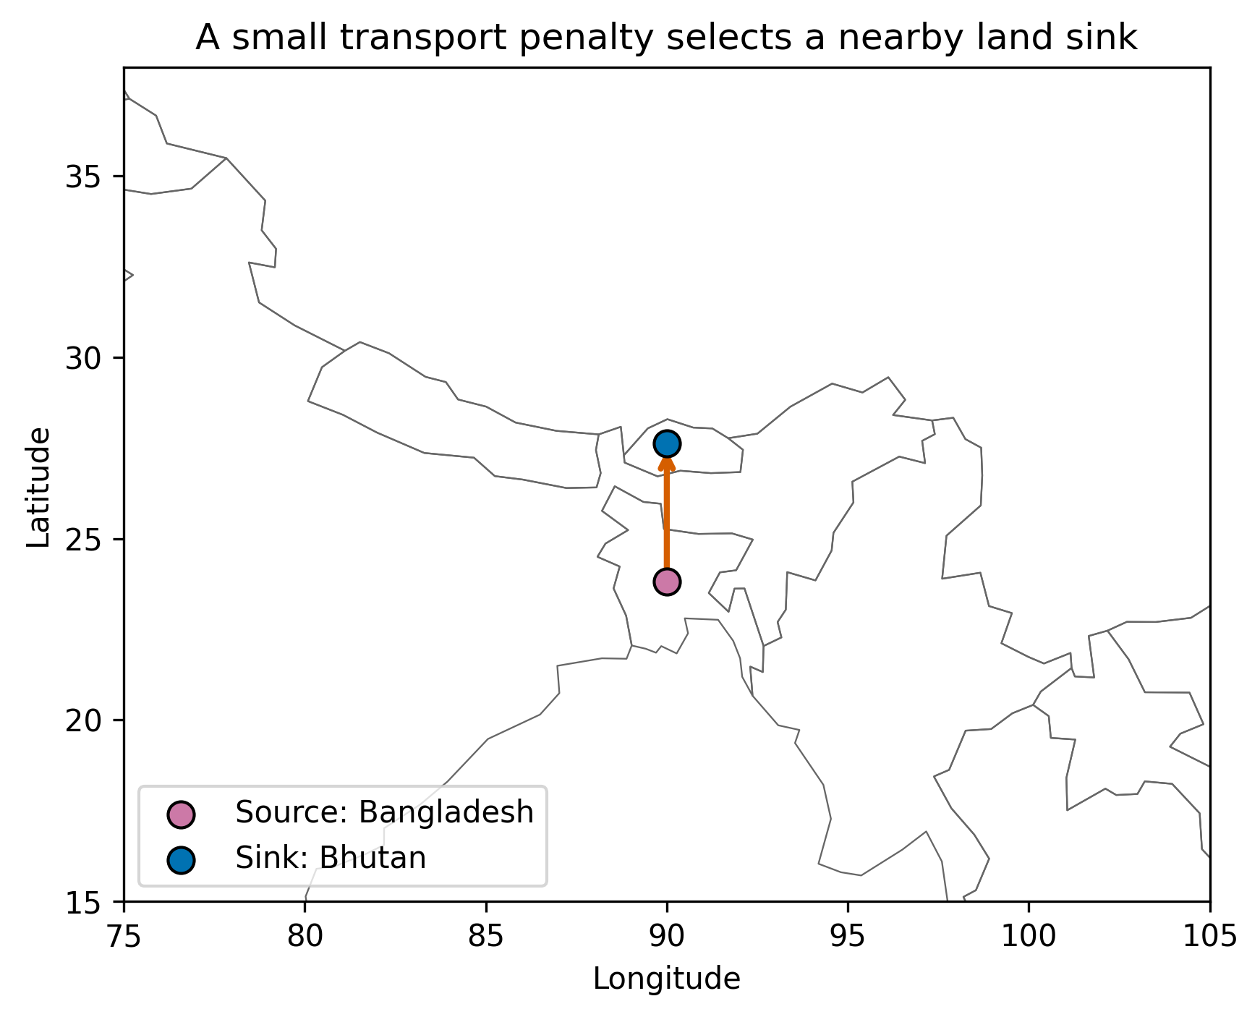
Figure 2
Figure 2. Primary spatial one-GJ transfer under a small transport penalty of 10^-5 burden units per GJ-km, a 5,000-km limit, and land/non-cryosphere sink constraints.

Slide 3
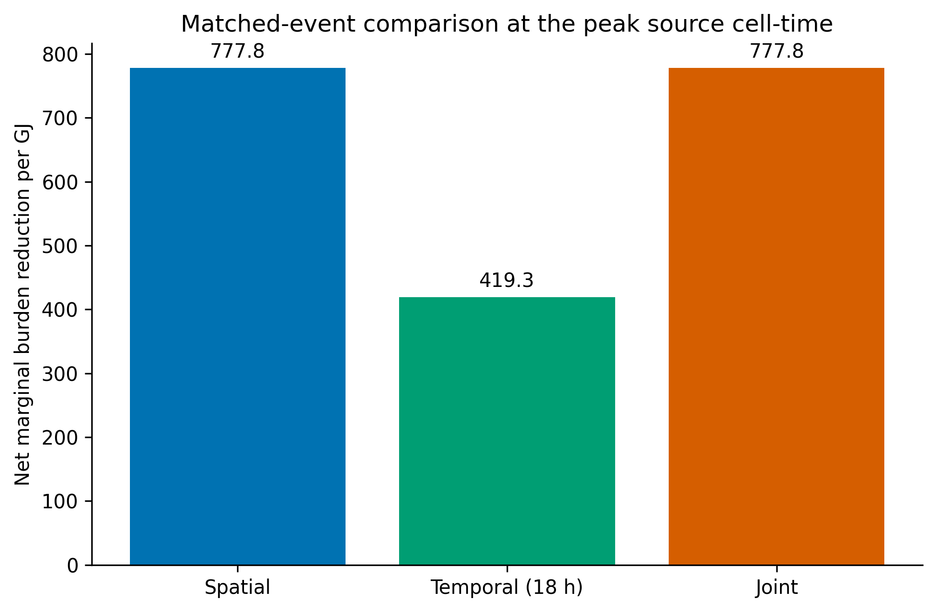
Figure 3
Figure 3. Net marginal burden reduction for zero-penalty spatial, temporal, and joint modes using the same peak source cell-time; the temporal candidate uses a 18-hour lag.

Slide 4
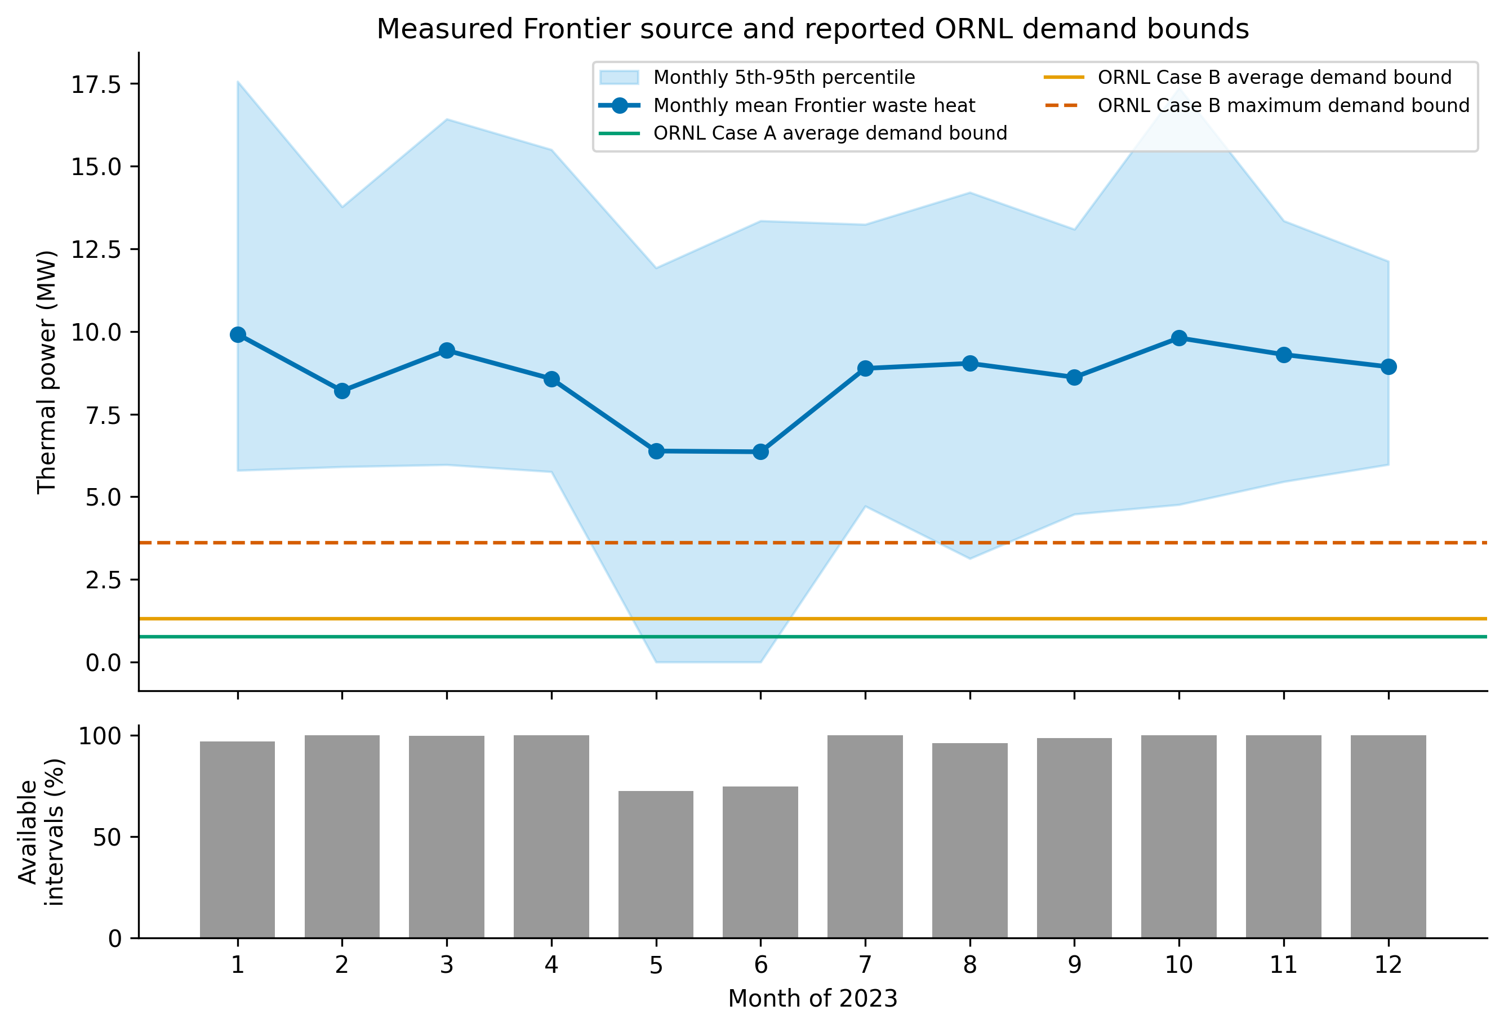
Figure 4
Figure 4. Measured Frontier waste-heat power and reported ORNL receiving-demand bounds. Monthly source summaries retain unavailable 10-minute intervals rather than imputing them; horizontal lines are annual demand-summary bounds, not a synchronized demand profile.

Slide 5
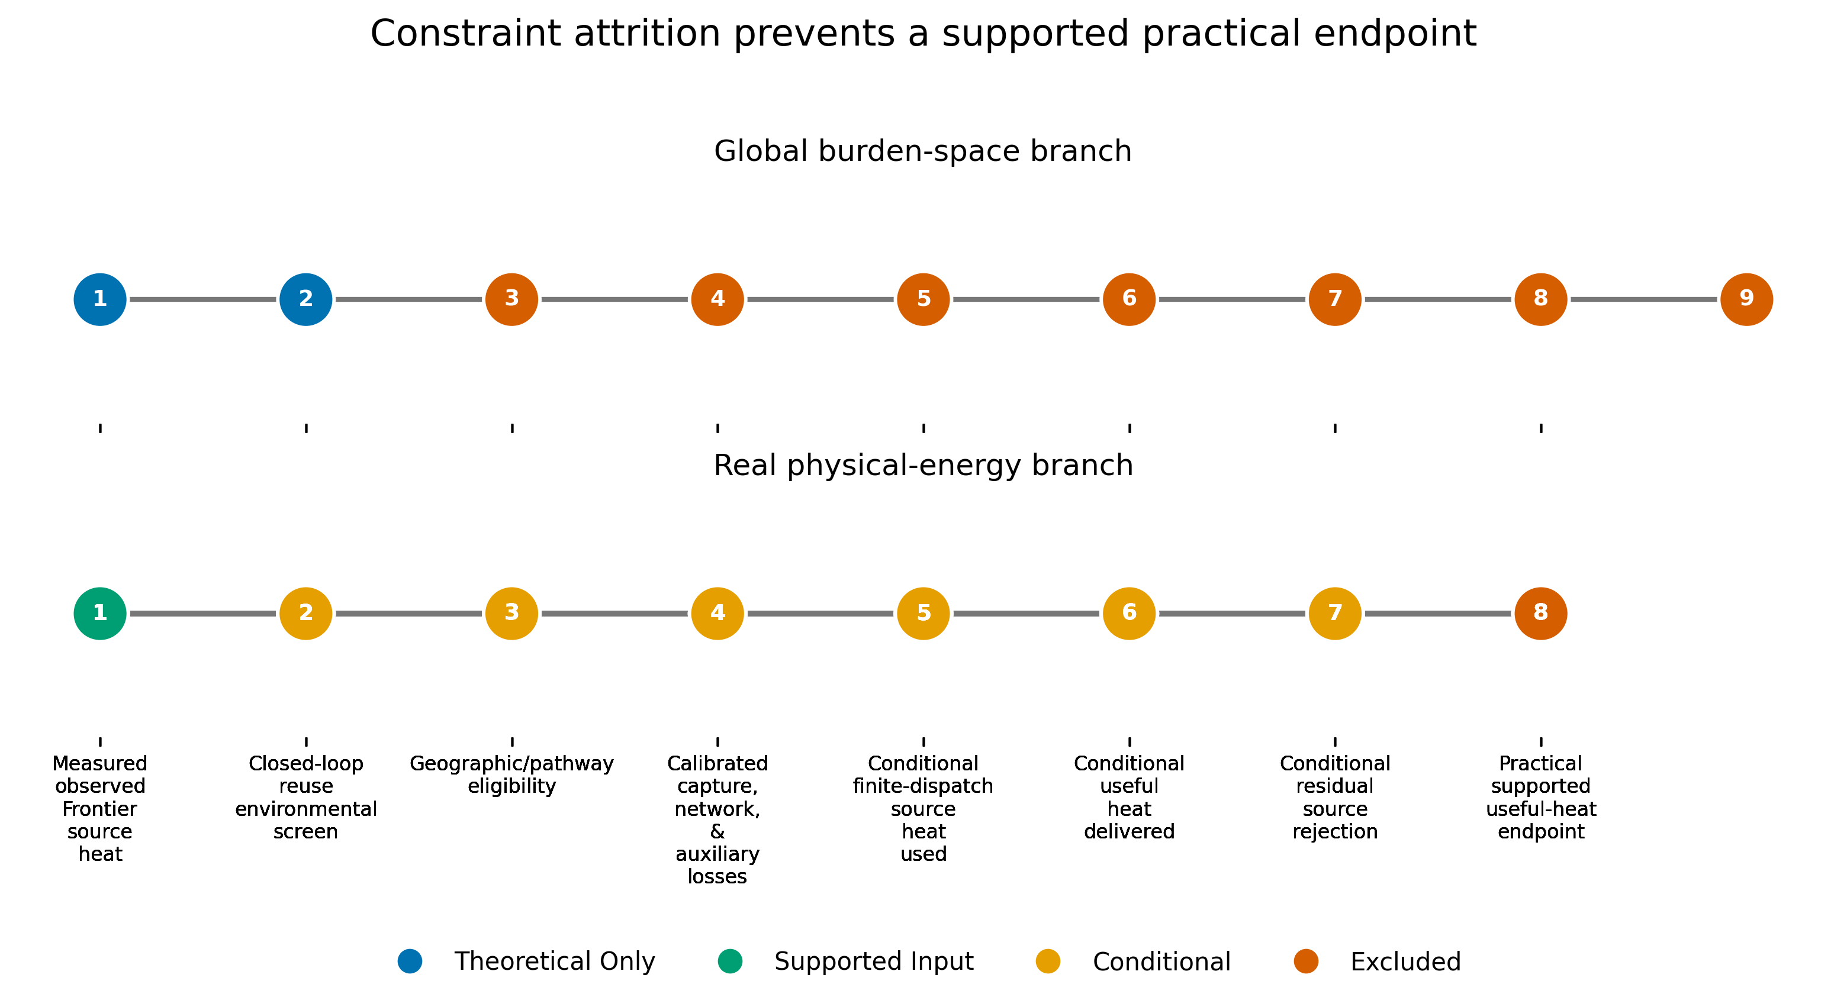
Figure 5
Figure 5. Global-to-real constraint waterfall. Burden-space and physical-energy branches remain separate because no supported unit bridge exists. The real pathway retains conditional inputs but reaches no supported practical endpoint.

Slide 6
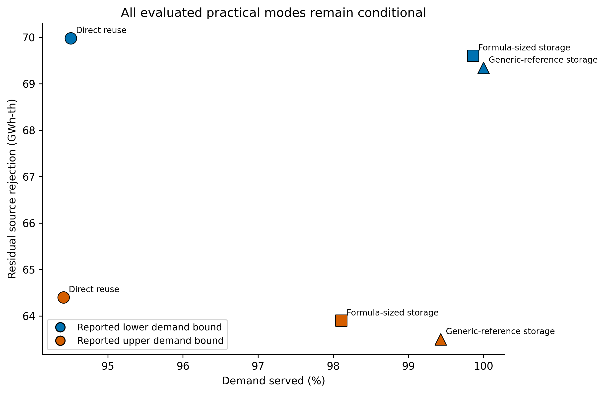
Figure 6
Figure 6. Conditional practical mode results under reported lower and upper demand bounds. All modes are sensitivity cases; storage labels do not imply a case-specific installed design.

Slide 7
Table 1. Public datasets used in the global analysis.
Product | Role | Version | Completion
Admin 0 countries | country_boundaries | 5.1.2, 1:110m | complete
NCEP/NCAR Reanalysis 1 | downward_longwave_flux | 2023 annual file | complete
NCEP/NCAR Reanalysis 1 | downward_shortwave_flux | 2023 annual file | complete
NCEP/NCAR Reanalysis 1 | eastward_wind_10m | 2023 annual file | complete
NCEP/NCAR Reanalysis 1 | land_fraction | invariant Gaussian grid | complete
NCEP/NCAR Reanalysis 1 | near_surface_air_temperature | 2023 annual file | complete
NCEP/NCAR Reanalysis 1 | near_surface_specific_humidity | 2023 annual file | complete
NCEP/NCAR Reanalysis 1 | northward_wind_10m | 2023 annual file | complete
NCEP/NCAR Reanalysis 1 | sea_ice_fraction | 2023 annual file | complete
NCEP/NCAR Reanalysis 1 | snow_water_equivalent | 2023 annual file | complete
NCEP/NCAR Reanalysis 1 | surface_pressure | 2023 annual file | complete
NCEP/NCAR Reanalysis 1 | upward_longwave_flux | 2023 annual file | complete
NCEP/NCAR Reanalysis 1 | upward_shortwave_flux | 2023 annual file | complete
Unconstrained global population mosaic at 30 arc seconds | population_count | 2020 | complete

Slide 8
Table 2. Canonical model assumptions.
Assumption | Value | Unit
Canonical transferred energy | 1 | GJ
Atmospheric mixing height | 100 | m
Air density | 1.23 | kg m-3
Air heat capacity | 1e+03 | J kg-1 K-1
Humidex reference | 26 | degrees C equivalent
Burden curvature | 2 | dimensionless
Maximum transfer distance | 5e+03 | km
Local heat-load cap | 1e+06 | GJ
Maximum local temperature perturbation | 0.1 | K

Slide 9
Table 3. Matched-event spatial, temporal, and joint allocation results.
Analysis | Source Country | Sink Country | Lag Steps | Distance Km | Net Benefit | Fraction Of Matched Spatial | Cooptimal Candidate Count | Near Optimal Candidate Count
spatial | Bangladesh | Russia | 0 | 4.67e+03 | 778 | 1 | 422 | 808
temporal | Bangladesh | Bangladesh | 3 | 0 | 419 | 0.539 | 1 | 1
joint | Bangladesh | Russia | 0 | 4.67e+03 | 778 | 1 | nan | nan

Slide 10
Table 4. Case-specific evidence status.
Evidence Domain | Status | Supported Statement
Source heat | Measured | 75,573.6 MWh-th; 49,869 valid intervals
Receiving demand | Summary bounds only | Case A 0.76–2.09 MW; no synchronized profile
Heat pump | Bounded | COP 3.08; 3.0 MW-th
Capture, route, auxiliaries | Not calibrated | No recovery efficiency, hydraulic design, or incremental load
Storage | Not designed | No case-specific tank volume or operating temperature range
Cost and lifecycle CO2e | Incomplete | No complete installed cost or case-specific lifecycle inventory
Environmental clearance | Not established | No route clearance or authorization for a new thermal discharge

Slide 11
Table 5. Global-to-real constraint summary.
Quantity | Value | Eligibility | Claim Limit
Global spatial bound | 777.7645 burden units/GJ | Theoretical only | No conversion to delivered heat
Global temporal bound | 419.3294 burden units/GJ | Theoretical only | Same-event marginal screening
Observed Frontier source | 75,573.6 MWh-th | Supported input | Missing intervals retained
ORNL demand | 0.76–3.61 MW | Summary bounds | No synchronized demand trace
Conditional finite dispatch | 94.4121%–100.0000% demand served | Conditional | Six sensitivity modes
Supported practical endpoint | 0 | Excluded | Required evidence gates remain open

Slide 12
Table 6. Conditional practical mode-decision results.
Mode | Demand | Useful Heat (Mwh) | Demand Served | Residual Heat (Mwh) | Eligibility
Direct | Lower bound | 8,278.8 | 94.5% | 69,982.7 | Conditional
Formula storage | Lower bound | 8,747.8 | 99.9% | 69,604.8 | Conditional
Generic storage | Lower bound | 8,760.0 | 100.0% | 69,346.2 | Conditional
Direct | Upper bound | 16,541.0 | 94.4% | 64,403.0 | Conditional
Formula storage | Upper bound | 17,188.5 | 98.1% | 63,903.4 | Conditional
Generic storage | Upper bound | 17,420.1 | 99.4% | 63,501.3 | Conditional

