Slide 1
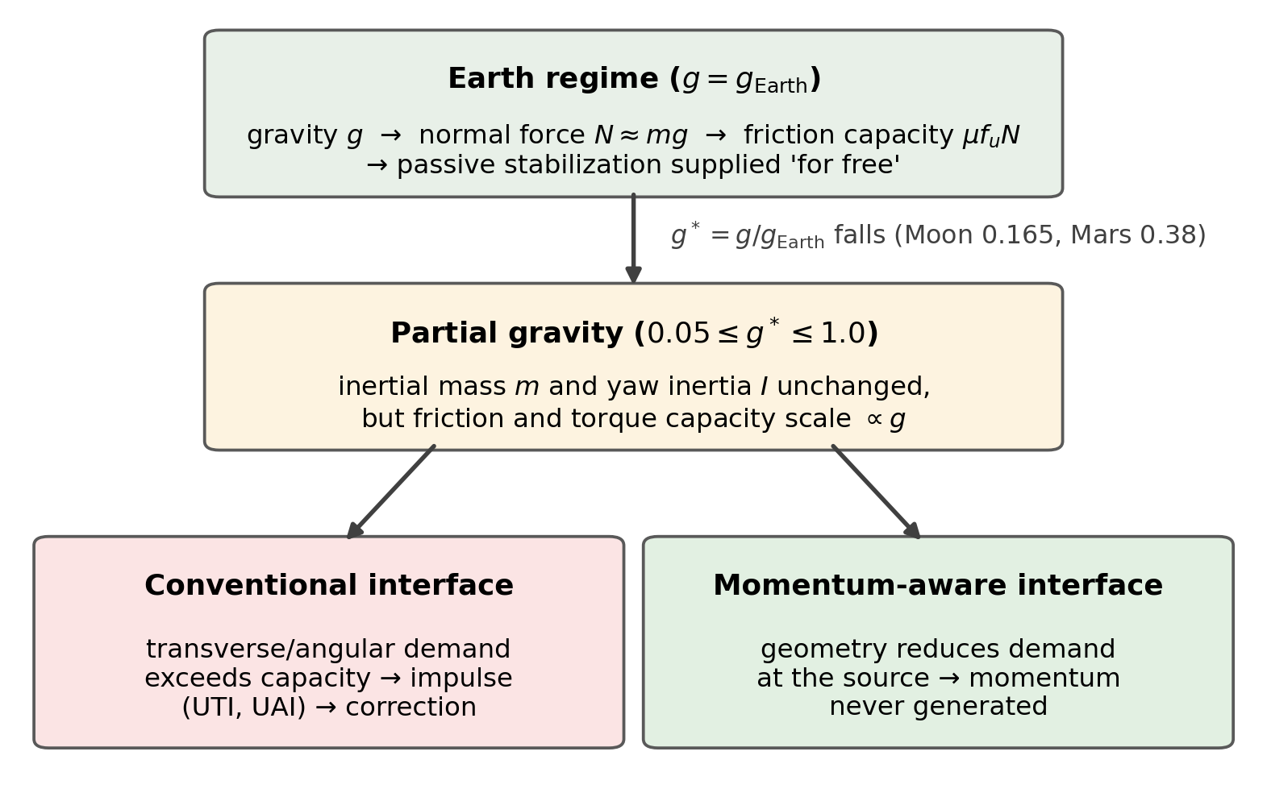
Figure 1. Conceptual framework. Terrestrial design treats gravity as a free stabilizer (normal force → friction capacity). Under partial gravity, capacity falls ∝ g while inertia is unchanged, so conventional interfaces increasingly inject task-irrelevant impulse. Momentum-aware geometry prevents generation instead of restraining it.

Slide 2
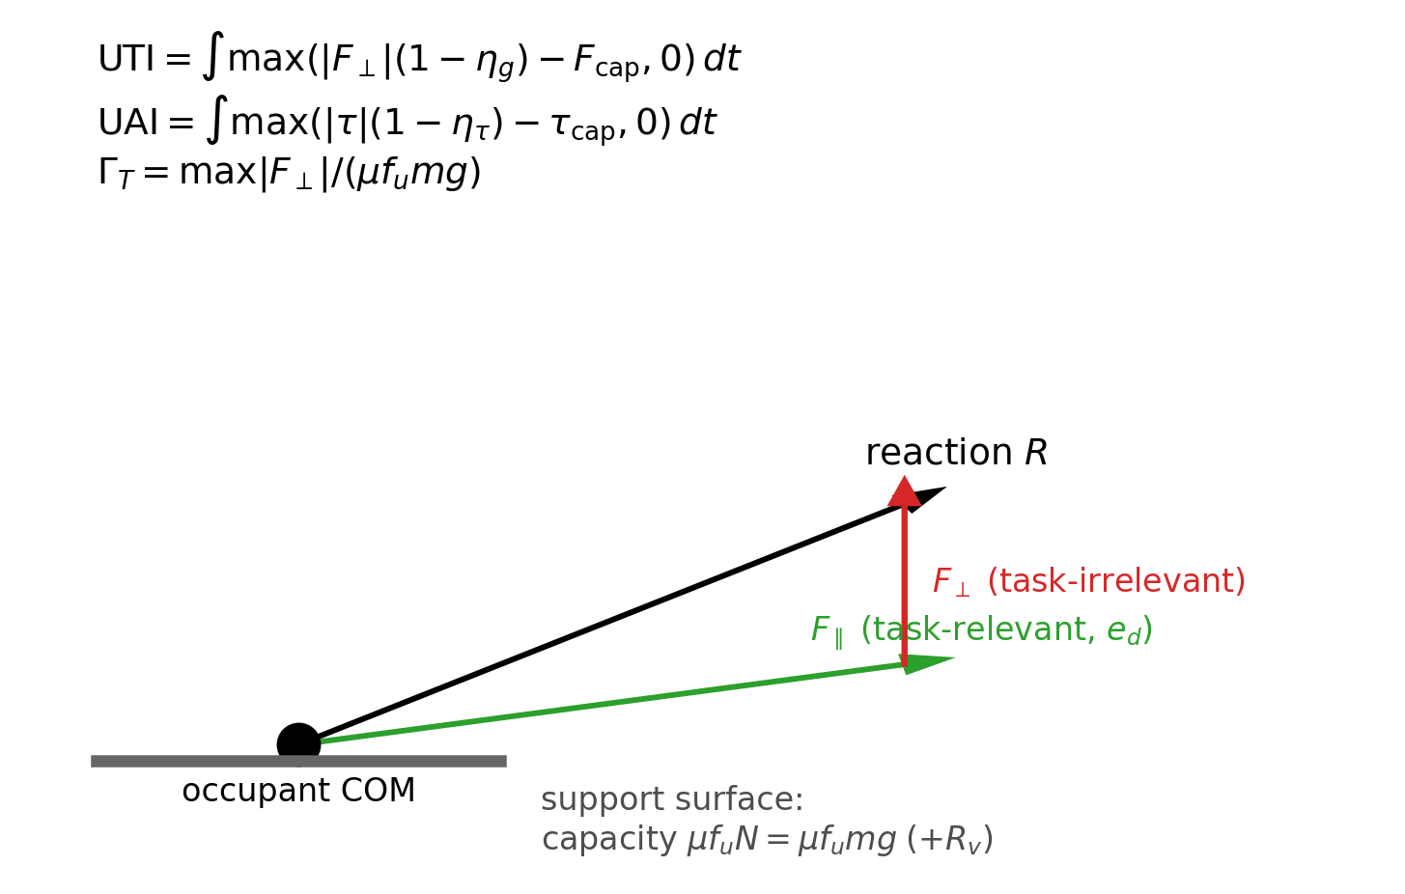
Figure 2. Mechanical framework. Interface reaction R decomposes into task-relevant and task-irrelevant ; the excess of demand over gravity-scaled capacity accumulates as UTI and UAI.

Slide 3
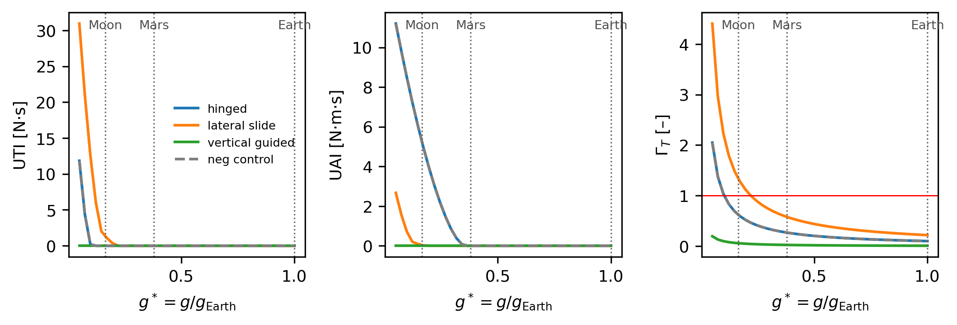
Figure 3. Gravity response of the door/hatch case: UTI, UAI and stabilization-demand ratio versus = g/ for hinged (conventional), lateral-slide, vertical-guided and cosmetic negative-control variants.

Slide 4
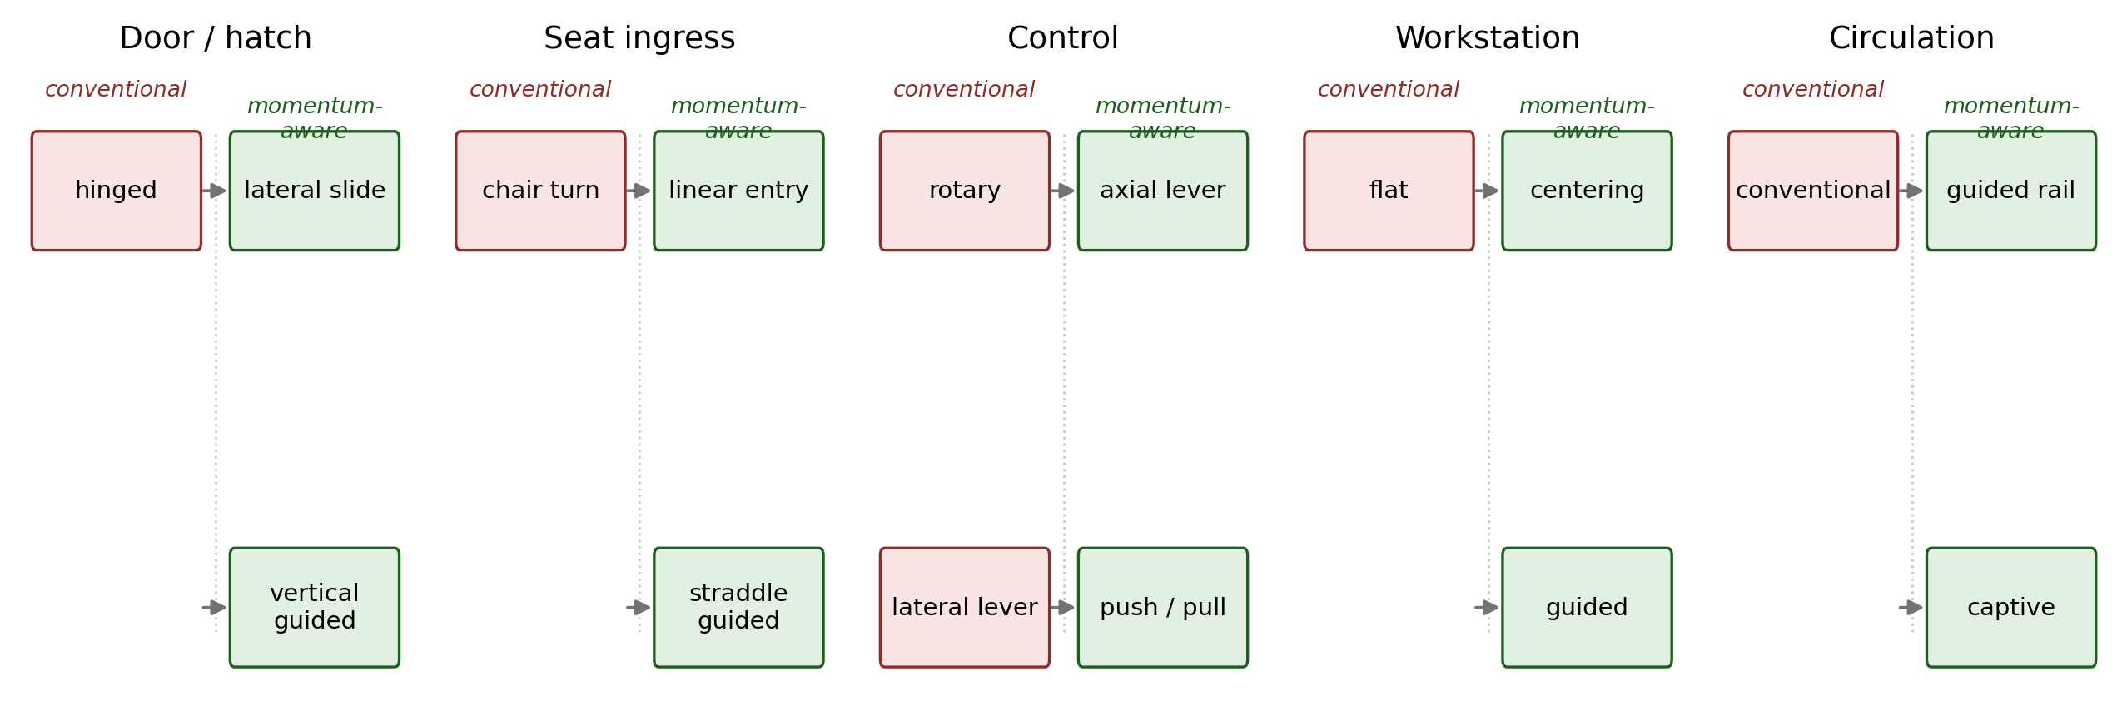
Figure 4. Canonical interface scenarios. Conventional versus candidate momentum-aware geometries for the five studied classes.

Slide 5
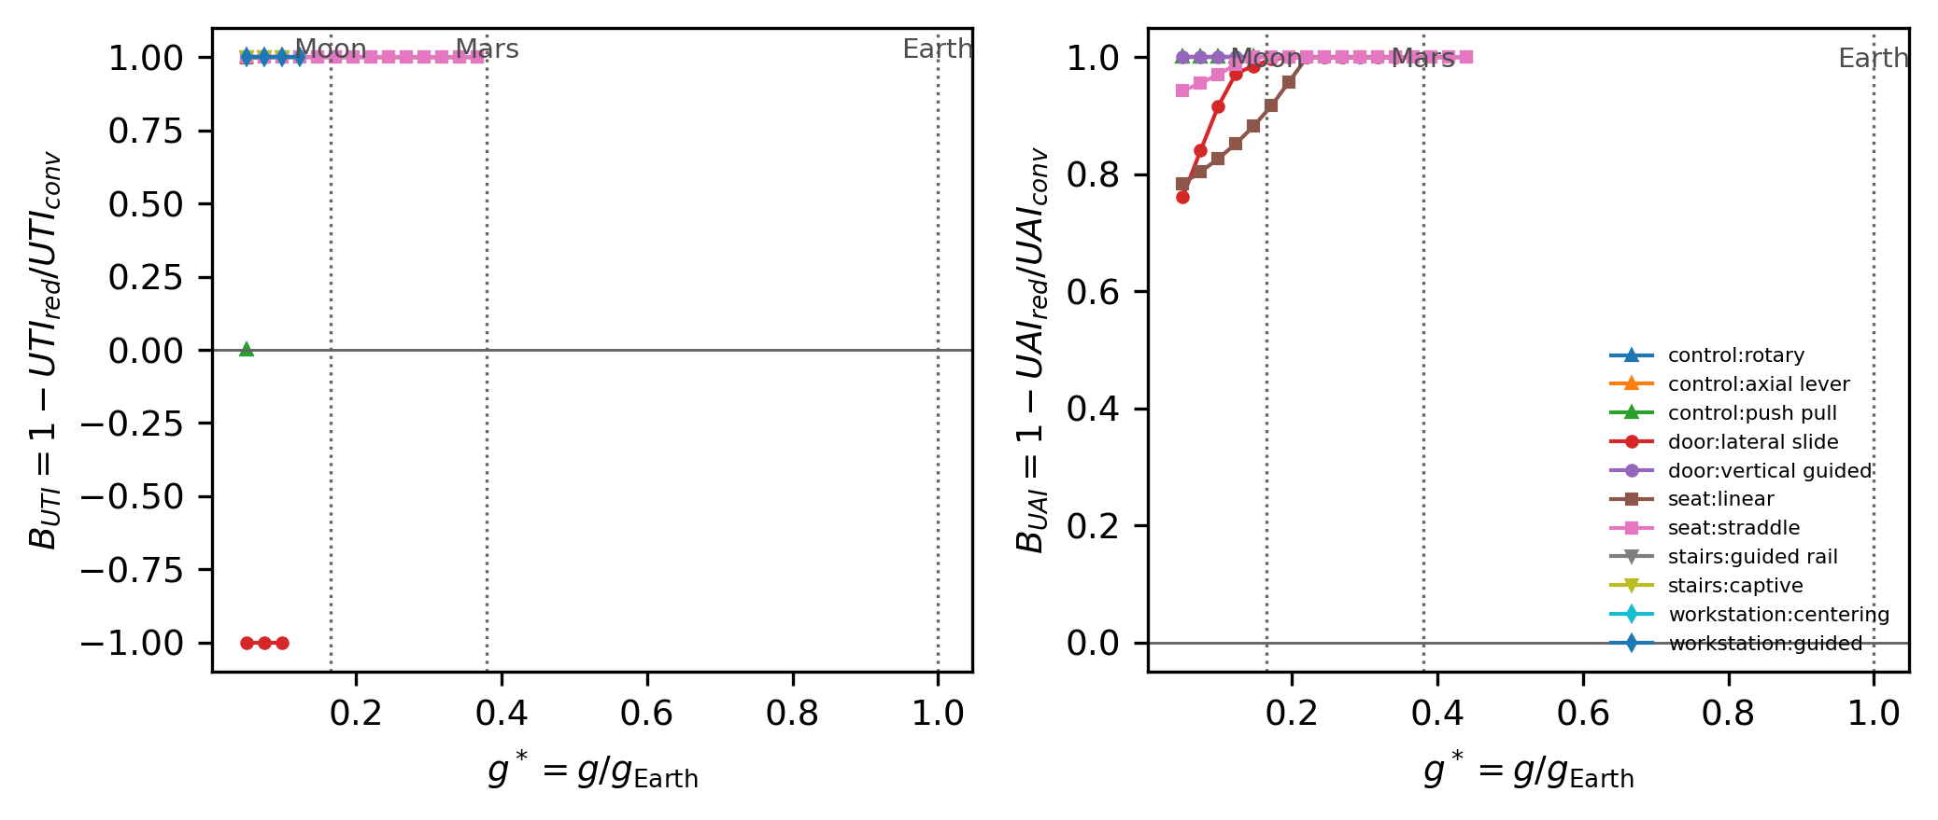
Figure 5. Cross-interface synthesis: normalized benefits (left) and (right) of redesigned variants versus conventional baselines, as a continuous function of gravity; masked where baseline impulse < 1e-3 N·s (N·m·s).

Slide 6
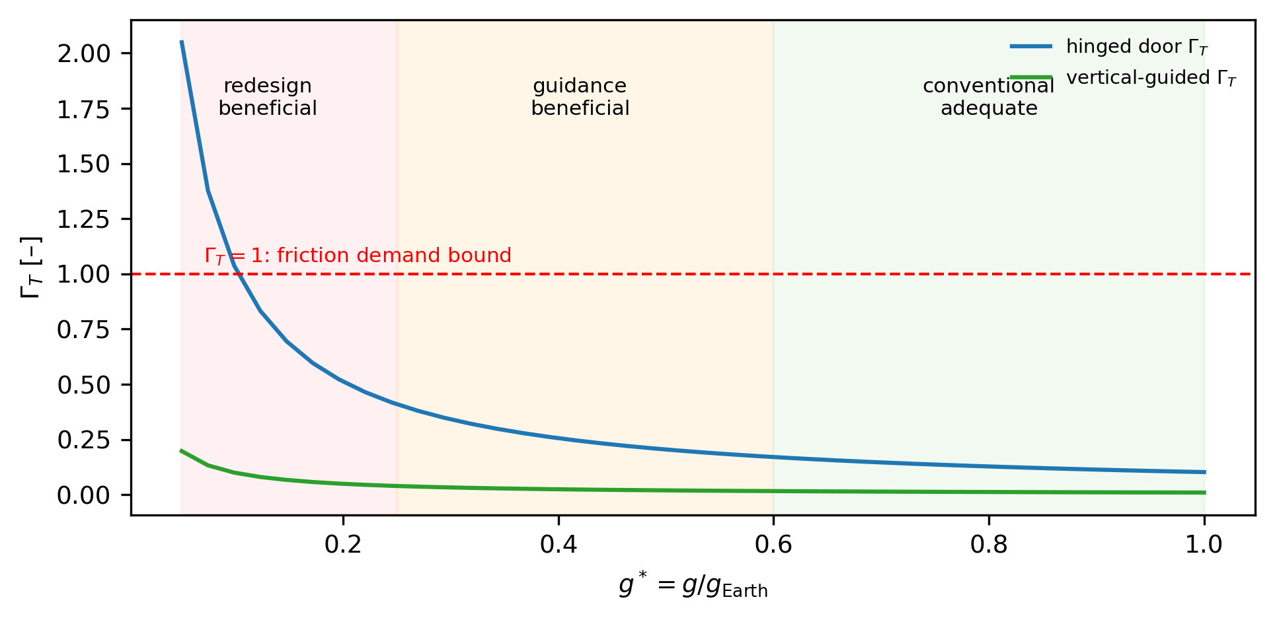
Figure 6. Design-regime map for the door case. < 1 region: conventional geometry adequate; intermediate region: passive guidance beneficial; low-g region: momentum-preventive redesign mechanically consequential. Bands are exploratory.

