Slide 1
Hansen's Disease Screening in Work Visa Medical Examinations
A Global Scoping Review of Administrative Requirements That Diverge from Standard Medical Practice
Figures and Tables PRISMA-ScR Scoping Review
[Author Names] | 2026

Slide 2
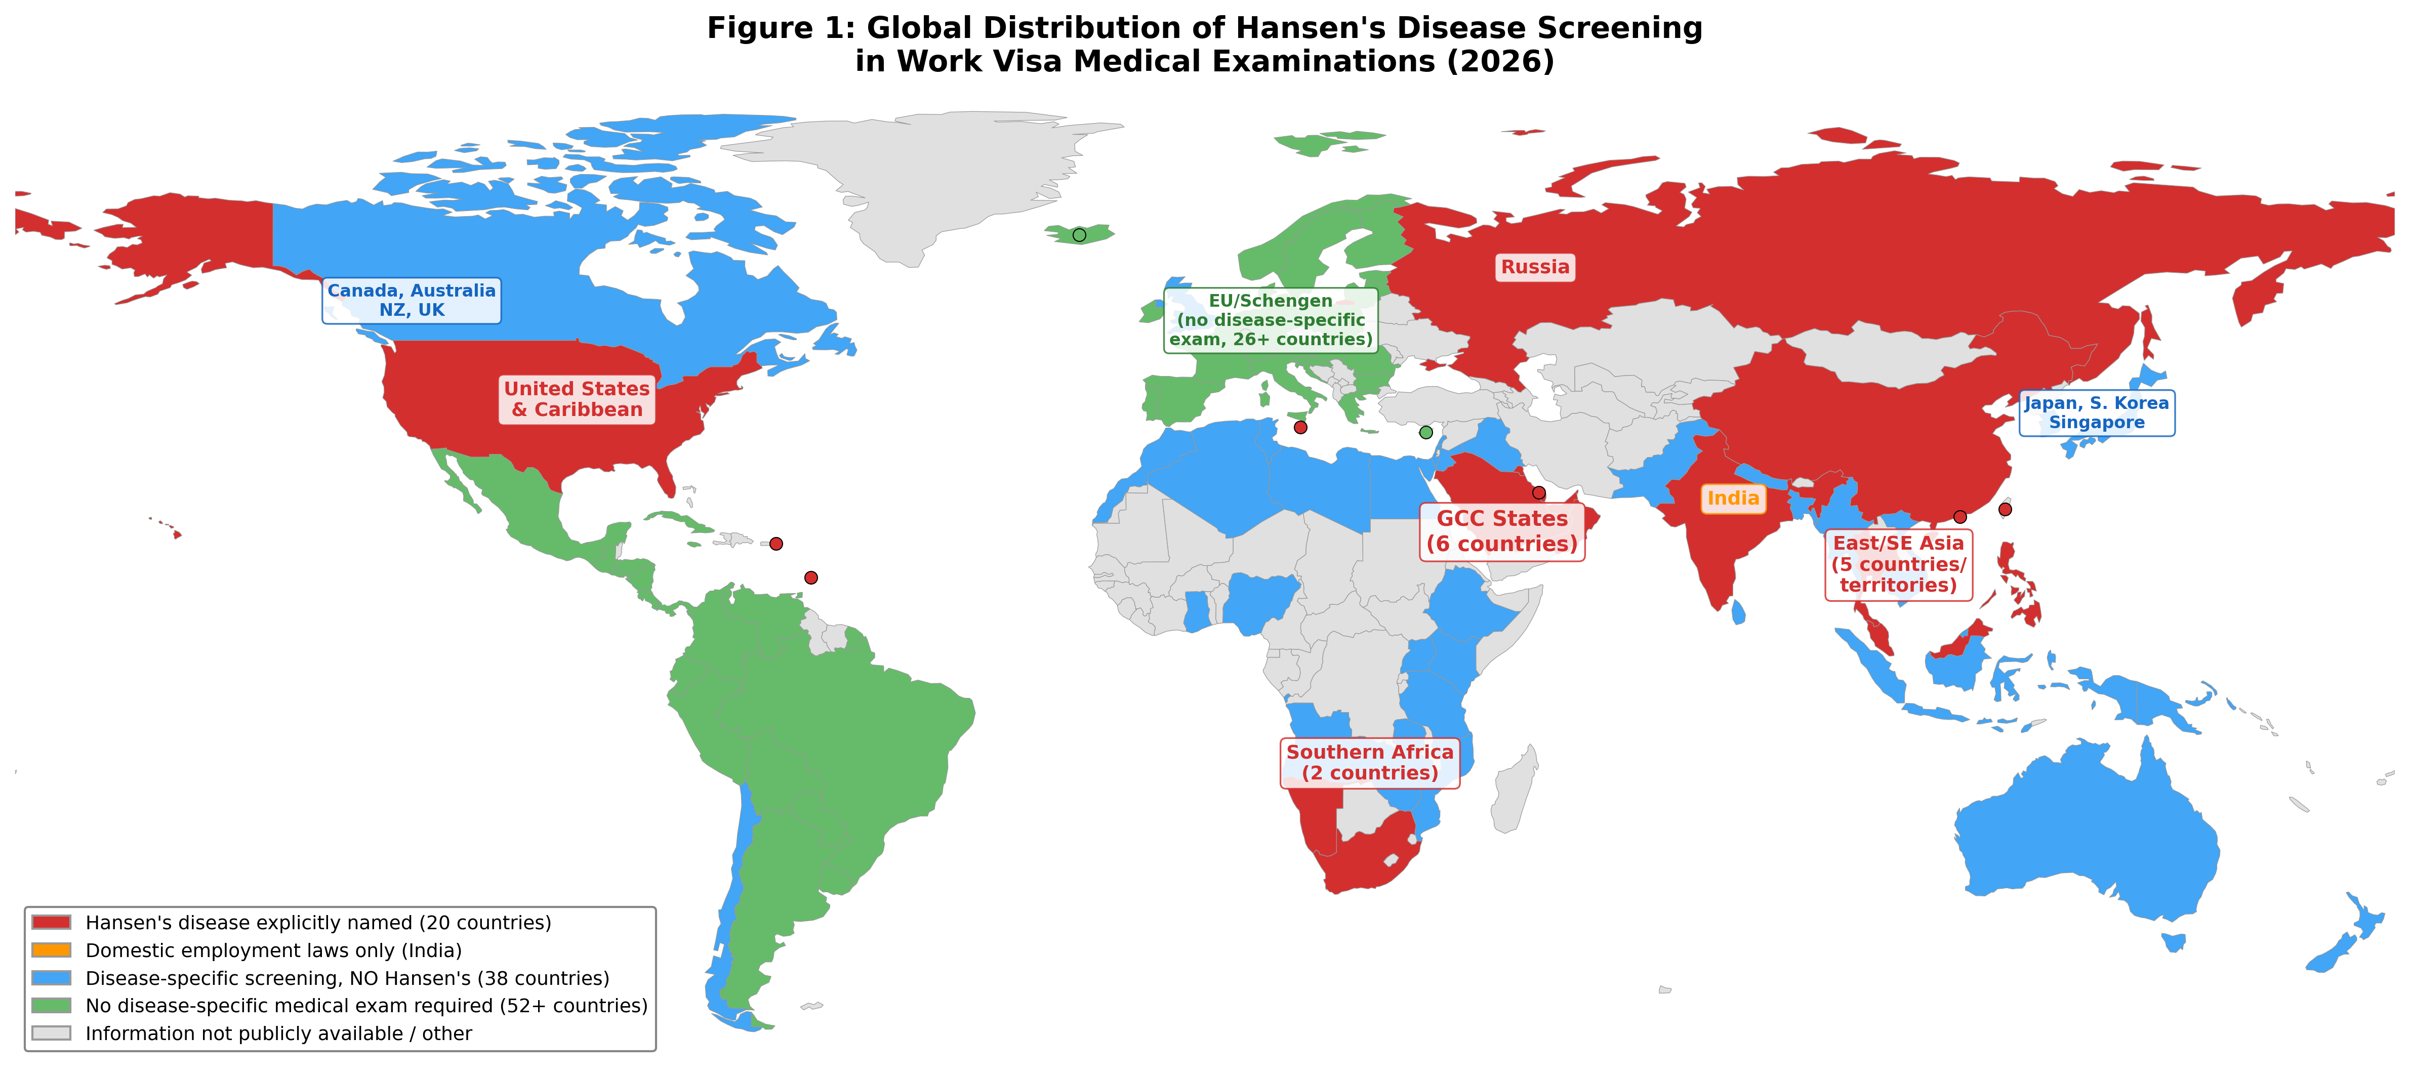
Figure 1: Global Distribution of Hansen's Disease Screening
Schematic regional map showing countries that screen for Hansen's disease (red), disease-specific screening without Hansen's (blue), and no disease-specific requirements (green).

Slide 3
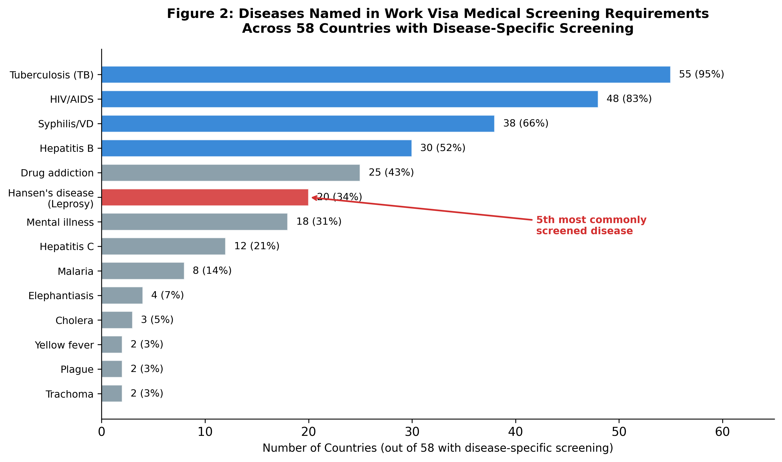
Figure 2: Diseases Named in Work Visa Medical Screening Requirements
Horizontal bar chart across 58 countries. Hansen's disease (red) is the 5th most commonly screened (34.5%).

Slide 4
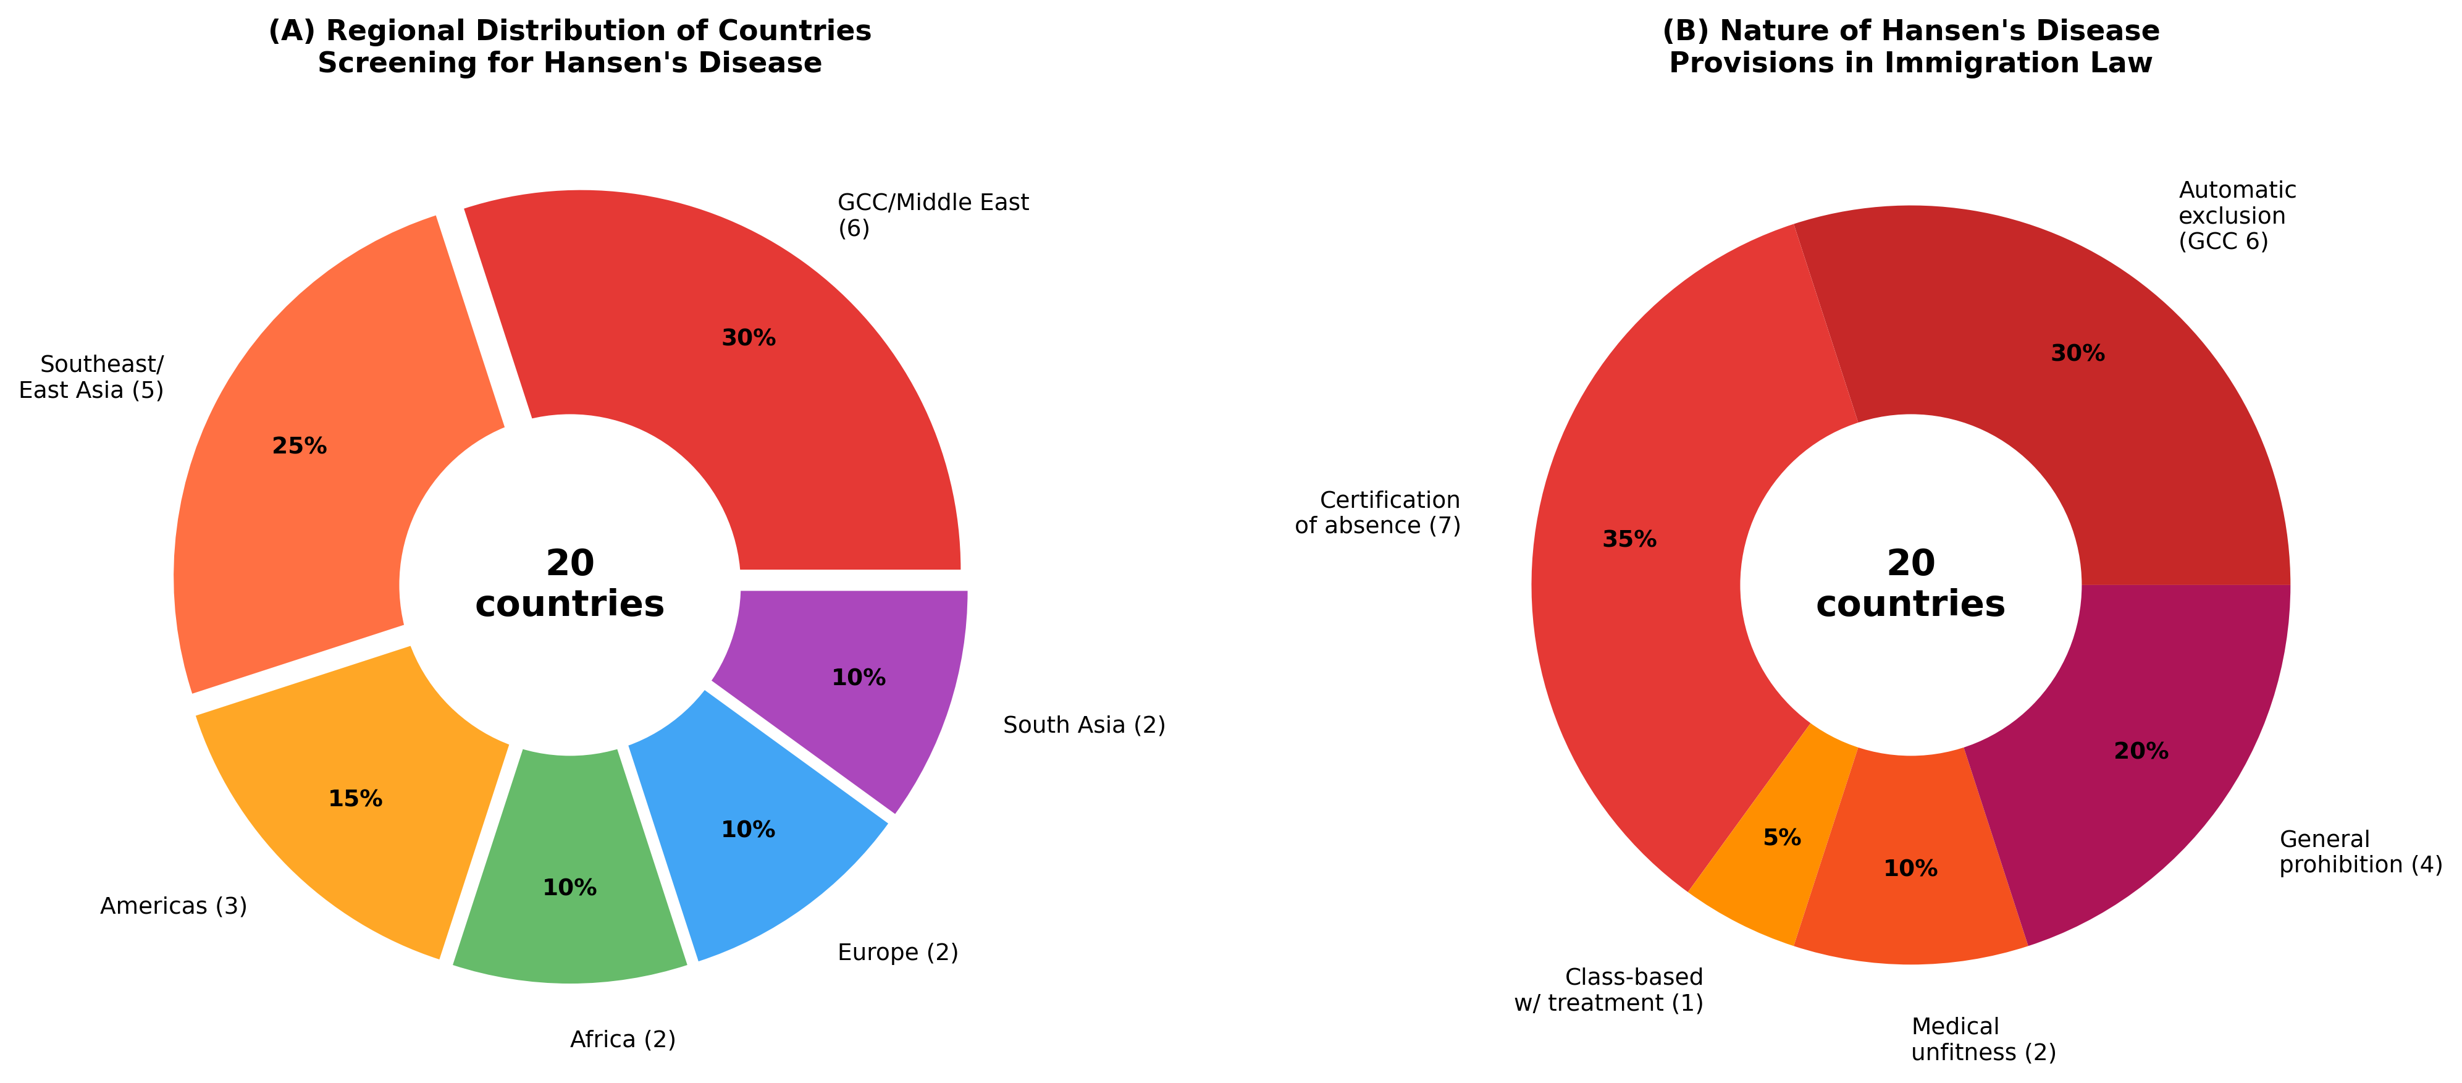
Figure 3: Regional Distribution and Legal Provisions
(A) Regional distribution of 20 countries screening for Hansen's disease. (B) Nature of Hansen's disease provisions in immigration law.

Slide 5
Figure 4: PRISMA-ScR Flow Diagram
IDENTIFICATION
Countries/territories identified for review
(n = 197: 193 UN member states + 4 observer entities)
SCREENING
Sources screened per country:
Government websites, legislation, official forms,
ILEP database, IOM reports, academic literature
ELIGIBILITY
English-language sources: characterized
(n = 110: 58 disease-specific + 52 no requirement)
English insufficient
(n = 87)
Supplementary multilingual research:
5 countries confirmed + 82 unresolved
Ultimately unresolved
despite multilingual search
(n = 82)
INCLUDED
Countries with Hansen's disease
explicitly named in work visa
medical requirements (n = 20)
Countries with disease-specific
screening but NO Hansen's
disease (n = 38)
By region:
GCC/Middle East: 6
SE/East Asia: 5
Americas: 3
Africa: 2
Europe: 2
South Asia: 2
Top screened diseases (excl. Hansen's):
TB: 38 countries
HIV: 35 countries
Syphilis: 28 countries
Hepatitis B: 22 countries

Slide 6
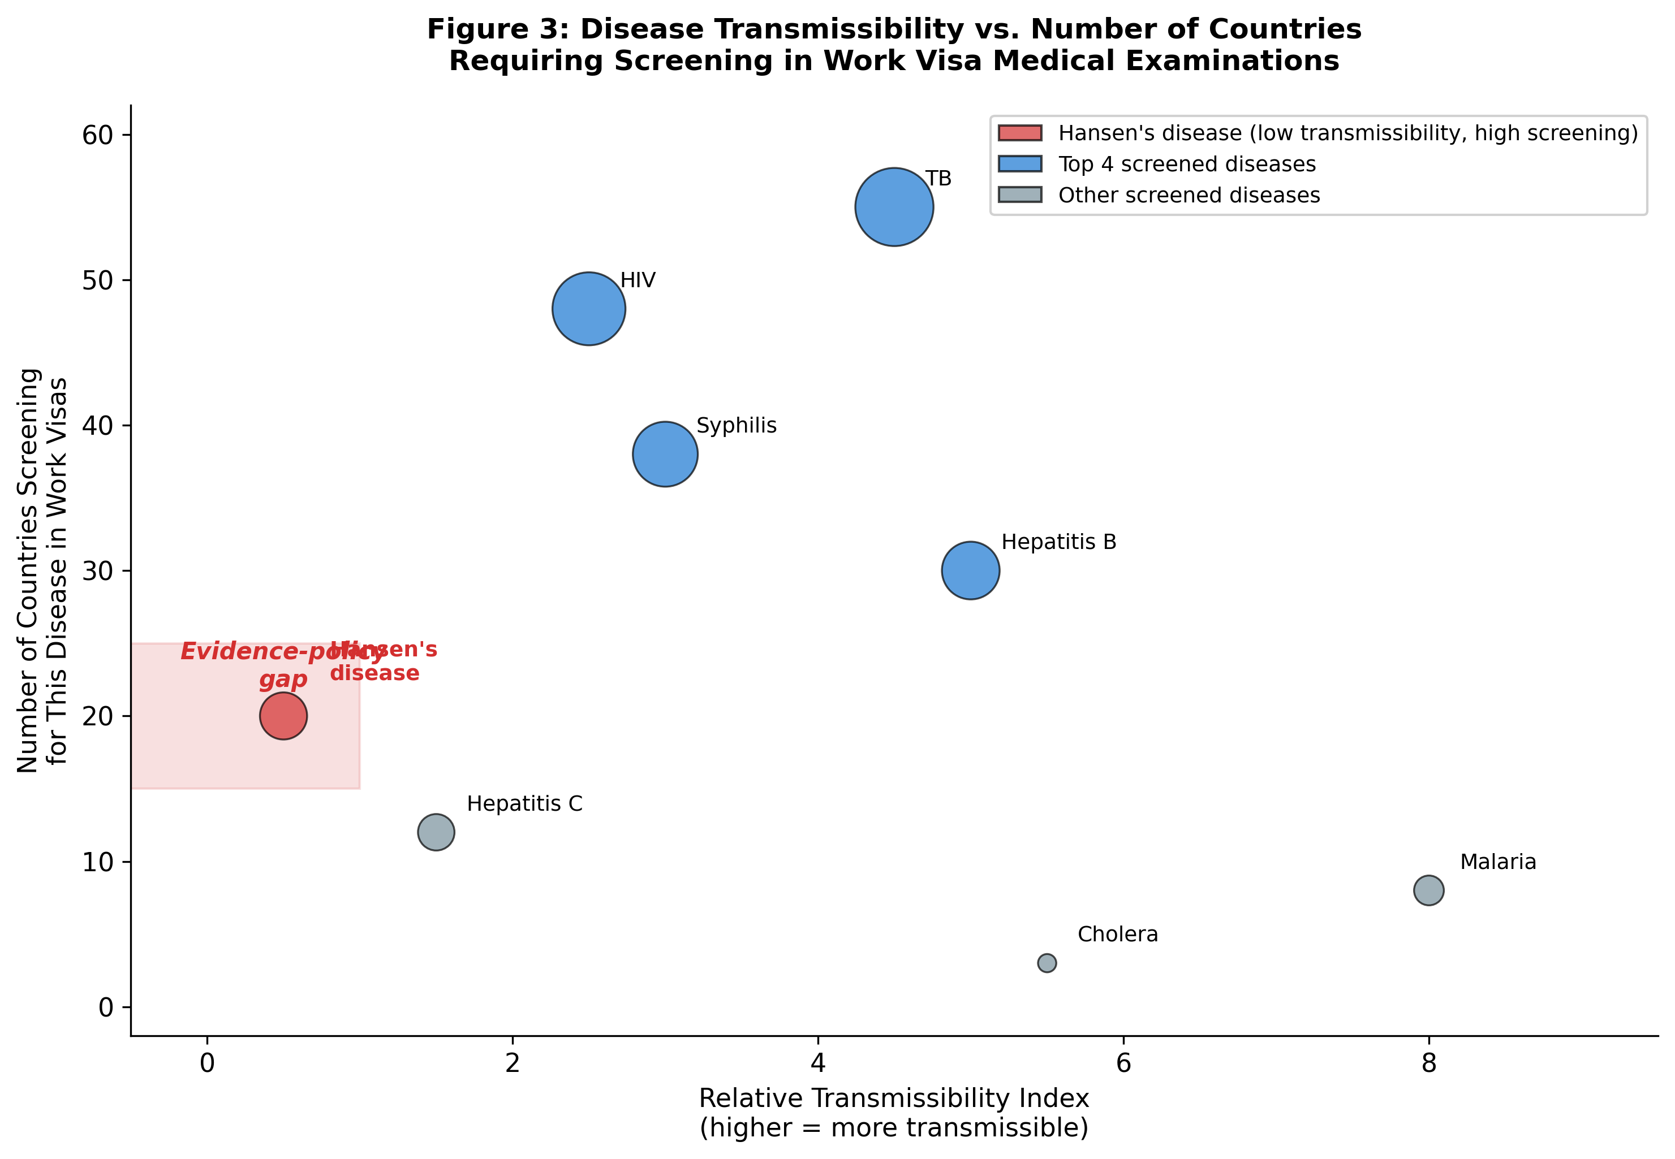
Figure 5: Disease Transmissibility vs. Screening Frequency
Hansen's disease (red) shows disproportionately high screening despite very low transmissibility. Bubble size proportional to number of countries screening for each disease.

Slide 7
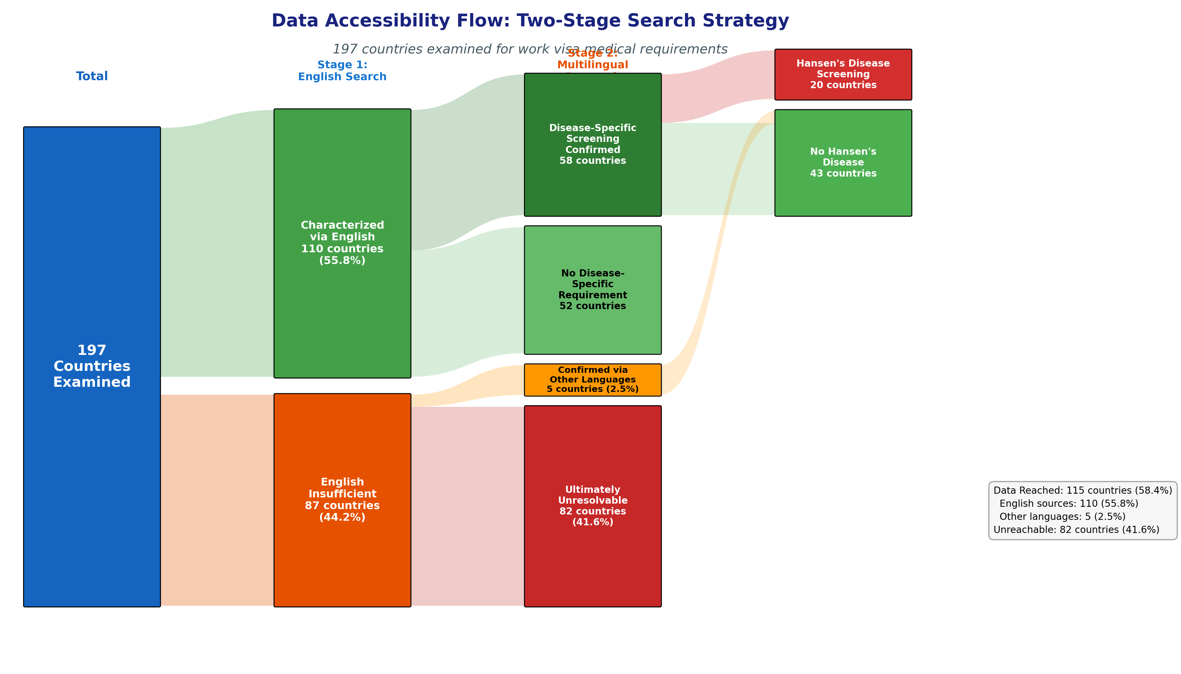
Figure 6: Data Accessibility Flow Diagram
Two-stage search strategy: 197 countries → 110 via English sources (58 disease-specific + 52 no requirement), 5 via multilingual research, 82 unreachable. Among 63 with confirmed screening, 20 named Hansen's disease.

Slide 8
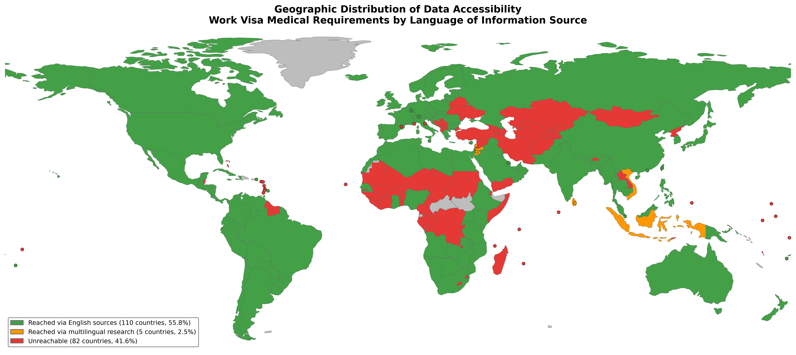
Figure 7: Geographic Distribution of Data Accessibility
Green: reached via English sources (110, 55.8%); Orange: reached via multilingual research (5, 2.5%); Red: unreachable (82, 41.6%). Gray: not in study scope.

Slide 9
Table 1: Countries with Hansen's Disease in Work Visa Medical Requirements (n=20)
Region | Country | Legal Instrument | Provision Type | Year
GCC/Middle East | Saudi Arabia | GAMCA/WAFID Regulations 6th Ed. | Automatic exclusion | 2021
 | UAE | GAMCA/WAFID Regulations | Automatic exclusion | 2021
 | Qatar | GAMCA/WAFID Regulations | Automatic exclusion | 2021
 | Kuwait | GAMCA/WAFID Regulations | Automatic exclusion | 2021
 | Oman | GAMCA/WAFID Regulations | Automatic exclusion | 2021
 | Bahrain | GAMCA/WAFID Regulations | Automatic exclusion | 2021
East/SE Asia | China | Foreigner Physical Exam. Form | Certification of absence | —
 | Thailand | Emergency Decree B.E.2560 | Prohibited disease | 2017
 | Taiwan | Work Permit Regulations | Certification of absence | —
 | Malaysia | FOMEMA Requirements | Medical unfitness | —
 | Philippines | OWWA Requirements | Certification of absence | —
Africa | South Africa | Immigration Act 2002; BI-811 | Certification of absence | 2002
 | Namibia | Immigration Control Act | Medical prohibition | 1993
Europe | Russia | Federal Law No.115-FZ | Deportation ground | 2002
 | Malta | Immigration Act Cap.217 | Medical inadmissibility | —
Americas | United States | INA §212(a)(1)(A)(i) | Class A condition* | 1952†
 | Barbados | Immigration Act Cap.190 | Medical prohibition | —
 | US Virgin Islands | US Federal Law | Class A condition* | —
South Asia | India | State-level Employment Acts | Employment restriction | Various
 | Hong Kong SAR | Immigration Ordinance Cap.115 | Medical inadmissibility | —

Slide 10
Table 2: Countries with Disease-Specific Screening but NOT Including Hansen's Disease (n=15)
Country | Diseases Screened | Notable Features | Hansen's Disease
Canada | TB, syphilis | Immigration Medical Exam (IME) | Not included
Australia | TB, HIV, Hep B/C | Panel physician system (Bupa) | Not included
United Kingdom | TB (visas >6 months) | IOM panel physician screening | Not included
New Zealand | TB, HIV, Hep B | Immigration NZ panel physicians | Not included
Japan | TB only (select nationalities) | JPETS pre-entry TB screening | Not included
South Korea | TB, HIV, drugs | E-9 visa medical examination | Not included
Singapore | TB, HIV, syphilis, Hep B, malaria | Foreign Worker Medical Exam | Not included
Israel | TB, HIV, Hep B/C | Entry medical requirements | Not included
Kenya | TB, HIV | Work permit medical certificate | Not included
Nigeria | TB, HIV, Hep B | Expatriate quota medical exam | Not included
Ghana | TB, HIV, yellow fever | Immigration medical certificate | Not included
Brazil | Yellow fever (vaccination) | No work visa medical exam | Not included
Mexico | None specified | No standard medical exam | Not included
Argentina | None specified | No disease-specific exam | Not included
Chile | TB, HIV (select visas) | Temporary resident visa medical | Not included

