Slide 1
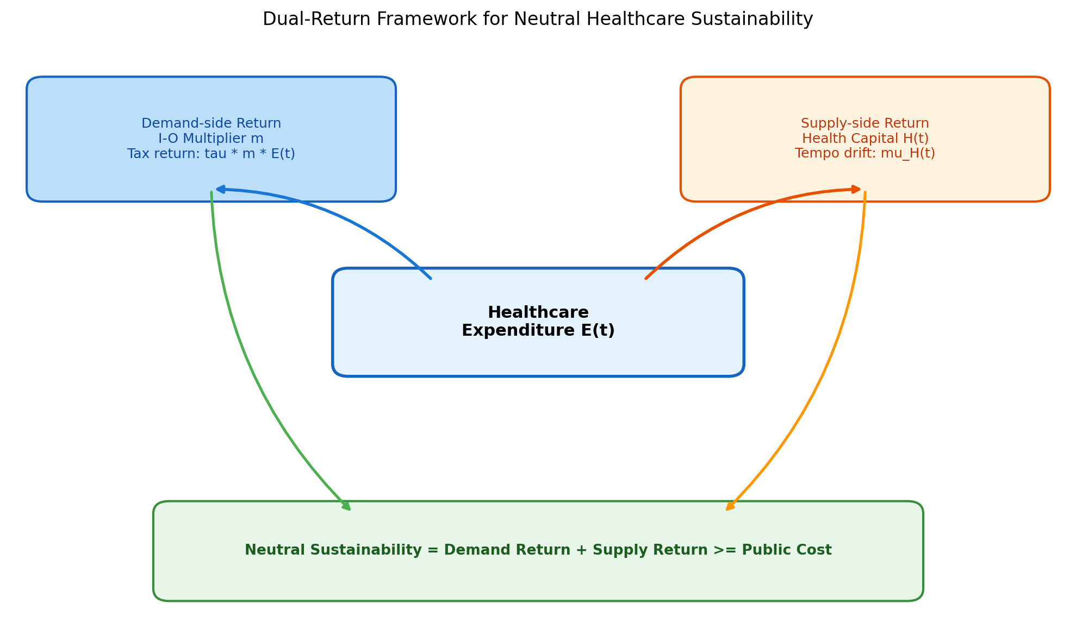
Figure 1. Dual-Return Framework
Demand-side (I-O multiplier) + Supply-side (health-capital tempo) = Total return.

Slide 2
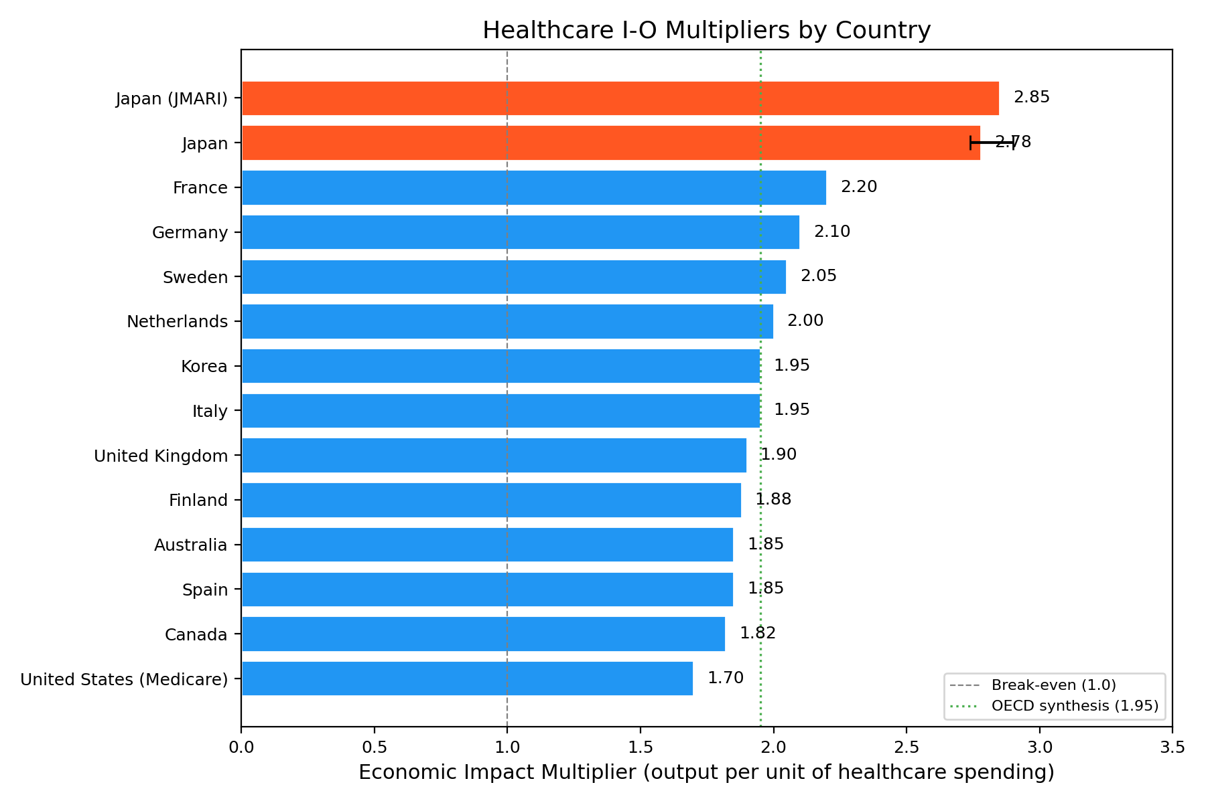
Figure 2. Healthcare I-O Multipliers
Healthcare sector I-O multipliers for 13 OECD countries.

Slide 3
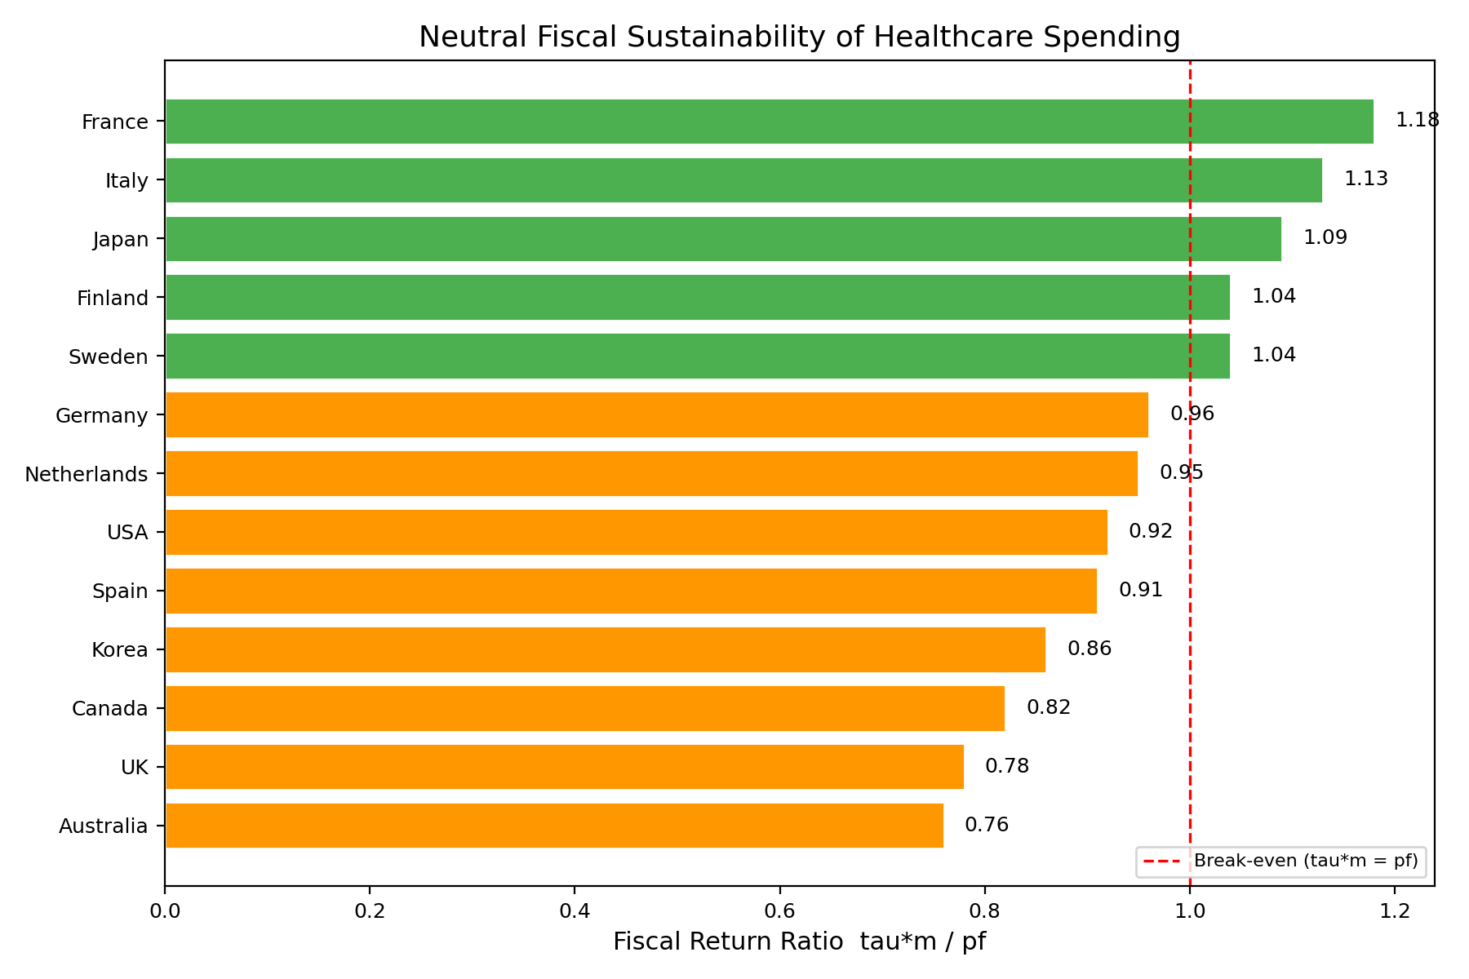
Figure 3. Fiscal Return Ratio
Fiscal Return = (tax rate x multiplier) / public share. Values >= 1.0 indicate fiscal sustainability.

Slide 4
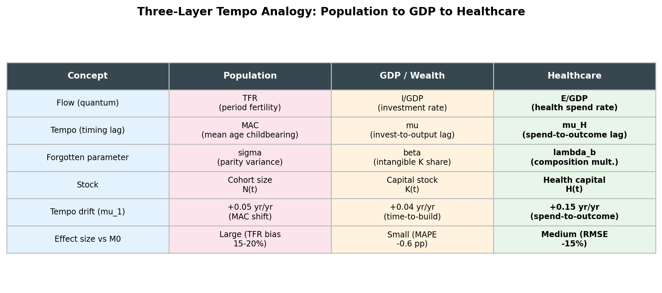
Figure 4. Three-Layer Tempo Analogy
Population -> GDP -> Healthcare tempo drift comparison.

Slide 5
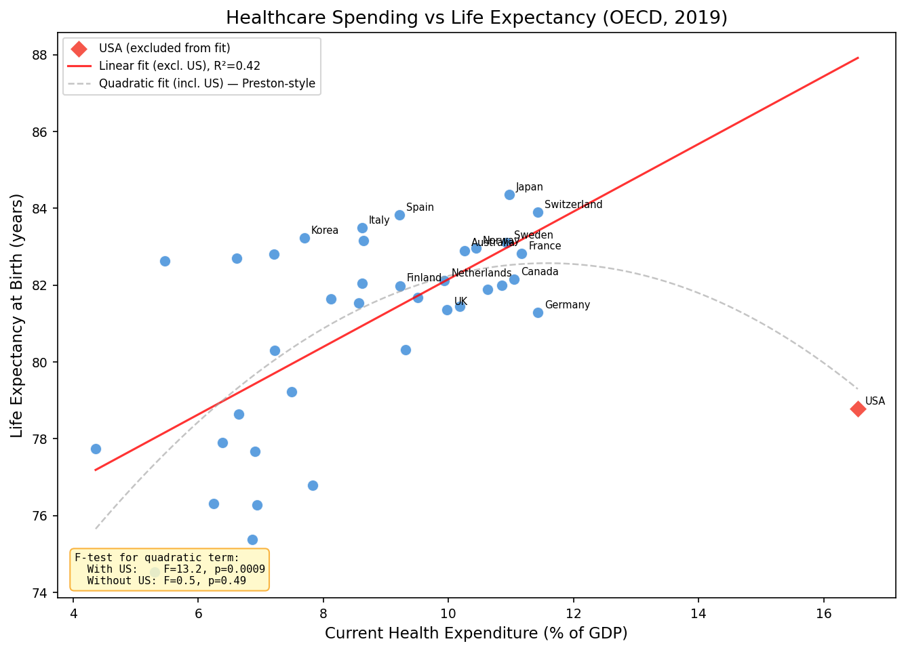
Figure 5. CHE vs Life Expectancy
Linear fit excluding US. Quadratic term non-significant when US excluded (F=0.5, p=0.49).

Slide 6
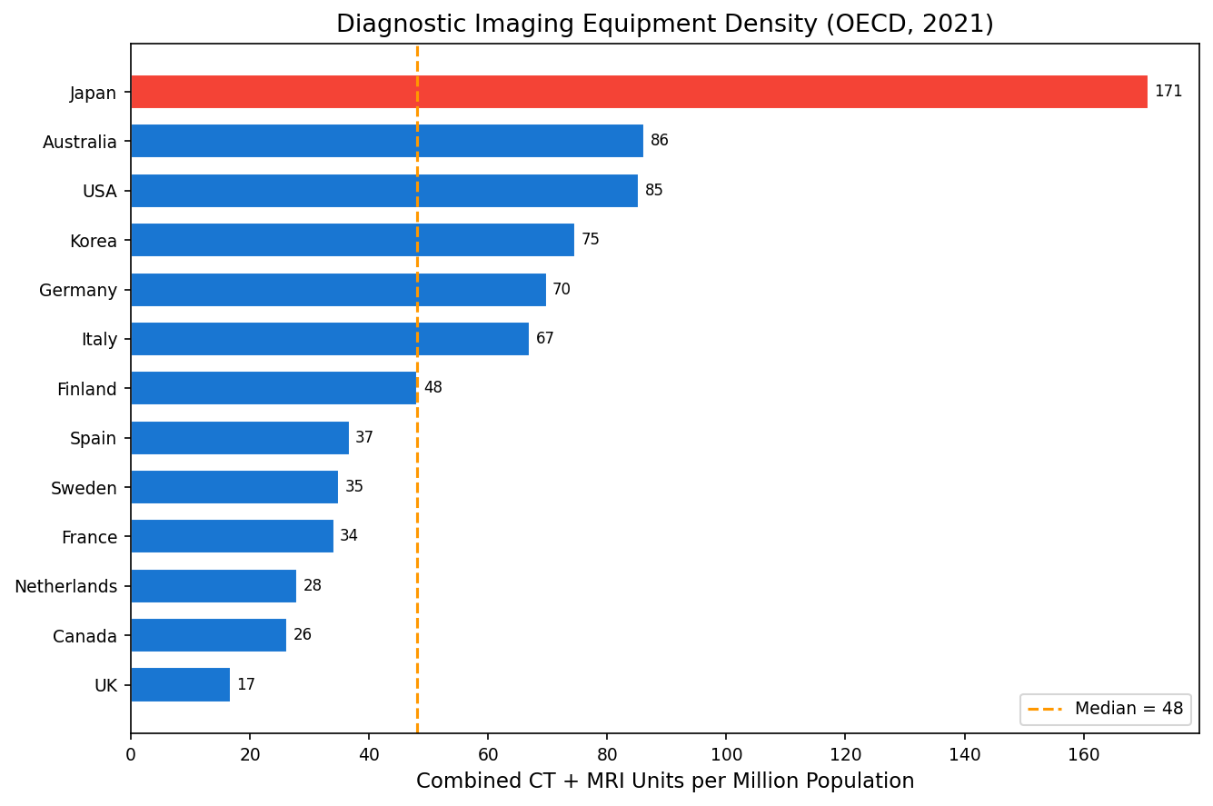
Figure 6. Diagnostic Imaging Density
CT + MRI per million population (OECD 2021). Japan at 170.9 is 4x OECD median.

Slide 7
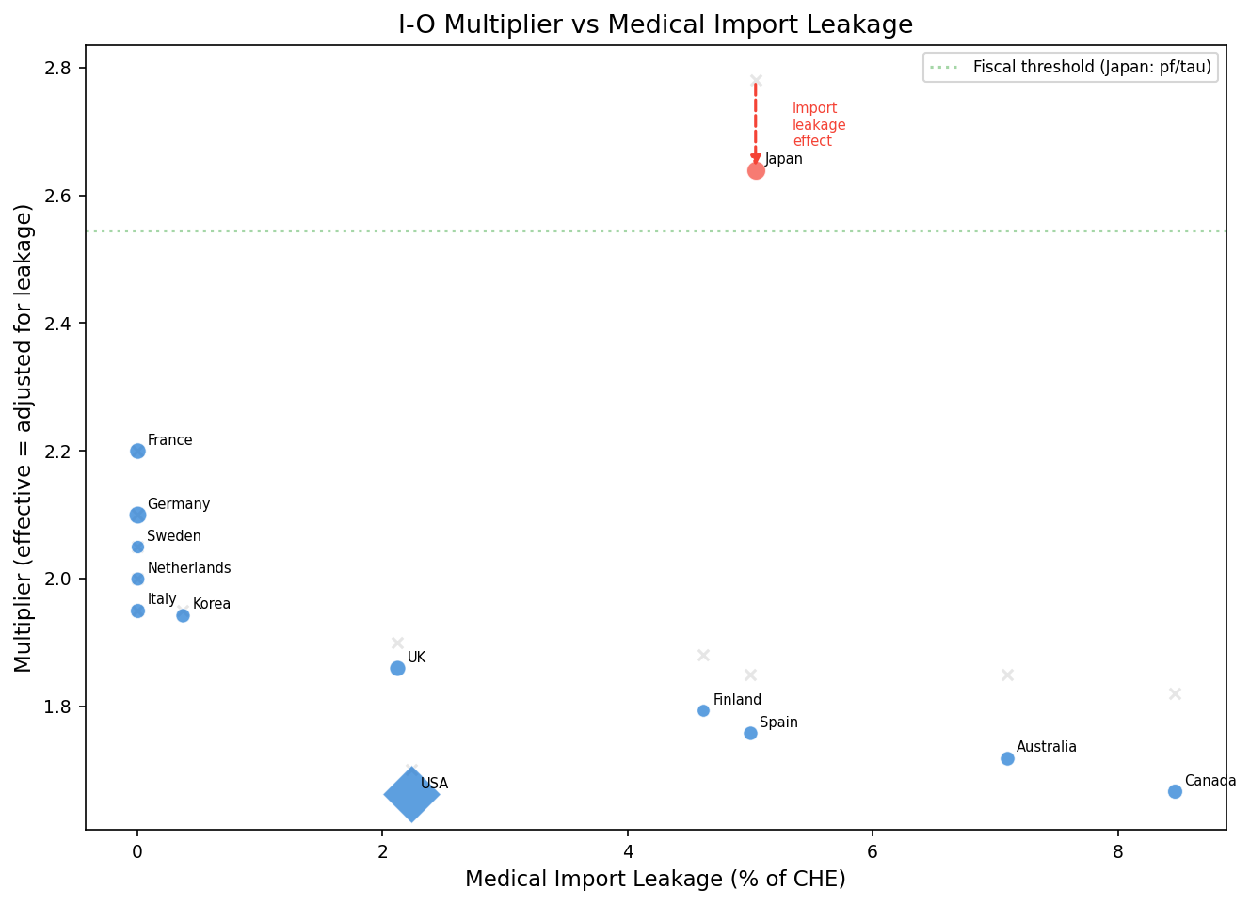
Figure 7. Import Leakage vs Multiplier
Leakage reduces effective multiplier. Japan: 2.78 -> 2.64 (5% leakage).

Slide 8
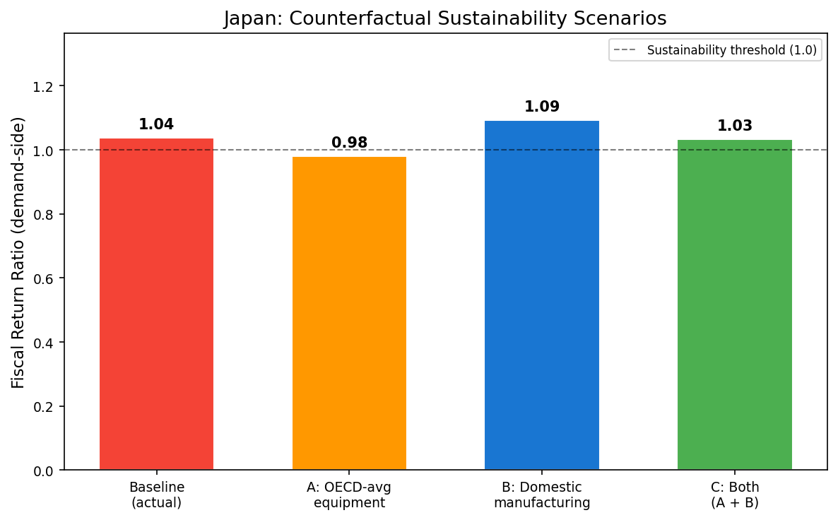
Figure 8. Japan Counterfactual Analysis
Baseline 1.04, A: avg equip 0.98, B: domestic mfg 1.09, C: both 1.03.

