Slide 1
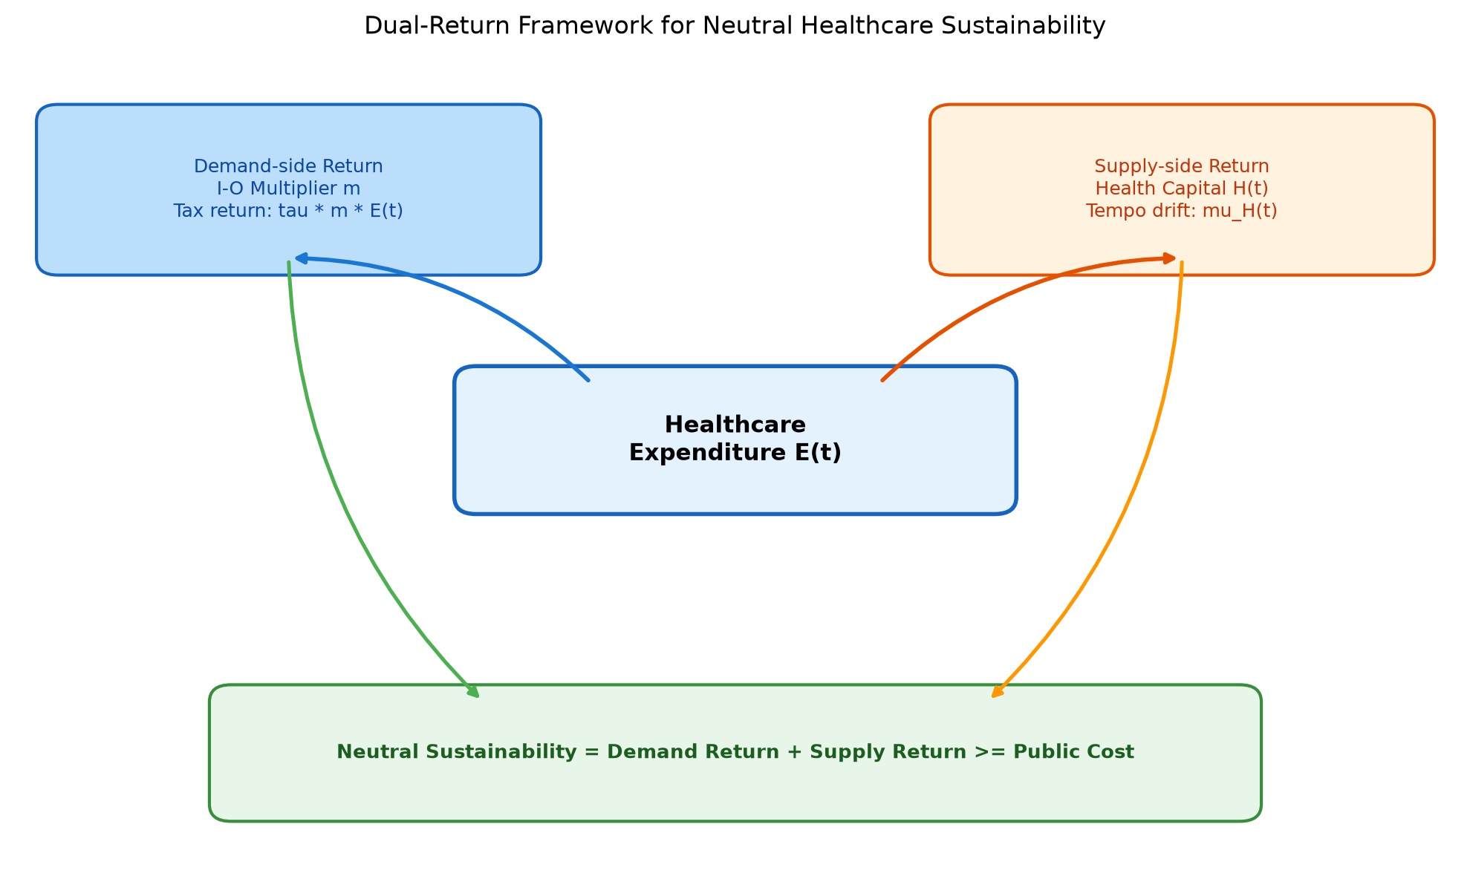
Figure 1. Dual-Return Framework

Slide 2
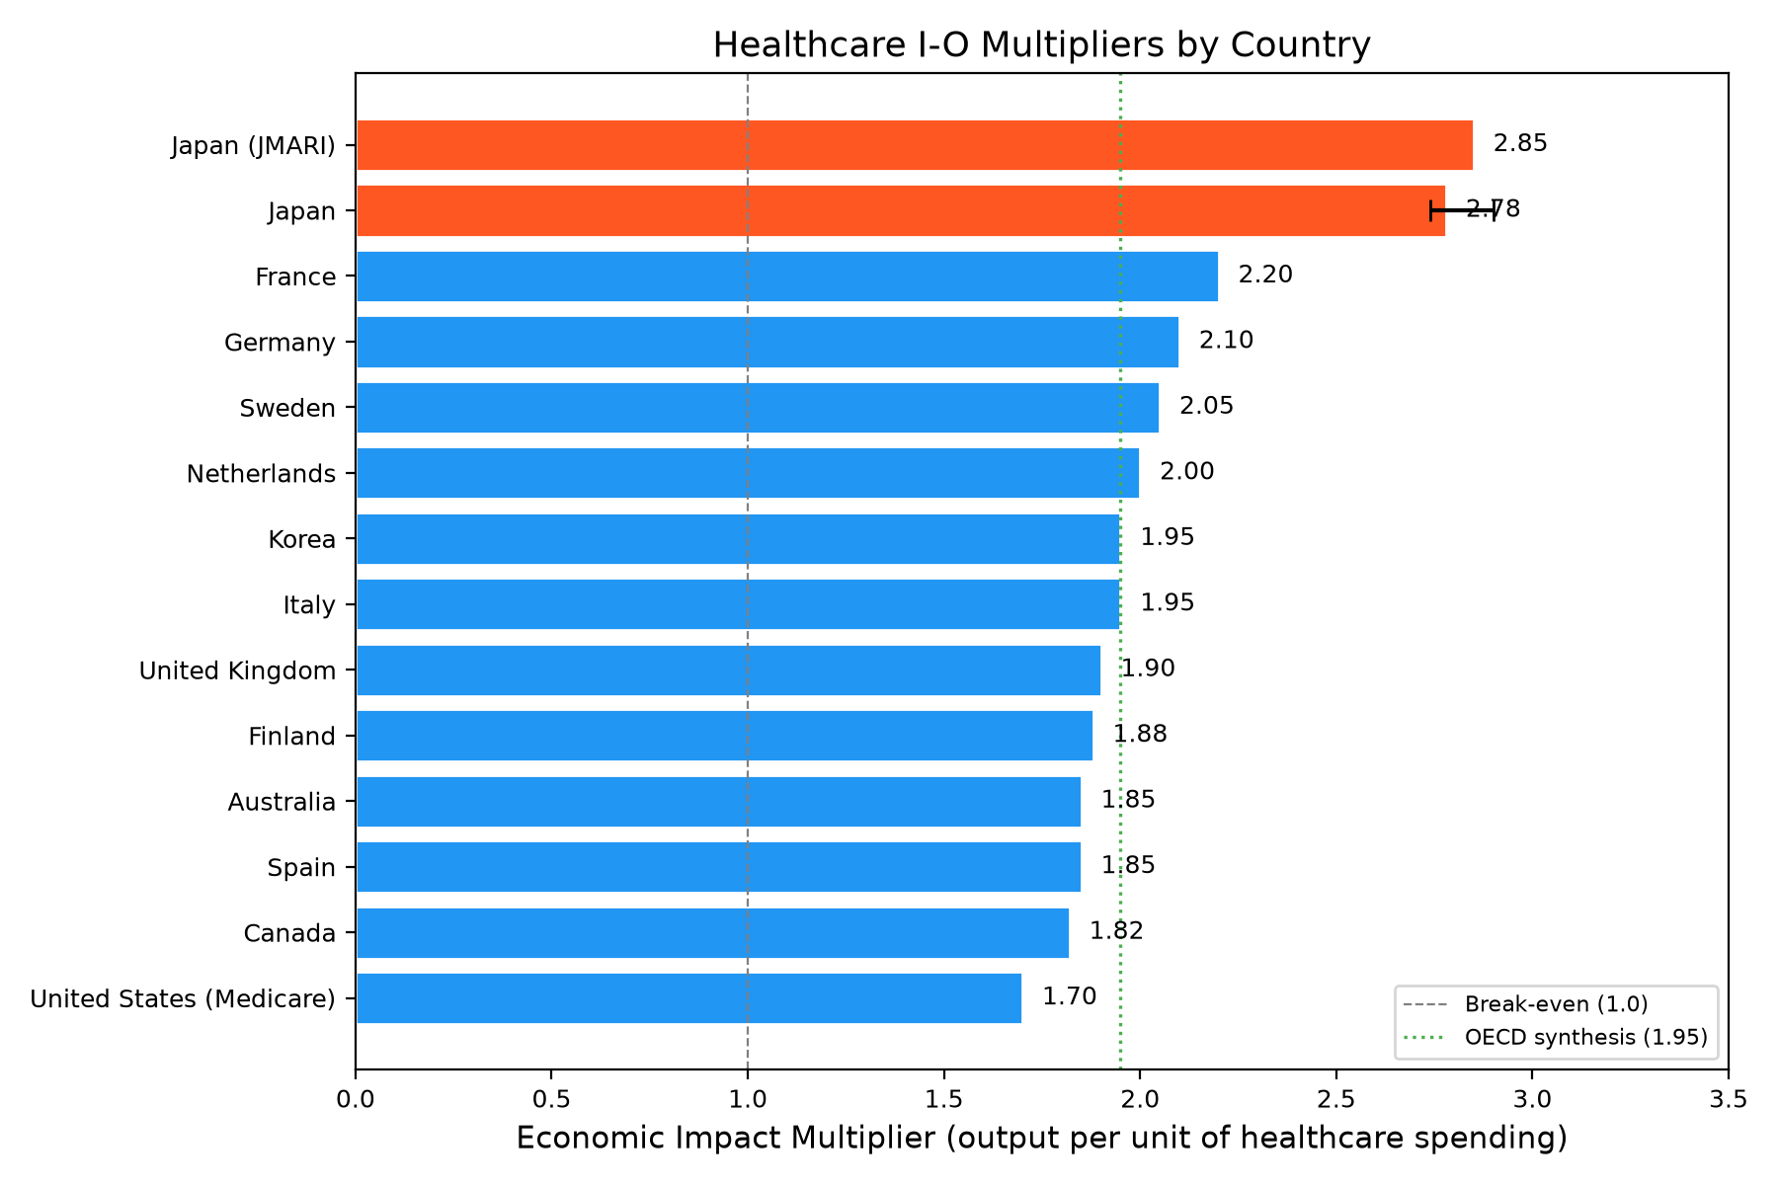
Figure 2. Healthcare I-O Output Multipliers
Note: US = Medicare only.

Slide 3
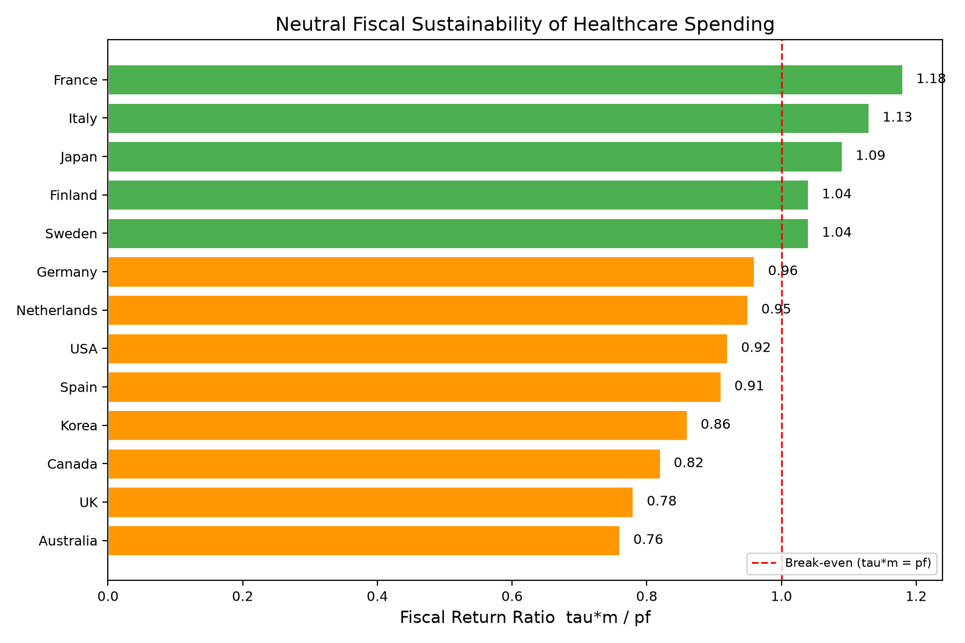
Figure 3. Fiscal Return Ratio

Slide 4
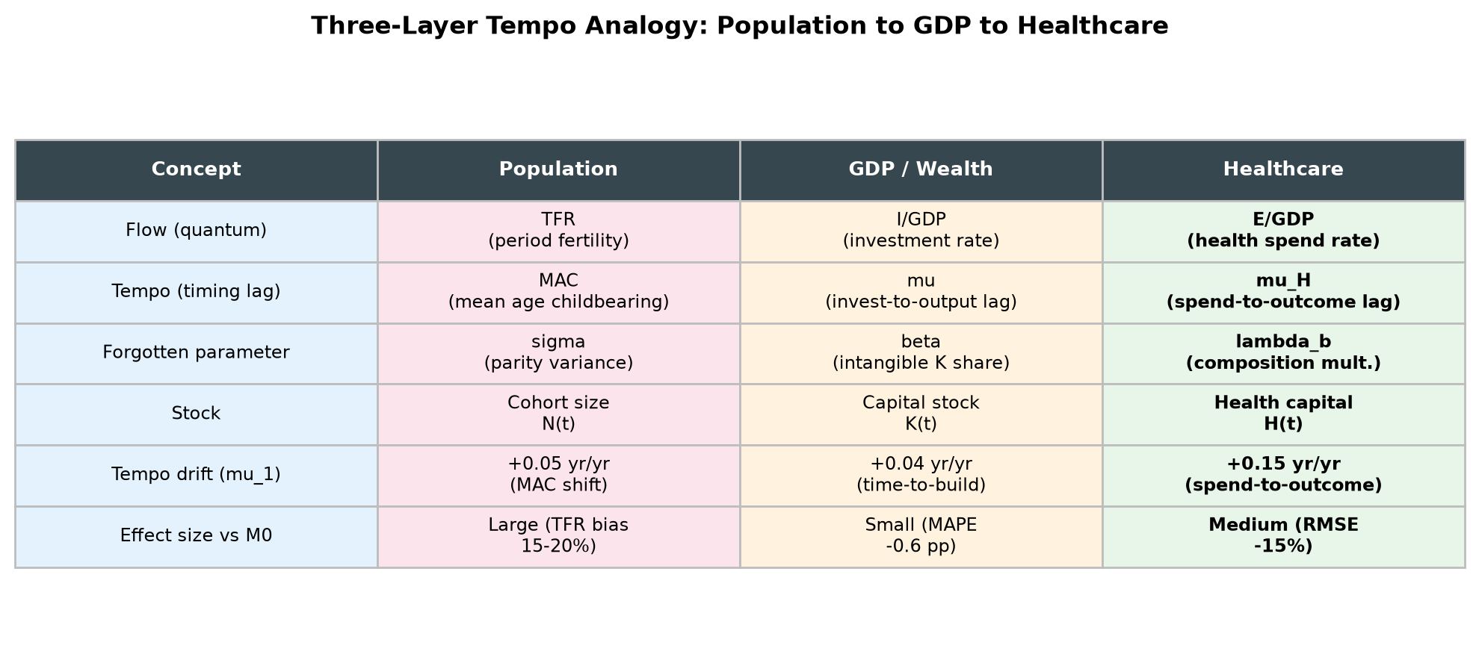
Figure 4. Three-Layer Tempo Analogy
M2 vs M1 does not survive BIC.

Slide 5
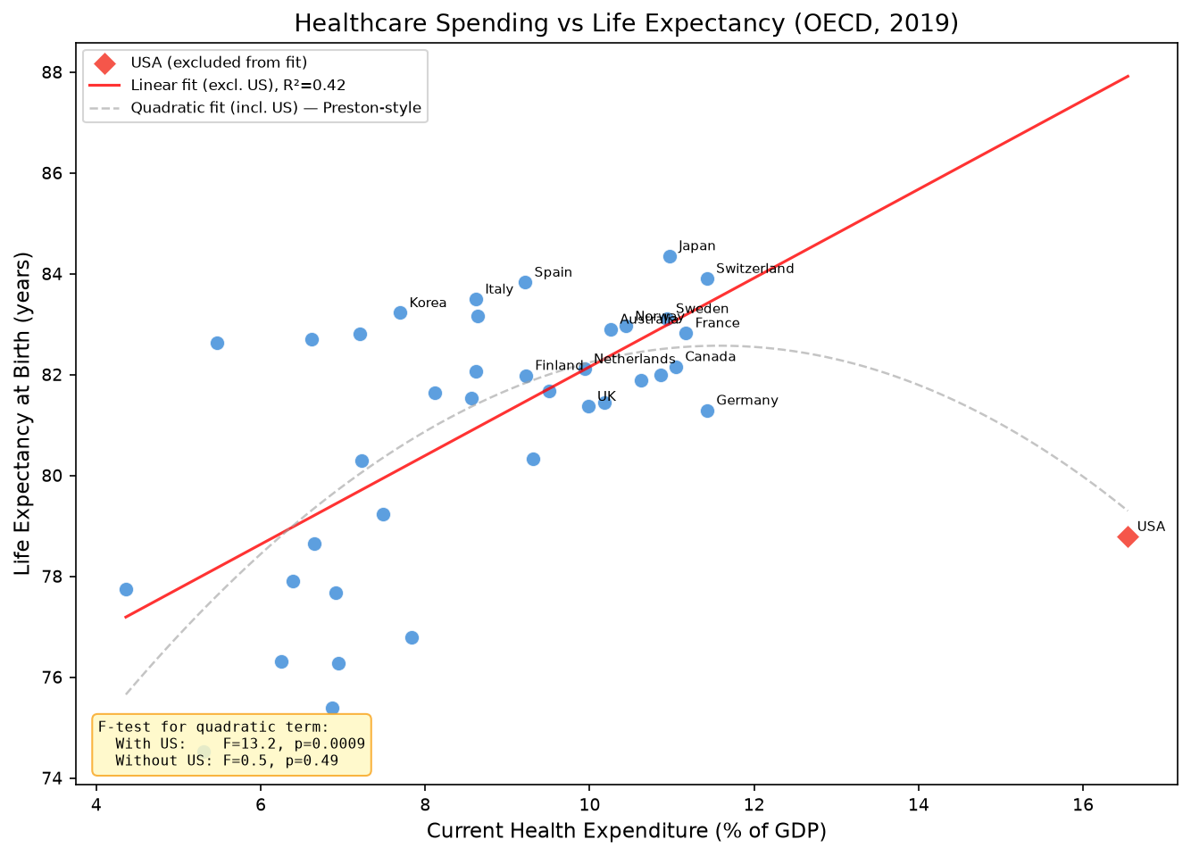
Figure 5. CHE vs Life Expectancy

Slide 6
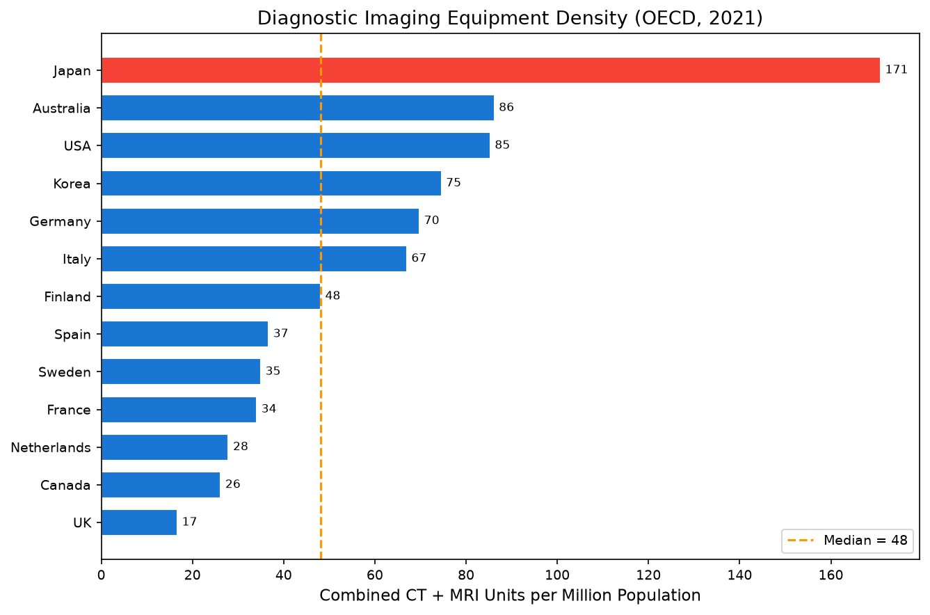
Figure 6. Equipment Density

Slide 7
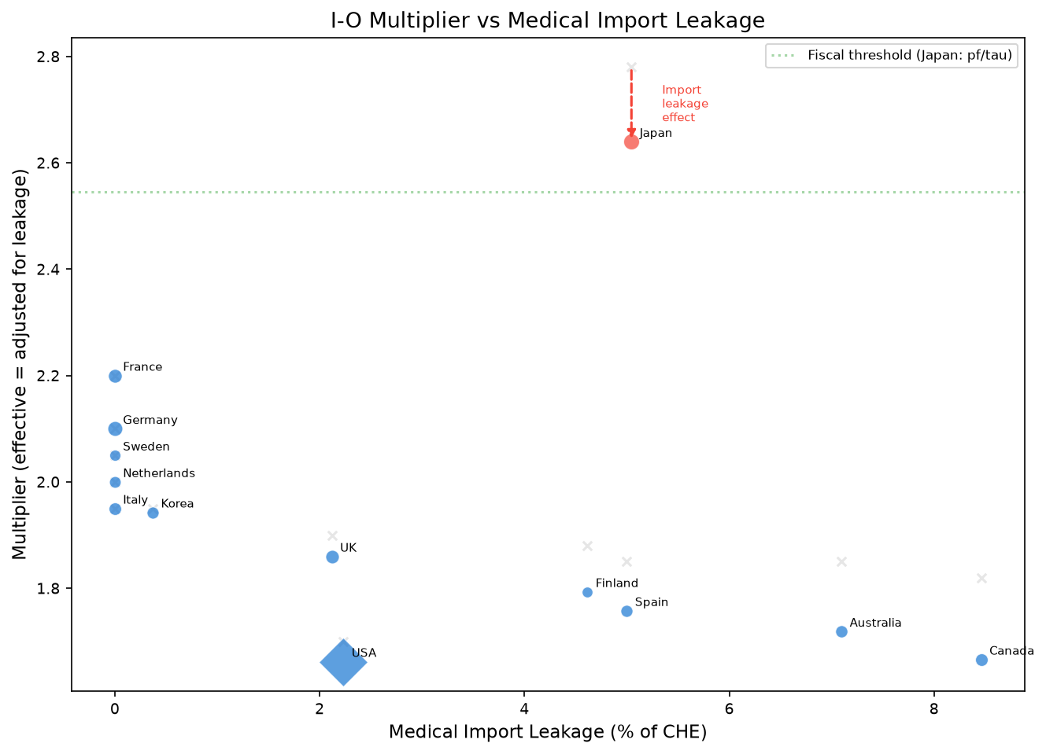
Figure 7. Import Leakage vs Multiplier

Slide 8
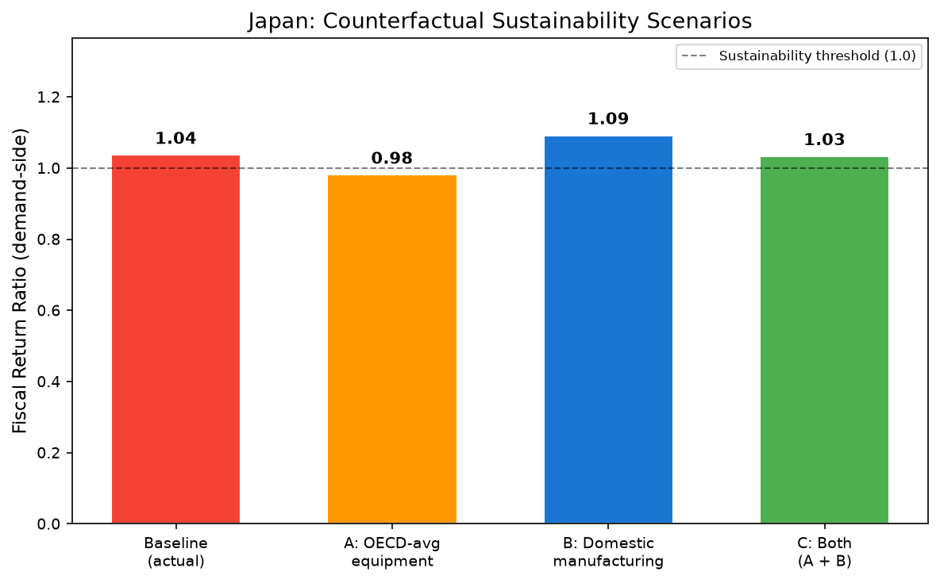
Figure 8. Japan Counterfactual

Slide 9
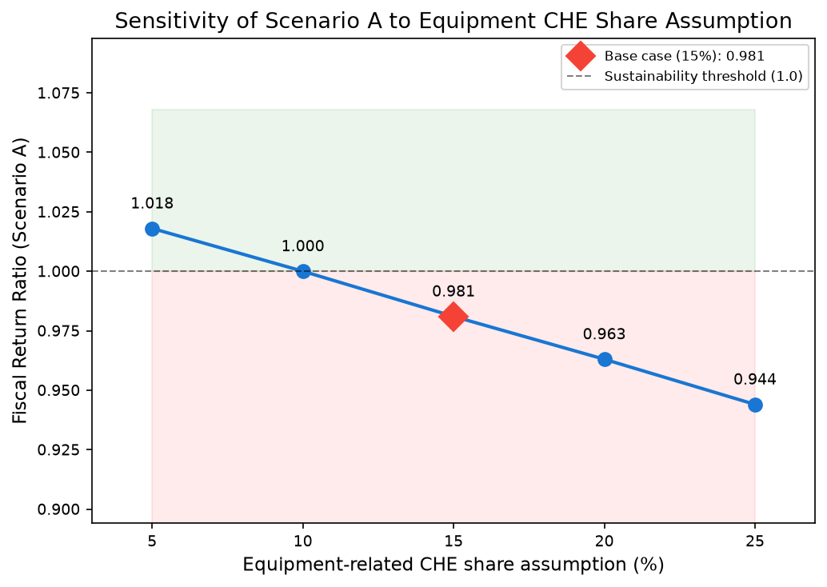
Figure 9. Equipment CHE Share Sensitivity
NEW in R1. Scenario A FR varies 0.94-1.02.

