Slide 1
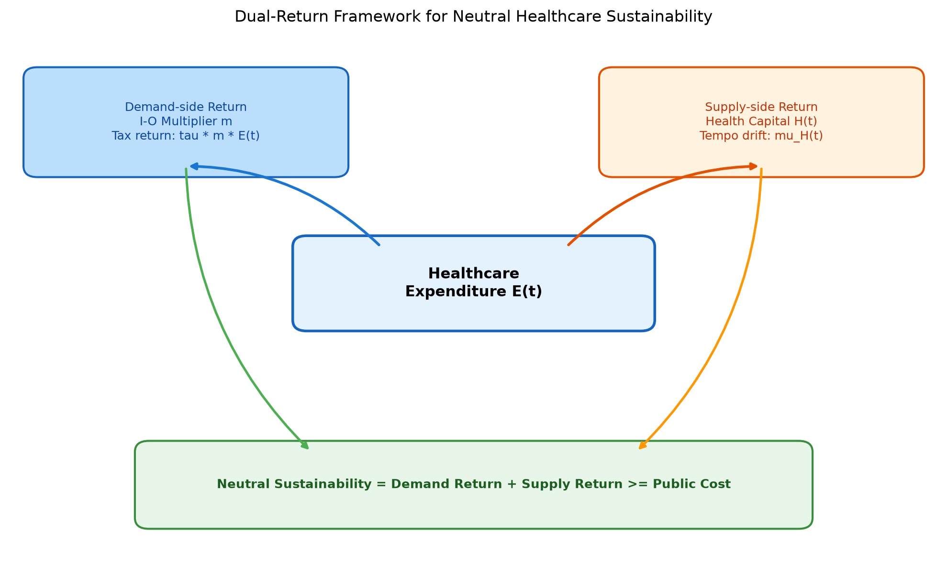
Figure 1. Demand-Side Fiscal Return and Health-Capital Lag Framework

Slide 2
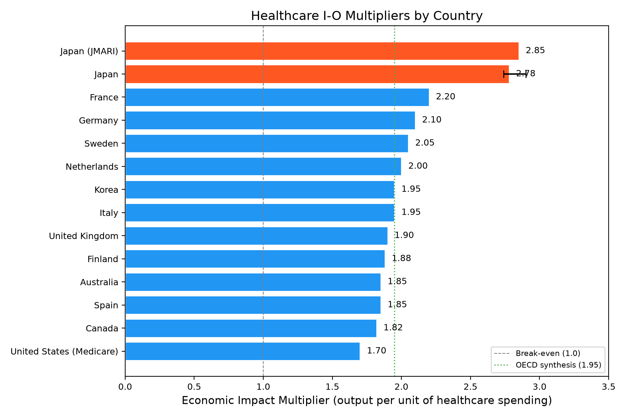
Figure 2. Healthcare I-O Output Multipliers
Note: US = Medicare only.

Slide 3
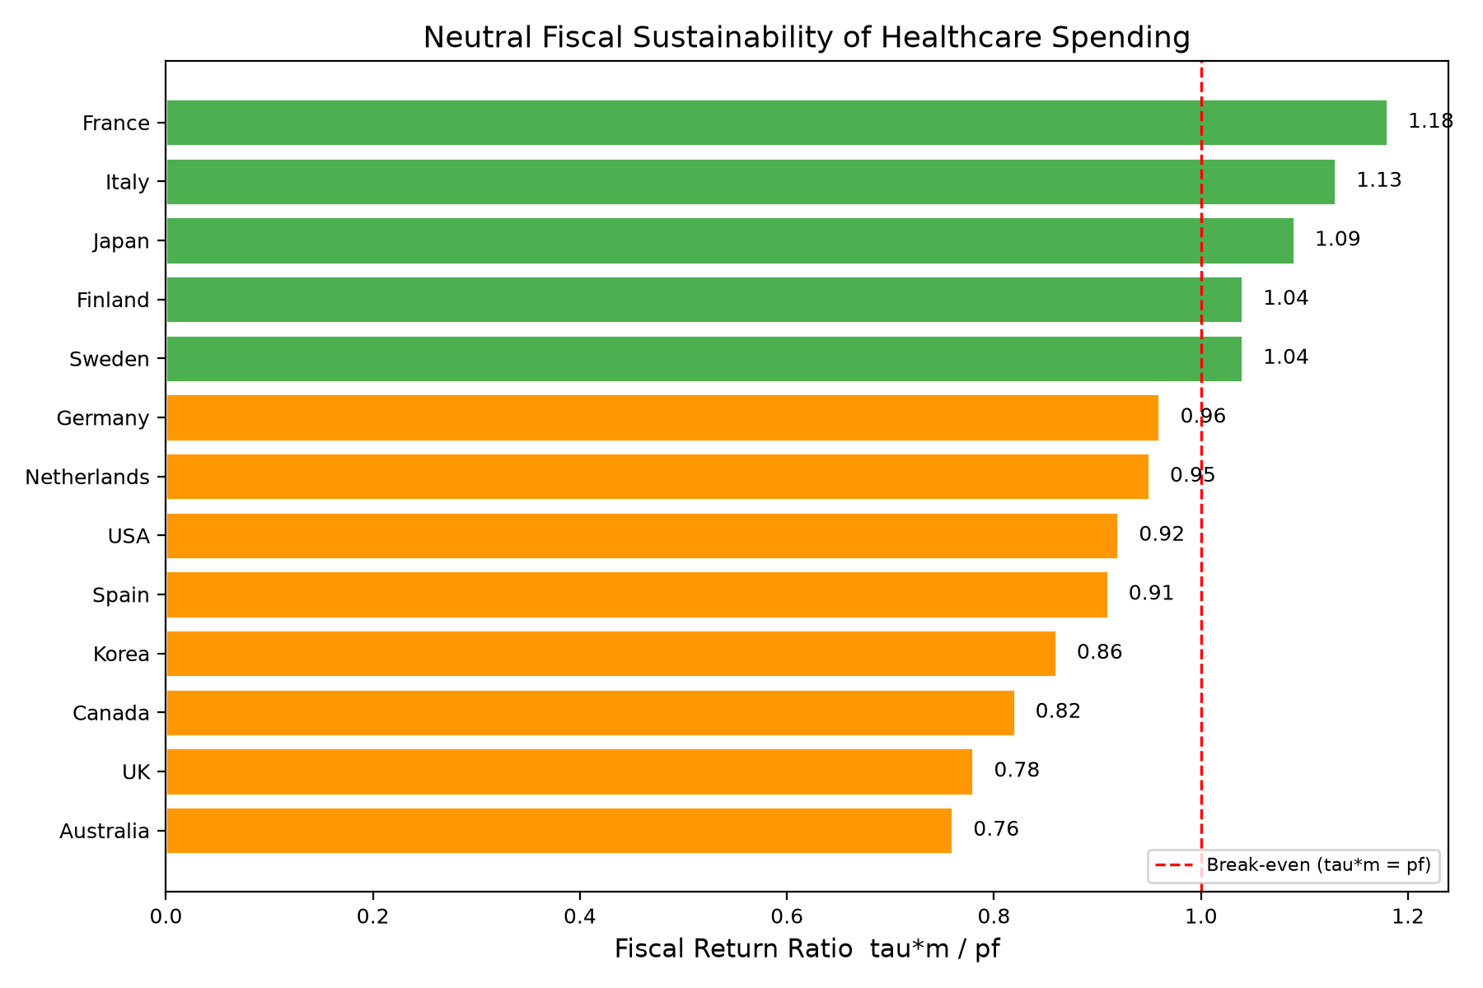
Figure 3. Fiscal Return Ratio

Slide 4
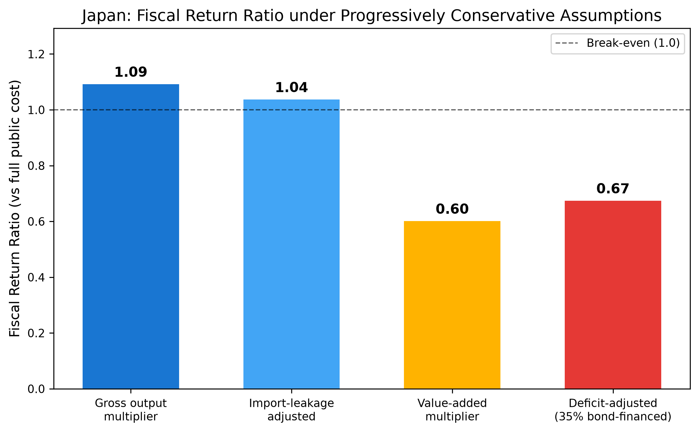
Figure 4. Japan Fiscal Return Ratio Cascade
R3. Gross 1.09 -> leakage 1.04 -> deficit-adjusted 0.67 -> value-added 0.60.

Slide 5
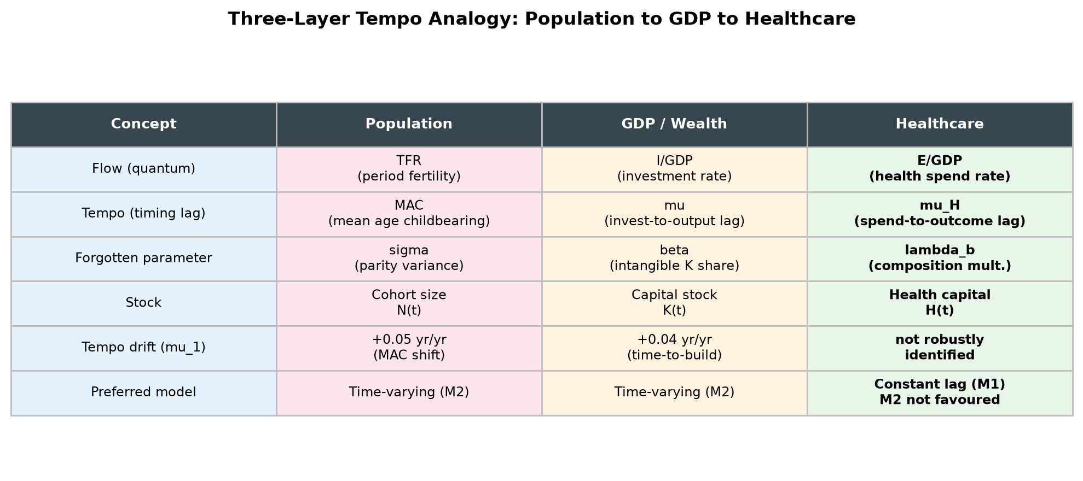
Figure 5. Three-Layer Tempo Analogy
Healthcare: constant lag (M1) preferred; M2 not favoured by AIC/BIC.

Slide 6
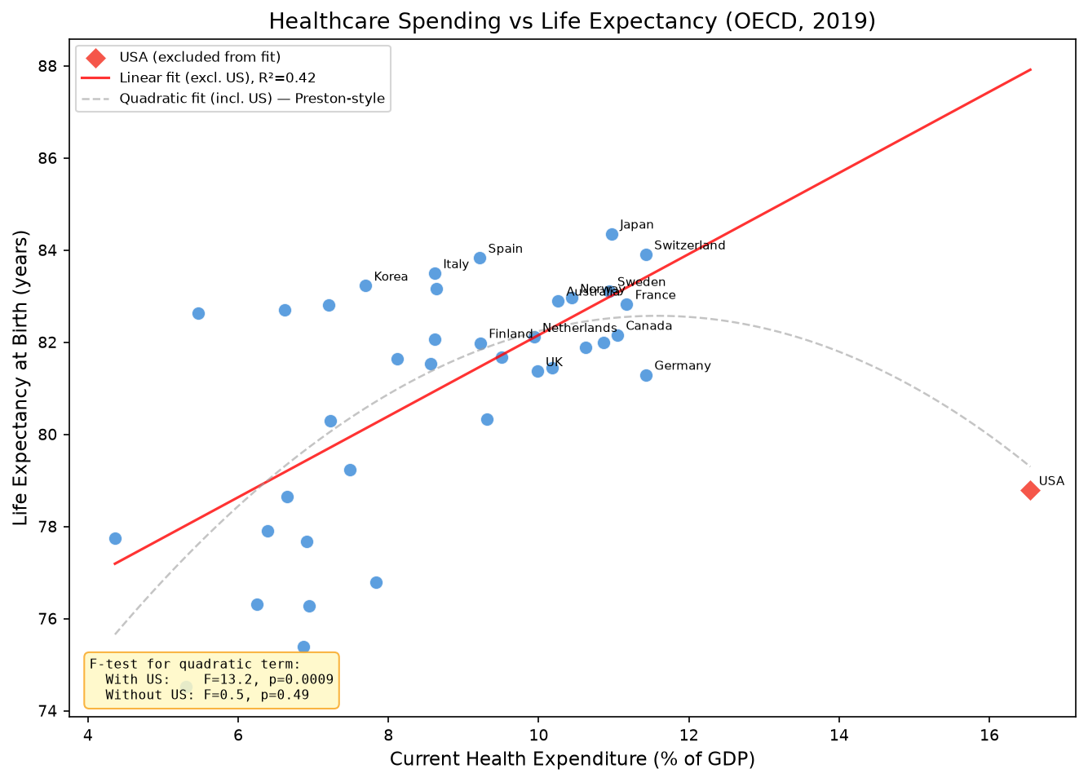
Figure 6. CHE vs Life Expectancy

Slide 7
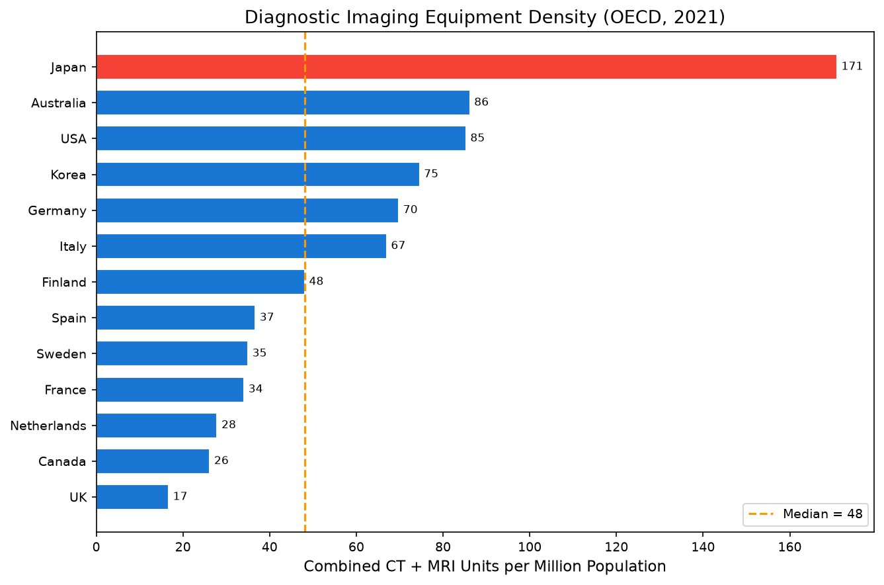
Figure 7. Equipment Density

Slide 8
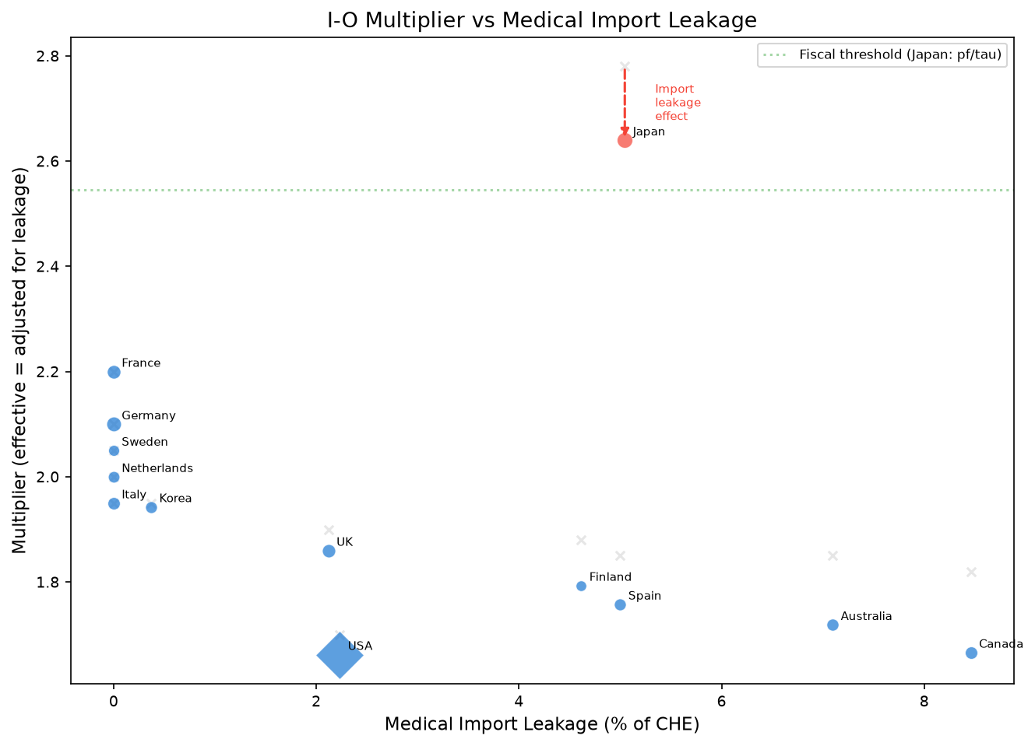
Figure 8. Import Leakage vs Multiplier

Slide 9
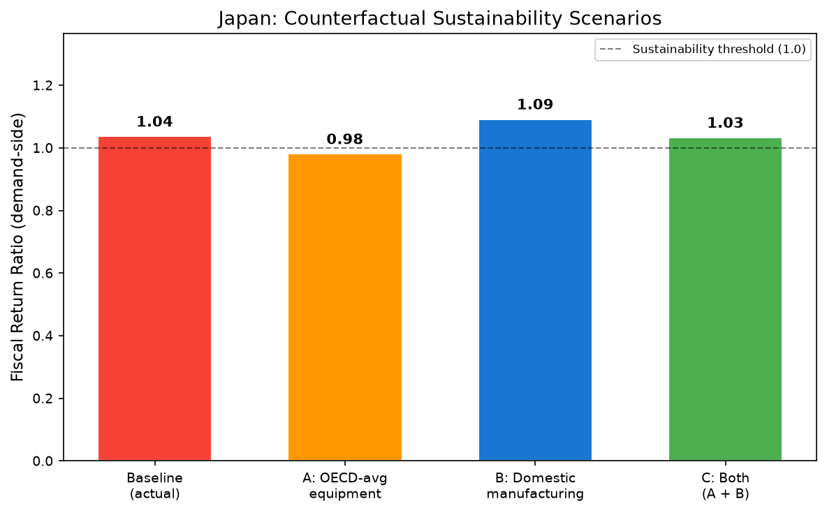
Figure 9. Japan Counterfactual

Slide 10
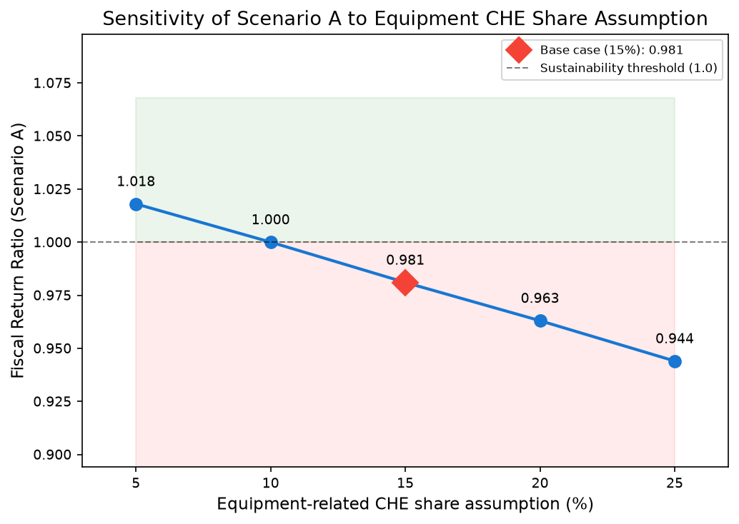
Figure 10. Equipment CHE Share Sensitivity
Scenario A FR varies 0.94-1.02.

