Slide 1
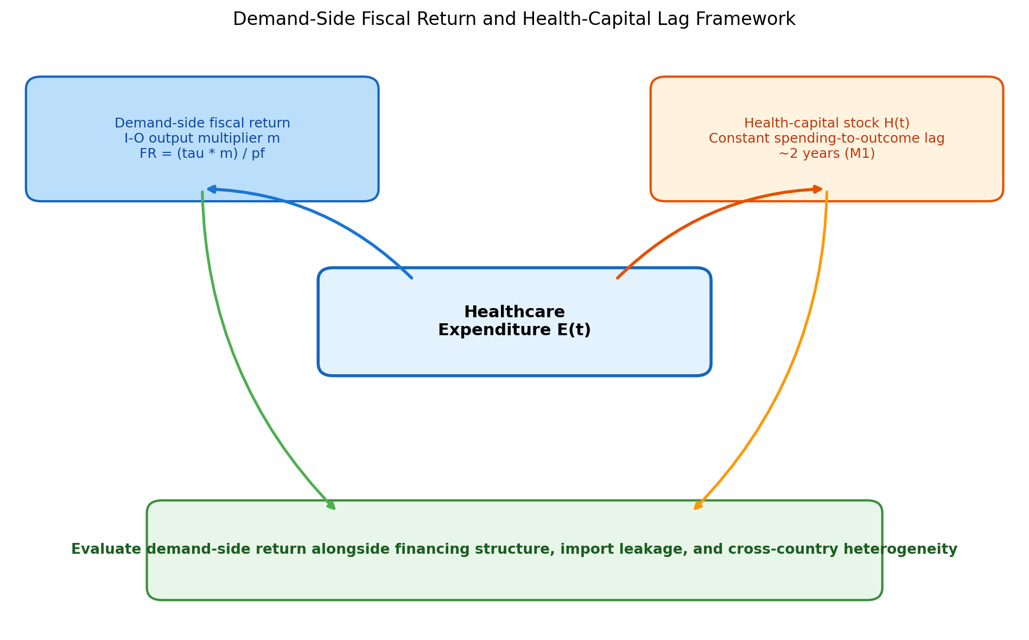
Figure 1. Demand-Side Fiscal Return and Health-Capital Lag Framework
Conceptual diagram of the analytical framework. Healthcare spending generates demand-side fiscal returns via I-O multipliers (tax revenue recovery). A constant spending-to-outcome lag links expenditure flows to health-capital stock; the supply-side effect is modelled as a timing lag rather than quantified as a fiscal return.

Slide 2
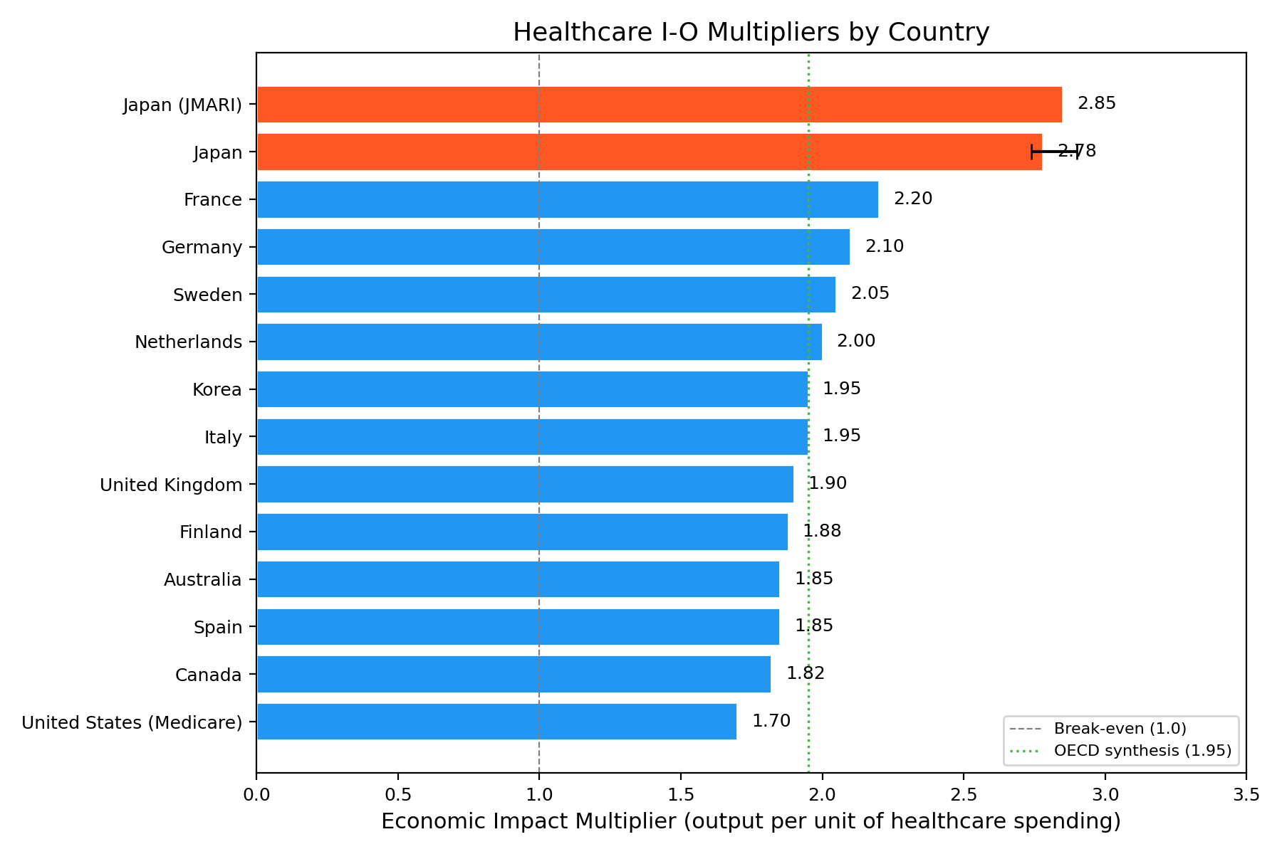
Figure 2. Healthcare I-O Output Multipliers by Country
Healthcare sector I-O output multipliers for 13 OECD countries. Note: US estimate is Medicare-only. See Table 1 for sources and estimation years.

Slide 3
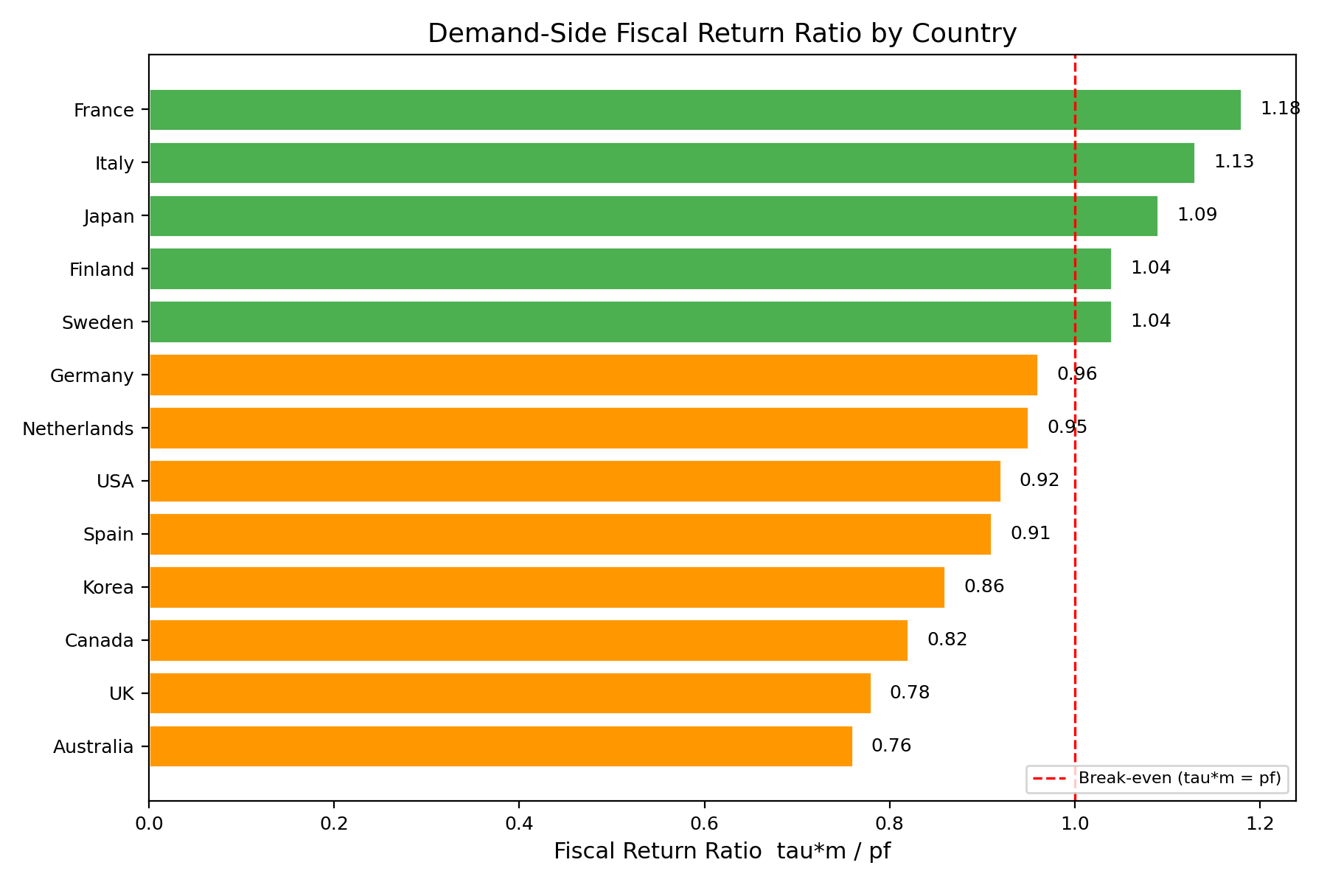
Figure 3. Demand-Side Fiscal Return Ratio by Country
Demand-side fiscal return ratio by country under output-multiplier assumptions. Values at or above 1.0 indicate that demand-side tax revenues cover public costs under output-multiplier assumptions. The dashed line marks the break-even threshold.

Slide 4
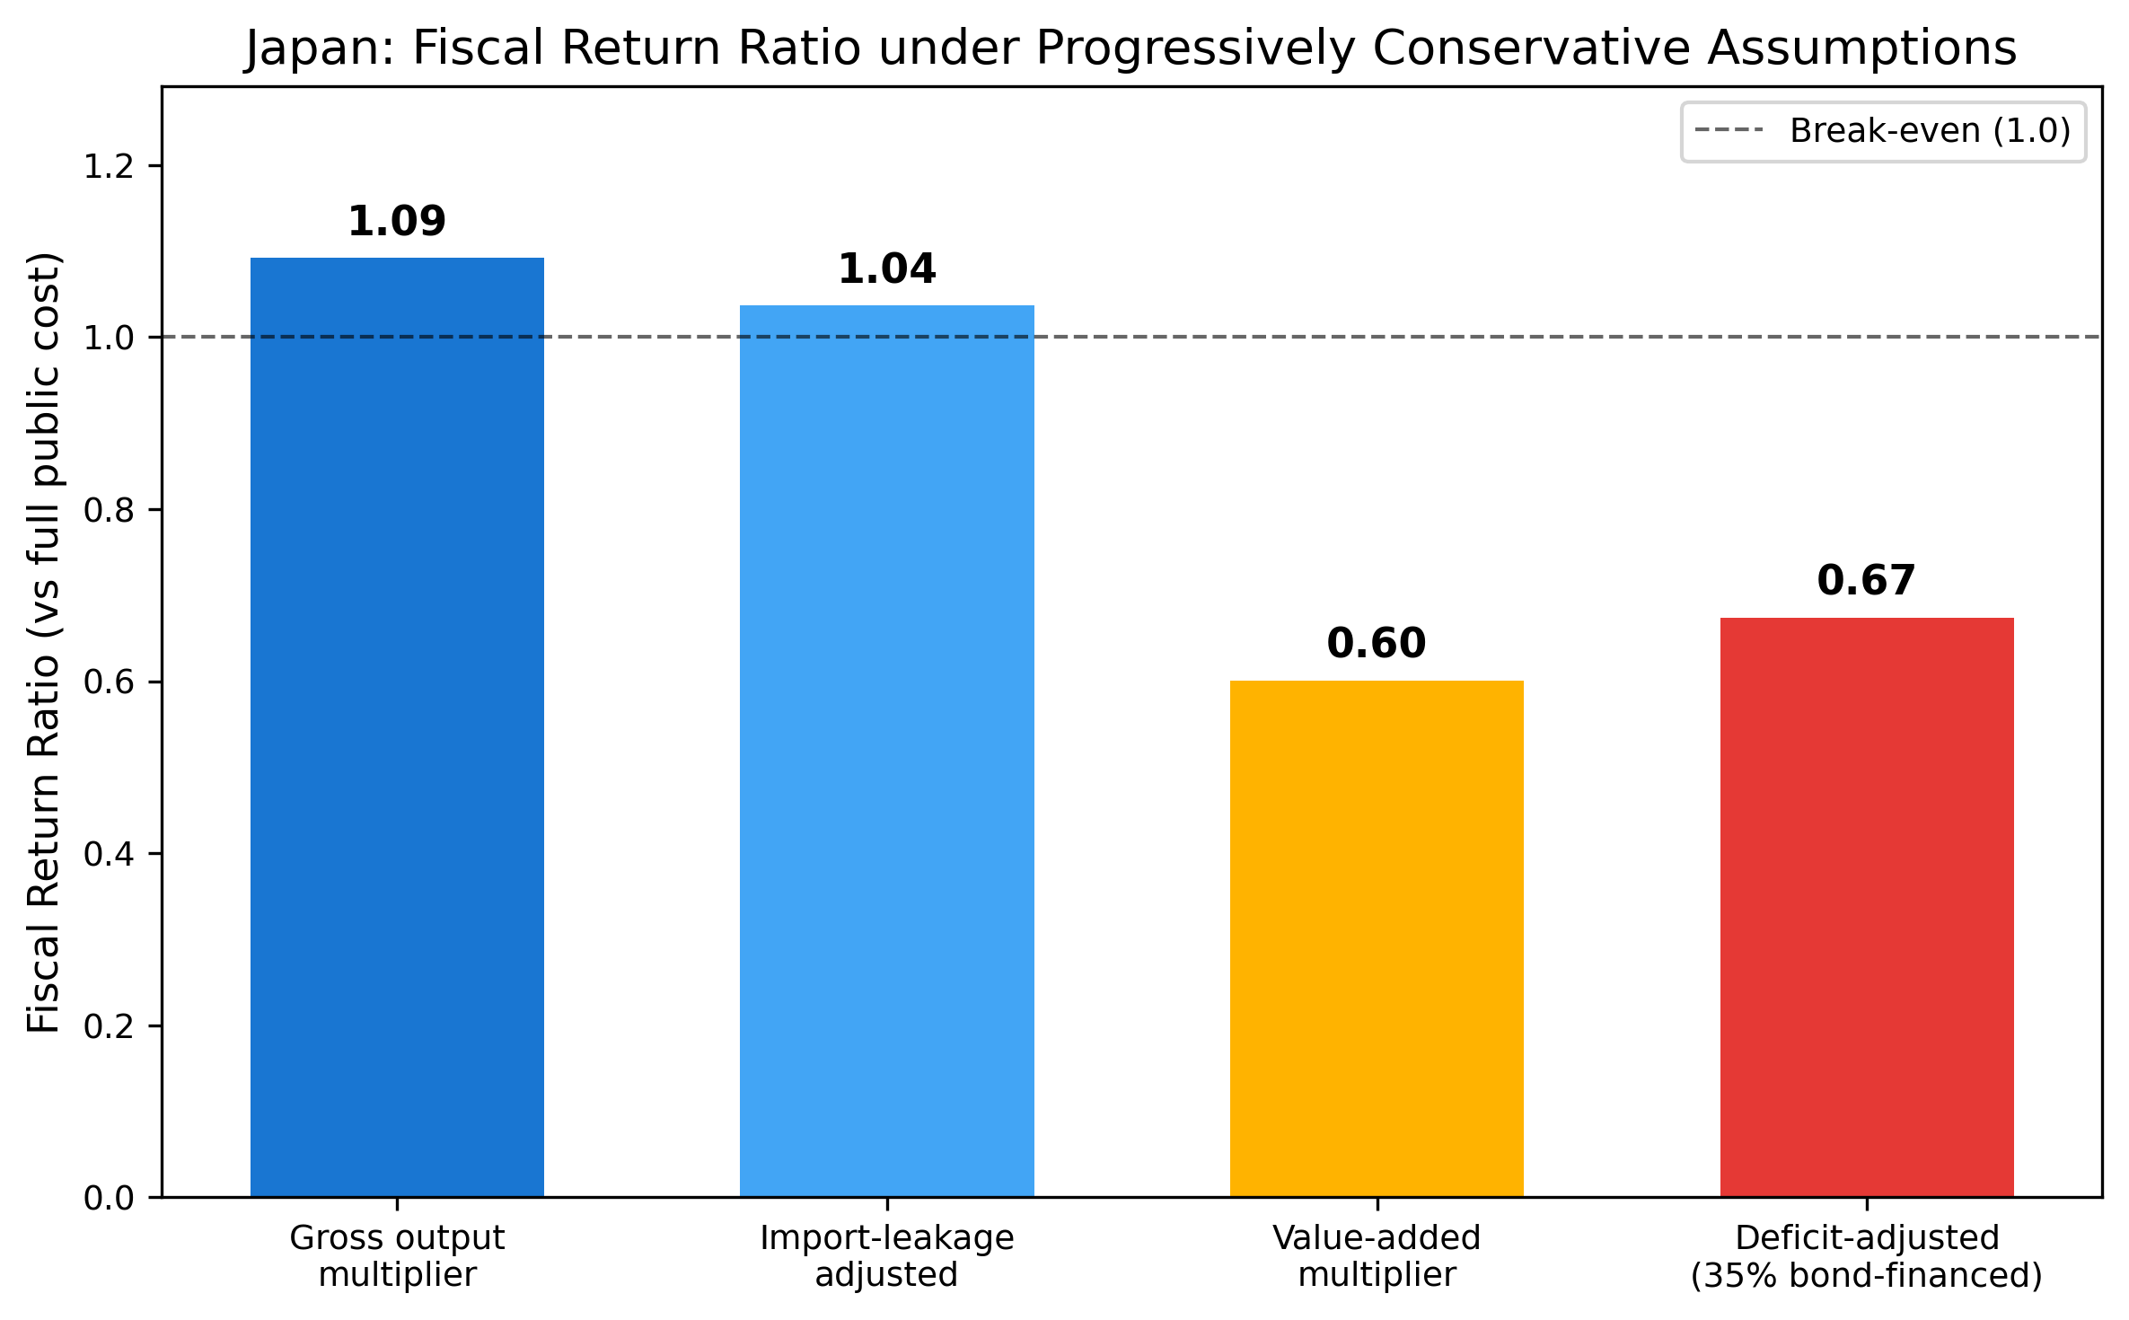
Figure 4. Japan Fiscal Return Ratio Cascade
Japan fiscal return ratio under progressively conservative assumptions: gross output multiplier (1.09), import-leakage adjusted (1.04), deficit-adjusted (0.67), and value-added multiplier (0.60).

Slide 5
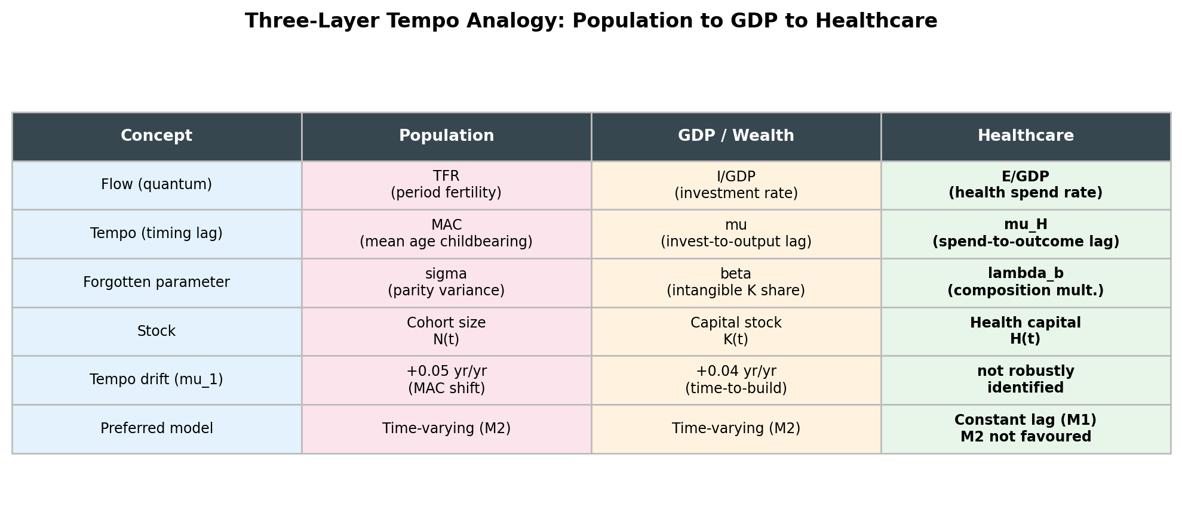
Figure 5. Three-Layer Tempo Analogy
Three-layer tempo analogy linking population structure, GDP, and healthcare expenditure through a constant spending-to-outcome lag.

Slide 6
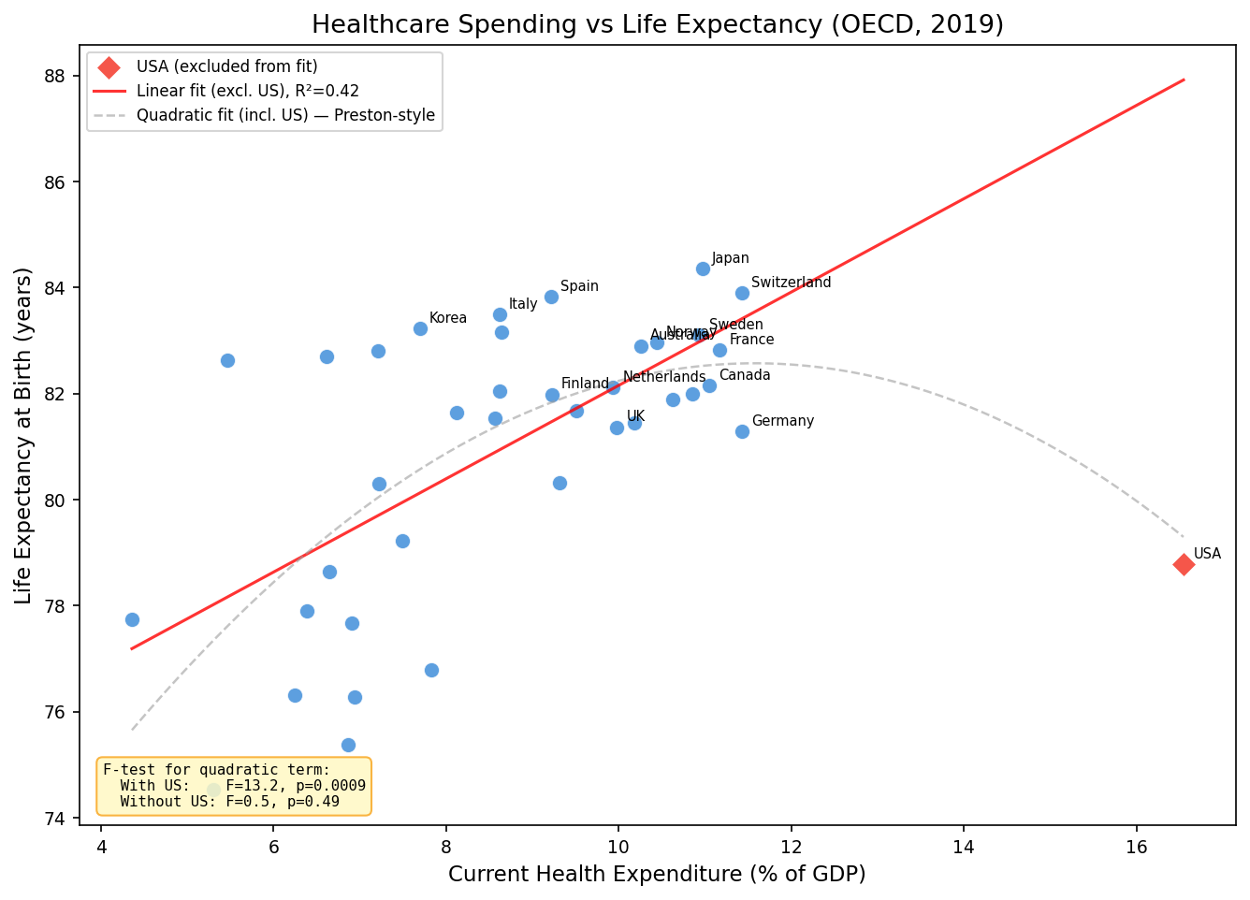
Figure 6. Healthcare Spending vs Life Expectancy with Preston Curve Overfit Test
Current health expenditure per capita versus life expectancy at birth (OECD and selected countries, 2019), with the Preston curve overfit test. The quadratic term is significant when the United States is included but not when it is excluded, indicating that the result is driven by a single high-leverage observation.

Slide 7
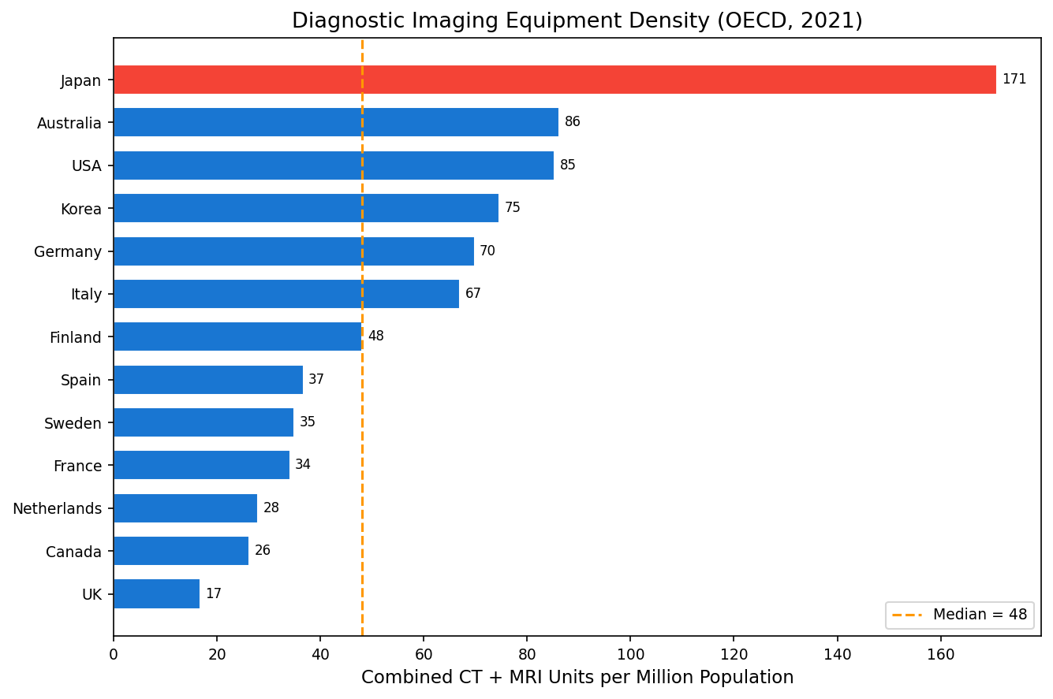
Figure 7. Diagnostic Imaging Equipment Density
Combined CT and MRI scanners per million population. Japan (170.9) is approximately four times the OECD median (48).

Slide 8
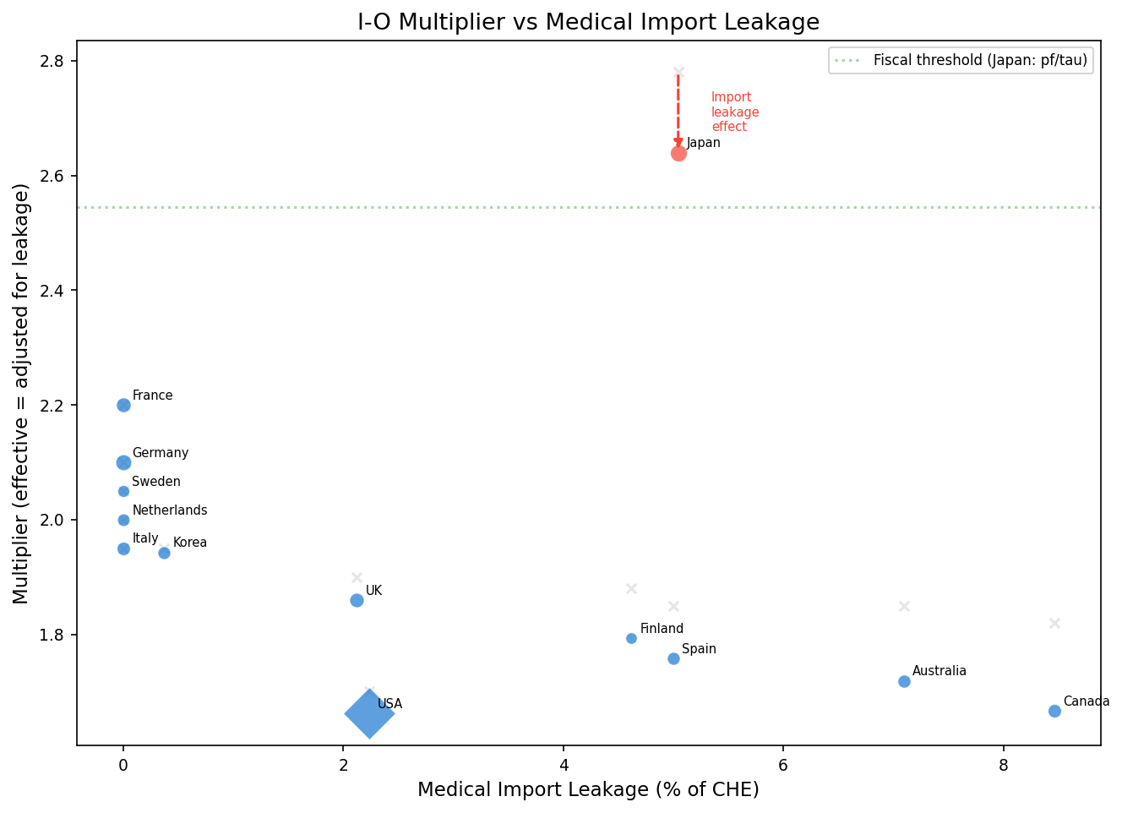
Figure 8. I-O Multiplier vs Medical Import Leakage
I-O output multiplier versus medical equipment import leakage rate. Higher leakage reduces the effective multiplier by lowering the share of induced output that remains domestic.

Slide 9
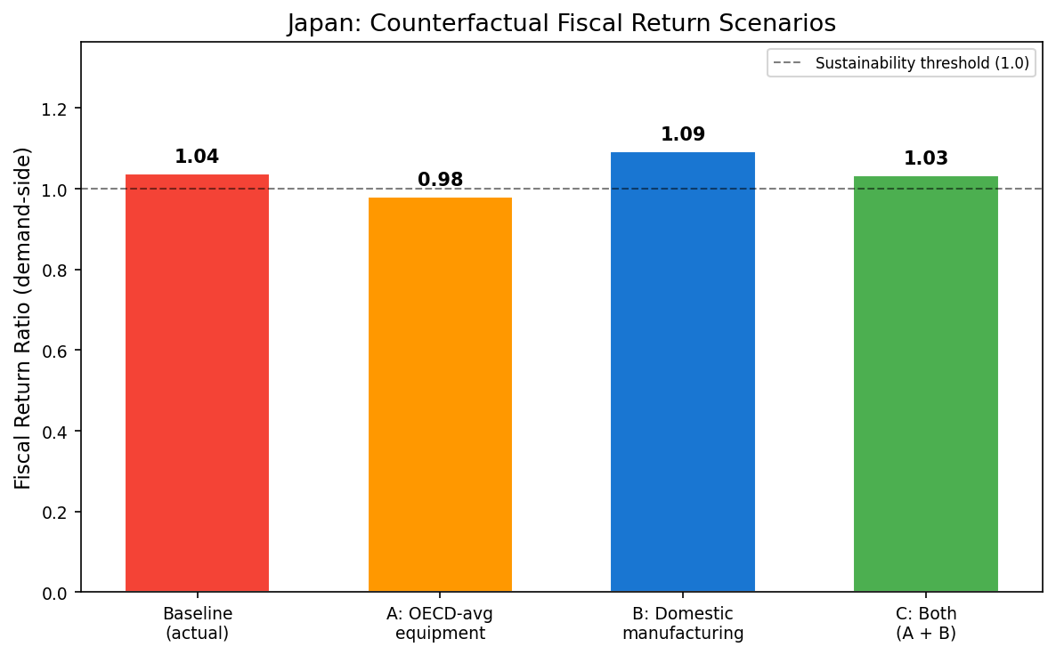
Figure 9. Japan Counterfactual Fiscal Return Scenarios
Japan counterfactual fiscal return scenarios. Baseline 1.04, A: OECD-average equipment density 0.98, B: domestic manufacturing 1.09, C: both 1.03.

Slide 10
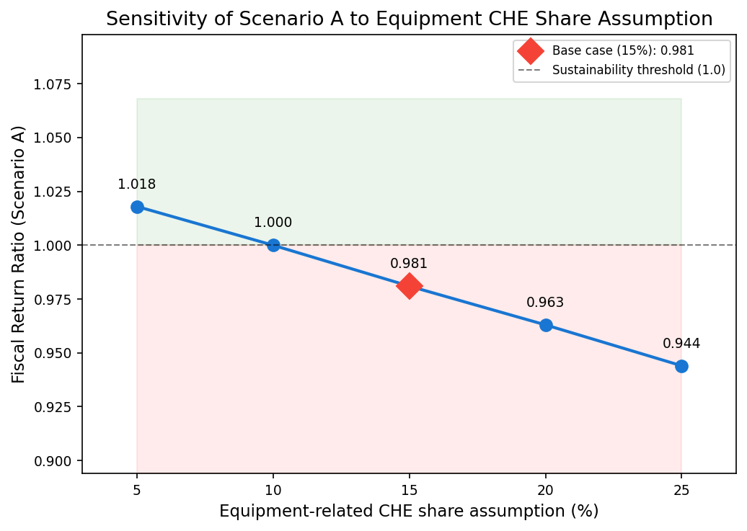
Figure 10. Sensitivity of Scenario A to Equipment-CHE Share
Sensitivity of Scenario A to the assumed equipment-related CHE share (5–25%). The fiscal return crosses the 1.0 threshold near 10%; values near the threshold should be interpreted as sensitivity outcomes, not a binary sustainability determination.

