Slide 1
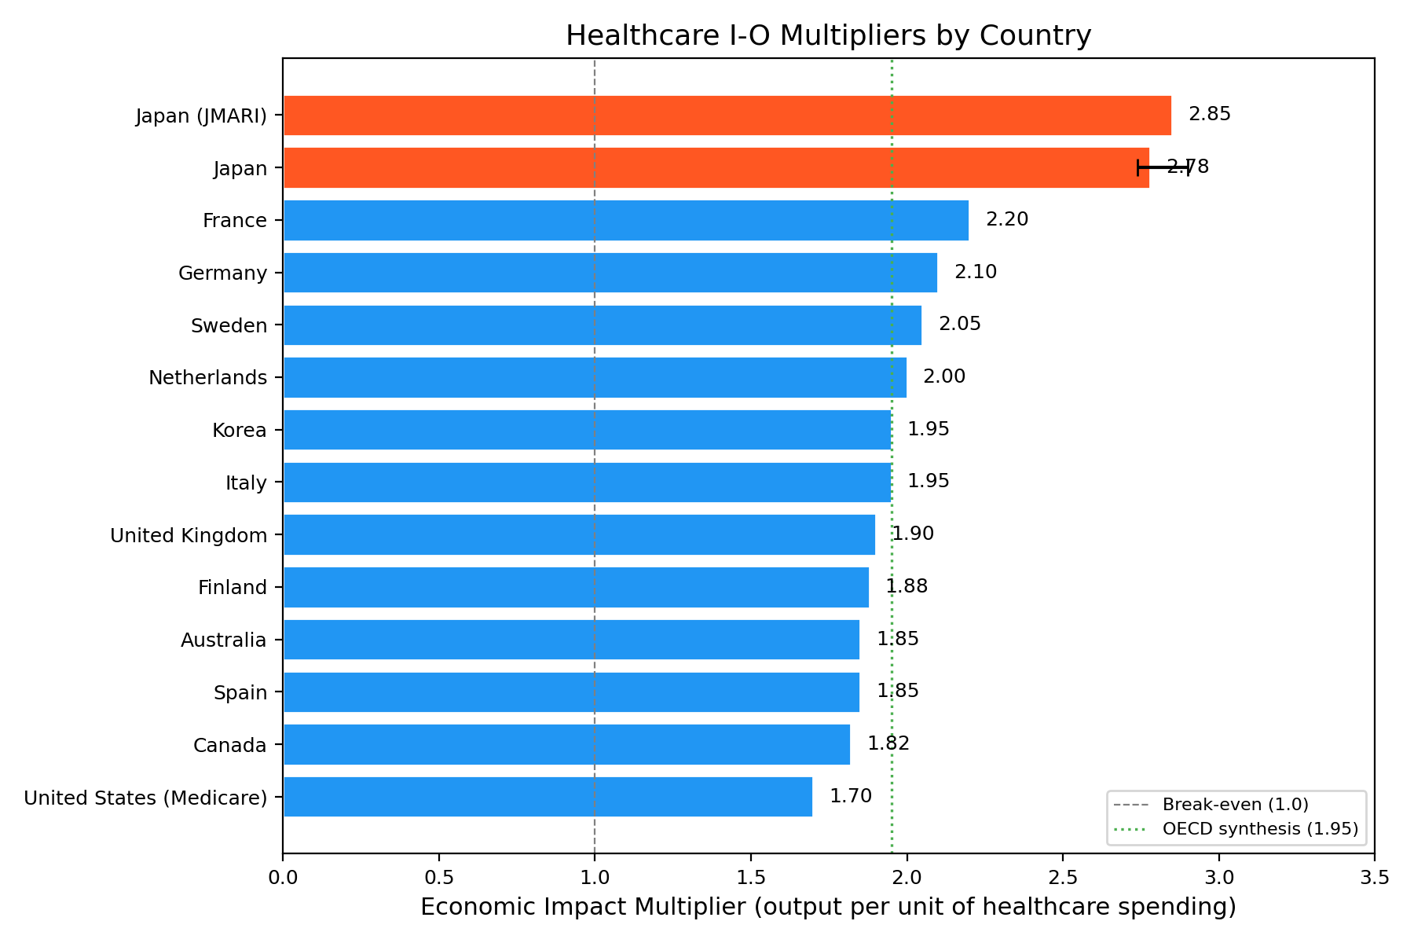
Figure 1. Healthcare I-O Multipliers by Country
Healthcare sector input-output multipliers. Japan leads at 2.78x. Sources: Yamada & Imanaka 2015, Gutierrez-Hernandez 2021, et al.

Slide 2
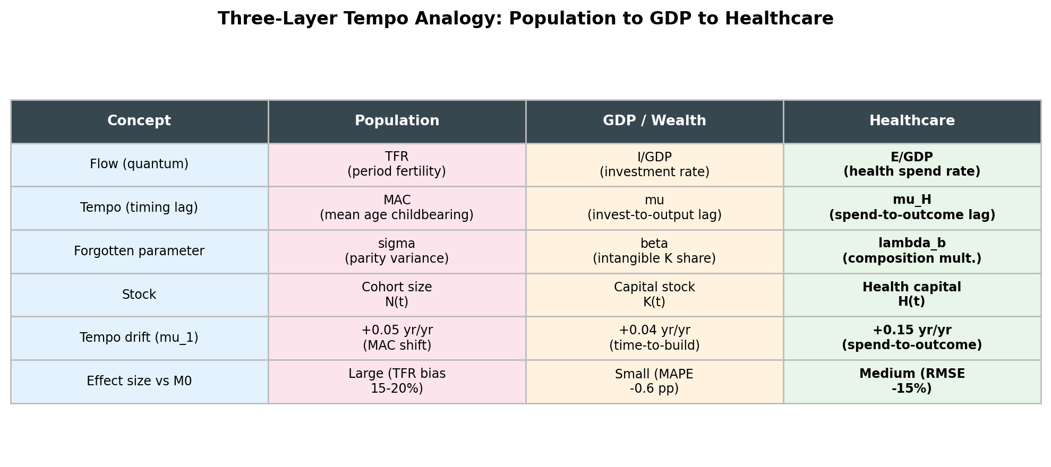
Figure 2. Three-Layer Tempo Analogy: Population -> GDP -> Healthcare
The Bongaarts-Feeney tempo framework ported across three domains. Healthcare shows the largest tempo drift (+0.15 yr/yr vs GDP +0.04).

Slide 3
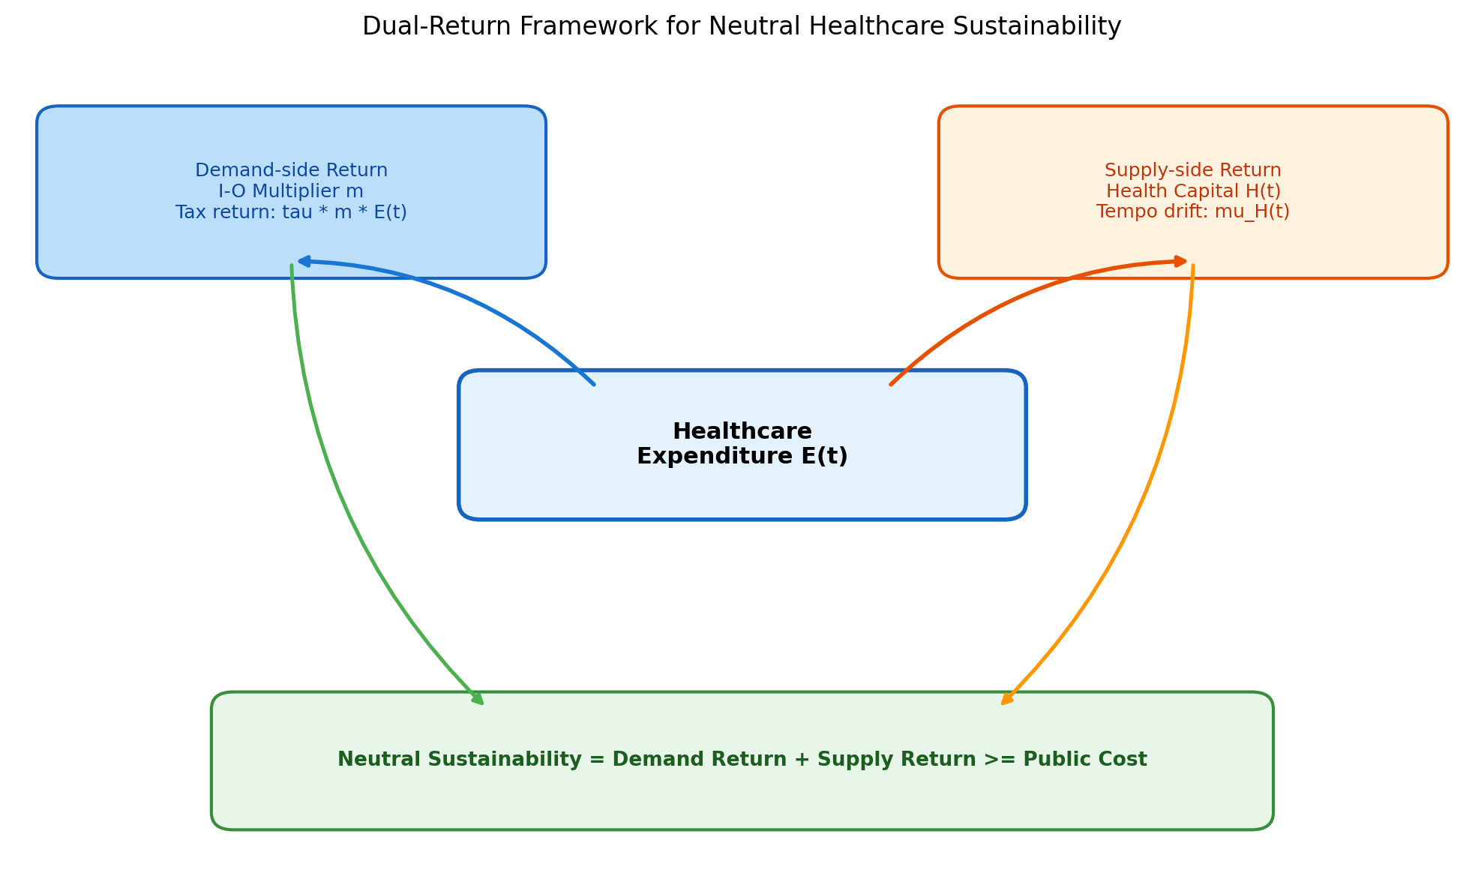
Figure 3. Dual-Return Framework for Neutral Sustainability
Healthcare spending generates returns through two channels: demand-side (I-O multiplier) and supply-side (health-capital tempo effect).

Slide 4
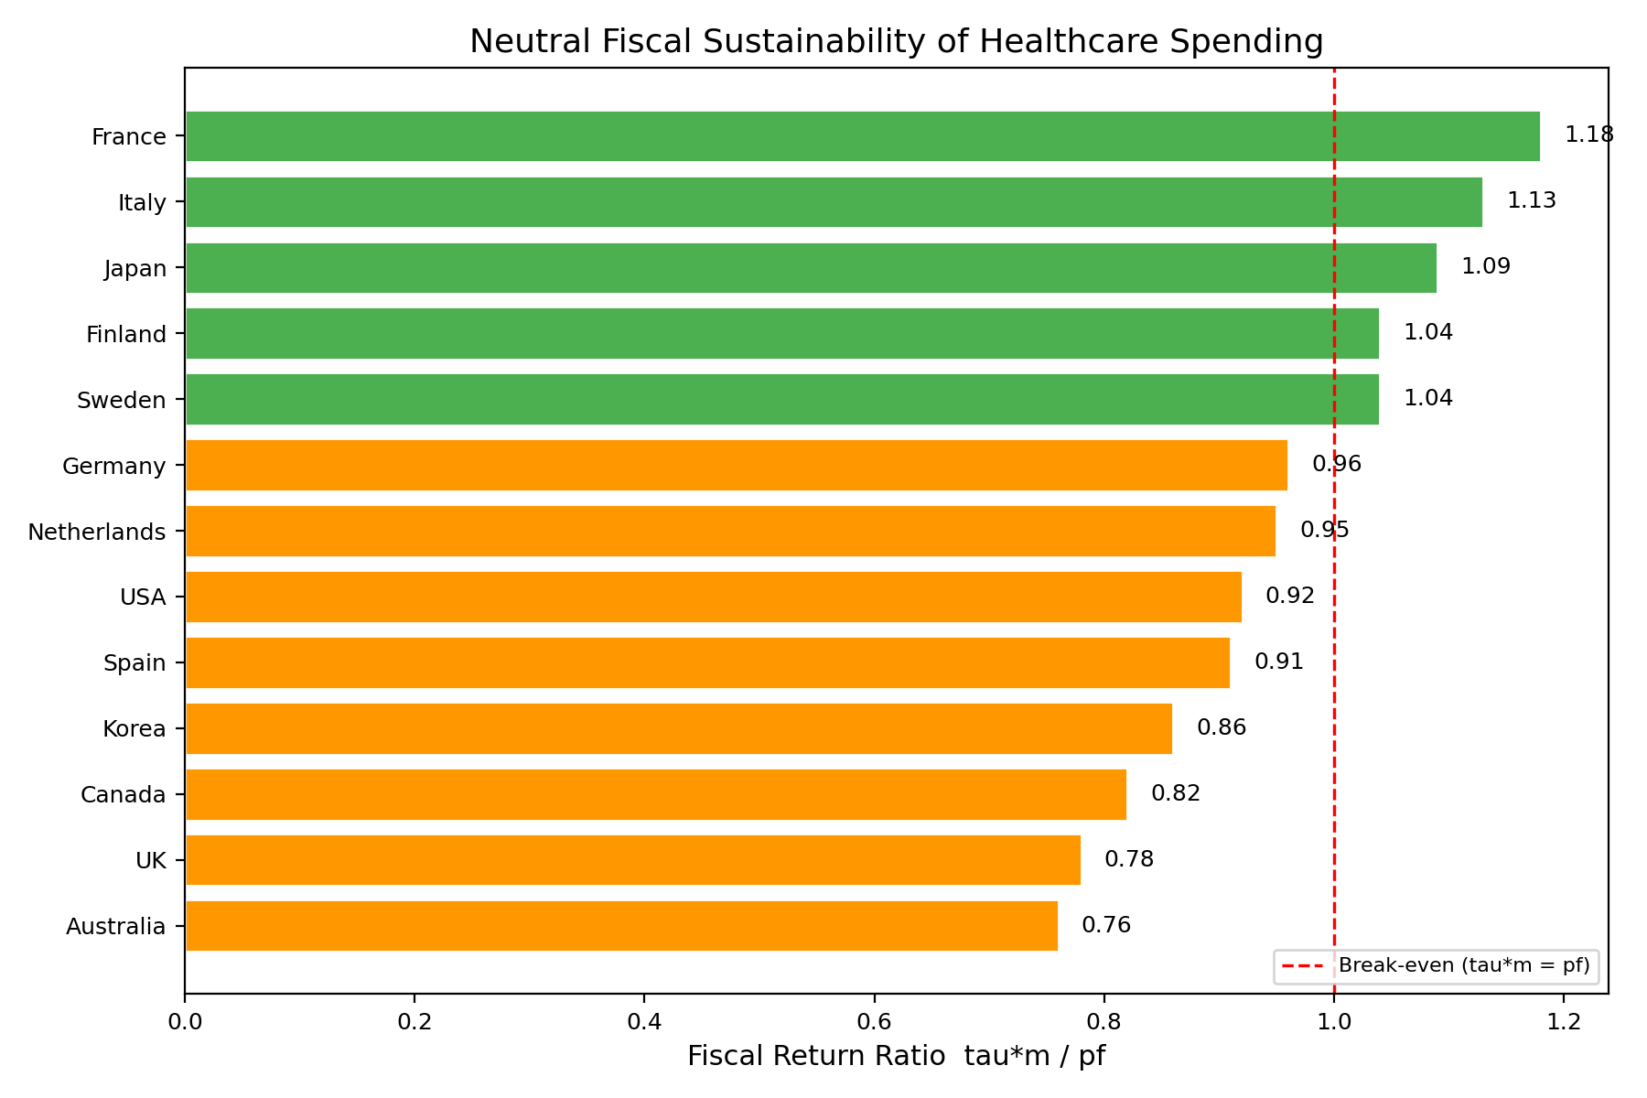
Figure 4. Fiscal Return Ratio of Healthcare Spending
Fiscal Return Ratio = (Effective tax rate x I-O multiplier) / Public share. Values >= 1.0 indicate fiscal self-sustainability.

Slide 5
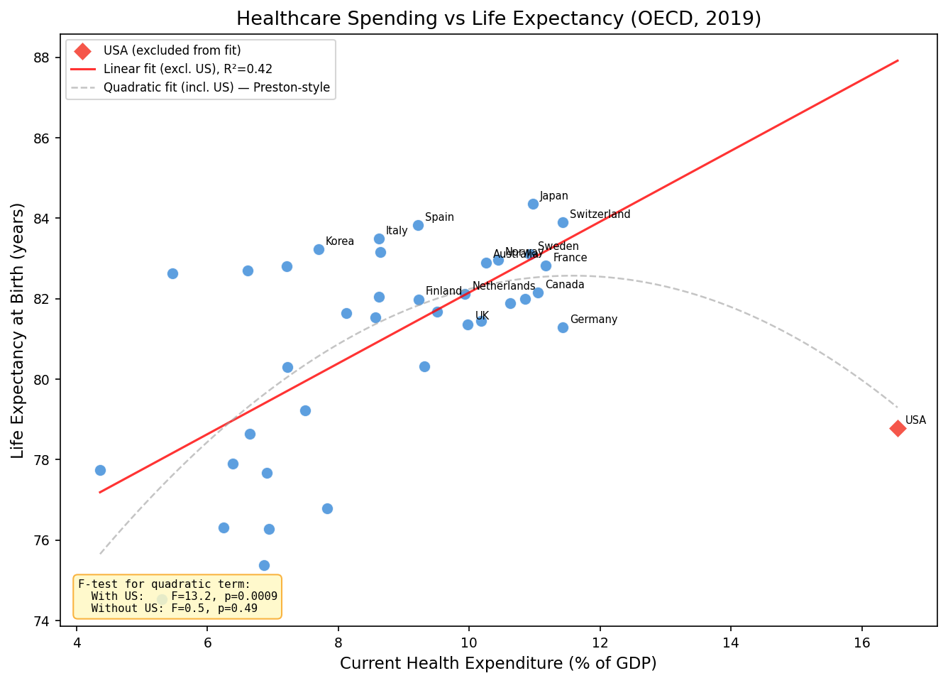
Figure 5. Healthcare Spending (% GDP) vs Life Expectancy (OECD, 2019)
X-axis: CHE as % of GDP. Y-axis: Life expectancy at birth (years). Linear fit excludes US (outlier shown in red). F-test results in figure.

Slide 6
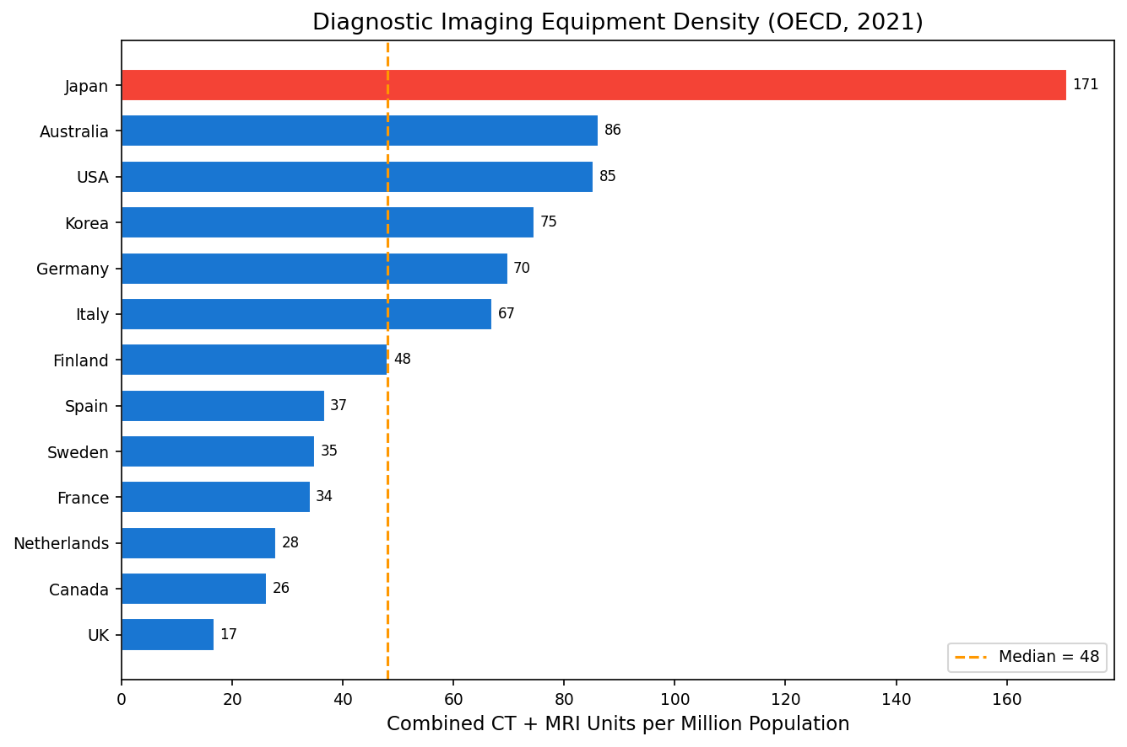
Figure 6. Diagnostic Imaging Equipment Density (CT+MRI, OECD 2021)
Combined CT and MRI scanners per million population. Japan (red) at 170.9 is approximately 4x the OECD median.

Slide 7
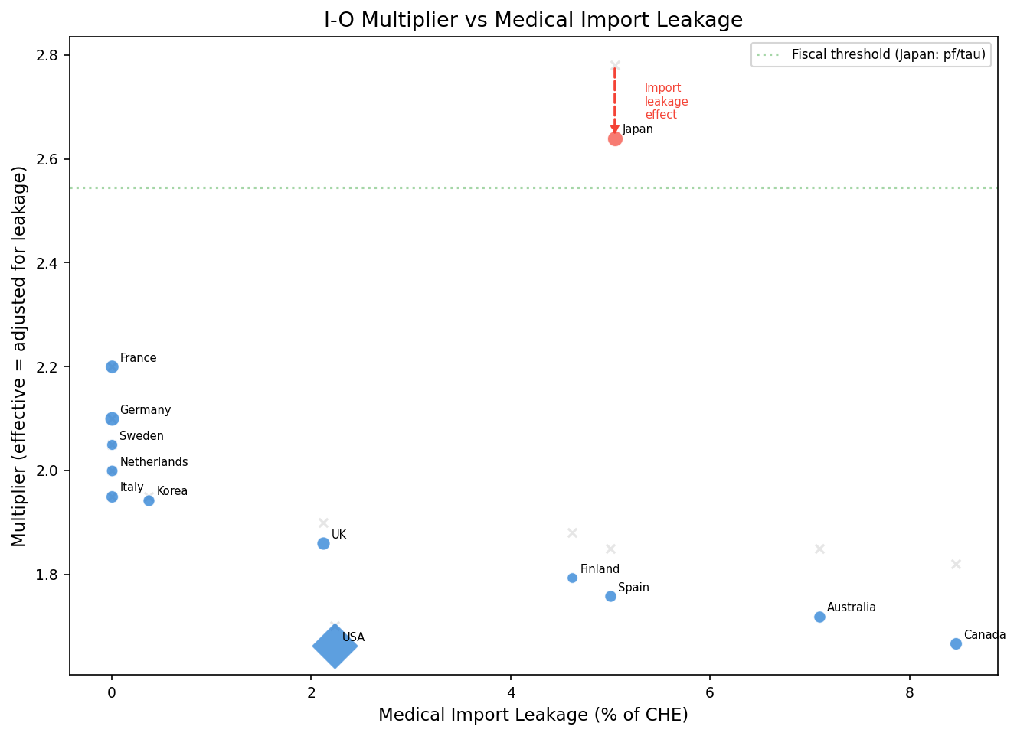
Figure 7. Medical Import Leakage vs Effective I-O Multiplier
Import leakage reduces the effective I-O multiplier. Gray x = nominal multiplier. Red arrow = Japan's leakage adjustment.

Slide 8
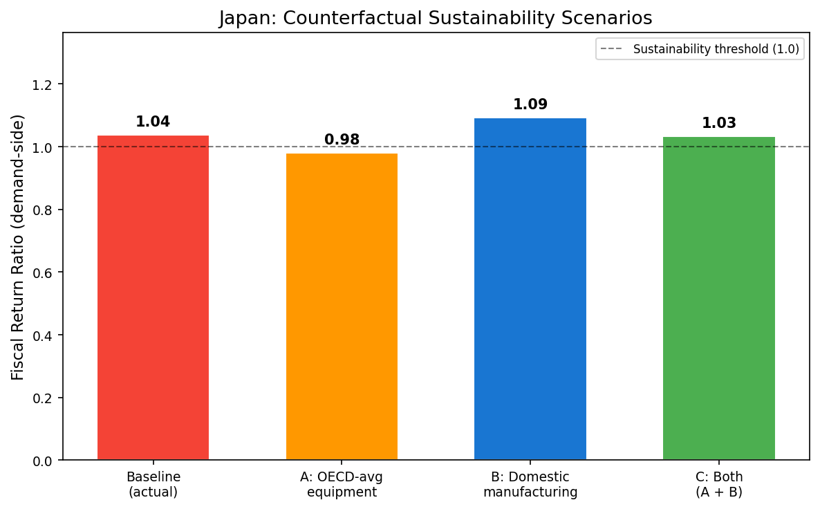
Figure 8. Japan Counterfactual Sustainability Scenarios
Baseline (1.04), A: OECD-avg equipment (0.98), B: Domestic manufacturing (1.09), C: Both (1.03).

