Slide 1
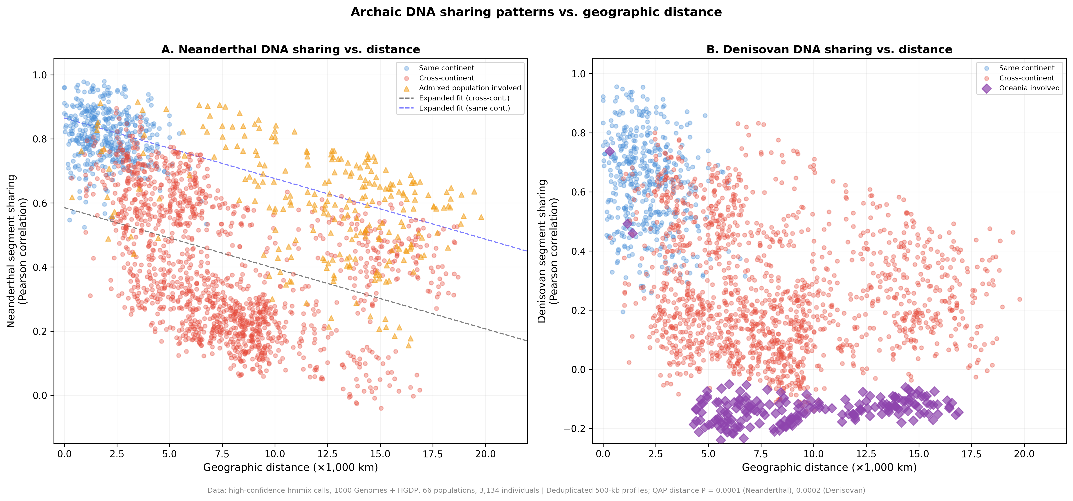
Figure 1
Archaic-segment profile similarity and geographic distance. Each point is a dependent population pair. Lines are descriptive distance-only fits; reported P values use population-label quadratic assignment permutations.

Slide 2
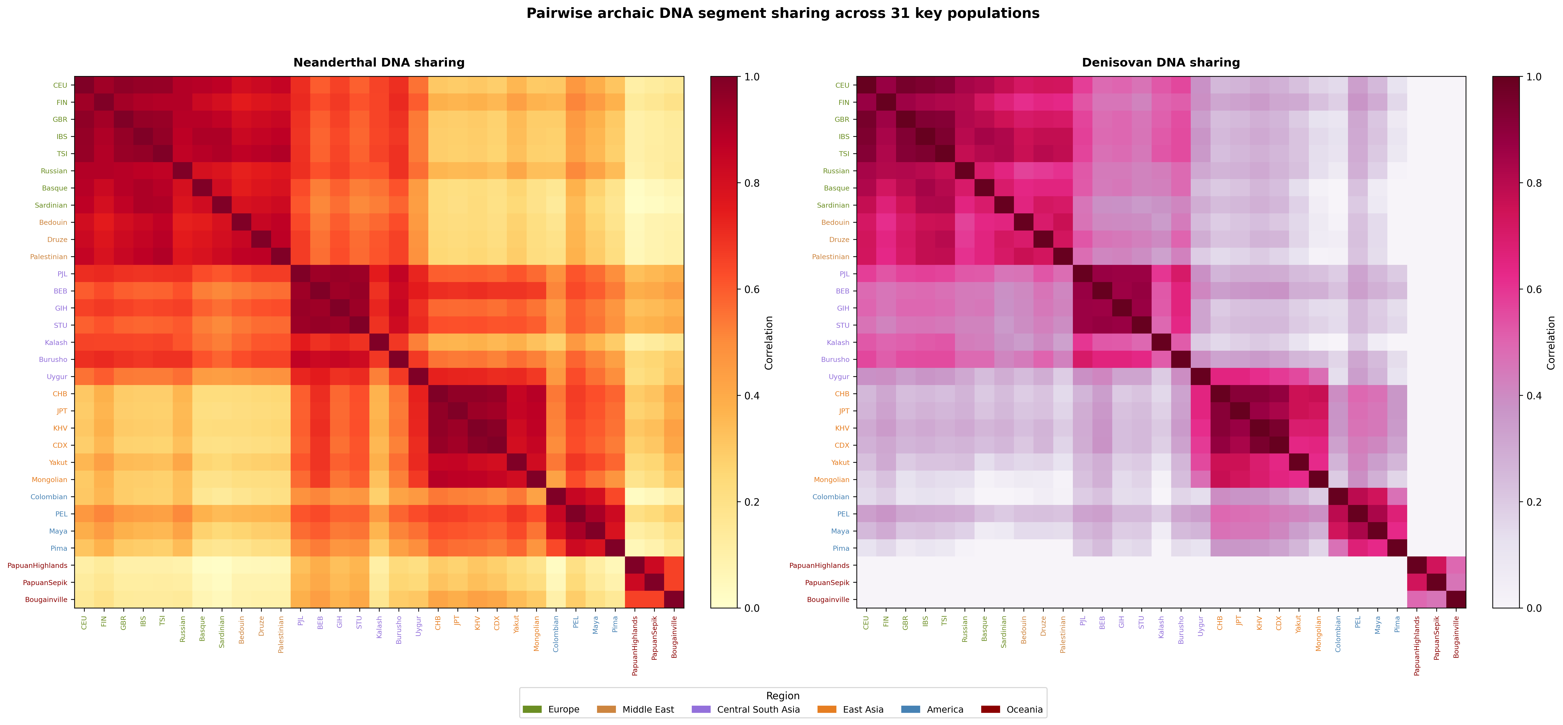
Figure 2
Pairwise archaic-segment profile similarity for 31 prespecified populations. The subset is displayed for legibility; all 66 populations were analyzed.

Slide 3
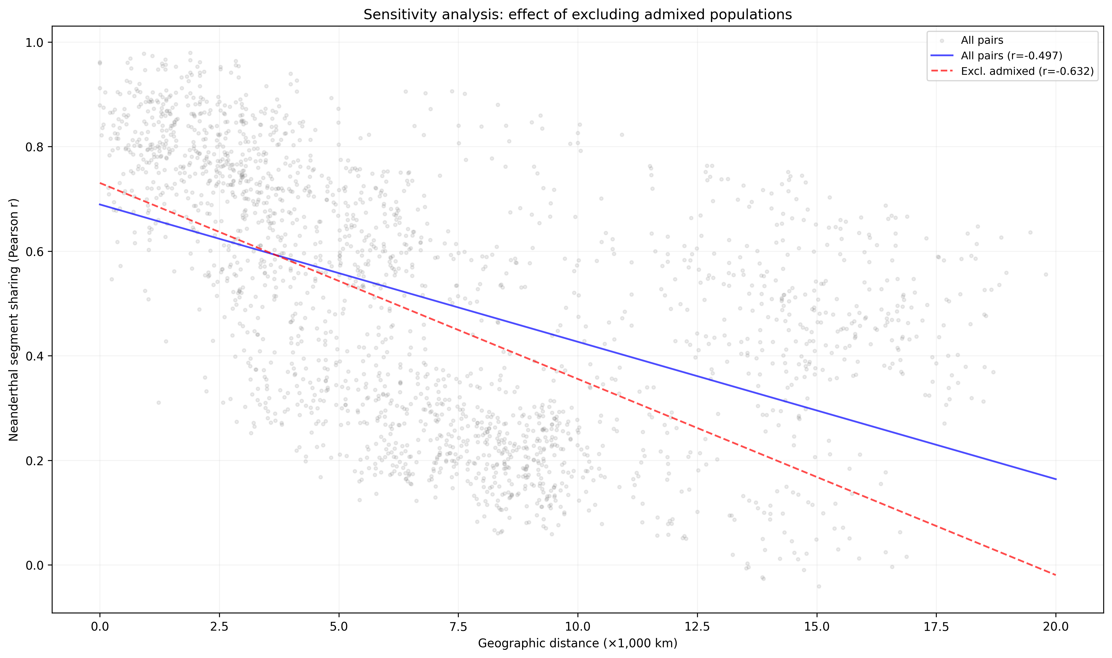
Figure 3
Sensitivity of the descriptive Neanderthal distance correlation to exclusion of designated recently admixed populations.

Slide 4
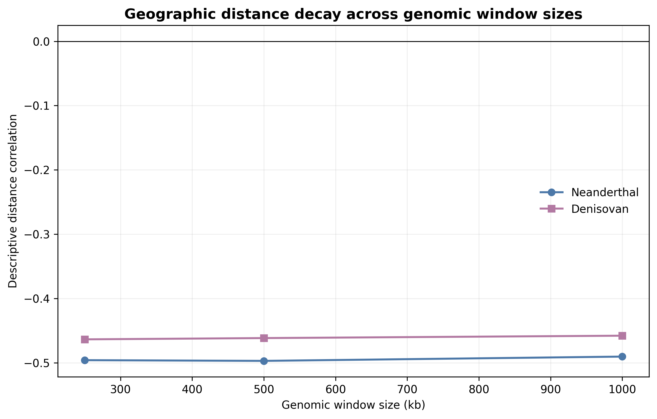
Figure 4
Descriptive geographic distance correlations at 250-kb, 500-kb, and 1-Mb window sizes. Quadratic assignment procedure results are tabulated in Supplementary Data.

Slide 5
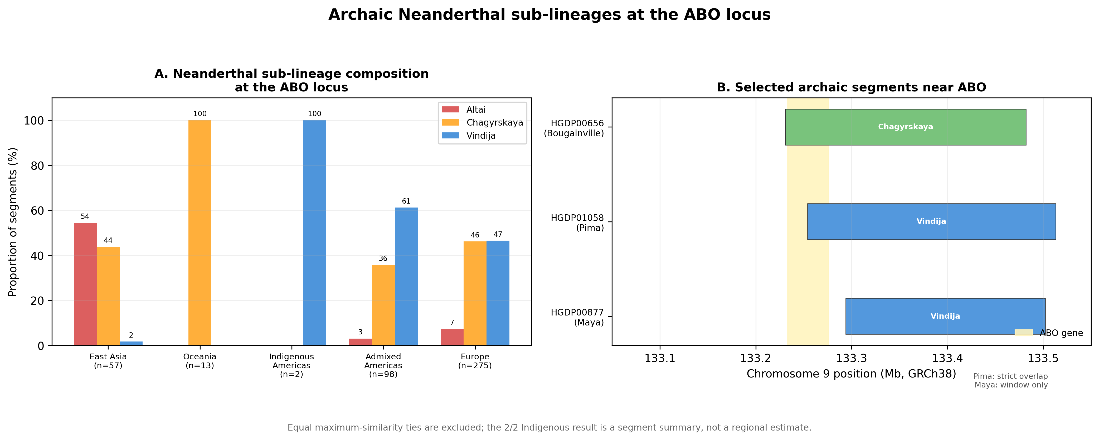
Figure 5
ABO-centered analysis preserving the historical grouped-bar and segment-map layout. Equal maximum-similarity ties are excluded from the displayed three-reference proportions and retained in Supplementary Data. The Pima segment overlaps ABO; the Maya segment is within the wider interval but does not overlap the gene. Counts are segments, not regional frequencies.

Slide 6
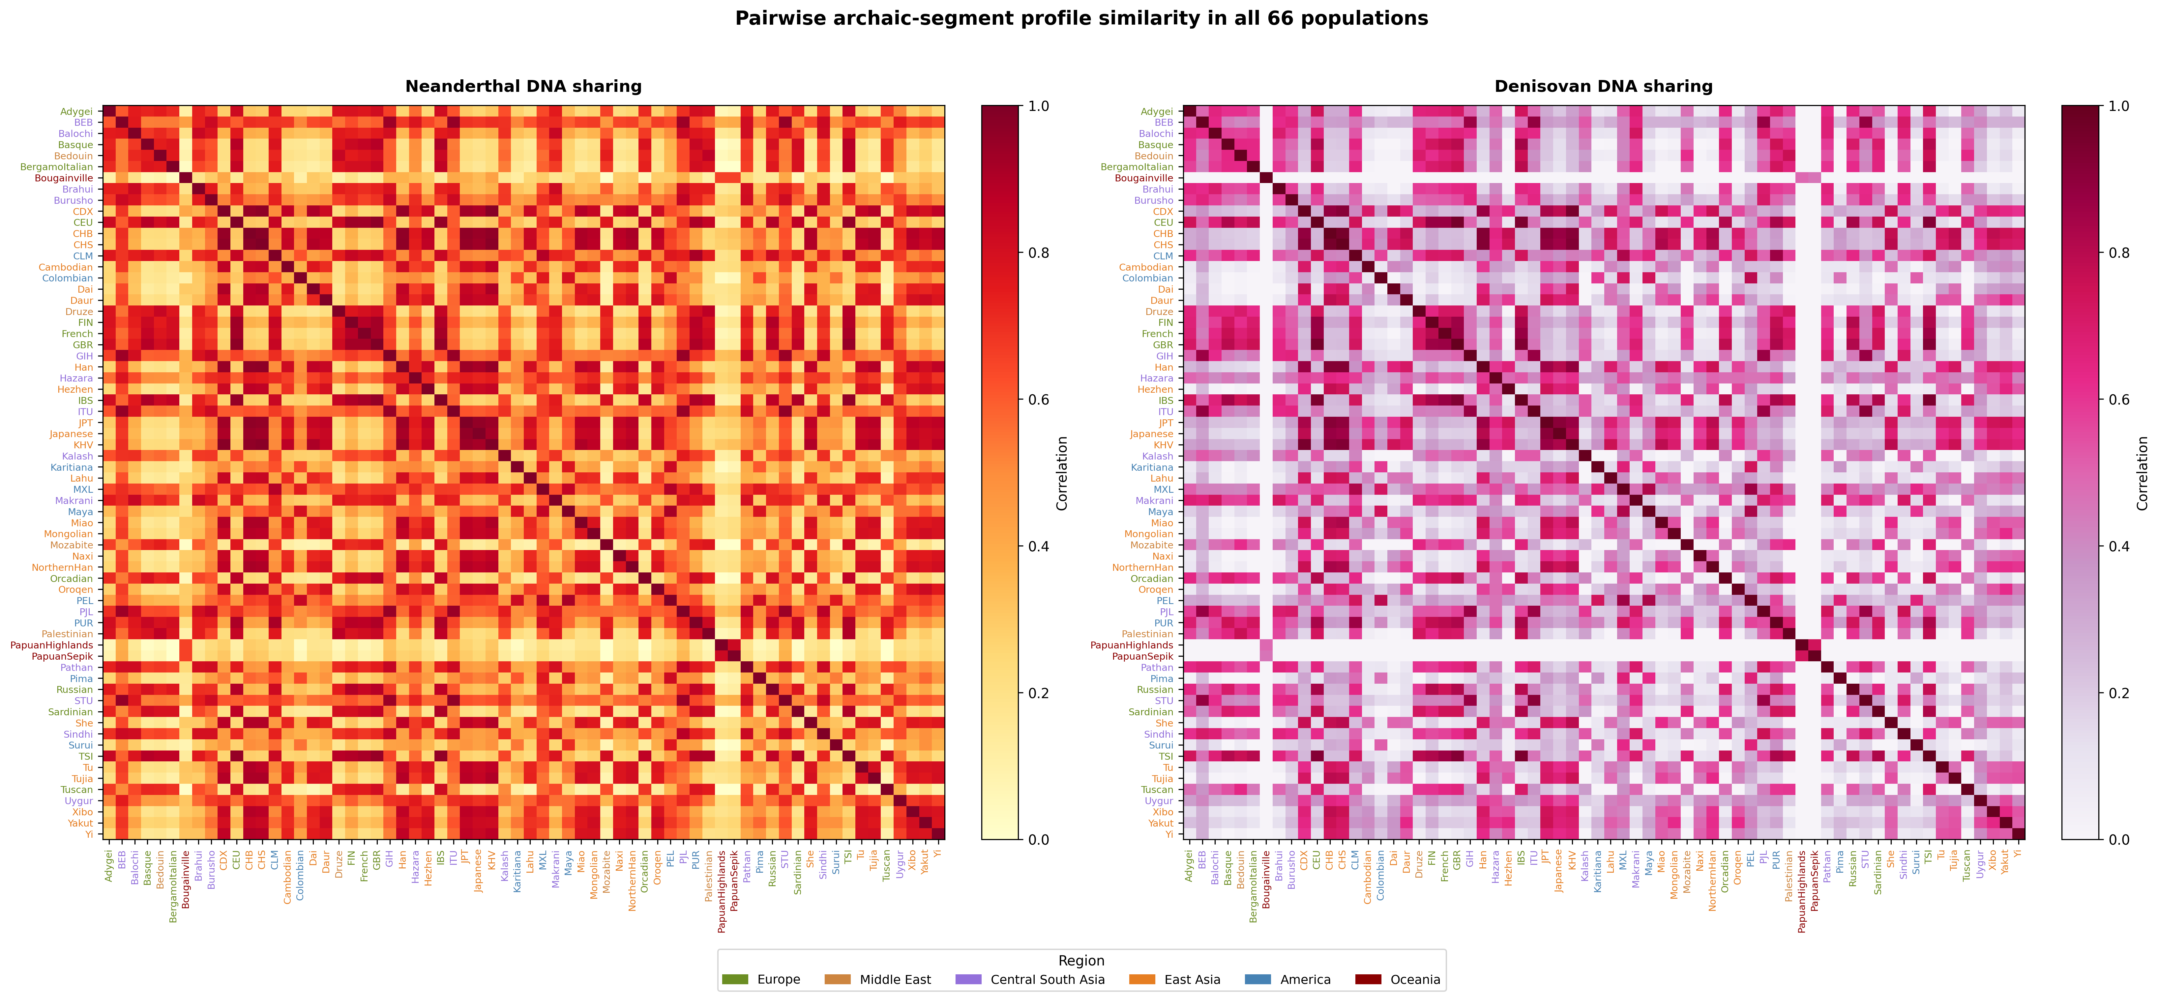
Figure S1
Complete 66-population Neanderthal and Denisovan profile-similarity matrices.

Slide 7
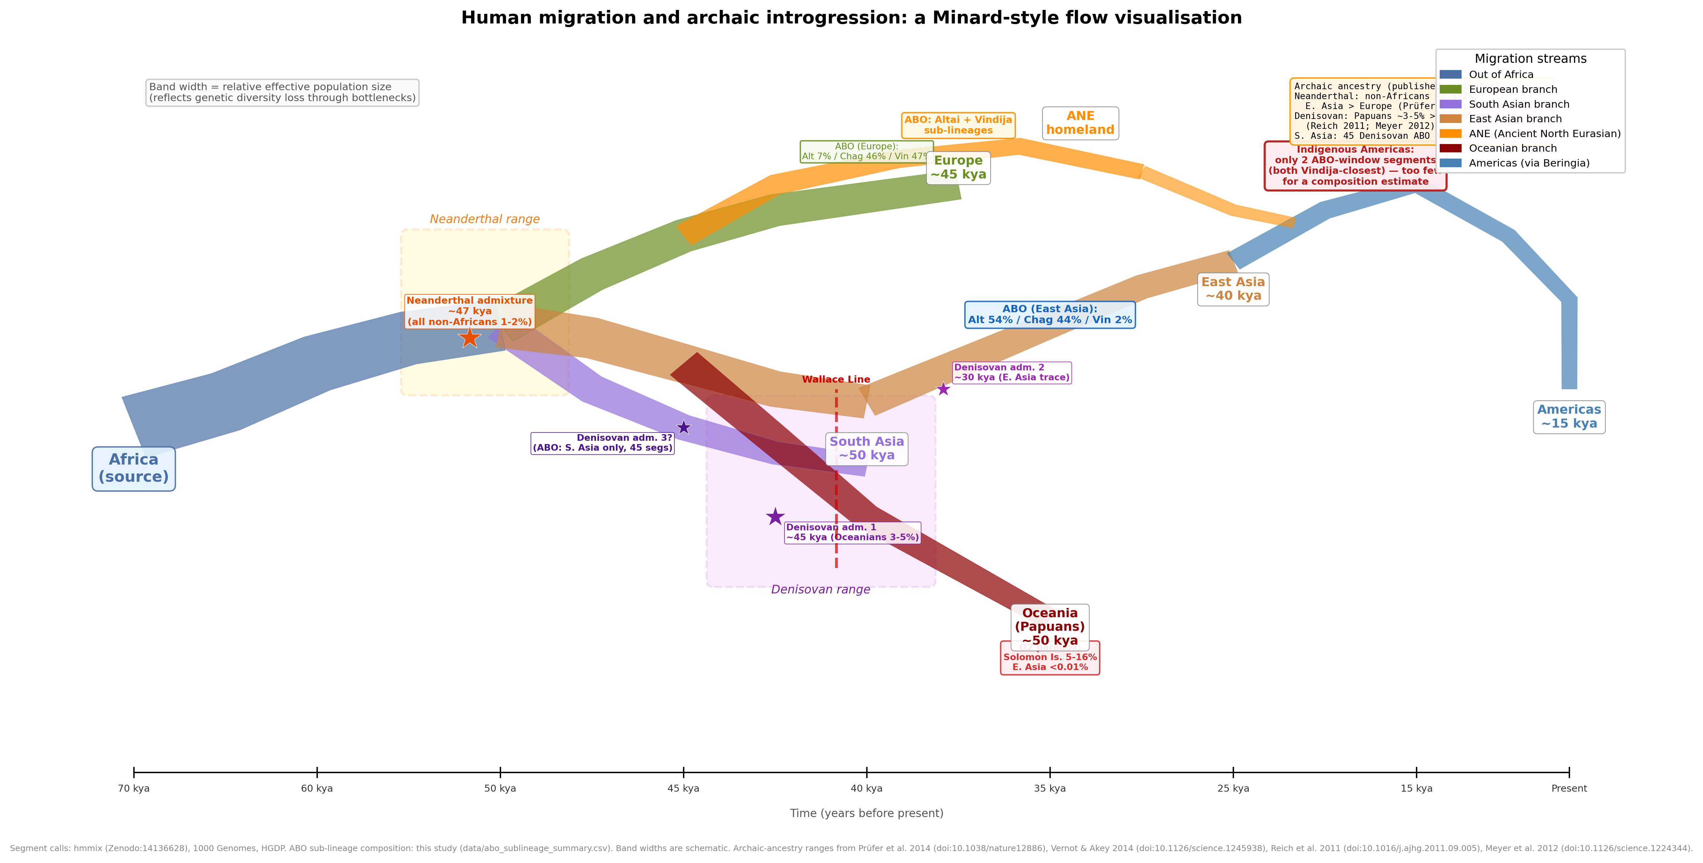
Figure S2
Minard-style schematic of human dispersal and archaic introgression. Band widths, branch positions, and event placement are illustrative and do not estimate migration magnitude or a route supported by the present analysis. The ABO sub-lineage compositions shown are computed in this study from data/abo_sublineage_summary.csv (segments, not individuals; ties excluded from the percentages) and the South Asian Denisovan-segment count from data/abo_denisovan_segments.csv; broad archaic-ancestry ranges are attributed on the figure to Prüfer et al. (2014), Vernot and Akey (2014), Reich et al. (2011), and Meyer et al. (2012).

Slide 8
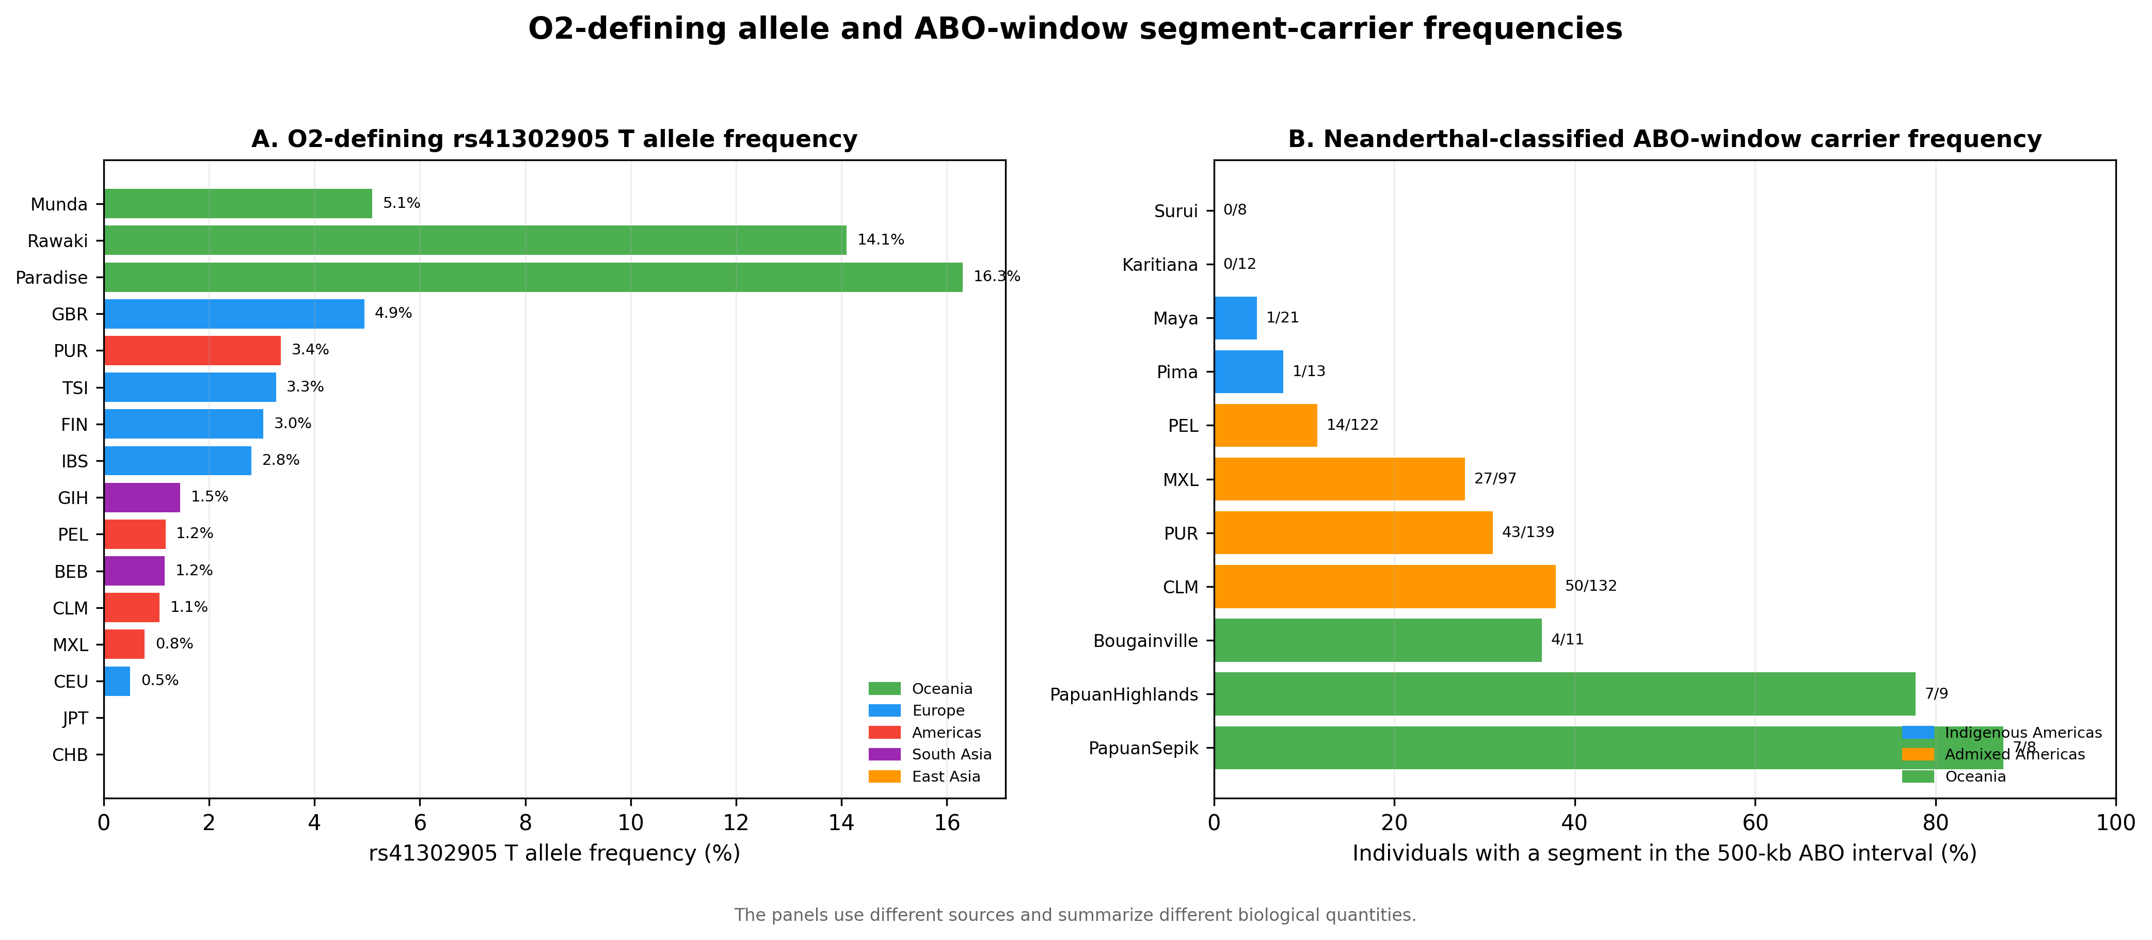
Figure S3
O2 blood-group subtype-defining allele frequencies and ABO-window segment-carrier frequencies. The panels use different sources and are not an association analysis; proximity does not establish that the O2 allele is Neanderthal-derived.

Slide 9
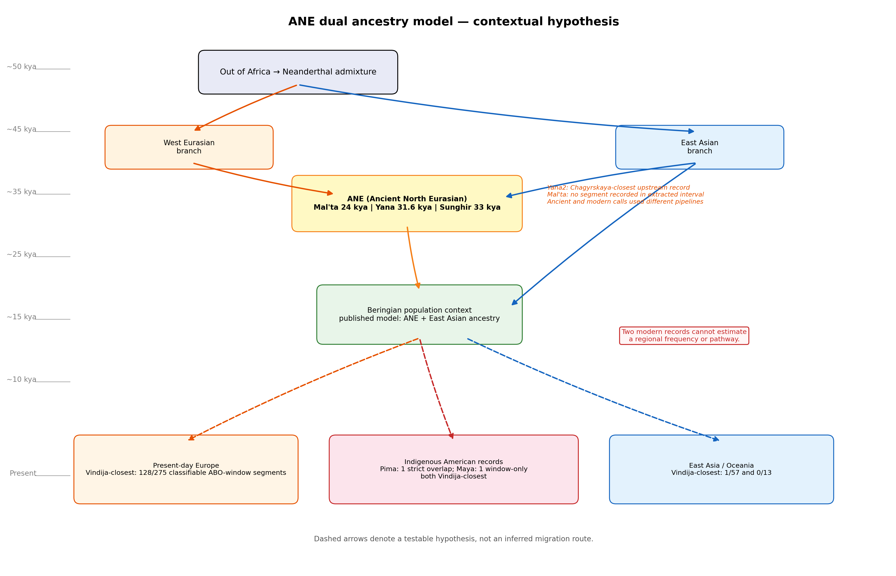
Figure S4
Ancient North Eurasian contextual hypothesis. Dashed arrows represent a testable narrative, not evidence that either observed segment followed the illustrated route.

Slide 10
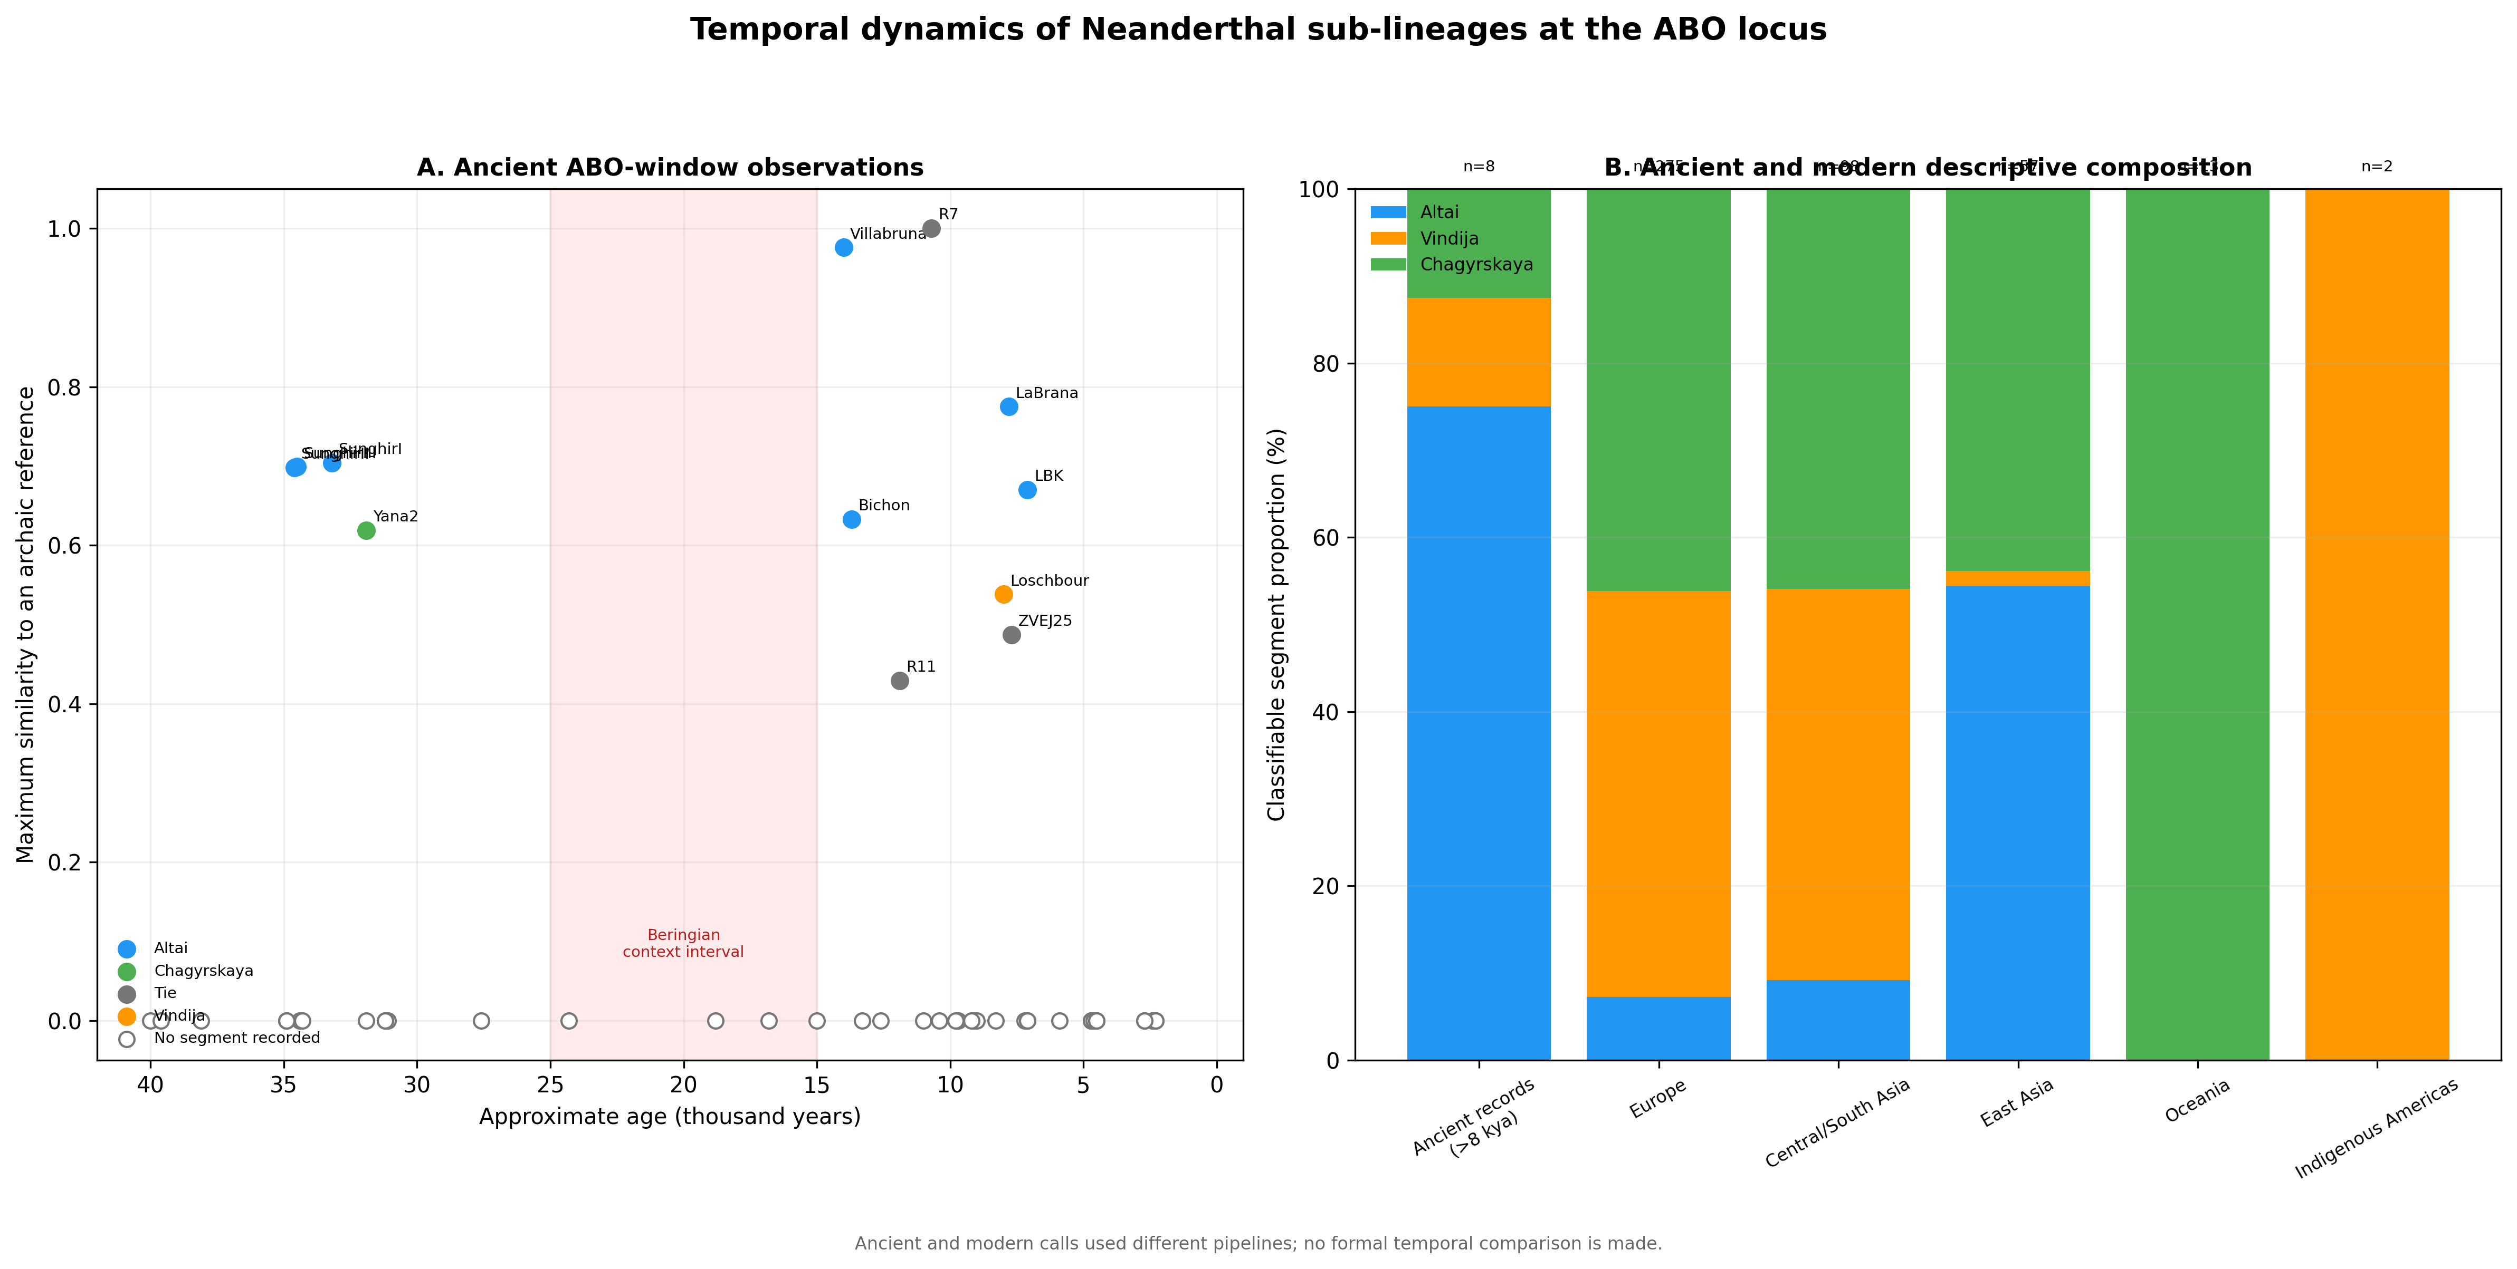
Figure S5
Descriptive ancient and modern ABO-window summaries generated by different pipelines; no formal temporal comparison is made.

Slide 11
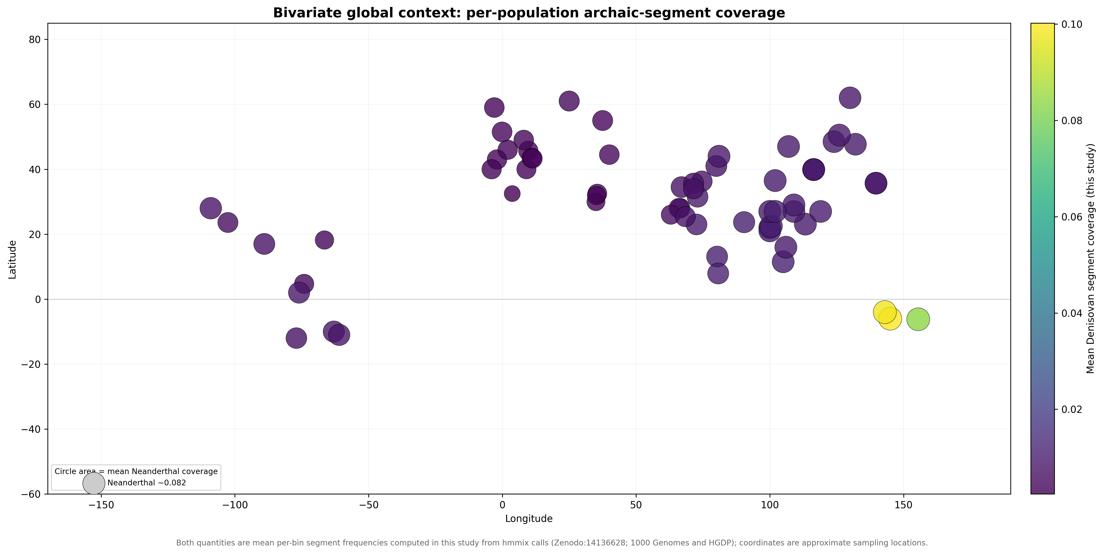
Figure S6
Bivariate global context computed in this study. Circle area encodes the mean per-bin Neanderthal-segment coverage and colour encodes the mean per-bin Denisovan-segment coverage for each population, both from data/population_profiles_500kb.npz; coordinates are approximate sampling locations from data/population_metadata.csv. These descriptive summaries were not used in the pairwise statistical models.

Slide 12
Table 1. Positive-residual Neanderthal pairs after false discovery rate control
Population 1 | Population 2 | Region 1 | Region 2 | Distance (km) | Sharing (r) | z-score
No qualifying pair | — | — | — | — | — | No z>2 and q<0.10 result
Note. The prespecified family contains all non-admixed population pairs. No pair met both z>2 and Benjamini-Hochberg q<0.10; the Denisovan analysis likewise identified no qualifying pair. Complete nominal rankings and dependence-aware model results are provided in Supplementary Data.

Slide 13
Table 2. ABO-window Neanderthal-reference composition
Region | n | Altai % | Vindija % | Chagyrskaya %
East Asia | 57 | 54.4 | 1.8 | 43.9
Europe | 275 | 7.3 | 46.5 | 46.2
Indigenous Americas | 2 | 0.0 | 100.0 | 0.0
Admixed Americas | 98 | 3.1 | 61.2 | 35.7
Central/South Asia | 98 | 9.2 | 44.9 | 45.9
Middle East | 44 | 11.4 | 52.3 | 36.4
Oceania | 13 | 0.0 | 0.0 | 100.0
Note. Counts are classifiable segments, not individuals. Percentages use the three-reference denominator shown by n. Equal maximum-similarity ties are excluded from these percentages but retained in Supplementary Data. The 2/2 Indigenous American value is not a regional frequency estimate; only one segment overlaps ABO.

