Slide 1
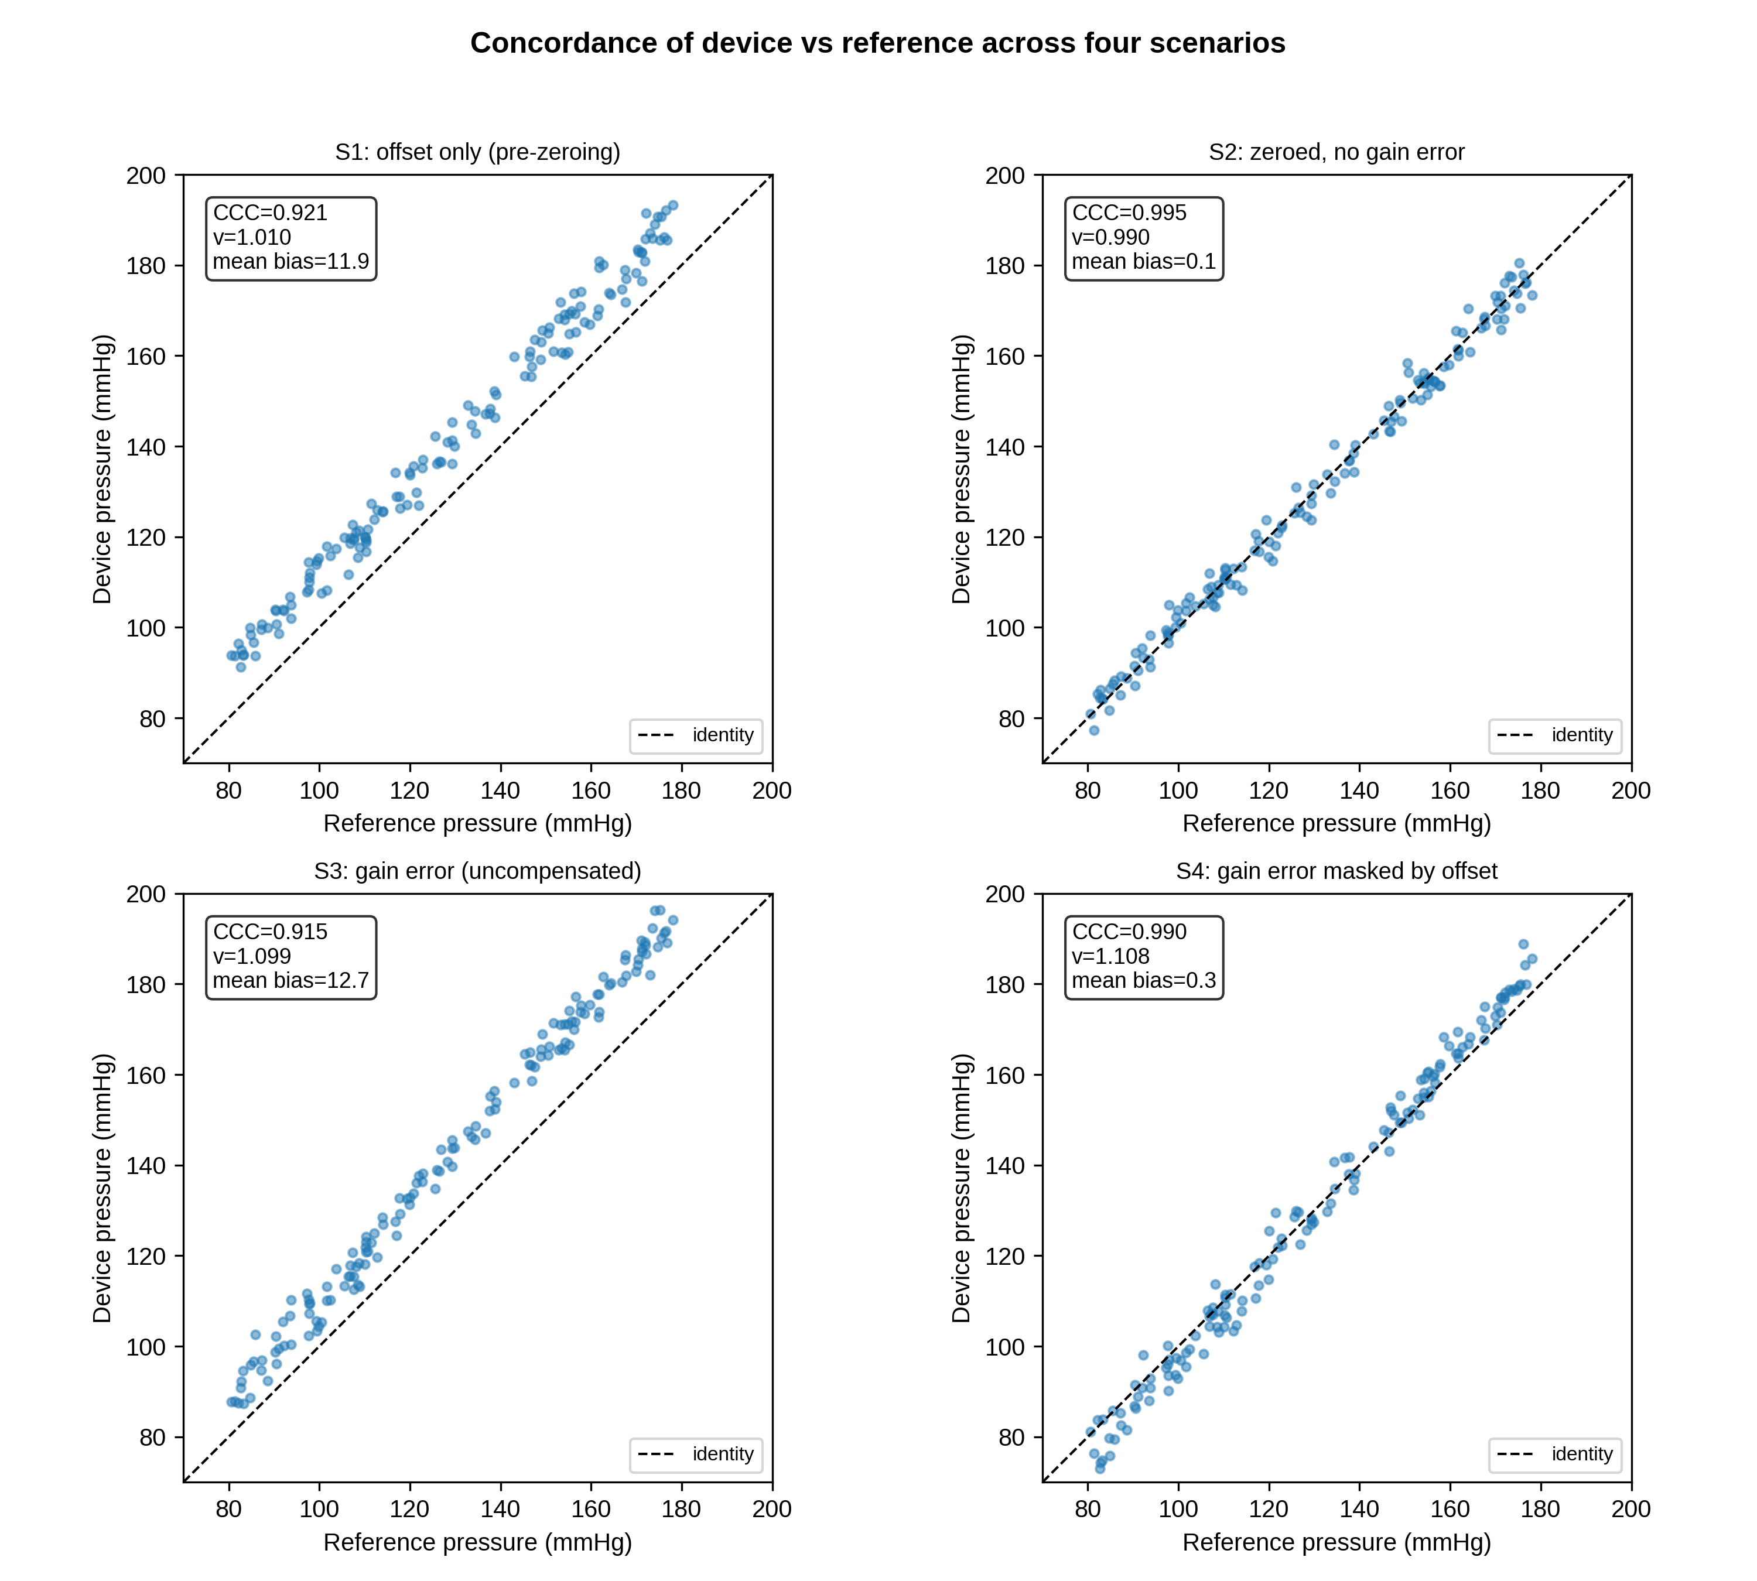
Figure 1. Concordance by scenario
Device-versus-reference concordance for the four static scenarios; each panel shows CCC, scale shift v and mean bias. S4 has near-zero bias despite a 10% gain error.

Slide 2
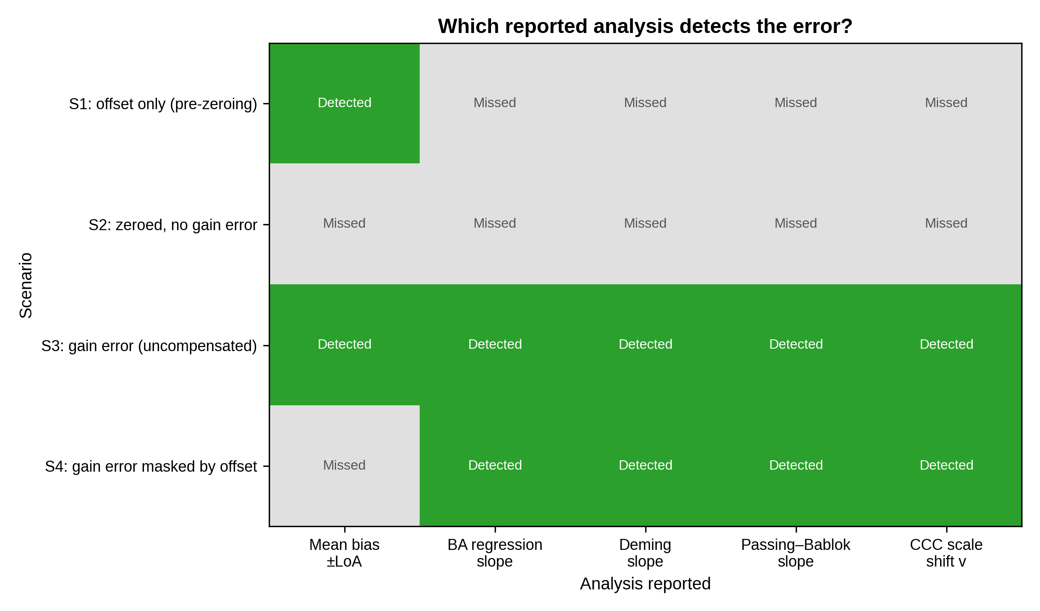
Figure 2. Detection pattern
Which reported analysis detects the error in each scenario (green = detected, grey = missed). In S4 the mean-bias summary misses the gain error that all proportional-bias–aware analyses detect.

Slide 3
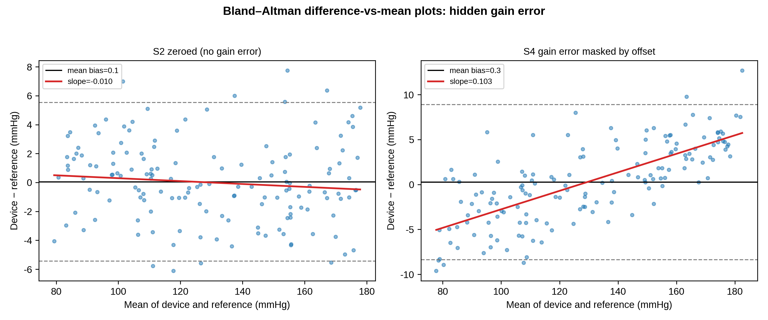
Figure 3. Bland–Altman regression
Difference-versus-mean plots for S2 (flat slope) and S4 (positive slope despite near-zero mean bias), revealing the masked proportional (gain) error.

Slide 4
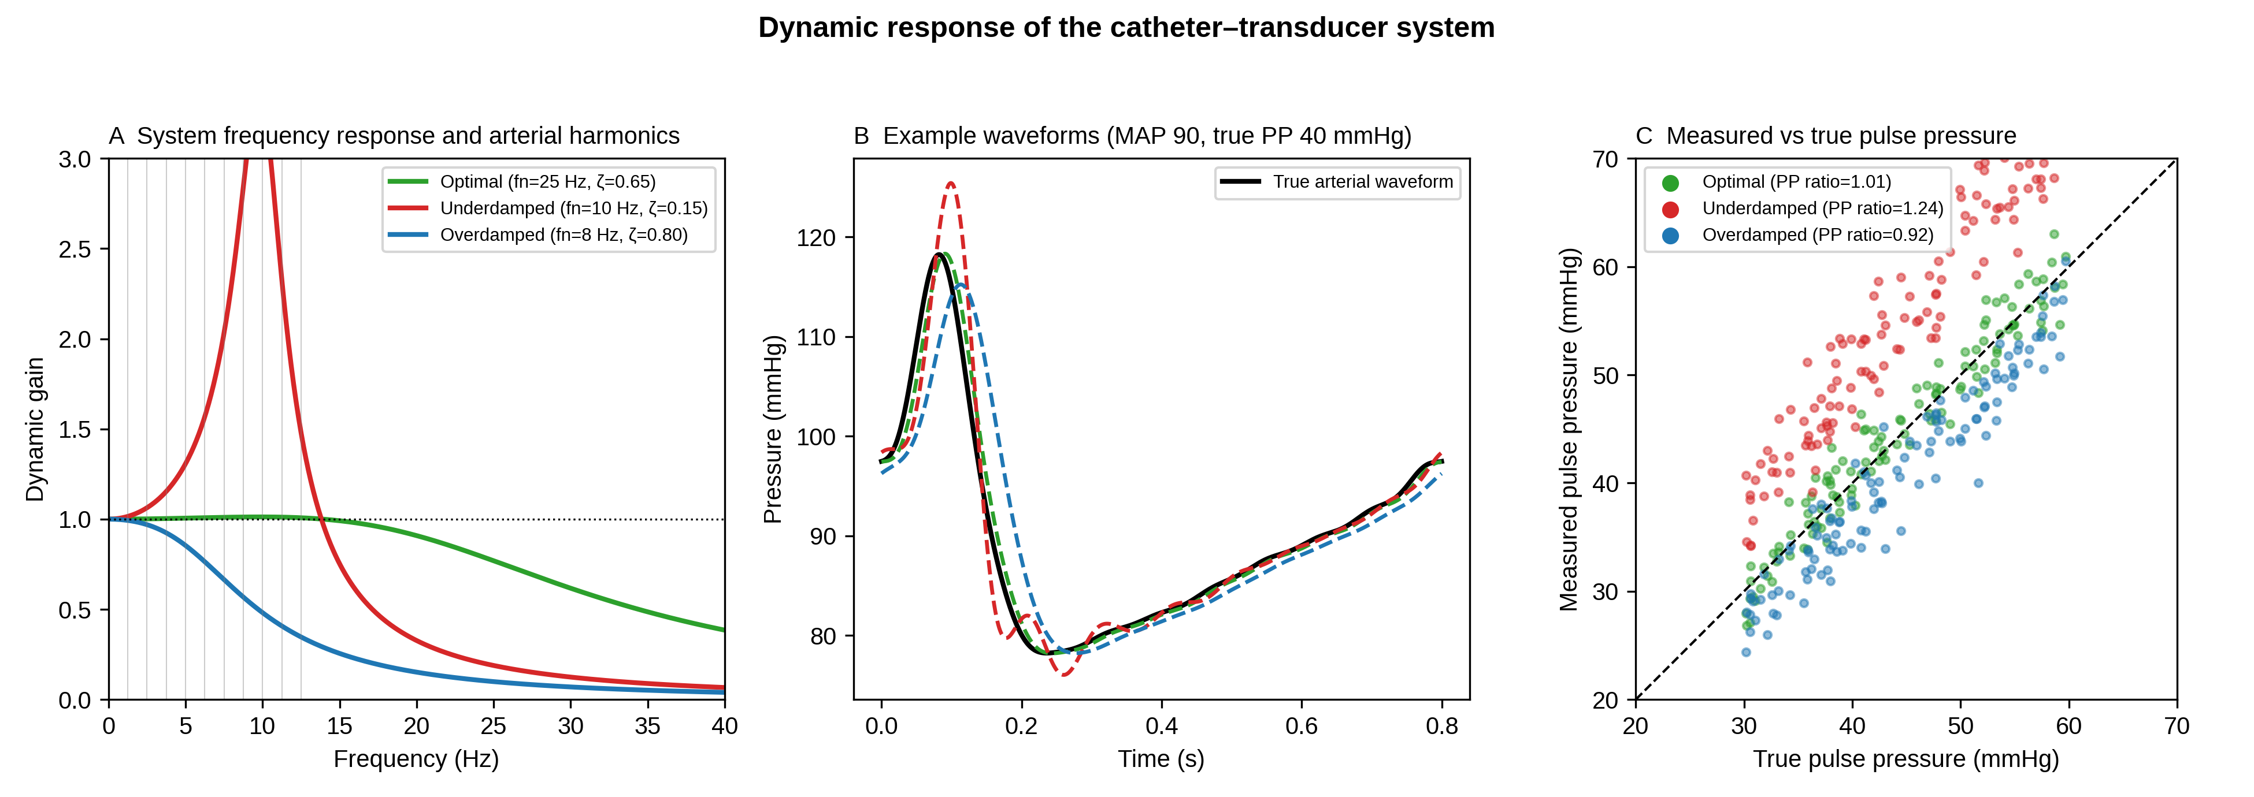
Figure 4. Dynamic response
Frequency response and waveforms for optimal, under-damped and over-damped systems, with measured-versus-true pulse pressure and the mean PP ratio.

Slide 5
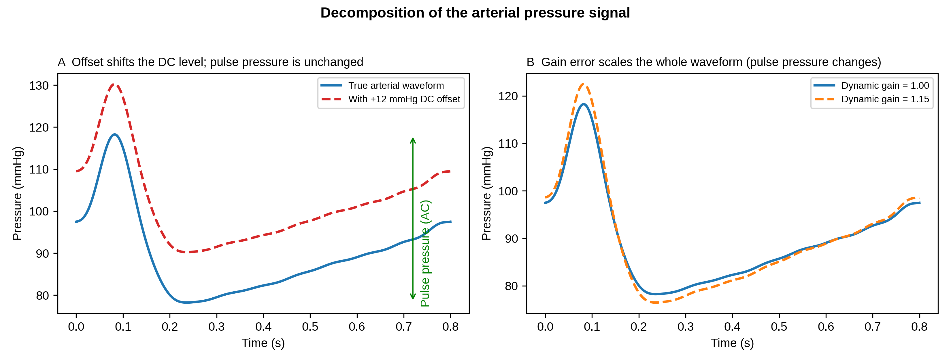
Supplemental Digital Content 1. Signal decomposition
A DC offset shifts the baseline but leaves pulse pressure unchanged; a gain error scales the whole waveform. Zeroing corrects the offset but not the gain error.

Slide 6
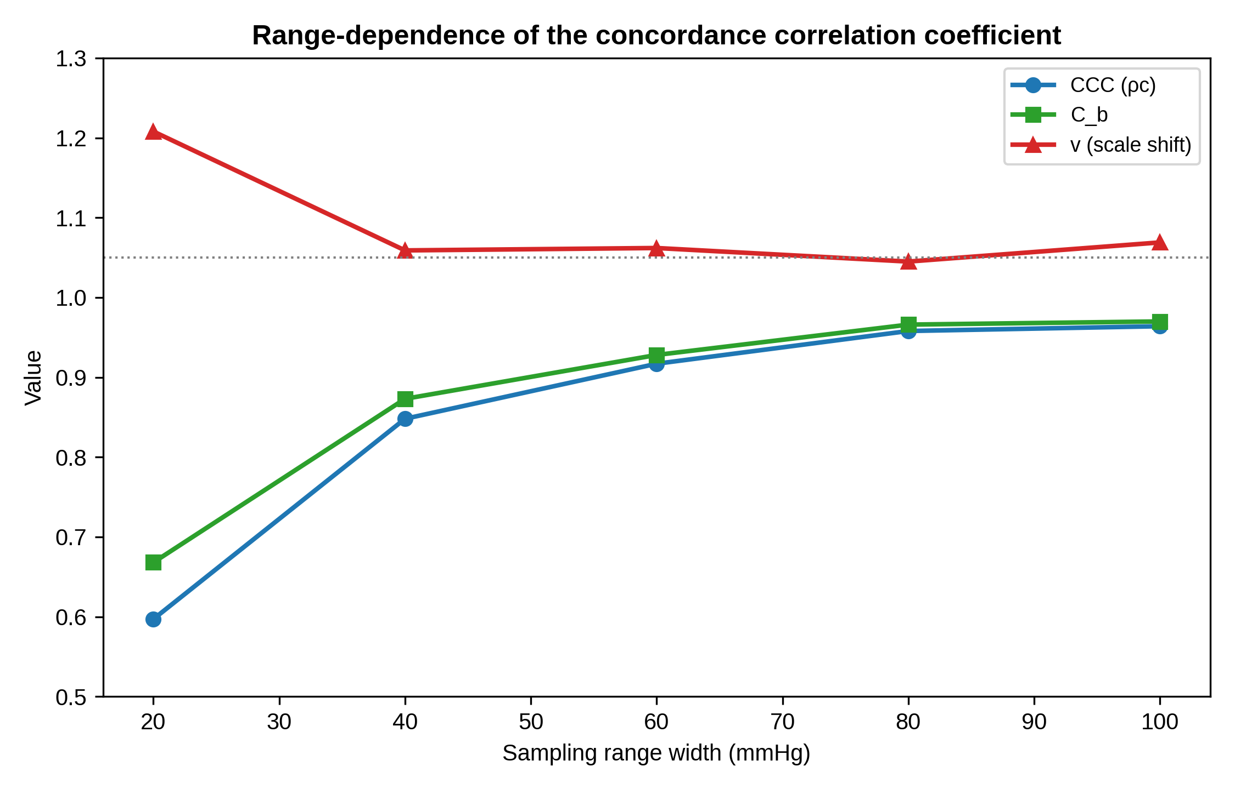
Supplemental Digital Content 2. Range-dependence of the CCC
For one fixed device, CCC and C_b increase as the sampled pressure range widens, while the scale shift v stays near the true gain ratio.

