Slide 1
Beyond Bland-Altman: Concordance Correlation Coefficient Decomposition for Diagnostic Validation of Haemodynamic Monitors
Figures and Tables

Slide 2
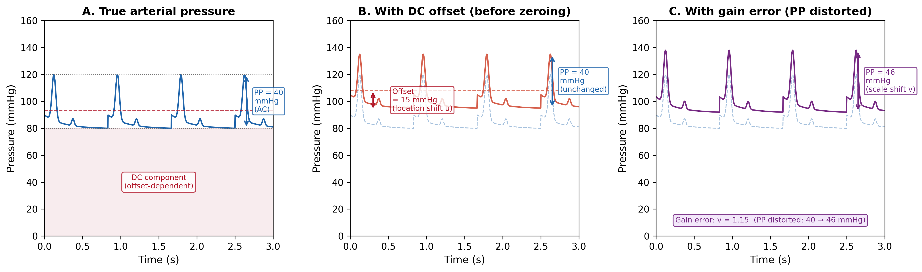
Figure 1. Arterial Pressure Waveform Decomposition
Figure 1. (A) True arterial pressure with DC baseline and AC pulsatile component (PP = 40 mmHg). (B) DC offset (+15 mmHg): PP unchanged at 40 mmHg. (C) Gain error (v = 1.15): PP distorted to 46 mmHg. Zero calibration corrects (B) but not (C).

Slide 3
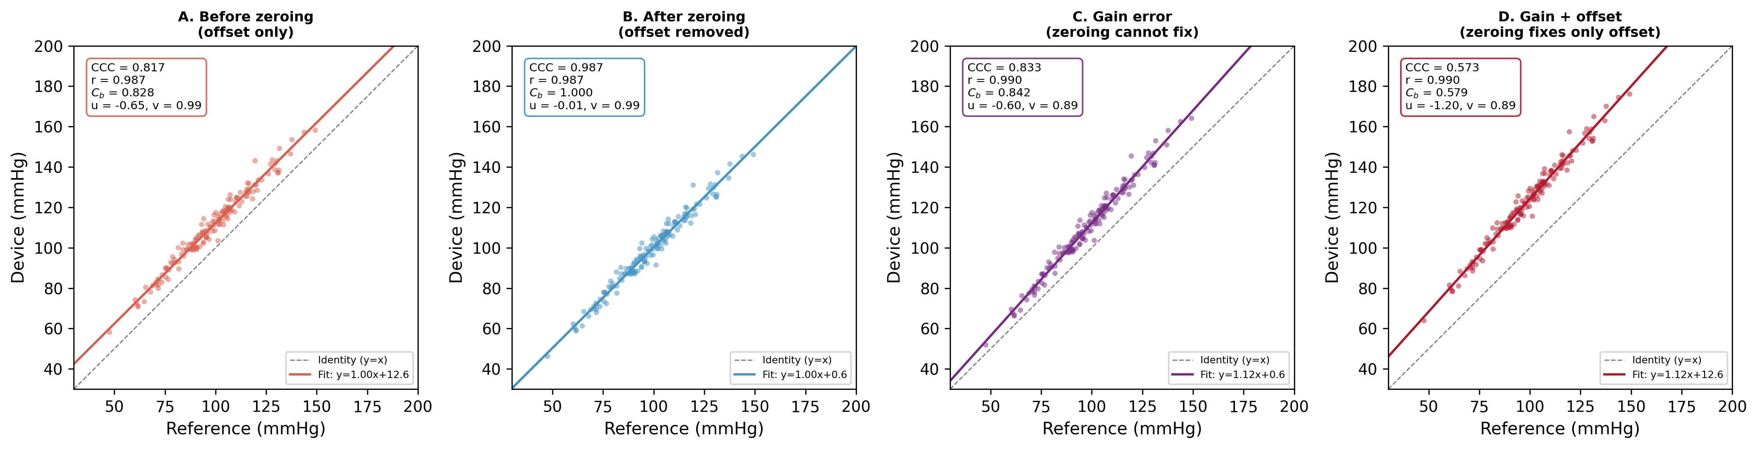
Figure 2. Concordance Plots — Four Simulation Scenarios
Figure 2. (A) Before zeroing: offset causes CCC = 0.855. (B) After zeroing: CCC = 0.986, Cb = 1.000. (C) Gain error (v = 1.11): Cb = 0.870, uncorrectable by zeroing. (D) Gain + offset: CCC = 0.976. Dashed = identity line; solid = regression.

Slide 4
Figure 3. Conventional vs. Proposed Zero-Calibration-Free System
A. Conventional fluid-filled system
B. Proposed zero-free system
Fluid-filled tubing
Smart Monitor
Built-in barometer + auto-compensation
Self-calibrating MEMS reference
External transducer
Monitor
Catheter-tip MEMS sensor (absolute pressure)
Display
Artery (catheter tip)
Hydrostatic column (ΔP = ρgh)
Atmospheric pressure reference
Transducer drift
Tip sensor → Δh = 0 ✓ Eliminated
Barometric compensation ✓ Eliminated
Self-calibrating MEMS ✓ Eliminated
Manual zero calibration required (corrects offset/u only; gain/v unchanged)
Zero calibration unnecessary by design (u = 0 by design; PP accuracy validates v = 1)
Figure 3. (A) Conventional fluid-filled system: three DC offset sources require manual zero calibration, which corrects offset (u) only. (B) Proposed zero-free system: catheter-tip MEMS eliminates hydrostatic column, built-in barometer compensates atmospheric pressure, self-calibrating MEMS eliminates drift. All offset sources eliminated by design; PP accuracy validates gain (v = 1).

Slide 5
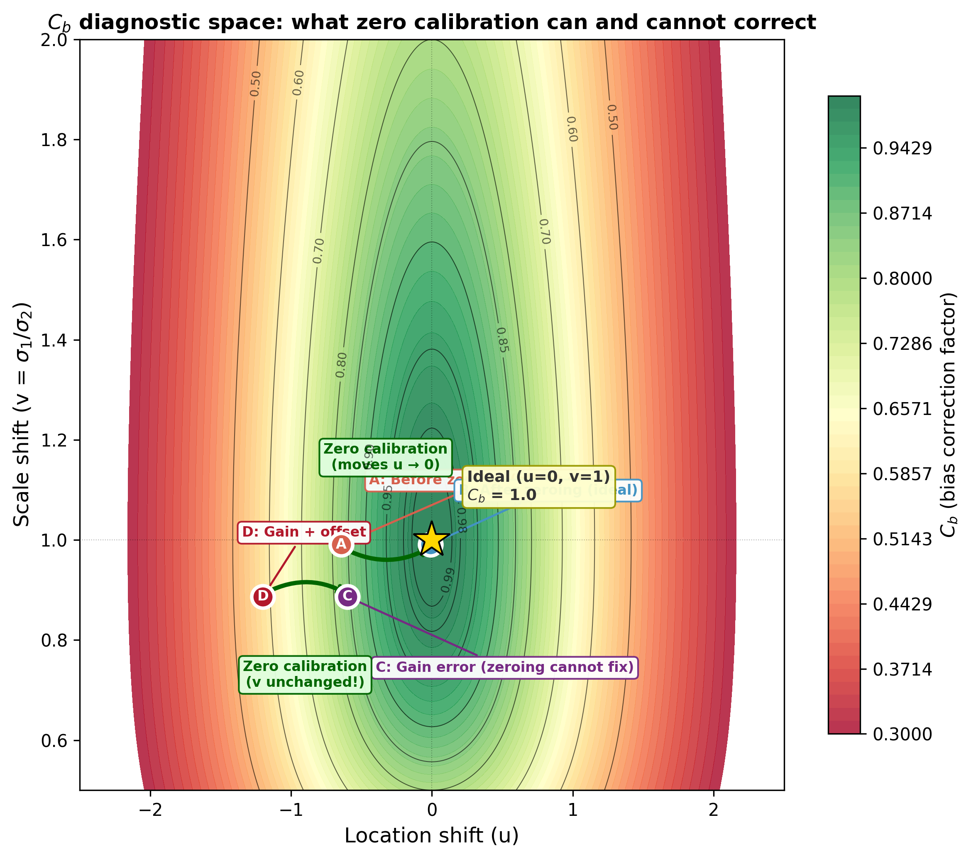
Figure 4. Cb Diagnostic Space (u–v Plane)
Figure 4. Bias correction factor (Cb) as a function of location shift (u) and scale shift (v). Zero calibration moves the device horizontally (u → 0) but does not change v. Only u = 0 and v = 1 achieves Cb = 1.0. Points A–D correspond to Figure 2 scenarios.

Slide 6
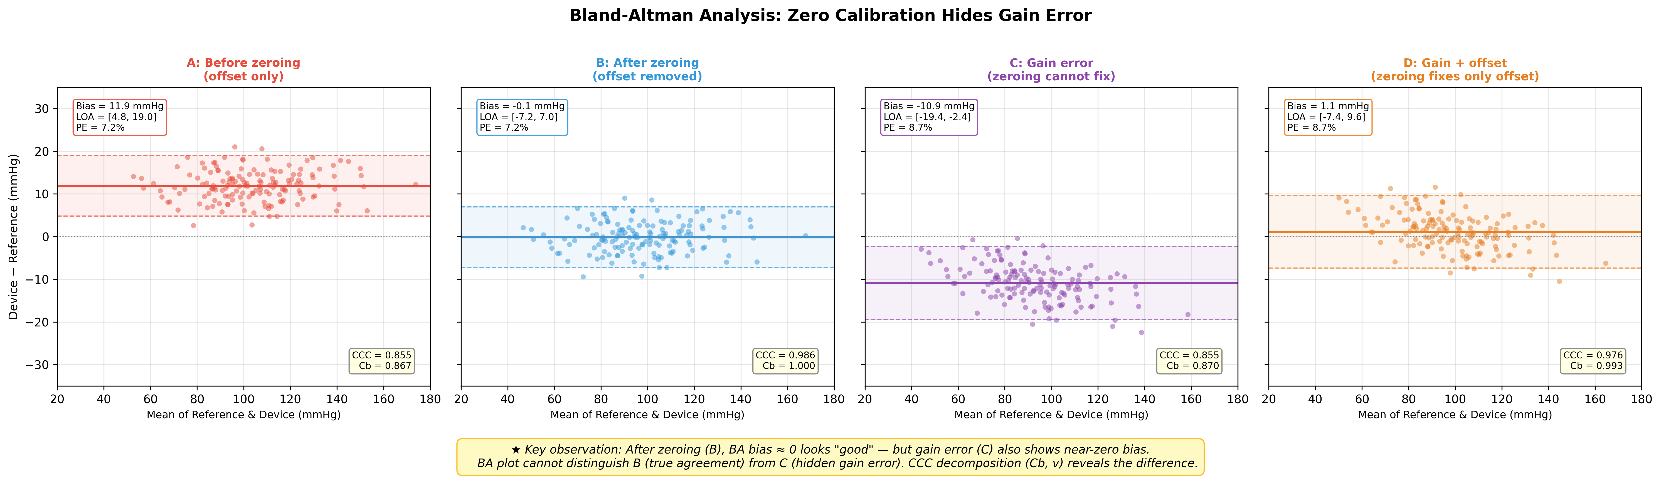
Figure 5. Bland-Altman Plots — Four Scenarios
Figure 5. (A) Before zeroing: bias = 11.9 mmHg. (B) After zeroing: bias ≈ 0. (C) Gain error: bias = −10.9 mmHg with proportional pattern. (D) Gain + offset: bias ≈ 1.1 mmHg — appears acceptable on BA but hides gain error. Red solid = mean bias; red dashed = 95% limits of agreement.

Slide 7
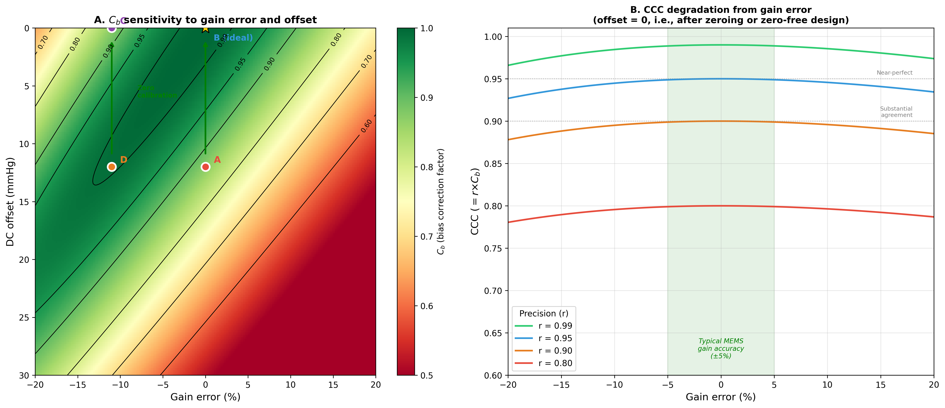
Figure 6. Sensitivity Analysis
Figure 6. (A) Cb heatmap as a function of gain error (%) and DC offset (mmHg). Zero calibration (horizontal move to offset = 0) only maximizes Cb when gain is correct. (B) CCC degradation with gain error at different sensor precision levels (r = 0.95, 0.97, 0.99). Grey band = typical MEMS gain accuracy range (±5%).

Slide 8
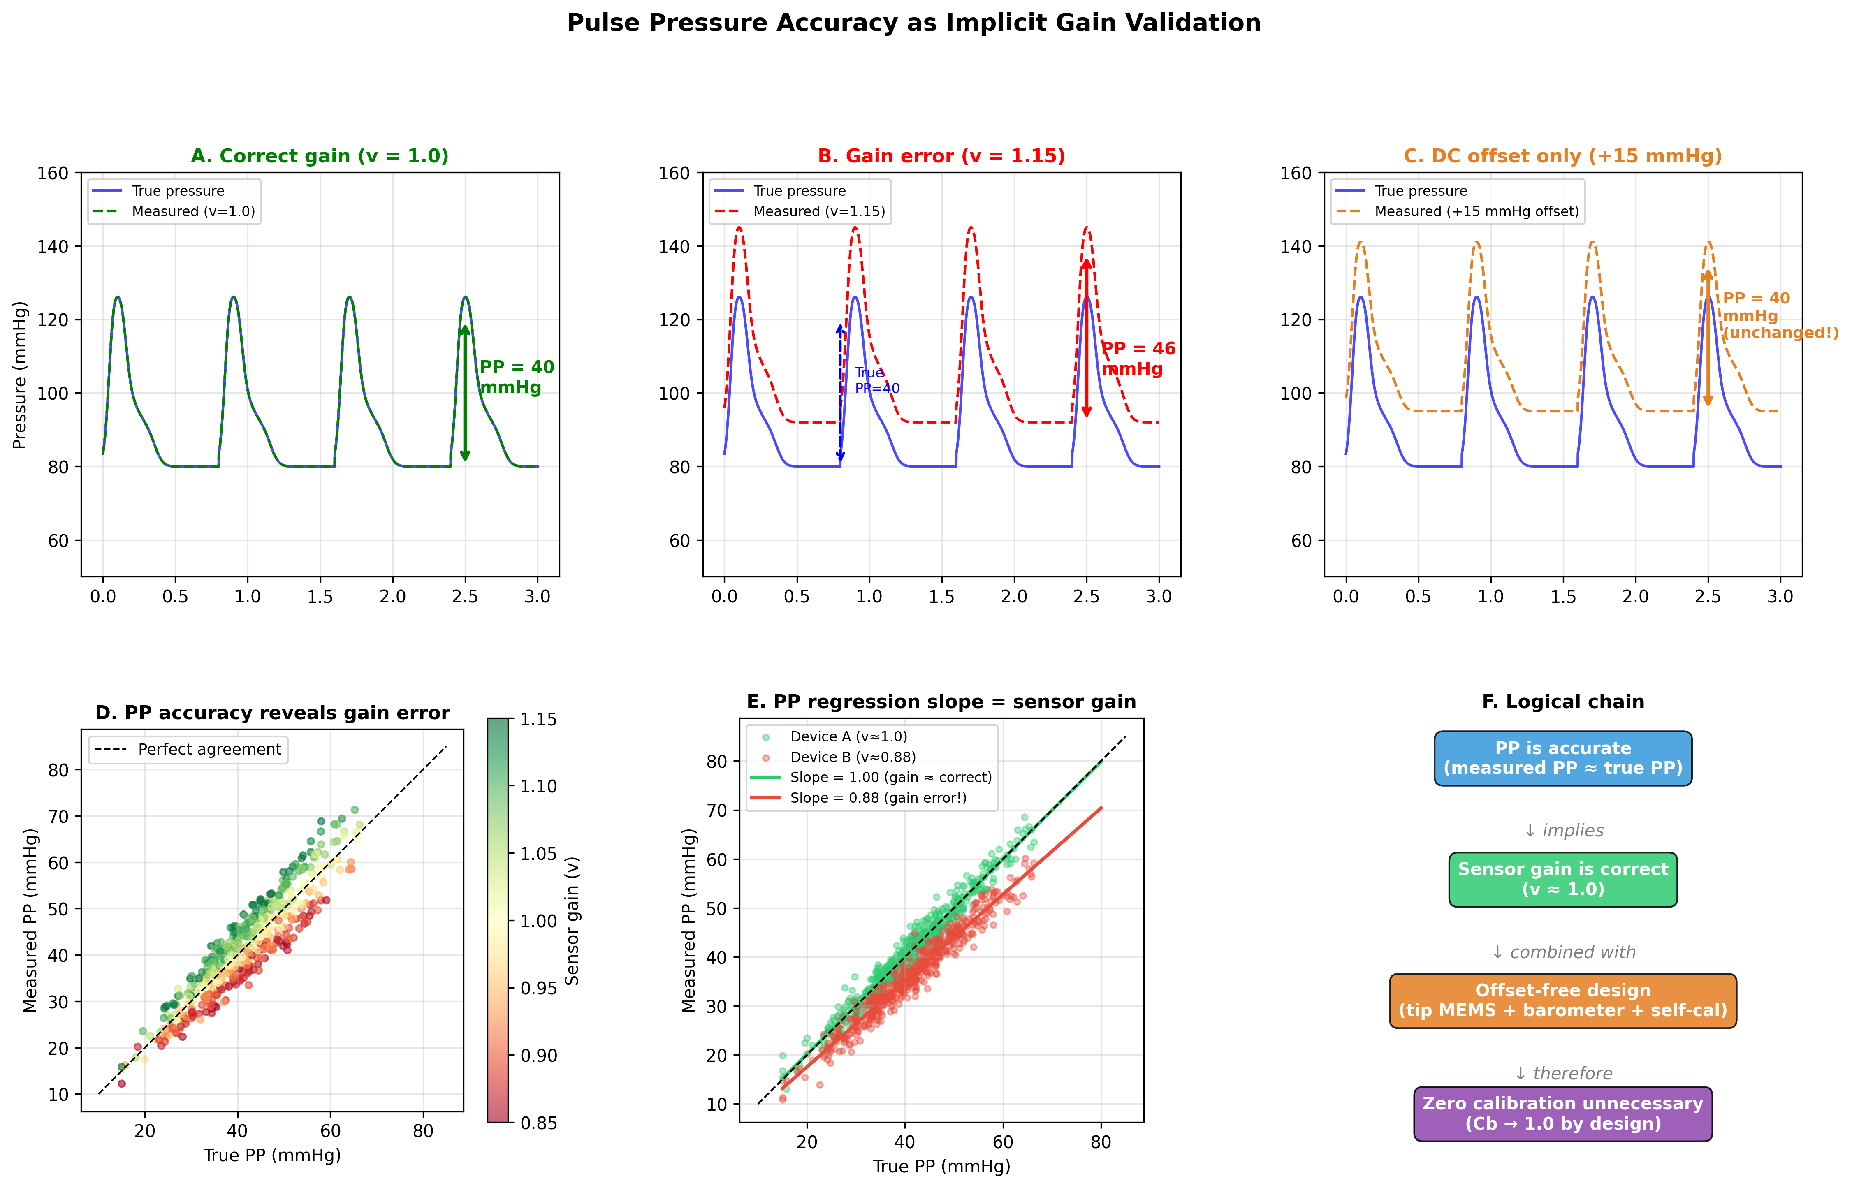
Figure 7. Pulse Pressure Validation Demonstration
Figure 7. (A) Correct gain: reference (blue) and measured (red) match, PP = 40 mmHg. (B) Gain error (v = 1.15): PP expanded to 46 mmHg. (C) DC offset only (+15 mmHg): PP unchanged. (D) Correct gain PP correlation (slope ≈ 1.0). (E) Gain error PP correlation (slope = 1.15). (F) Logical chain from PP accuracy to zero-calibration-free monitoring.

Slide 9
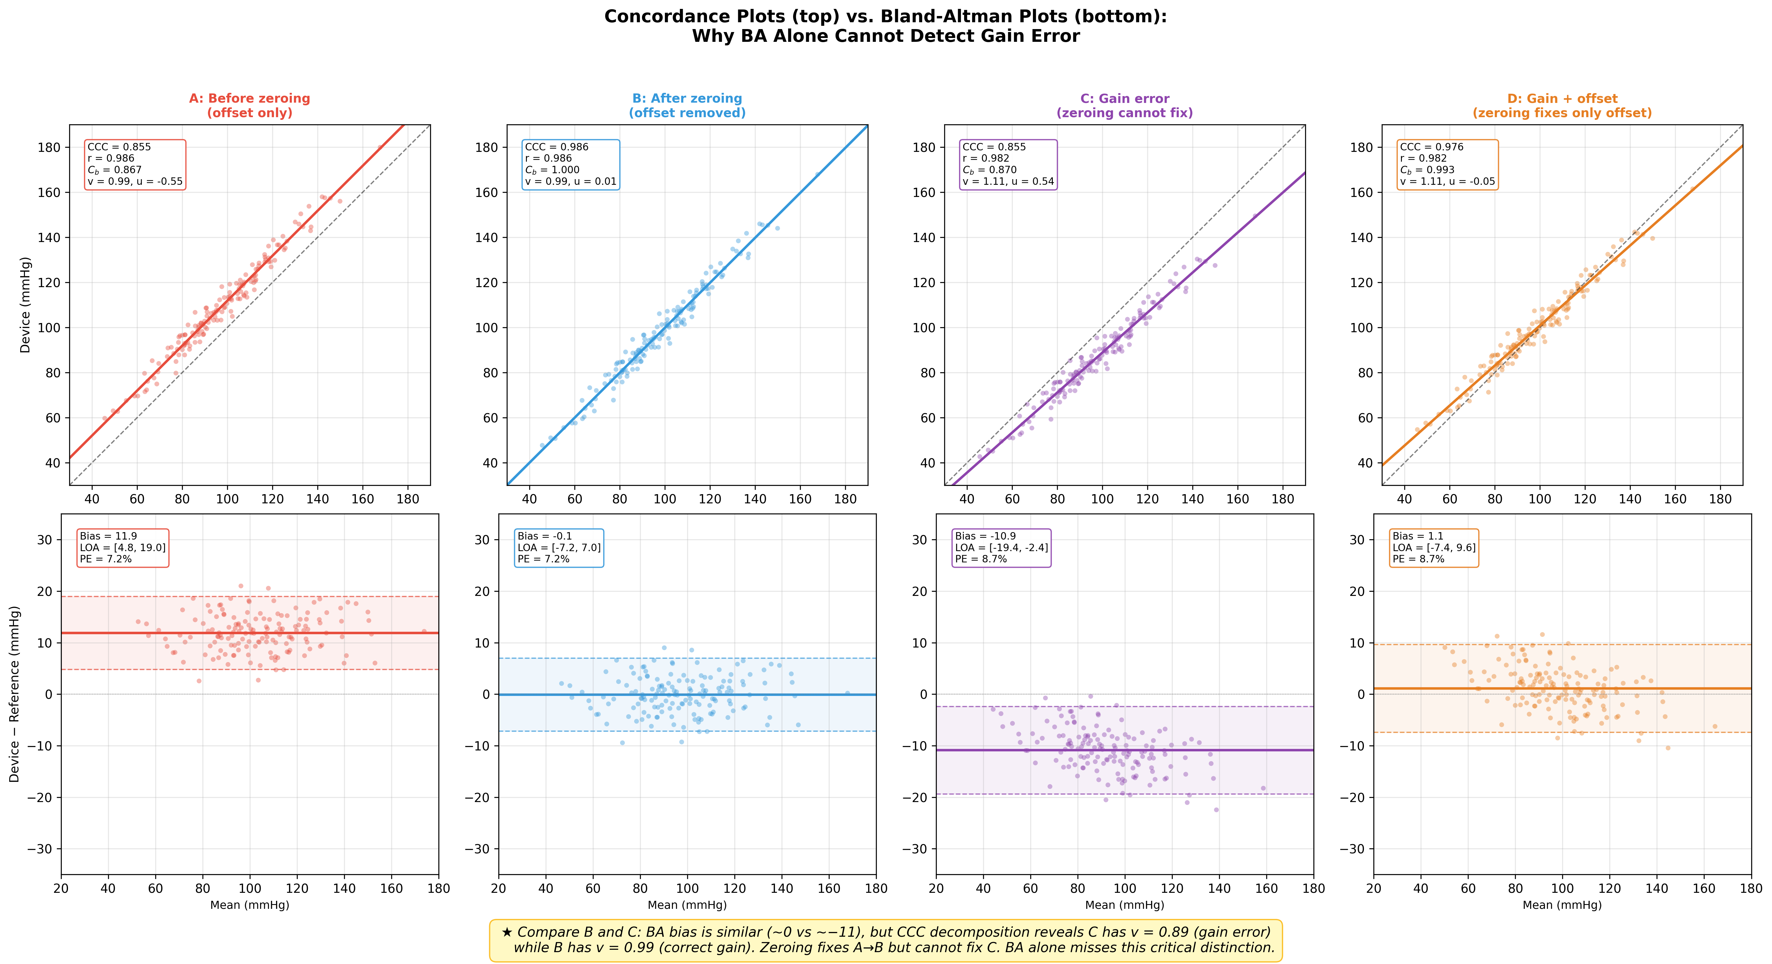
Figure 8. Concordance Plots vs. Bland-Altman Plots — Side-by-Side
Figure 8. Top row: concordance plots. Bottom row: Bland-Altman plots. Same data, two methods. Scenarios B and D show similar BA bias distributions, but concordance plots reveal gain error as regression slope deviation. Demonstrates the complementary value of CCC decomposition.

Slide 10
Table 1. DC Offset Sources and Engineering Solutions
Offset Source | Physical Mechanism | Magnitude | Engineering Solution | CCC Component
Hydrostatic column | ΔP = ρgh (transducer–catheter tip height) | ~0.74 mmHg/cm | Catheter-tip MEMS sensor (eliminates fluid column) | Reduces u (location shift)
Atmospheric pressure reference | Gauge measurement relative to ~760 mmHg | Entire baseline | Absolute pressure sensor + built-in barometer | Reduces u (location shift)
Transducer drift | Mechanical creep, thermal effects | ~1–5 mmHg/day | Self-calibrating MEMS with reference cavity | Reduces u (location shift)
Gain error (NOT corrected by zero calibration) | Sensitivity mismatch: output/pressure ≠ nominal | 1–15% (typical) | Factory calibration; PP accuracy validates gain | Affects v (scale shift); zeroing ineffective
Table 1. Three DC offset sources in conventional invasive arterial pressure monitoring and engineering solutions for elimination. Note that gain error (bottom row) is NOT correctable by zero calibration and requires separate validation via pulse pressure accuracy.

Slide 11
Table 2. Statistical Comparison Across Four Simulation Scenarios (n = 150)
Scenario | CCC | r | Cb | u | v | Bias (mmHg) | LOA low (mmHg) | LOA high (mmHg) | PE (%)
A: Before zeroing | 0.855 | 0.986 | 0.867 | −0.55 | 0.99 | 11.9 | 4.8 | 19.0 | 7.2
B: After zeroing | 0.986 | 0.986 | 1.000 | 0.01 | 0.99 | −0.1 | −7.2 | 7.0 | 7.2
C: Gain error | 0.855 | 0.982 | 0.870 | 0.54 | 1.11 | −10.9 | −19.4 | −2.4 | 8.7
D: Gain + offset | 0.976 | 0.982 | 0.993 | −0.05 | 1.11 | 1.1 | −7.4 | 9.6 | 8.7
Table 2. CCC = Lin's concordance correlation coefficient; r = Pearson correlation (precision); Cb = bias correction factor (accuracy); u = location shift; v = scale shift; LOA = limits of agreement; PE = percentage error. Scenarios B and C have similar bias (≈0) but very different Cb (1.000 vs. 0.870), demonstrating that BA analysis alone cannot detect gain error.

