Slide 1
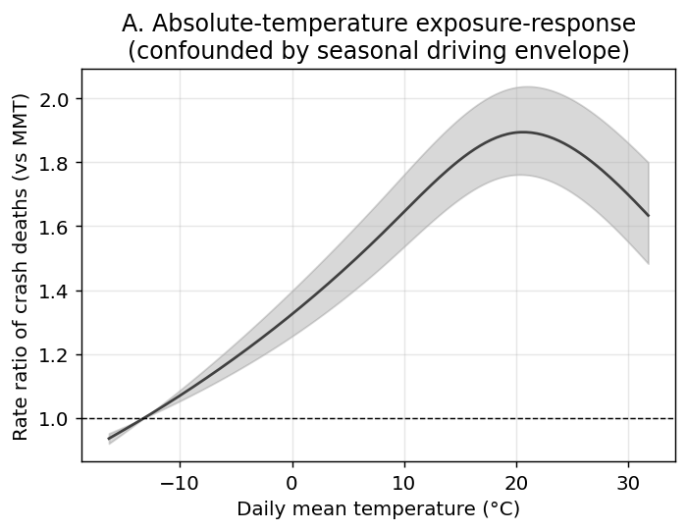
Figure 1
United States absolute-temperature exposure-response for daily traffic-crash deaths (cumulative over lag 0-10 days), relative to the minimum-mortality temperature. The curve peaks at mild temperatures and declines at extreme heat, reflecting the seasonal driving-exposure envelope rather than an acute heat effect. Black-and-white version: line styles and marker shapes distinguish categories.

Slide 2
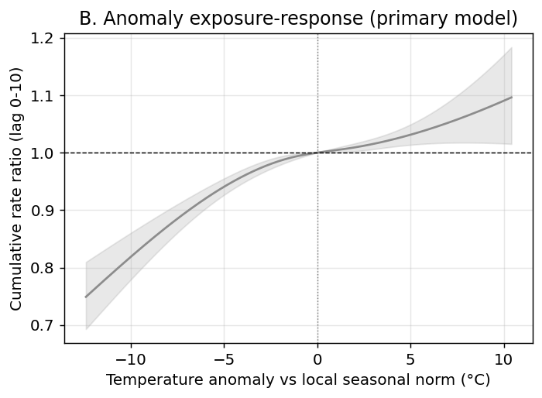
Figure 2
United States temperature-anomaly exposure-response (primary analysis): cumulative rate ratio of crash deaths versus the local day-of-year seasonal norm. Days hotter than normal carry higher crash mortality. Black-and-white version: line styles and marker shapes distinguish categories.

Slide 3
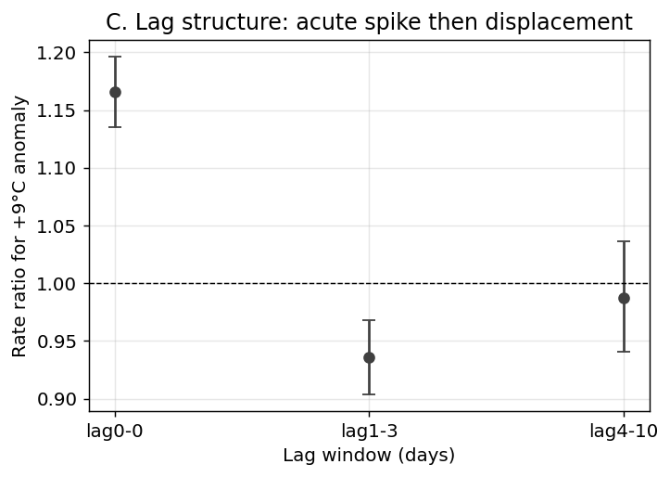
Figure 3
United States lag structure of the crash-death response to a +9 °C anomaly: an acute same-day excess followed by a 1-3 day deficit consistent with short-term displacement (harvesting) rather than a net addition of deaths. Black-and-white version: line styles and marker shapes distinguish categories.

Slide 4
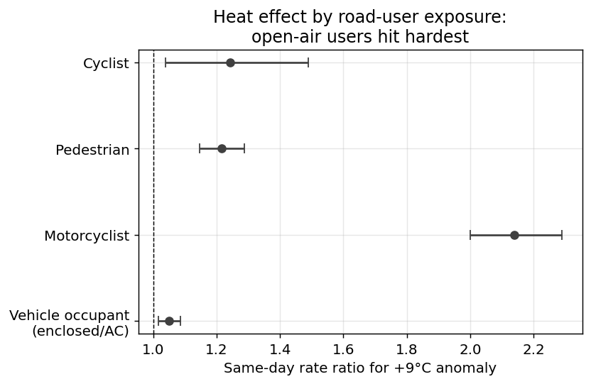
Figure 4
United States same-day rate ratio of crash death for a +9 °C anomaly by road-user type. Open-air users (motorcyclists, pedestrians, cyclists) show much larger heat effects than enclosed, often air-conditioned, vehicle occupants—a gradient that tracks direct heat exposure rather than driving volume. This subgroup analysis is exploratory and is not adjusted for multiple comparisons. Black-and-white version: categories are distinguished by the y-axis labels.

Slide 5
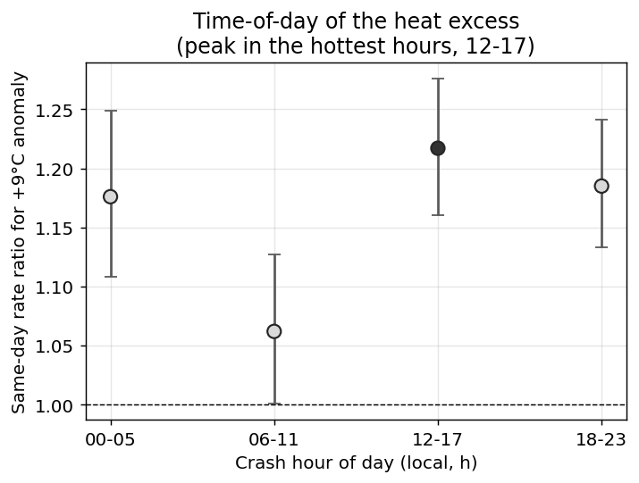
Figure 5
United States same-day rate ratio of crash death for a +9 °C anomaly by crash hour of day. The excess is largest for crashes in the hottest part of the day (12-17 h) and weakest in the cool morning (06-11 h). This subgroup analysis is exploratory and is not adjusted for multiple comparisons. Black-and-white version: the 12-17 h point is filled and the others are open to highlight the peak band.

Slide 6
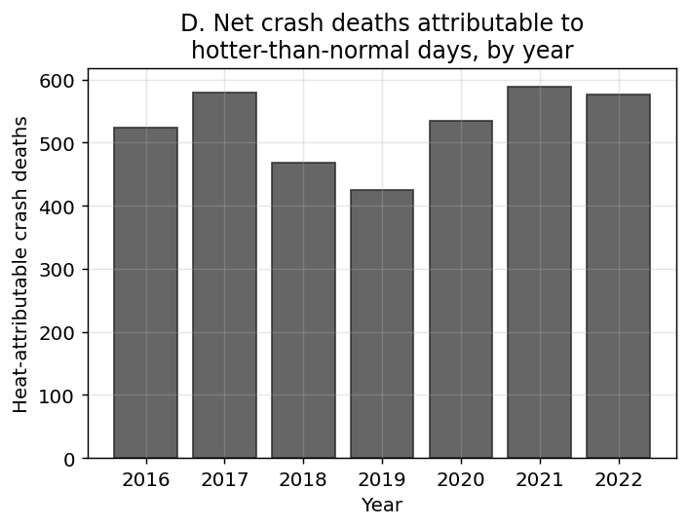
Figure 6
United States estimated net heat-attributable crash deaths per year, 2016-2022. Black-and-white version: line styles and marker shapes distinguish categories.

Slide 7
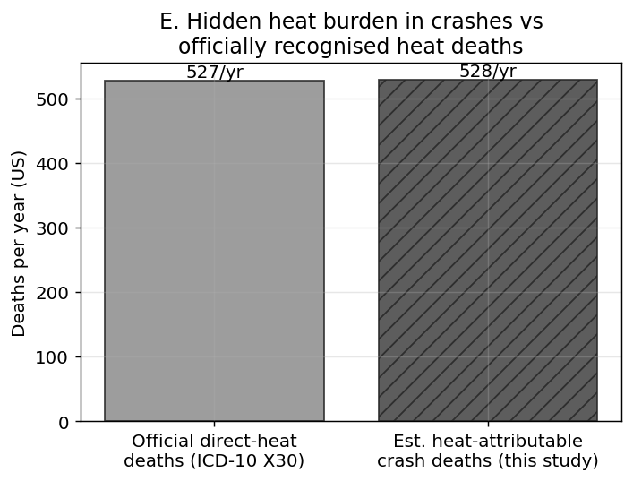
Figure 7
United States comparison of estimated net heat-attributable crash deaths per year with officially recorded direct-heat deaths (ICD-10 X30) from CDC WONDER. Black-and-white version: the right-hand (estimate) bar is hatched to distinguish it from the left-hand (official) bar.

Slide 8
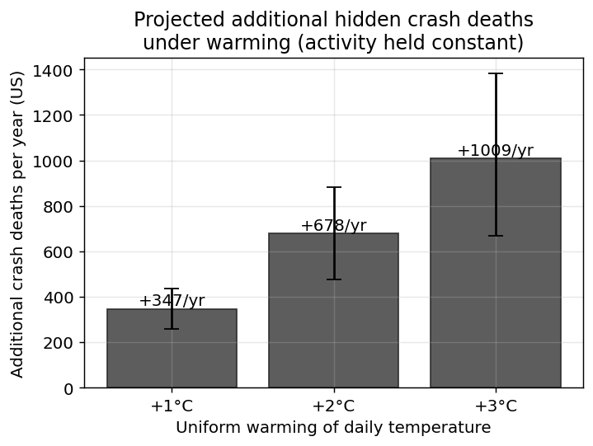
Figure 8
United States projected additional traffic-crash deaths per year under uniform warming of the daily temperature distribution by +1, +2 and +3 °C, holding driving activity and baseline rates constant. Bars show the point estimate with 95% Monte Carlo confidence intervals; this is a scenario projection, not an observed quantity. Black-and-white version: line styles and marker shapes distinguish categories.

Slide 9
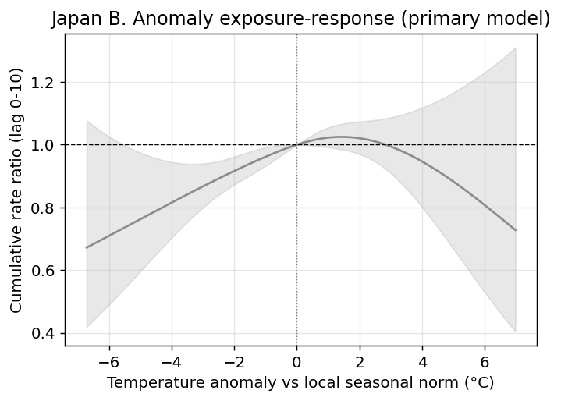
Figure 9
Japan temperature-anomaly exposure-response (2019-2024). The estimate is imprecise: the confidence band is wide and includes the null throughout. Black-and-white version: line styles and marker shapes distinguish categories.

Slide 10
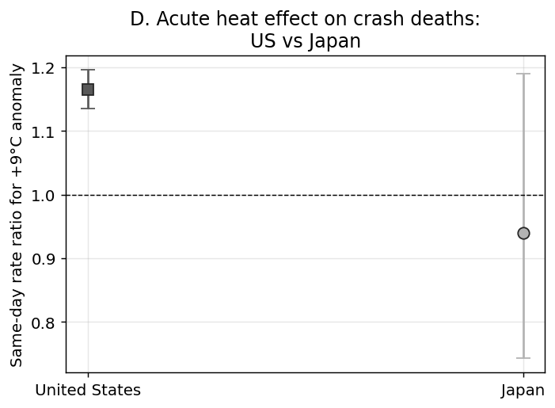
Figure 10
Same-day rate ratio of traffic-crash deaths for a +9 °C anomaly, United States versus Japan. The US shows a precise acute effect; the Japanese estimate is underpowered. This comparison is exploratory and is not adjusted for multiple comparisons. Black-and-white version: US (square) and Japan (circle) estimates use different marker shapes.

