Slide 1
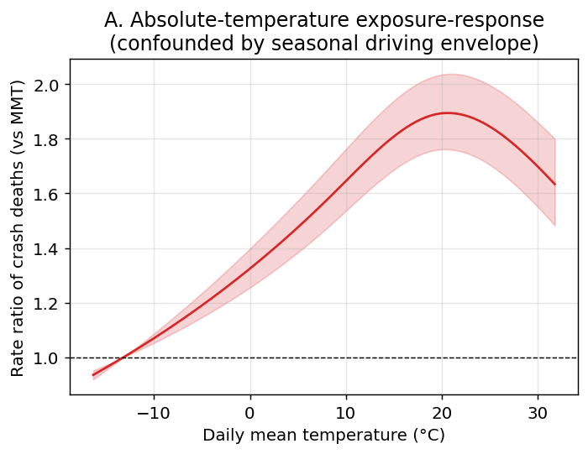
Figure 1
United States absolute-temperature exposure-response for daily traffic-crash deaths (cumulative over lag 0-10 days), relative to the minimum-mortality temperature. The curve peaks at mild temperatures and declines at extreme heat, reflecting the seasonal driving-exposure envelope rather than an acute heat effect.

Slide 2
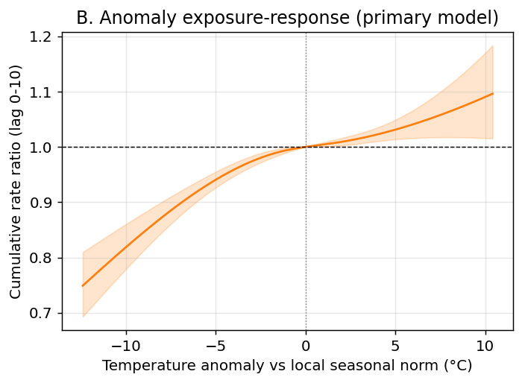
Figure 2
United States temperature-anomaly exposure-response (primary analysis): cumulative rate ratio of crash deaths versus the local day-of-year seasonal norm. Days hotter than normal carry higher crash mortality.

Slide 3
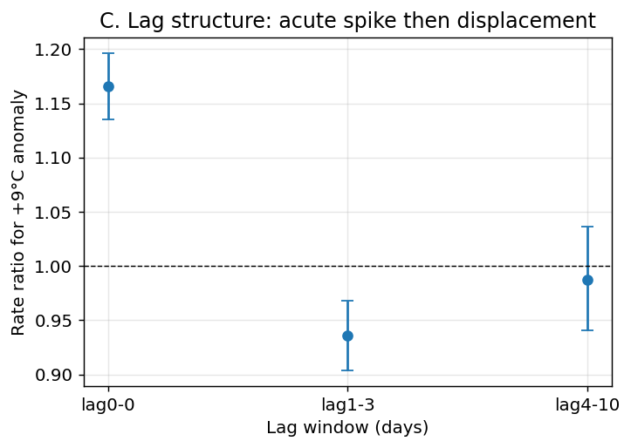
Figure 3
United States lag structure of the crash-death response to a +9 °C anomaly: an acute same-day excess followed by a 1-3 day deficit consistent with short-term displacement (harvesting) rather than a net addition of deaths.

Slide 4
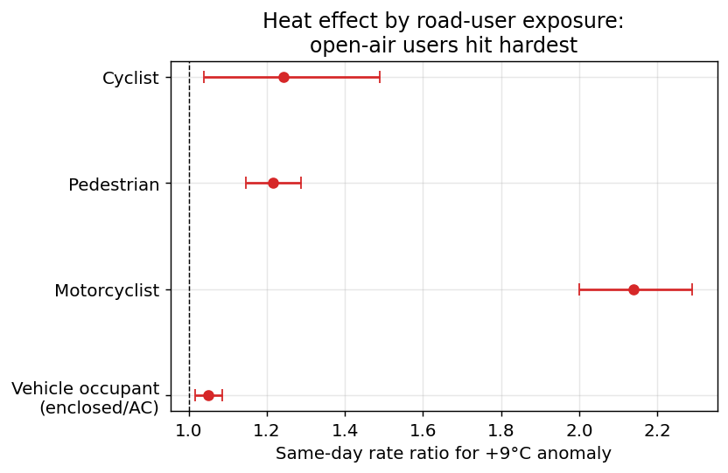
Figure 4
United States same-day rate ratio of crash death for a +9 °C anomaly by road-user type. Open-air users (motorcyclists, pedestrians, cyclists) show much larger heat effects than enclosed, often air-conditioned, vehicle occupants—a gradient consistent with greater direct heat exposure, although mode-specific activity changes on hot days cannot be excluded. This subgroup analysis is exploratory and is not adjusted for multiple comparisons.

Slide 5
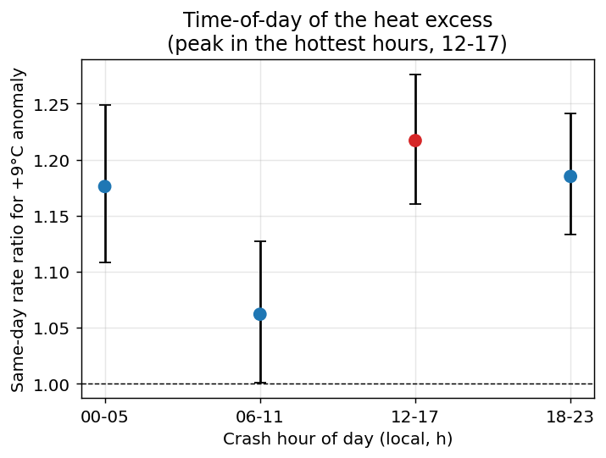
Figure 5
United States same-day rate ratio of crash death for a +9 °C anomaly by crash hour of day. The excess is largest for crashes in the hottest part of the day (12-17 h) and weakest in the cool morning (06-11 h). This subgroup analysis is exploratory and is not adjusted for multiple comparisons.

Slide 6
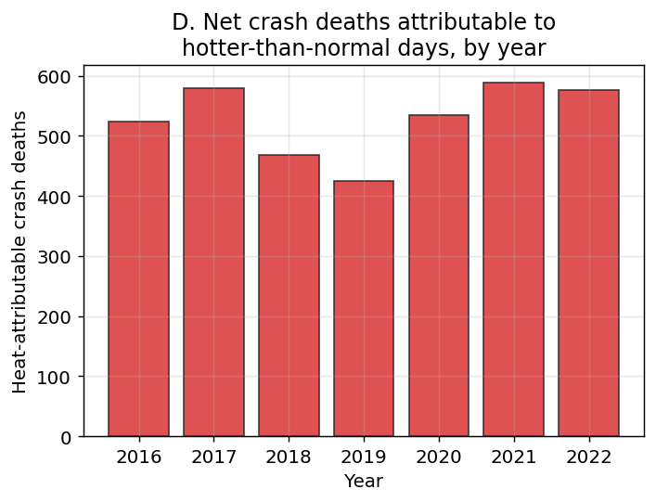
Figure 6
United States estimated net heat-attributable crash deaths per year, 2016-2022.

Slide 7
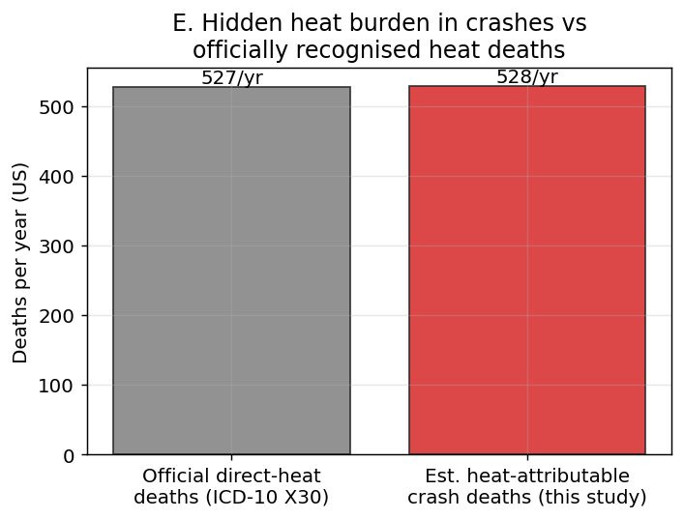
Figure 7
United States comparison of estimated net heat-attributable crash deaths per year with officially recorded direct-heat deaths (ICD-10 X30) from CDC WONDER.

Slide 8
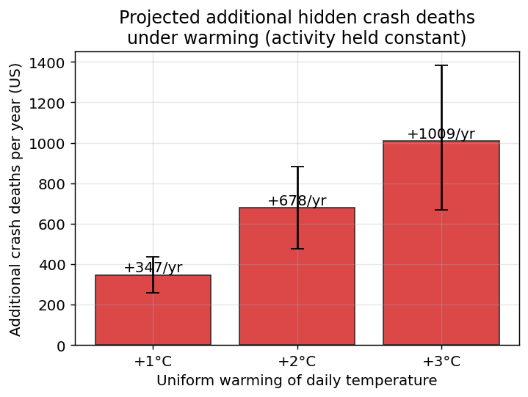
Figure 8
United States projected additional traffic-crash deaths per year under uniform warming of the daily temperature distribution by +1, +2 and +3 °C, holding driving activity and baseline rates constant. Bars show the point estimate with 95% Monte Carlo confidence intervals; this is a scenario projection, not an observed quantity.

Slide 9
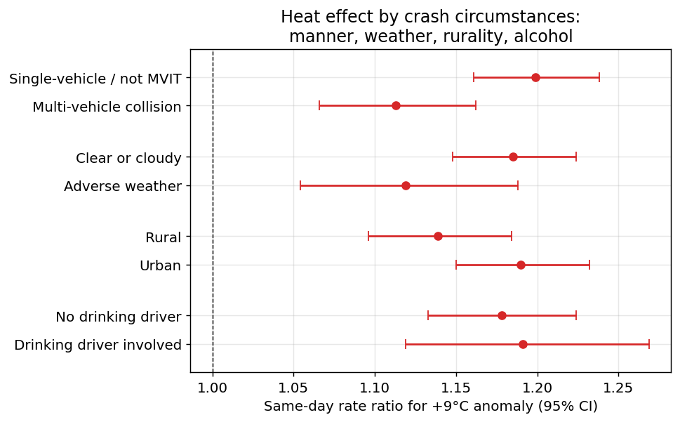
Figure 9
United States same-day rate ratio of crash death for a +9 °C anomaly by crash circumstances: manner of collision, weather condition, rural/urban land use and police-reported driver drinking. The excess is present for clear or cloudy days, is larger for single-vehicle (not a collision with a motor vehicle in transport) than multi-vehicle crashes, and is similar regardless of reported driver drinking—patterns consistent with a direct heat contribution rather than adverse-weather surface conditions or a purely behavioural pathway. These subgroup analyses are exploratory and are not adjusted for multiple comparisons.

Slide 10
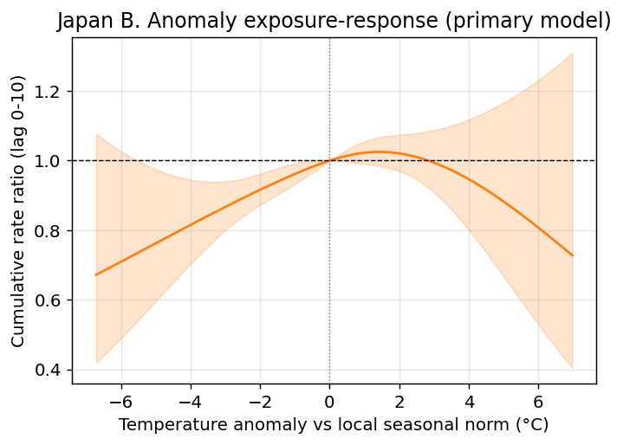
Figure 10
Japan temperature-anomaly exposure-response (2019-2024). The estimate is imprecise: the confidence band is wide and includes the null throughout.

Slide 11
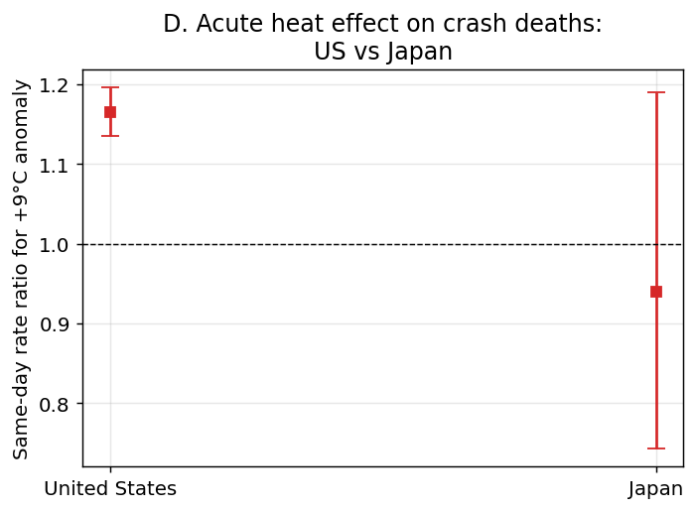
Figure 11
Same-day rate ratio of traffic-crash deaths for a +9 °C anomaly, United States versus Japan. The US shows a precise acute effect; the Japanese estimate is underpowered. This comparison is exploratory and is not adjusted for multiple comparisons.

Slide 12
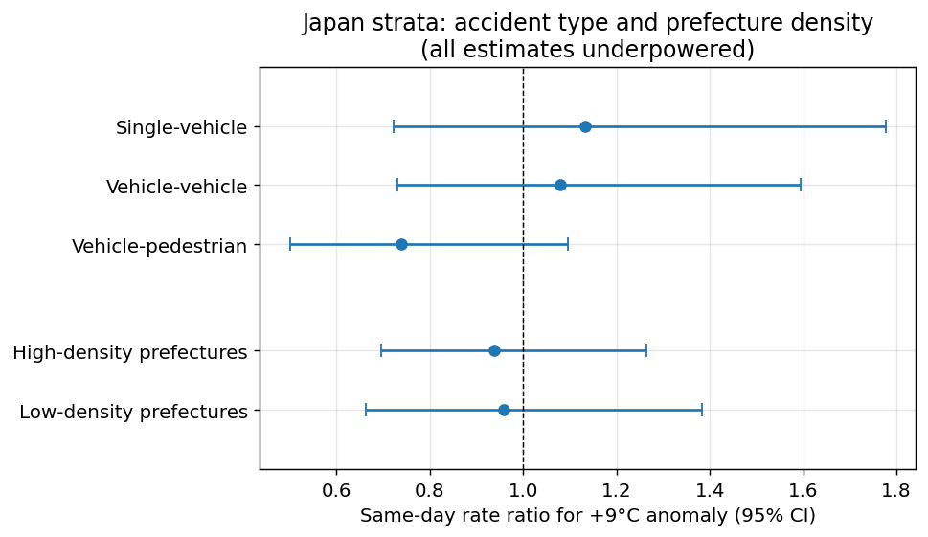
Figure 12
Japan same-day rate ratio of crash death for a +9 °C anomaly by accident type (single-vehicle, vehicle-vehicle, vehicle-pedestrian) and by prefecture population density (a proxy for public-transport availability, split at the median). All confidence intervals are wide and include the null; these stratified analyses are exploratory and are not adjusted for multiple comparisons.

