Slide 1
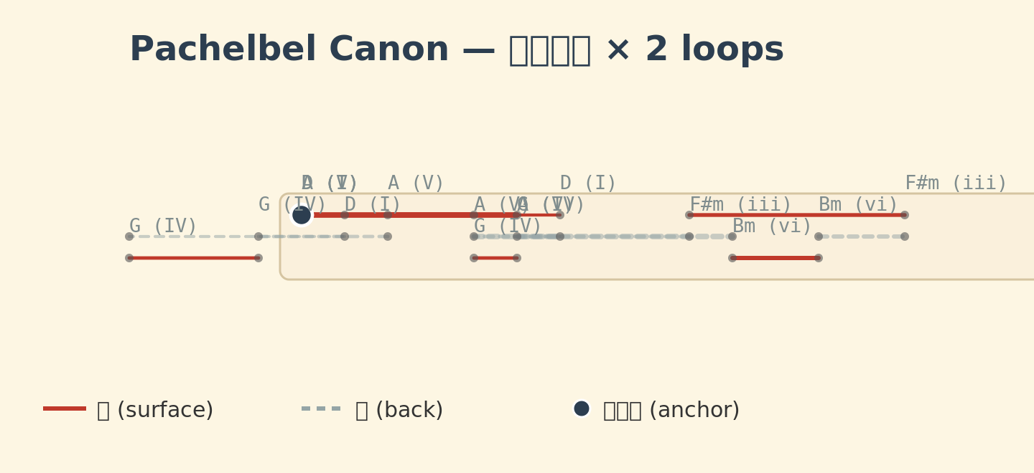
Figure 1
Figure 1. UNSHIN-IL Loom Renderer output for Pachelbel's Canon (I-V-vi-iii-IV-I-IV-V, 2 loops). Red solid lines = surface stitches; grey dashed lines = back stitches; filled black circles = anchor points (knots).

