Slide 1
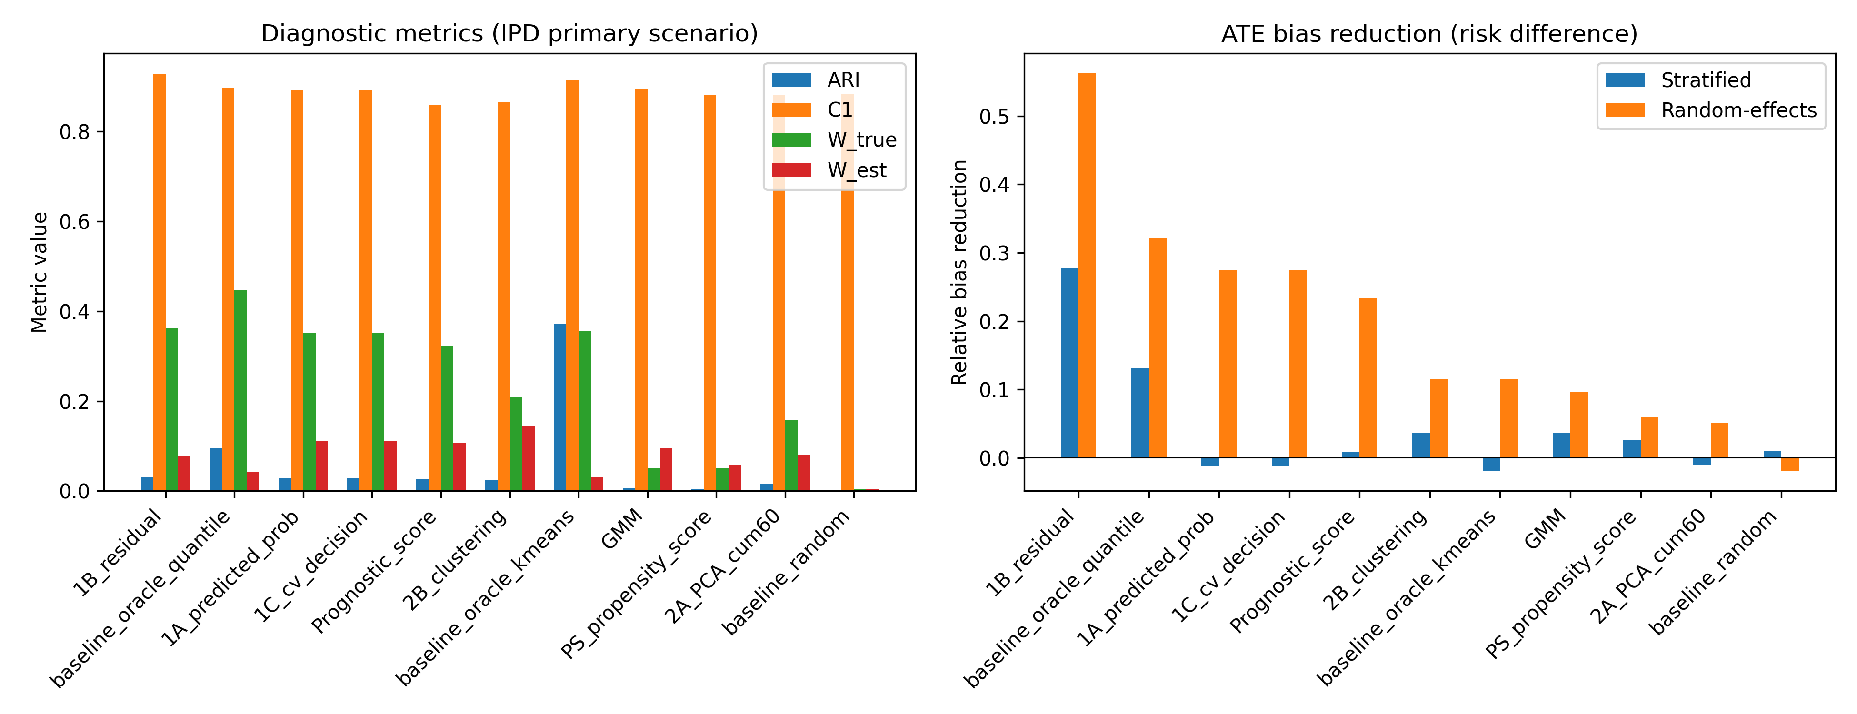
Figure 1
Primary IPD scenario: diagnostic metrics and ATE bias reduction by method.

Slide 2
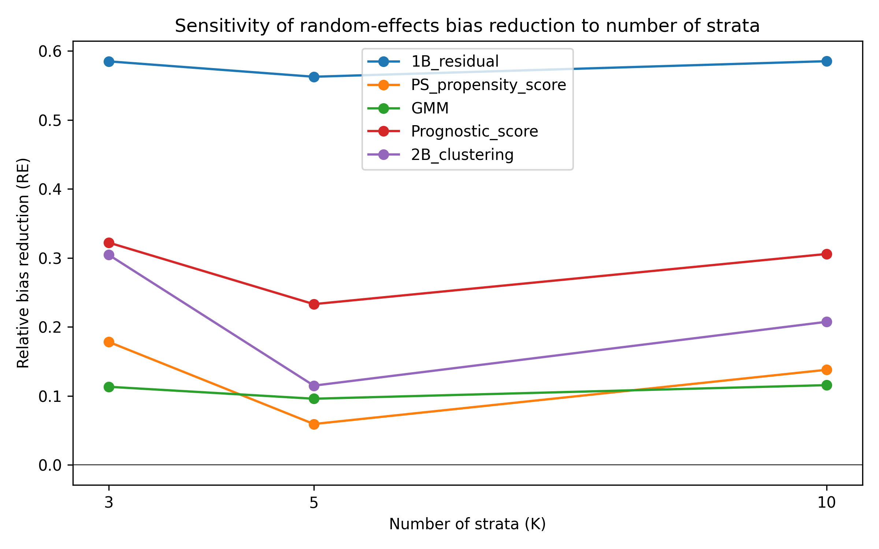
Figure 2
Random-effects ATE bias reduction as the number of strata varies.

Slide 3
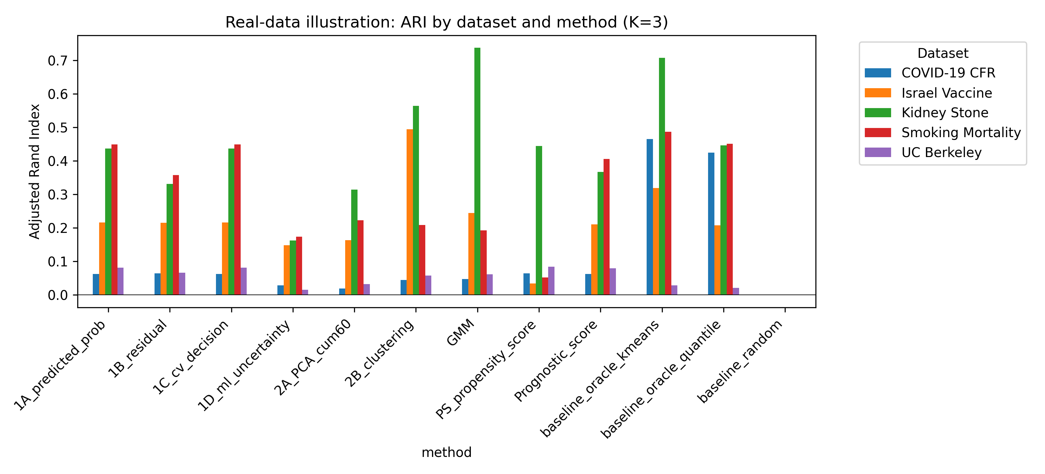
Figure 3
Real-data illustration: ARI by dataset and method.

Slide 4
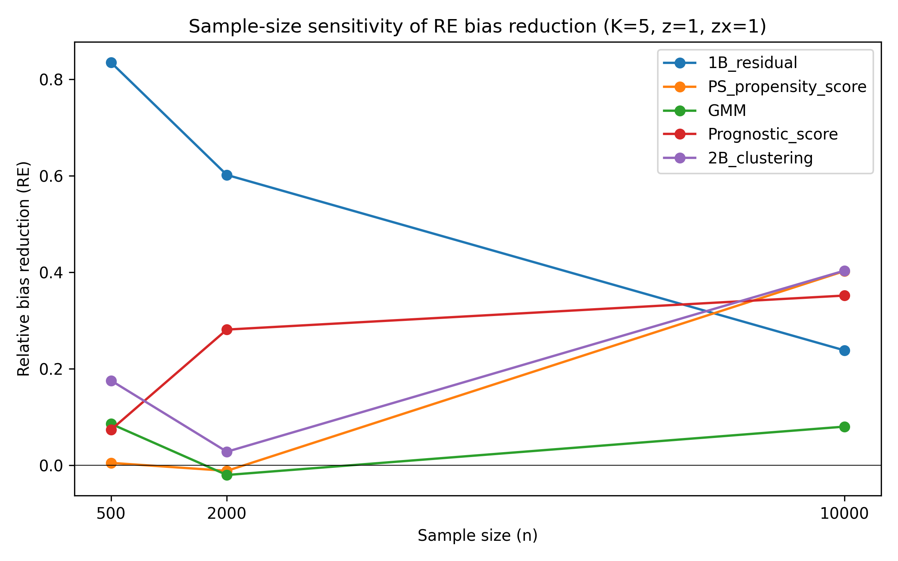
Figure 4
Sample-size sensitivity of random-effects ATE bias reduction (K=5).

Slide 5
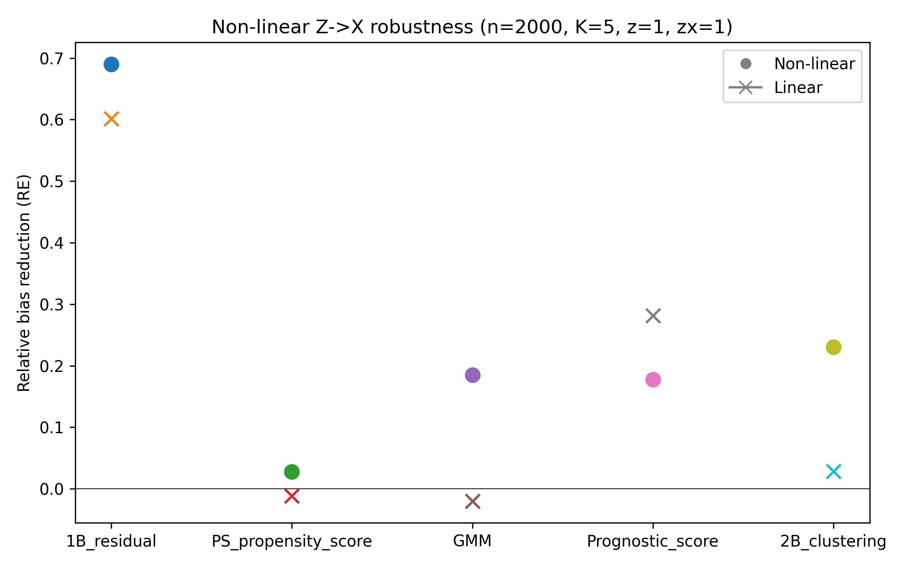
Figure 5
Non-linear Z->X robustness: random-effects ATE bias reduction (n=2000, K=5).

