Slide 1
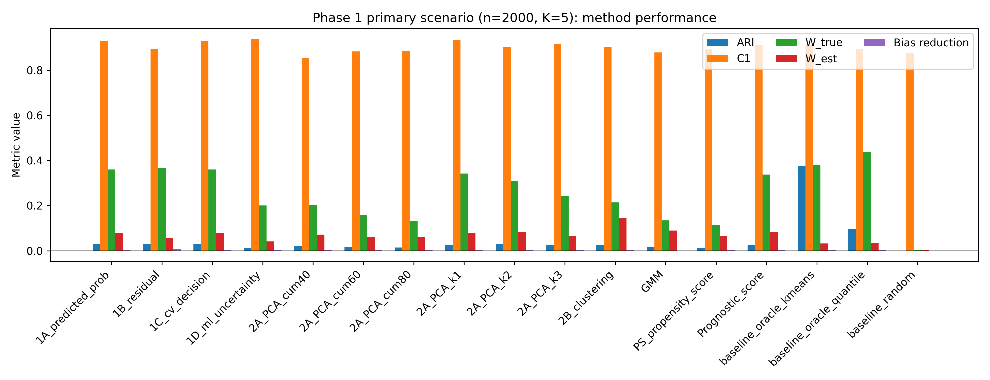
Figure 1
Phase 1 primary metrics across methods.

Slide 2
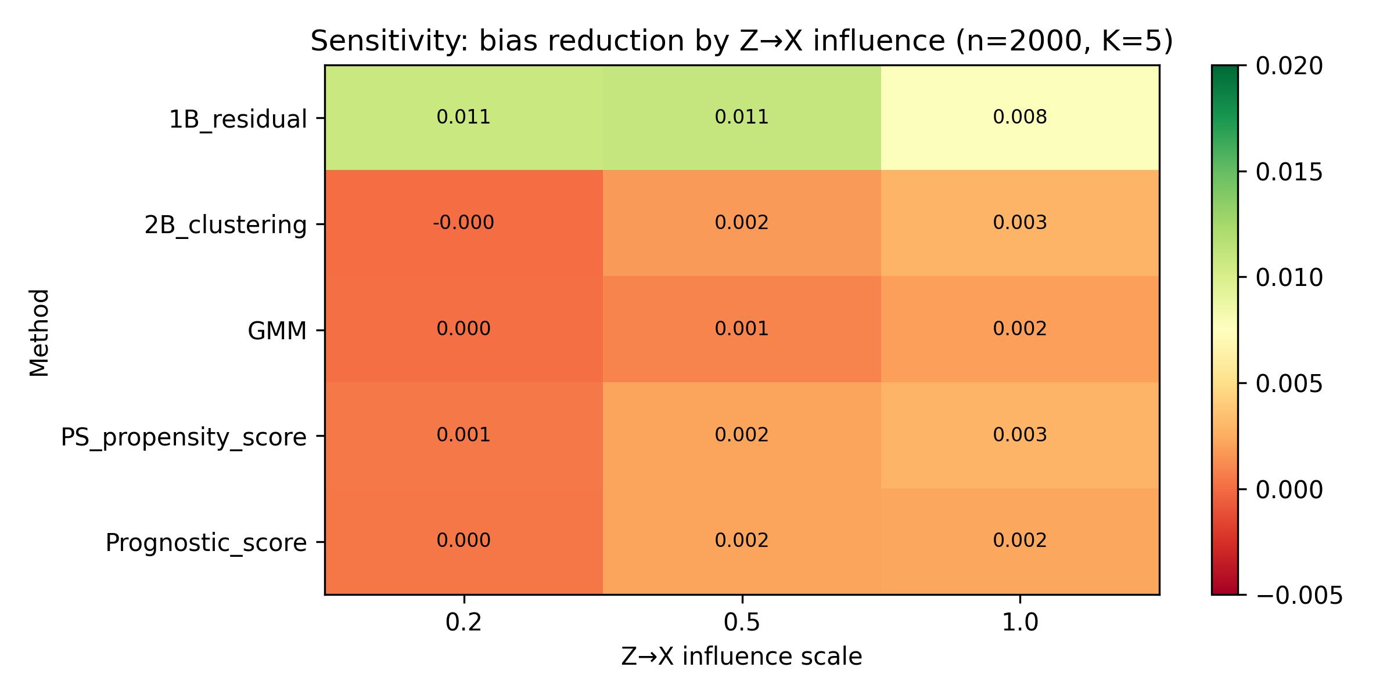
Figure 2
Sensitivity of bias reduction to Z→X influence.

Slide 3
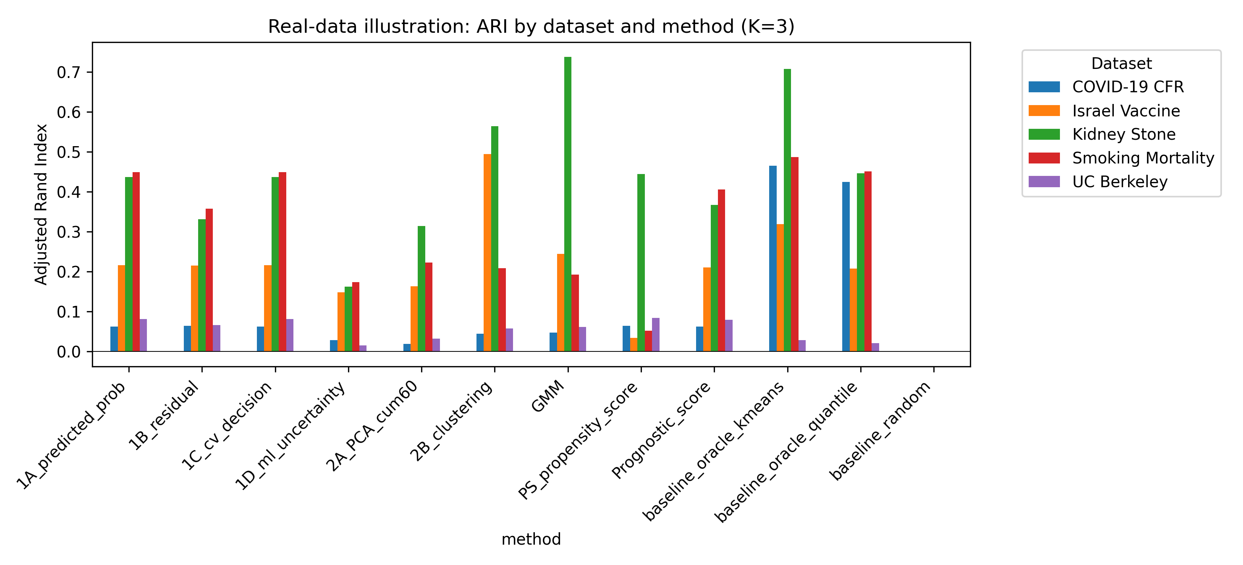
Figure 3
Real-data ARI by dataset and method.

