Slide 1
IONE
Incoherence-Oriented Neutralisation and Extraction for Detecting Hidden Population Structure in Observational Studies
Figures and Tables
BMC Medical Research Methodology

Slide 2
Causal Directed Acyclic Graph (DAG)
Data-generating mechanism: Z (critical) -> X (general) -> Y (outcome)
Critical Variables Z (Withheld)
General Variables X (Measured)
X1 (HbA1c)
Z1 (Age)
N(60, 12²)
X2 (Cholesterol)
Outcome
Z → X
(α_jl)
X → Y
(β_Xj)
X3 (SBP)
Y (Binary Outcome)
Event rate 10–20%
X4 (ALT)
Z2 (Sex)
Bernoulli(0.5)
X5 (Creatinine)
X6 (Haemoglobin)
X7 (WBC)
Z3 (BMI)
3 categories
X8 (Albumin)
X9 (CRP)
X10 (Uric acid)
Z → Y (direct: β_Zl, OR 1.5–3.0)

Slide 3
IONE Framework: Two-Stage Workflow
Stage 1: Detection (C1 coherence indicator) → Stage 2: Extraction (stratification)
Stage 1: DETECTION
Compute C1 coherence indicator from I^2 heterogeneity C1 < 0.05 -> Incoherent C1 >= 0.05 -> Coherent 'Warning function' No assumptions needed
Stage 2: EXTRACTION
If incoherent: Family 1 (Decision power) 1A Predicted probability 1B Residual 1C Cross-validated 1D ML uncertainty Family 2 (Feature score) 2A PCA 2B Clustering
Input Data
Observational study N observations X1...X10 (measured) Y (outcome) (Z unmeasured)
Output
Coherent subpopulations for valid within-subgroup inference Bias reduction Paradox resolution Effect modification detected
C1 < 0.05?
← No (Coherent)
Yes →

Slide 4
IONE Methods Overview
Two families of stratification methods plus baselines
Family 1: Decision Power-Based (Outcome-Informed)
Family 2: Feature Score-Based (Outcome-Free)
Baselines
1A: Predicted Probability
Logistic regression P(Y|X) → quantile strata
2A: PCA
PC1 score → quantile strata
Random: Random assignment (lower bound)
1B: Residual
|Y − p̂| → quantile strata (most robust)
2B: Clustering
k-means on X → cluster = stratum
Oracle: k-means on Z (upper bound)
1C: Cross-Validated
K-fold CV to prevent overfitting
1D: ML Uncertainty
Random forest prediction variance → strata

Slide 5
IONE Application Guidance
Decision framework based on η² and subgroup structure
η² > 0.4 2–3 discrete subgroups
Feature score clustering (2B)
Expected: ARI > 0.7
Kidney stone, Israeli vaccine
0.15 < η² ≤ 0.4 Multi-group / continuous
Decision power (1A, 1B) Both families recommended
Expected: ARI 0.1–0.5
Smoking–mortality
η² < 0.15 Weak traces
C1 detection only Extraction limited
Expected: ARI < 0.1
COVID-19, Berkeley

Slide 6
Table 1. Published Simpson's Paradox Examples
Five examples used for empirical validation
Example | Source | N | Hidden Confounder | Groups | Paradox
COVID-19 CFR | von Kugelgen 2021 | 50,459 | Age group | 9 | Italy > China overall, reversed within age groups
Kidney stone | Charig 1986 | 700 | Stone size | 2 | Treatment B > A overall, A > B within each size
UC Berkeley | Bickel 1975 | 4,425 | Department | 6 | Males > females overall, reversed in most departments
Israeli vaccine | Morris 2021 | 6,100 | Age group | 2 | Vaccine ineffective overall, effective in both groups
Smoking-mortality | Appleton 1996 | 1,314 | Age group | 7 | Smokers lower mortality overall, higher within groups

Slide 7
Table 2. Method Performance Ranking (Phase 1 Simulation)
Averaged across all scenarios (N=2,000; 200 repetitions per scenario)
Rank | Method | Family | ARI | NMI | eta^2 (mean) | C1
1 | Oracle (k-means on Z) | Baseline (upper) | 0.353 | 0.616 | 0.562 | 0.019
2 | Oracle (quantile on Z) | Baseline (upper) | 0.073 | 0.260 | 0.283 | 0.010
3 | 1B: Residual | Decision power | 0.020 | 0.069 | 0.091 | 0.001
4 | 1D: ML uncertainty | Decision power | 0.017 | 0.056 | 0.074 | 0.001
5 | 1A: Predicted probability | Decision power | 0.014 | 0.053 | 0.069 | 0.022
6 | 1C: Cross-validated | Decision power | 0.014 | 0.051 | 0.067 | 0.028
7 | 2A: PCA (k=2) | Feature score | 0.012 | 0.042 | 0.052 | 0.098
8 | 2A: PCA (k=1) | Feature score | 0.011 | 0.047 | 0.063 | 0.095
9 | 2B: Clustering | Feature score | 0.011 | 0.041 | 0.053 | 0.079
10 | Random | Baseline (lower) | -0.000 | 0.007 | 0.002 | 0.863

Slide 8
Table 3. ARI by Z->X Influence Strength (K=5 strata)
The Z->X influence is the single most important determinant of performance
Method | zx=0.3 (weak) | zx=0.5 (moderate) | zx=1.0 (strong) | Strong/weak ratio
1A: Predicted probability | 0.004 | 0.010 | 0.030 | 8.7
1B: Residual | 0.014 | 0.018 | 0.029 | 1.9
1C: Cross-validated | 0.003 | 0.009 | 0.029 | 9.6
2A: PCA (k=2) | 0.002 | 0.006 | 0.029 | 18.3
2B: Clustering | 0.002 | 0.006 | 0.025 | 14.0
Oracle (k-means on Z) | 0.378 | 0.378 | 0.380 | 1.0

Slide 9
Table 4. Eta-Squared for Each Critical Variable (K=5, zx=1.0)
Age (continuous) captured best; sex (binary) captured poorly
Method | Z1 (age) | Z2 (sex) | Z3 (BMI) | Mean
Oracle (k-means on Z) | 0.312 | 0.982 | 0.663 | 0.652
1A: Predicted probability | 0.327 | 0.008 | 0.092 | 0.142
1C: Cross-validated | 0.322 | 0.007 | 0.090 | 0.140
1B: Residual | 0.295 | 0.012 | 0.093 | 0.133
2B: Clustering | 0.238 | 0.026 | 0.090 | 0.118
Random | 0.002 | 0.002 | 0.002 | 0.002

Slide 10
Table 5. ARI by Z->X Influence in Sensitivity Analysis
Confirming Z->X influence as the most important parameter
Method | zx=0.2 (weak) | zx=0.5 (moderate) | zx=1.0 (strong) | Strong/weak ratio
1A: Predicted probability | 0.002 | 0.009 | 0.028 | 17.5
1C: Cross-validated | 0.001 | 0.008 | 0.027 | 22.3
2B: Clustering | 0.001 | 0.006 | 0.024 | 34.3
2A: PCA (60%) | 0.001 | 0.004 | 0.015 | 30.8

Slide 11
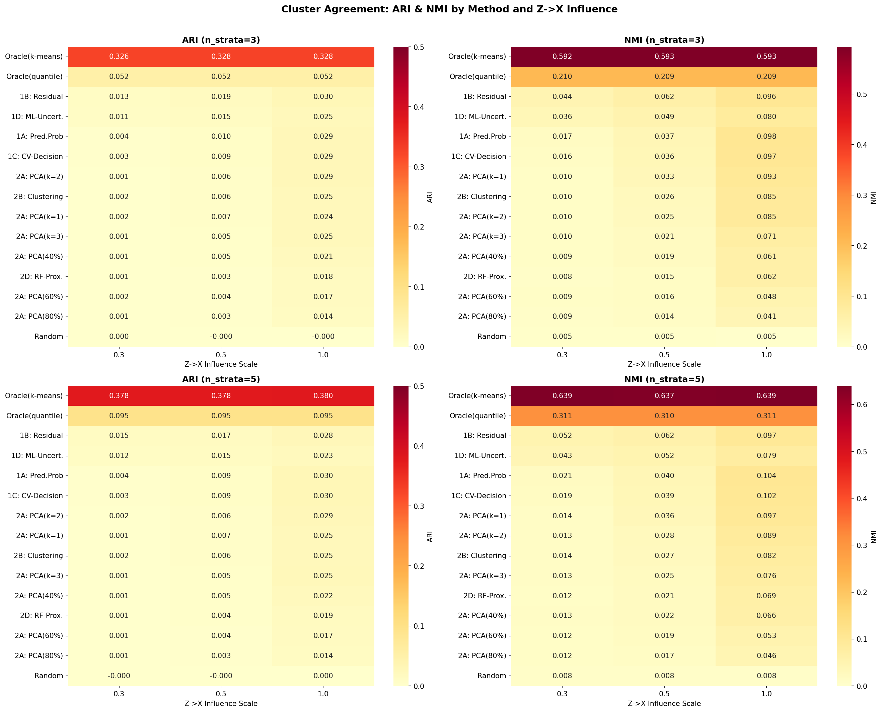
Figure 1. ARI and NMI Heatmap (Phase 1 Simulation)
Method x scenario performance across all Phase 1 conditions

Slide 12
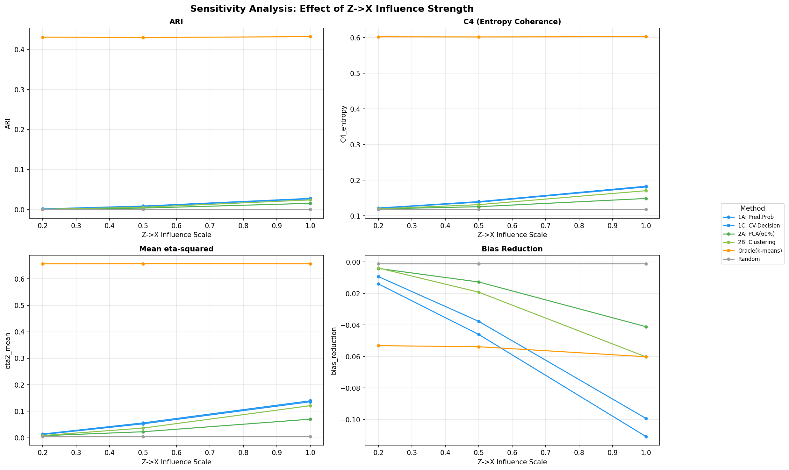
Figure 2. Effect of Z->X Influence Strength
Sensitivity analysis: ARI increases up to 18-fold from weak to strong Z->X influence

Slide 13
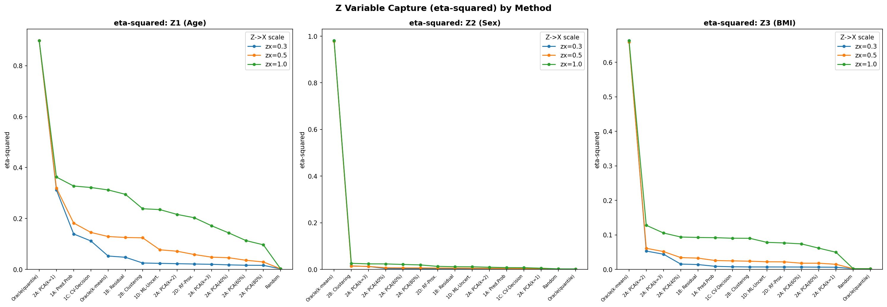
Figure 3. Eta-Squared by Method and Critical Variable
Differential capture: age (continuous) >> BMI (ordinal) >> sex (binary)

Slide 14
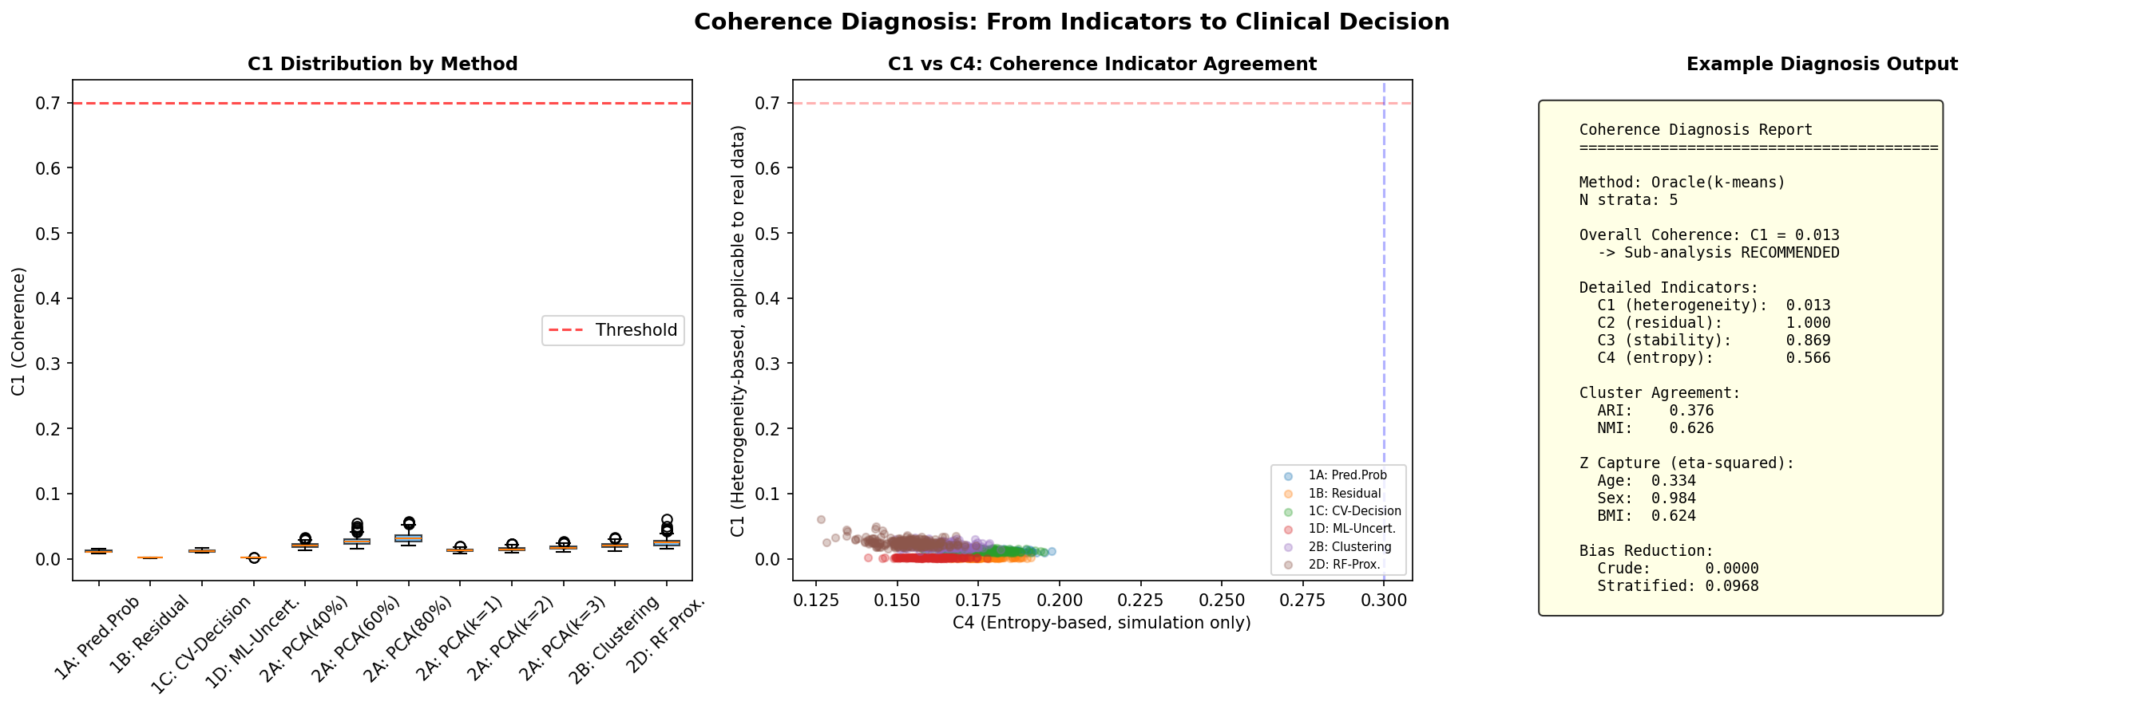
Figure 4. Coherence Indicator C1 Across Methods
Low C1 = successful detection of population incoherence; proposed methods C1~0.001 vs random C1~0.863

Slide 15
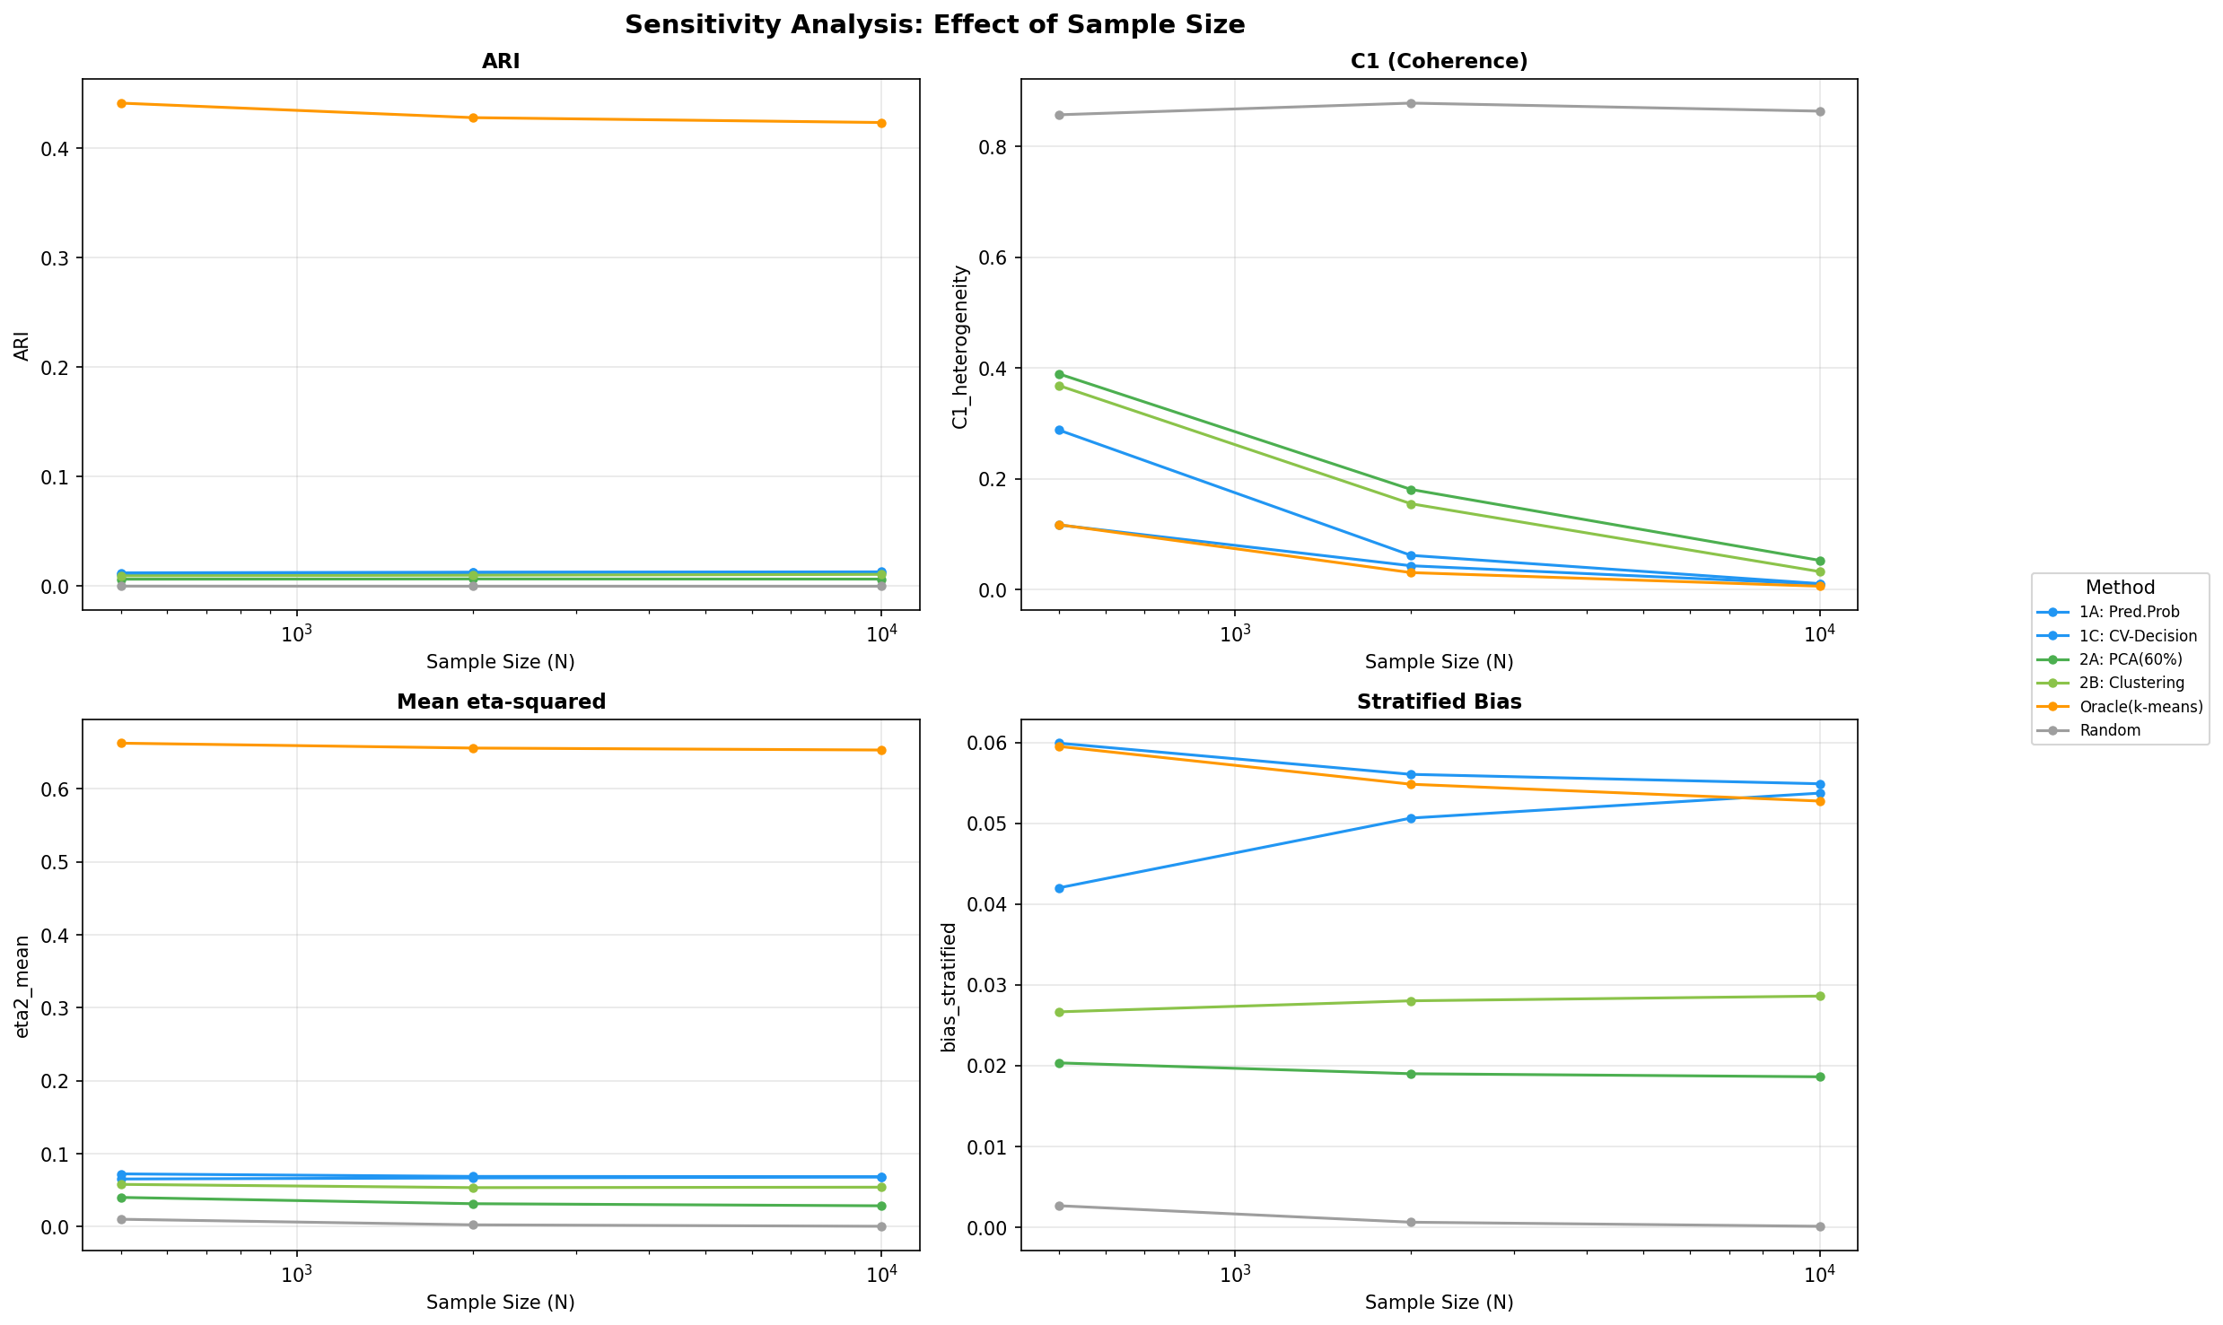
Figure 5. Effect of Sample Size
Performance is largely insensitive to sample size (N=500 to N=10,000)

Slide 16
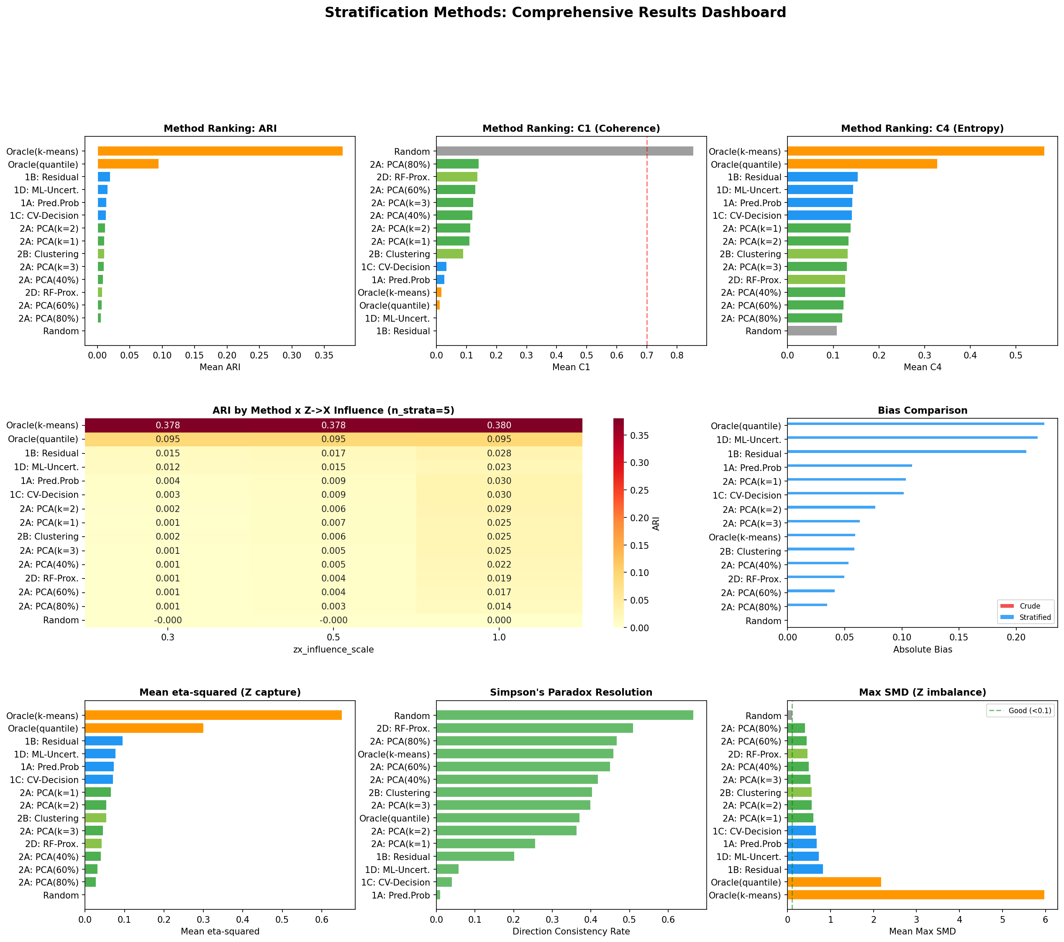
Figure 6. Phase 1 Simulation Summary Dashboard
Comprehensive overview of simulation results across all methods and conditions

Slide 17
Table 6. Summary of Empirical Validation Results
IONE applied to five published Simpson's paradox examples
Example | Best Method | Best ARI | Oracle ARI | Achievement | C1 (best) | C1 (random) | eta^2
Kidney stone | 2B Clustering | 0.851 | 1.000 | 85.1% | 0.034 | 0.695 | 0.428
Israeli vaccine | 2B Clustering | 0.746 | 1.000 | 74.6% | 0.005 | 0.770 | 0.432
Smoking-mortality | 1A Pred. prob. | 0.498 | 1.000 | 49.8% | 0.005 | 1.000 | 0.686
UC Berkeley | 1A Pred. prob. | 0.082 | 1.000 | 8.2% | 0.011 | 0.954 | 0.152
COVID-19 CFR | 1B Residual | 0.064 | 1.000 | 6.4% | 0.001 | 0.778 | 0.171

Slide 18
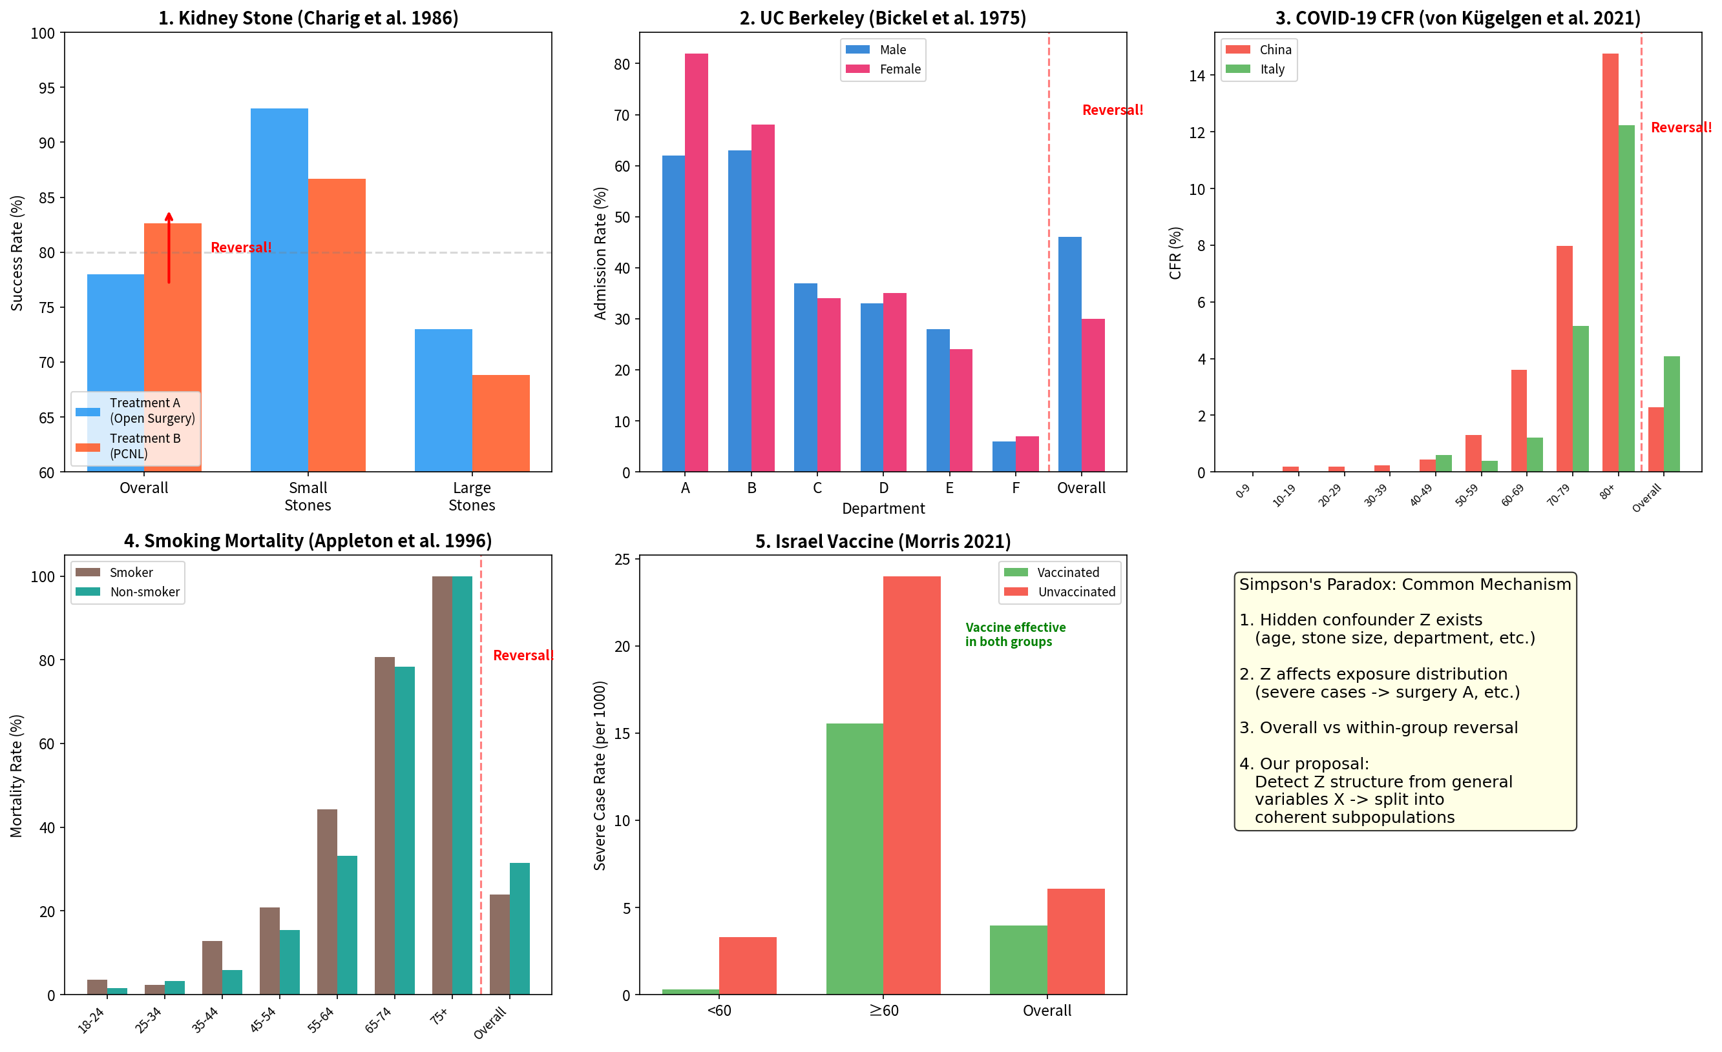
Figure 7. Simpson's Paradox Demonstration
Visualisation of the paradox in all five published examples

Slide 19
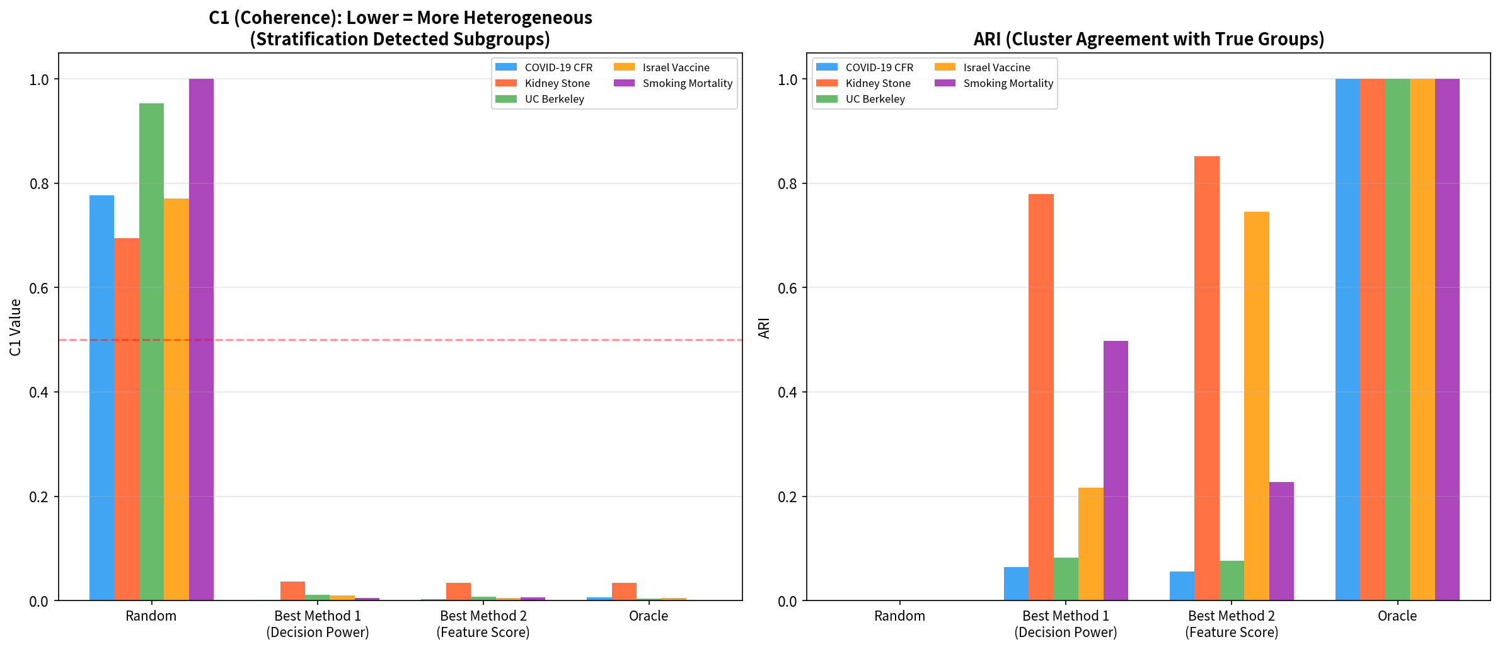
Figure 8. Coherence Analysis (C1) Across Examples
C1 correctly detected incoherence in all five examples (C1=0.001-0.034 vs random C1=0.695-1.000)

Slide 20
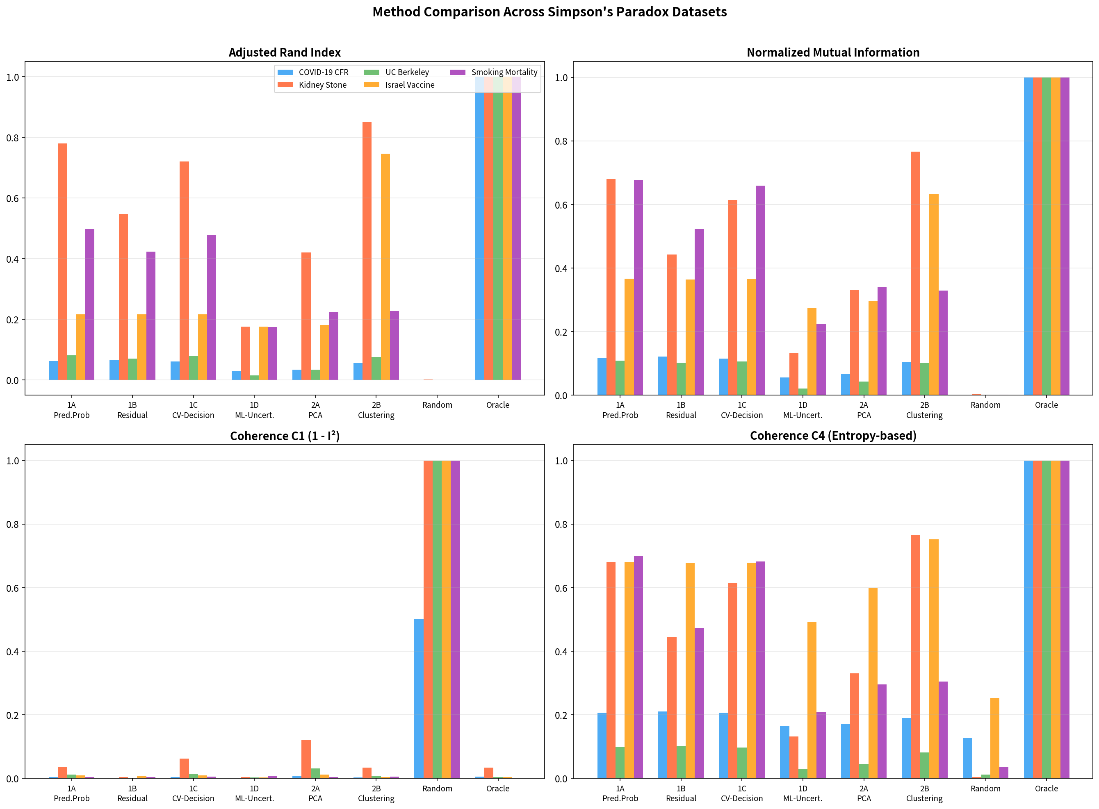
Figure 9. Method Comparison Across Examples (ARI)
2B Clustering best for 2-group; 1A/1B best for multi-group structures

Slide 21
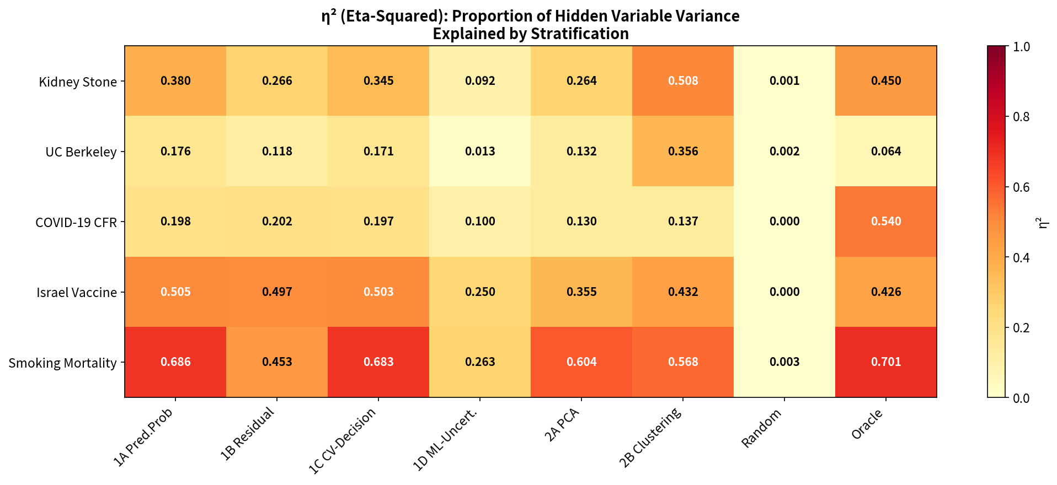
Figure 10. Eta-Squared Heatmap (Empirical Validation)
Higher eta-squared correlates with higher ARI, consistent with simulation findings

Slide 22
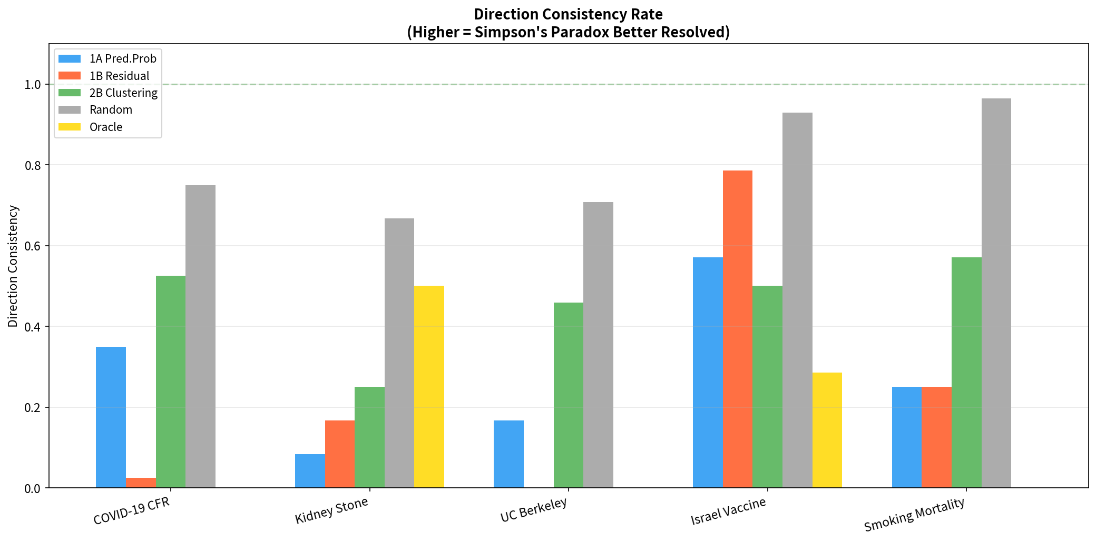
Figure 11. Direction Consistency Analysis
Consistency of exposure-outcome association direction across strata

Slide 23
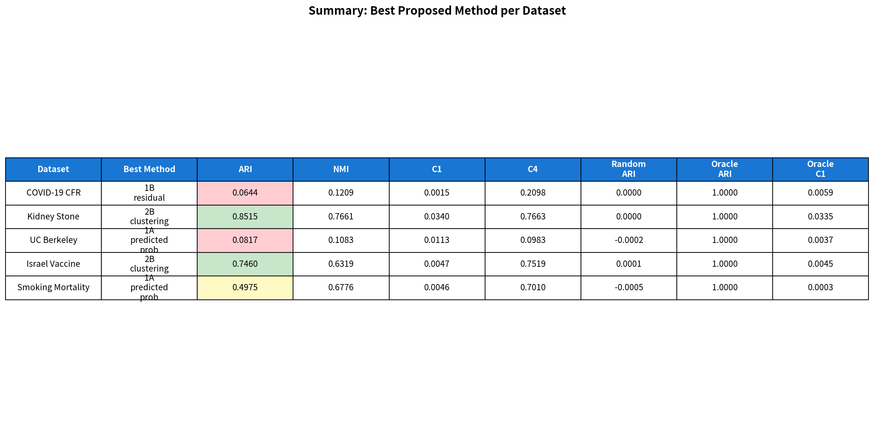
Figure 12. Empirical Validation Summary Dashboard
Comprehensive overview of all five Simpson's paradox applications

Slide 24
Table 7. Concordance Between Simulation and Empirical Findings
Key findings from simulation replicated in empirical validation
Finding | Simulation | Empirical Validation
1B Residual is most robust | Highest ARI (0.020) | Best for COVID-19 (ARI=0.064)
C1 detects incoherence | Random 0.863 vs proposed 0.001 | Random 0.70-1.00 vs proposed 0.00-0.03
Z->X influence is decisive | ARI increases with zx | Higher eta^2 -> higher ARI
All methods outperform random | All scenarios | All five examples

