Slide 1
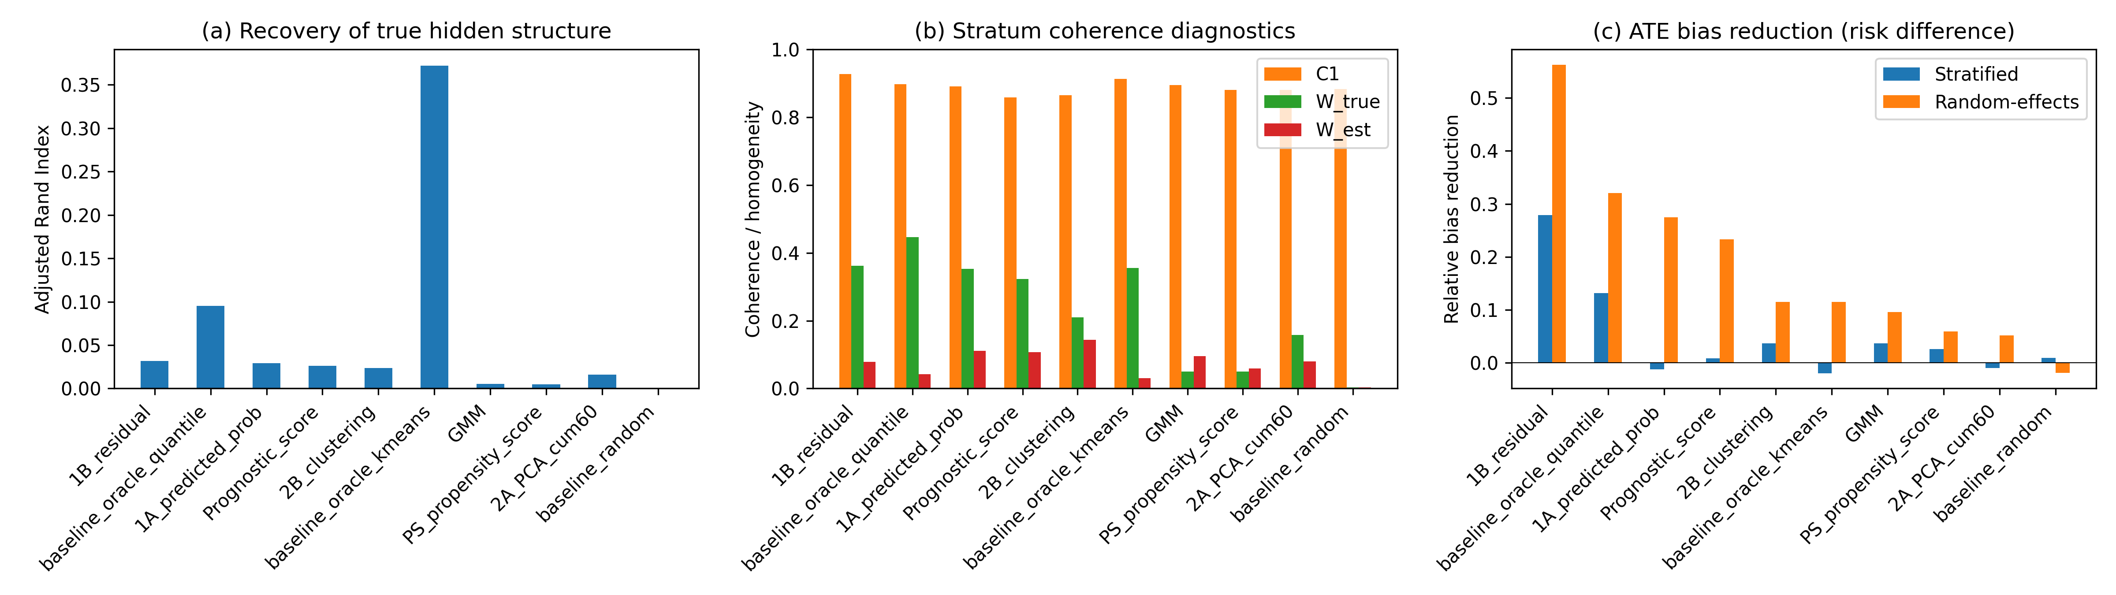
Figure 1
Primary IPD scenario: (a) ARI, (b) C1/W coherence diagnostics, and (c) ATE bias reduction by method.

Slide 2
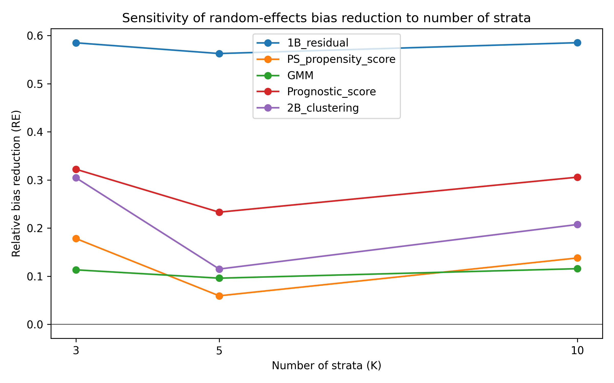
Figure 2
Random-effects ATE bias reduction as the number of strata varies.

Slide 3
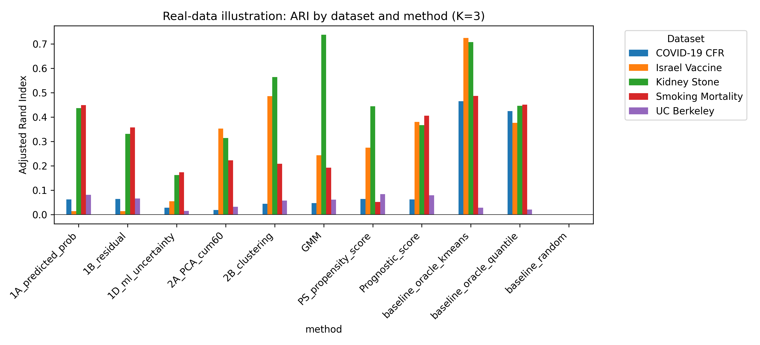
Figure 3
Real-data illustration: ARI by dataset and method.

Slide 4
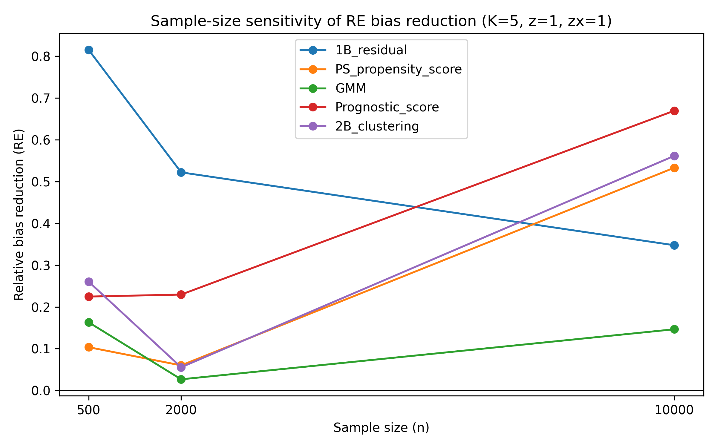
Figure 4
Sample-size sensitivity of random-effects ATE bias reduction (K=5).

Slide 5
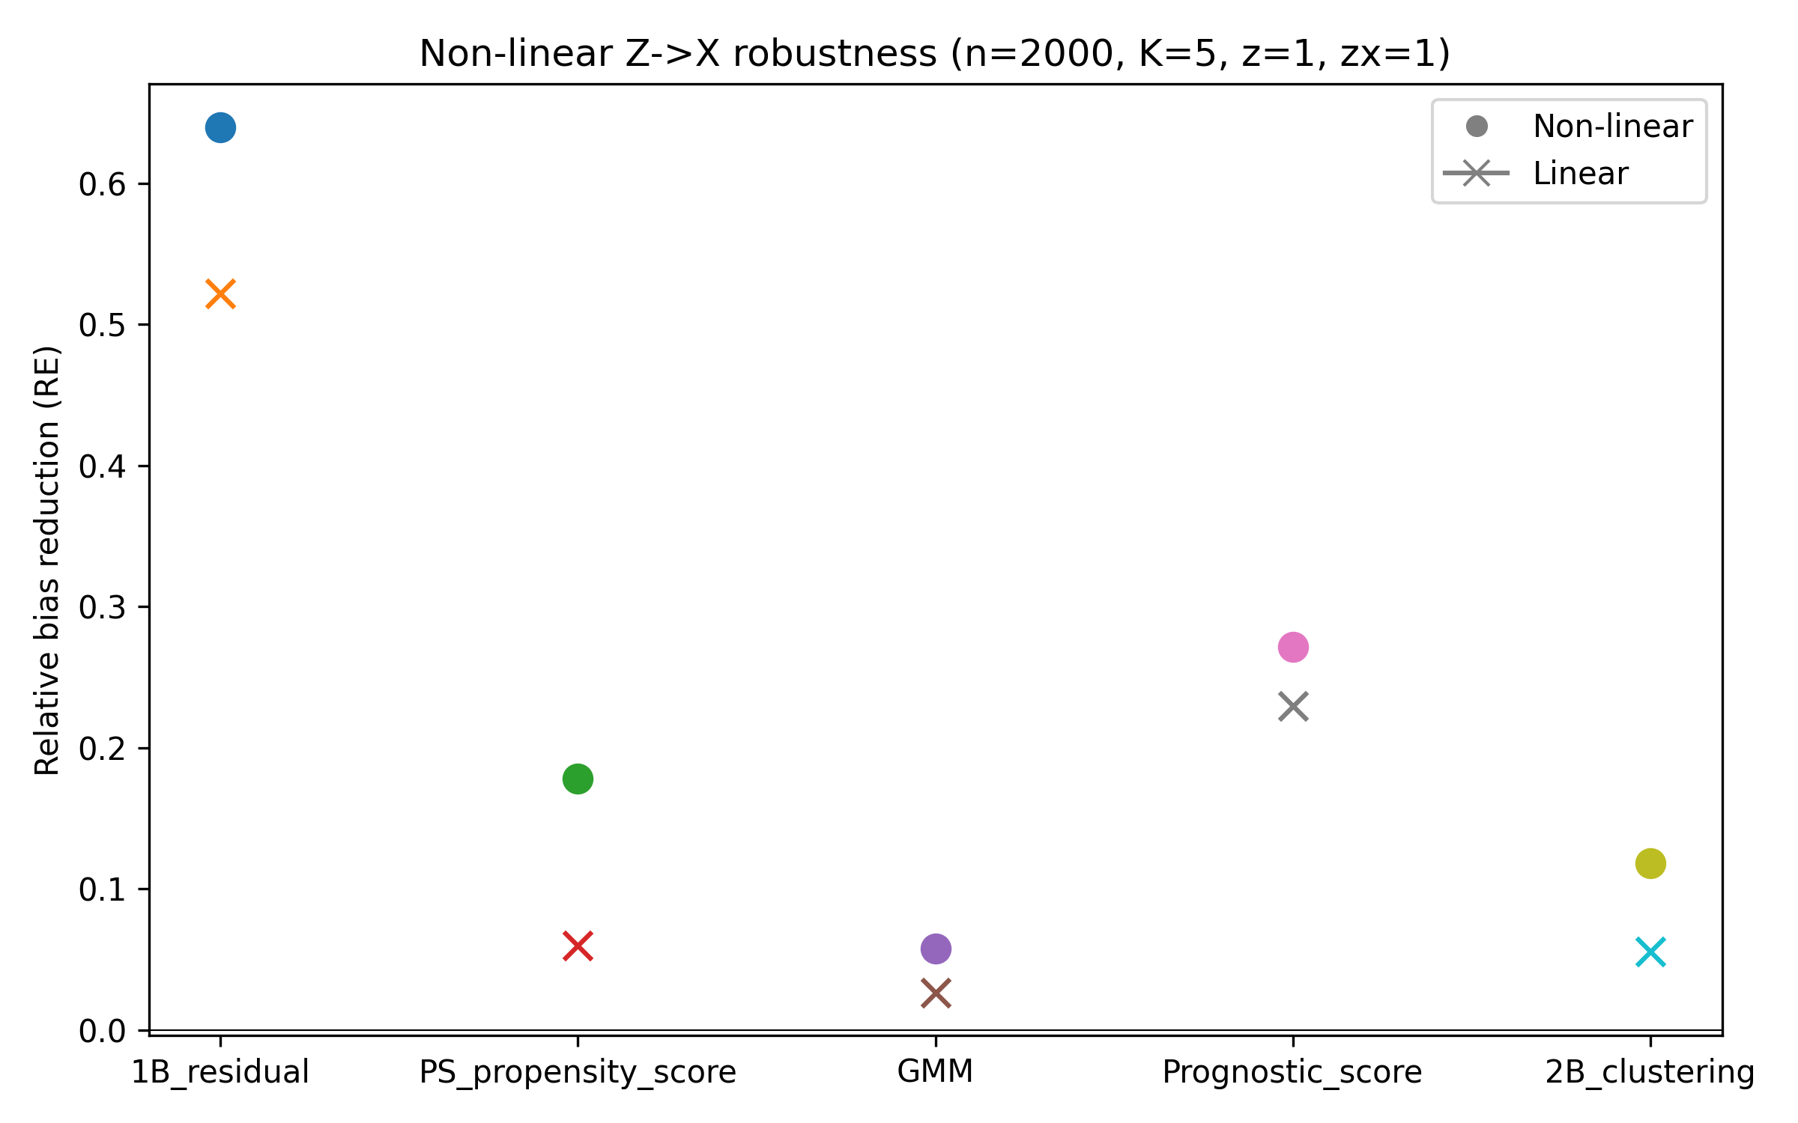
Figure 5
Non-linear Z->X robustness: random-effects ATE bias reduction (n=2000, K=5).

Slide 6
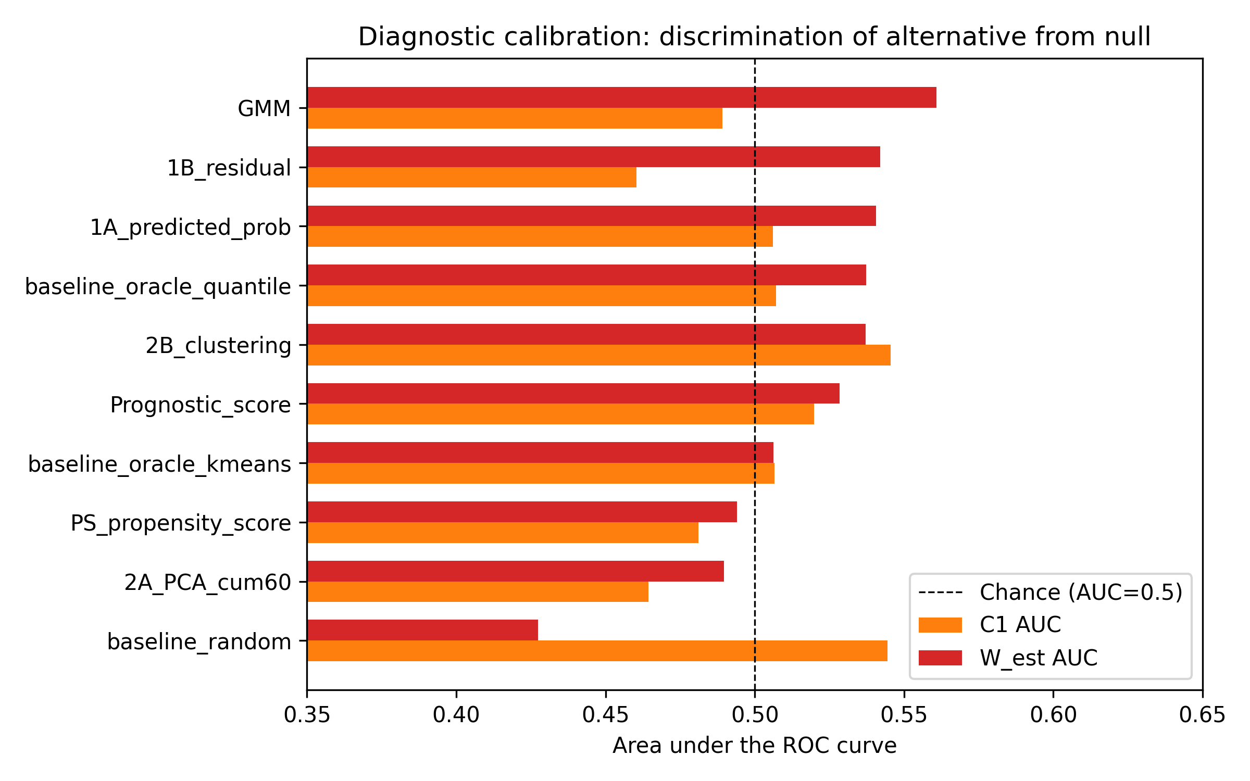
Figure 6
Diagnostic calibration of C1 and W_est: AUC for discriminating the alternative DGM from the empirical null distribution (n=2000, K=5).

Slide 7
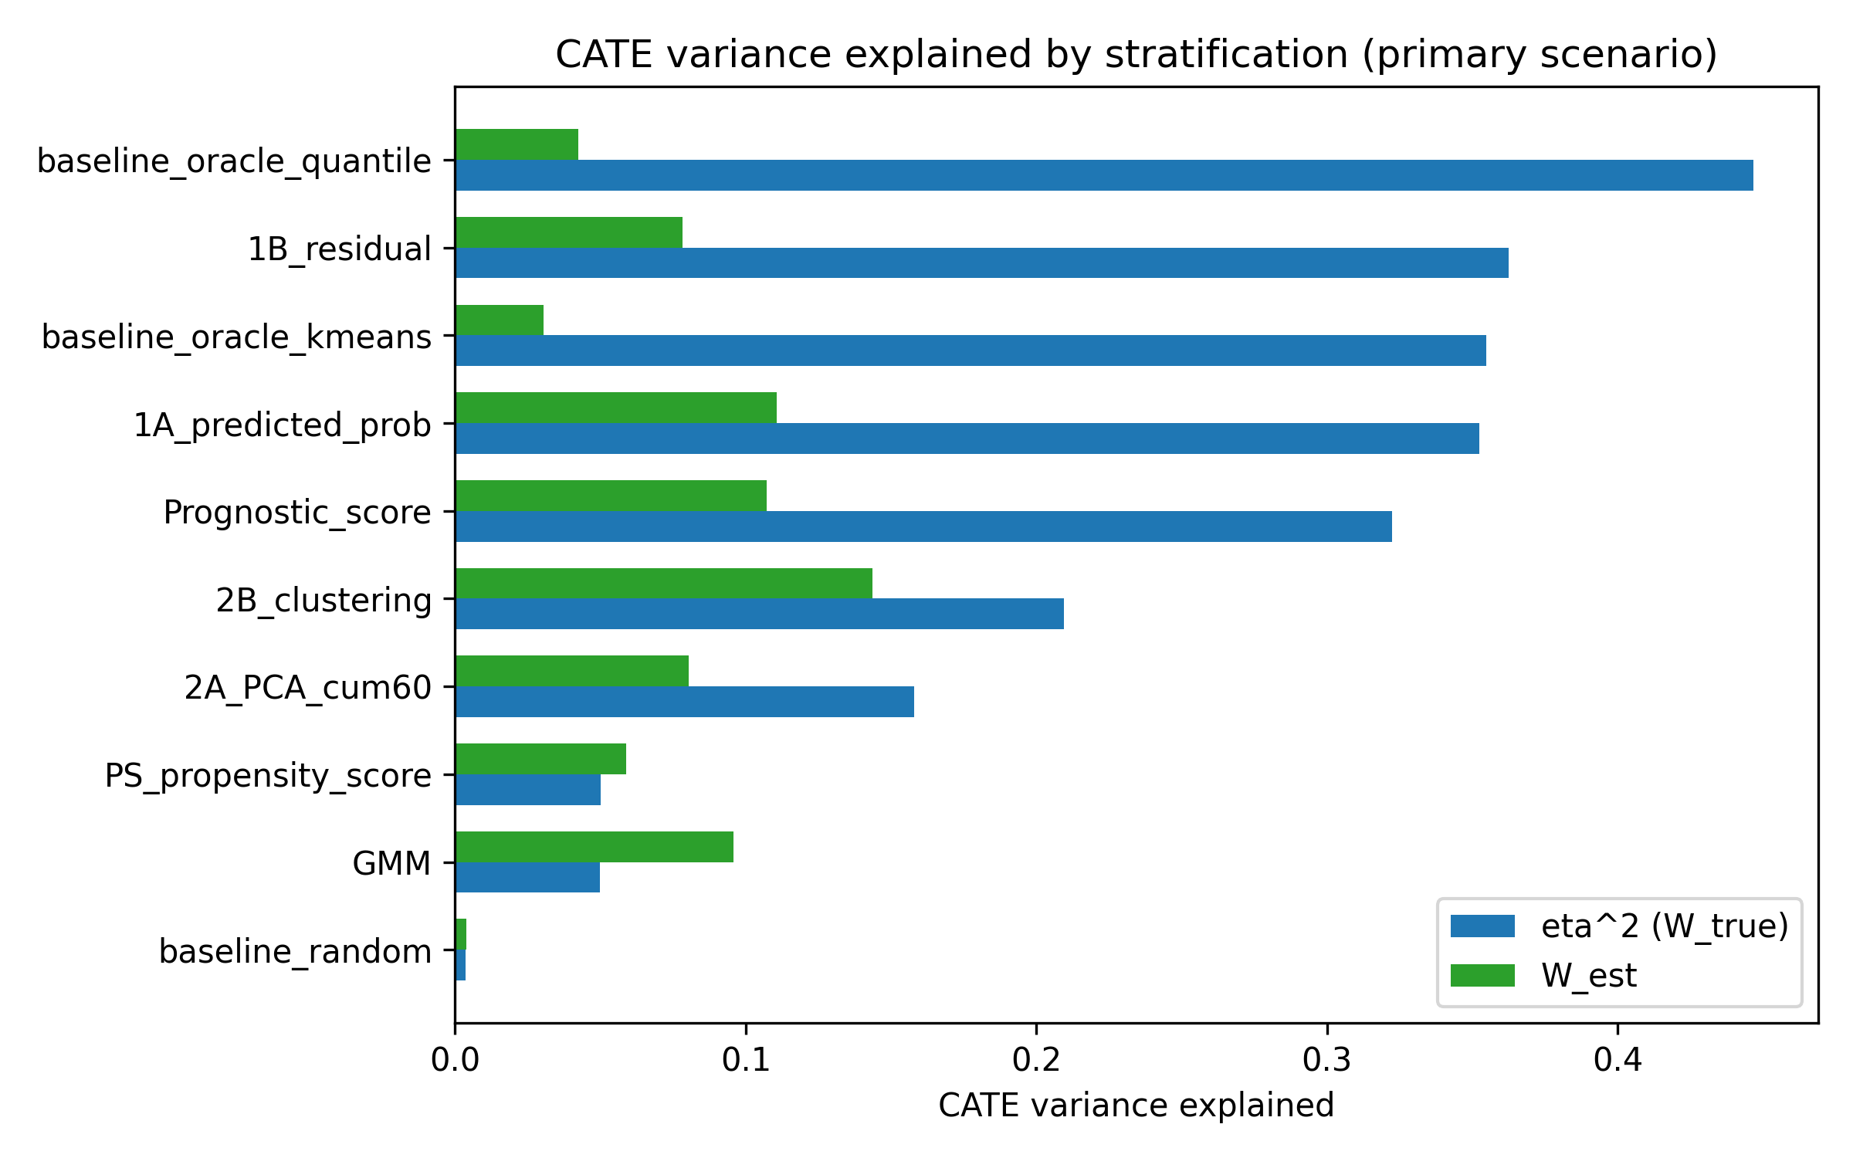
Figure 7
CATE variance explained (eta^2 = W_true) and estimated W_est by method in the primary scenario (n=2000, K=5).

