Slide 1
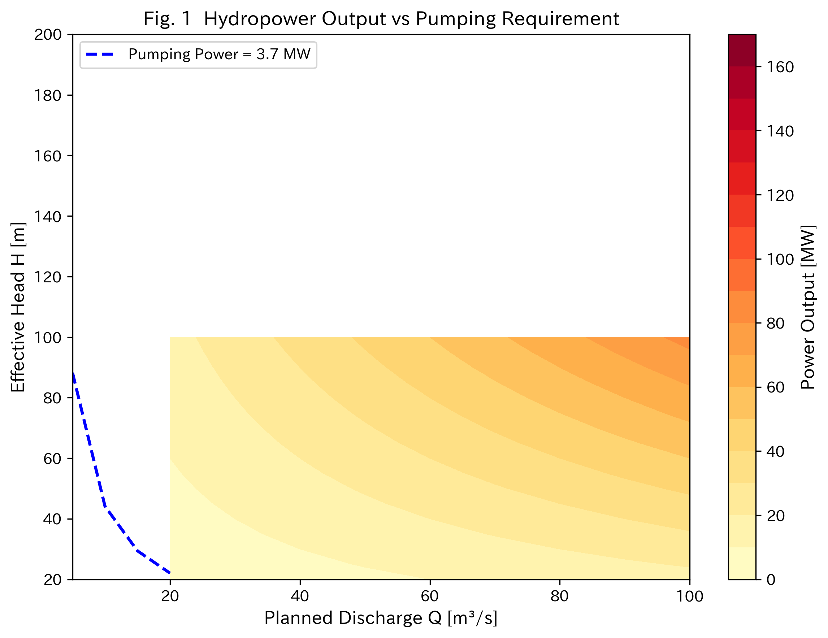
Fig. 1 Hydropower Output vs Pumping Requirement
Blue dashed line: pumping power = 3.7 MW. Area above the line is energy-positive.

Slide 2
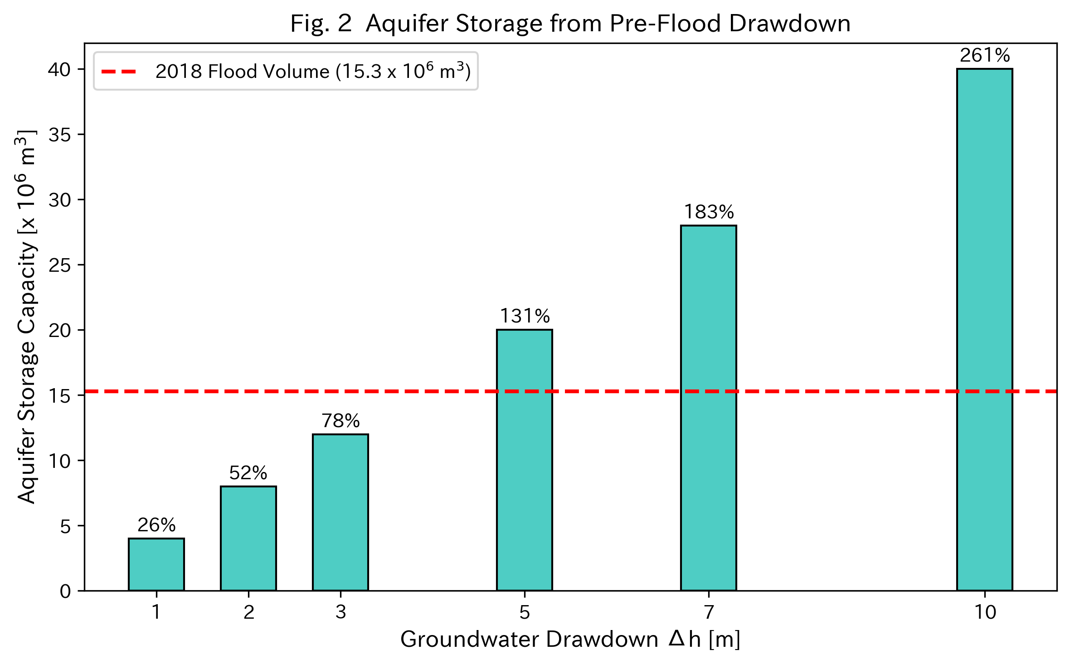
Fig. 2 Aquifer Storage from Pre-Flood Drawdown
Red dashed line: 2018 flood volume (15.3 x 10^6 m3). Percentages show fraction of flood volume absorbable.

Slide 3
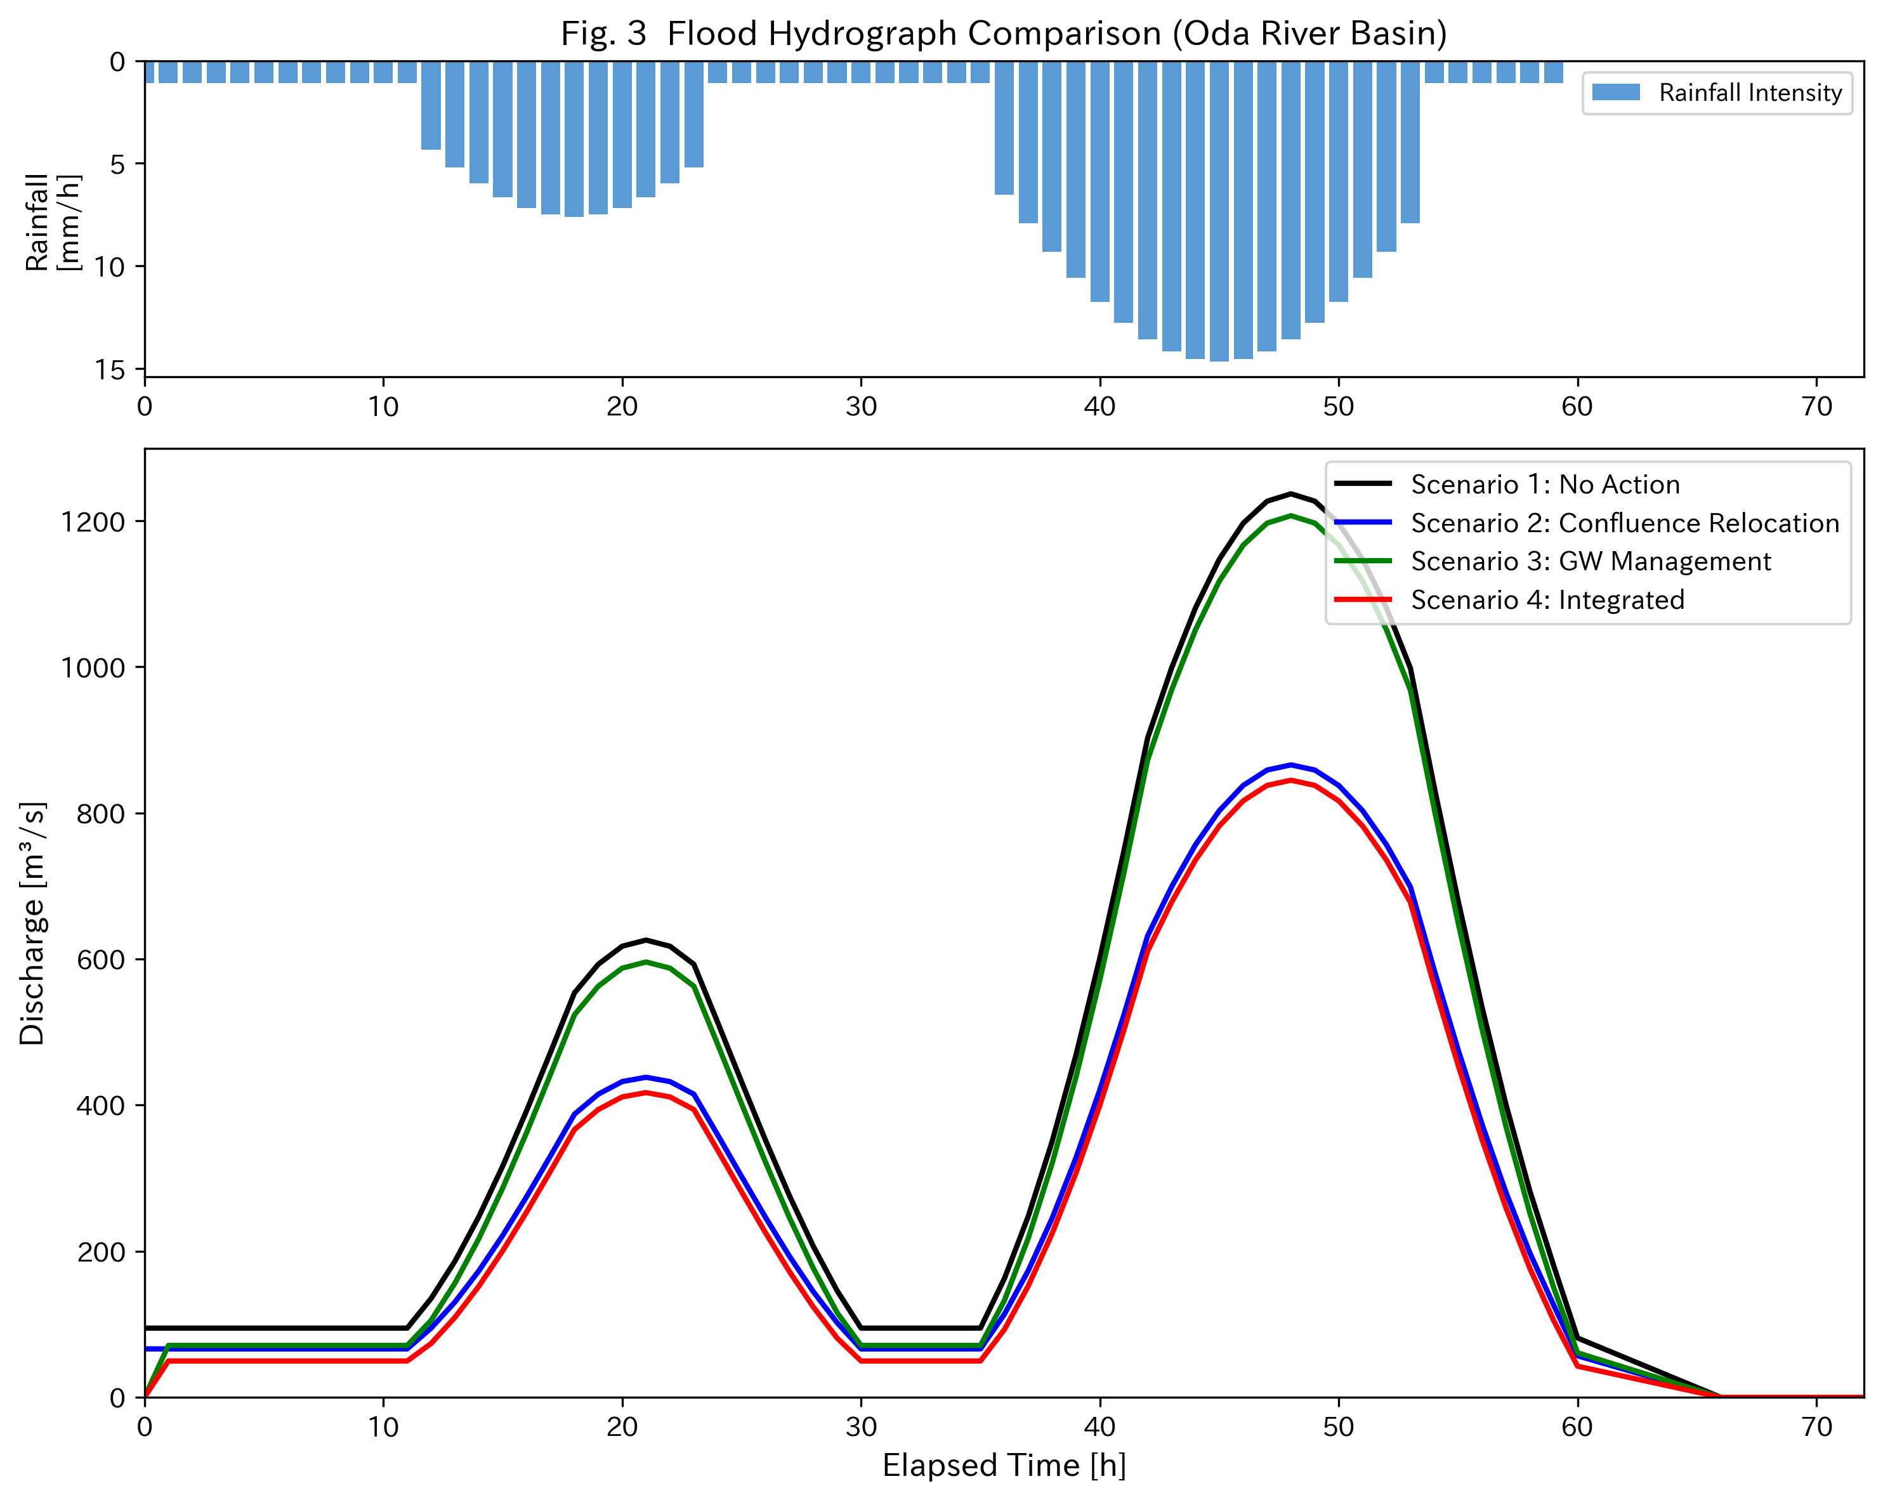
Fig. 3 Flood Hydrograph Comparison (Oda River Basin)
Upper: rainfall intensity. Lower: discharge. Scenarios 1-4 as described in text.

Slide 4
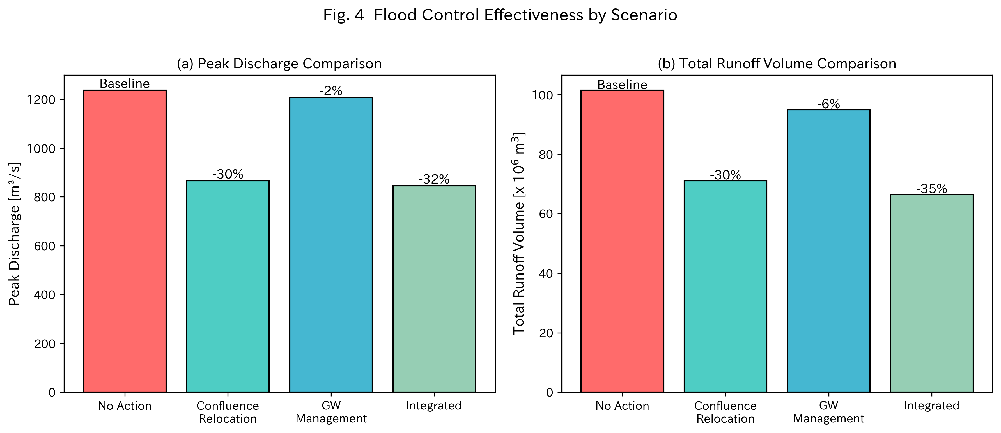
Fig. 4 Flood Control Effectiveness by Scenario
(a) Peak discharge, (b) Total runoff volume. Percentages show reduction from no-action baseline.

