Slide 1
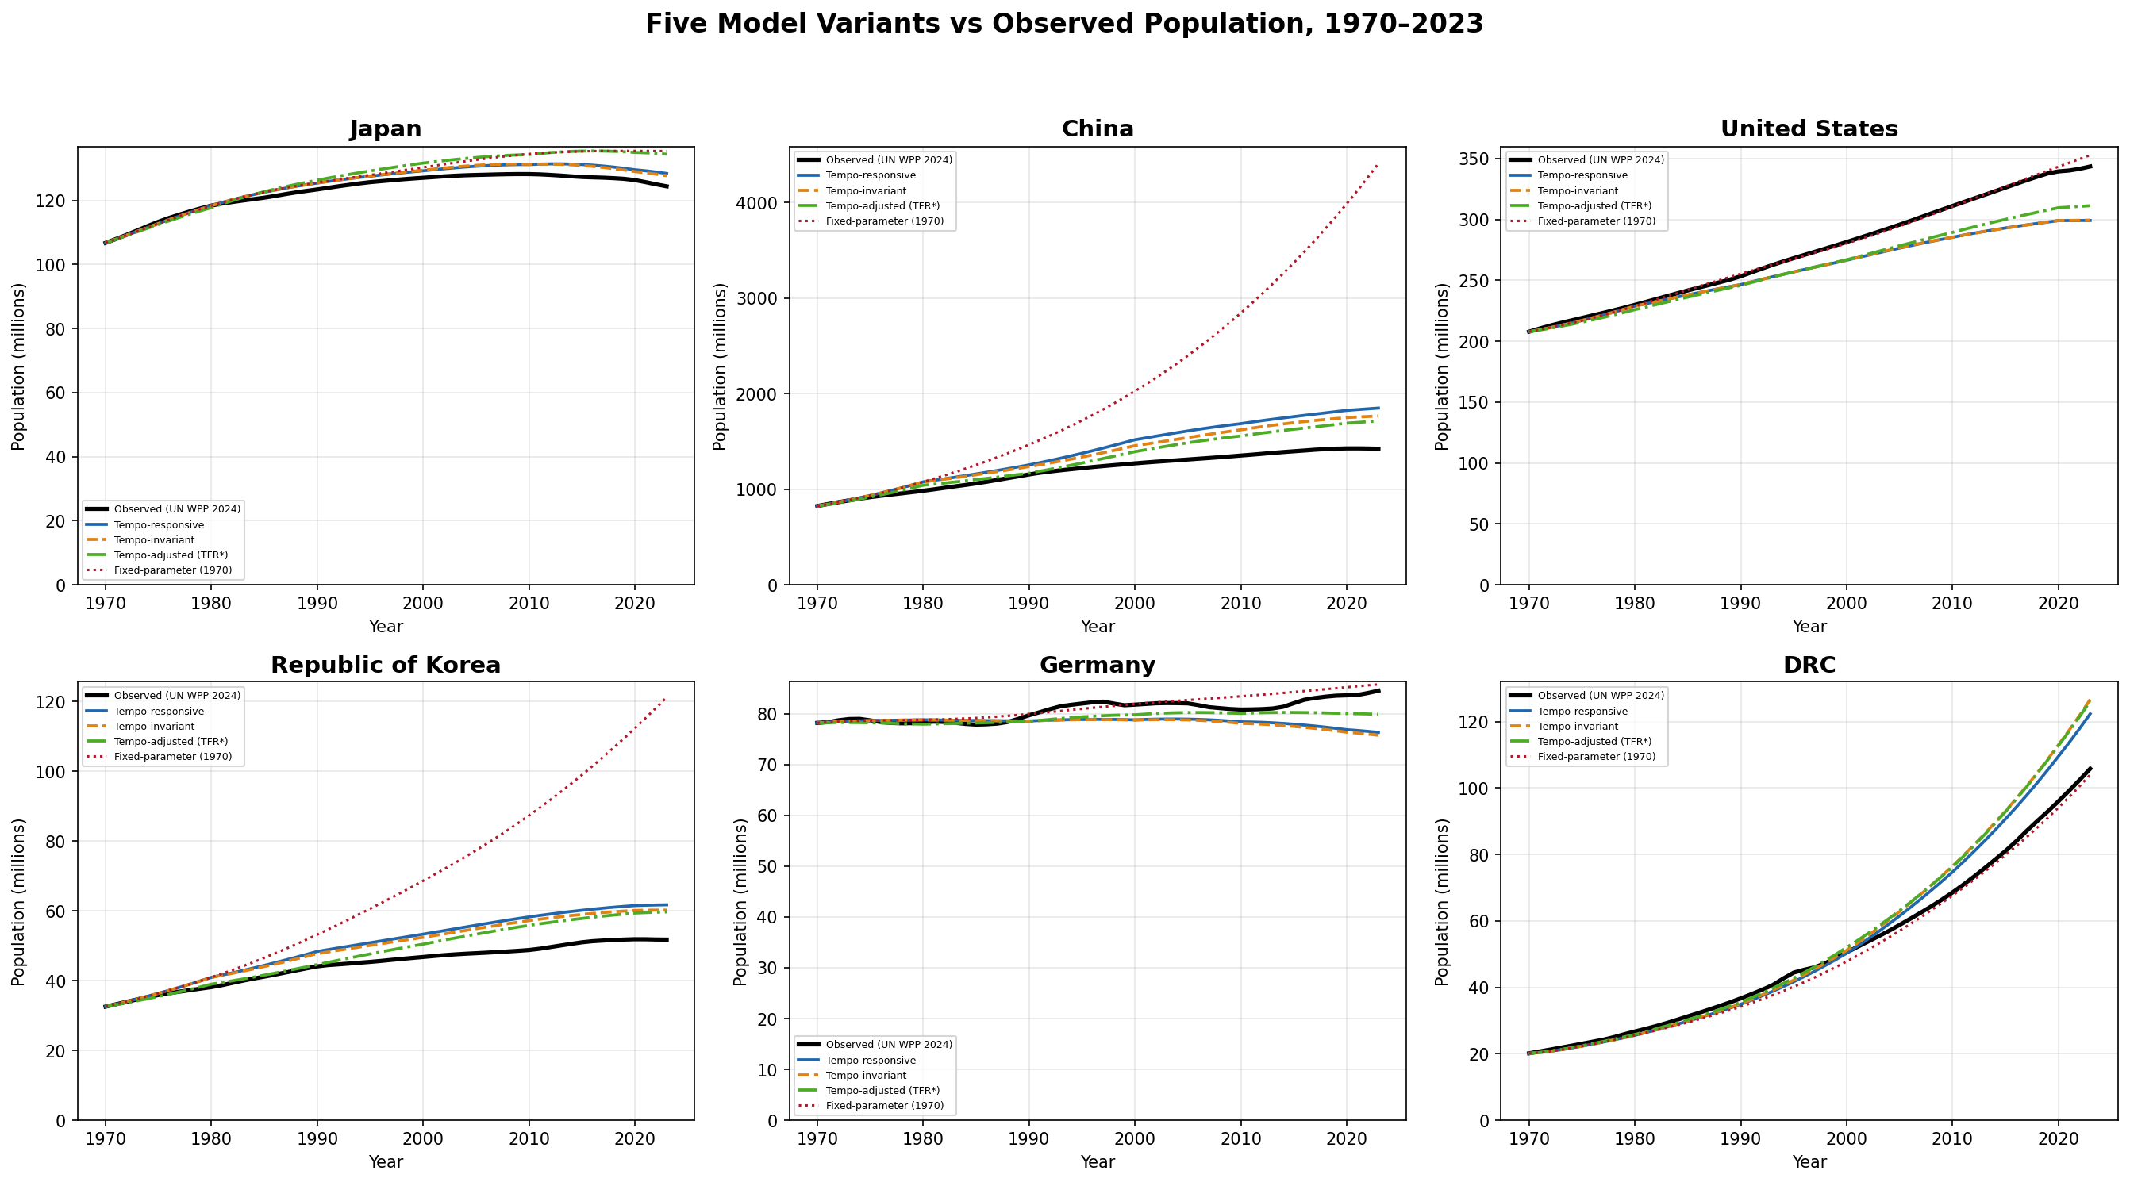
Figure 1: Five model variants versus observed population, six representative countries, 1970–2023
Observed = black solid (UN WPP 2024); Tempo-responsive = blue; Tempo-invariant = orange dashed; Tempo-adjusted (TFR*) = green dash-dot; Fixed-parameter (1970) = red dotted.

Slide 2
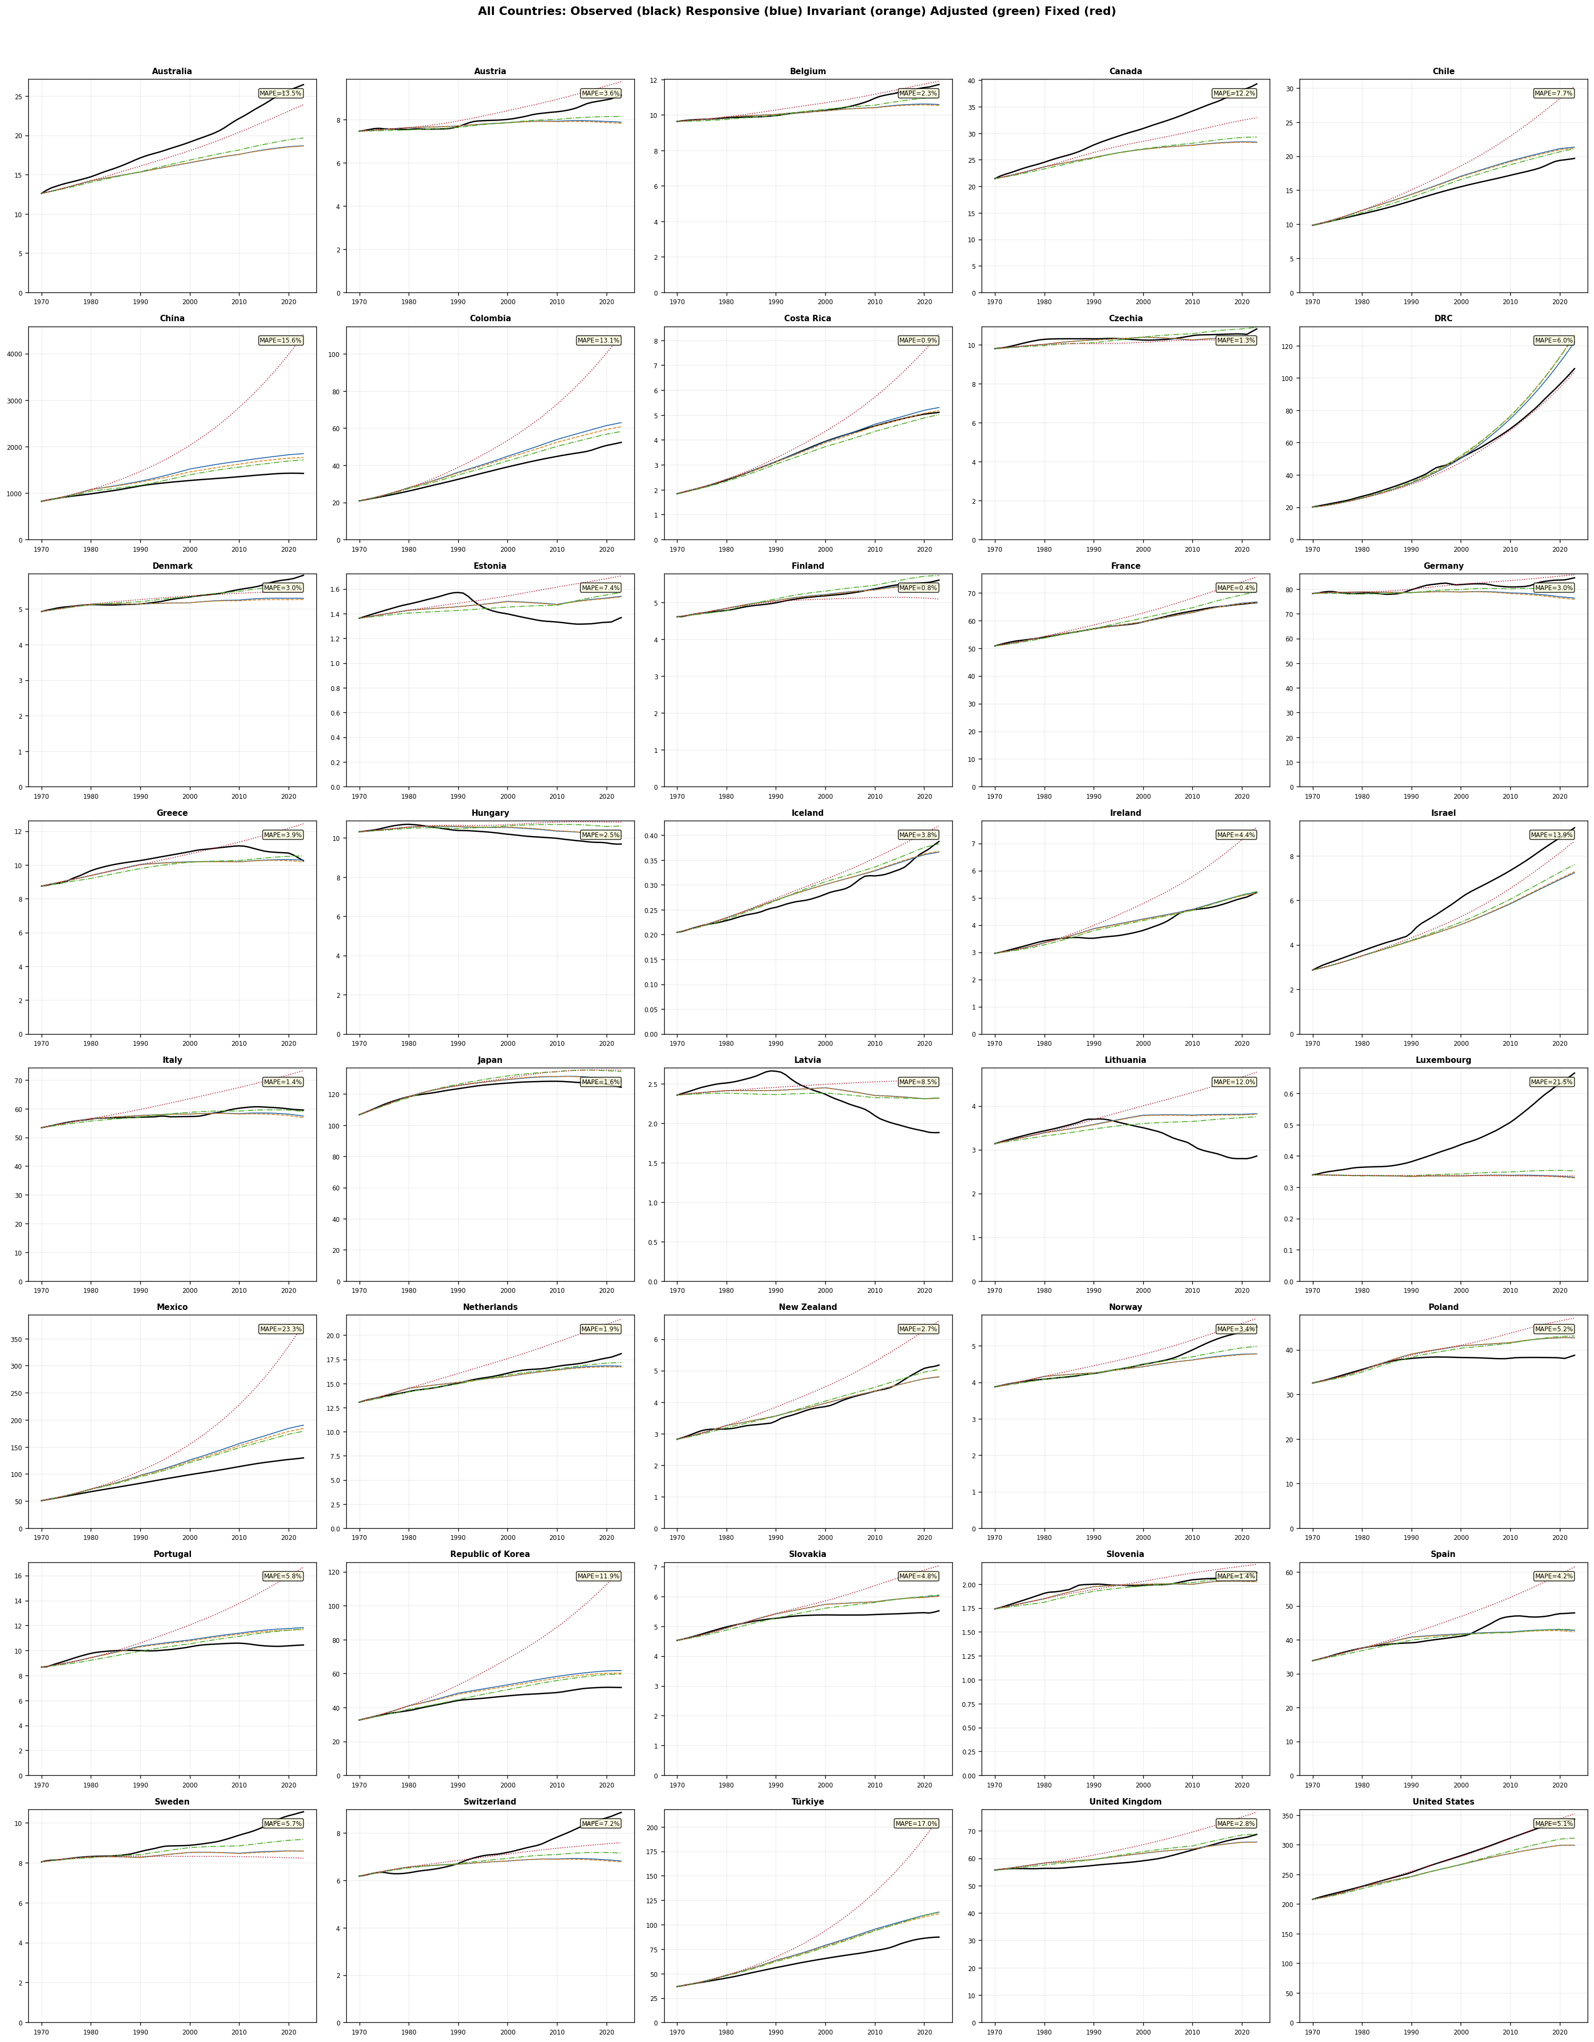
Figure 2: Five-model validation across all 40 countries
Observed = black; Responsive = blue; Invariant = orange; Adjusted (TFR*) = green; Fixed = red. MAPE shown in upper-right corner. Countries sorted alphabetically.

Slide 3
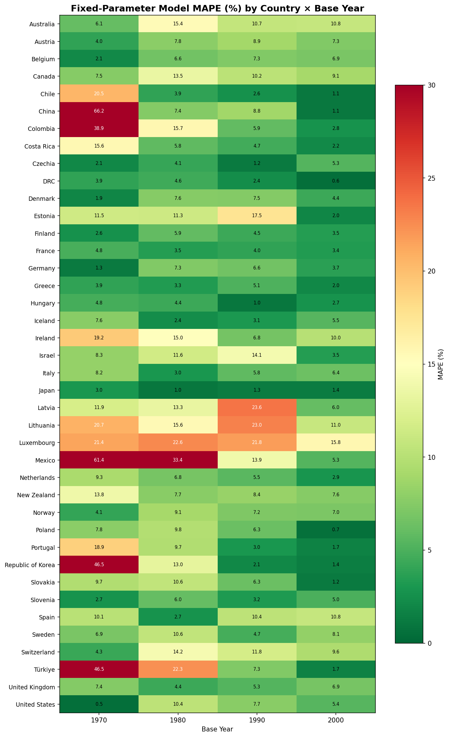
Figure 3: Fixed-parameter model MAPE (%) by country and base year
Greener cells indicate better fit; redder cells indicate poorer fit. Scale capped at 30%.

Slide 4
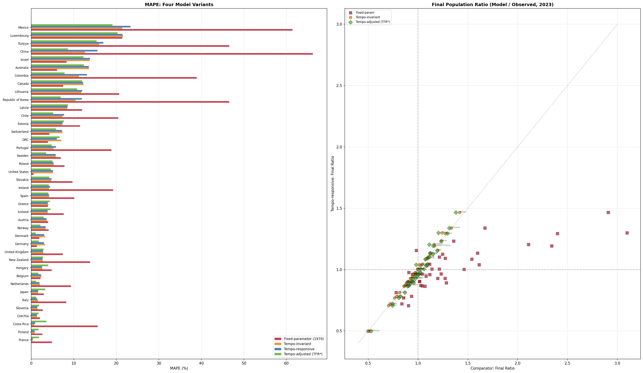
Figure 4: Four-model comparison — MAPE and final population ratio
Left: MAPE by country for fixed (red), invariant (orange), responsive (blue), adjusted TFR* (green). Right: final ratio (model/observed, 2023). TFR* achieves best overall fit.

Slide 5
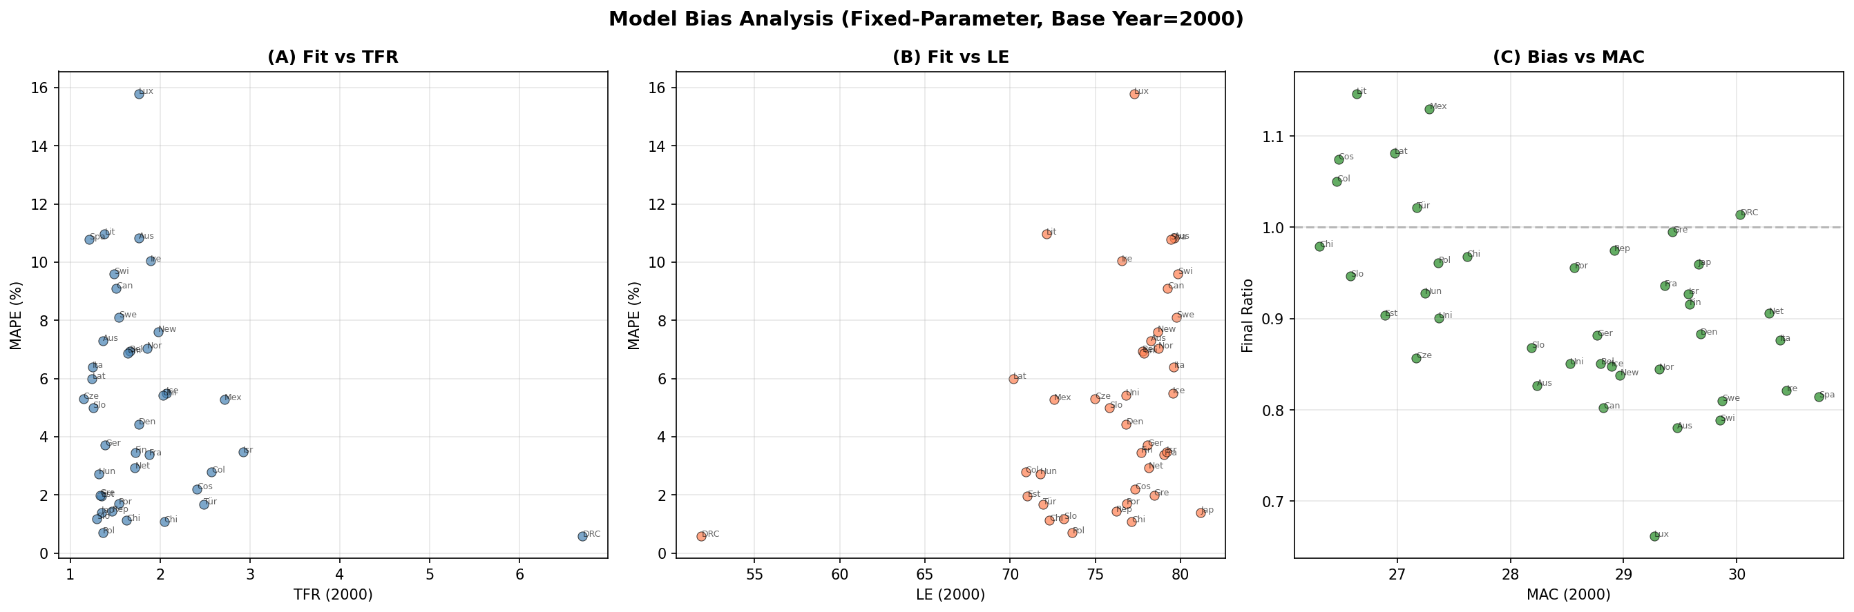
Figure 5: Model bias analysis using base year 2000
(a) Fit versus TFR; (b) fit versus life expectancy; (c) bias versus MAC. No systematic relationship observed.

