Slide 1
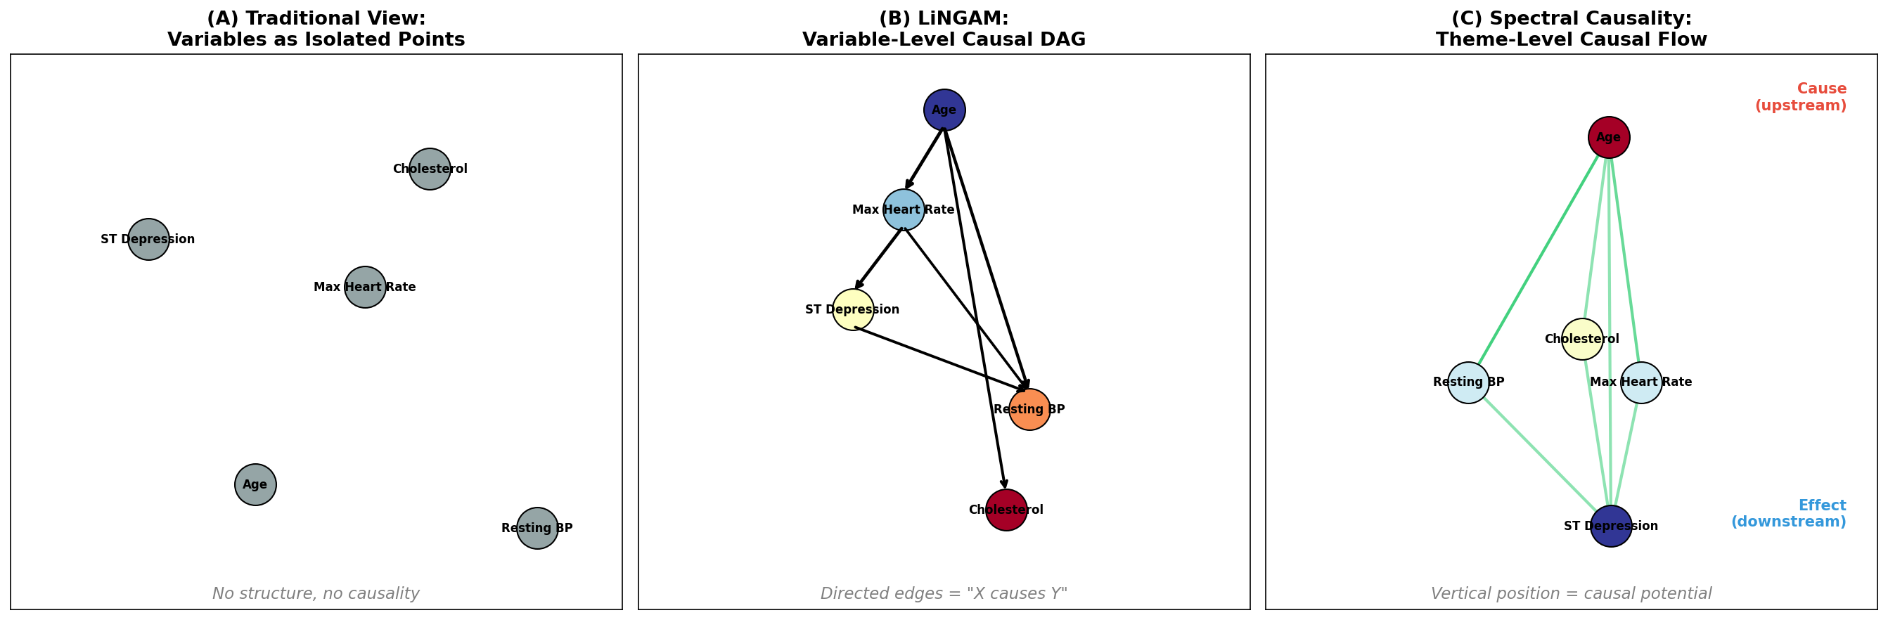
Figure 1: Three Approaches to Causal Analysis
(A) Conventional variable-level analysis, (B) LiNGAM causal DAG, (C) Spectral causality theme-level causal flow. UCI Heart Disease Data (n=297).

Slide 2
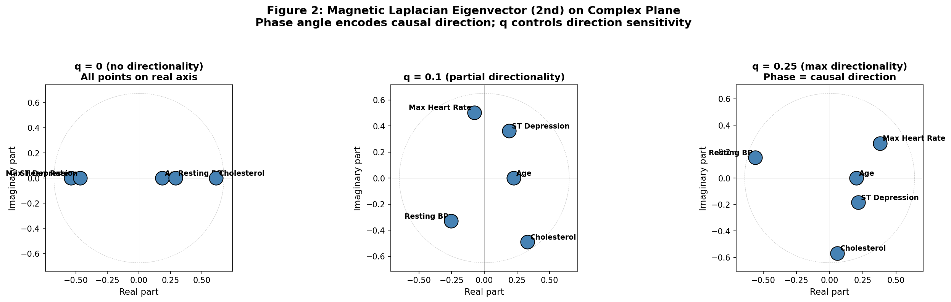
Figure 2: Magnetic Laplacian Eigenvectors
Second eigenvector of the magnetic Laplacian plotted in the complex plane for q=0, 0.1, 0.25. Phase angle order encodes causal flow direction.

Slide 3
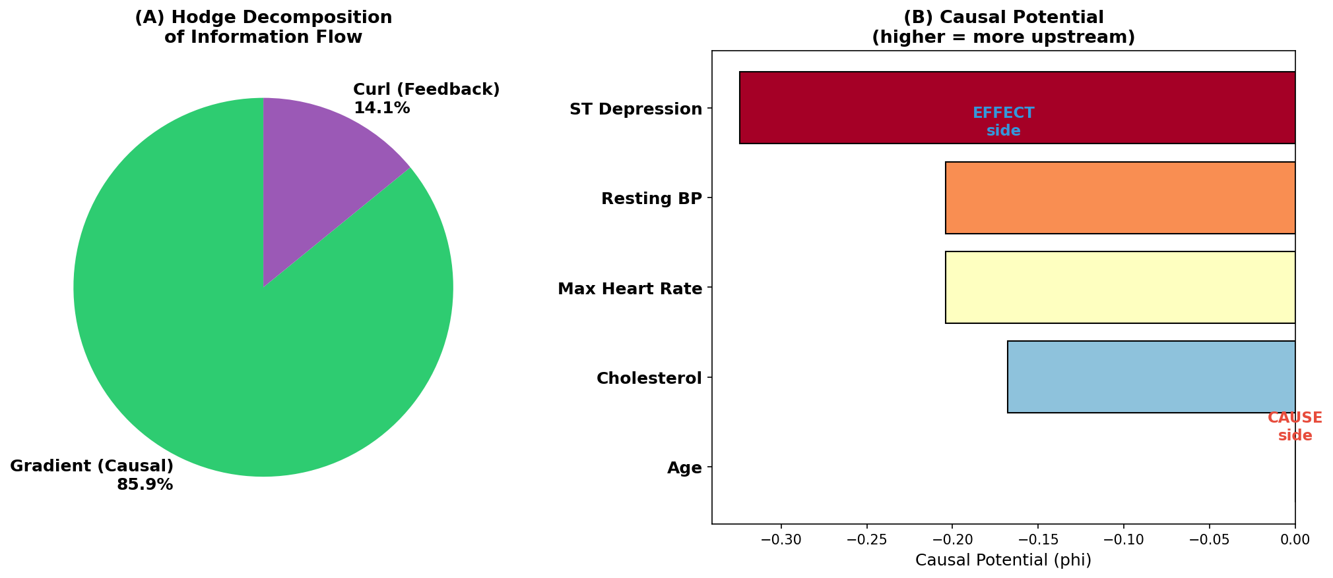
Figure 3: Hodge Decomposition
(A) Gradient (85.9%) vs curl (14.1%) energy decomposition. (B) Causal potential phi for each variable. Age=most upstream, STDep=most downstream.

Slide 4
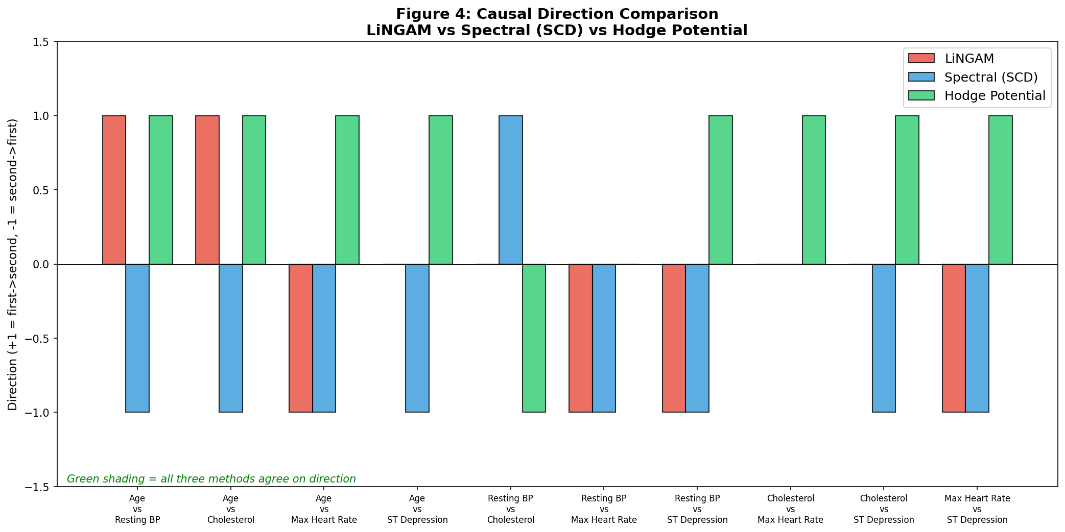
Figure 4: Causal Direction Comparison (3 Methods)
Comparison of causal directions across all 10 variable pairs. LiNGAM (red), SCD (blue), Hodge potential (green). Green background = all methods agree.

Slide 5
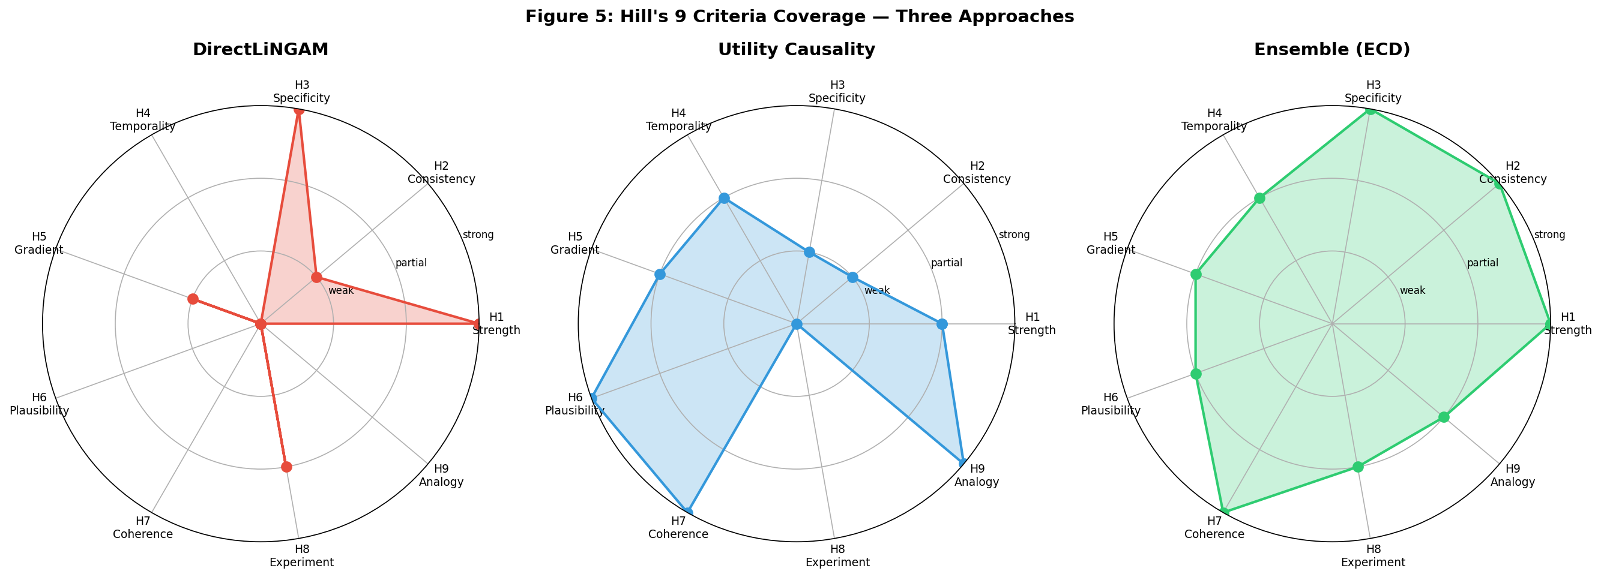
Figure 5: Hill's 9 Criteria Coverage by Method
Radar chart showing Hill's 9 criteria coverage. LiNGAM covers H1/H3, Utility Causality covers H6/H7/H9. ECD ensemble covers nearly all criteria.

Slide 6
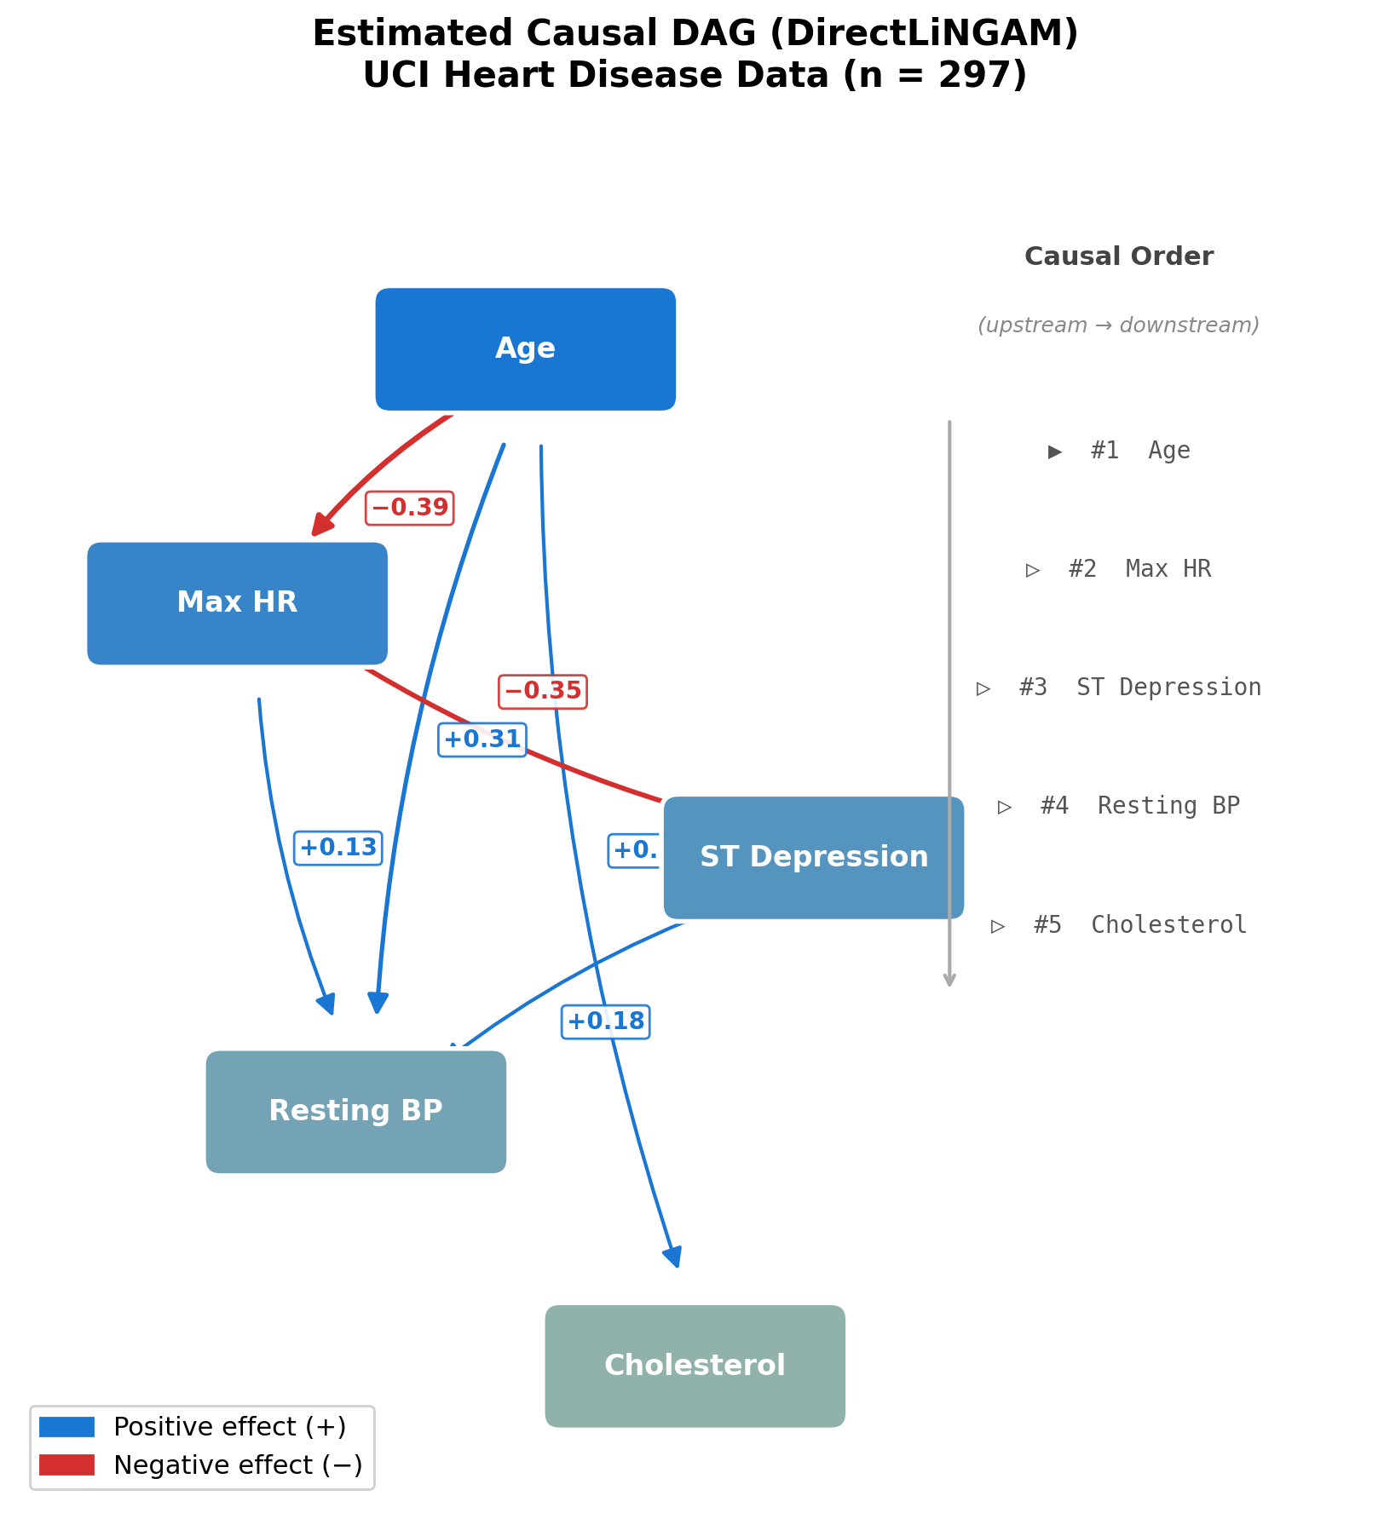
Figure 6: DirectLiNGAM Causal DAG
Estimated causal DAG by DirectLiNGAM. UCI Heart Disease (Cleveland, n=297). Blue=positive effect, red=negative effect. Edge width proportional to effect size.

Slide 7
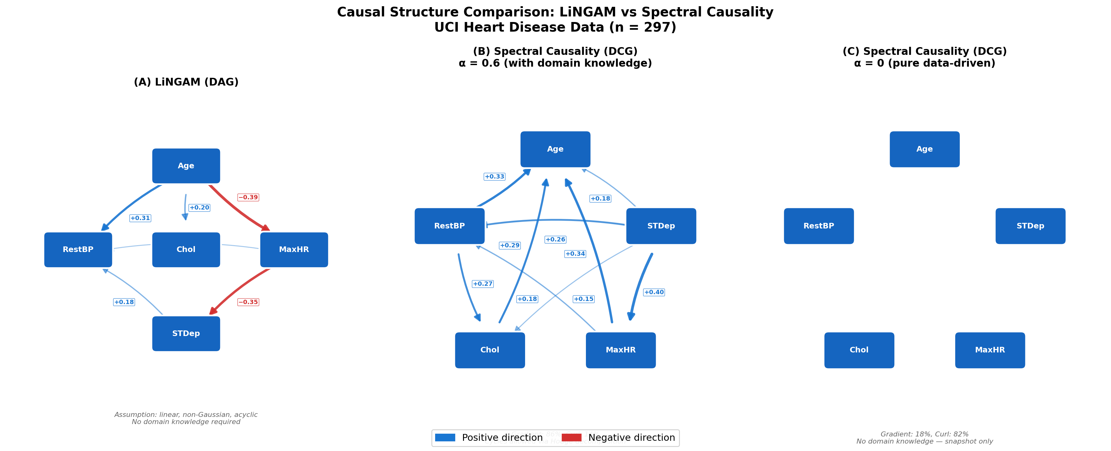
Figure 7: LiNGAM DAG vs Spectral Causality DCG
(A) LiNGAM DAG, (B) Spectral (alpha=0.6, domain knowledge), (C) Spectral (alpha=0, pure data-driven: no edges detected).

Slide 8
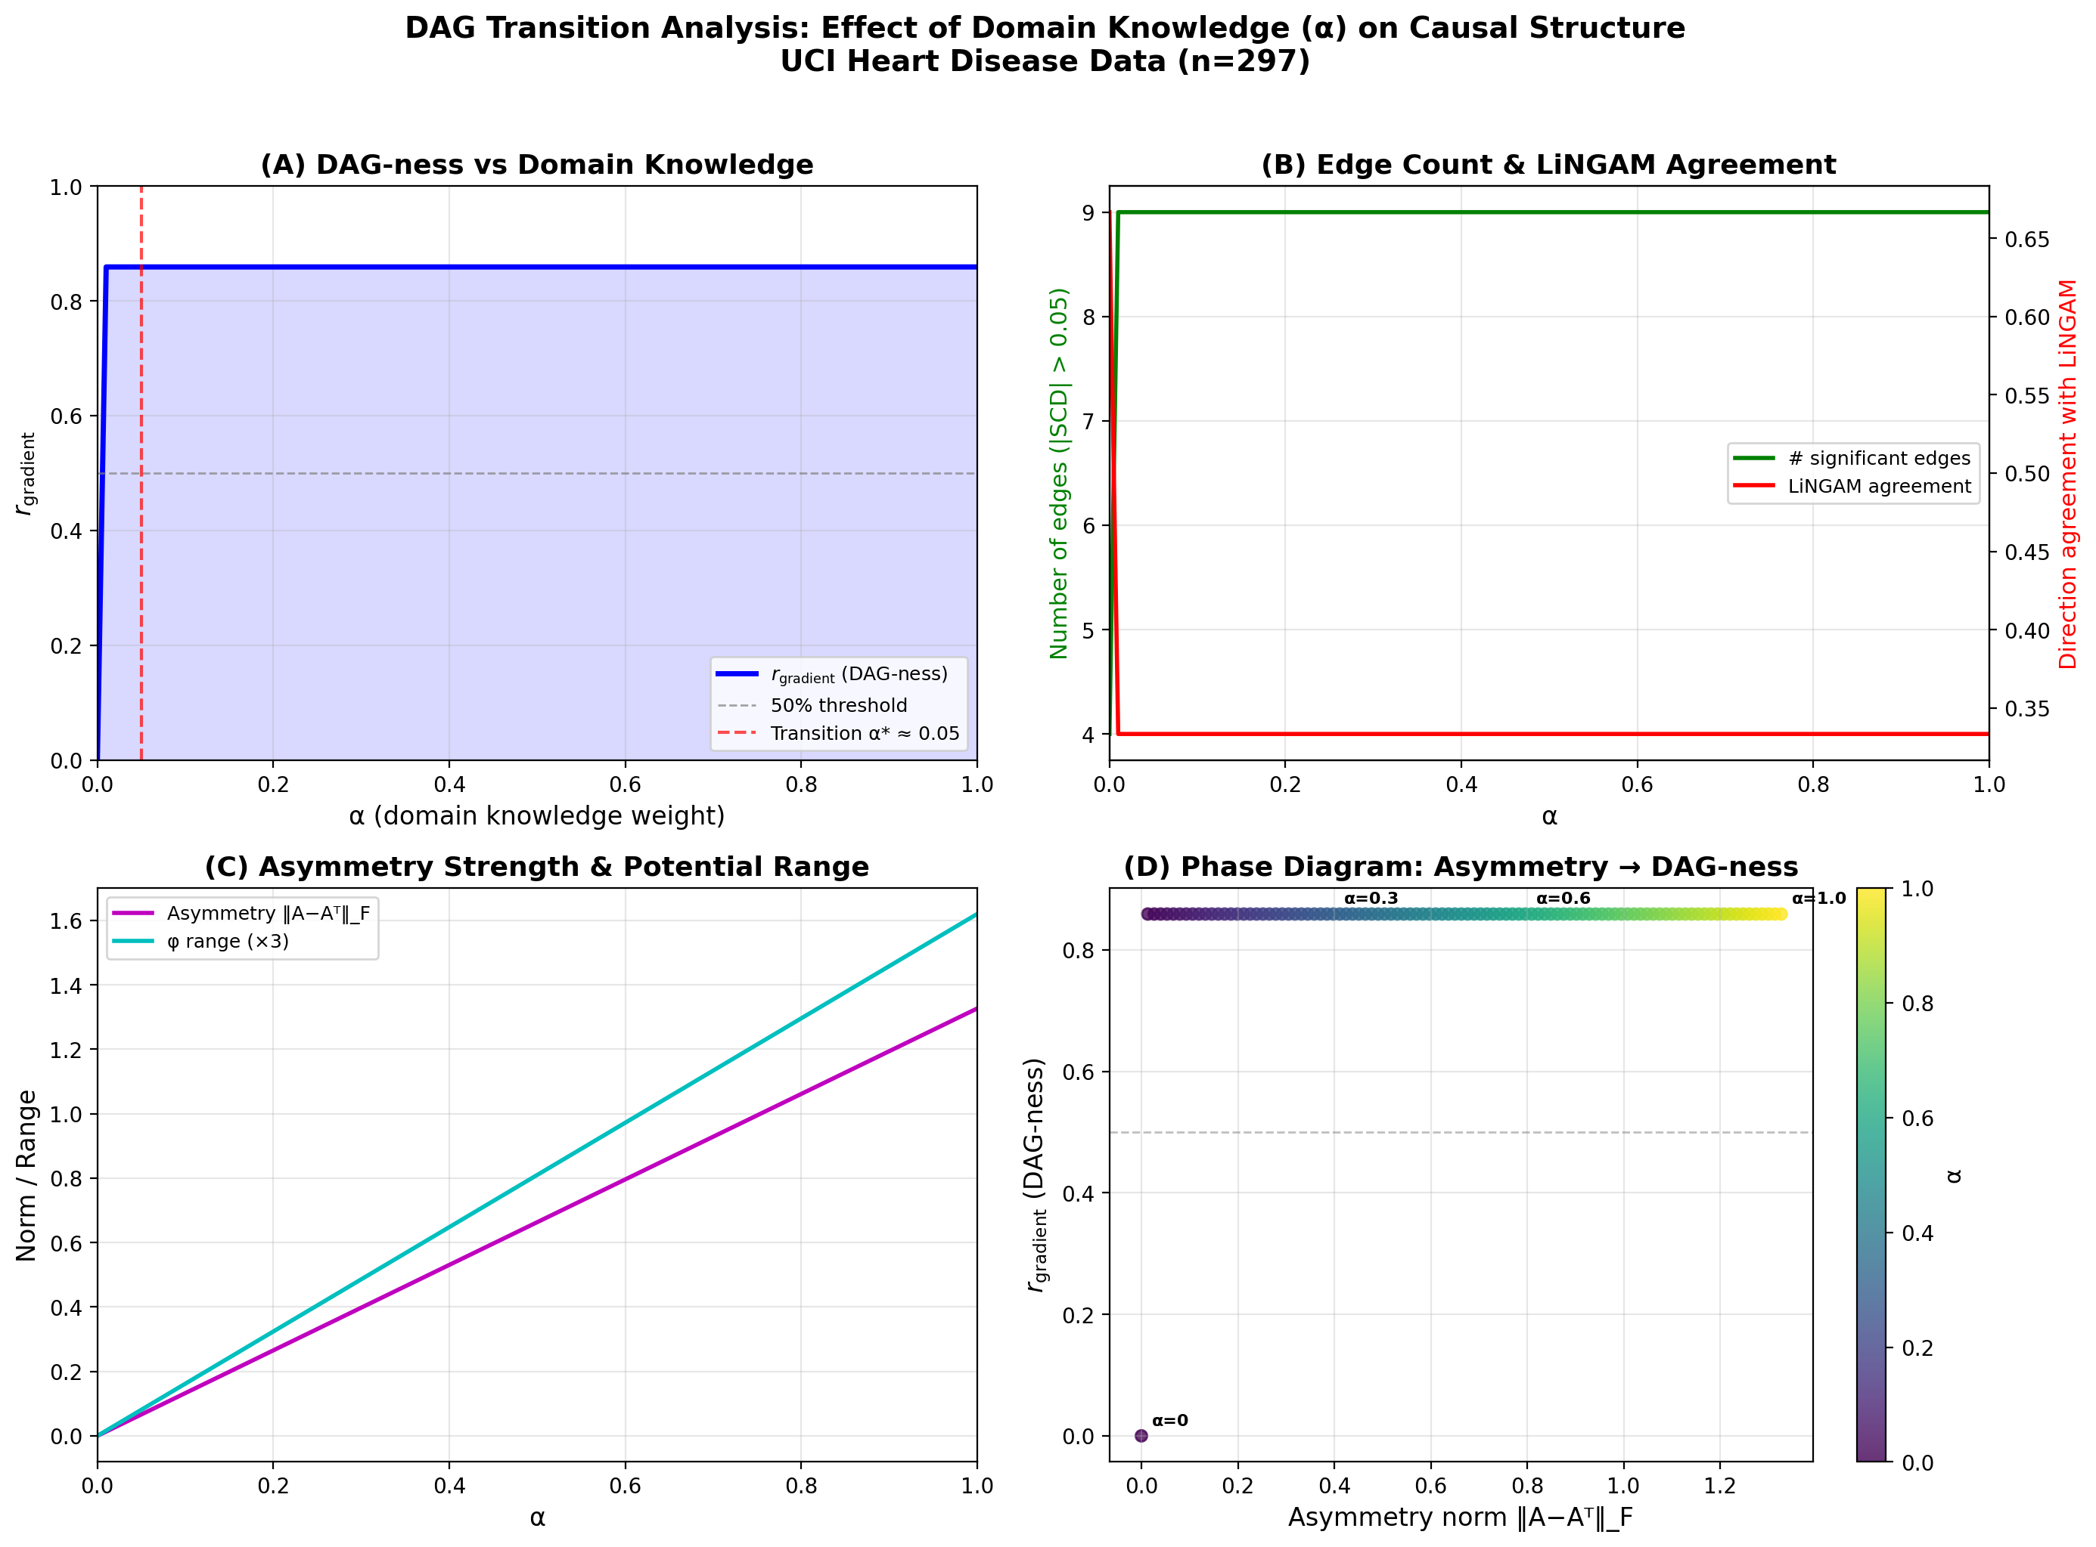
Figure 8: Alpha Sweep — DAG Transition Analysis
Gradient ratio r_gradient as a function of alpha. Discontinuous jump at alpha=0+ demonstrates that knowledge amount is irrelevant; only structure matters.

Slide 9
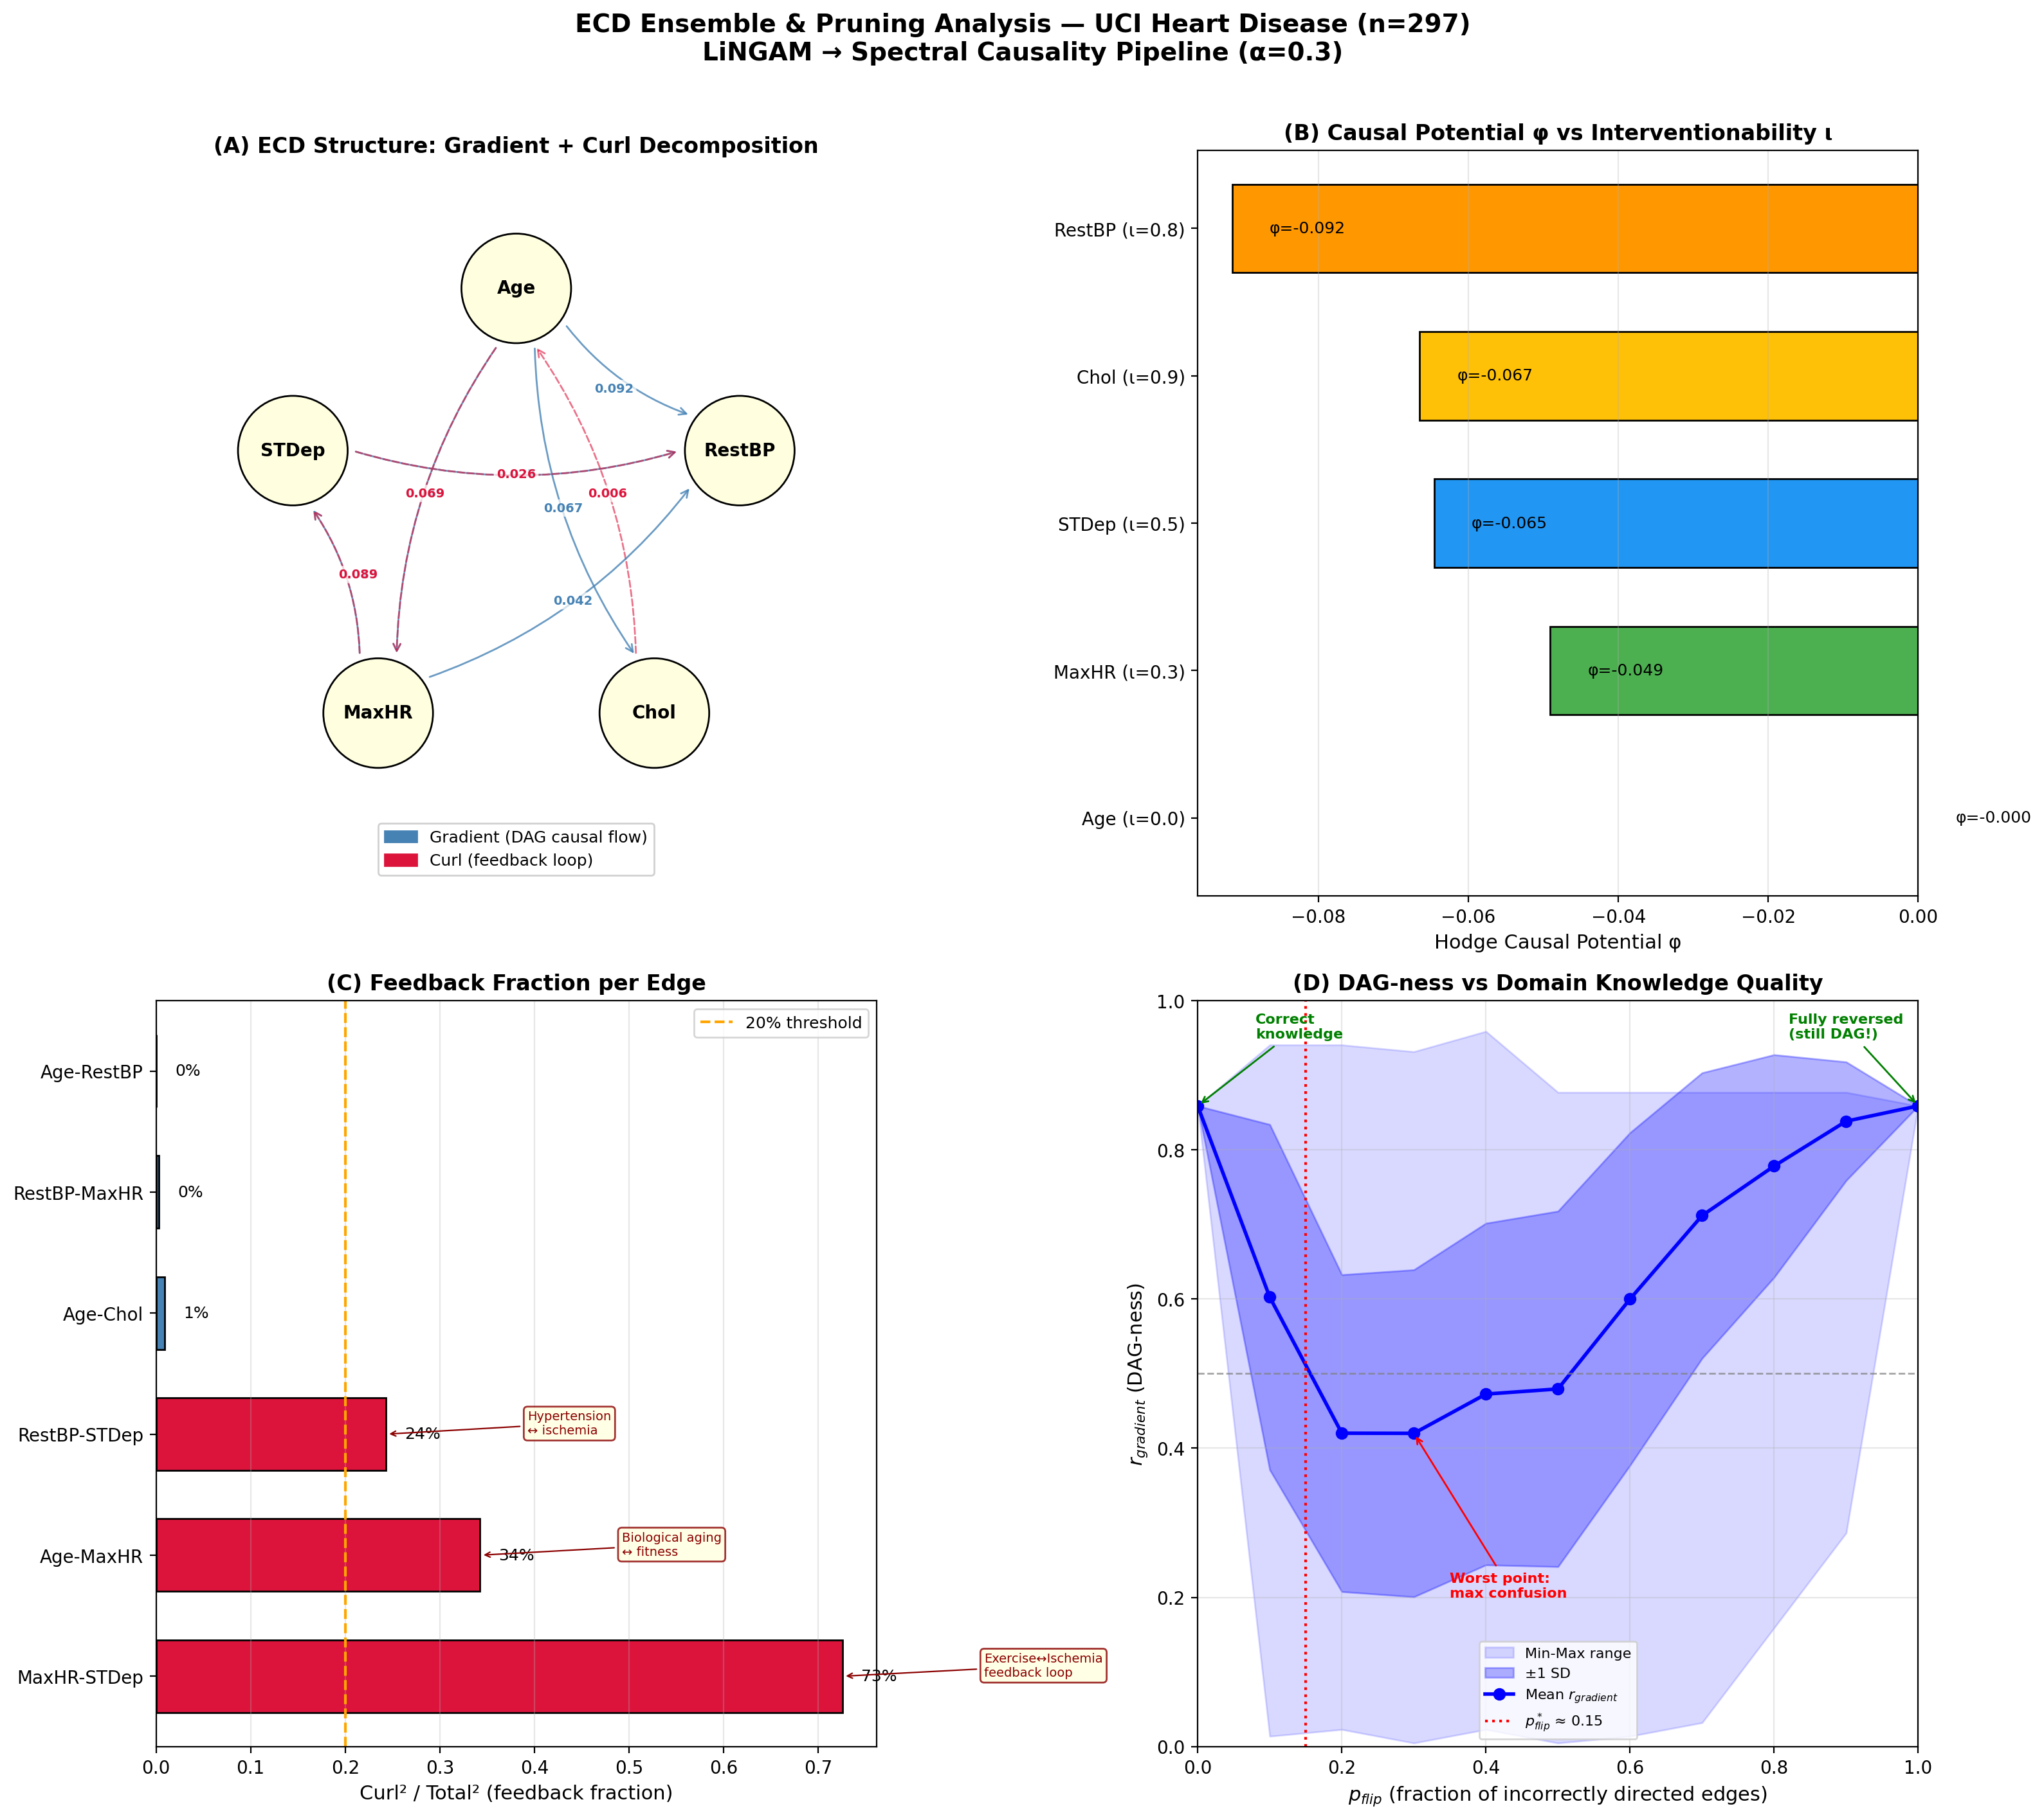
Figure 9: ECD Ensemble + Pruning Analysis
(A) Hodge gradient/curl decomposition, (B) Causal potential vs interventionability, (C) Per-edge feedback fraction, (D) DAG-ness vs knowledge quality (U-shaped curve, p_flip*≈0.15).

