Slide 1
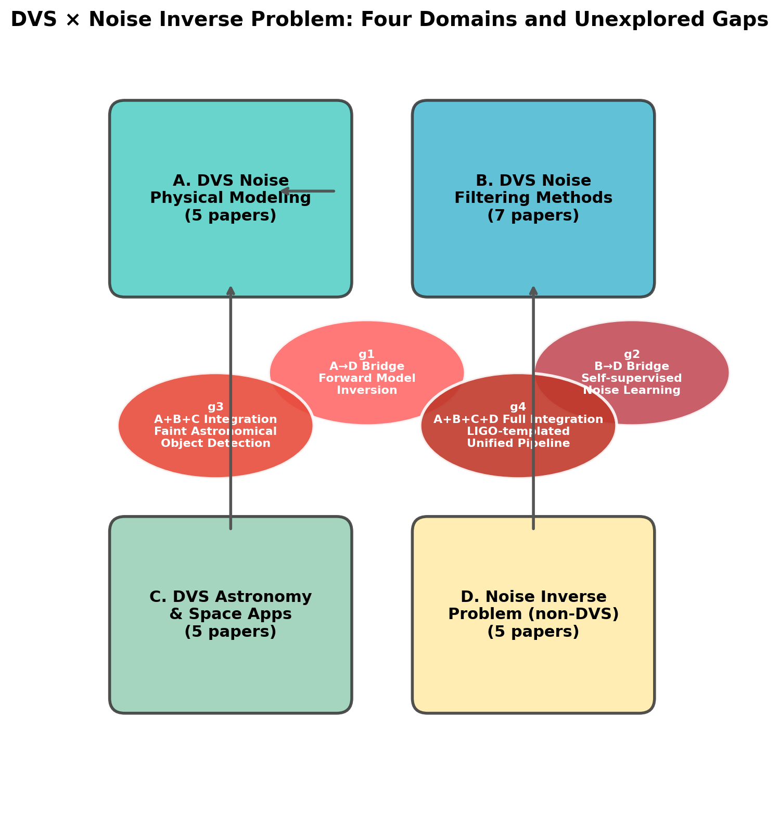
Fig. 1: DVS × Noise Inverse Problem — Four Research Domains and Unexplored Gaps
Prior work categorized into four domains (A: DVS noise physical modeling, B: DVS noise filtering, C: DVS astronomical applications, D: Noise inverse problem in non-DVS fields). Four unexplored gaps (g1–g4) identified at domain intersections. g4 represents the most ambitious fully integrated approach.

Slide 2
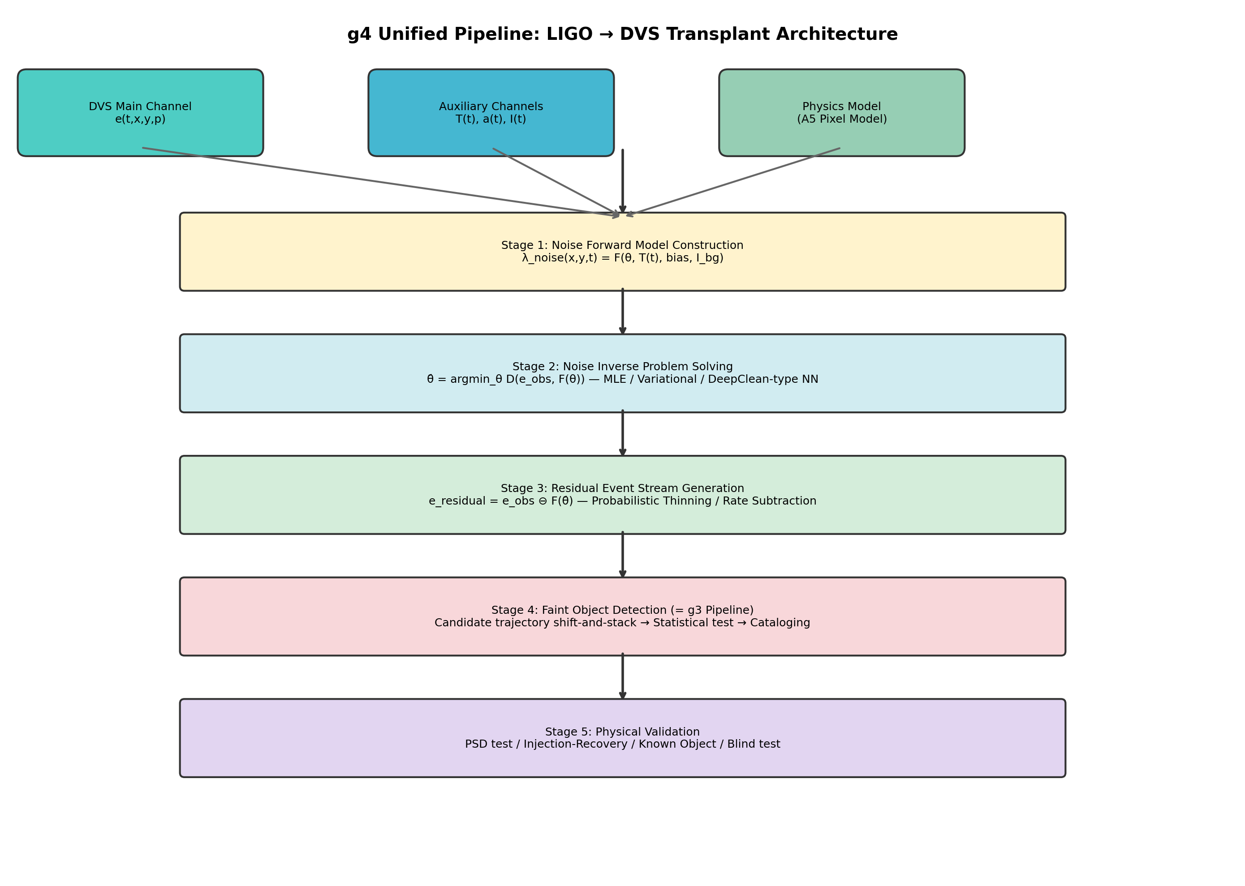
Fig. 2: g4 Unified Pipeline — LIGO → DVS Transplant Architecture
Five-stage architecture transplanting the LIGO noise reconstruction pipeline (Vajente et al. 2020) to DVS astronomical observation. Inputs: DVS main channel, auxiliary sensors (temperature, vibration, illuminance), and physics-based pixel model (A5). Pipeline: noise forward model → inverse problem solving → residual generation → faint object detection → physical validation.

