Slide 1
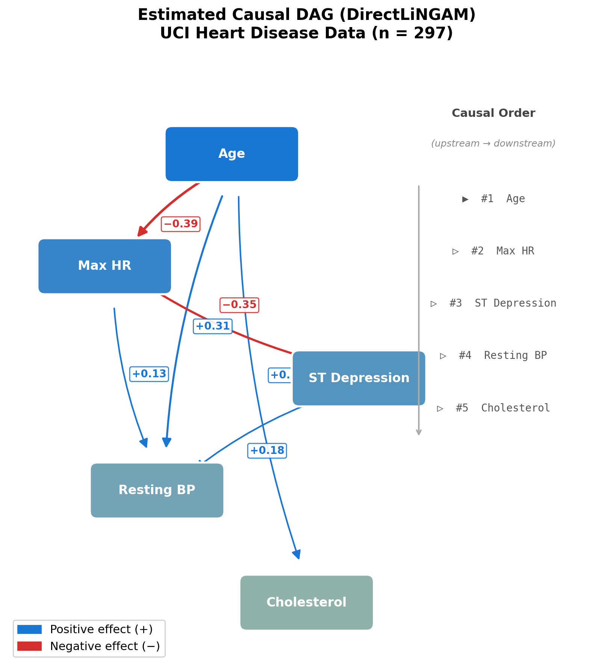
Figure 1: Estimated Causal DAG (DirectLiNGAM)
Arrow weight indicates estimated causal effect size |B_ij|.

Slide 2
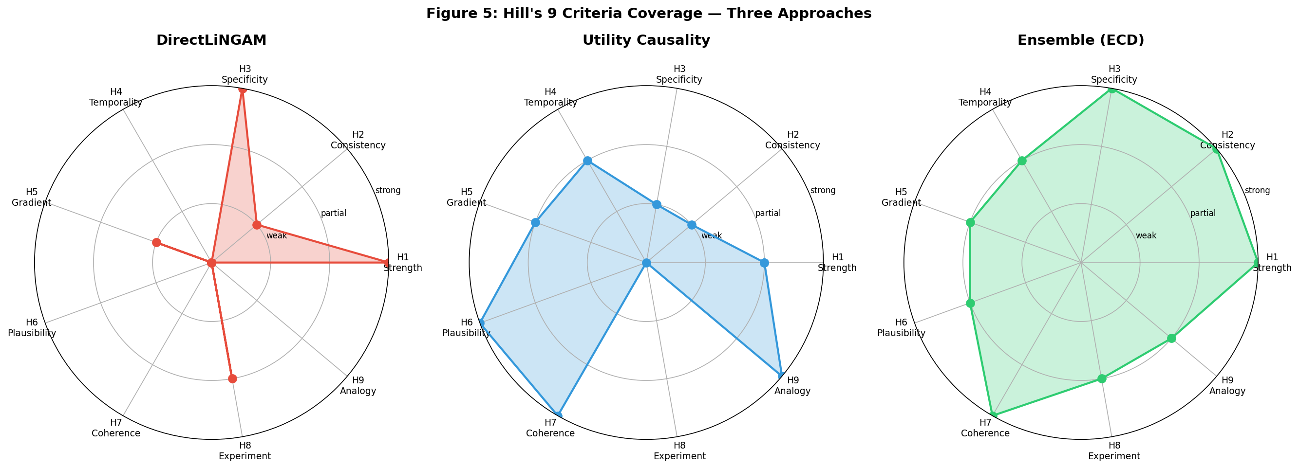
Figure 2: Hill's Nine Criteria Coverage
ECD (purple) achieves broader coverage than any single method.

Slide 3
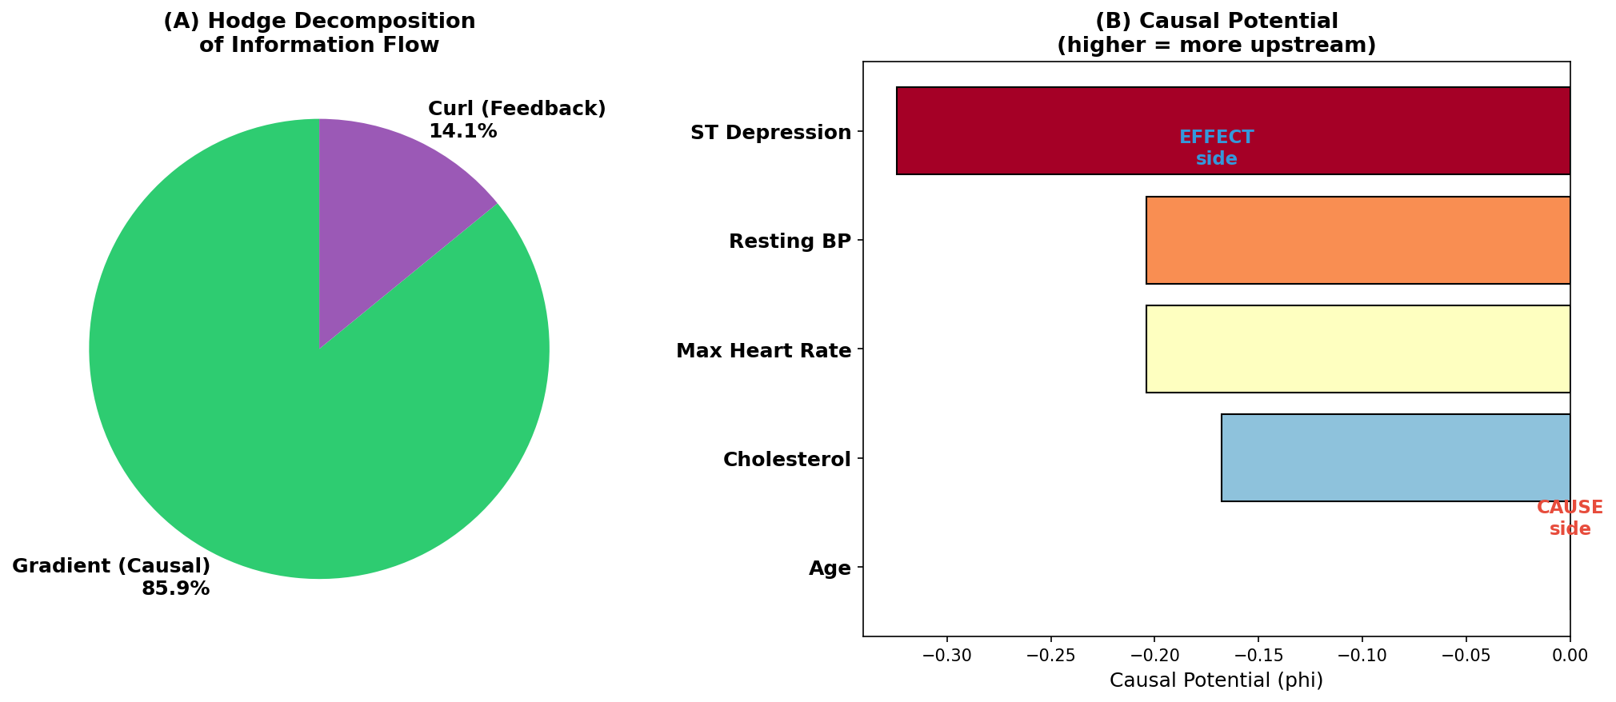
Figure 3: Hodge Decomposition of Causal Flows
Left: gradient (DAG). Middle: curl (feedback). Right: combined.

Slide 4
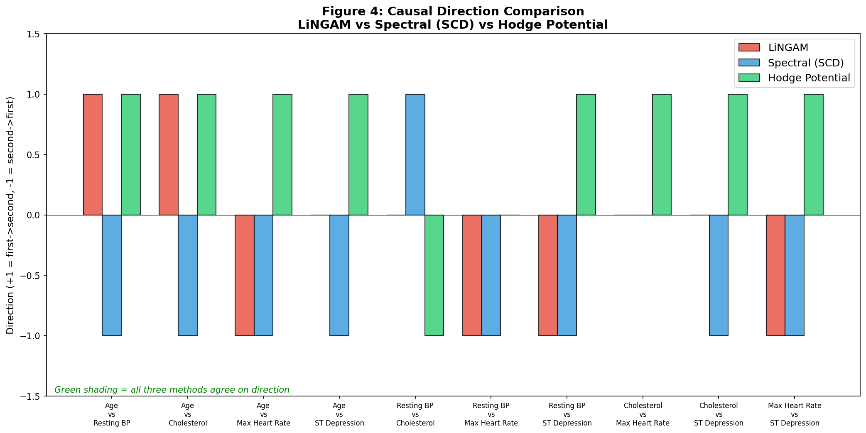
Figure 4: Three-Method Direction Comparison
Green = agreement, Red = disagreement between methods.

Slide 5
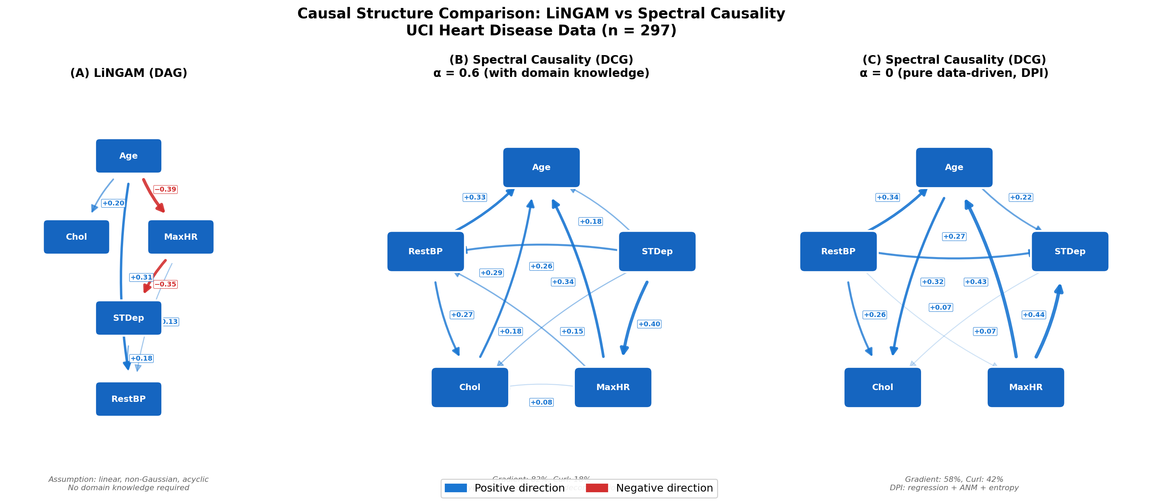
Figure 5: LiNGAM DAG vs. Spectral Causality DCG
Dashed lines indicate feedback edges absent in the DAG.

Slide 6
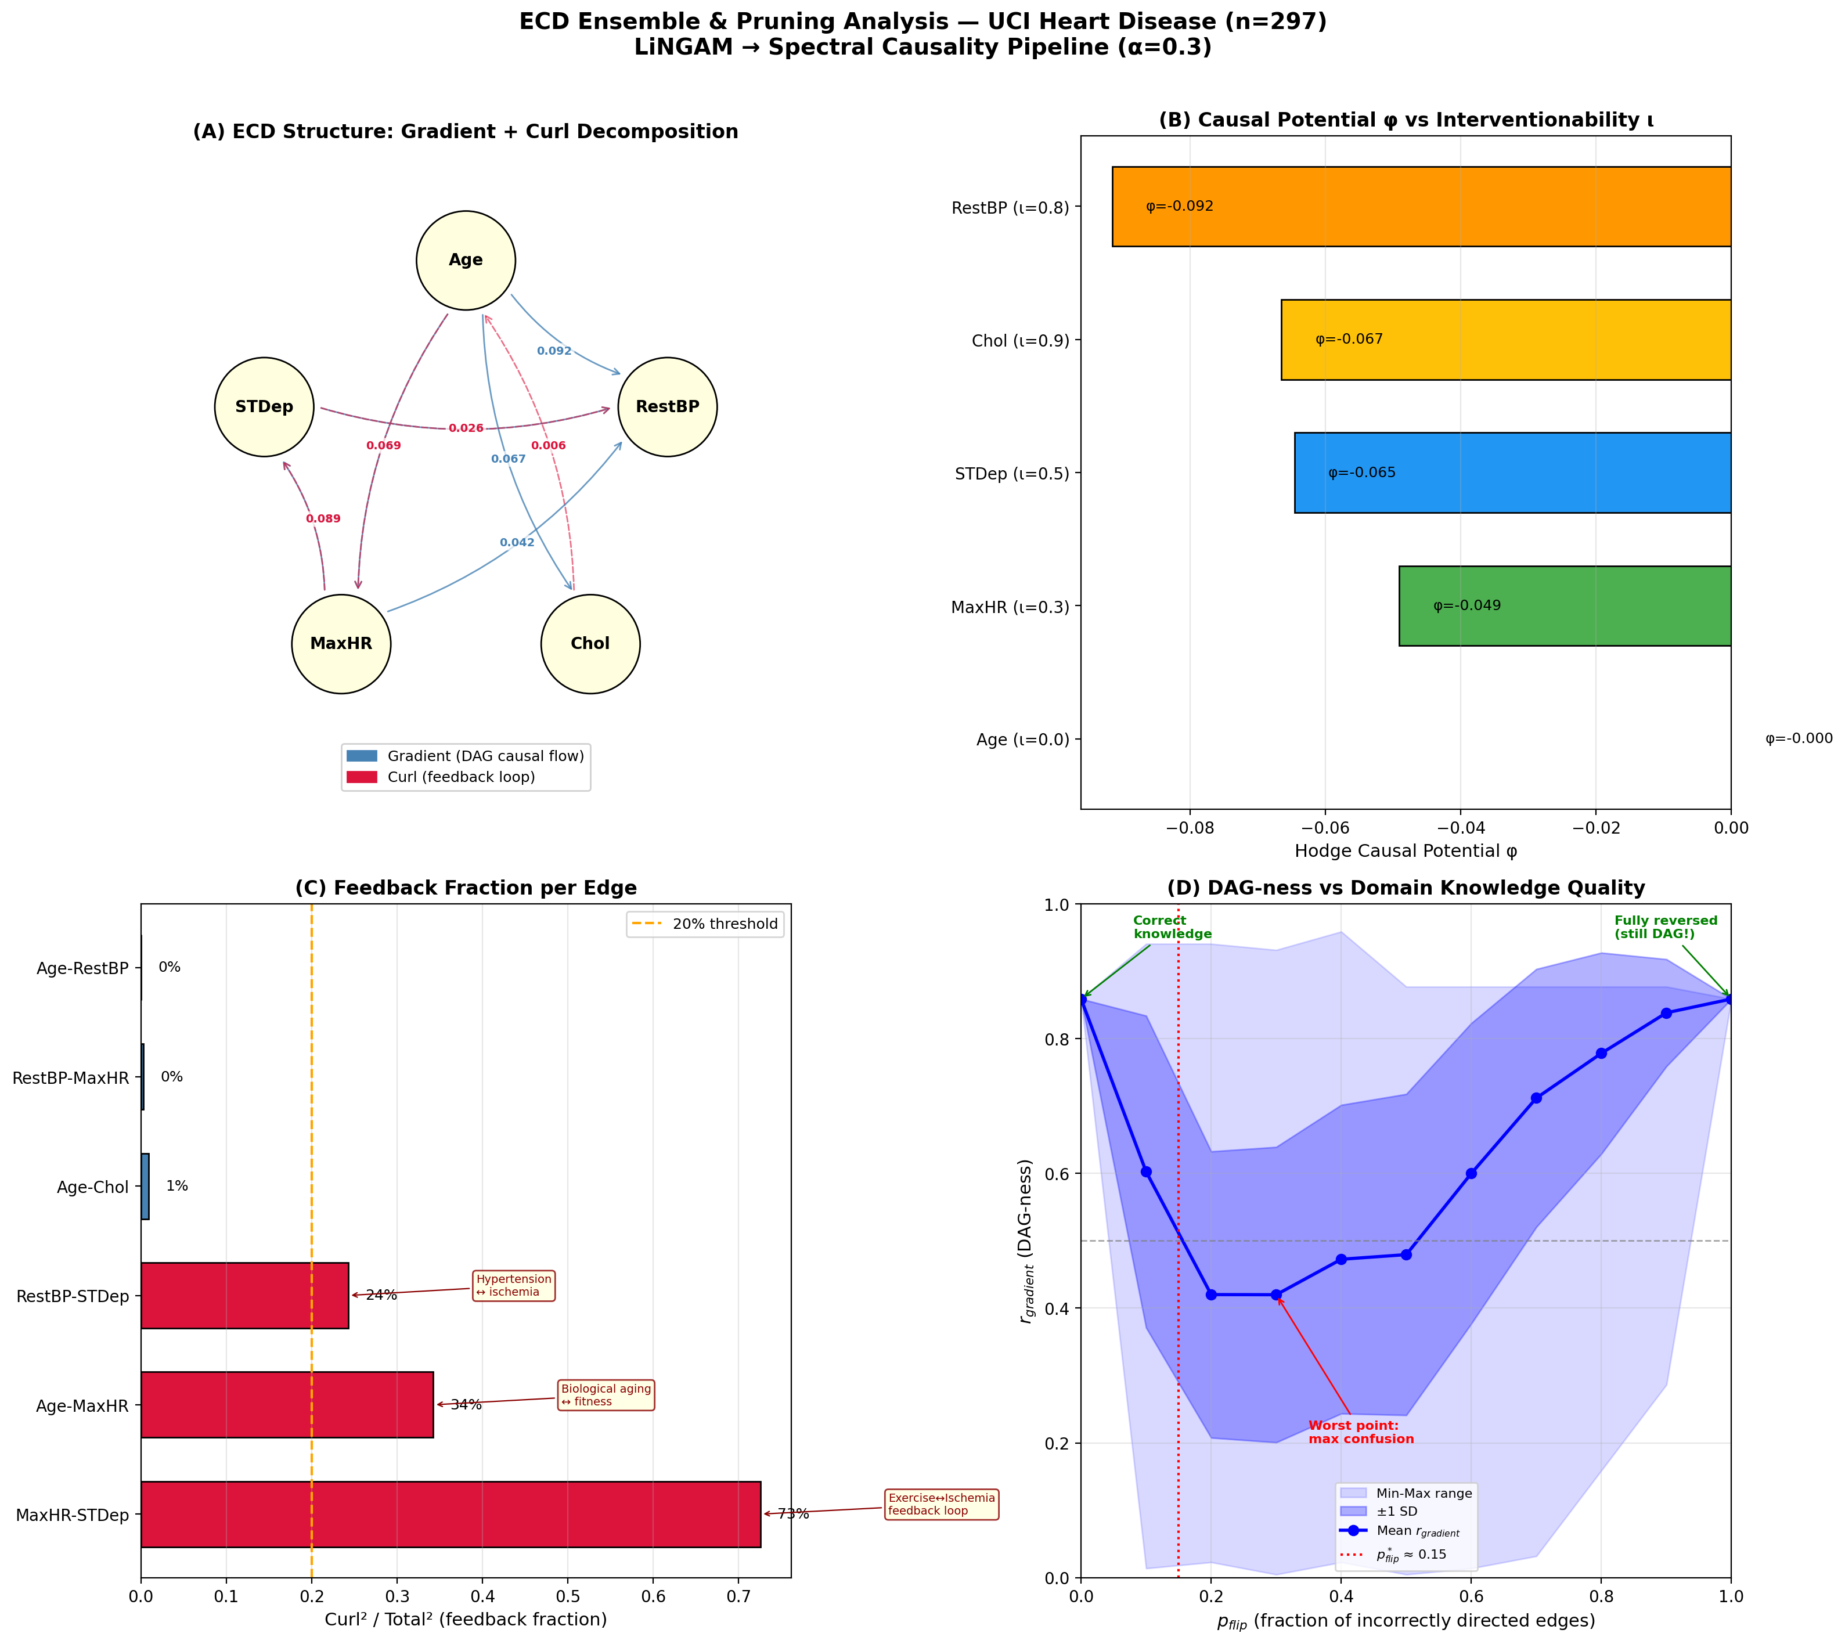
Figure 6: ECD Ensemble & Pruning Analysis
Edge-level feedback rates and bootstrap confidence intervals.

Slide 7
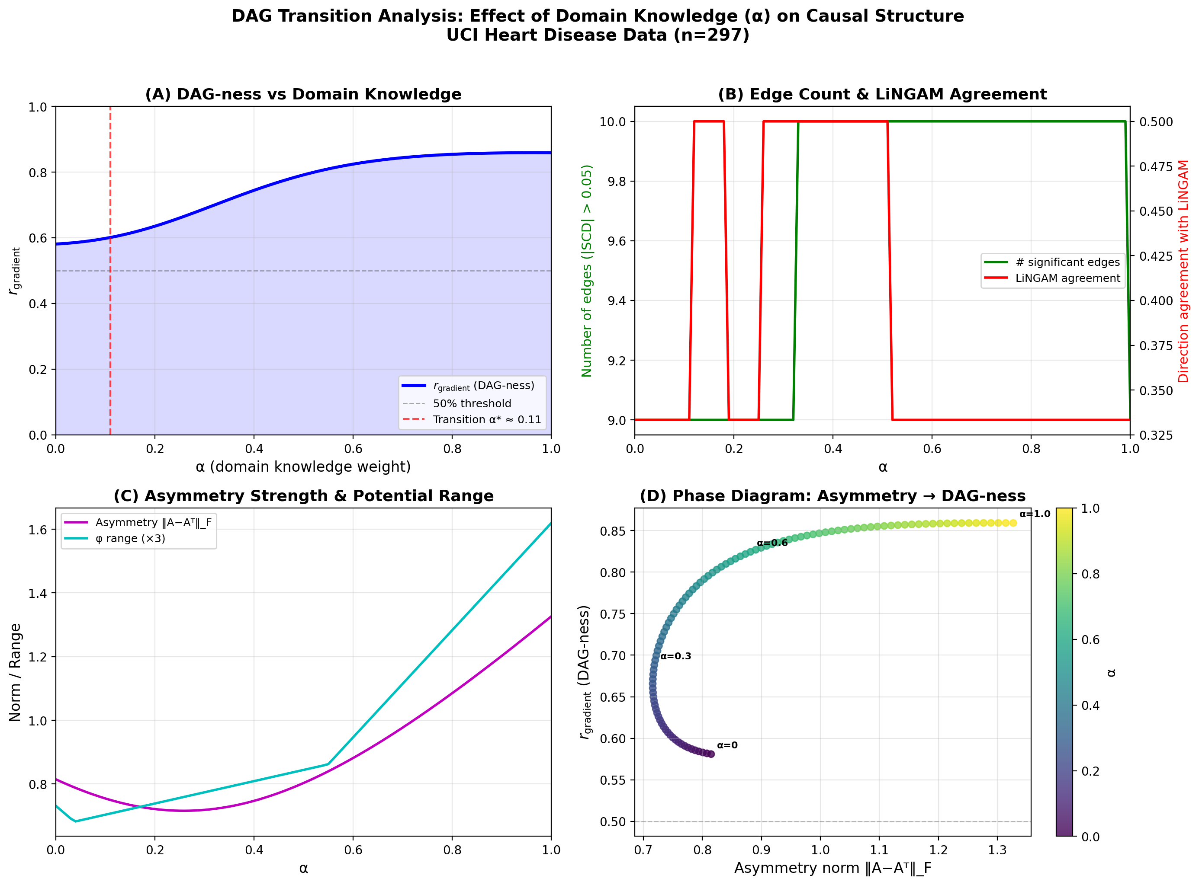
Figure 7: DAG Transition Analysis
(A) r_gradient vs alpha. (B) Edge count and LiNGAM agreement.

