Slide 1
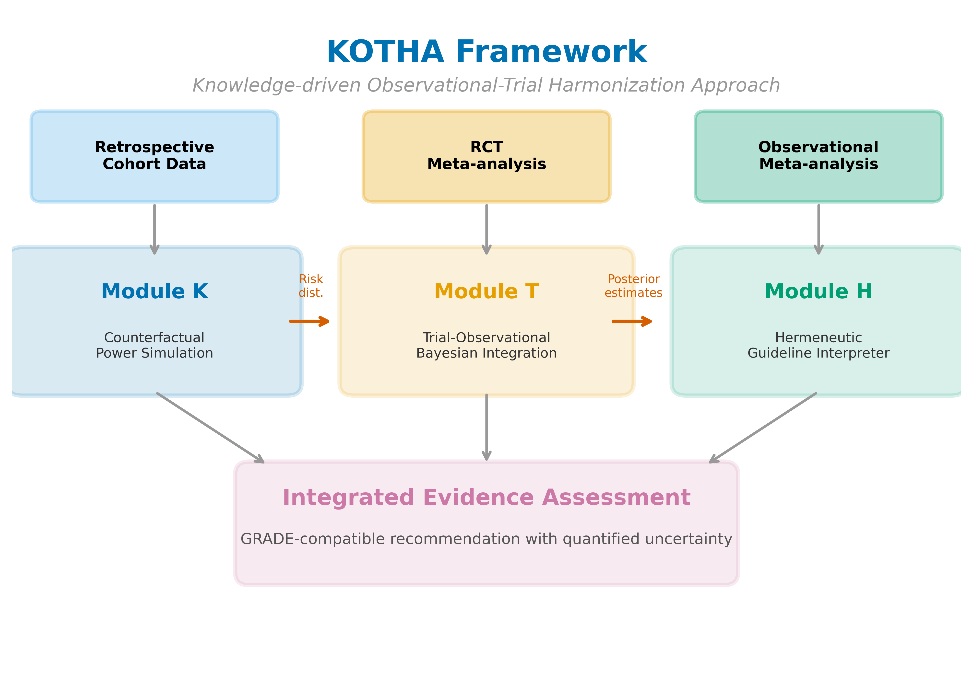
Figure 1
Figure 1. Overview of the KOTHA Framework. Module K (Counterfactual Power Simulation) quantifies risk-profile shift and estimates power under counterfactual enrollment scenarios. Module T (Bayesian Evidence Integration) combines RCT and observational evidence using power-prior discounting. Module H (Guideline Interpreter) synthesizes outputs into a structured GRADE-compatible assessment.

Slide 2
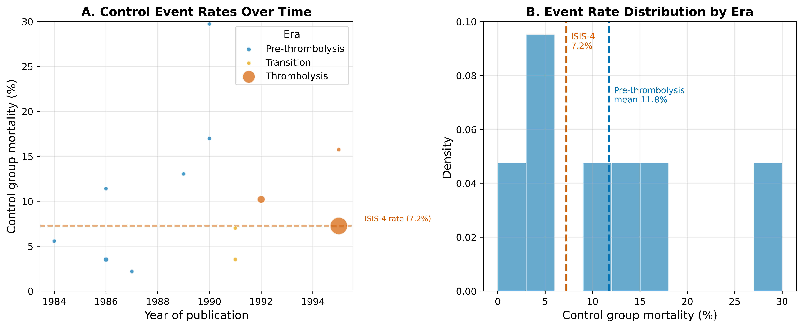
Figure 2
Figure 2. Risk-profile shift in the magnesium-in-AMI case. (A) Control-group mortality rates over time, with bubble size proportional to study sample size and colors indicating era. (B) Weighted mean control mortality by era.

Slide 3
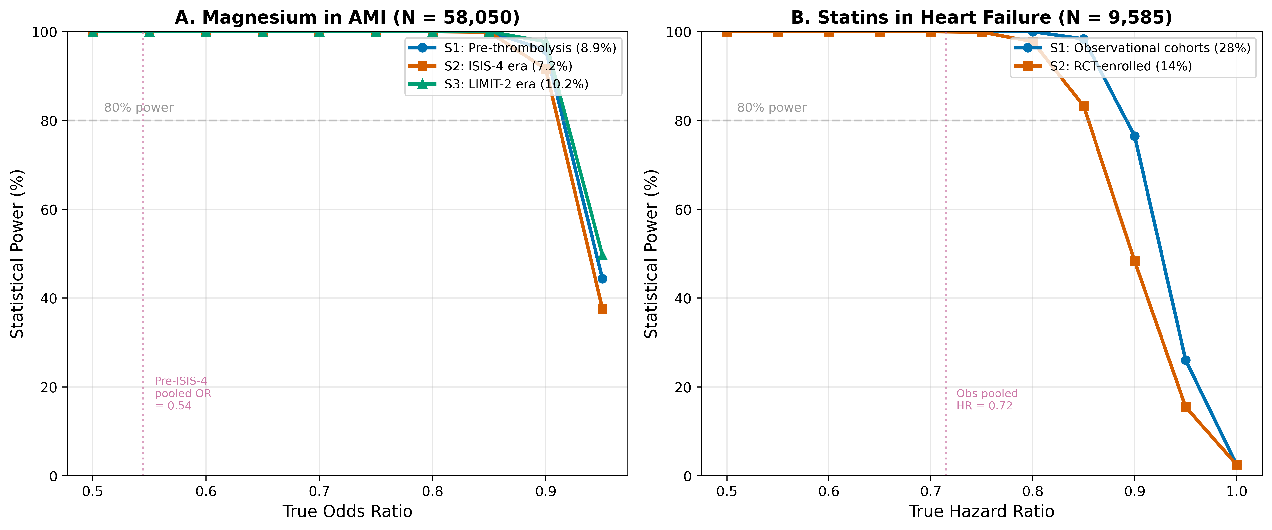
Figure 3
Figure 3. Estimated power by enrollment scenario and true effect size. (A) Magnesium in AMI at the ISIS-4 sample size (N = 58,050). (B) Statins in HF at the combined RCT sample size (N = 9,585). S1 = real-world/observational event rate; S2 = RCT event rate; S3 = intermediate/enriched rate. Horizontal dashed lines indicate 80% power.

Slide 4
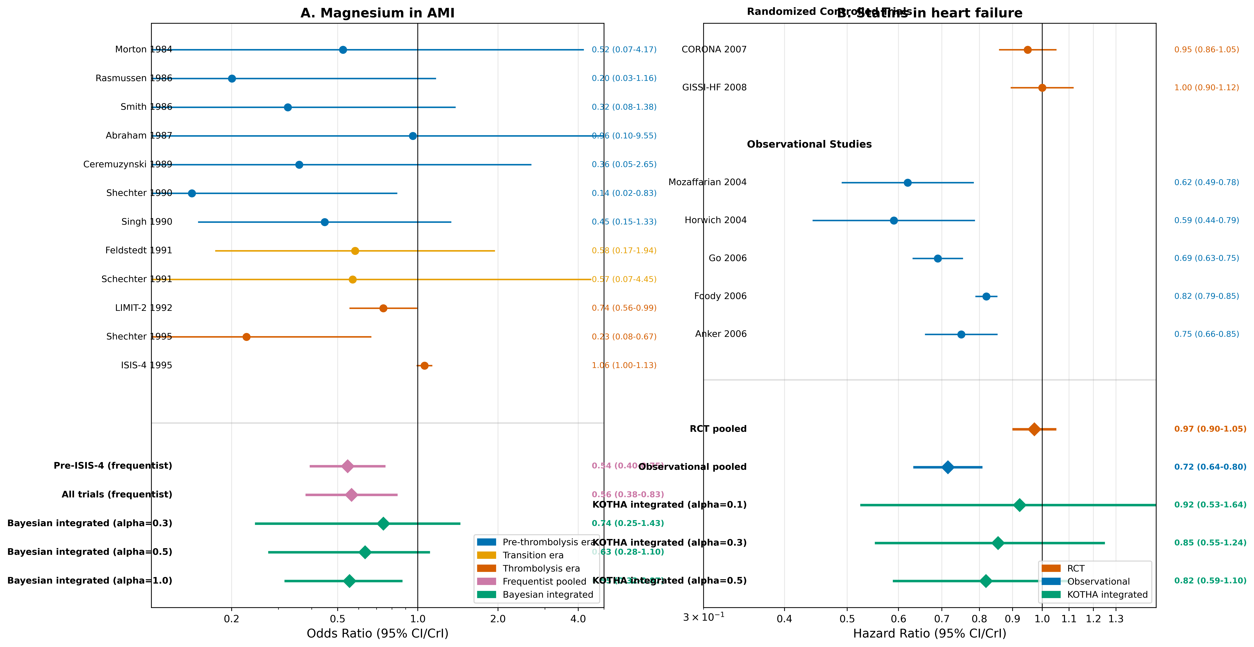
Figure 4
Figure 4. Forest plots for (A) magnesium in AMI and (B) statins in heart failure. Individual study effect estimates are shown with 95% confidence intervals. Pooled estimates include frequentist random-effects and Bayesian integrated estimates at selected discounting levels (alpha = 0.3, 0.5, 1.0 for magnesium; 0.1, 0.3, 0.5 for statins).

Slide 5
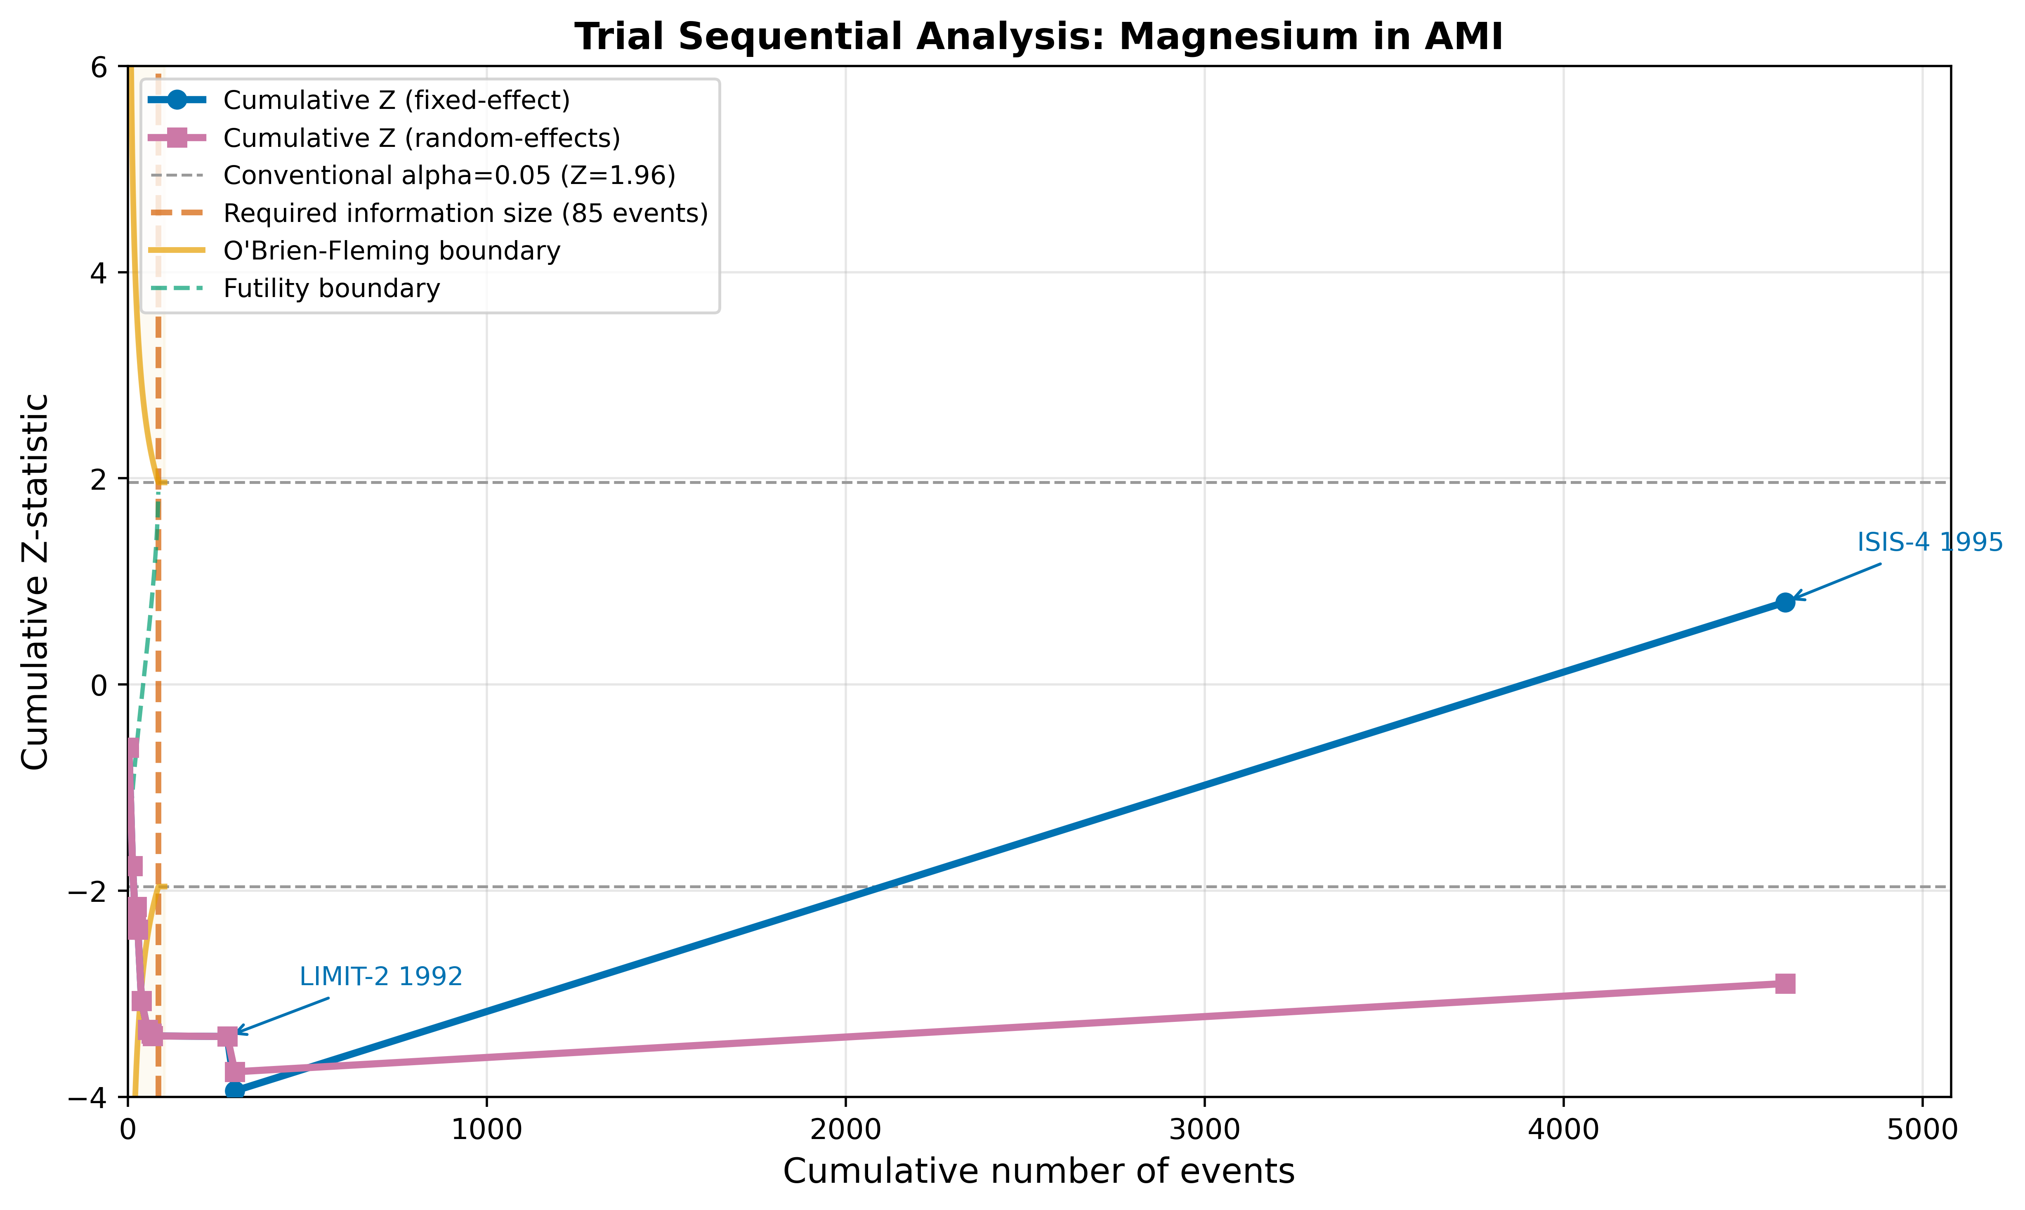
Figure 5
Figure 5. Trial sequential analysis for magnesium in AMI. The cumulative Z-curve is plotted against cumulative events. Vertical dashed line indicates the optimal information size (OIS). Curved lines show O'Brien-Fleming monitoring boundaries.

Slide 6
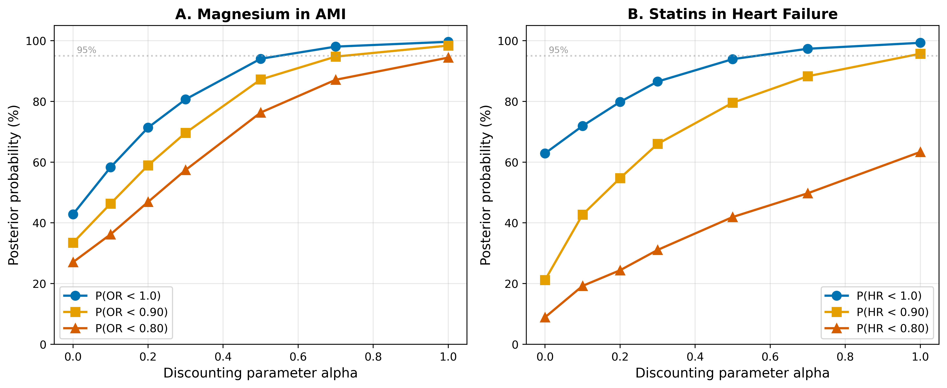
Figure 6
Figure 6. Sensitivity analysis of Bayesian integration to the discounting parameter alpha. (A) Magnesium in AMI. (B) Statins in HF. Three posterior probability thresholds are shown: P(effect < 1.0), P(effect < 0.90), and P(effect < 0.80). Horizontal dashed line indicates 95% probability.

Slide 7
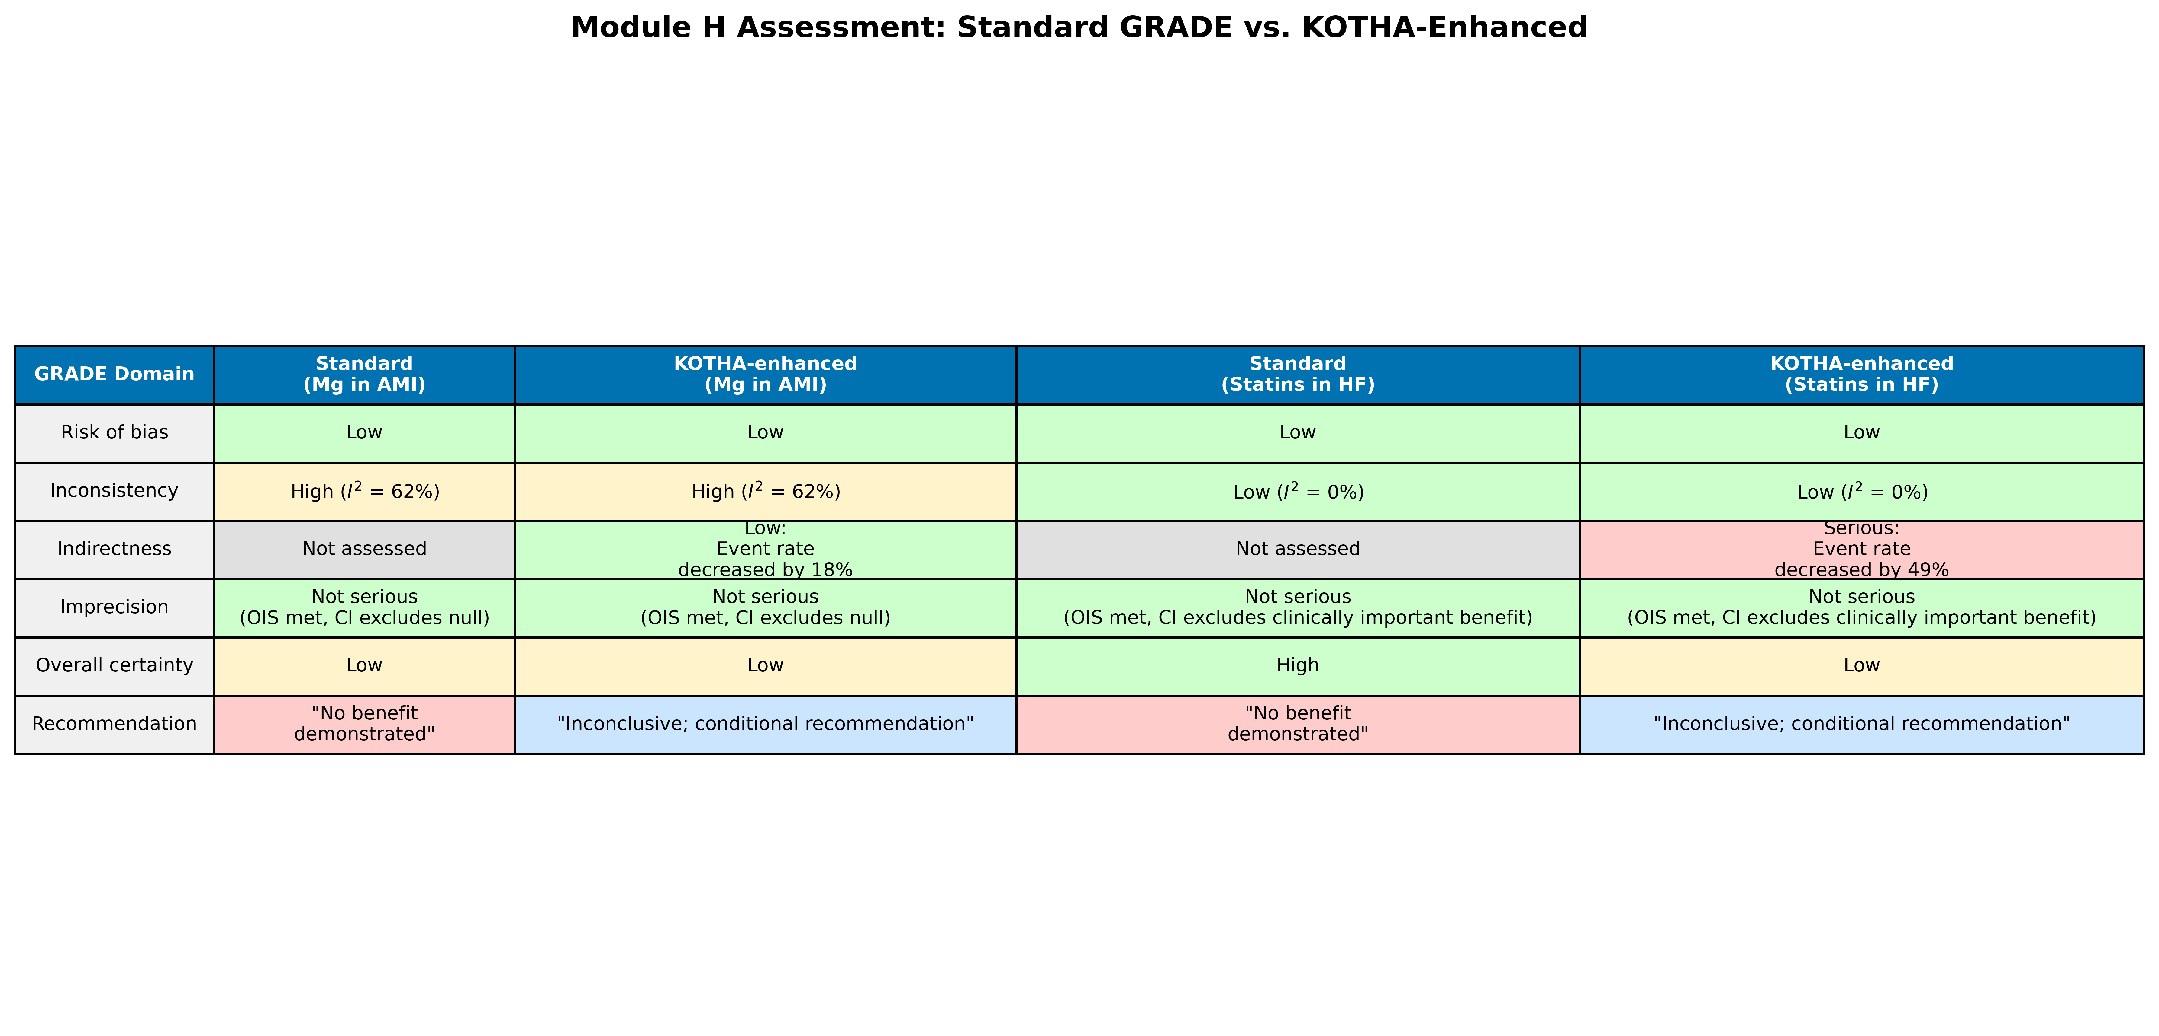
Figure 7
Figure 7. Module H assessment comparison: standard GRADE vs. KOTHA-enhanced evaluation for both illustrative cases. Color coding indicates severity of concern (green = no concern, yellow = moderate, red = serious).

Slide 8
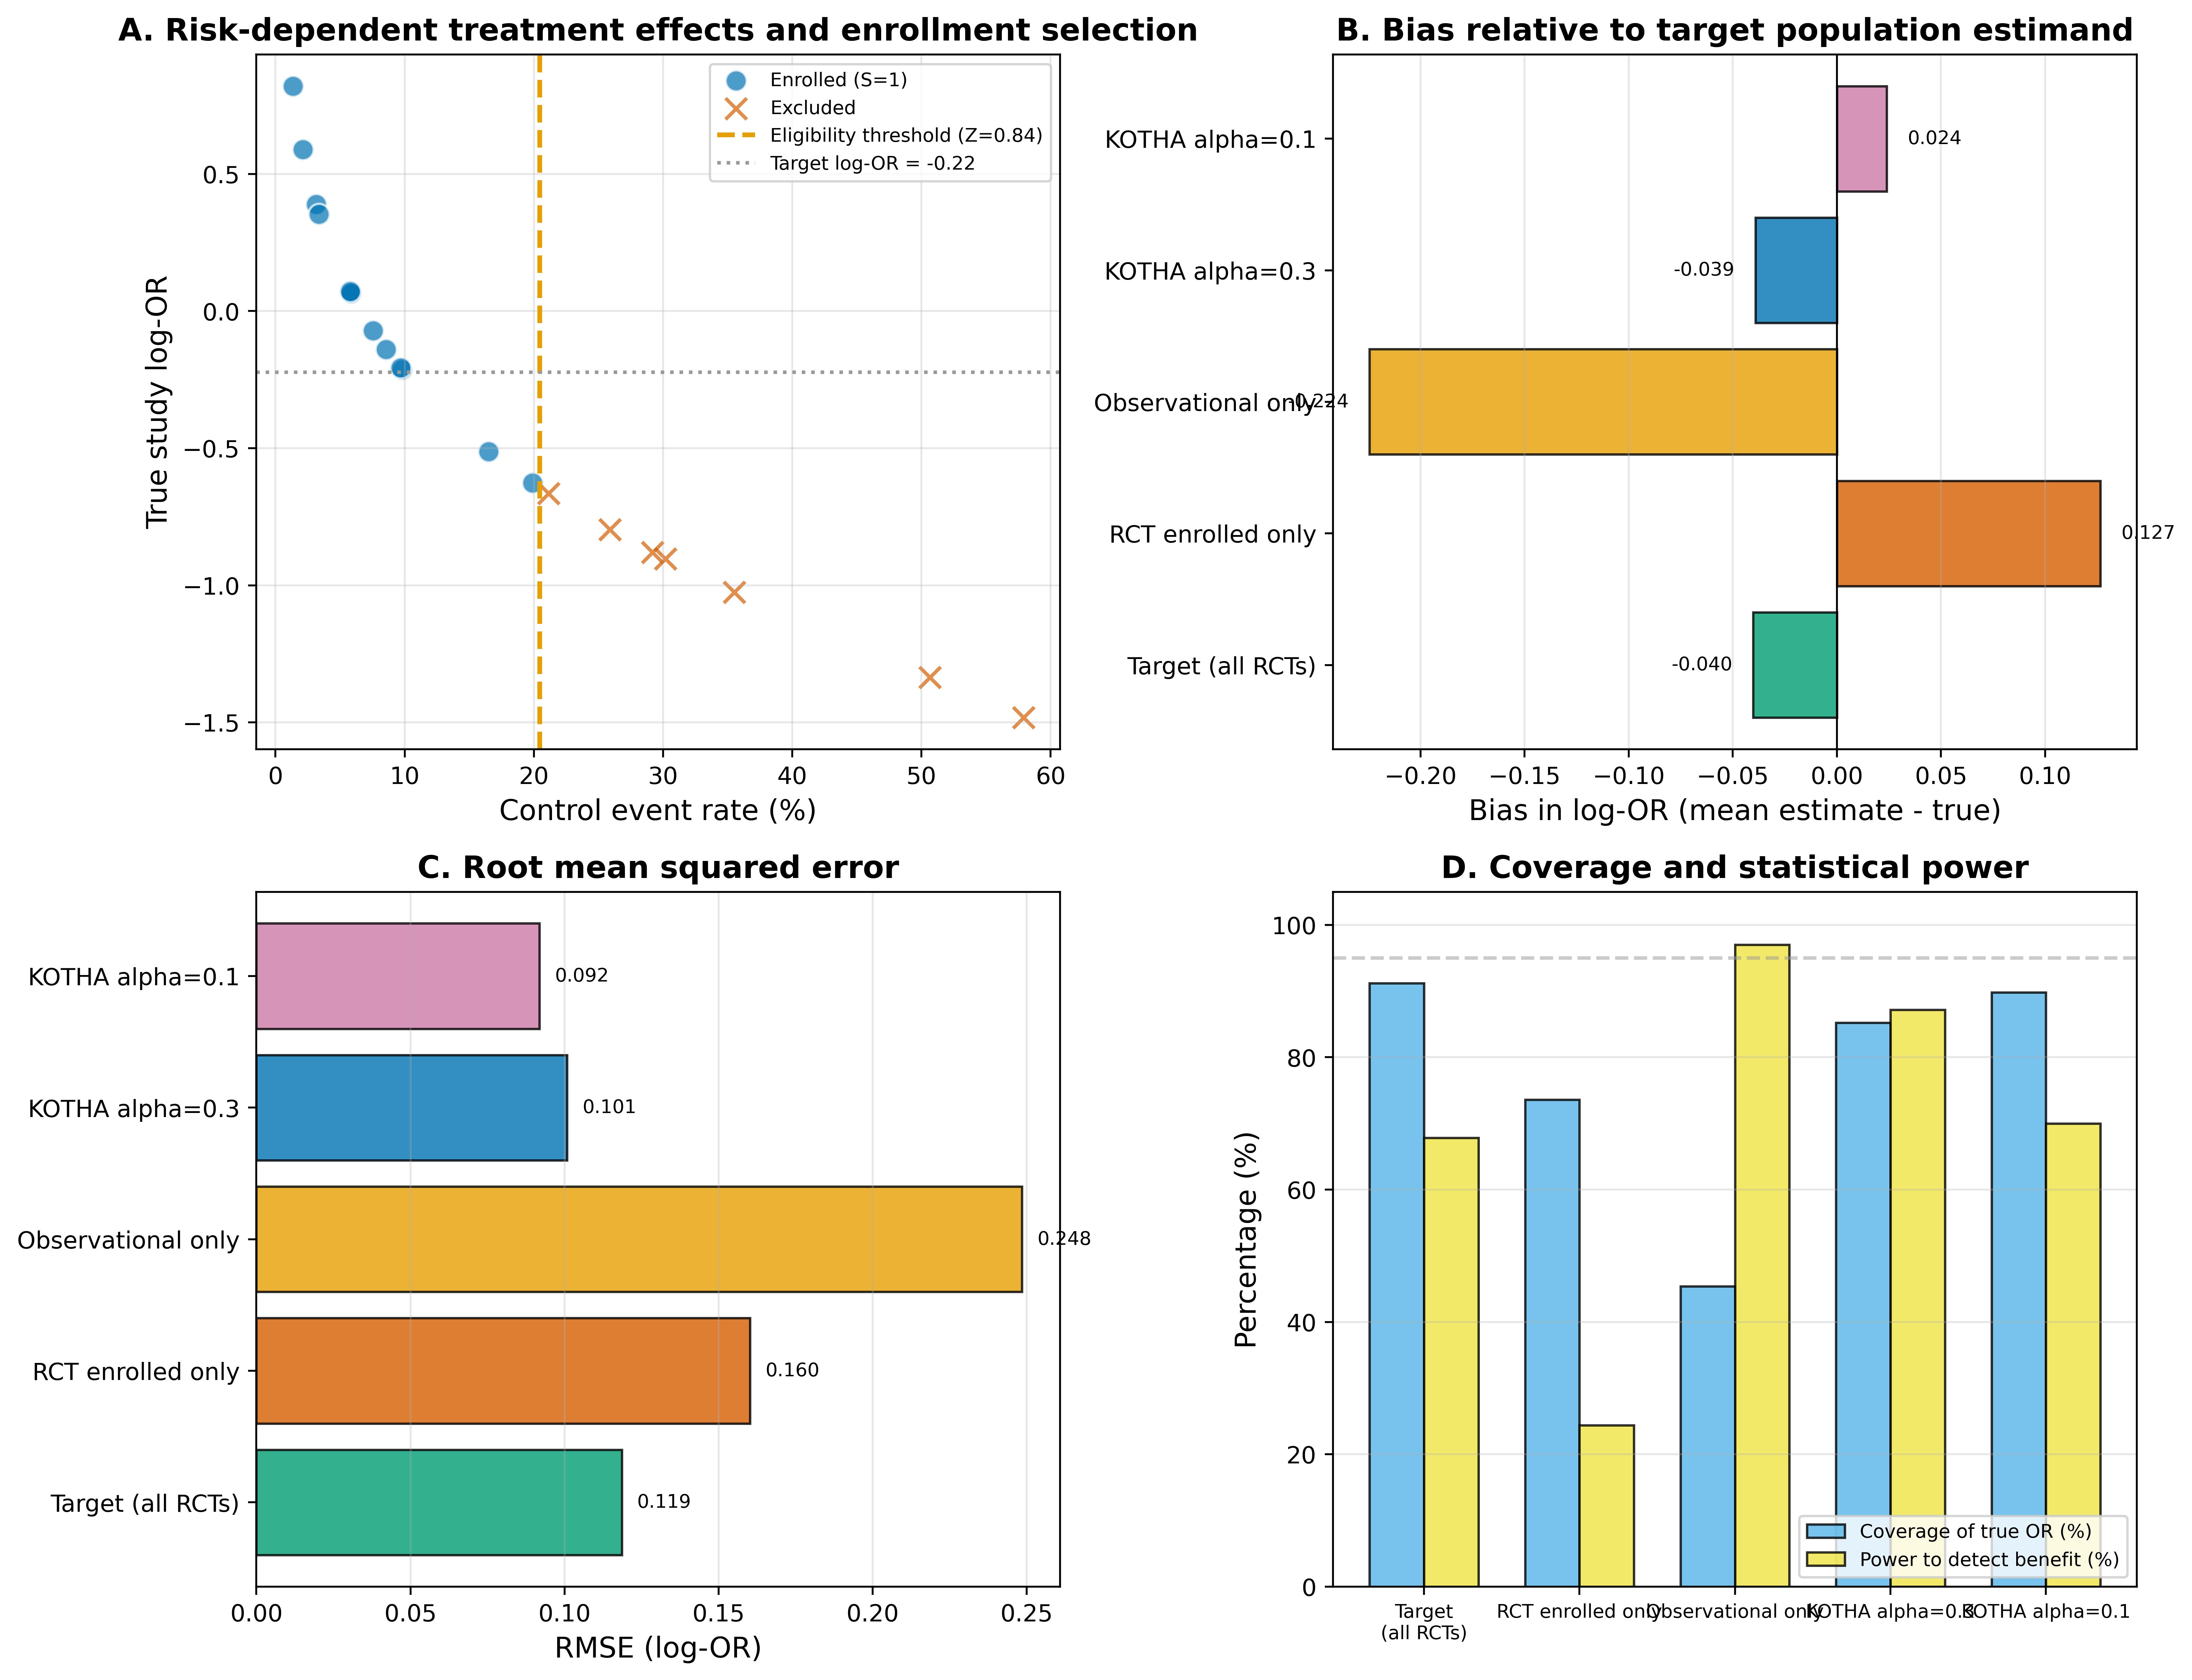
Figure 8
Figure 8. Operating characteristics of the simulation study. (A) Bias and RMSE for the target, RCT-enrolled-only, observational-only, fixed KOTHA (α = 0.3), and RMSE-optimal KOTHA estimators. (B) Coverage and power. Error bars in A show RMSE around the bias estimate; coverage and power are empirical proportions across replications.

