Slide 1
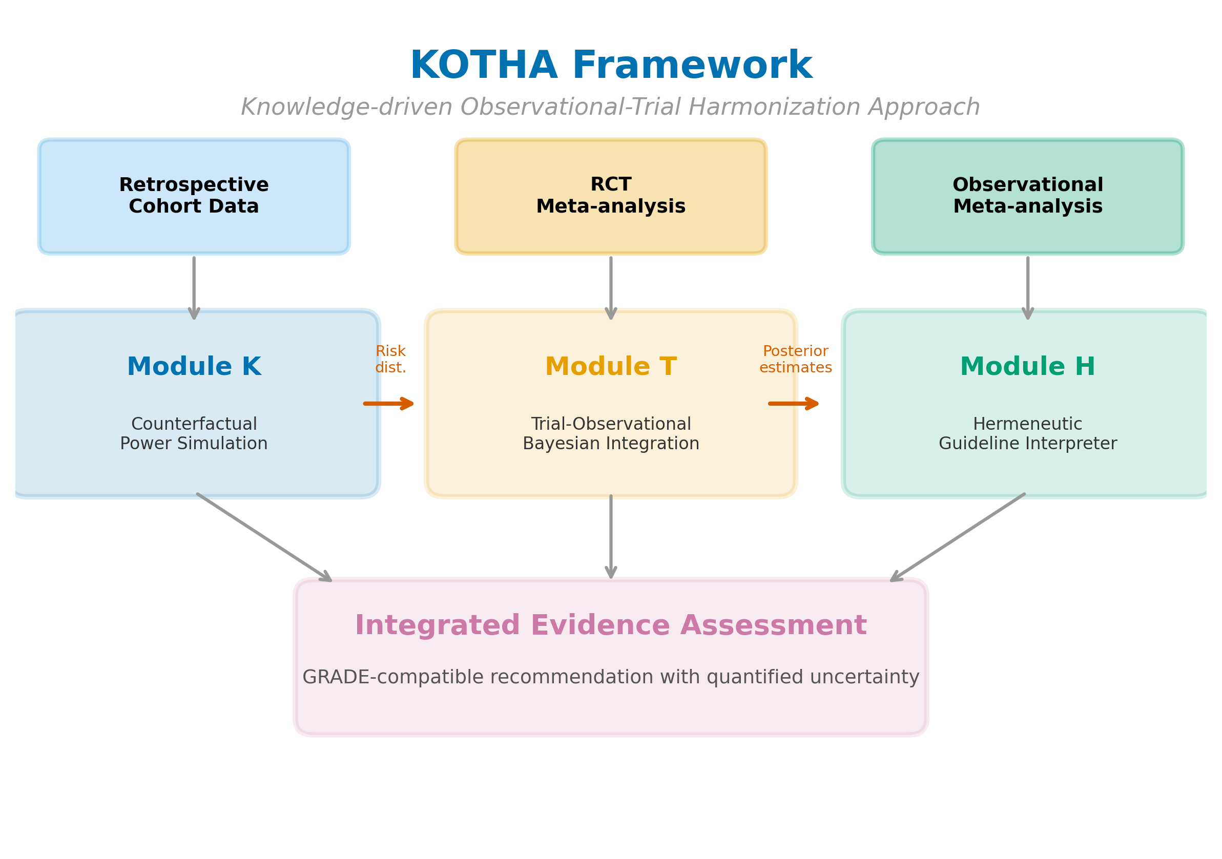
Figure 1
Figure 1. Overview of the KOTHA Framework. Module K (Counterfactual Power Simulation) quantifies risk-profile shift and estimates power under counterfactual enrollment scenarios. Module T (Bayesian Evidence Integration) combines RCT and observational evidence using power-prior discounting. Module H (Guideline Interpreter) synthesizes outputs into a structured GRADE-compatible assessment.

Slide 2
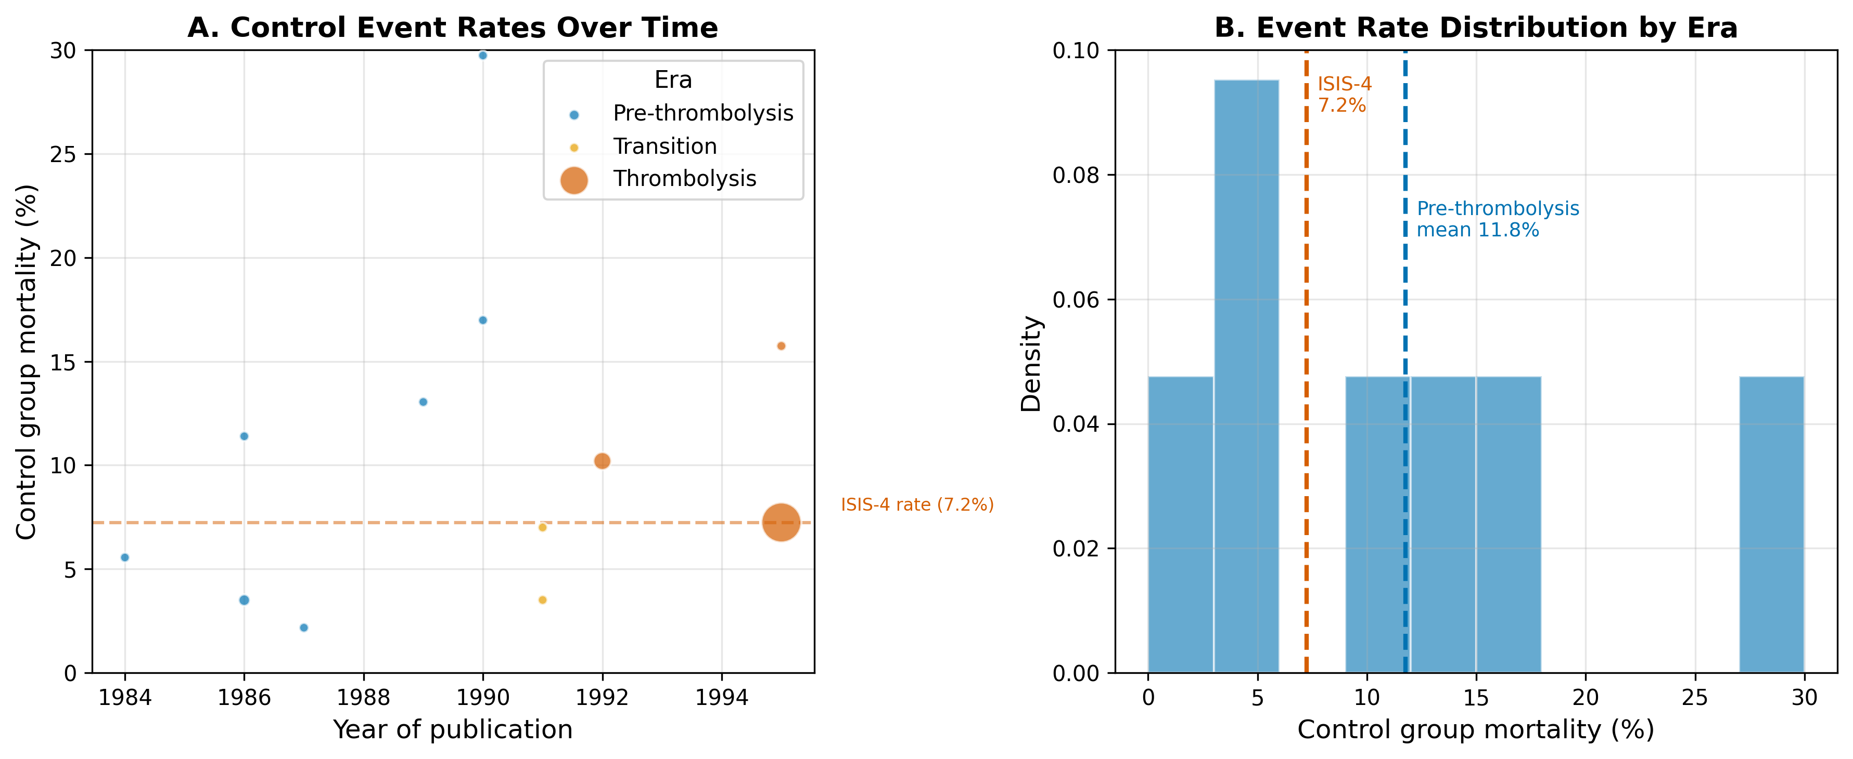
Figure 2
Figure 2. Risk-profile shift in the magnesium-in-AMI case. (A) Control-group mortality rates over time, with bubble size proportional to study sample size and colors indicating era. (B) Weighted mean control mortality by era.

Slide 3
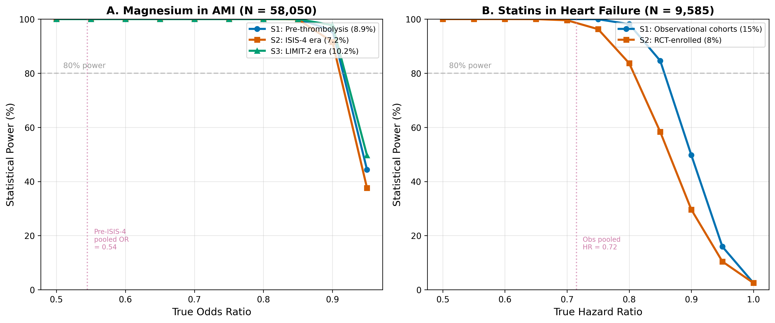
Figure 3
Figure 3. Estimated power by enrollment scenario and true effect size. (A) Magnesium in AMI at the ISIS-4 sample size (N = 58,050). (B) Statins in HF at the combined RCT sample size (N = 9,585). S1 = real-world/observational event rate; S2 = RCT event rate; S3 = intermediate/enriched rate. Horizontal dashed lines indicate 80% power.

Slide 4
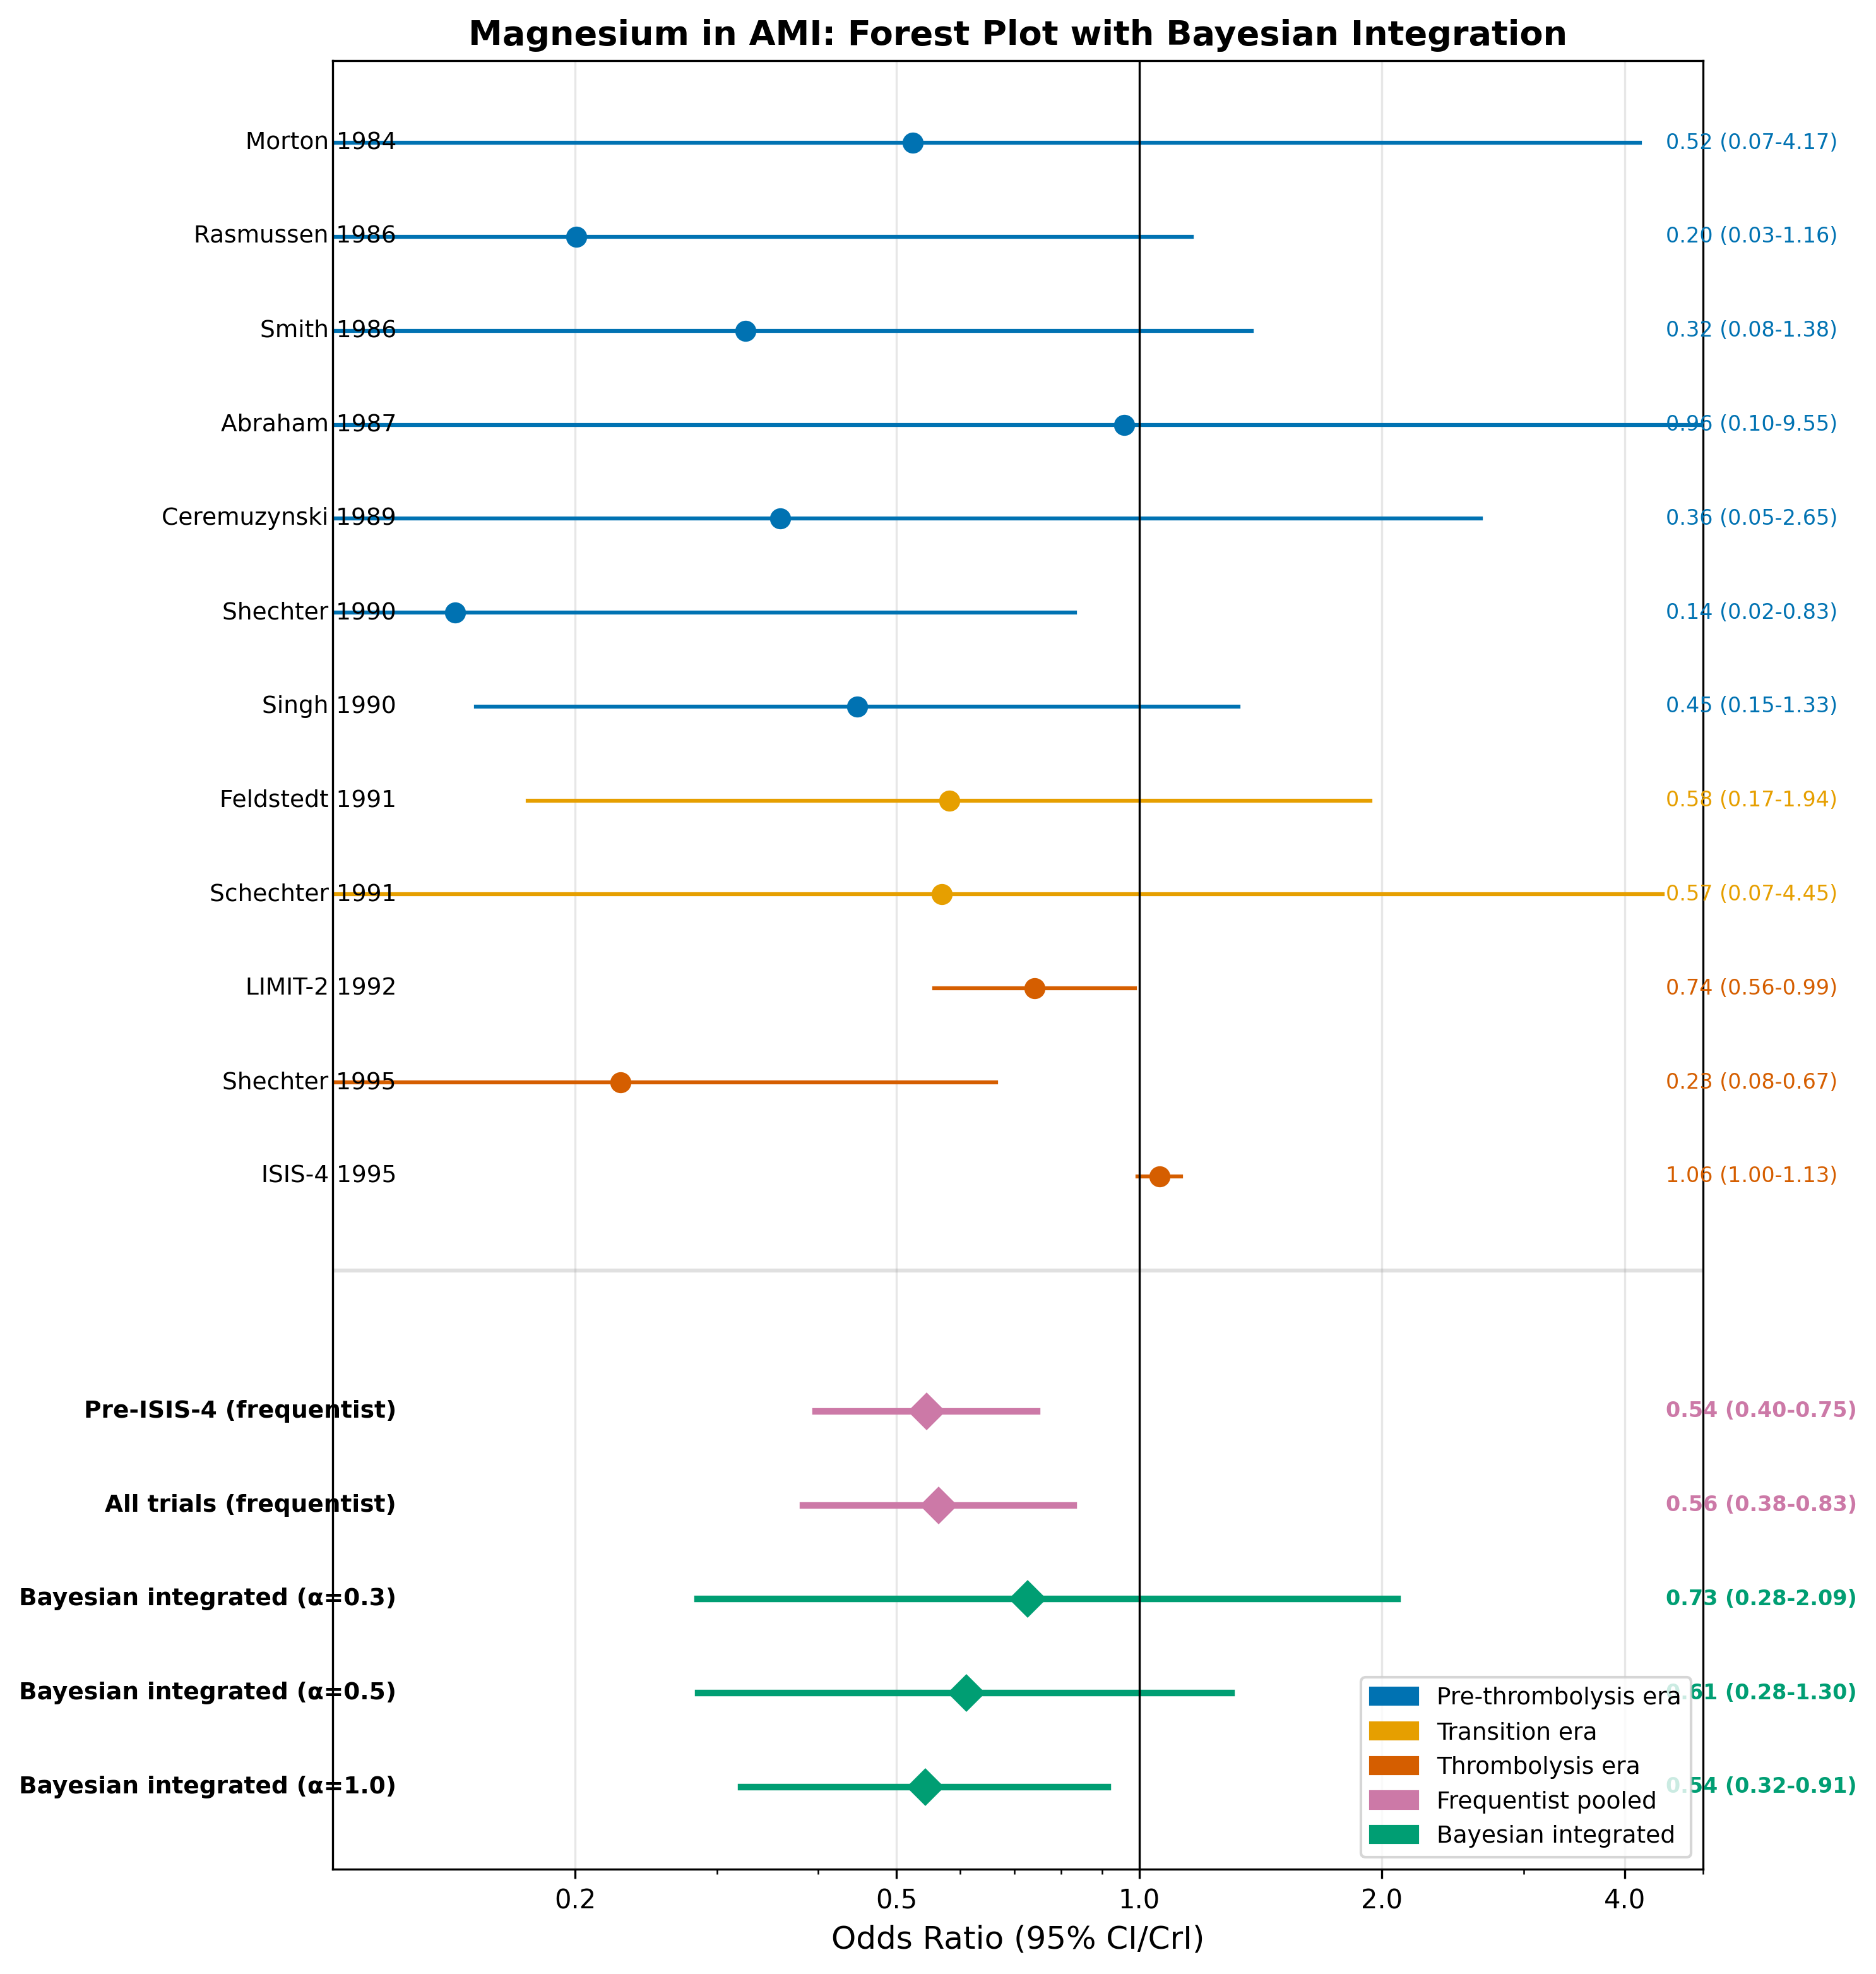
Figure 4
Figure 4. Forest plot for magnesium in AMI. Individual study odds ratios are shown with 95% confidence intervals, color-coded by era. Pooled estimates include frequentist random-effects (pre-ISIS-4 and all trials) and Bayesian integrated estimates at selected discounting levels (α = 0.3, 0.5, 1.0).

Slide 5
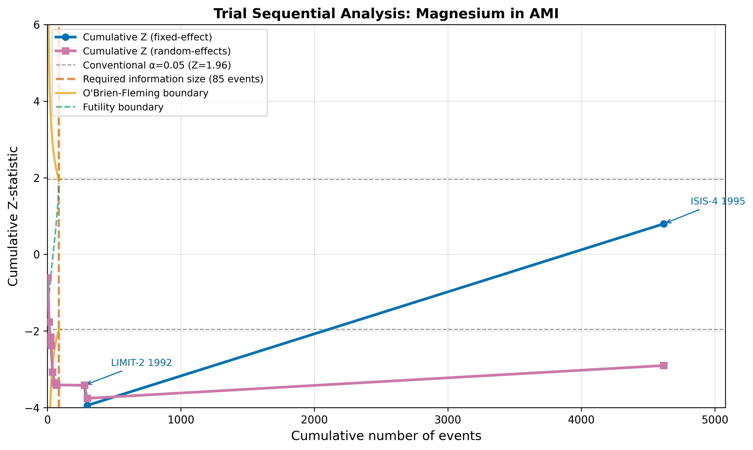
Figure 5
Figure 5. Trial sequential analysis for magnesium in AMI. The cumulative Z-curve is plotted against cumulative events. Vertical dashed line indicates the optimal information size (OIS). Curved lines show O'Brien-Fleming monitoring boundaries.

Slide 6
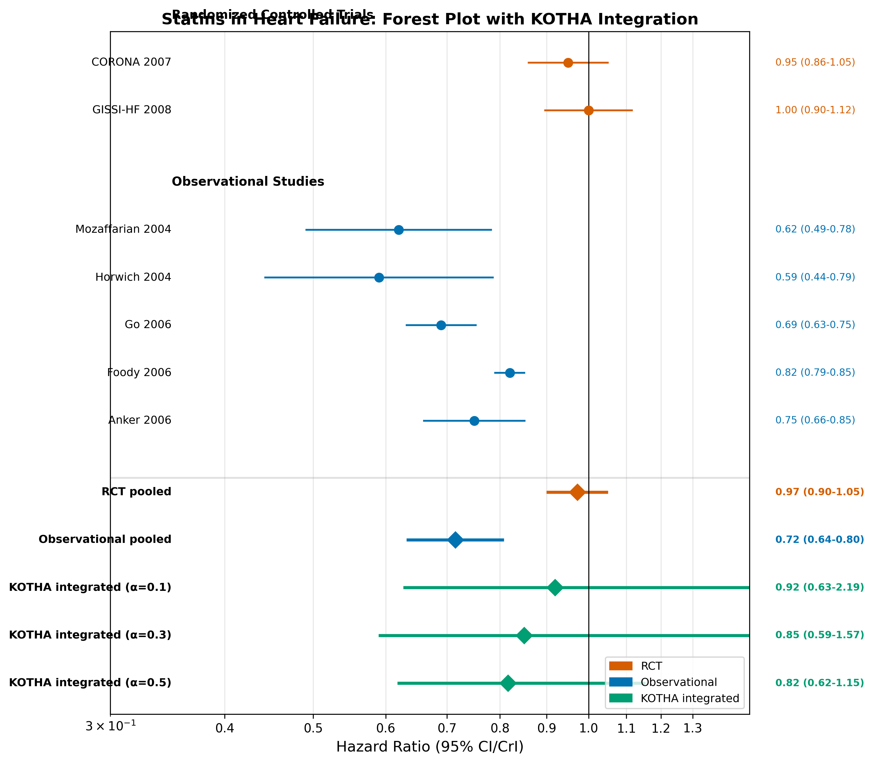
Figure 6
Figure 6. Forest plot for statins in heart failure. Individual study hazard ratios are shown with 95% confidence intervals, grouped by design. Pooled estimates include design-specific frequentist pooling and KOTHA-integrated estimates at selected discounting levels (α = 0.1, 0.3, 0.5).

Slide 7
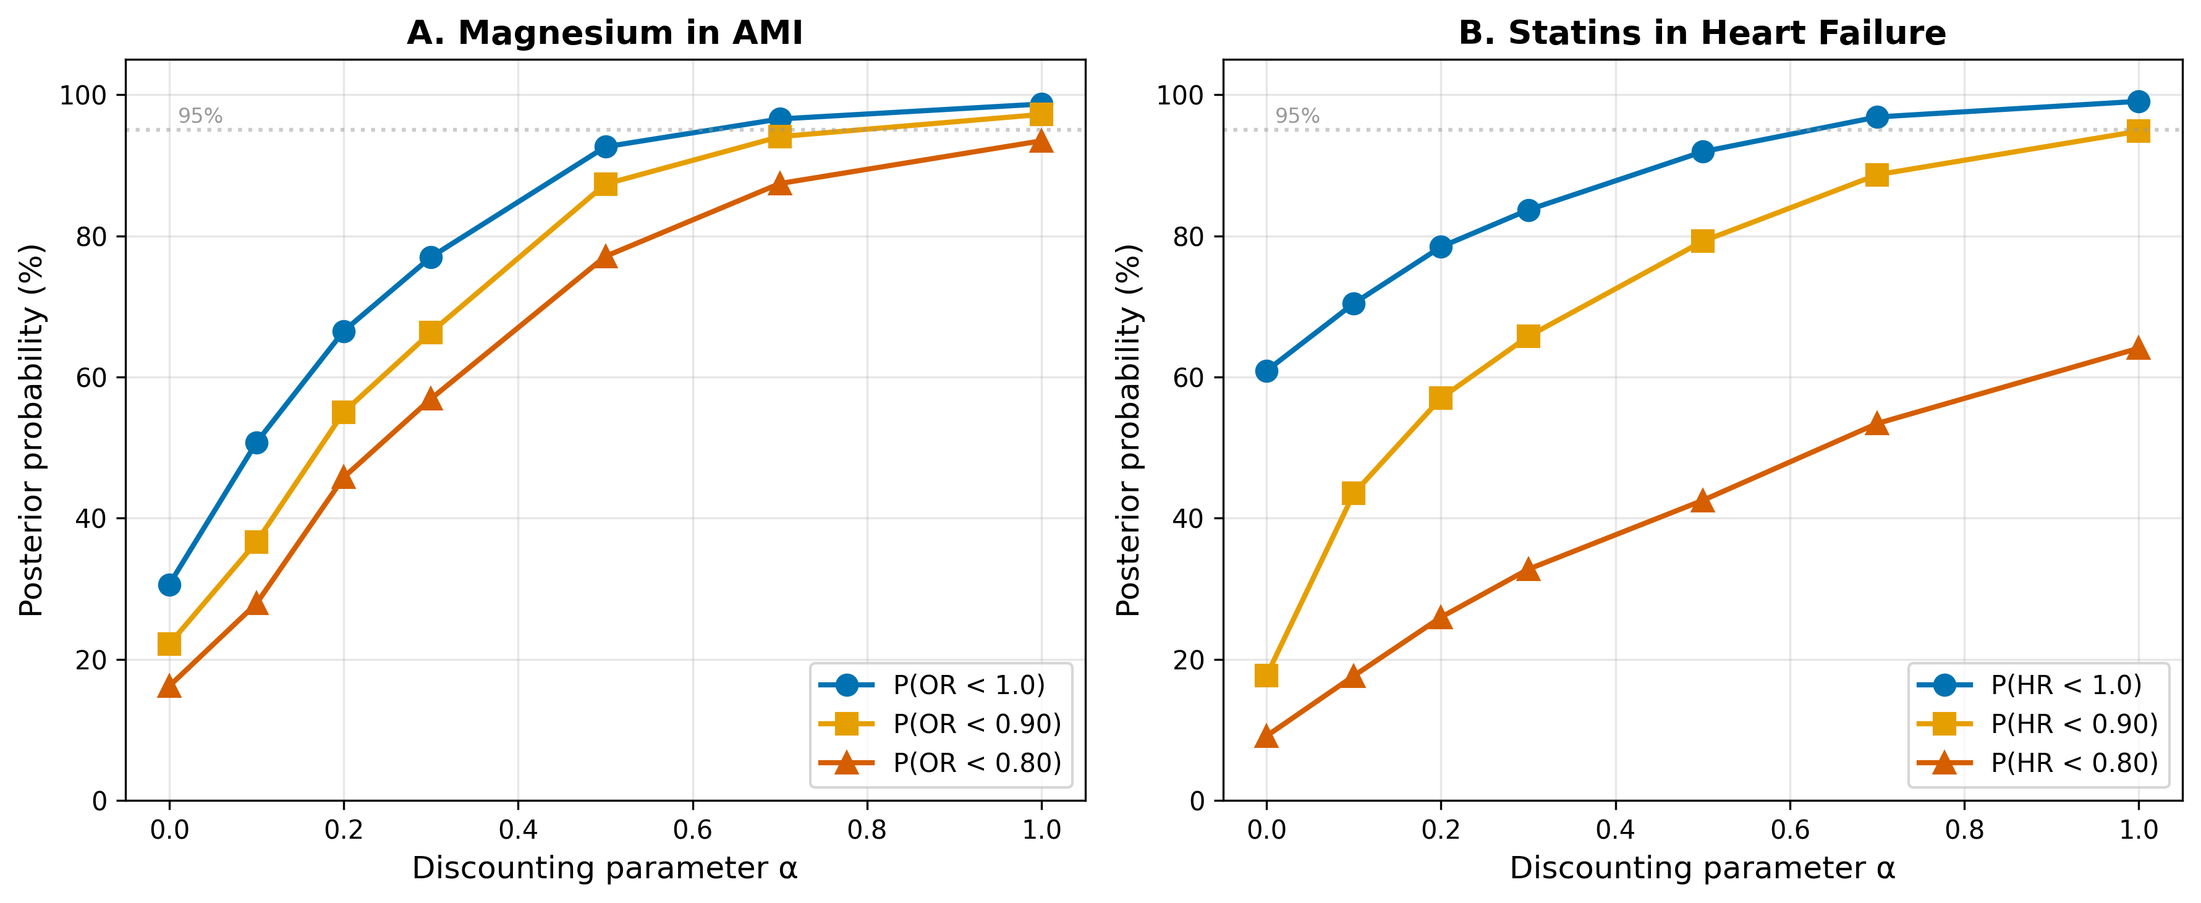
Figure 7
Figure 7. Sensitivity analysis of Bayesian integration to the discounting parameter α. (A) Magnesium in AMI. (B) Statins in HF. Three posterior probability thresholds are shown: P(effect < 1.0), P(effect < 0.90), and P(effect < 0.80). Horizontal dashed line indicates 95% probability.

Slide 8
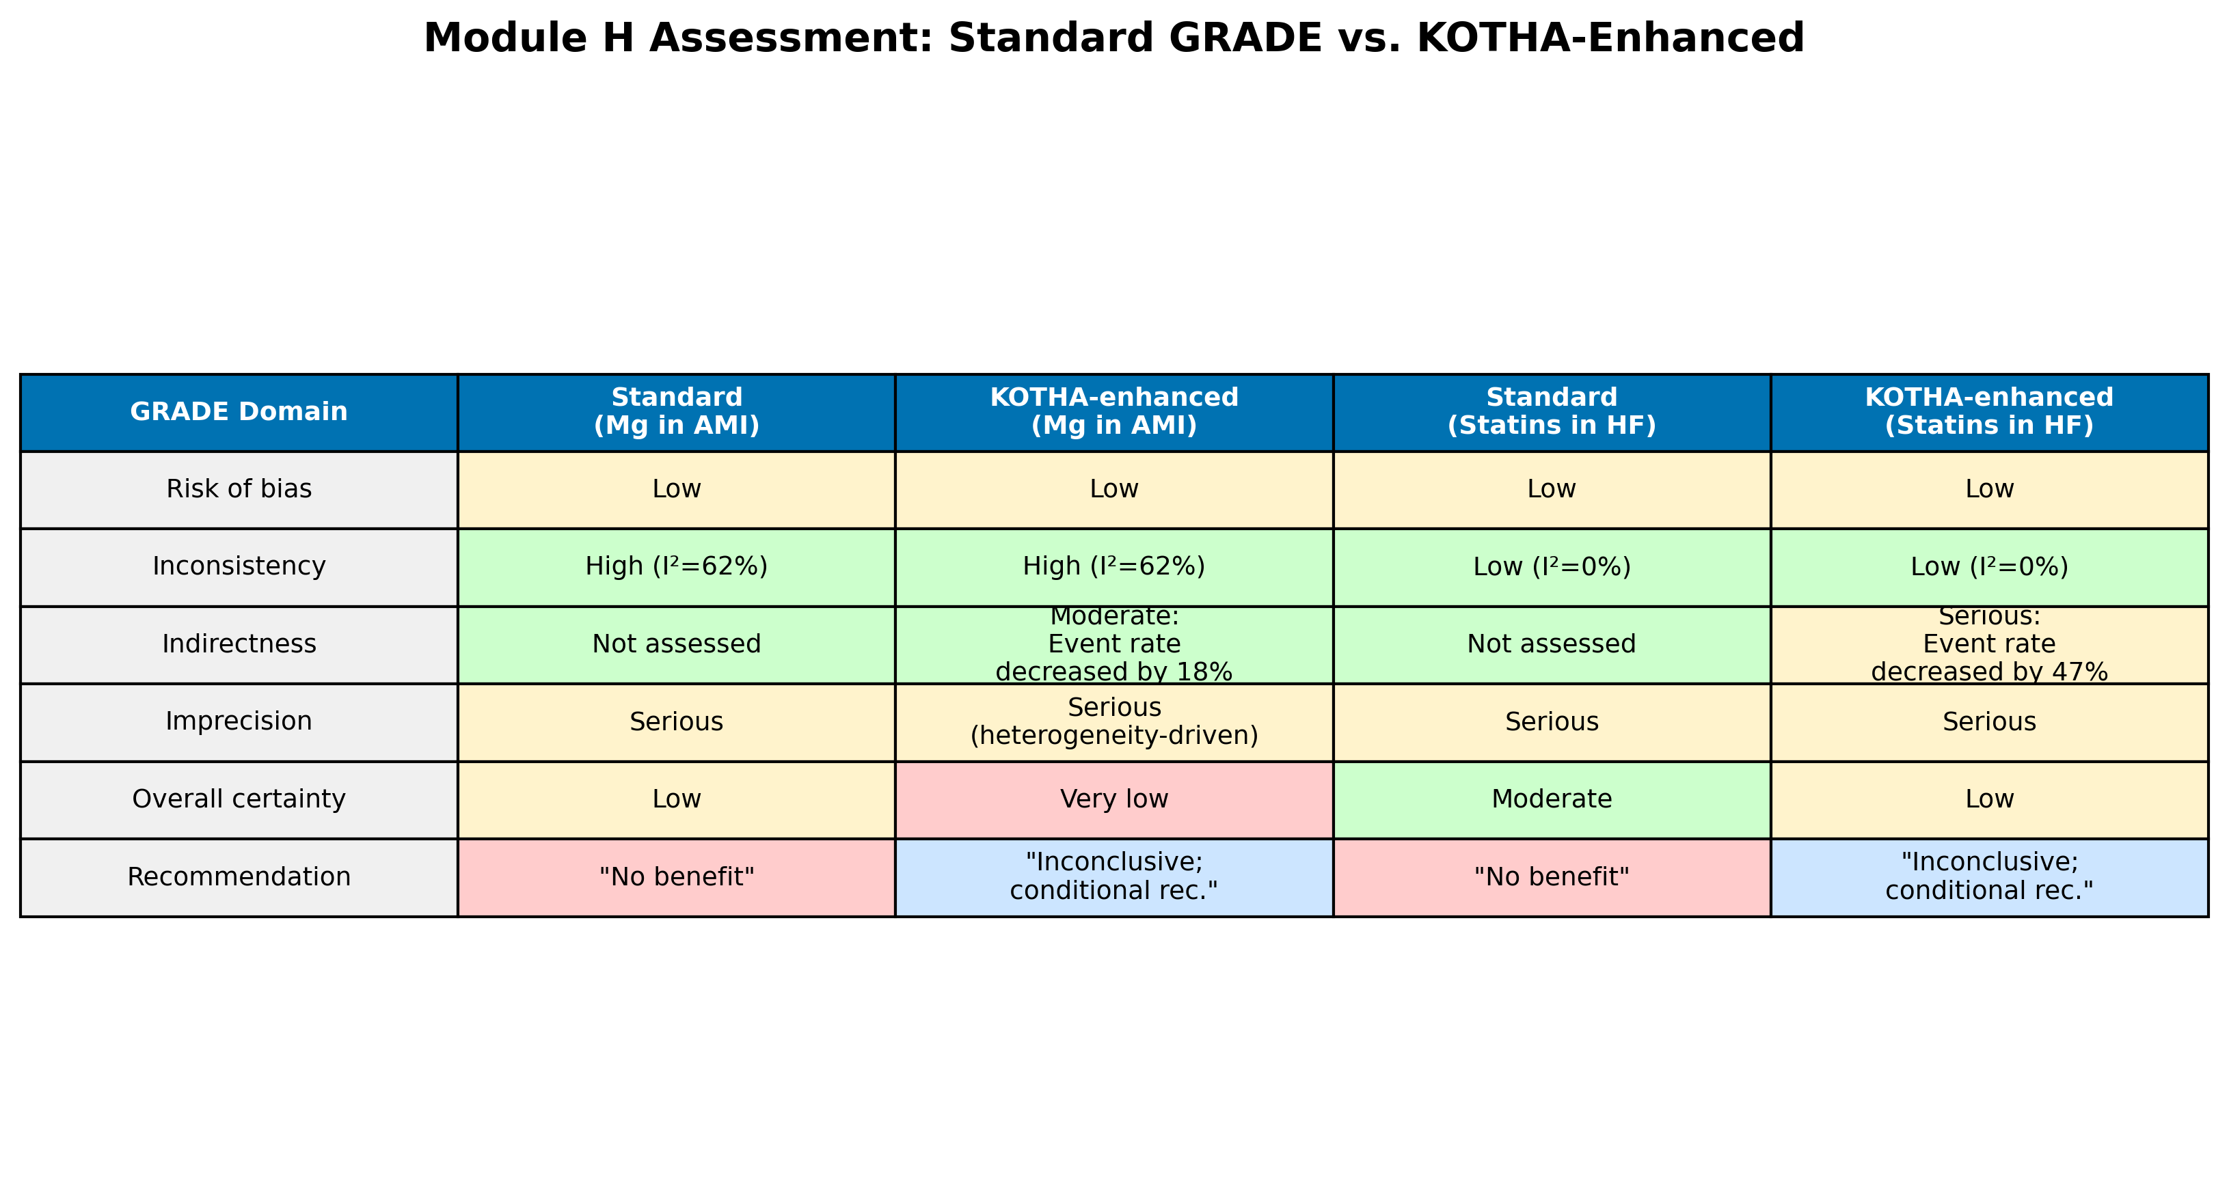
Figure 8
Figure 8. Module H assessment comparison: standard GRADE vs. KOTHA-enhanced evaluation for both illustrative cases. Color coding indicates severity of concern (green = no concern, yellow = moderate, red = serious).

