Slide 1
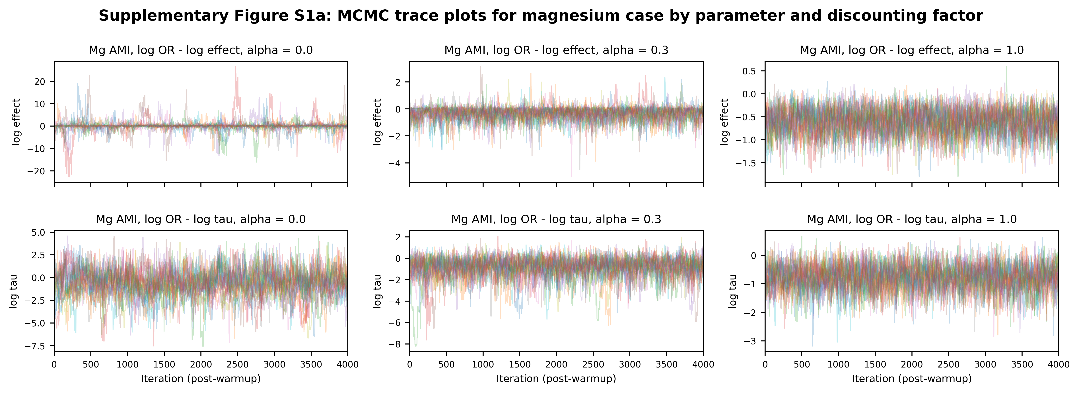
Supplementary Figure S1a
Supplementary Figure S1a. MCMC trace plots for selected parameters in the Bayesian power-prior model for magnesium in acute myocardial infarction (discounting factor alpha = 0.3). Chains show no obvious non-stationarity.

Slide 2
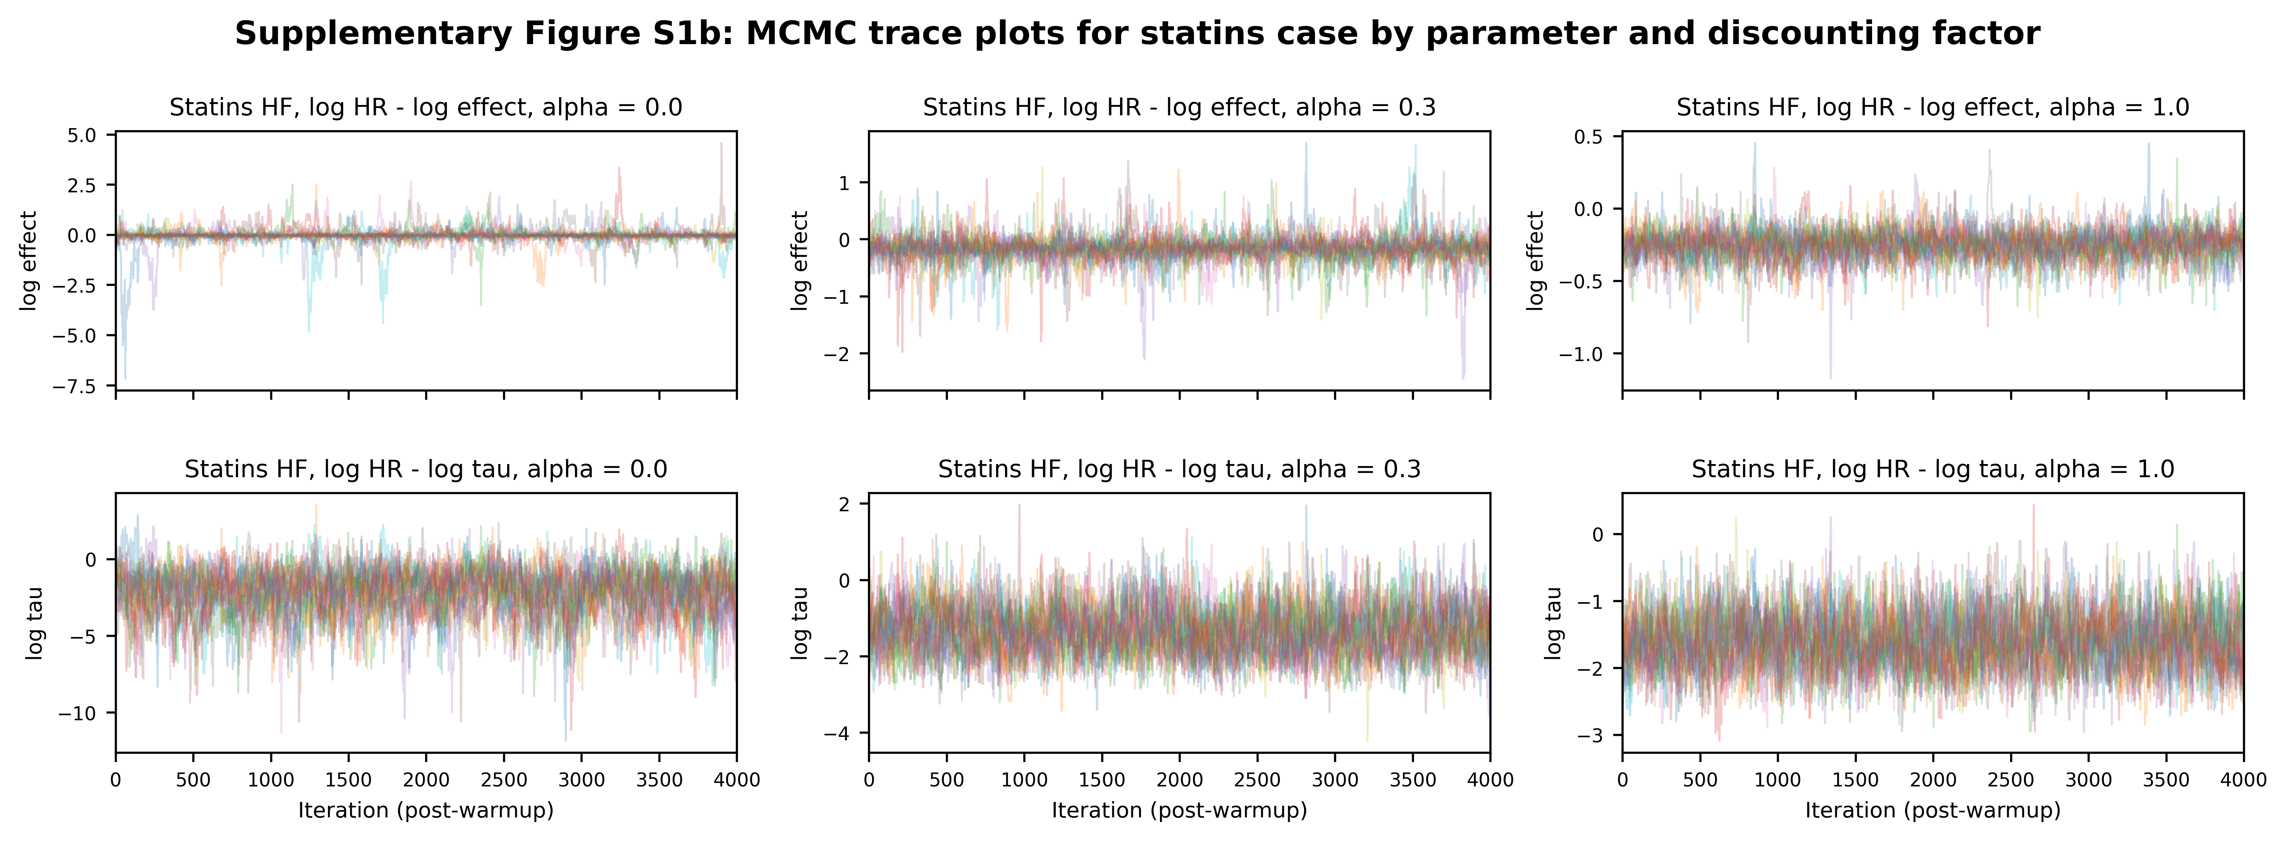
Supplementary Figure S1b
Supplementary Figure S1b. MCMC trace plots for selected parameters in the Bayesian power-prior model for statins in heart failure (discounting factor alpha = 0.3). Chains show no obvious non-stationarity.

Slide 3
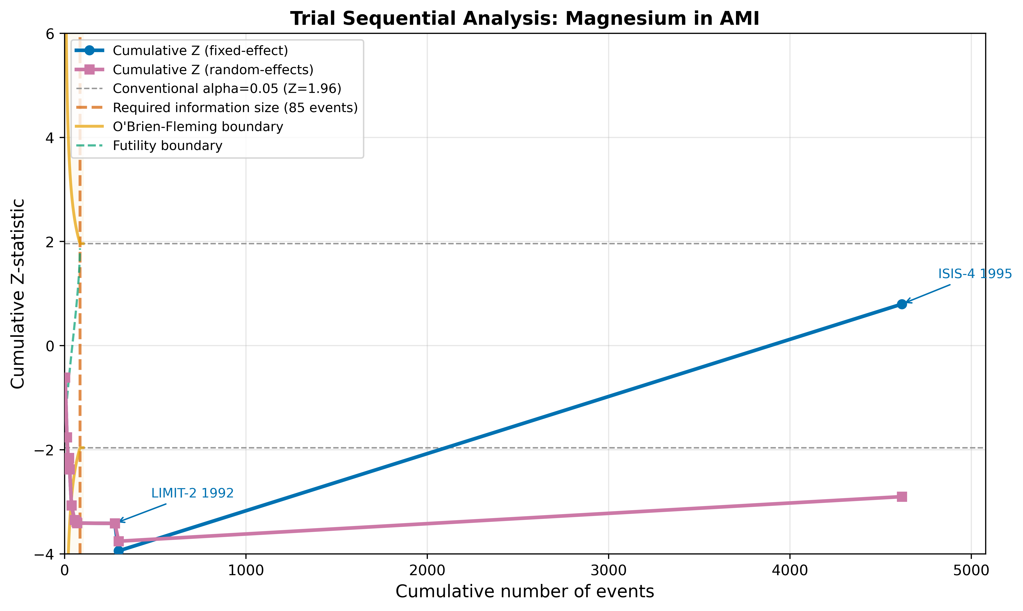
Supplementary Figure S2
Supplementary Figure S2. Trial sequential analysis for magnesium in AMI. The cumulative Z-curve is plotted against cumulative events. Vertical dashed line indicates the optimal information size (OIS). Curved lines show O'Brien-Fleming monitoring boundaries.

Slide 4
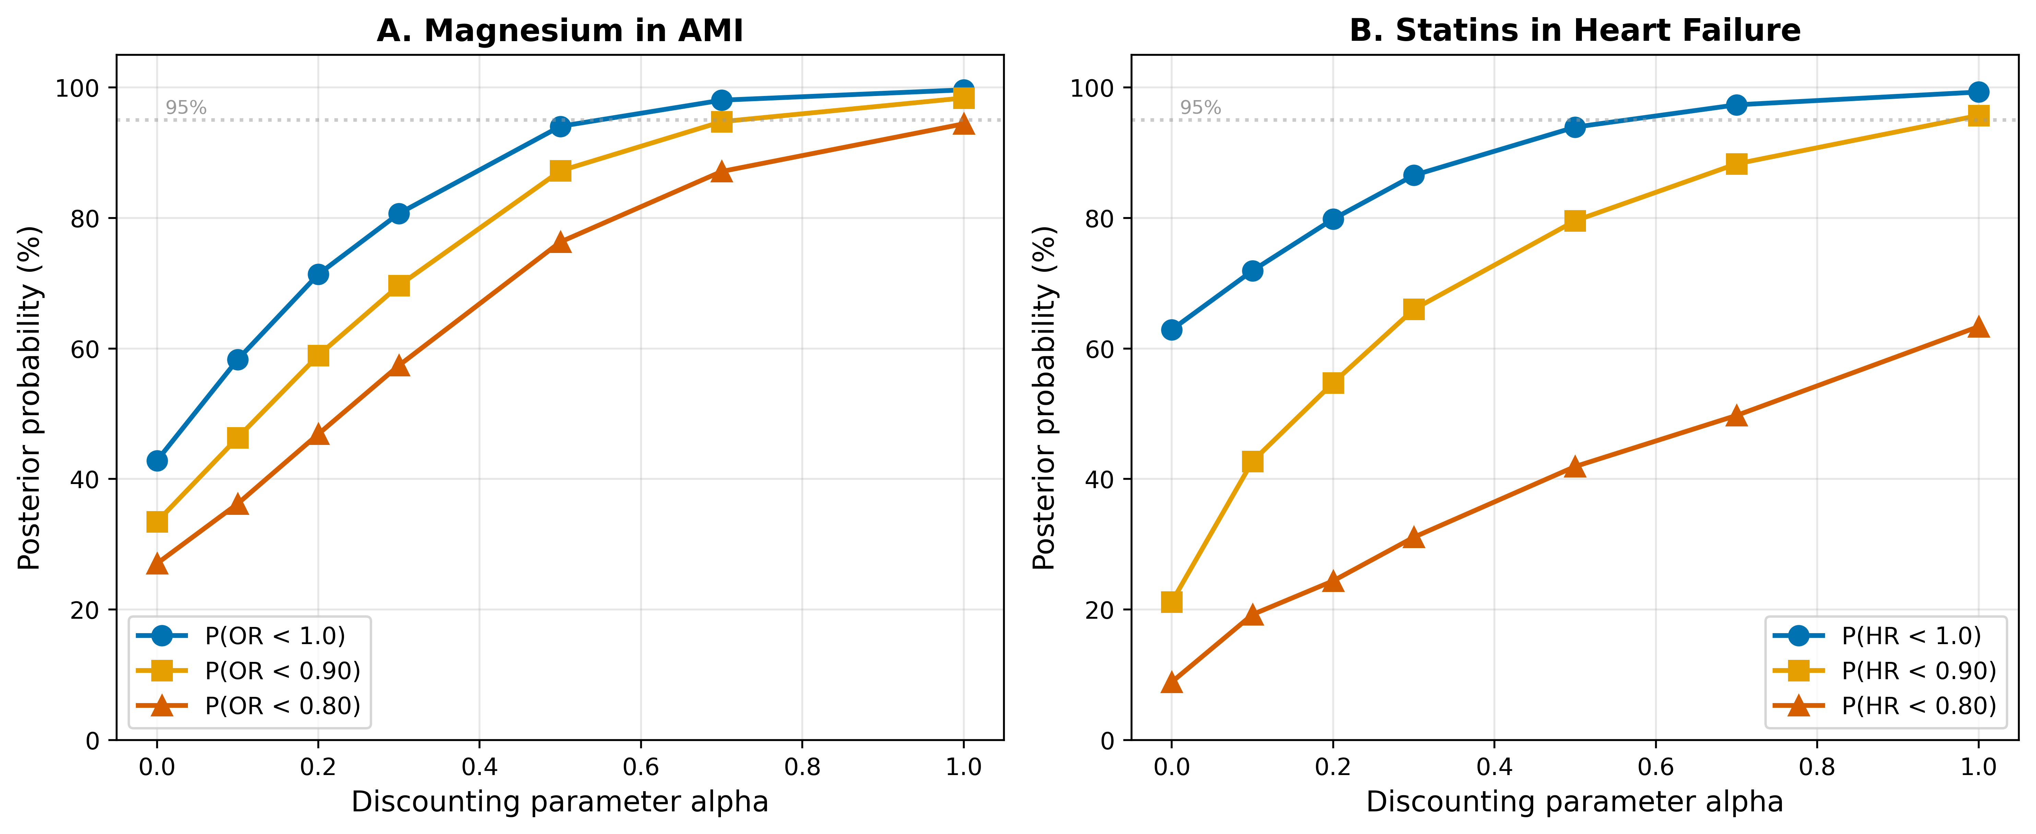
Supplementary Figure S3
Supplementary Figure S3. Sensitivity analysis of Bayesian integration to the discounting parameter alpha. (A) Magnesium in AMI. (B) Statins in HF. Three posterior probability thresholds are shown: P(effect < 1.0), P(effect < 0.90), and P(effect < 0.80). Horizontal dashed line indicates 95% probability.

Slide 5
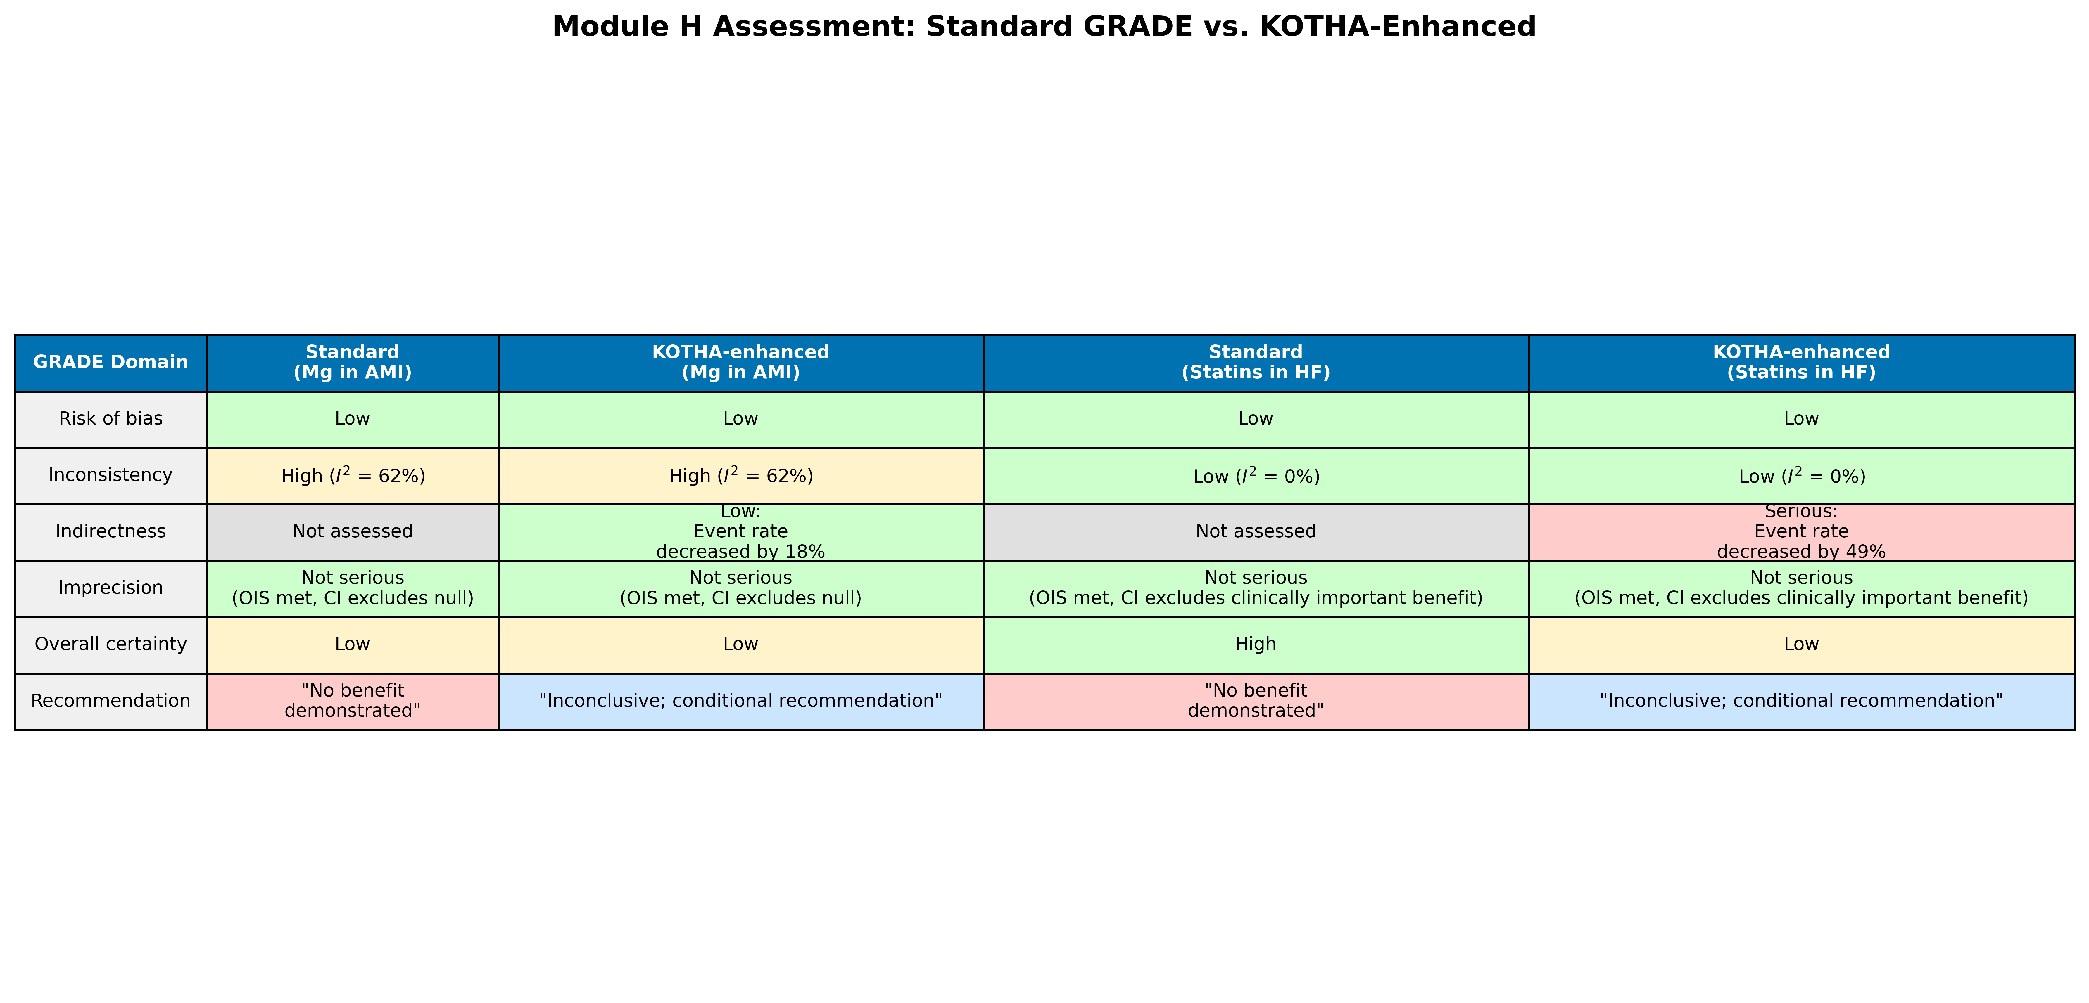
Supplementary Figure S4
Supplementary Figure S4. Module H assessment comparison: standard GRADE vs. KOTHA-enhanced evaluation for both illustrative cases. Color coding indicates severity of concern (green = no concern, yellow = moderate, red = serious).

