Slide 1
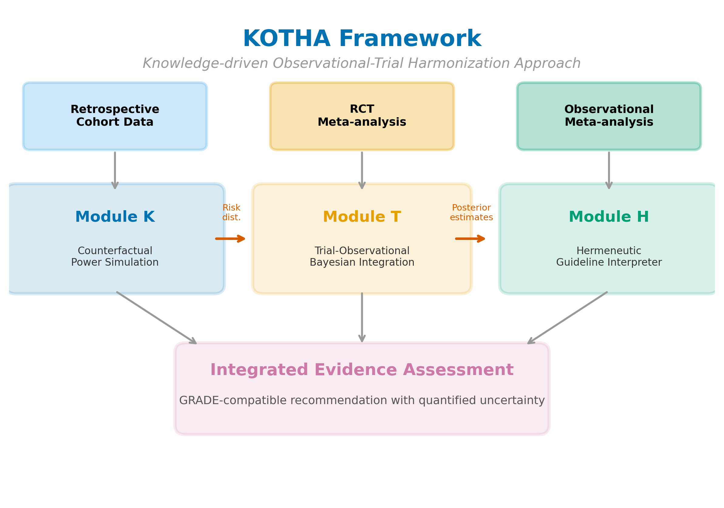
Fig. 1: Overview of the KOTHA Framework. Module K (Counterfactual Power Simulation) uses retrospective cohort data to quantify risk-profile shift and estimate power under counterfactual enrollment scenarios. Module T (Bayesian Evidence Integration) combines RCT and observational evidence using hierarchical models with power-prior discounting. Module H (Guideline Interpreter) synthesizes outputs from Modules K and T into a structured GRADE-compatible assessment for guideline committees. Arrows indicate data flow between modules.

Slide 2
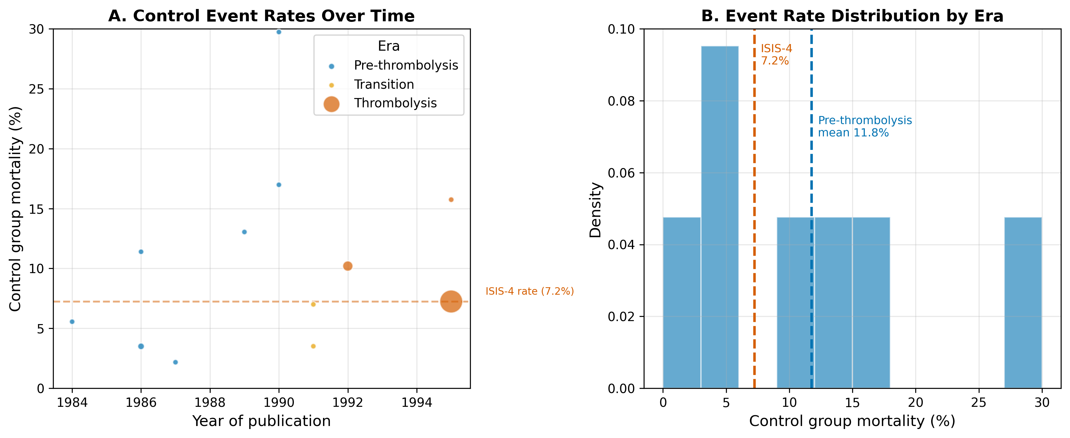
Fig. 2: Risk-profile shift in the magnesium-in-AMI case. (A) Control-group mortality rates over time, with bubble size proportional to study sample size. Colors indicate era classification. (B) Weighted mean control mortality by era, showing the decline from pre-thrombolysis to thrombolysis era.

Slide 3
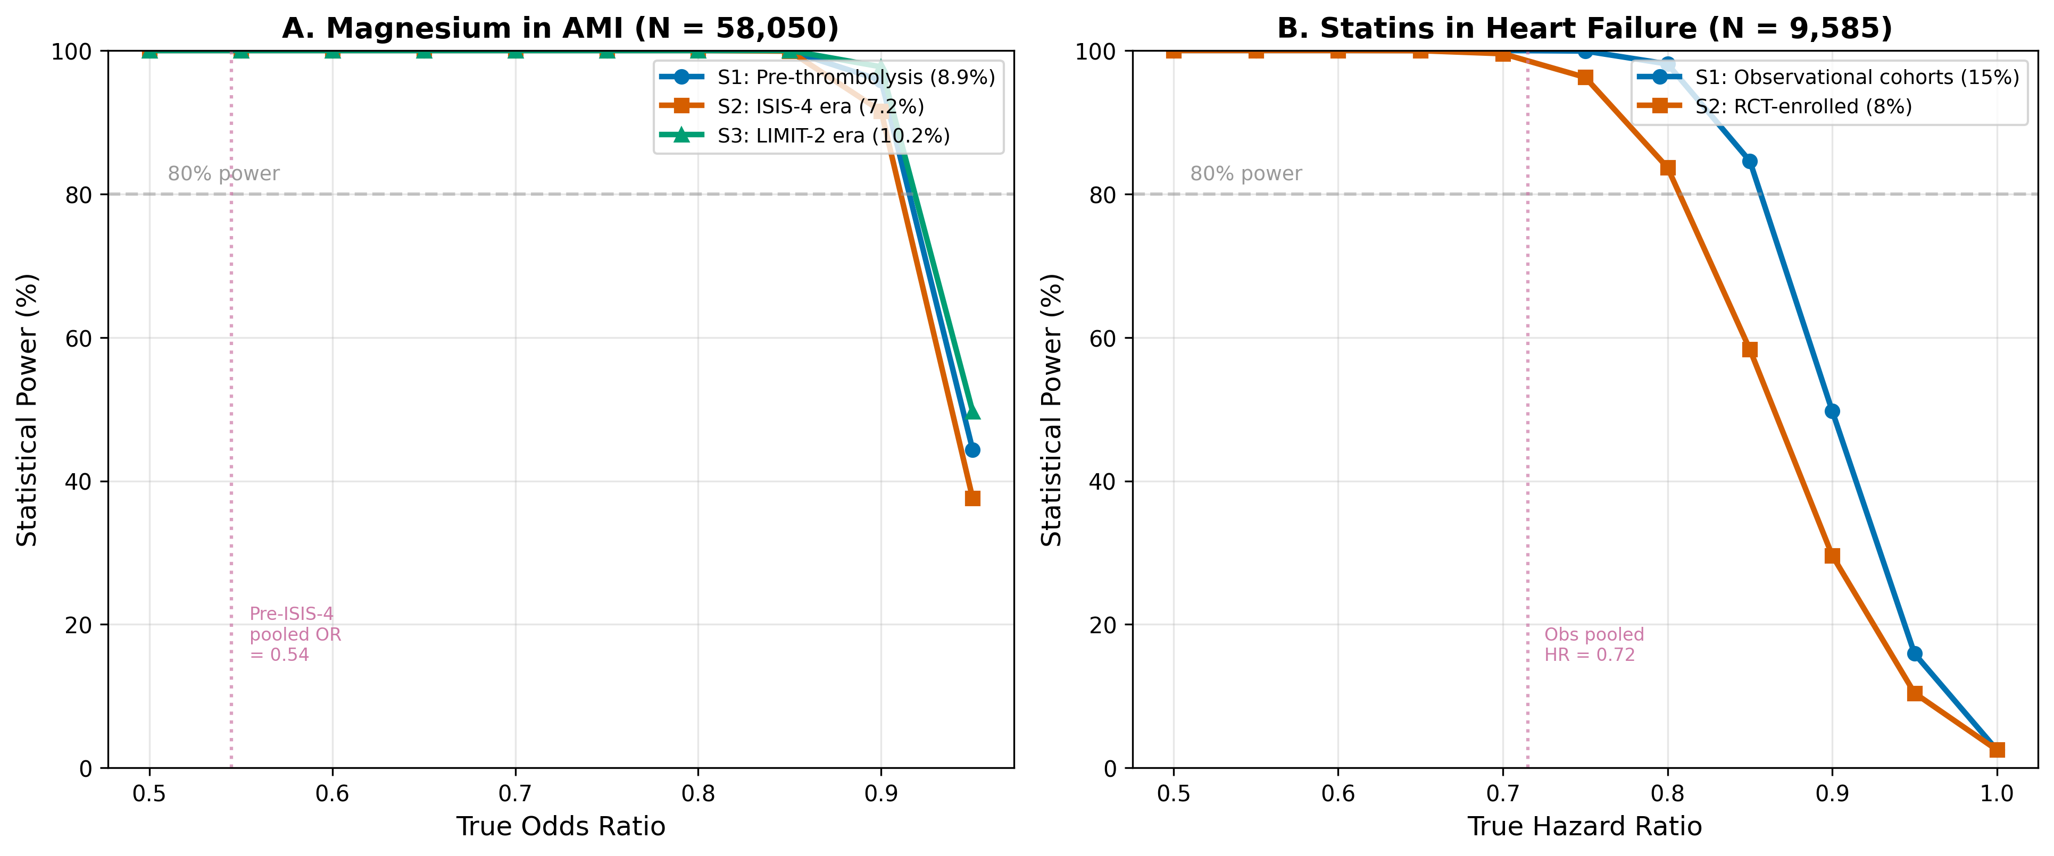
Fig. 3: Estimated power by enrollment scenario and true effect size. (A) Magnesium in AMI at the ISIS-4 sample size (N = 58,050). (B) Statins in HF at the combined RCT sample size (N = 9,585). Horizontal dashed lines indicate 80% power threshold. S1 = real-world/observational event rate; S2 = RCT event rate; S3 = intermediate/enriched rate.

Slide 4
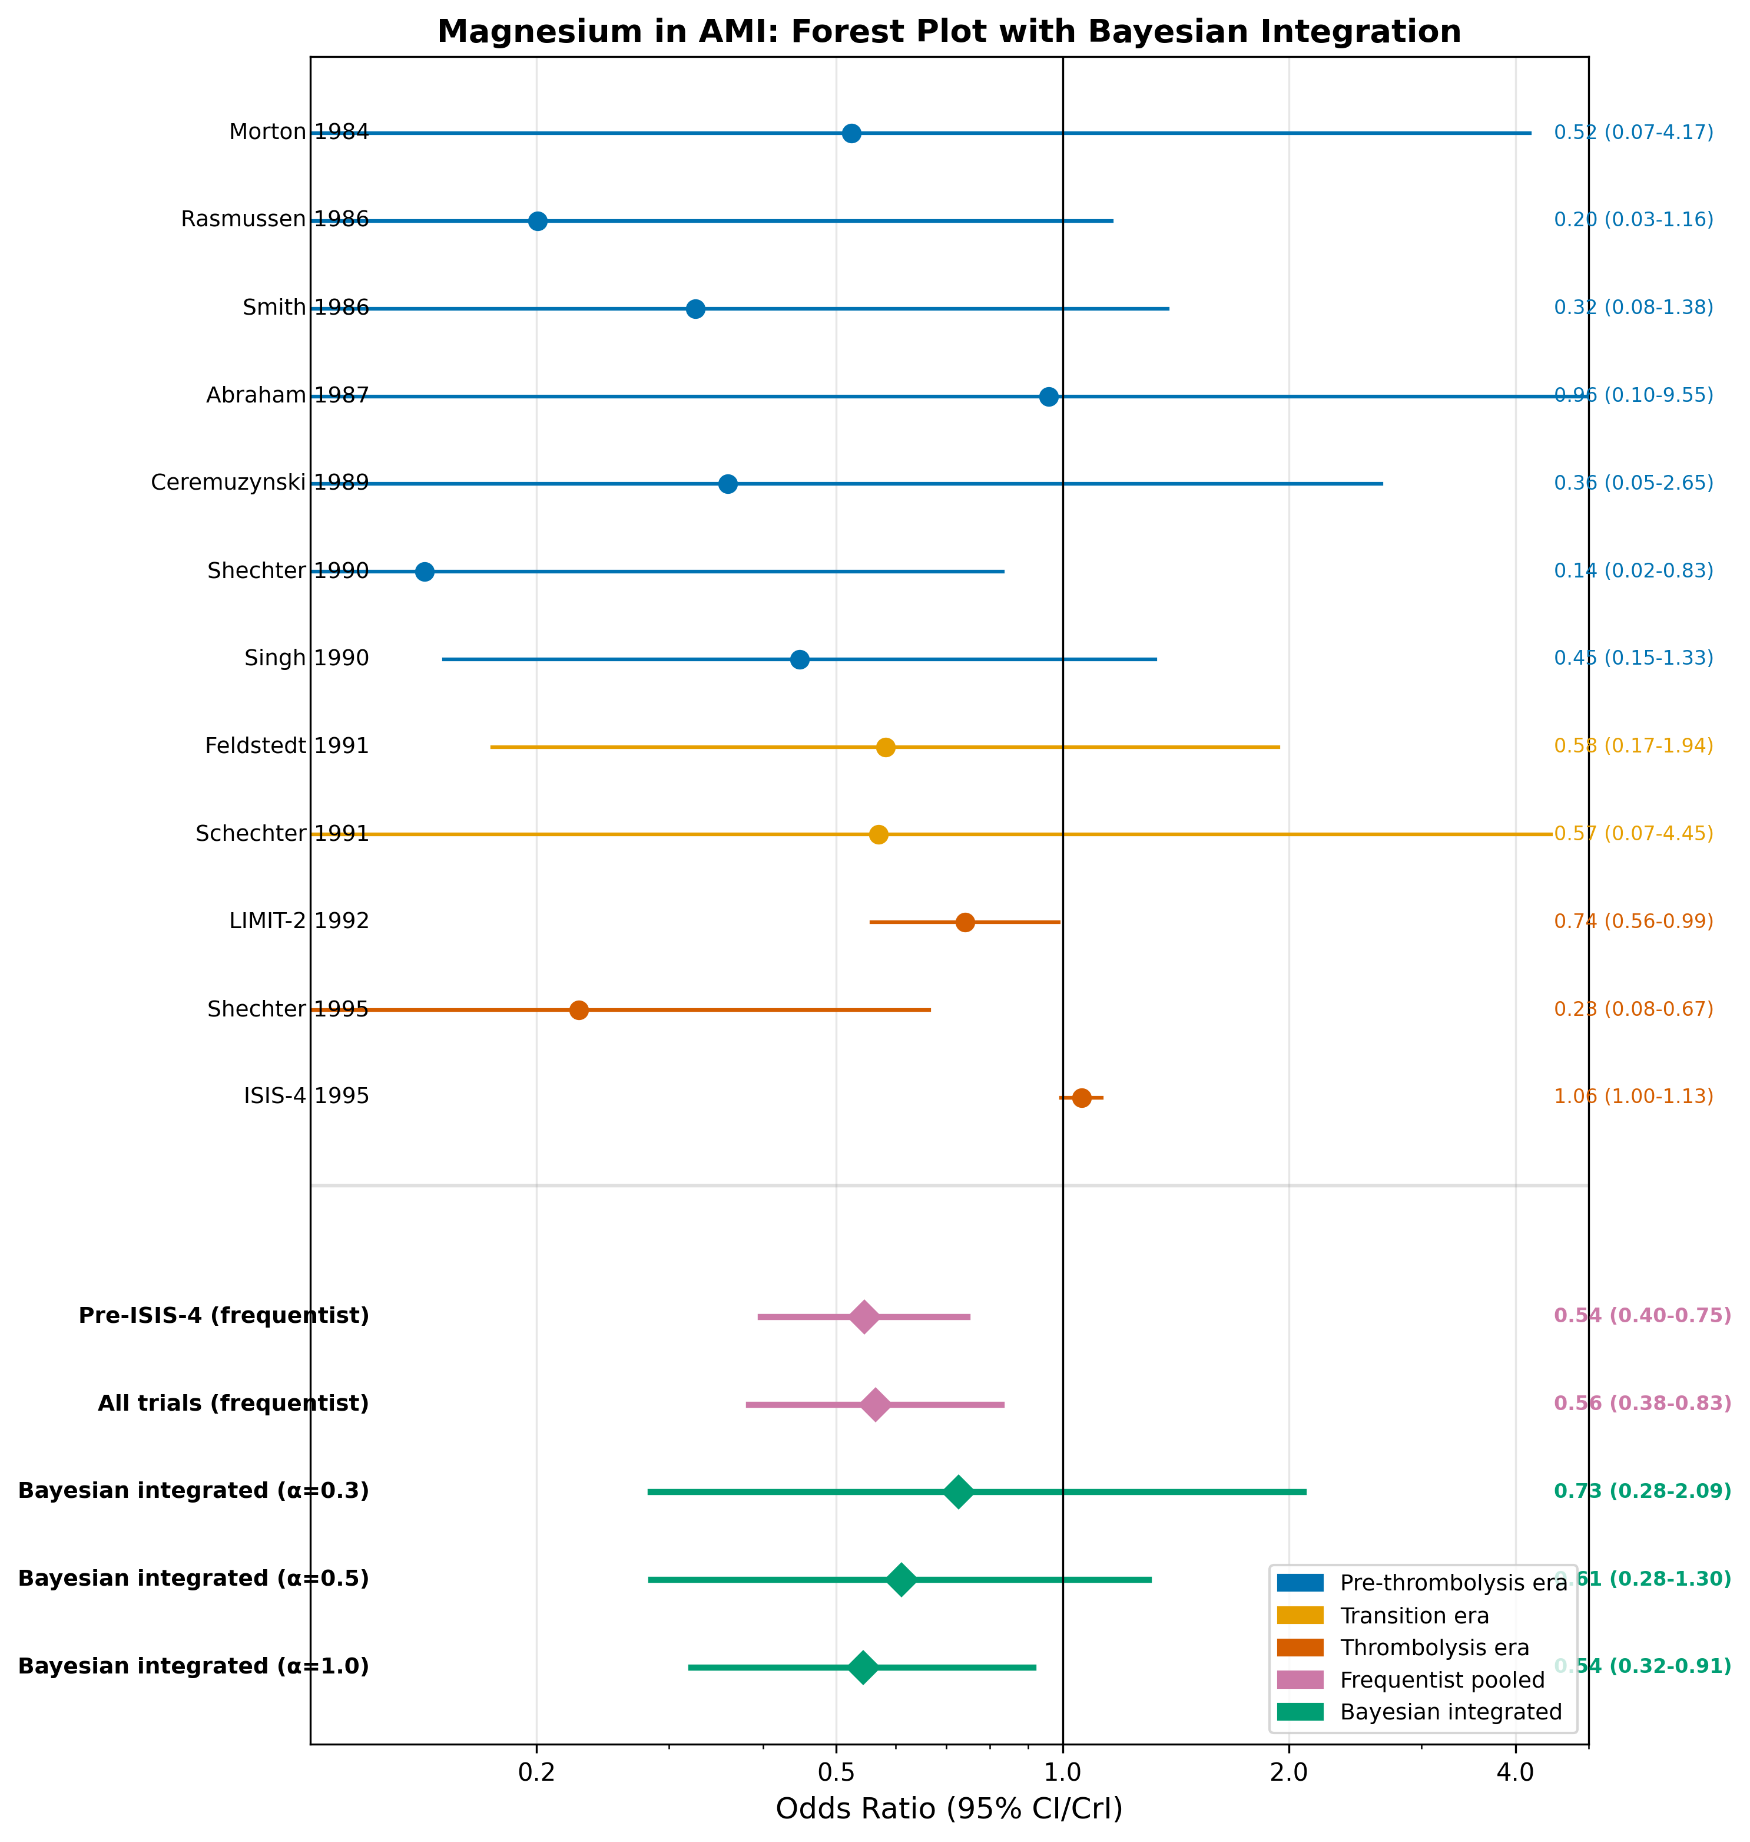
Fig. 4: Forest plot for magnesium in AMI. Individual study odds ratios are shown with 95% confidence intervals, color-coded by era. Pooled estimates include frequentist random-effects (pre-ISIS-4 and all trials) and Bayesian integrated estimates at selected discounting levels (alpha = 0.3, 0.5, 1.0).

Slide 5
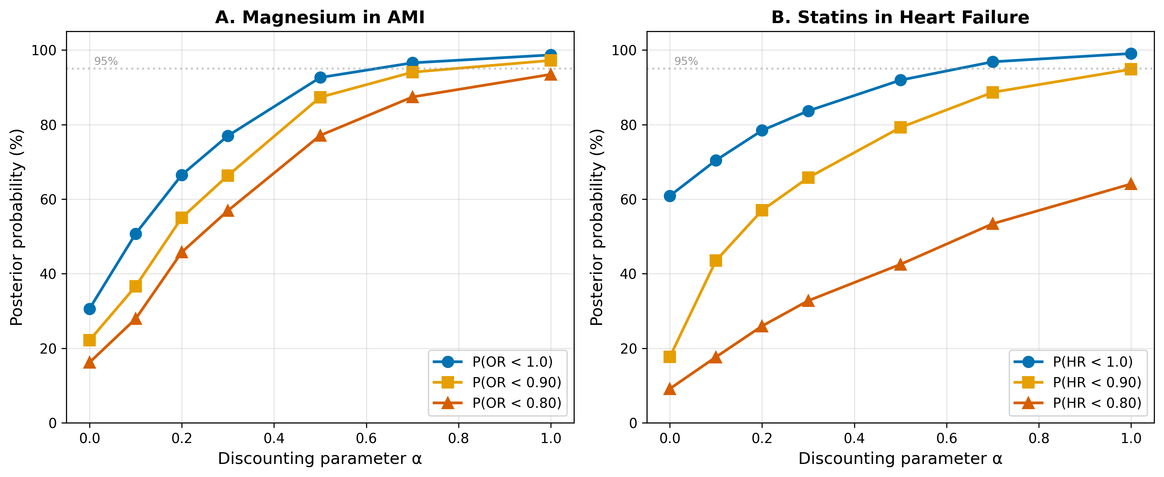
Fig. 5: Sensitivity analysis of Bayesian integration to the discounting parameter alpha. (A) Magnesium in AMI. (B) Statins in HF. Three posterior probability thresholds are shown: P(effect < 1.0), P(effect < 0.90), and P(effect < 0.80). Horizontal dashed line indicates 95% probability threshold.

Slide 6
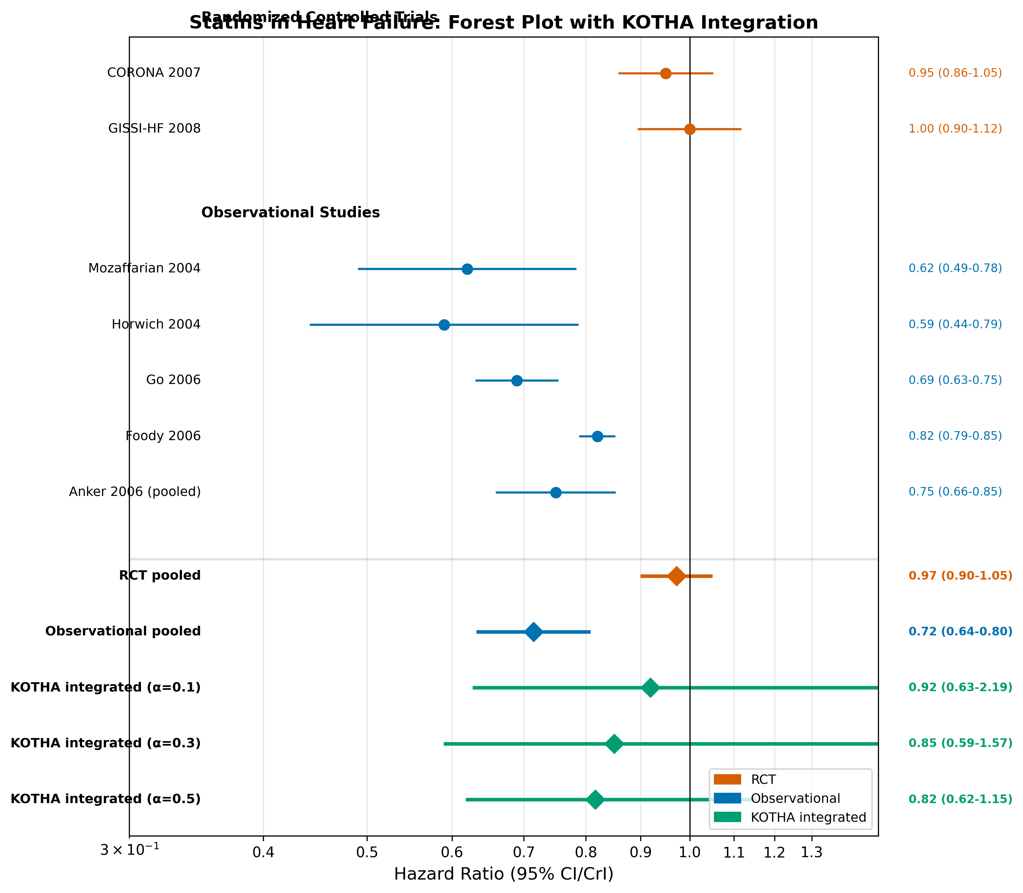
Fig. 6: Forest plot for statins in heart failure. Individual study hazard ratios are shown with 95% confidence intervals, grouped by design (RCT vs. observational). Pooled estimates include design-specific frequentist pooling and KOTHA-integrated estimates at selected discounting levels (alpha = 0.1, 0.3, 0.5).

Slide 7
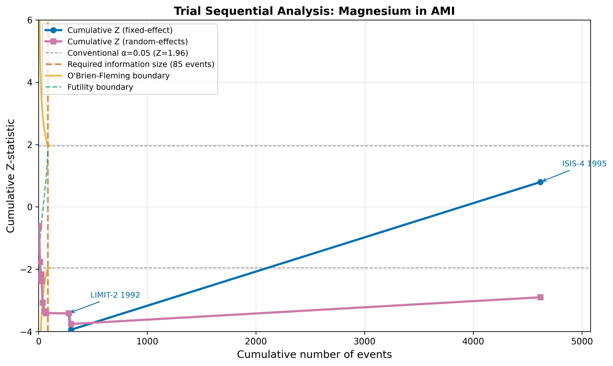
Fig. 7: Trial sequential analysis for magnesium in AMI. The cumulative Z-curve is plotted against cumulative events. Vertical dashed line indicates the optimal information size (OIS). Curved lines show O'Brien-Fleming monitoring boundaries. Key studies (LIMIT-2, ISIS-4) are annotated.

Slide 8
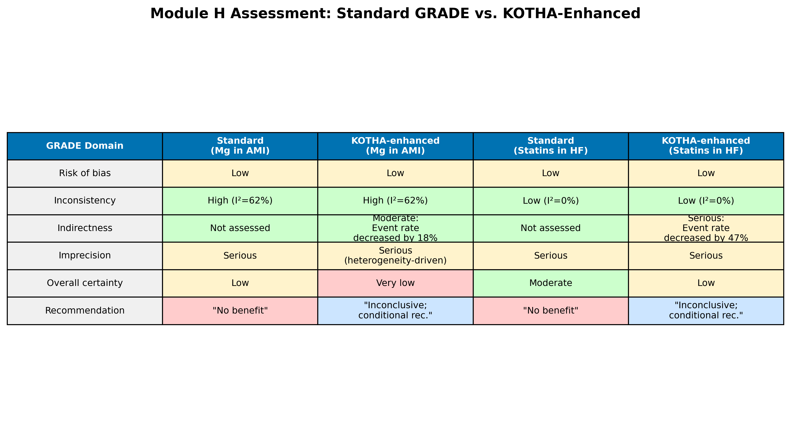
Fig. 8: Module H assessment comparison: standard GRADE vs. KOTHA-enhanced evaluation for both illustrative cases. Color coding indicates severity of concern (green = no concern, yellow = moderate, red = serious).

