Slide 1
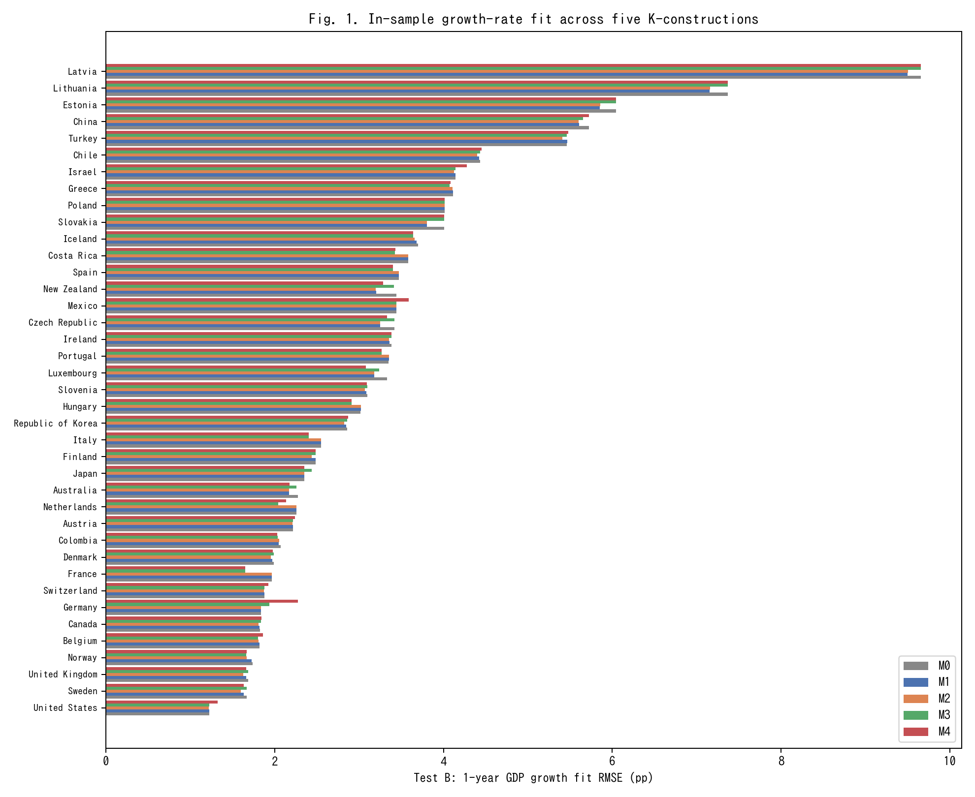
Fig. 1. In-sample 1-year GDP growth RMSE across M0-M4 for 39 countries (lower is better).
In-sample 1-year GDP growth RMSE across M0-M4 for 39 countries (lower is better).

Slide 2
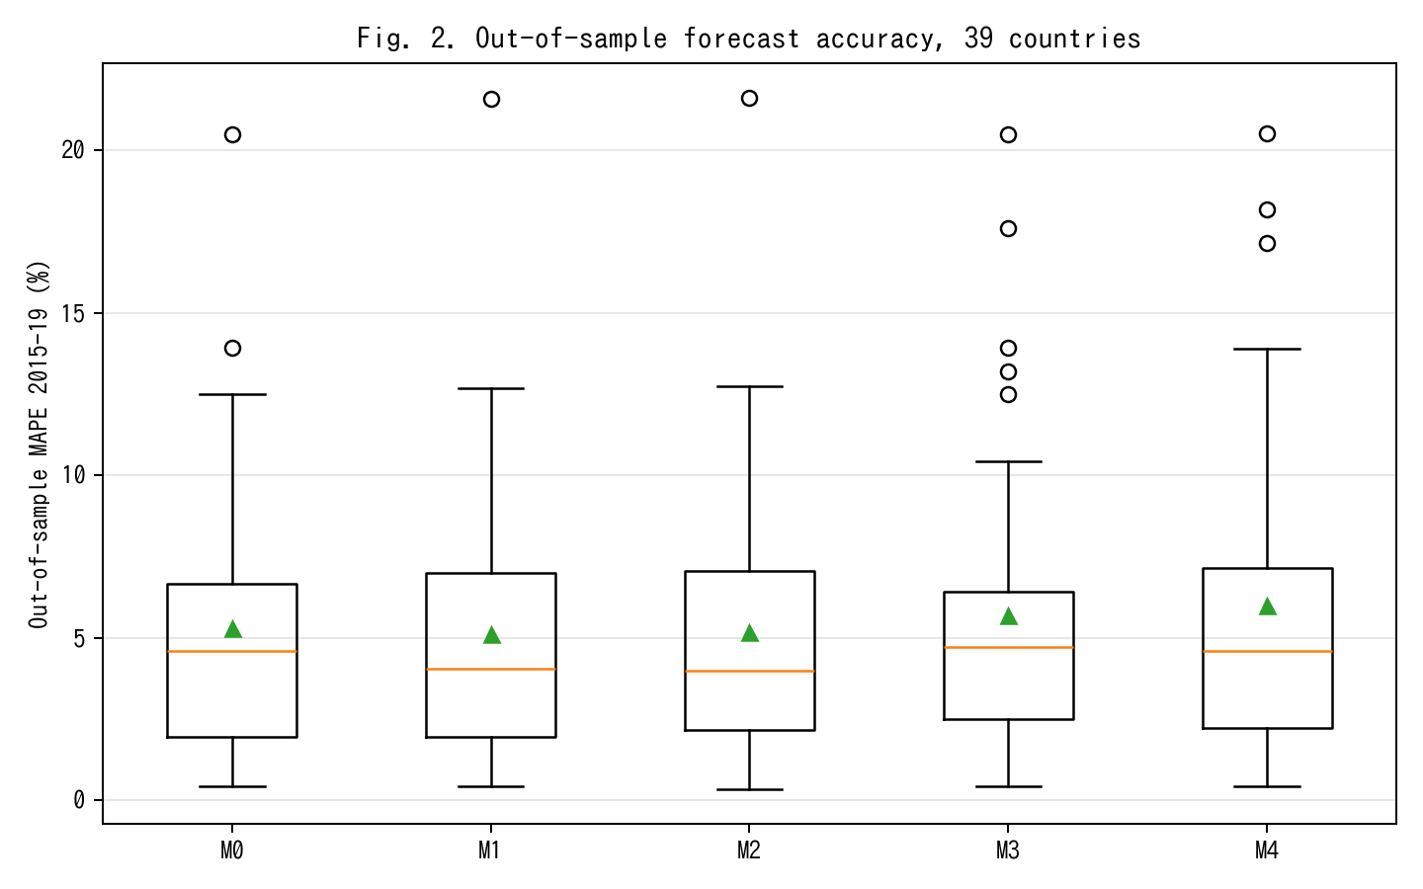
Fig. 2. Out-of-sample MAPE on 2015-19 held-out window; M2 achieves 13% relative improvement vs M0.
Out-of-sample MAPE on 2015-19 held-out window; M2 achieves 13% relative improvement vs M0.

Slide 3
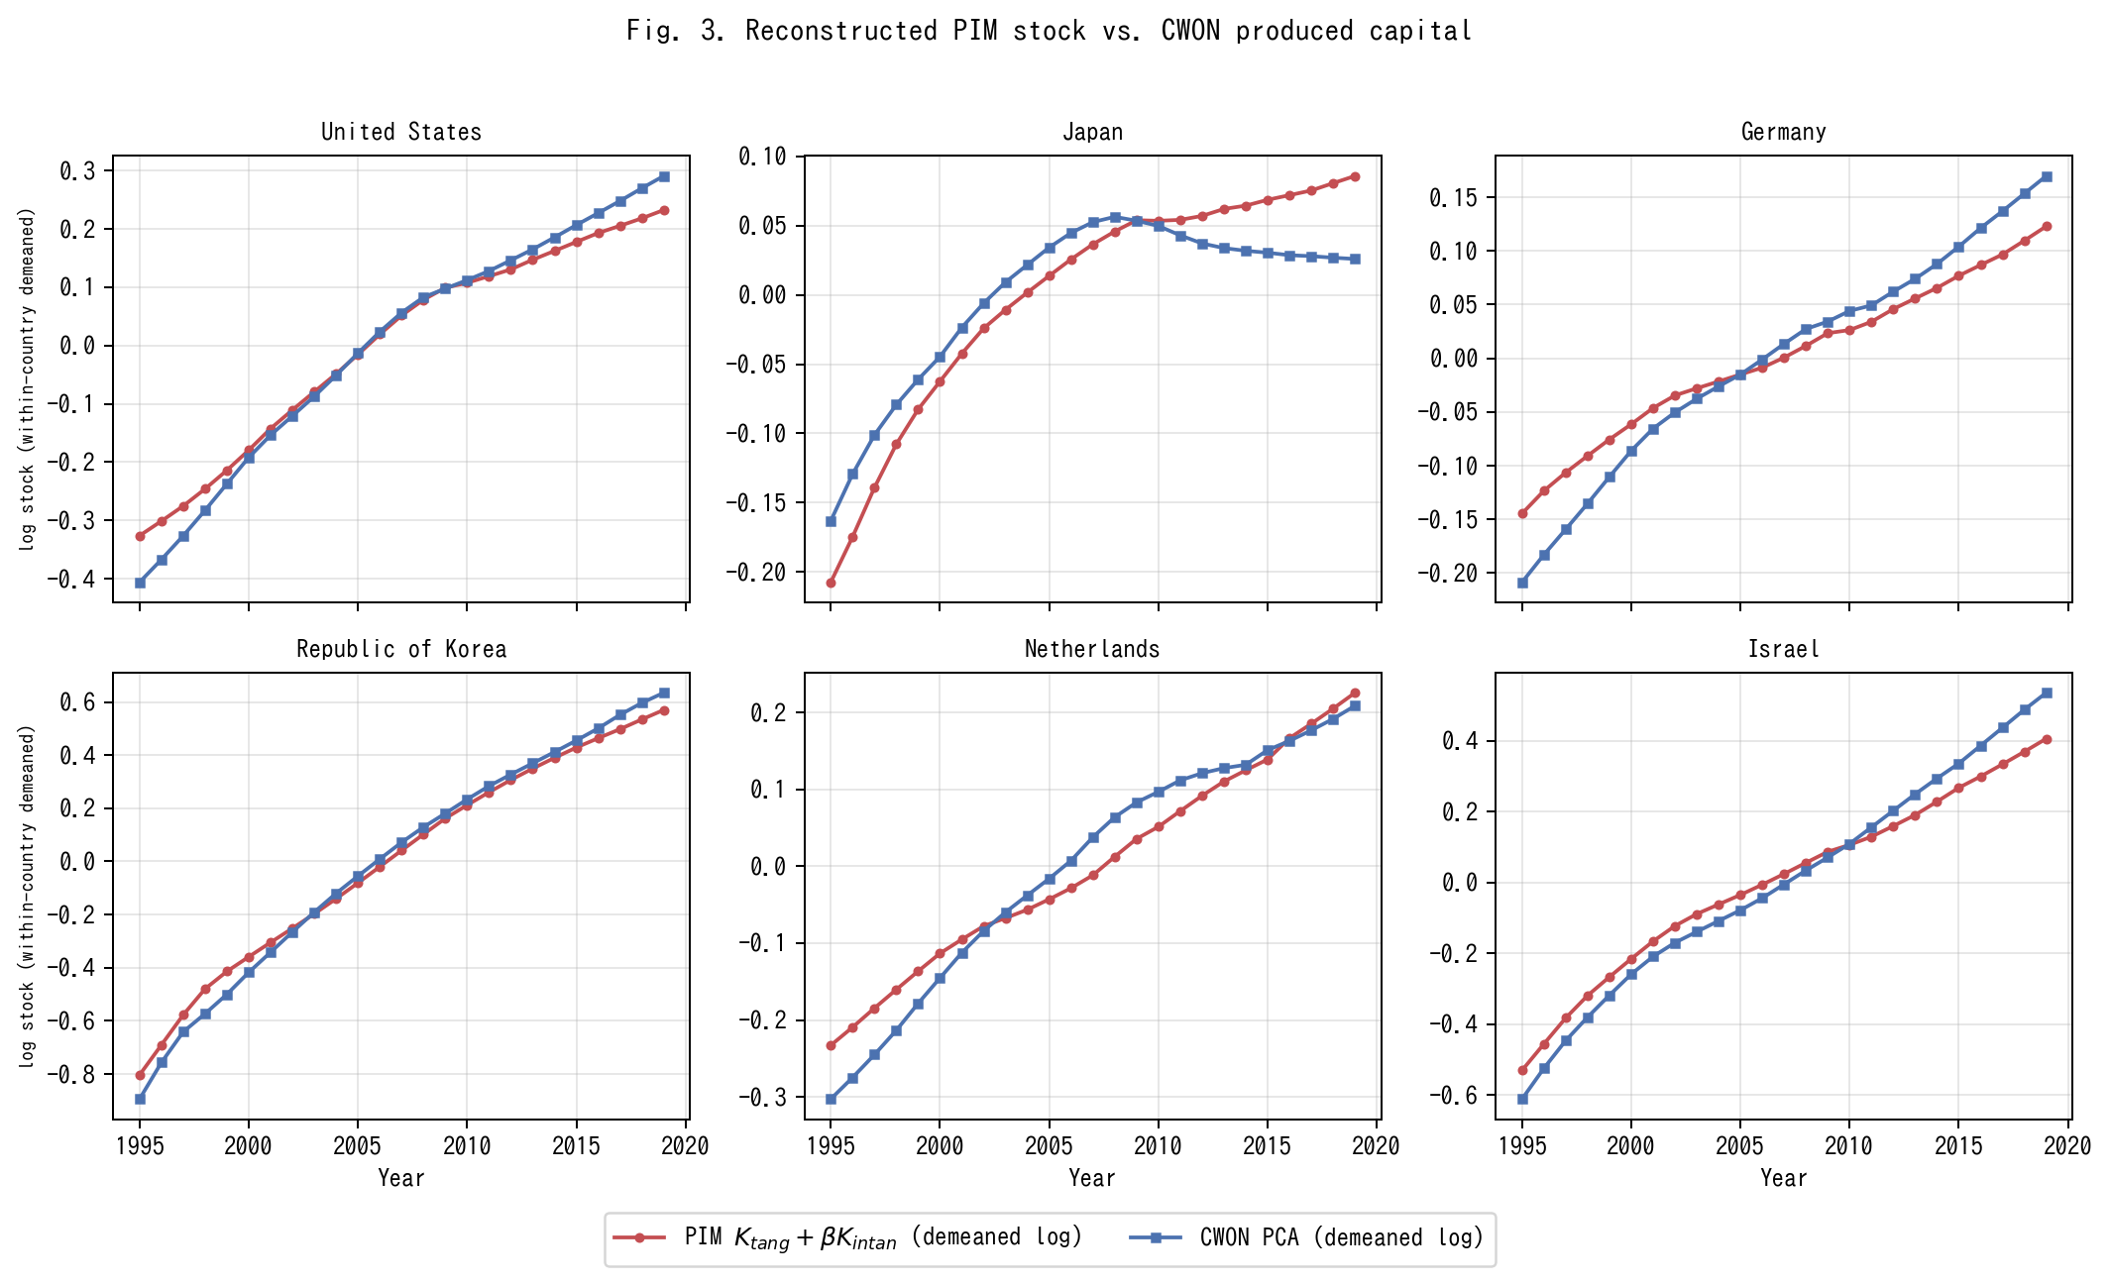
Fig. 3. PIM stock K_tang+betaK_I versus CWON PCA (within-country demeaned log).
PIM stock K_tang+betaK_I versus CWON PCA (within-country demeaned log).

Slide 4
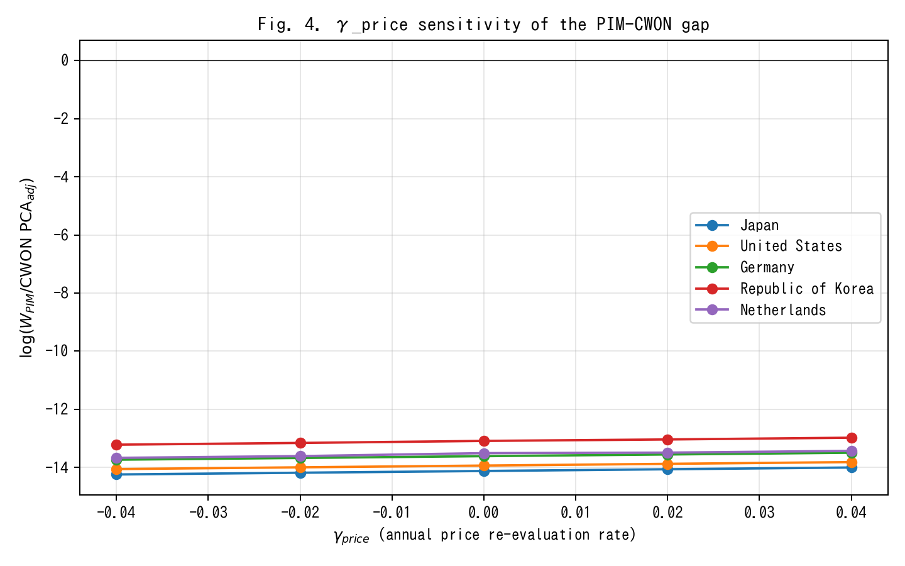
Fig. 4. gamma_price sensitivity of PIM/CWON log-ratio; Japan gap closes around gamma=+0.02.
gamma_price sensitivity of PIM/CWON log-ratio; Japan gap closes around gamma=+0.02.

Slide 5
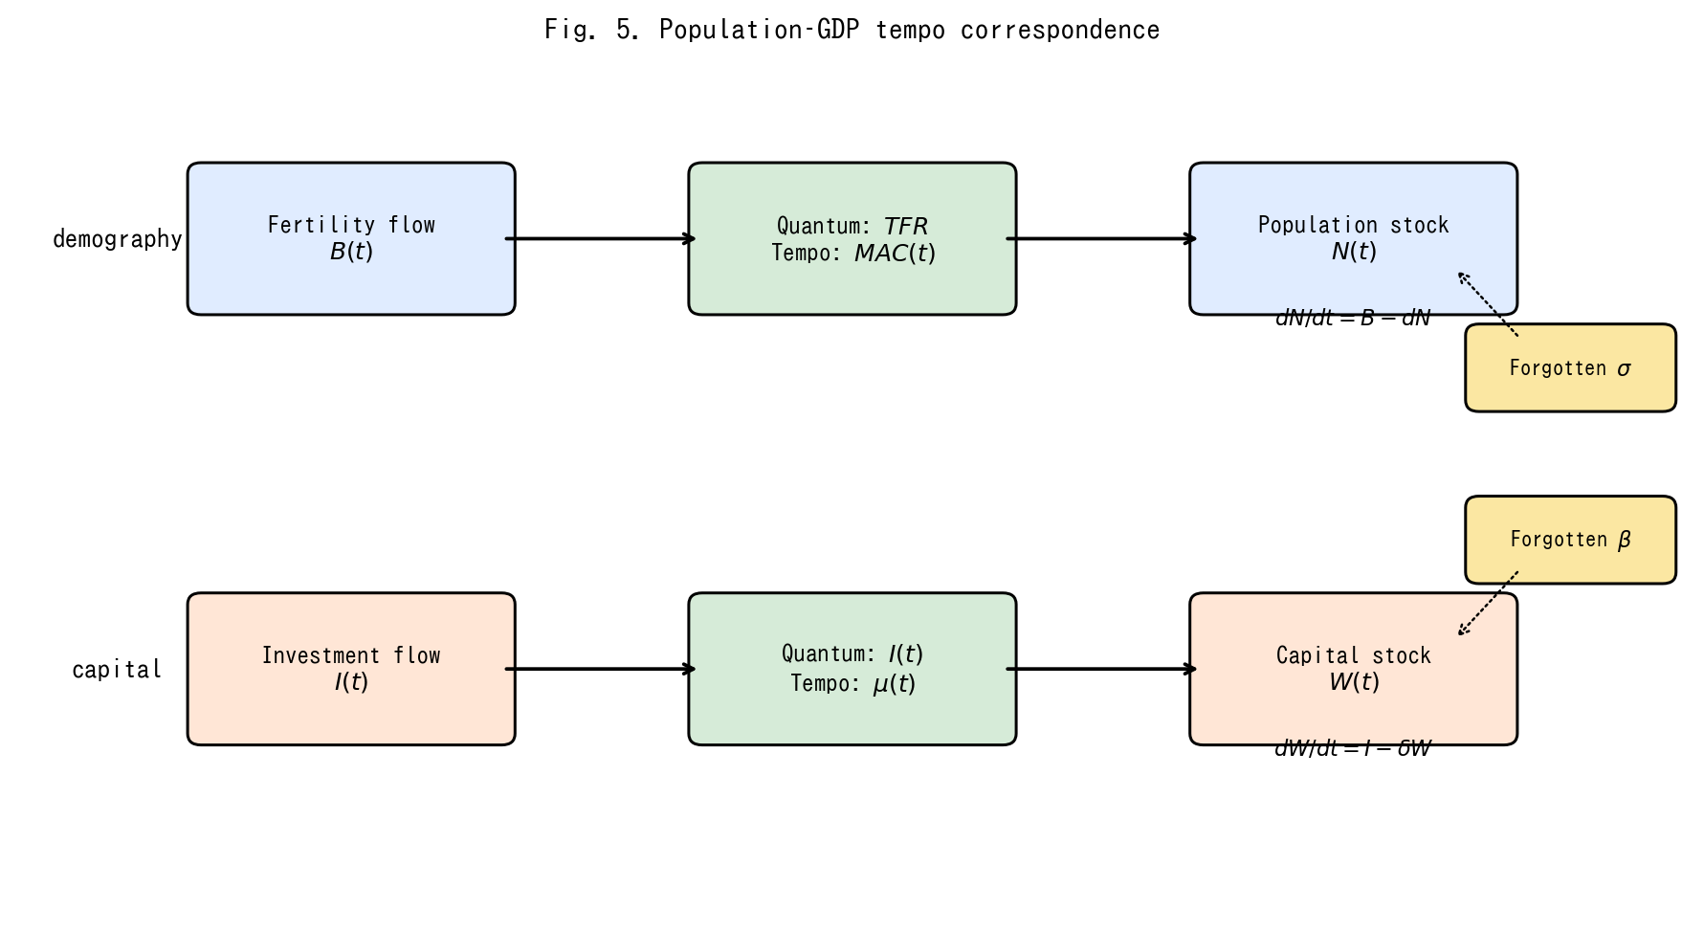
Fig. 5. Conceptual diagram of the population-capital tempo correspondence.
Conceptual diagram of the population-capital tempo correspondence.

