Slide 1
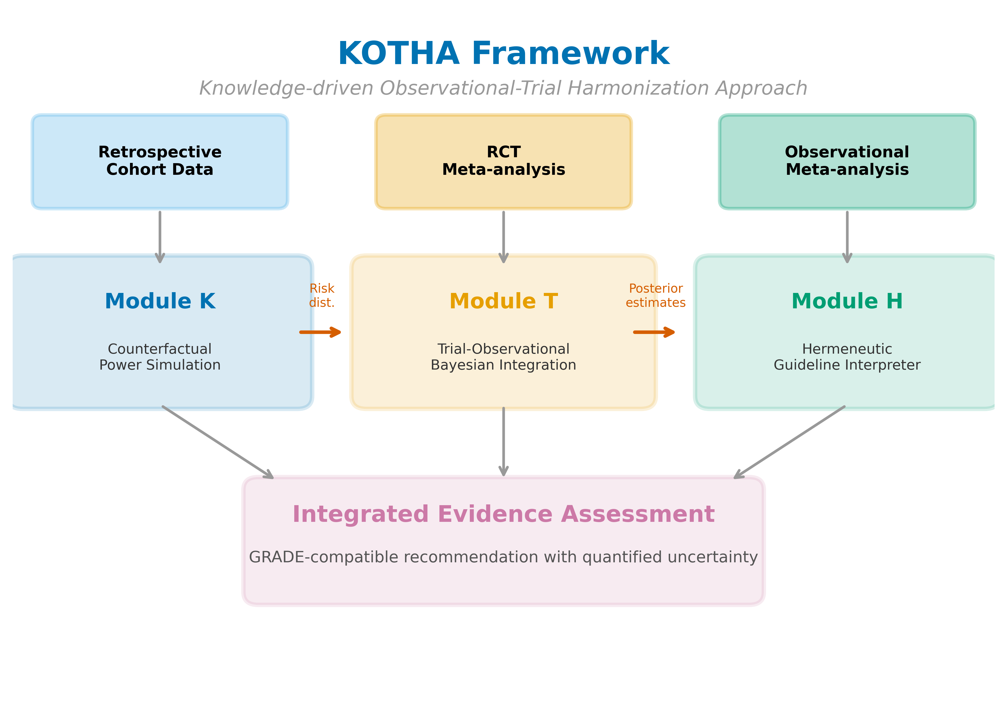
Figure 1
Figure 1. Overview of the KOTHA Framework. Module K (Counterfactual Power Simulation) quantifies risk-profile shift and estimates power under counterfactual enrollment scenarios. Module T (Bayesian Evidence Integration) combines RCT and observational evidence using power-prior discounting. Module H (Guideline Interpreter) synthesizes outputs into a structured GRADE-compatible assessment.

Slide 2
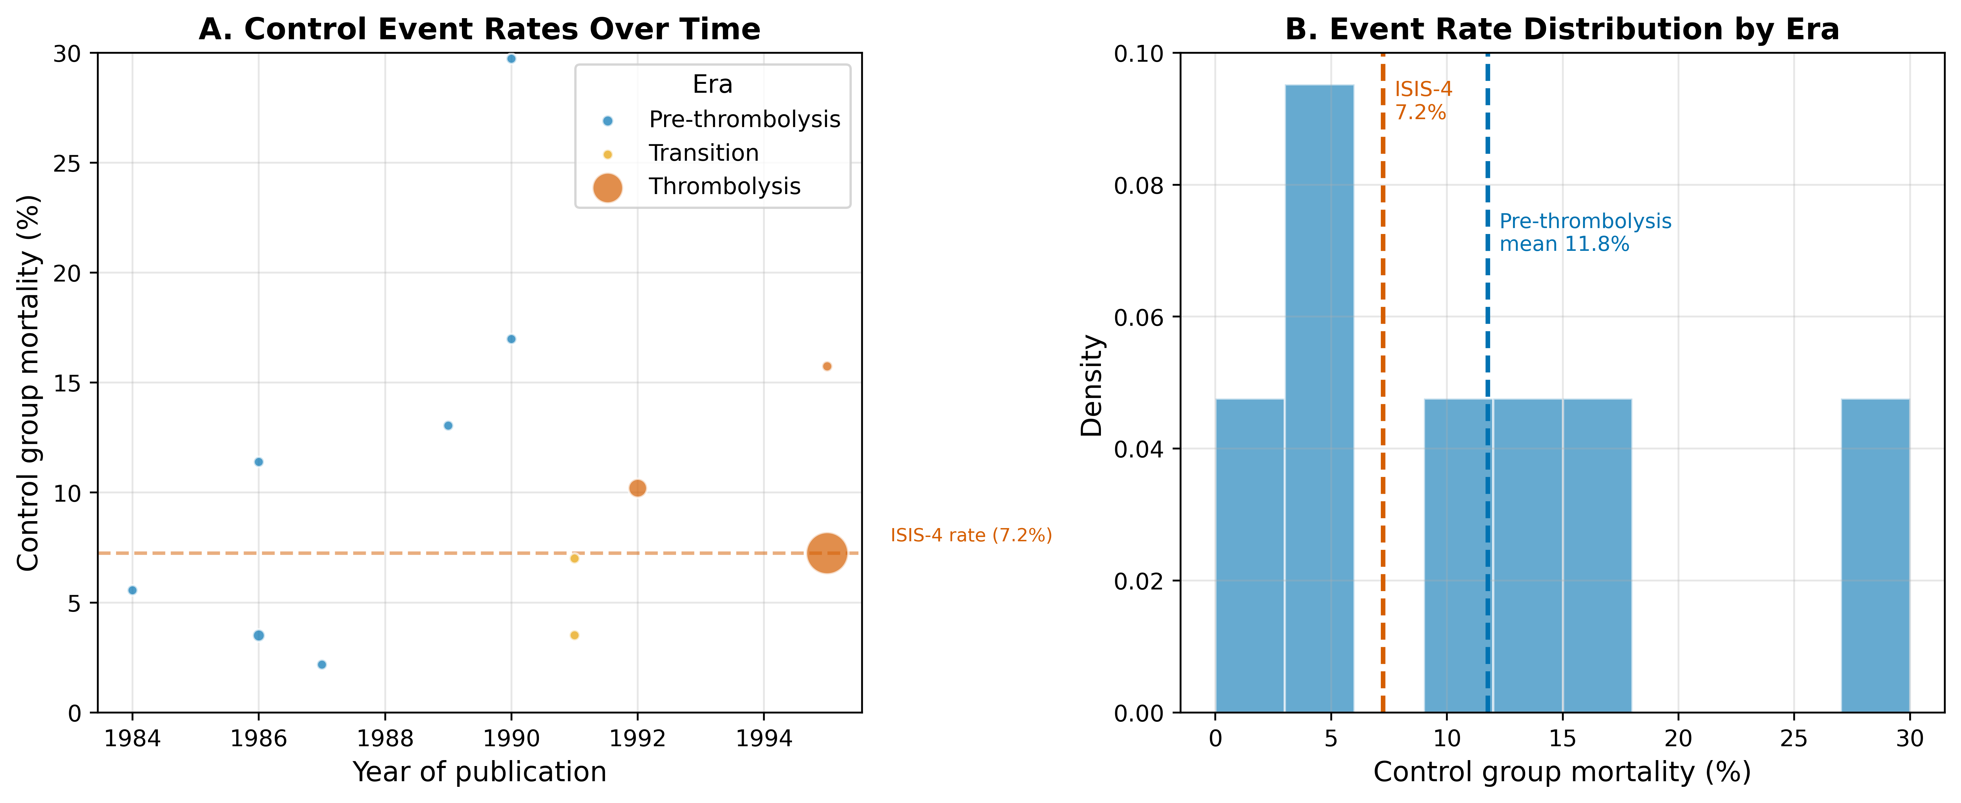
Figure 2
Figure 2. Risk-profile shift in the magnesium-in-AMI case. (A) Control-group mortality rates over time, with bubble size proportional to study sample size and colors indicating era. (B) Weighted mean control mortality by era.

Slide 3
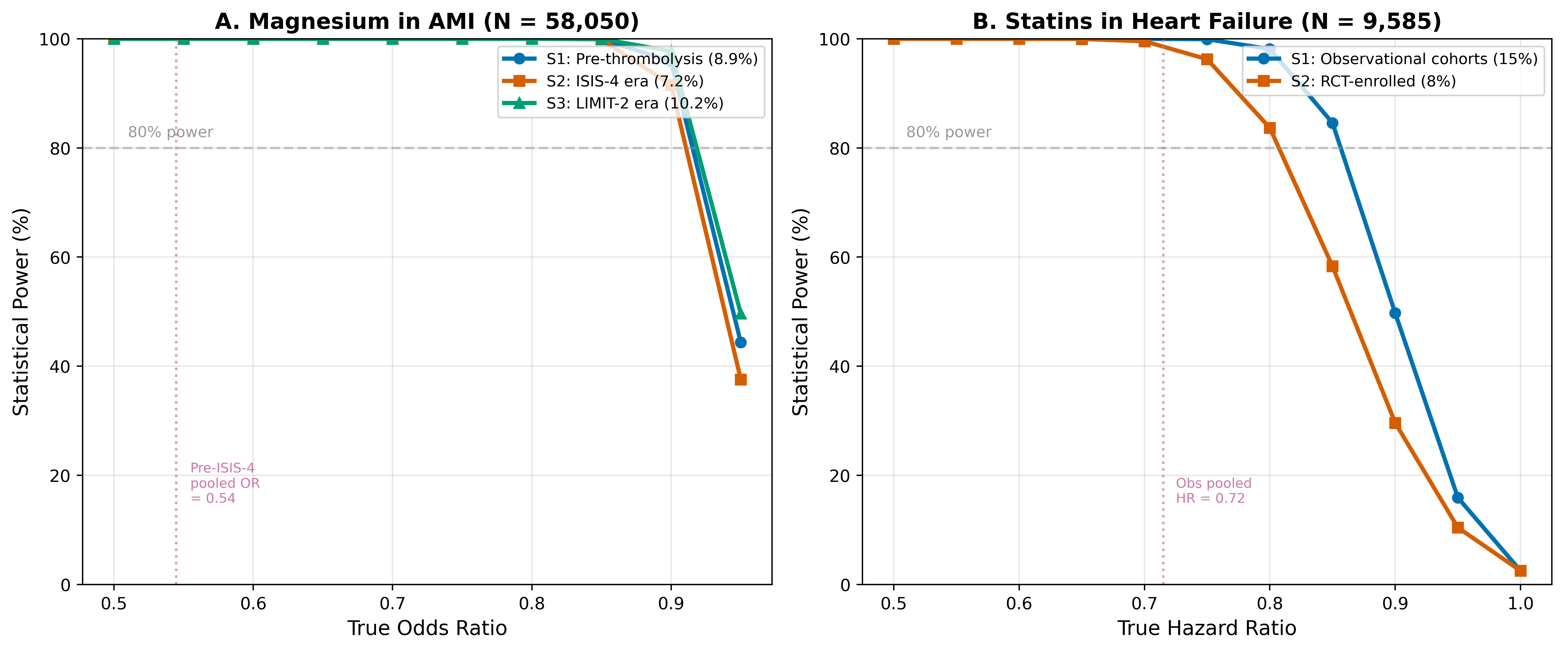
Figure 3
Figure 3. Estimated power by enrollment scenario and true effect size. (A) Magnesium in AMI at the ISIS-4 sample size (N = 58,050). (B) Statins in HF at the combined RCT sample size (N = 9,585). S1 = real-world/observational event rate; S2 = RCT event rate; S3 = intermediate/enriched rate. Horizontal dashed lines indicate 80% power.

Slide 4
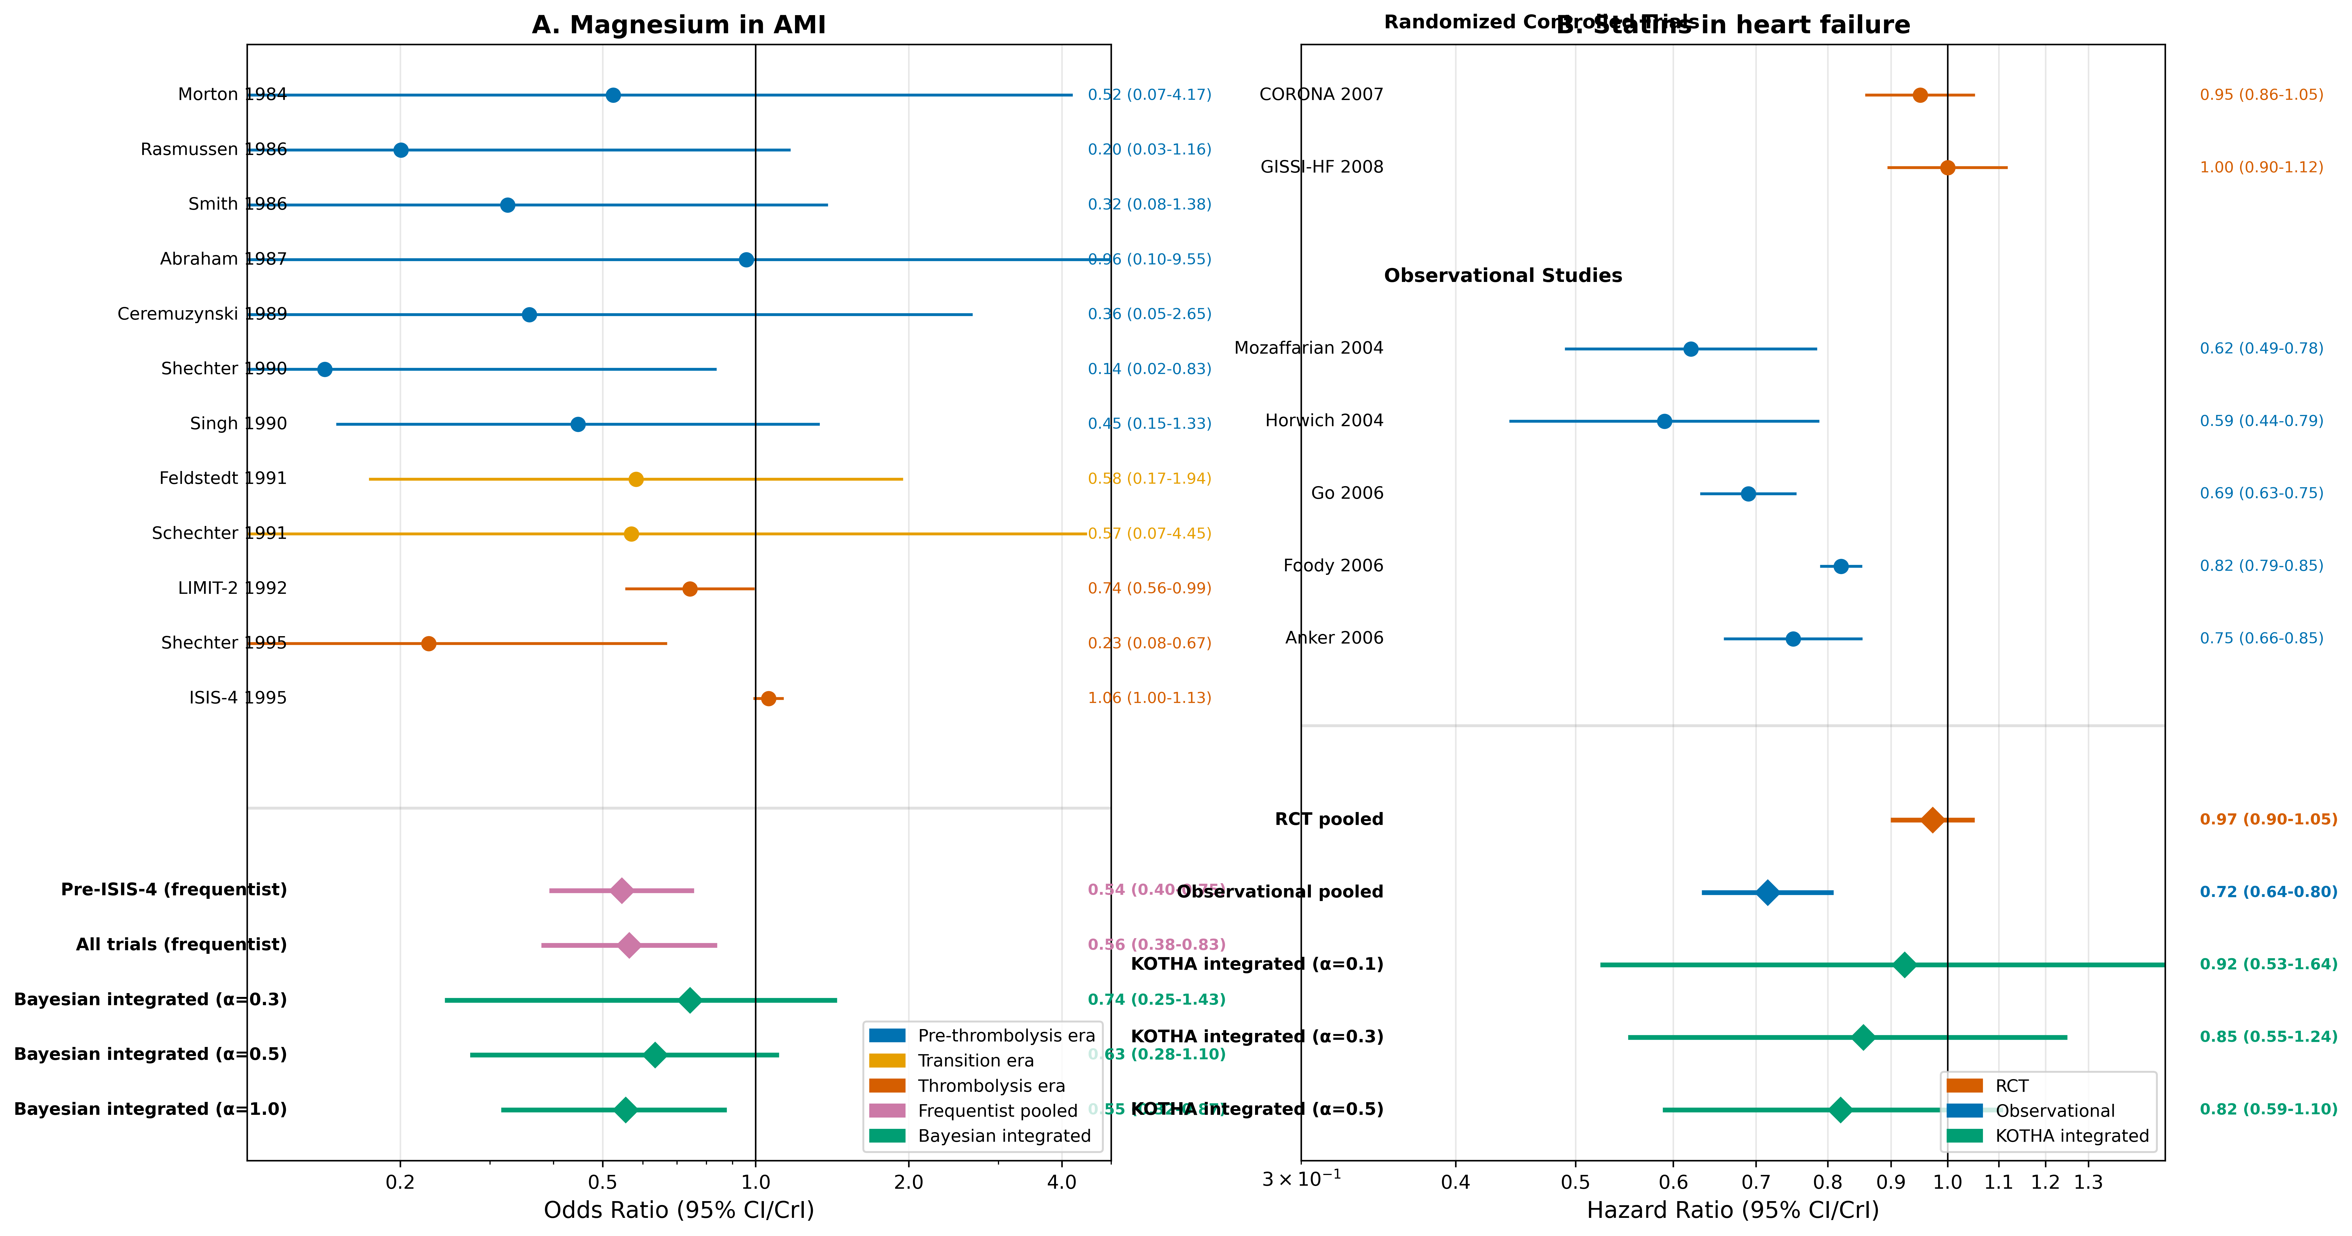
Figure 4
Figure 4. Forest plots for (A) magnesium in AMI and (B) statins in heart failure. Individual study effect estimates are shown with 95% confidence intervals. Pooled estimates include frequentist random-effects and Bayesian integrated estimates at selected discounting levels (α = 0.3, 0.5, 1.0 for magnesium; 0.1, 0.3, 0.5 for statins).

