Slide 1
LINKO (Latent Information Normalization for Key Outcomes): A Framework for Evaluating the Validity of Meta-Analytic Pooling Across Heterogeneous RCT Data Structures
Editable figures (7), generated from results/results.json on 2026-08-03T11:10:15Z

Slide 2
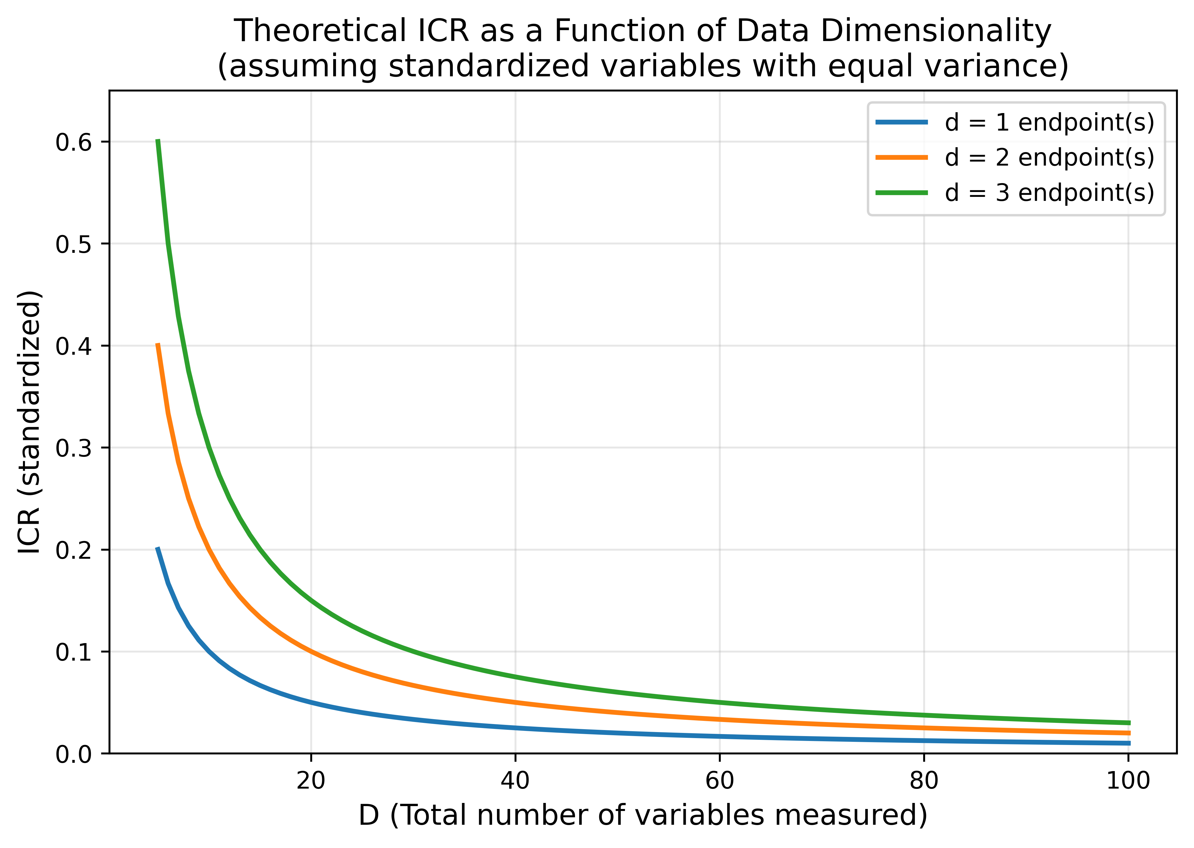
Figure 1
Figure 1. Relationship between the number of measured variables and the dimension-counting Information Contribution Ratio (ICR_std = d/D) for a single endpoint. The curve is deterministic and illustrates why the measure is dominated by variable counting.

Slide 3
Figure 2
Figure 2. Simulation results for the uniform-ICR (Scenario A) and heterogeneous-ICR (Scenario B) designs: distributions of I-squared, tau-squared, ICR discrepancy and the pooled effect.

Slide 4
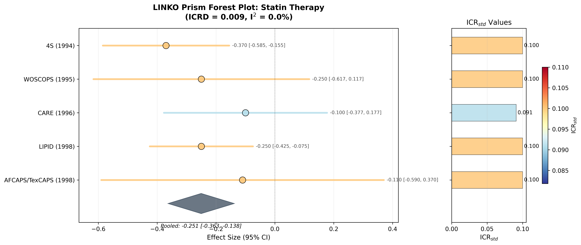
Figure 3
Figure 3. Prism forest plot for the statin collection. Marker colour encodes ICR_std; the side panel lists the values. The display is descriptive.

Slide 5
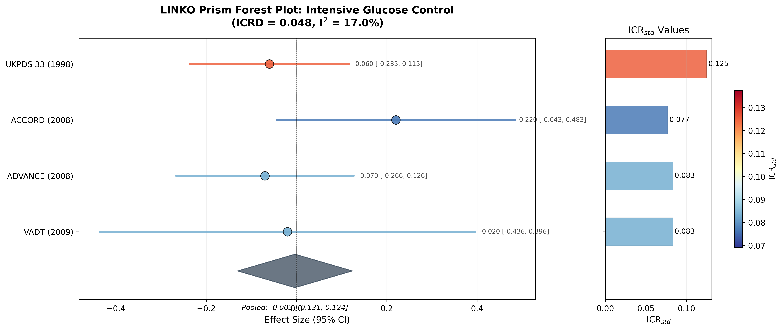
Supplementary Figure S1
Supplementary Figure S1. Prism forest plot for the intensive glucose-control collection.

Slide 6
Figure 4
Figure 4. Principal-component-based ICR in eight International Stroke Trial country groups: estimator values, their dispersion, and their relation to 14-day mortality.

Slide 7
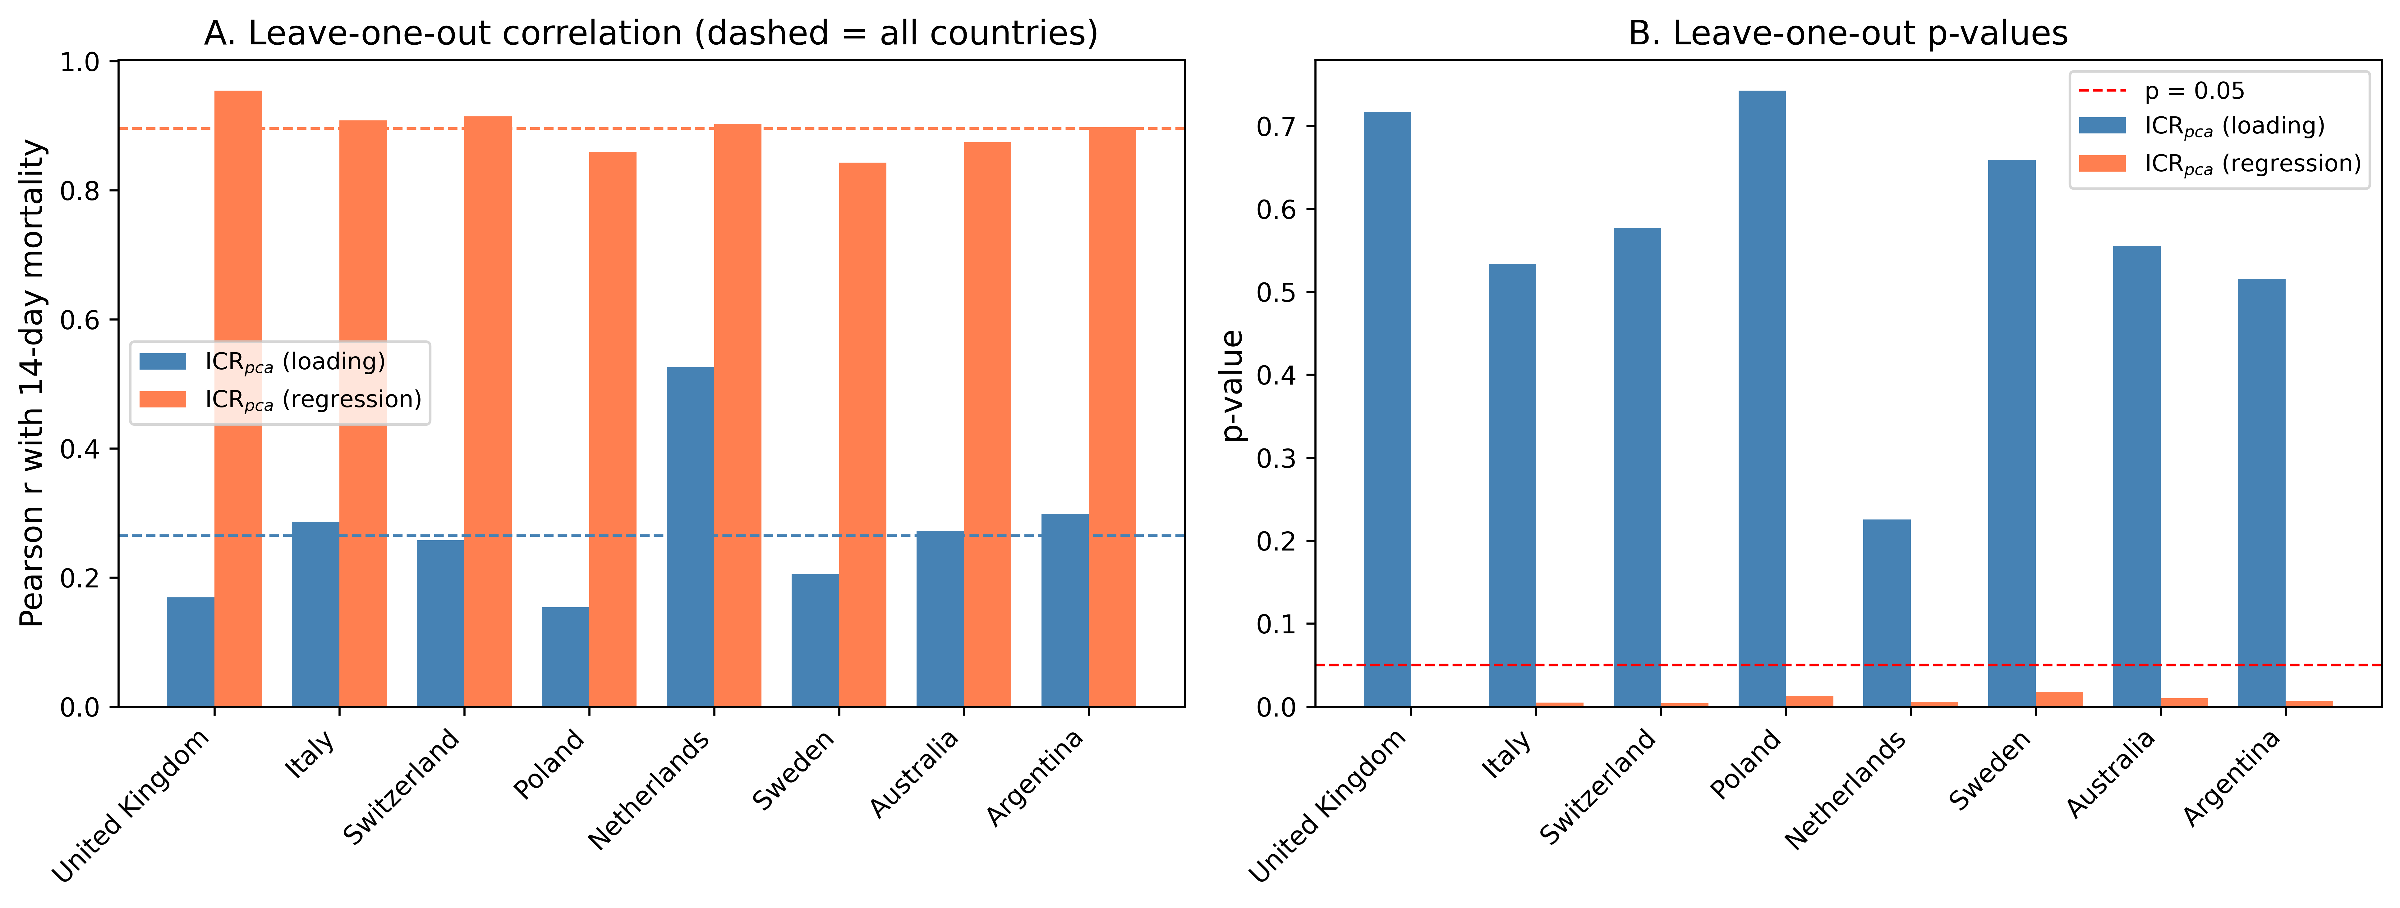
Supplementary Figure S2
Supplementary Figure S2. Leave-one-out recomputation of the association between each PCA-based ICR estimator and 14-day mortality across the eight country groups.

Slide 8
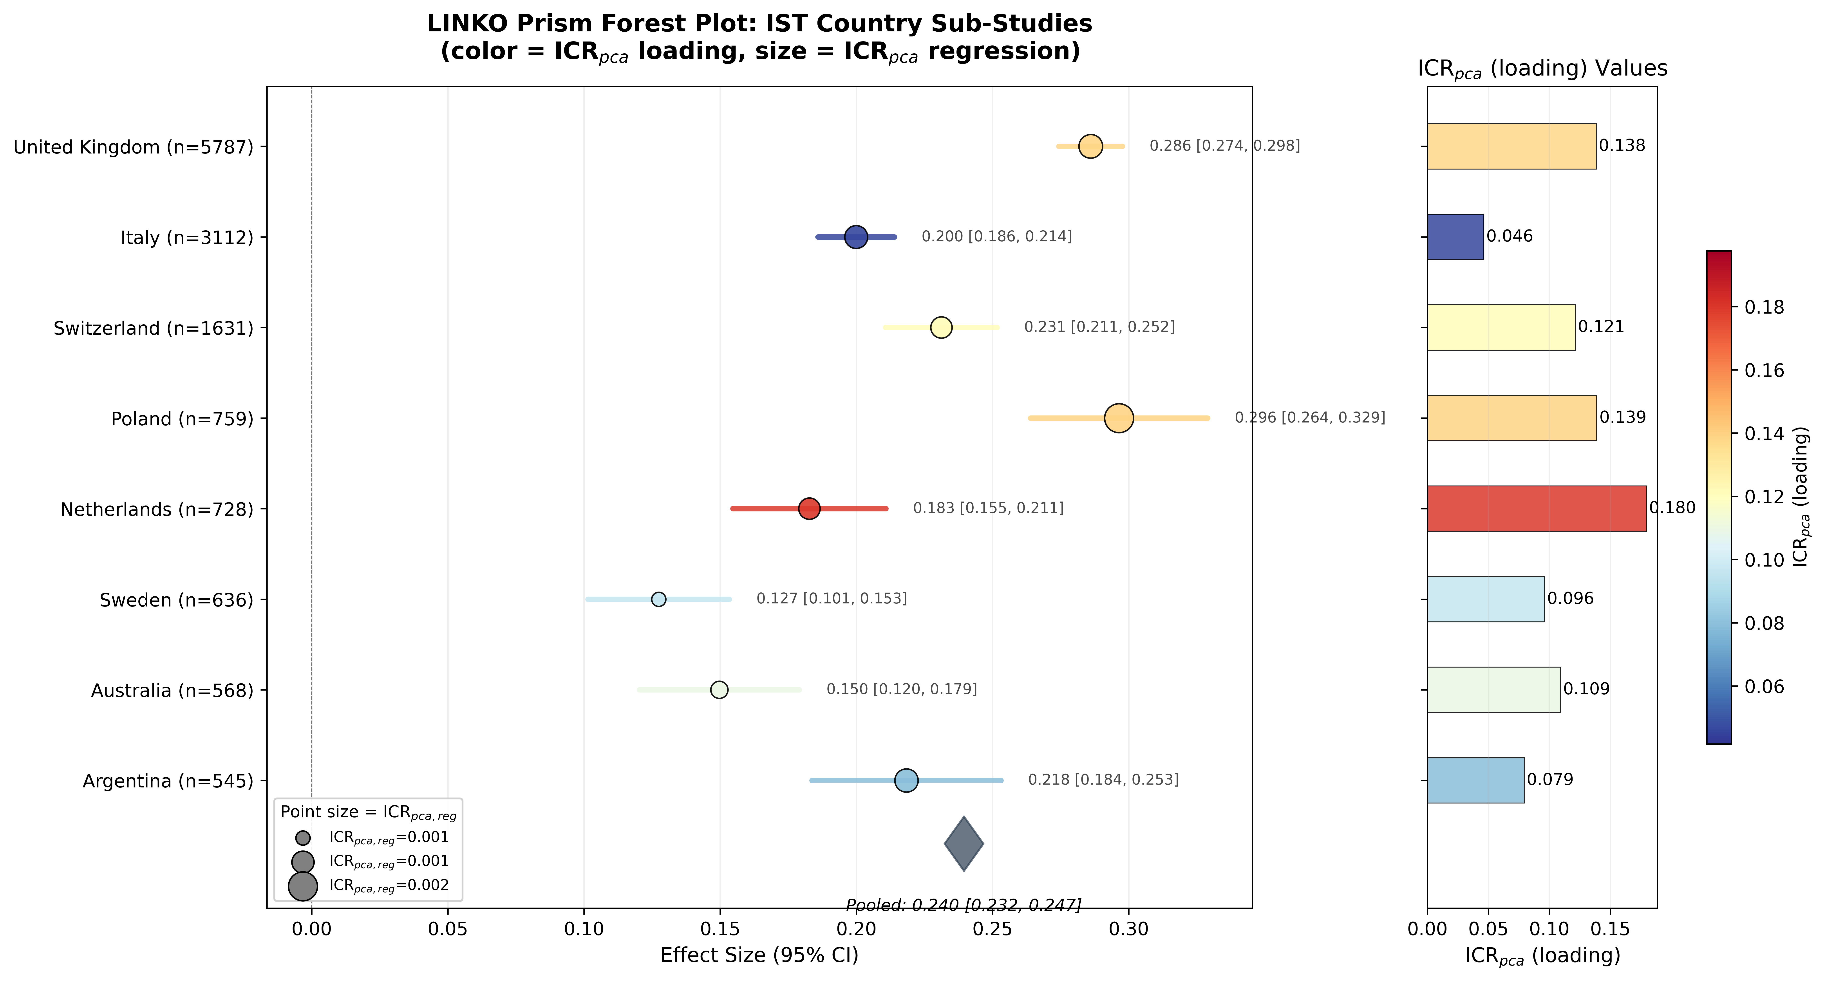
Figure 5
Figure 5. Prism forest plot for the International Stroke Trial country groups, with colour encoding the loading-based estimator and marker size the regression-based estimator. Rates are shown for display; the groups are not independent trials.

