Slide 1
LINKO (Latent Information Normalization for Key Outcomes)
A Framework for Evaluating the Validity of Meta-Analytic Pooling Across Heterogeneous RCT Data Structures

Slide 2
ICR Concept: Why Data Dimensionality Matters
Study A (D = 10)
EP
V1
V2
V3
V4
V5
V6
V7
V8
V9
ICR = 1/10 = 0.10 (10%)
Study B (D = 50)
EP
...
ICR = 1/50 = 0.02 (2%)
Same endpoint, same effect size estimate
→ But endpoint represents 10% vs 2% of the data space
→ ICRD = 0.08 → Are these truly comparable for pooling?

Slide 3
LINKO Framework Overview
LINKO
(Latent Information Normalization
for Key Outcomes)
Core Question: Does the endpoint carry the same
informational weight in every study?
Approach 1: Variance-based ICR
Approach 2: PCA-based ICR
ICR_std = d / D
Computable from published Table 1
Loading-based + Regression-based
Requires individual patient data (IPD)
ICR Discrepancy (ICRD) = max(ICR) - min(ICR)
+ Prism Forest Plot Visualization
Report ICRD alongside I² and τ² in meta-analyses

Slide 4
LINKO Study Design and Validation Workflow
1. Simulation
(Monte Carlo)
2. Real-World
(Table 1 ICR)
3. PCA Validation
(IST IPD)
4. Visualization
(Prism Forest Plot)
5. Convergence
Analysis
Scenario A: Uniform ICR
Scenario B: Heterogeneous ICR
Scenario C: Sequential
Statin therapy (5 RCTs)
Glucose control (4 RCTs)
19,435 patients
8 country sub-studies
25 variables
Color = ICR value
Size = Secondary ICR
Side panel = ICR bars
500 iterations
3 strategies
ICR-guided selection
Key Findings
Simulation
Real-World
PCA (IST)
LOO Sensitivity
Convergence
Heterogeneous ICR → Higher I²
(11.7% vs 11.0%)
Low ICRD = Stable MA
High ICRD = Heterogeneous MA
ICR_pca × Mortality
r = 0.90 (p = 0.003)
Robust: r = 0.84–0.95
All p < 0.02
LINKO: lowest mean
studies to I²<25%

Slide 5
Prism Forest Plot: Concept
Standard Forest Plot
LINKO Prism Forest Plot
• x-axis: Effect size
x-axis: Effect size (unchanged)
• Study weight: Inverse variance
Prism
→
BAR COLOR = ICR value
(warm red = high, cool blue = low)
• All bars same color
✗ No ICR information visible
POINT SIZE = Secondary ICR
(e.g., ICR_pca regression)
SIDE PANEL = ICR bar chart
aligned with each study
Like a prism decomposes white light into its spectrum,
the Prism Forest Plot decomposes the forest plot to reveal
hidden ICR dimensions of each study.

Slide 6
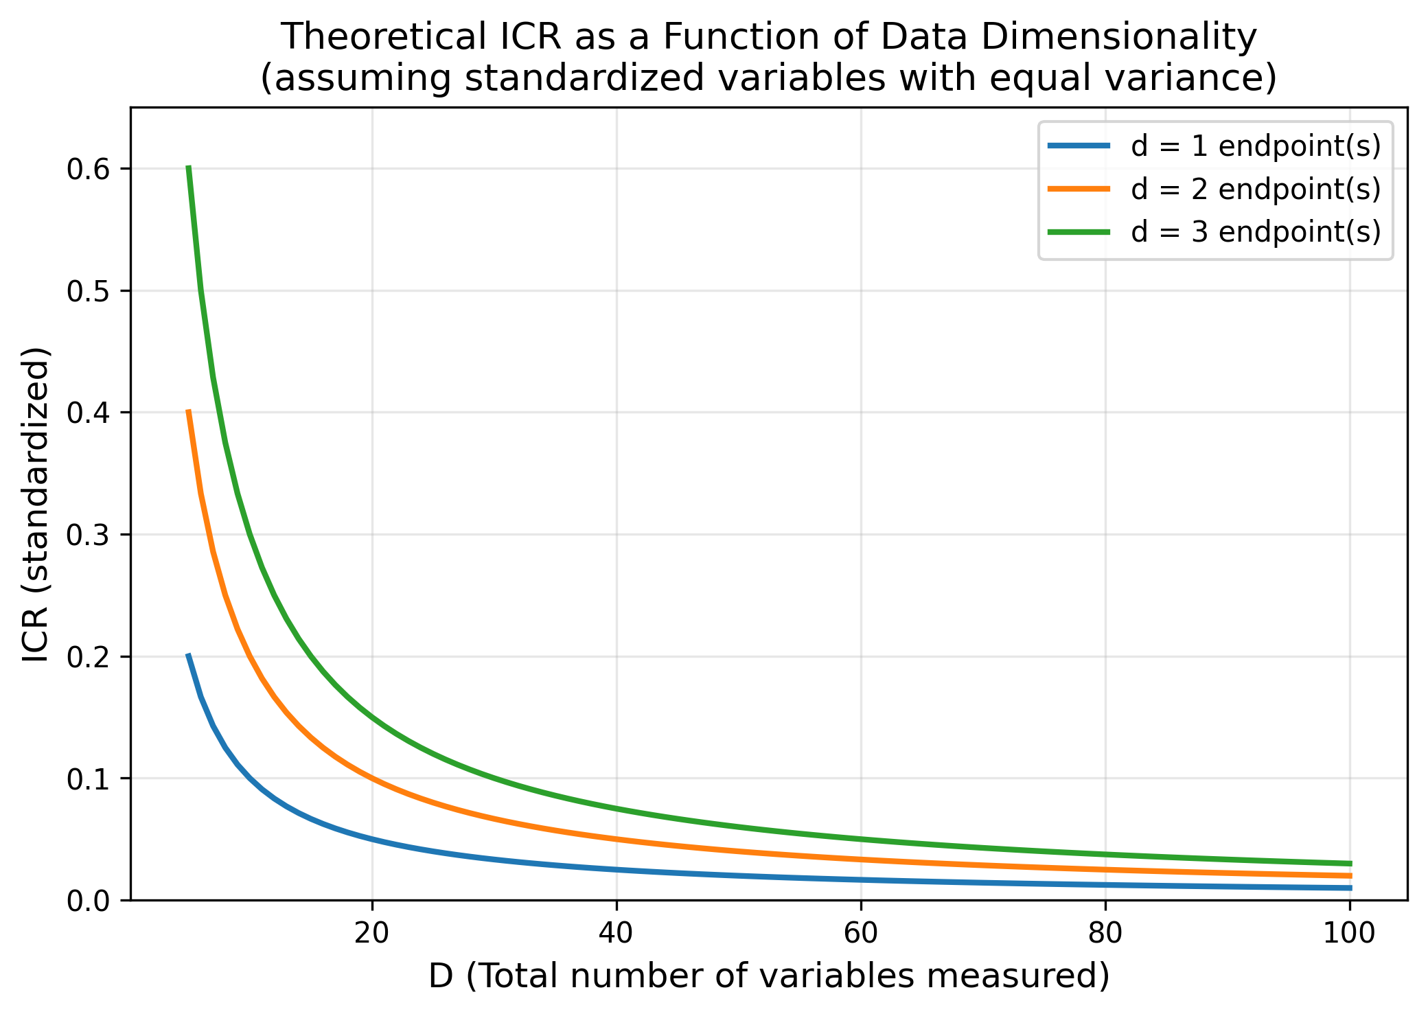
Figure 1. Theoretical ICR as a Function of Data Dimensionality

Slide 7
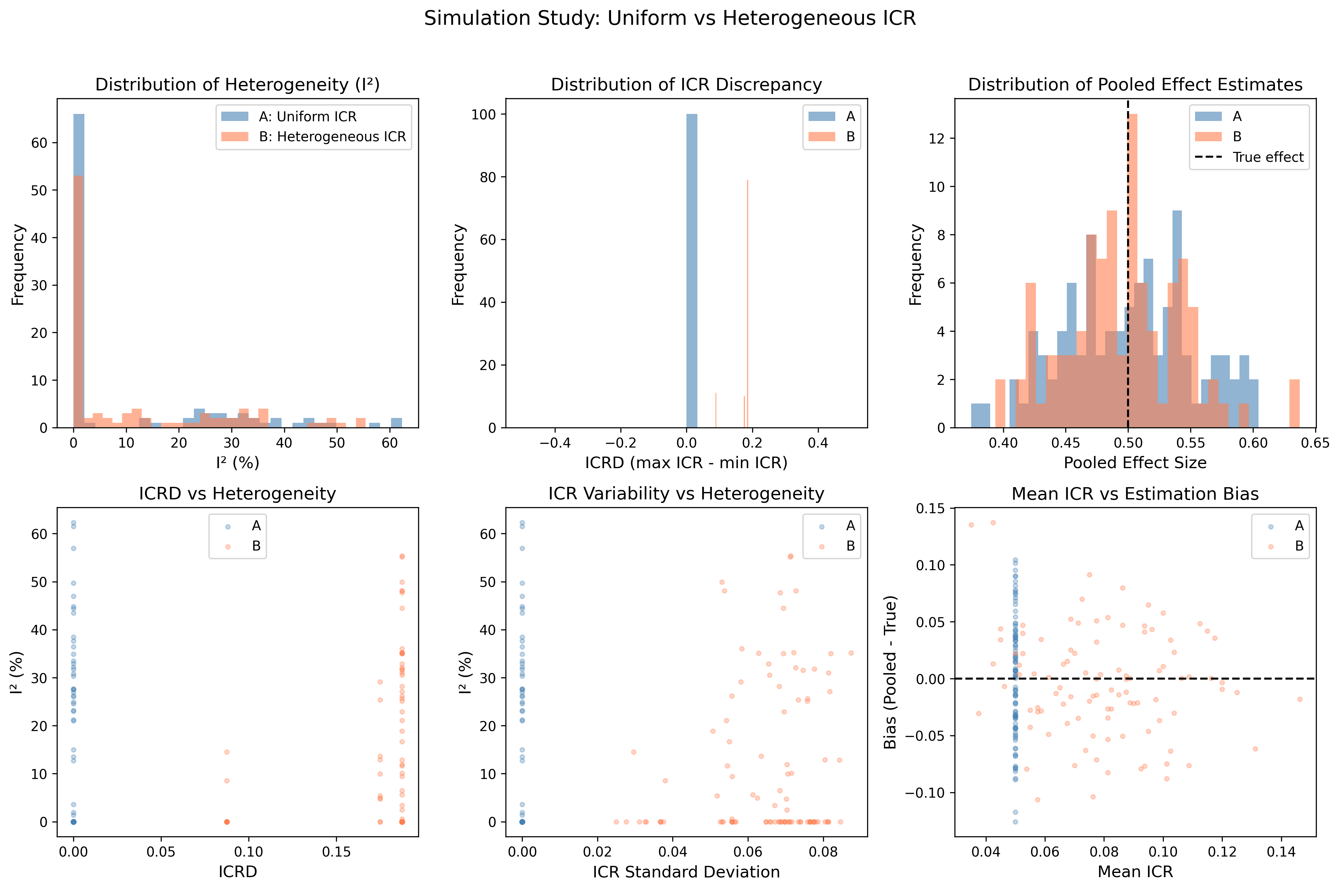
Figure 2. Simulation: Scenario A vs B Comparison

Slide 8
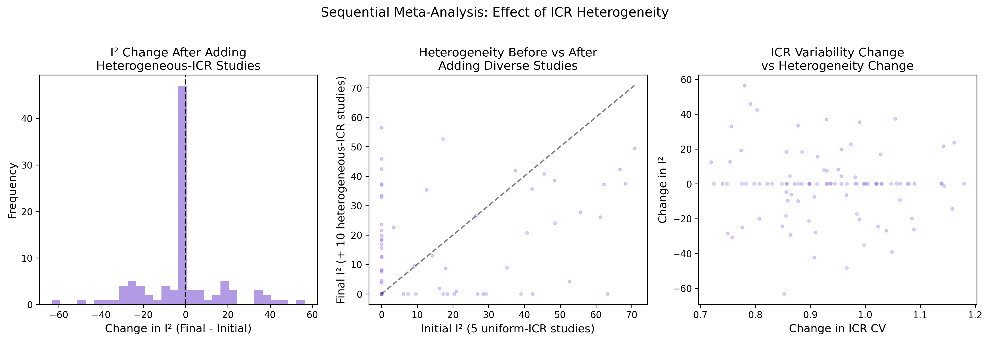
Figure 3. Sequential Meta-Analysis (Scenario C)

Slide 9
Table 1. Simulation Results
Metric | Scenario A (Uniform ICR) | Scenario B (Heterogeneous ICR)
Mean I² (SD) | 11.0% (17.2) | 11.7% (16.0)
Mean ICRD (SD) | 0.0000 | 0.1753 (0.031)
Mean Pooled Effect | 0.500 | 0.496
Effect Bias | +0.0004 | -0.0042

Slide 10
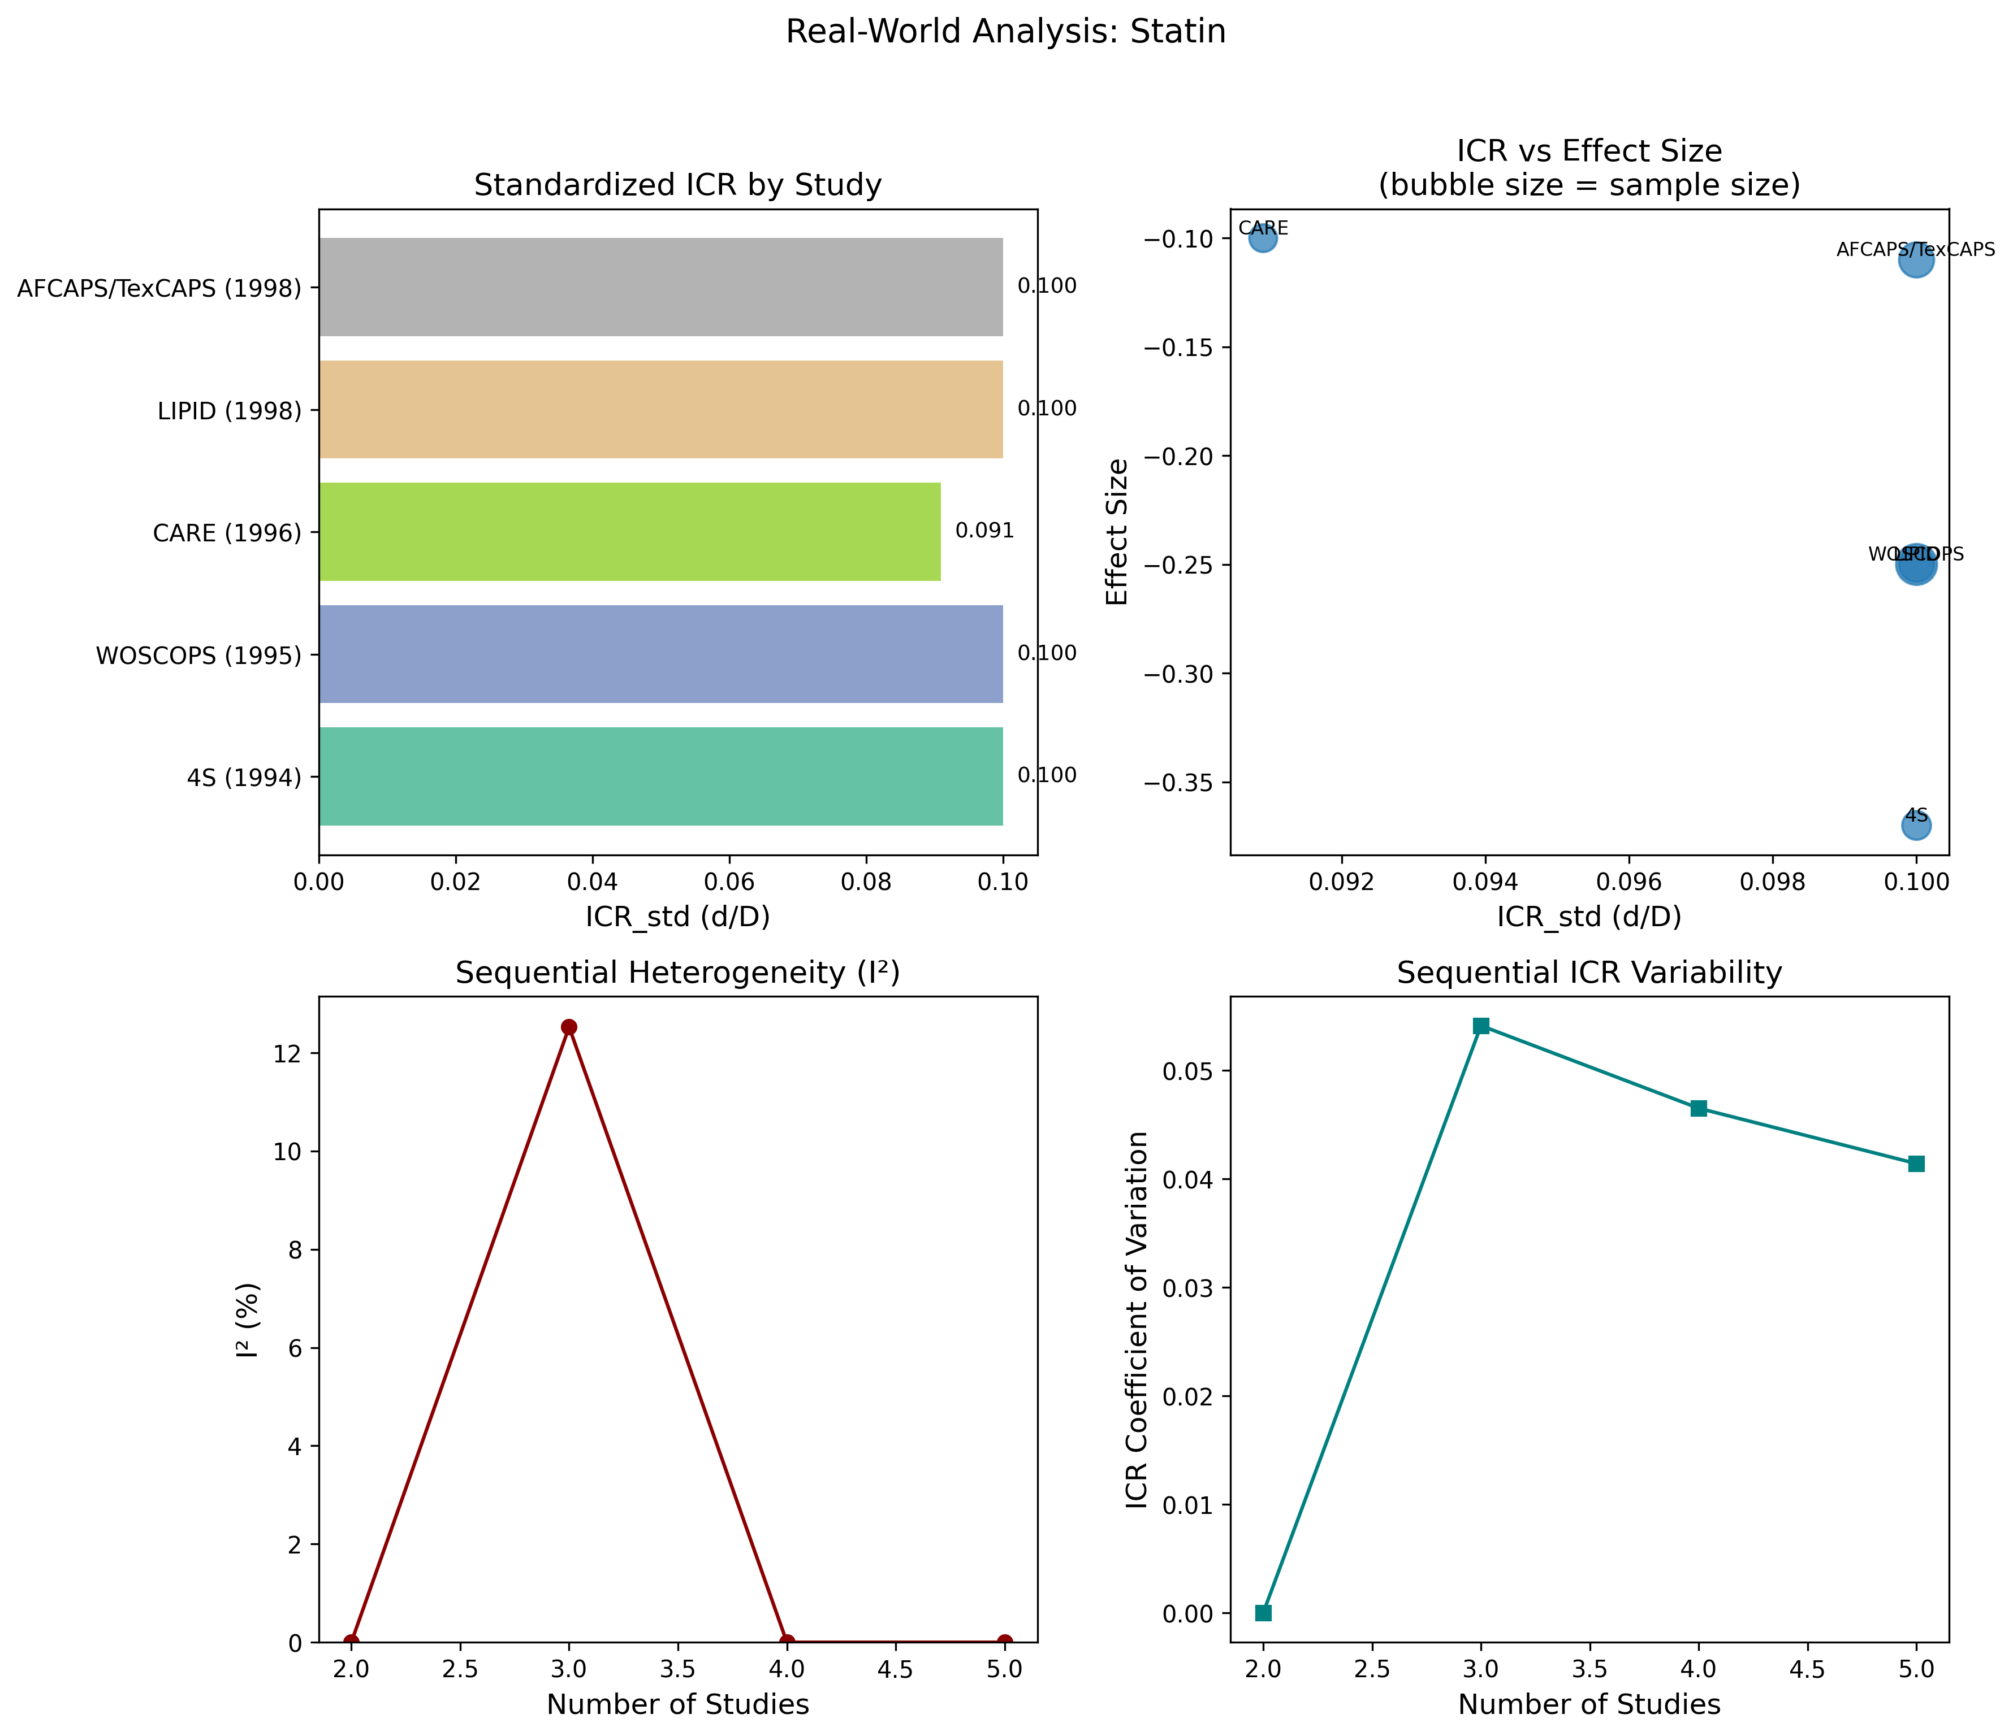
Figure 4. ICR Analysis: Statin Therapy

Slide 11
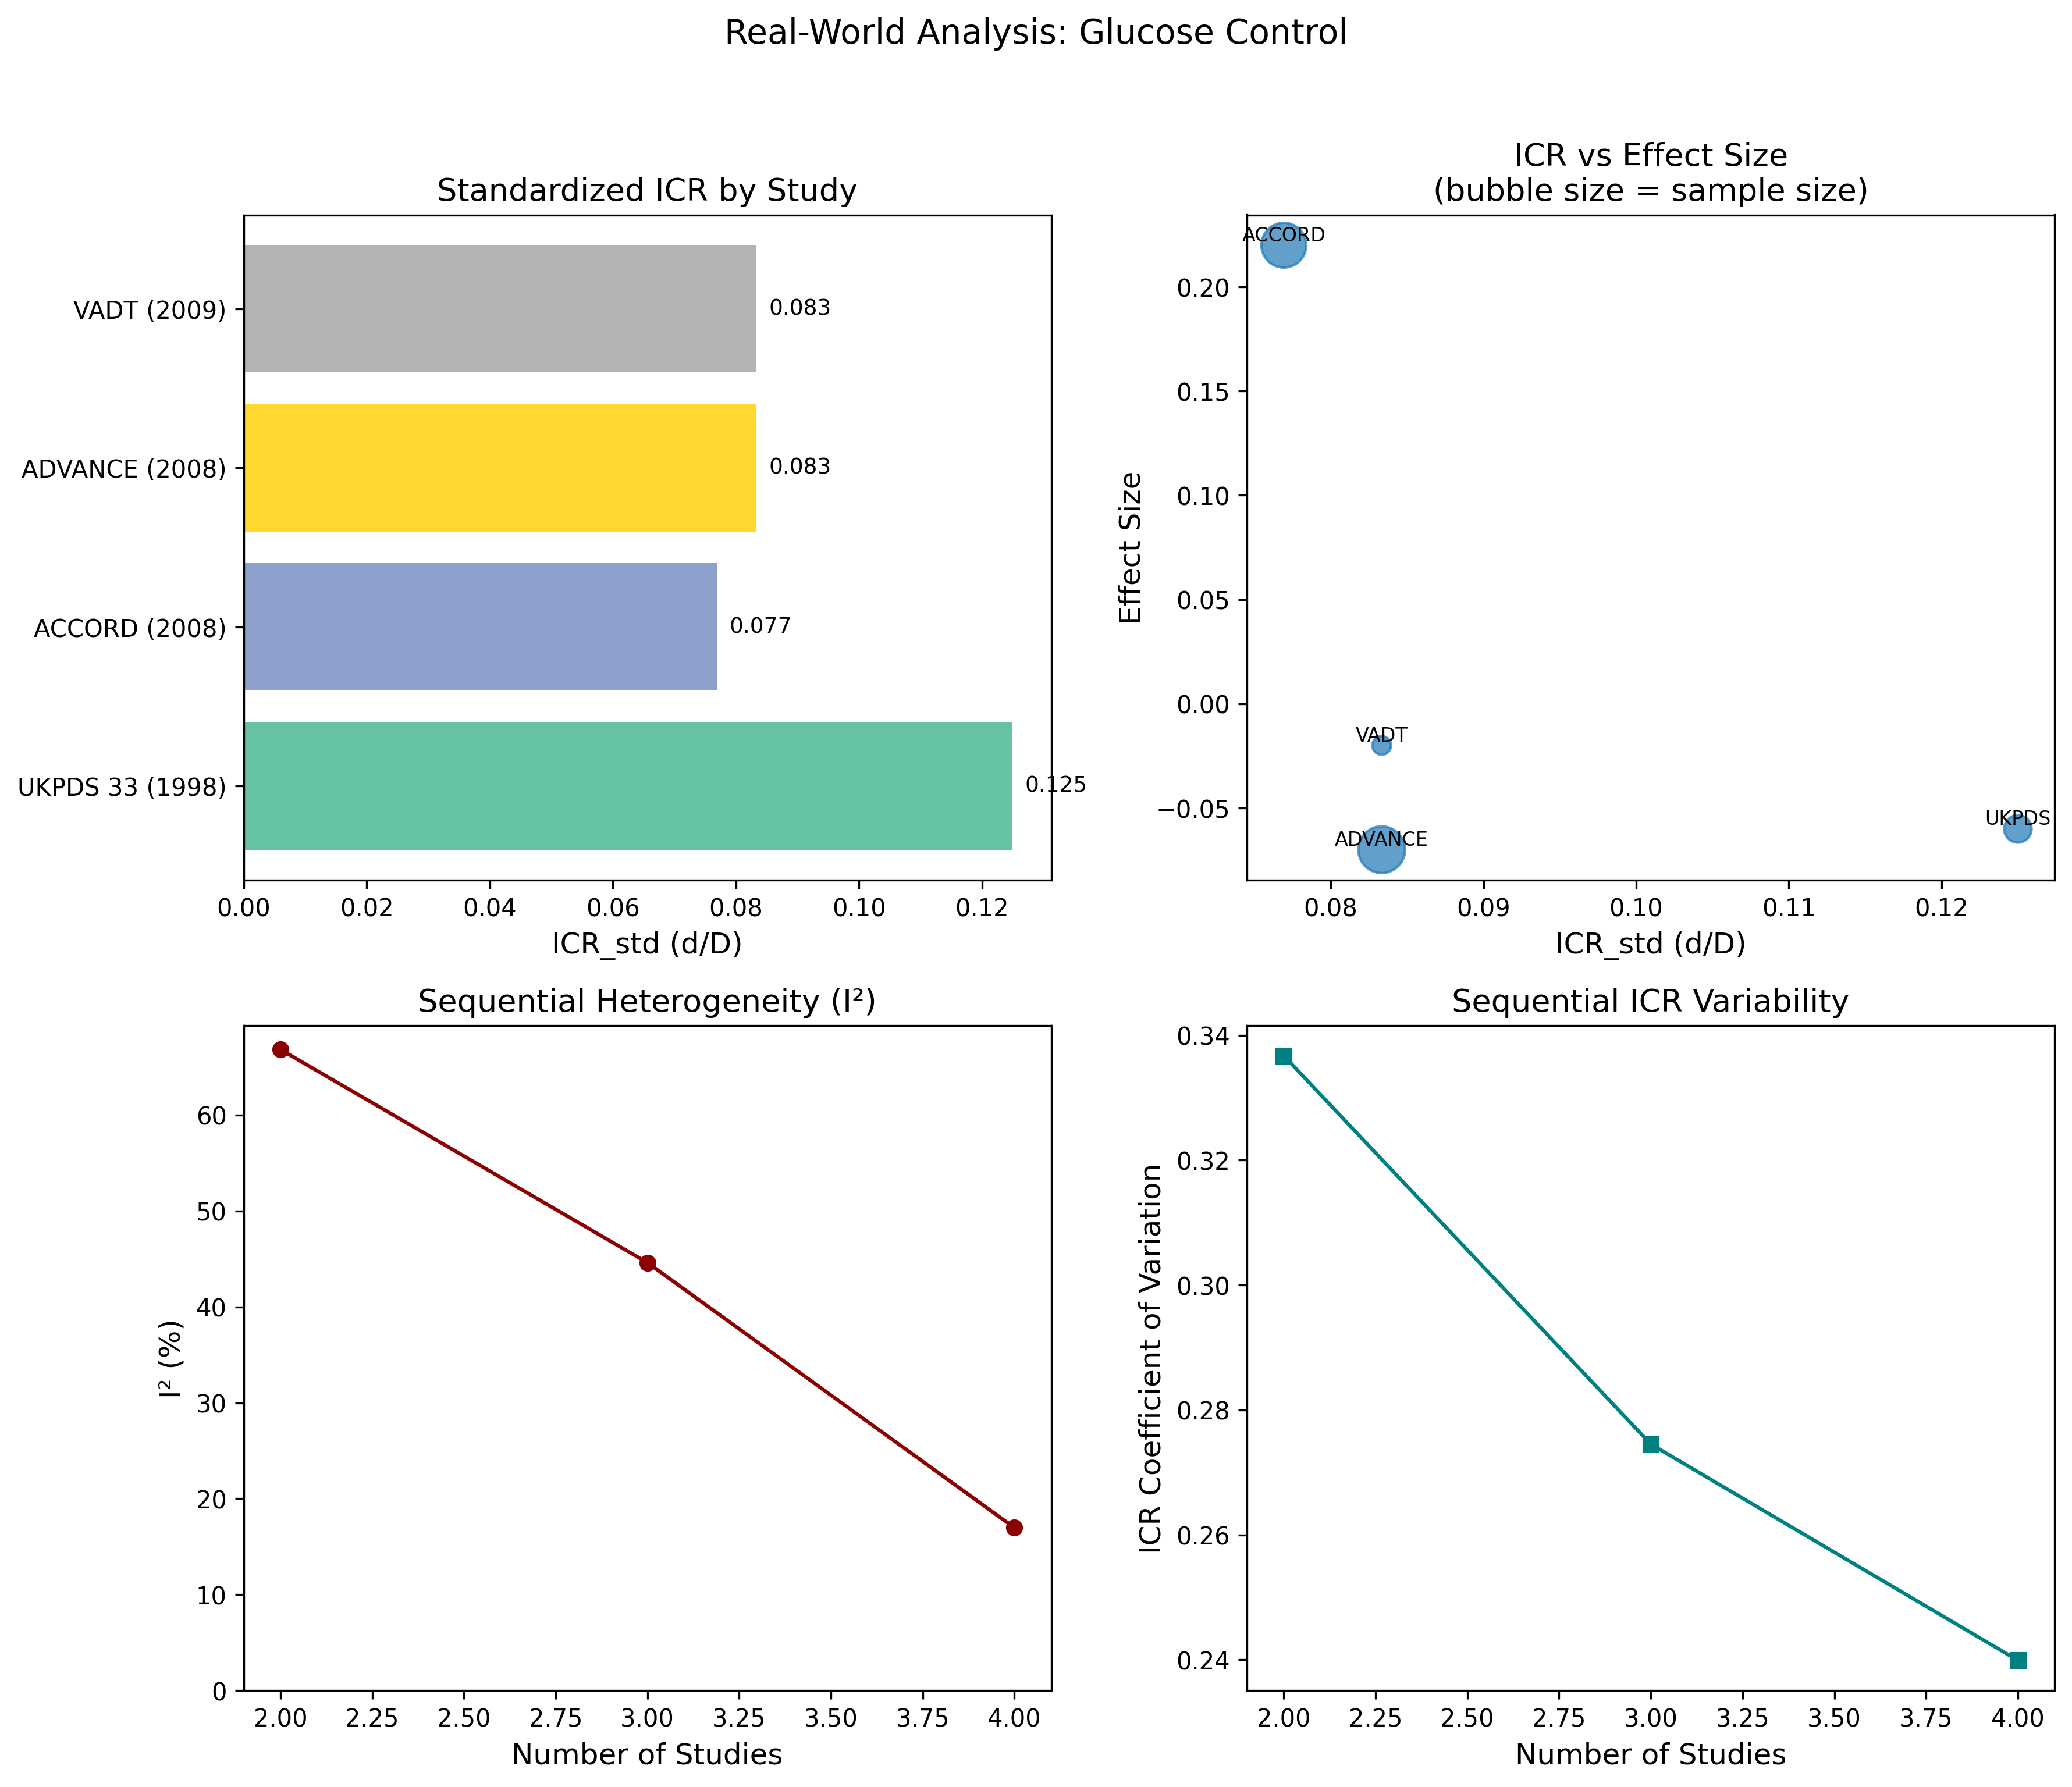
Figure 5. ICR Analysis: Intensive Glucose Control

Slide 12
Table 2. Statin Therapy RCTs
Study | D | d | ICR_std | Effect Size
4S (1994) | 10 | 1 | 0.100 | -0.370
WOSCOPS (1995) | 10 | 1 | 0.100 | -0.250
CARE (1996) | 11 | 1 | 0.091 | -0.100
LIPID (1998) | 10 | 1 | 0.100 | -0.250
AFCAPS (1998) | 10 | 1 | 0.100 | -0.110
ICRD = 0.009, I² = 0.0%, Pooled = -0.251

Slide 13
Table 3. Glucose Control RCTs
Study | D | d | ICR_std | Effect Size
UKPDS 33 (1998) | 8 | 1 | 0.125 | -0.060
ACCORD (2008) | 13 | 1 | 0.077 | +0.220
ADVANCE (2008) | 12 | 1 | 0.083 | -0.070
VADT (2009) | 12 | 1 | 0.083 | -0.020
ICRD = 0.048, I² = 17.0%, Pooled = -0.003

Slide 14
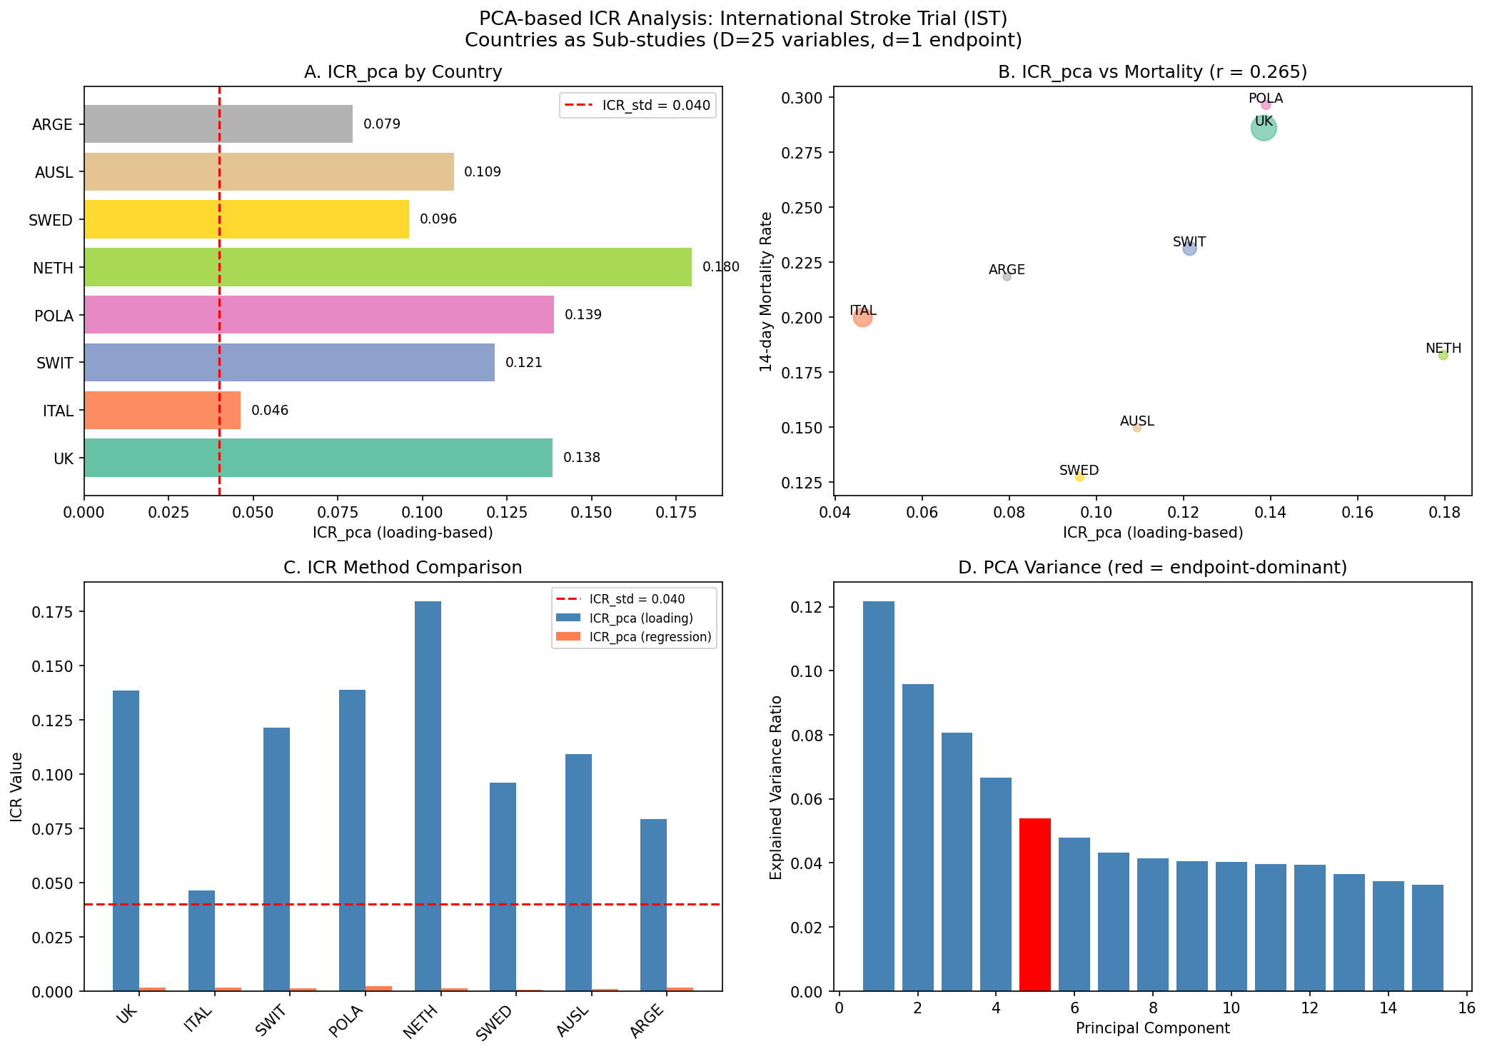
Figure 6. PCA-Based ICR Analysis (IST)

Slide 15
Table 4. IST PCA-Based ICR by Country
Country | n | Mortality | ICR_std | ICR_pca (loading) | ICR_pca (reg) | PCs
UK | 5,787 | 28.6% | 0.040 | 0.138 | 0.00162 | 4
Italy | 3,112 | 20.0% | 0.040 | 0.046 | 0.00153 | 2
Switzerland | 1,631 | 23.1% | 0.040 | 0.121 | 0.00135 | 4
Poland | 759 | 29.6% | 0.040 | 0.139 | 0.00230 | 4
Netherlands | 728 | 18.3% | 0.040 | 0.180 | 0.00136 | 5
Sweden | 636 | 12.7% | 0.040 | 0.096 | 0.00073 | 3
Australia | 568 | 15.0% | 0.040 | 0.109 | 0.00096 | 4
Argentina | 545 | 21.8% | 0.040 | 0.079 | 0.00157 | 3
r(ICR_pca_reg, mortality) = 0.90, p = 0.003

Slide 16
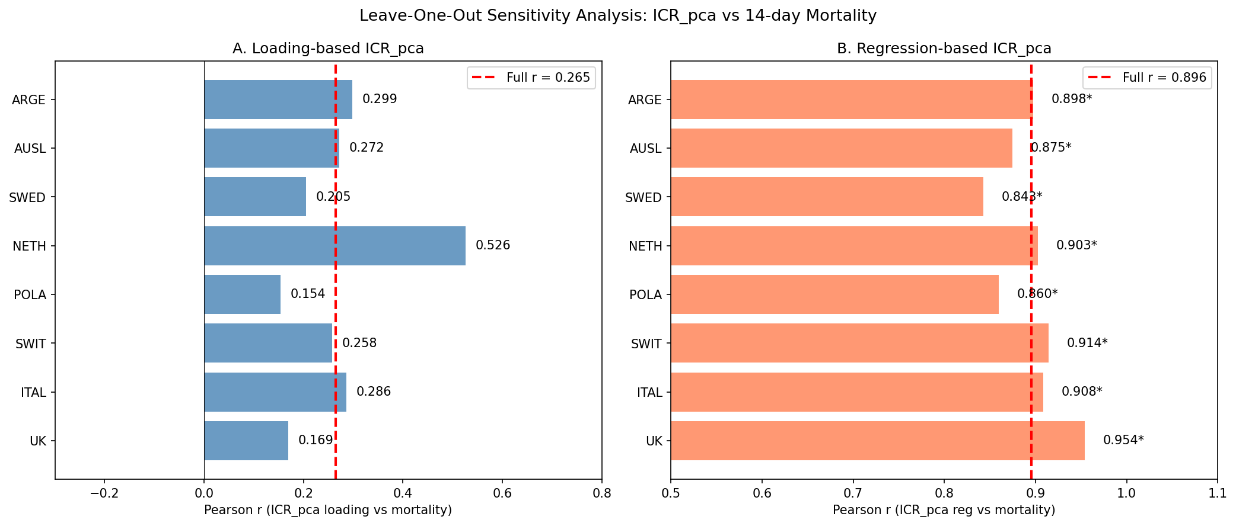
Figure 7. Leave-One-Out Sensitivity Analysis

Slide 17
Table 5. Leave-One-Out Sensitivity
Excluded | r (loading) | p | r (regression) | p
UK | 0.169 | 0.717 | 0.954 | 0.001
Italy | 0.286 | 0.534 | 0.908 | 0.005
Switzerland | 0.258 | 0.577 | 0.914 | 0.004
Poland | 0.154 | 0.742 | 0.860 | 0.013
Netherlands | 0.526 | 0.225 | 0.903 | 0.005
Sweden | 0.205 | 0.659 | 0.843 | 0.017
Australia | 0.272 | 0.555 | 0.875 | 0.010
Argentina | 0.299 | 0.515 | 0.898 | 0.006
Full (n=8) | 0.265 | 0.526 | 0.896 | 0.003
Regression-based ICR_pca robust: r = 0.84–0.95, all p < 0.02

Slide 18
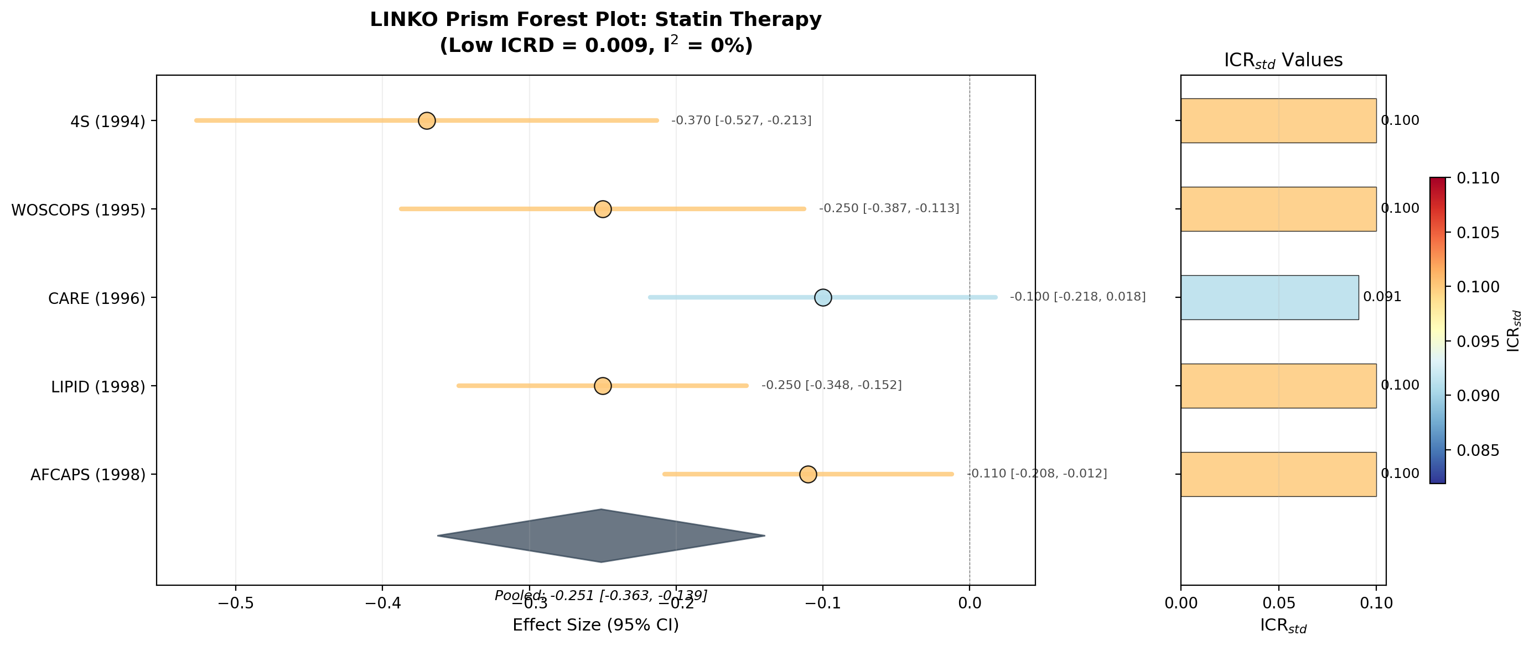
Figure 8. LINKO Prism Forest Plot: Statin Therapy
Low ICRD = 0.009: uniform color across all studies

Slide 19
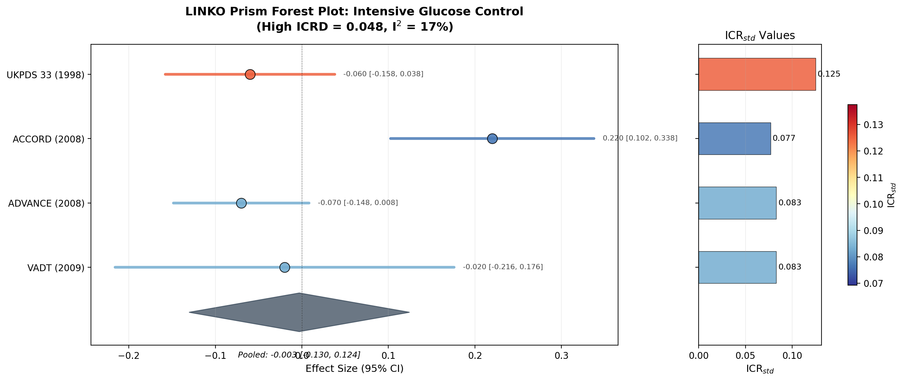
Figure 9. LINKO Prism Forest Plot: Glucose Control
High ICRD = 0.048: visible color gradient (UKPDS warm vs ACCORD cool)

Slide 20
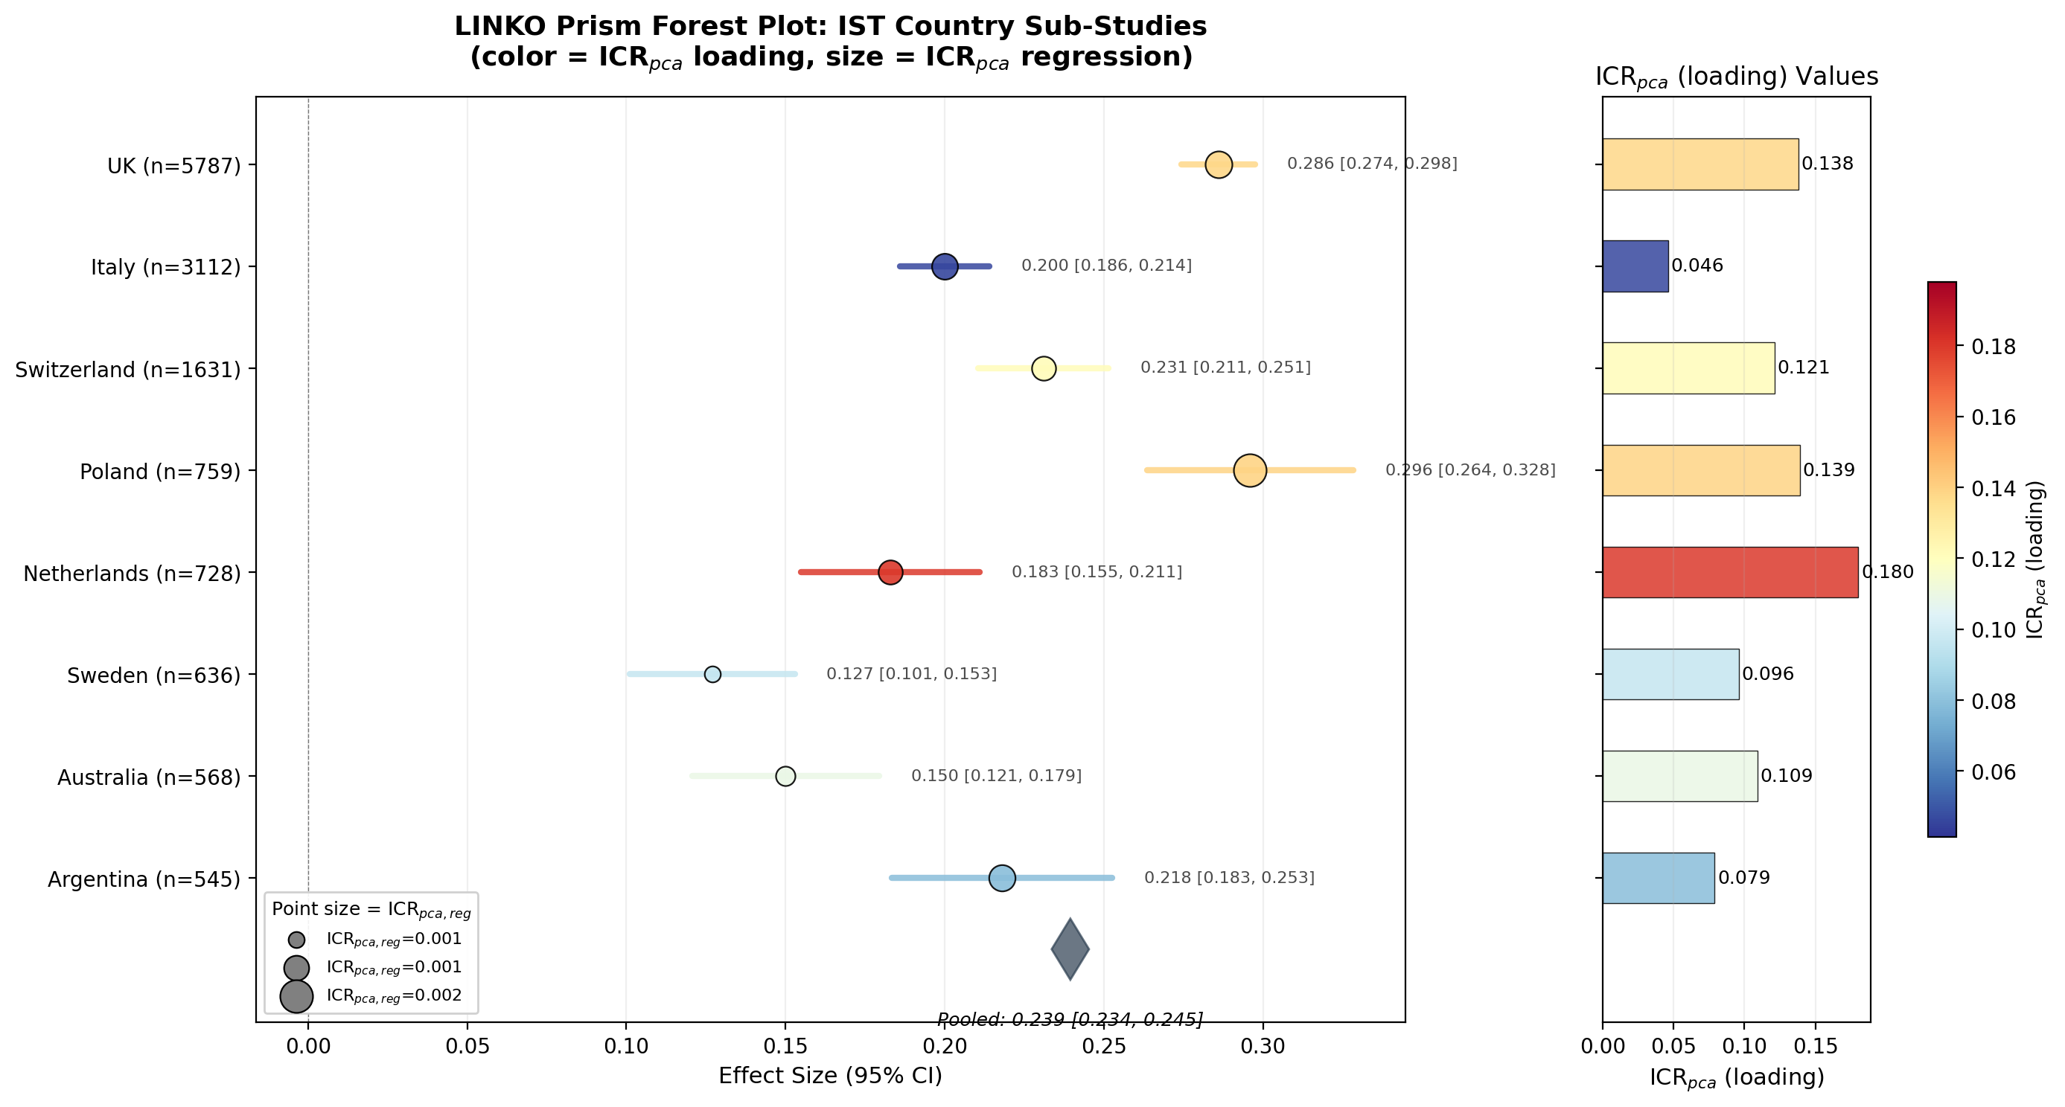
Figure 10. LINKO Prism Forest Plot: IST Country Sub-Studies
Color = ICR_pca (loading), Size = ICR_pca (regression)

Slide 21
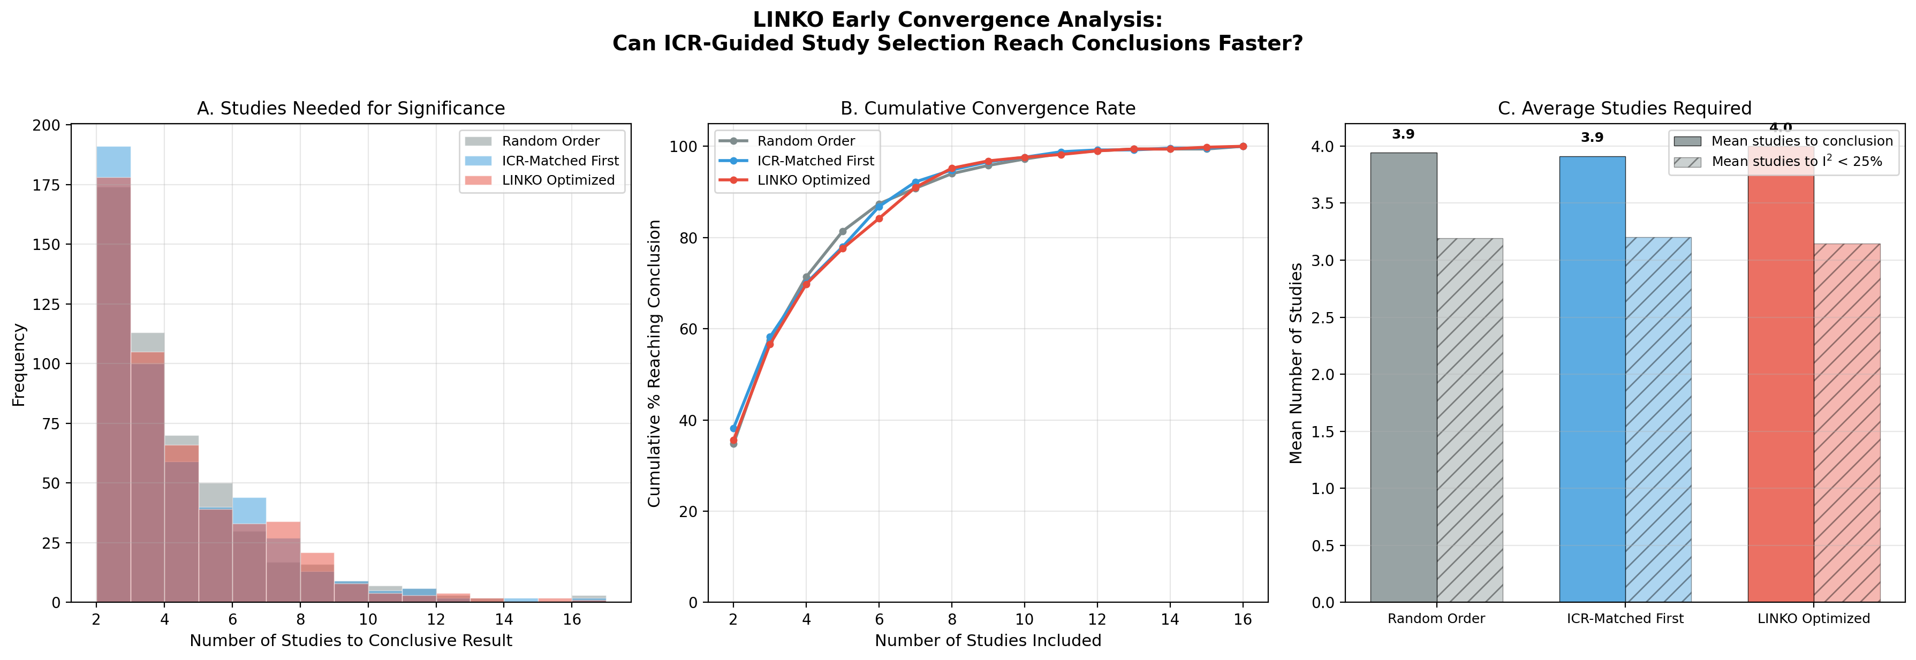
Figure 11. LINKO Early Convergence Analysis

Slide 22
Table 6. Early Convergence Results (500 iterations)
Strategy | Mean to conclusion | Median | % by 5 | % by 10 | Mean to I²<25%
Random | 3.94 | 3.0 | 81.4% | 97.2% | 3.19
ICR-matched | 3.91 | 3.0 | 78.0% | 97.6% | 3.20
LINKO optimized | 4.00 | 3.0 | 77.6% | 97.6% | 3.14
LINKO achieved lowest mean studies for I² < 25% (3.14 vs 3.19–3.20)

Slide 23
Table 7. Summary: ICR Approaches Comparison
Analysis | ICR Measure | Variation (CV) | Association
Statin therapy | ICR_std (Approach 1) | 0.041 | I² = 0.0% (stable)
Glucose control | ICR_std (Approach 1) | 0.240 | I² = 17.0% (heterogeneous)
IST (loading) | ICR_pca (Approach 2) | 0.360 | r = 0.27 with mortality
IST (regression) | ICR_pca_reg (Approach 2) | 0.329 | r = 0.90 with mortality

