Slide 1
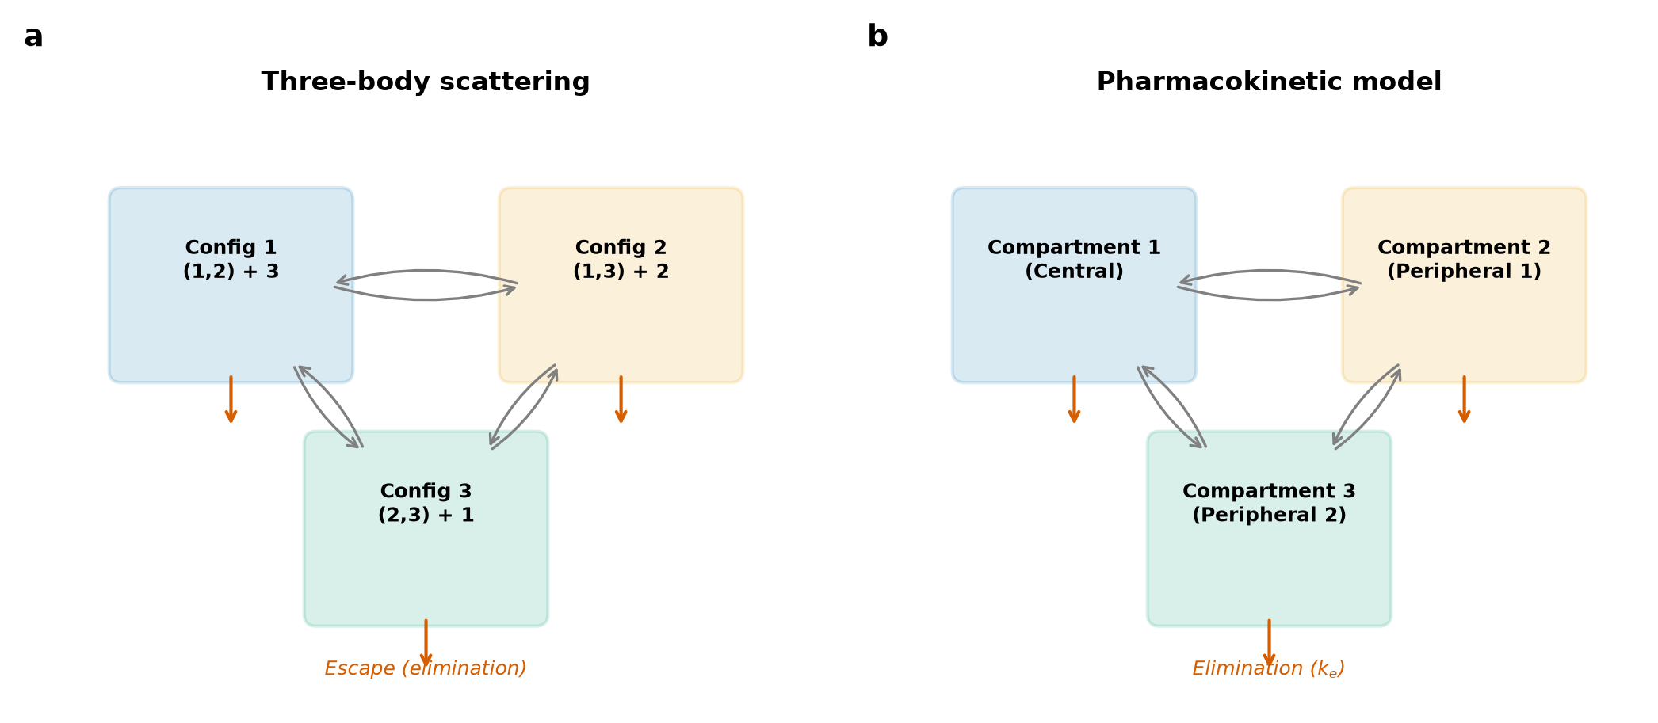
Figure 1
Mapping three-body scattering onto pharmacokinetic compartments. (a) Each bound pair is a compartment; configuration changes are inter-compartmental transfers at rates kij; escape is irreversible elimination at rate kei. (b) The equivalent three-compartment PK model.

Slide 2
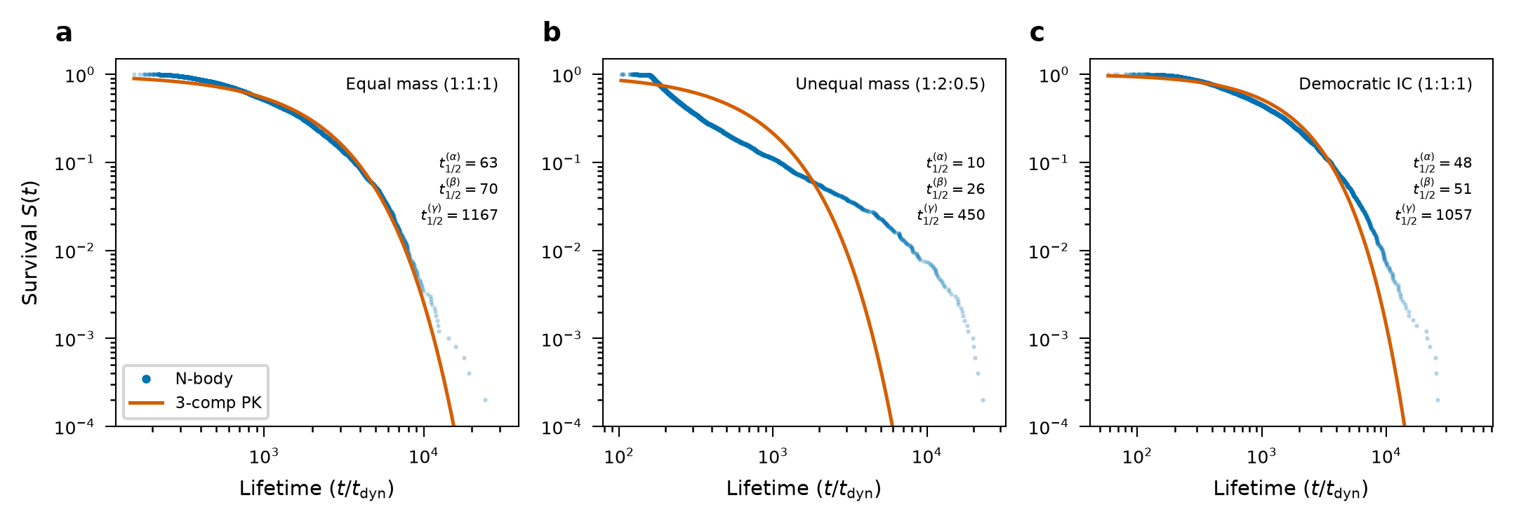
Figure 2
Survival curves for the three mass configurations. Blue: empirical survival from 5,000 N-body experiments. Red: linear three-compartment PK prediction. The multi-exponential form is statistically required (KS test p < 0.001 versus a single exponential). (a) Equal mass, (b) unequal mass, (c) democratic.

Slide 3
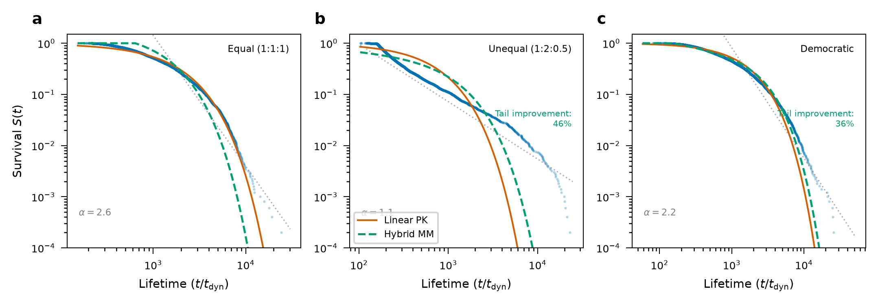
Figure 3
Linear versus nonlinear PK on log–log survival axes. Blue: N-body data; red: linear PK; green dashed: hybrid Michaelis–Menten model capturing the sticky-chaos tail. (a) Equal mass (linear adequate), (b) unequal (42 per cent tail RMSE improvement), (c) democratic (36 per cent).

Slide 4
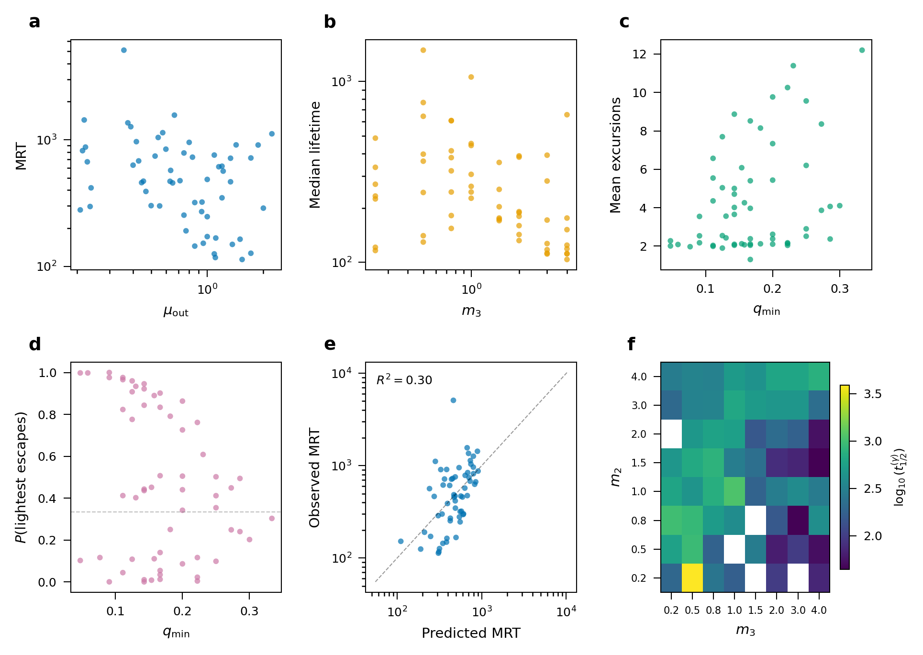
Figure 4
Population-PK analysis of the mass-ratio dependence. (a) MRT versus binary–single reduced mass; (b) median lifetime versus intruder mass; (c) mean excursions versus lightest mass fraction; (d) lightest-body escape probability with logistic fit; (e) predicted versus observed MRT (R^2 = 0.30); (f) slowest half-life across the (m_2, m_3) grid.

Slide 5
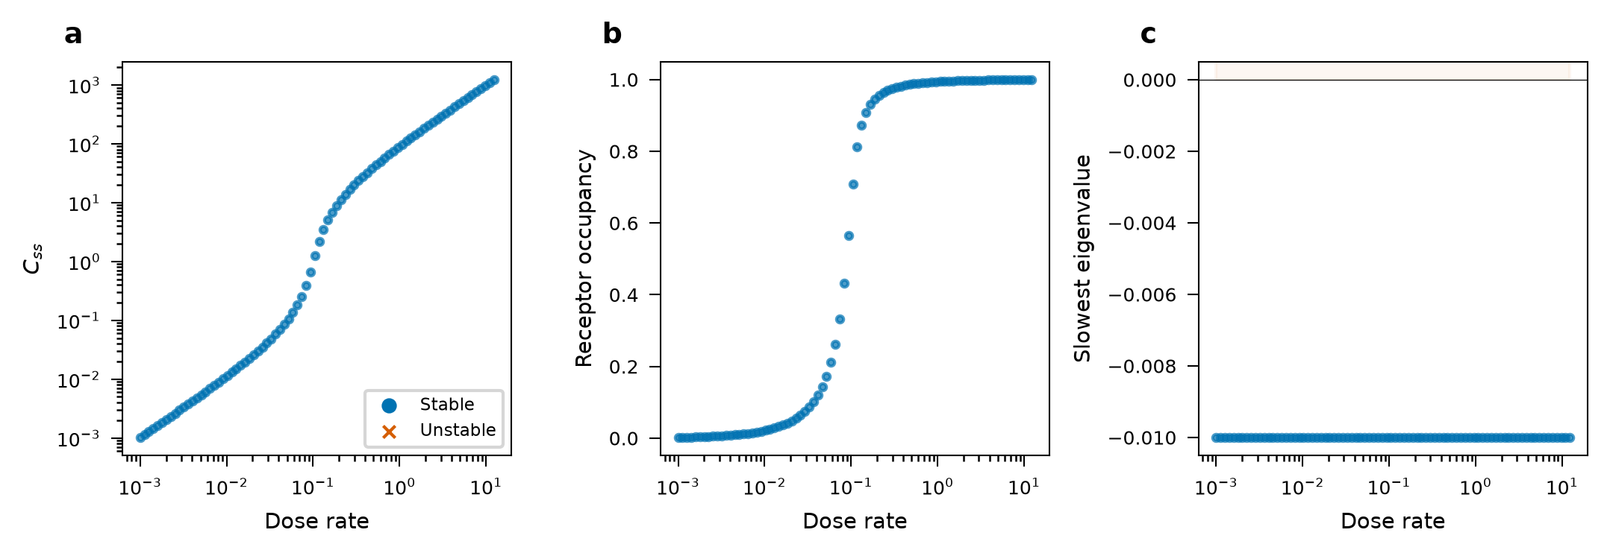
Figure 5
Reverse mapping to TMDD. (a) Dose–response bifurcation with stable (blue) and unstable (red) steady states; (b) receptor occupancy versus dose rate; (c) slowest Jacobian eigenvalue versus dose, marking the stability boundary — the analogue of Lagrange-point stability.

Slide 6
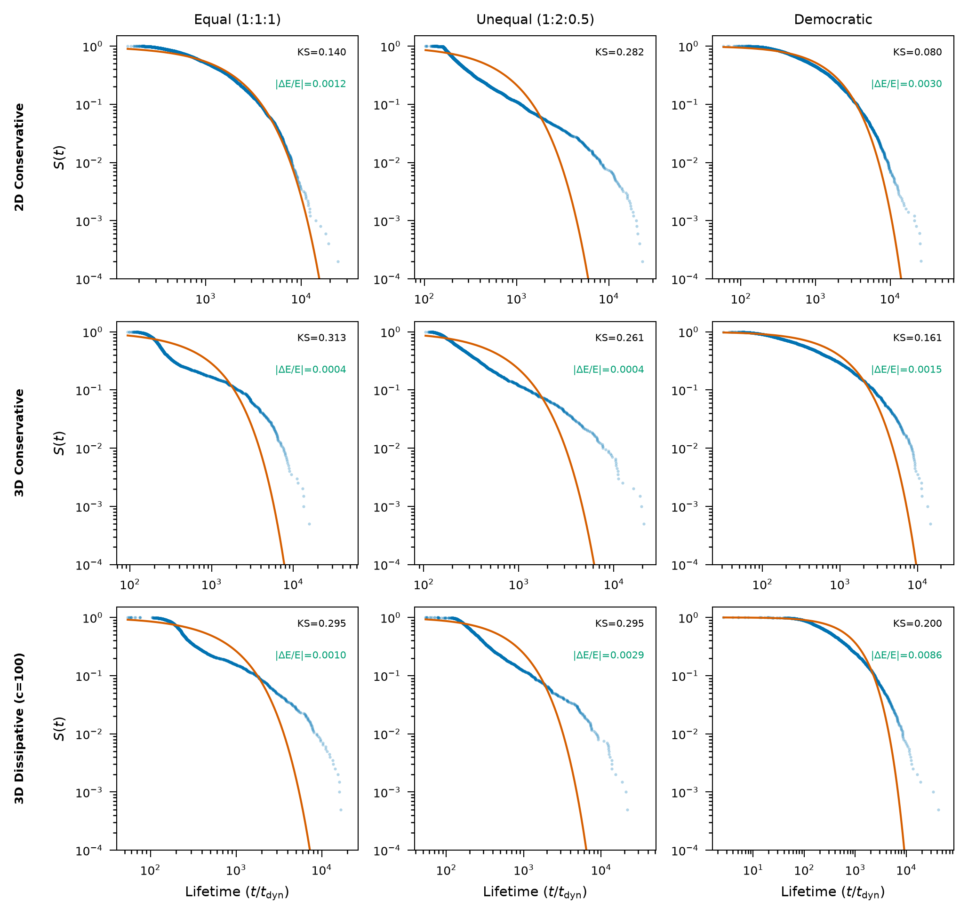
Figure 6
PK validity across dimensionality and dissipation. Rows: 2D conservative, 3D conservative, 3D dissipative (c = 100). Columns: equal, unequal, democratic. Blue: N-body survival; red: linear PK fit; KS statistics annotated.

Slide 7
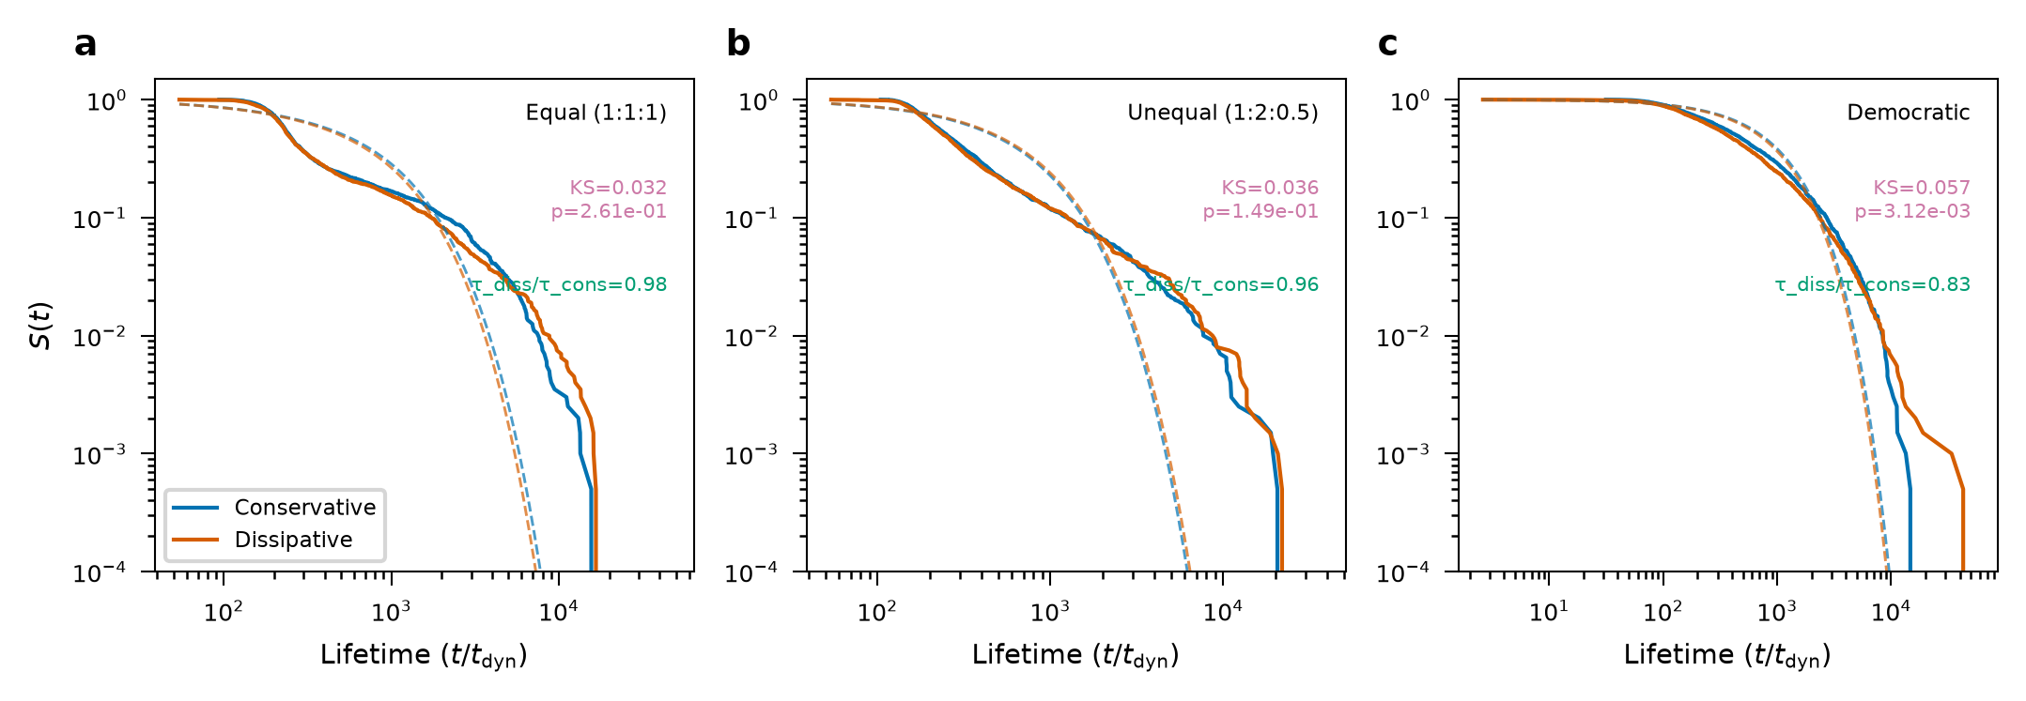
Figure 7
Effect of 2.5PN GW radiation reaction on lifetimes. Blue: 3D conservative; red: 3D dissipative; dashed: PK fits. Dissipation shortens lifetimes (τdiss/τcons = 0.83–0.98) while preserving the PK structure.

Slide 8
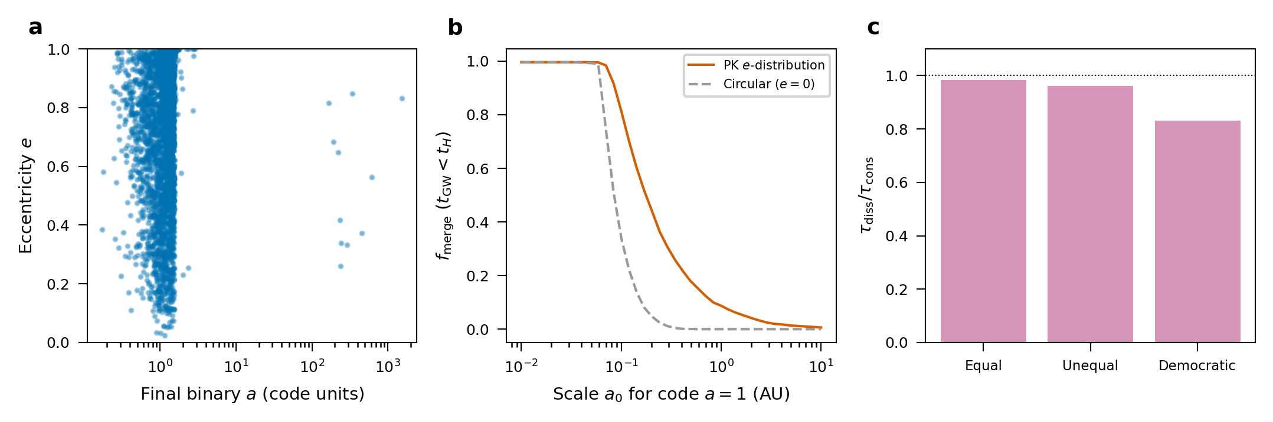
Figure 8
Gravitational-wave merger outcomes from the PK-selected binaries. (a) Eccentricity versus semi-major axis of the surviving binaries. (b) Peters-inspiral merger fraction (tGW < tH) versus the assumed physical scale of the code-unit a = 1, for the measured thermal eccentricity distribution against circular orbits, showing the eccentricity boost of the merger rate. (c) Lifetime ratio τdiss/τcons under 2.5PN dissipation for the three mass configurations.

Slide 9
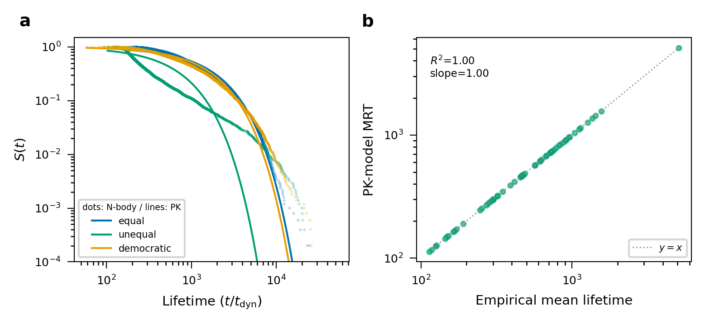
Figure 9
Benchmark against phase-space flux theory. (a) Empirical survival (dots) with the PK multi-exponential (ergodic) prediction (lines) for the three canonical mass configurations. (b) PK-model MRT versus empirical mean lifetime across 64 mass configurations, with the y = x line.

Slide 10
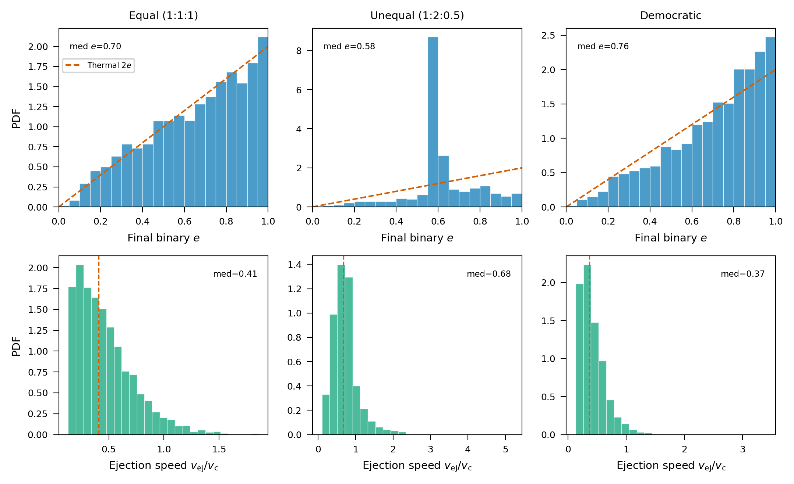
Figure 10
Distributions from 3D Newtonian encounters. Top: final-binary eccentricity with the thermal 2e reference; bottom: ejection speed in units of the critical velocity. Columns: equal, unequal, democratic.

Slide 11
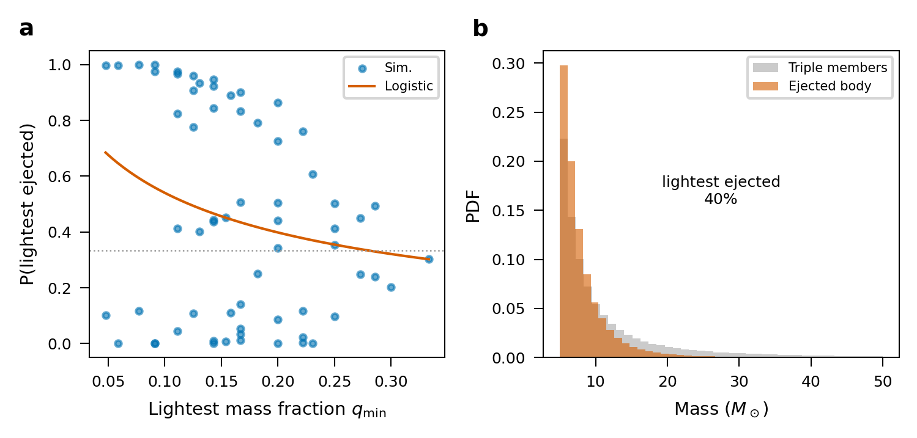
Figure 11
Which body is ejected. (a) Lightest-body escape probability versus minimum mass ratio with the fitted dose–response logistic (points: simulations). (b) Ejected-mass distribution from a Kroupa-sampled black-hole mass function, showing preferential ejection of the lighter members.

Slide 12
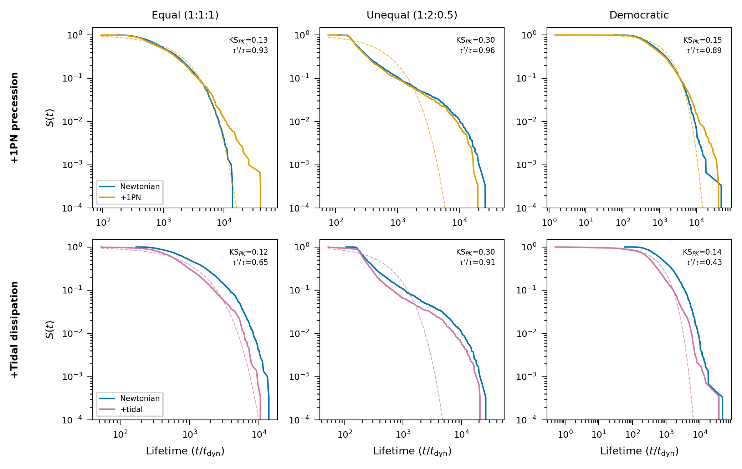
Figure 12
Robustness to additional physics. Survival functions for 3D encounters with 1PN precession (top) and tidal dissipation (bottom), each against the Newtonian baseline and its own PK fit (dashed). Columns: equal, unequal, democratic; KS and lifetime ratios annotated.

Slide 13
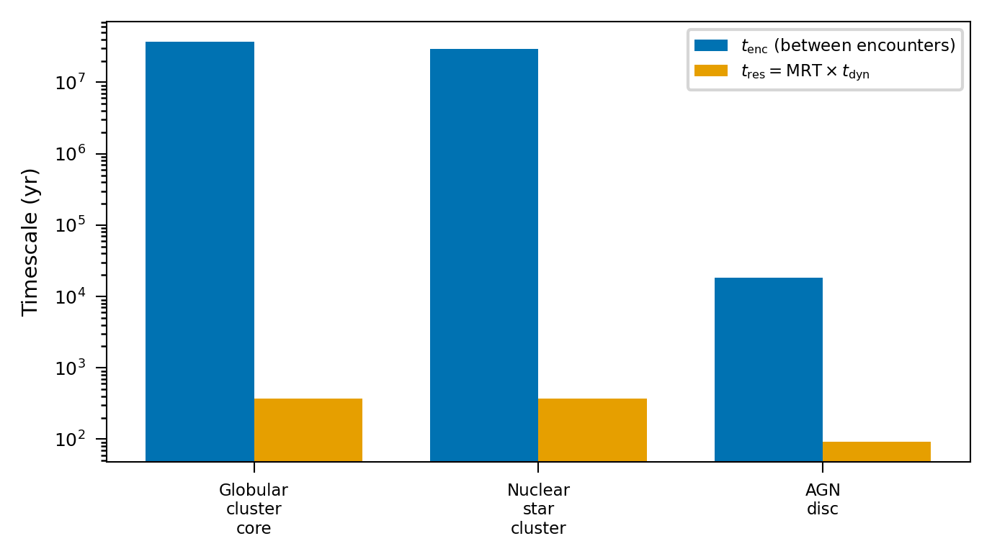
Figure 13
Application to dense environments. Encounter interval (blue) versus PK-model resonance duration MRT × t_dyn (orange) for a globular-cluster core, a nuclear star cluster, and an AGN-disc migration trap.

