Slide 1
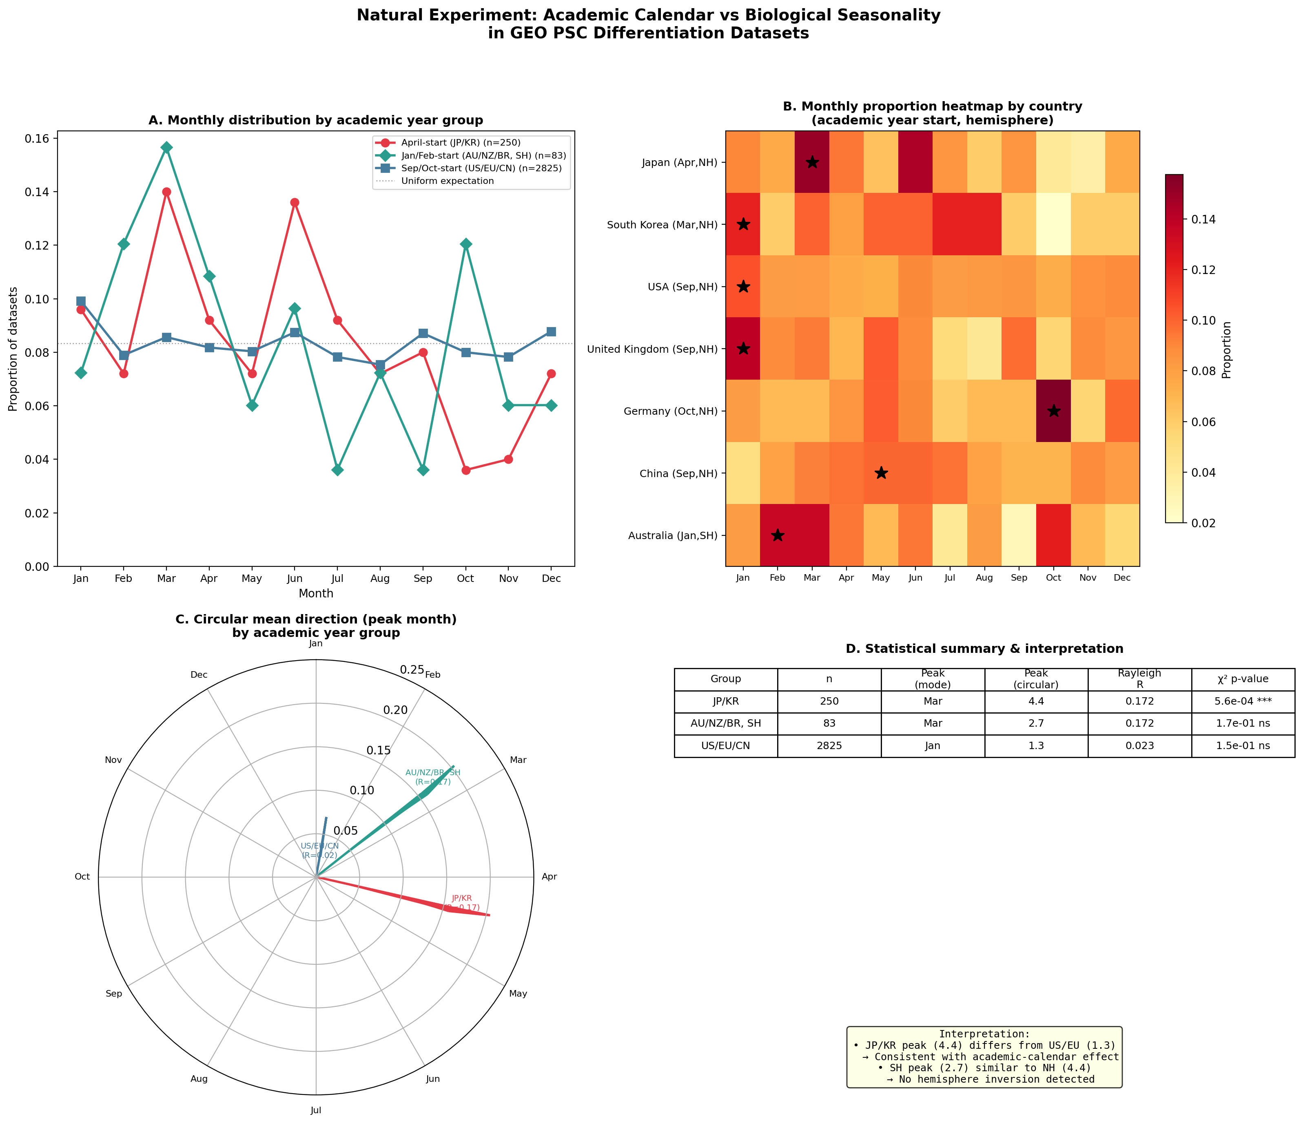
Figure 3. Natural Experiment: Academic Calendar vs Biological Seasonality
Geographic variation in academic year start months used as instrument. Japan/Korea (April, n=250), USA/EU/CN (Sep/Oct, n=2825), Australia/NZ/BR (Jan/Feb, SH, n=83). Japan shows significant March peak (p=0.0006); USA/EU shows no significant seasonality.

