Slide 1
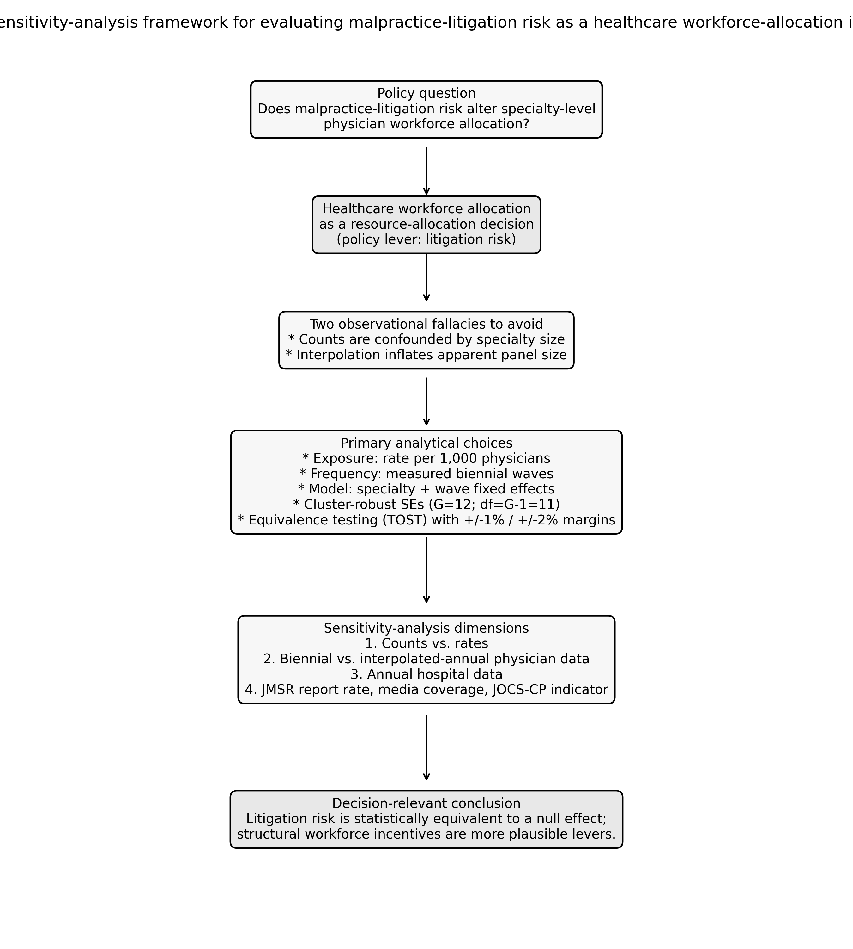
Figure 1
Sensitivity-analysis framework for evaluating malpractice-litigation risk as a healthcare workforce-allocation instrument.

Slide 2
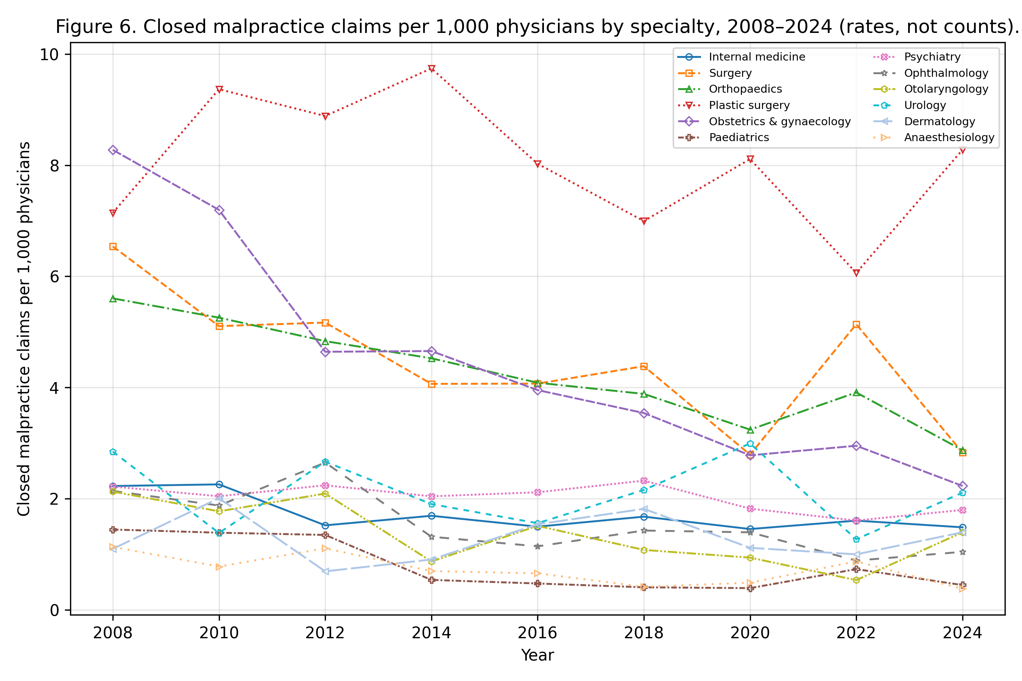
Figure 2
Closed malpractice claims per 1,000 physicians by specialty, 2008-2024 (rates, not counts).

Slide 3
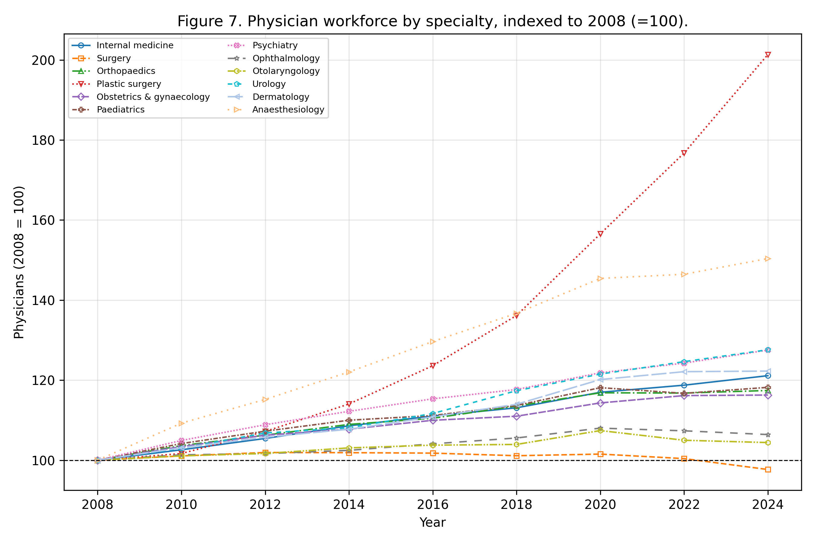
Figure 3
Physician workforce by specialty, indexed to 2008 (=100).

Slide 4
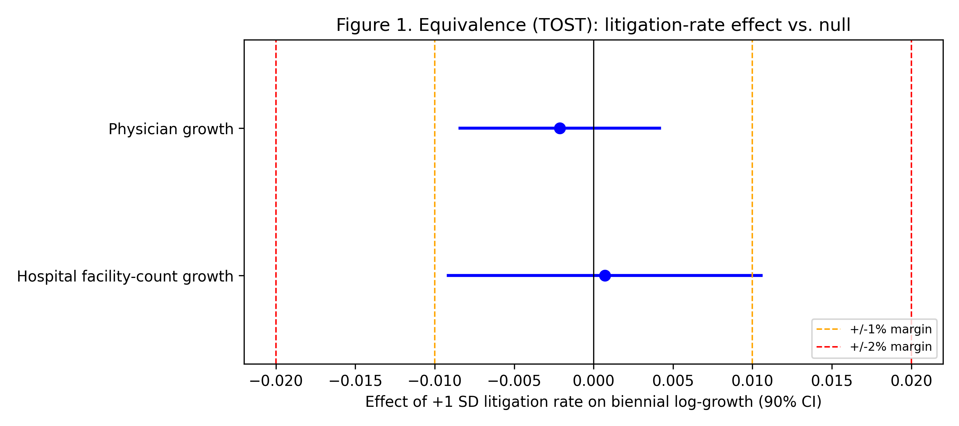
Figure 4
Equivalence (TOST) of the litigation-rate effect against +/-1% and +/-2% margins; horizontal bars are 90% confidence intervals.

Slide 5
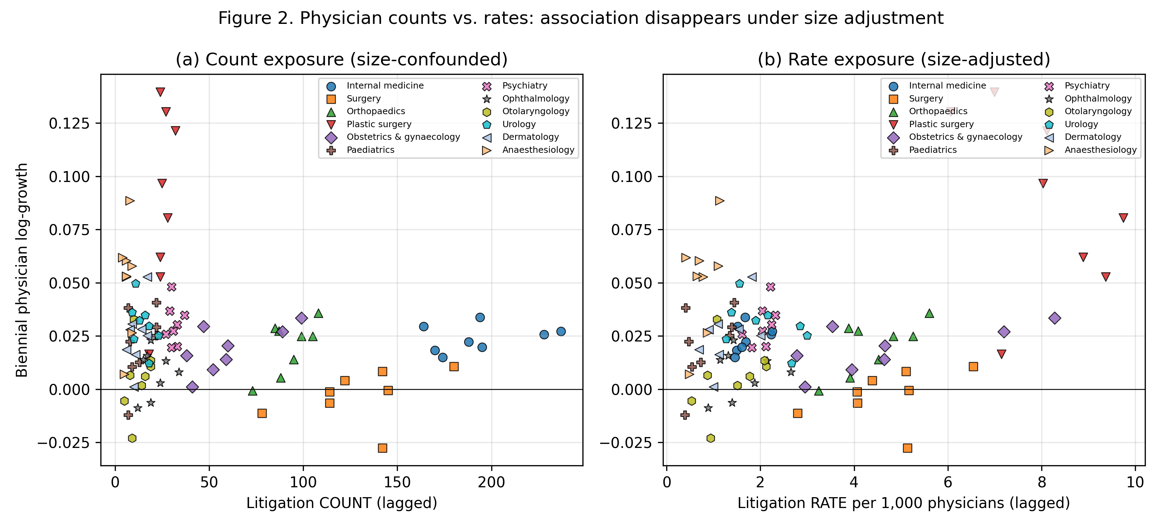
Figure 5
Biennial physician growth against lagged litigation exposure measured as (a) counts and (b) rates. Points are coloured by specialty; the count panel shows the size confounding that the rate panel removes.

Slide 6
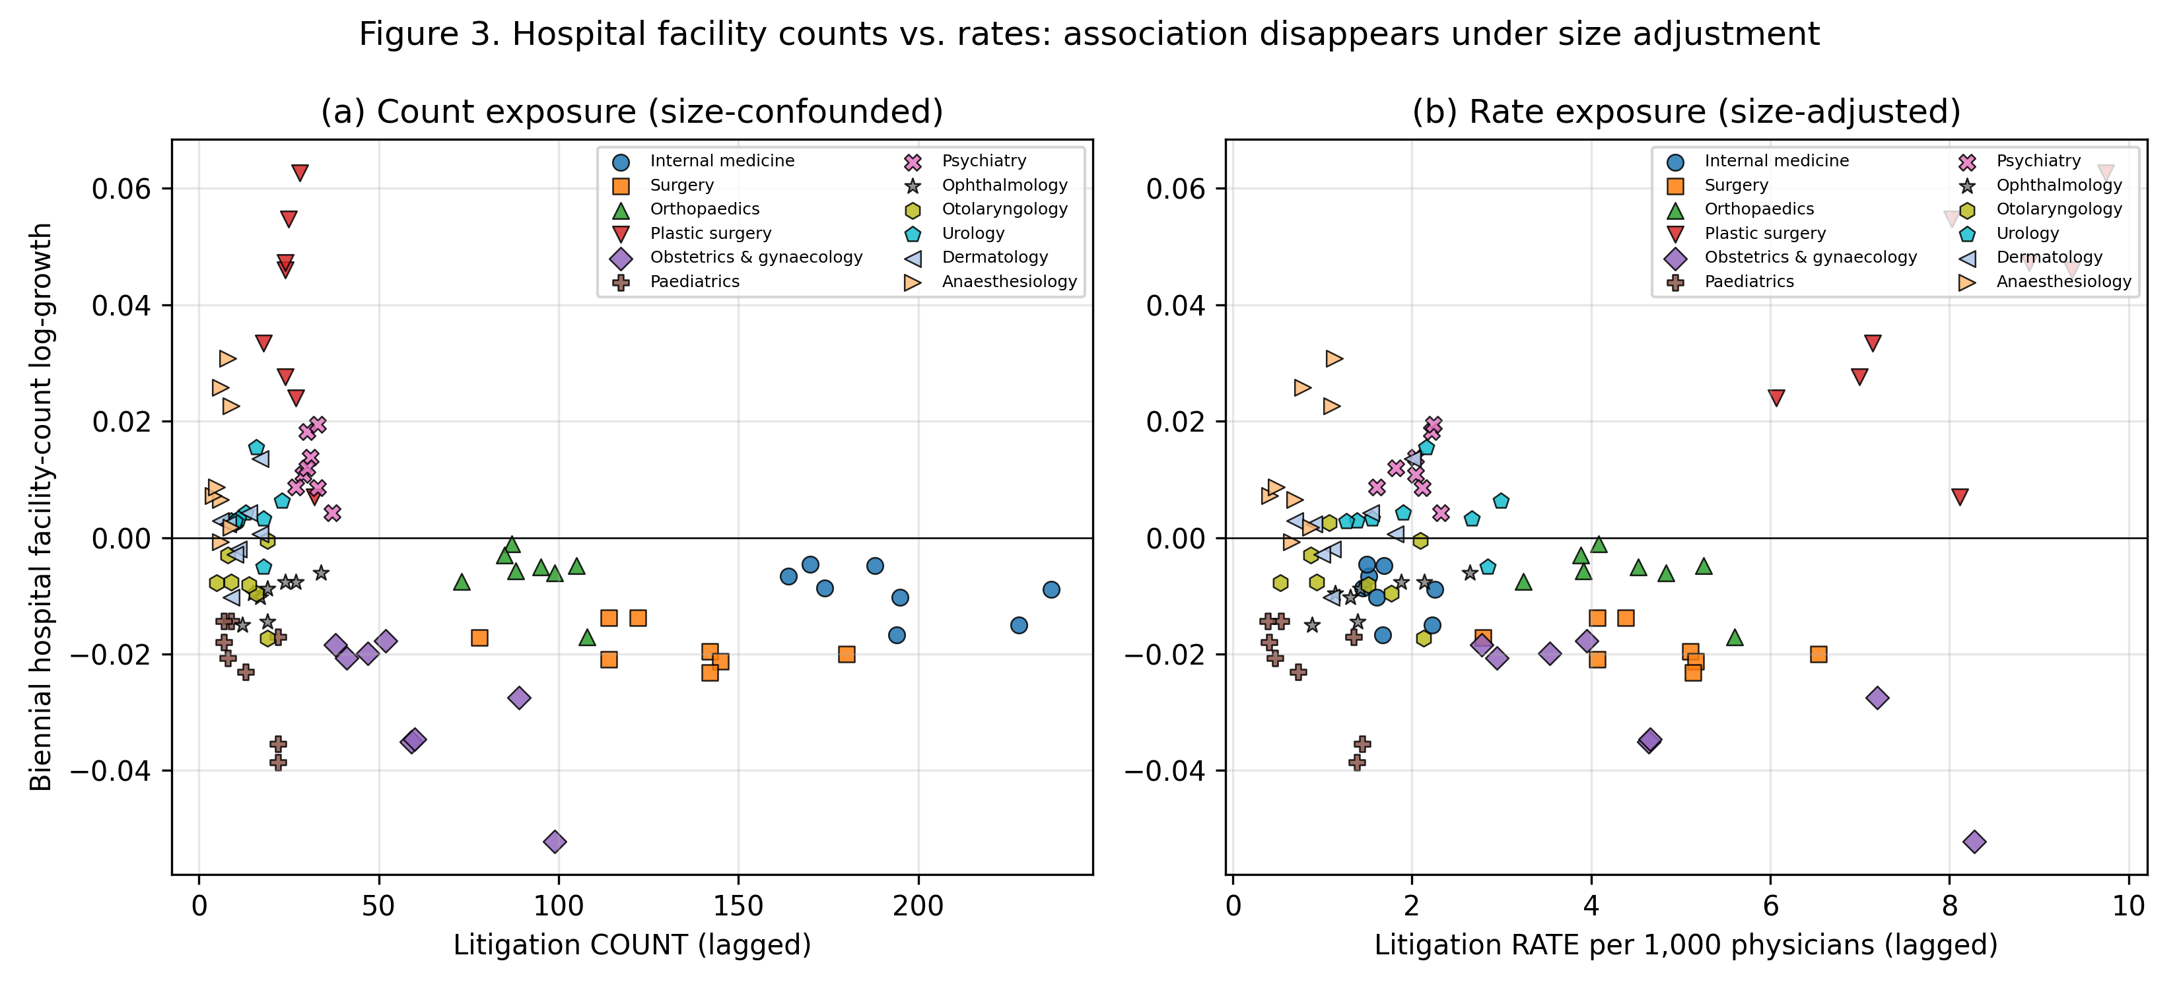
Figure 6
Biennial hospital facility-count growth against lagged litigation exposure measured as (a) counts and (b) rates. Points are coloured by specialty; the rate-adjusted panel shows no systematic association.

Slide 7
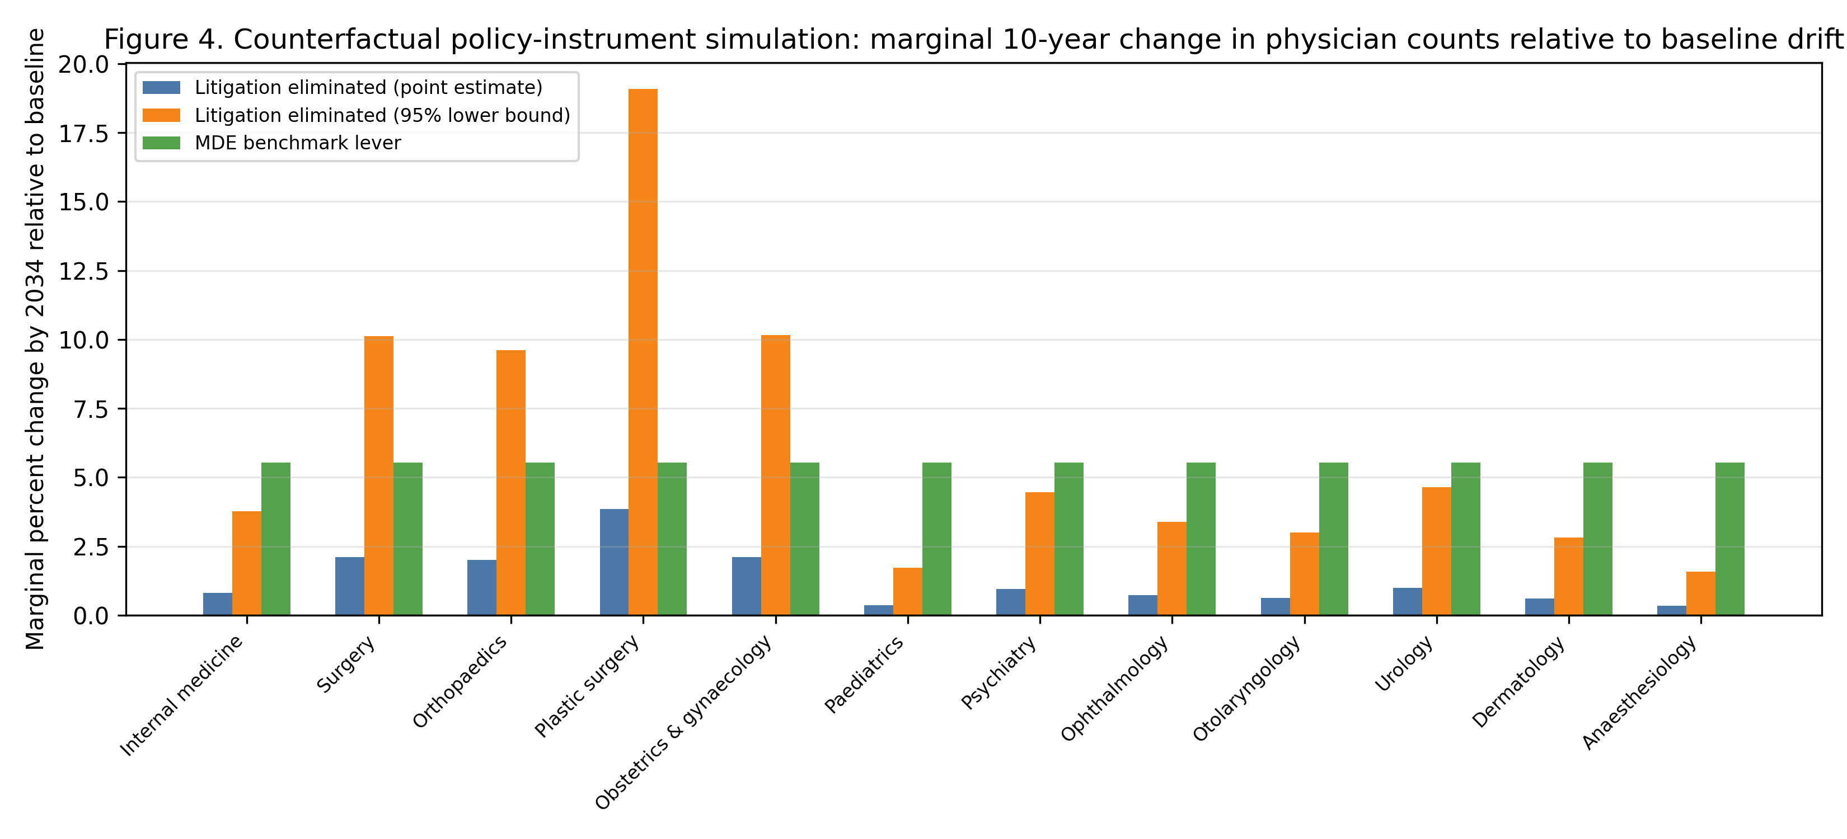
Figure 7
Counterfactual policy-instrument simulation: marginal 10-year change in physician counts by specialty relative to the projected baseline drift. The MDE benchmark is the minimum detectable per-SD effect from the primary analysis.

