Slide 1
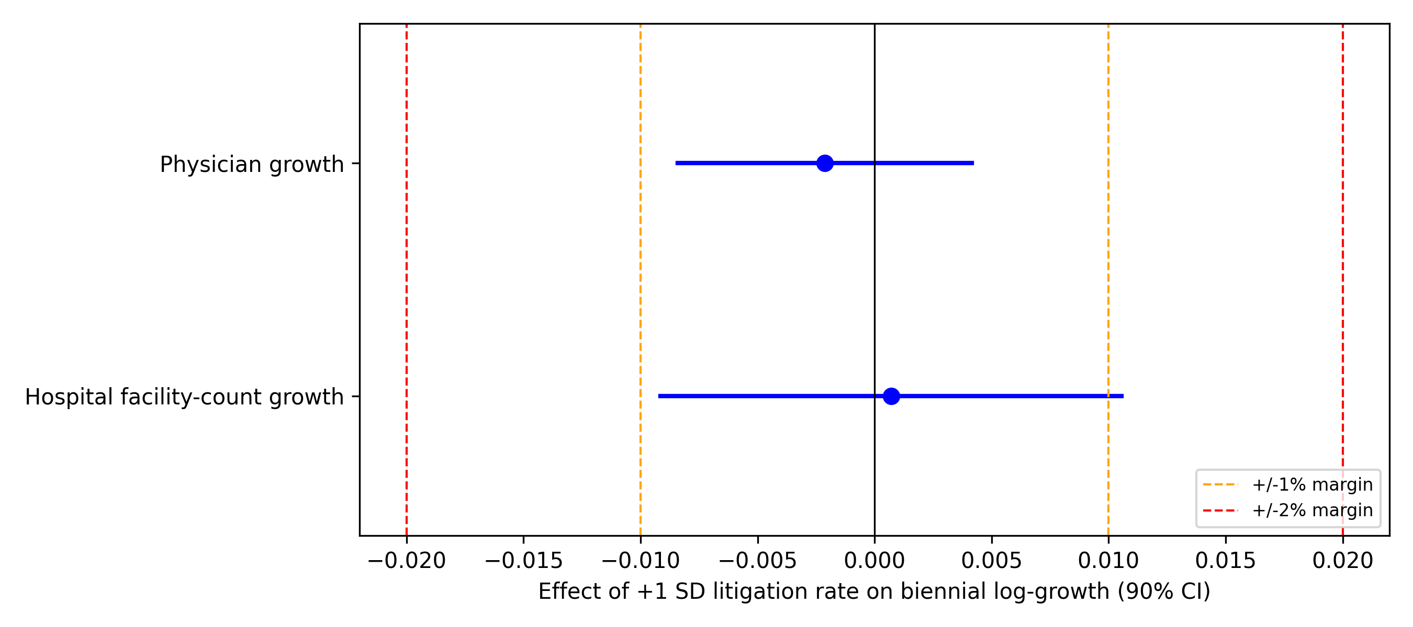
Figure 1
Equivalence (TOST) of the litigation-rate effect against ±1% and ±2% margins; horizontal bars are 90% confidence intervals.

Slide 2
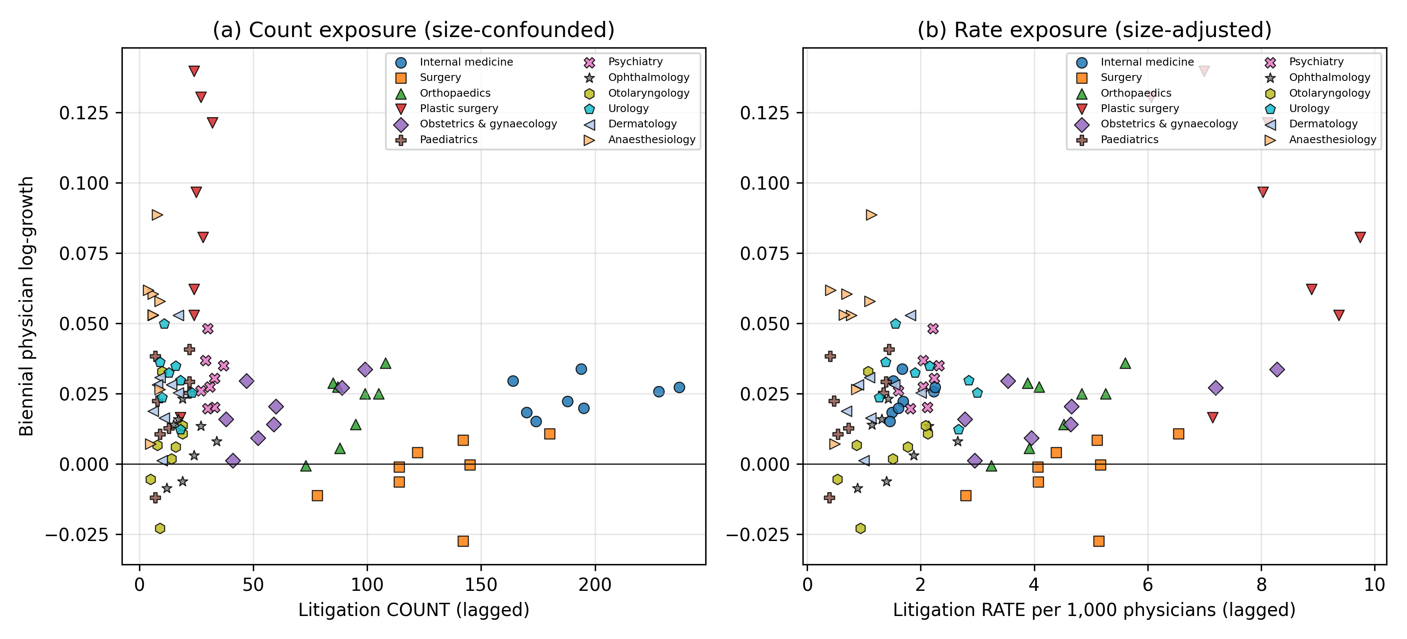
Figure 2
Biennial physician growth against lagged litigation exposure measured as (a) counts and (b) rates.

