Slide 1
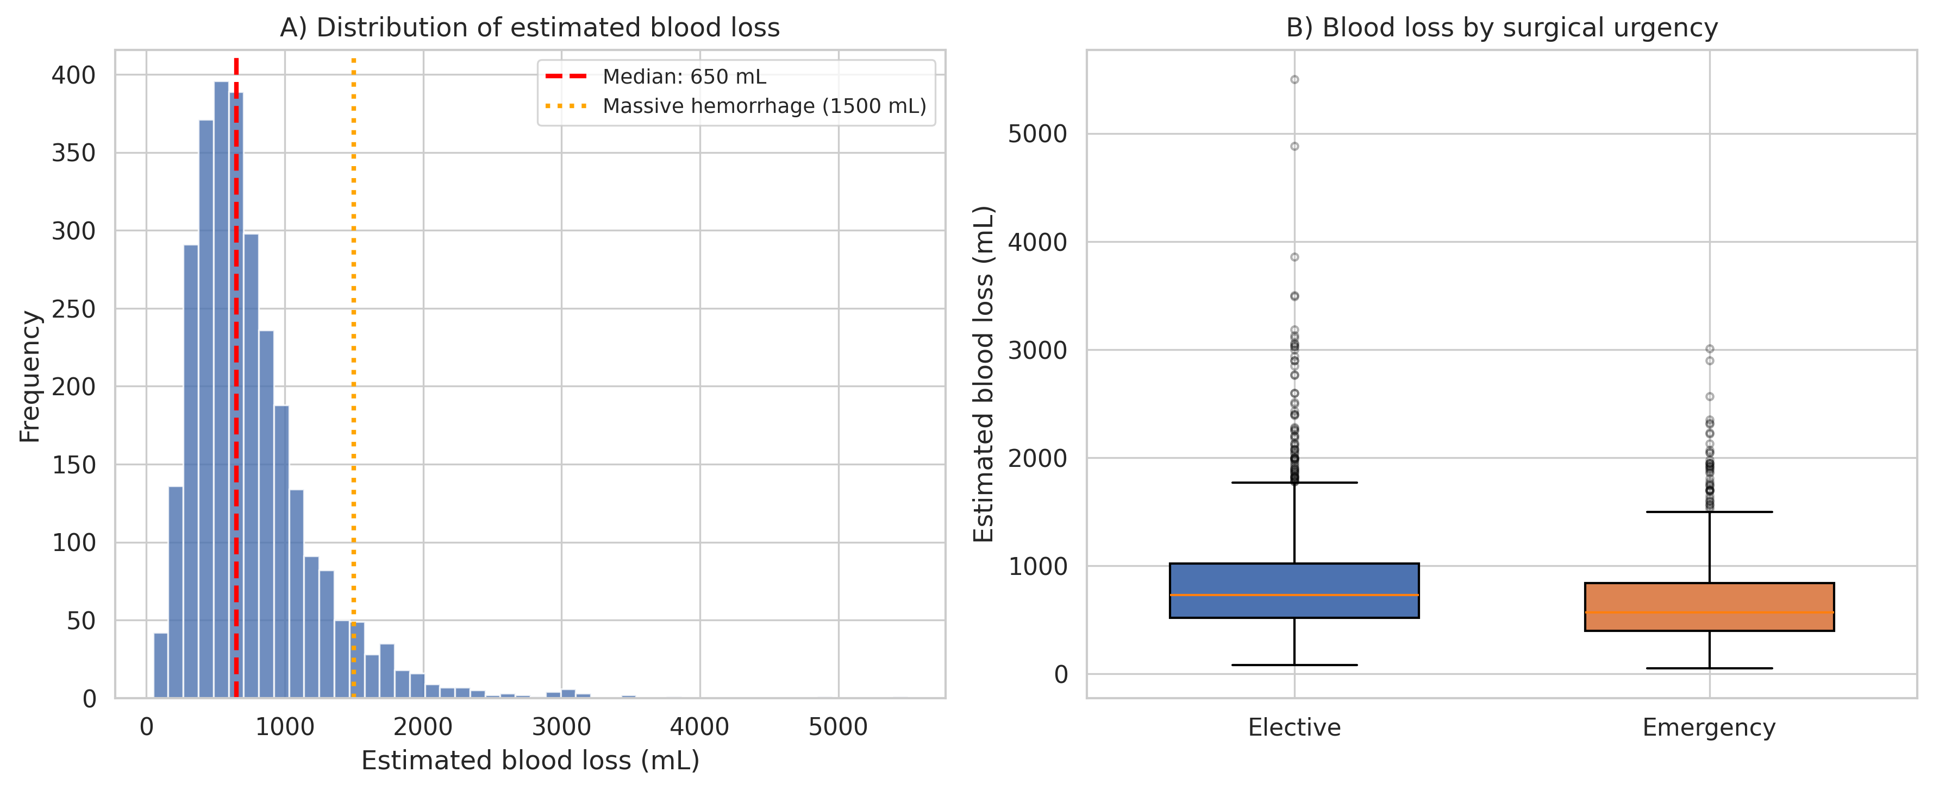
Figure 1
Distribution of estimated blood loss during cesarean section

Slide 2
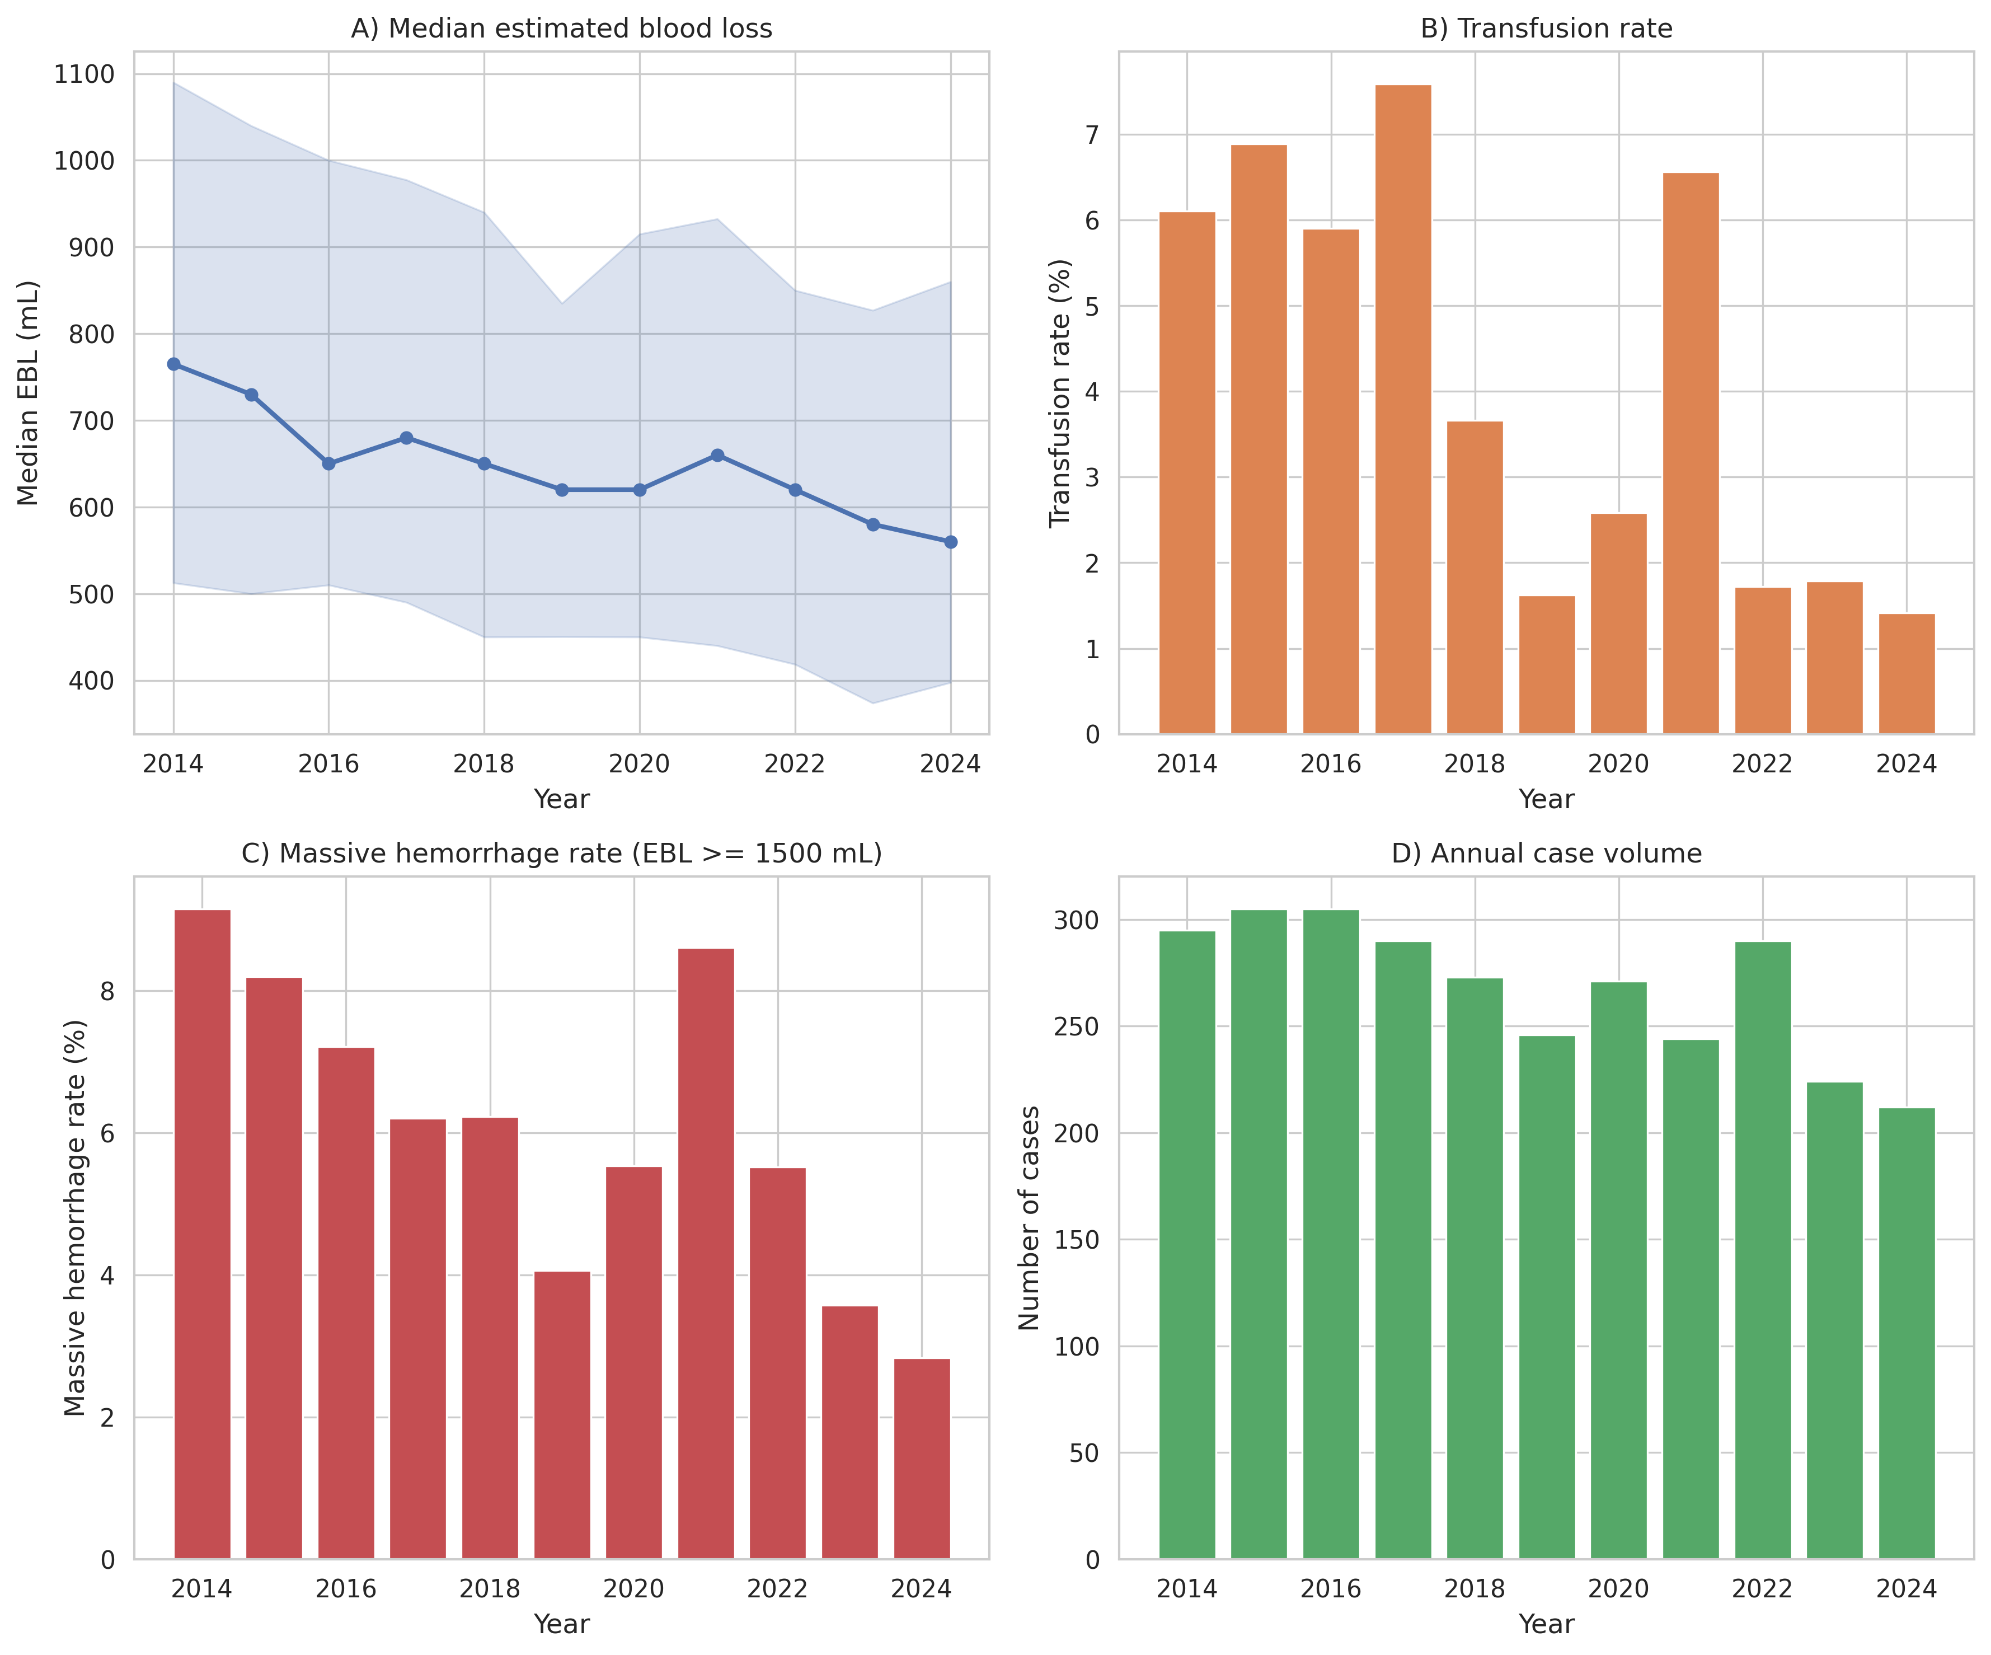
Figure 2
Temporal trends in cesarean section outcomes (2014–2024)

Slide 3
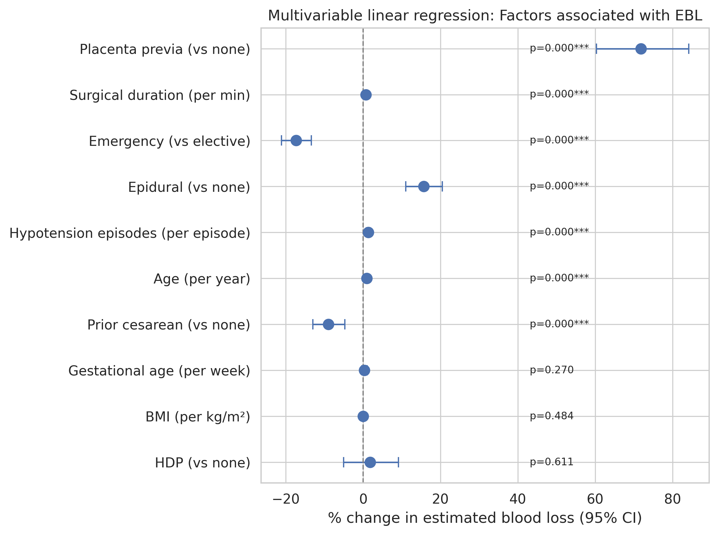
Figure 3
Forest plot: Factors associated with estimated blood loss

Slide 4
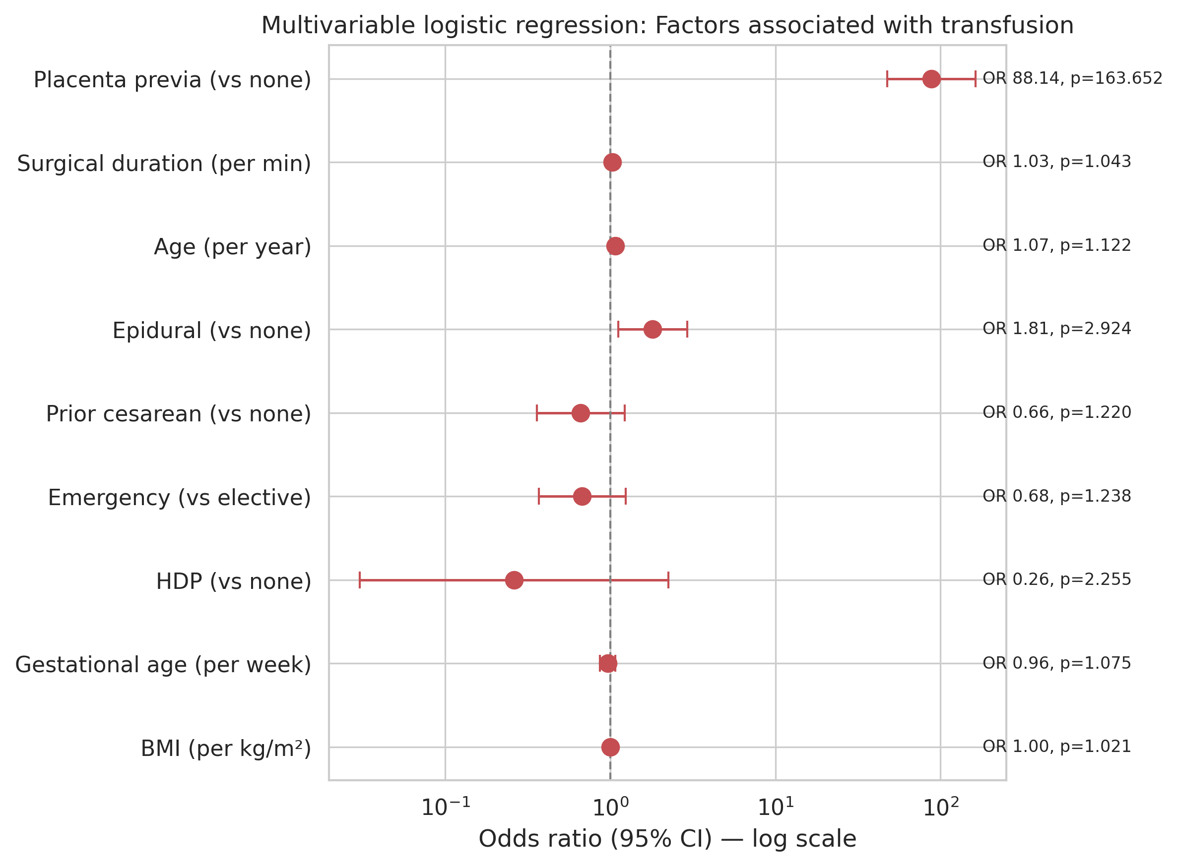
Figure 4
Forest plot: Factors associated with transfusion

Slide 5
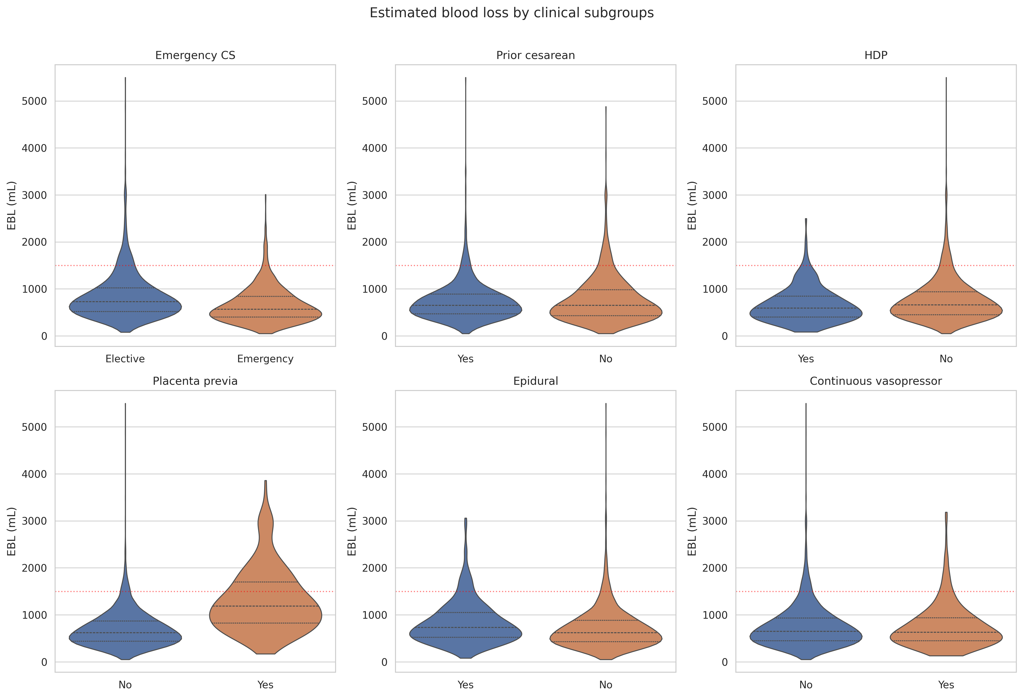
Figure 5
Estimated blood loss by clinical subgroups

Slide 6
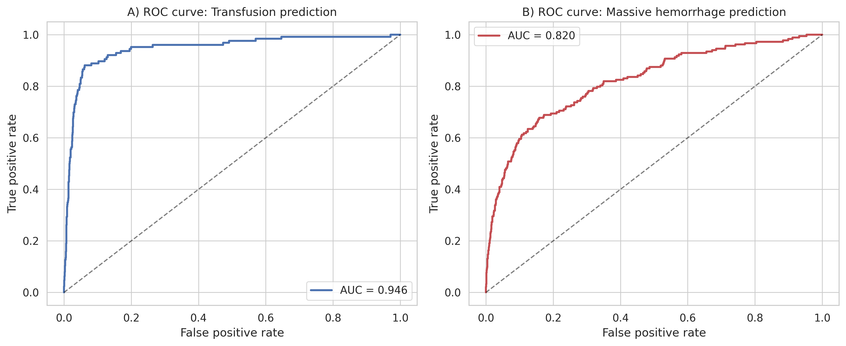
Figure 6
ROC curves for transfusion and massive hemorrhage prediction

