Slide 1
Figure 1. The Environmental Iceberg of Stem Cell Culture
[Conceptual diagram — controlled vs uncontrolled environmental variables]

Slide 2
Figure 2. Research Roadmap for Environmental Profiling
[Evidence matrix + 3-phase investigation strategy]

Slide 3
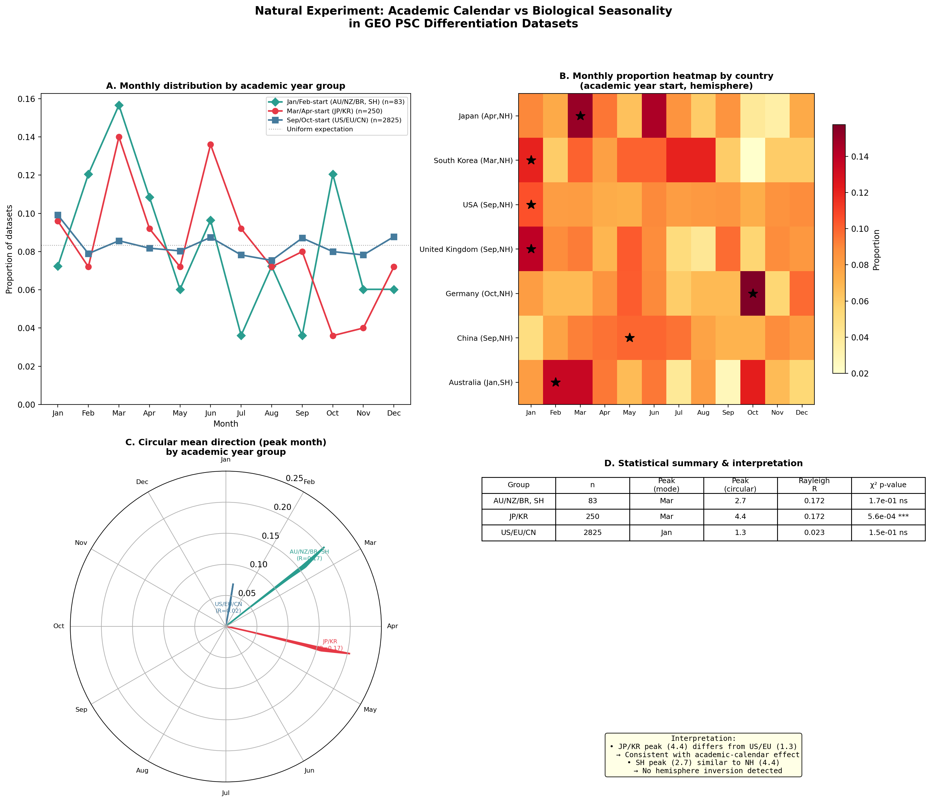
Figure 3. Natural Experiment: Academic Calendar vs Biological Seasonality
Japan/Korea (Mar/Apr start) shows March peak (p=0.0006); USA/EU/CN (Sep/Oct start) shows no seasonality (p=0.15). Sensitivity: removing Japan eliminates March peak.

