Slide 1
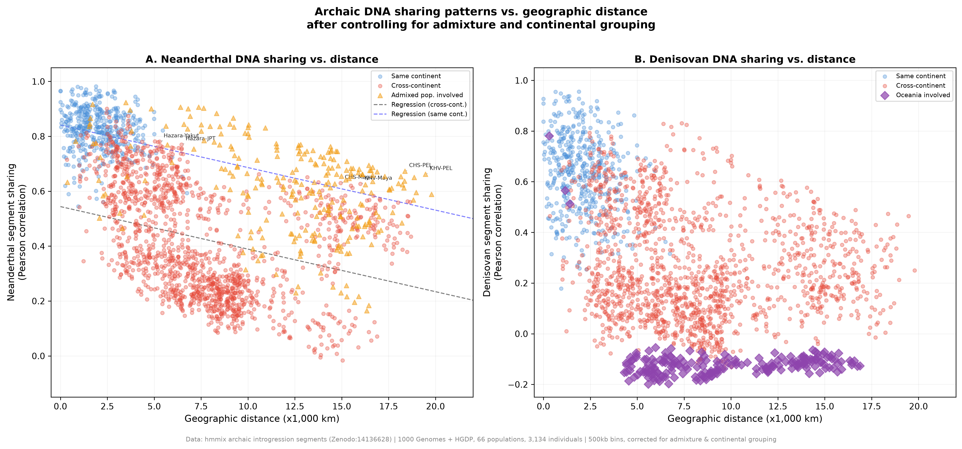
Figure 1
Archaic-segment sharing and geographic distance. Each point is a population pair. Lines summarize distance associations for Neanderthal and Denisovan sharing. Source identifiers in selected labels include CHS (Southern Han Chinese), FIN (Finnish), and PEL (Peruvian in Lima). Pairwise rows are dependent and are not interpreted as independent observations.

Slide 2
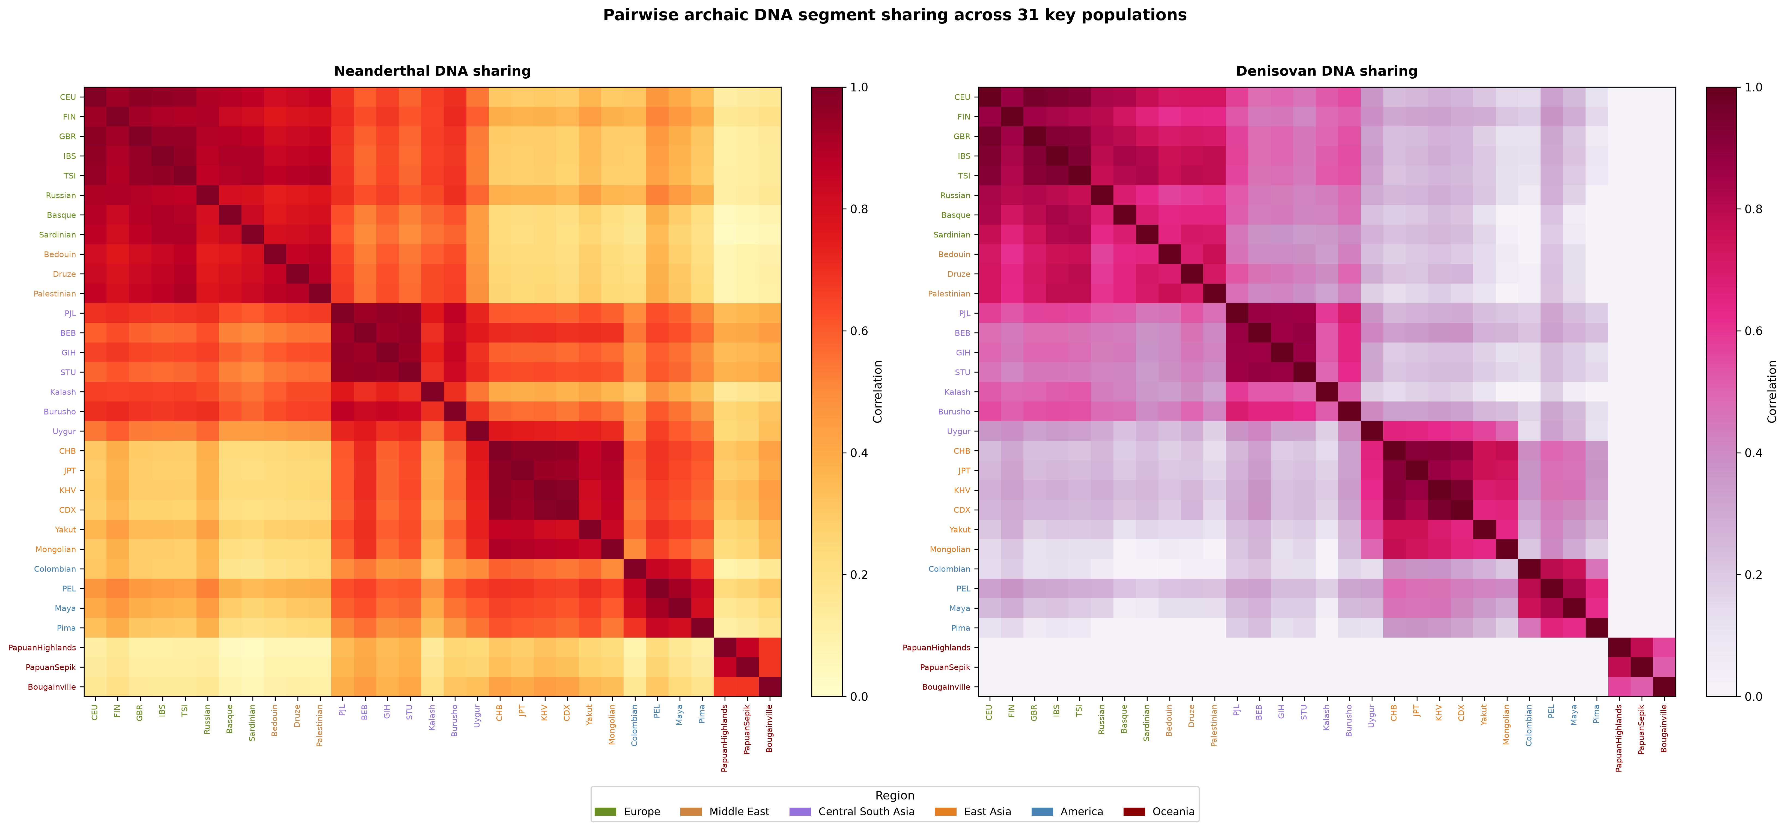
Figure 2
Pairwise sharing heat maps for 31 representative populations. Axis labels are source population identifiers. The displayed subset improves legibility; regression and Mantel analyses used all 66 populations.

Slide 3
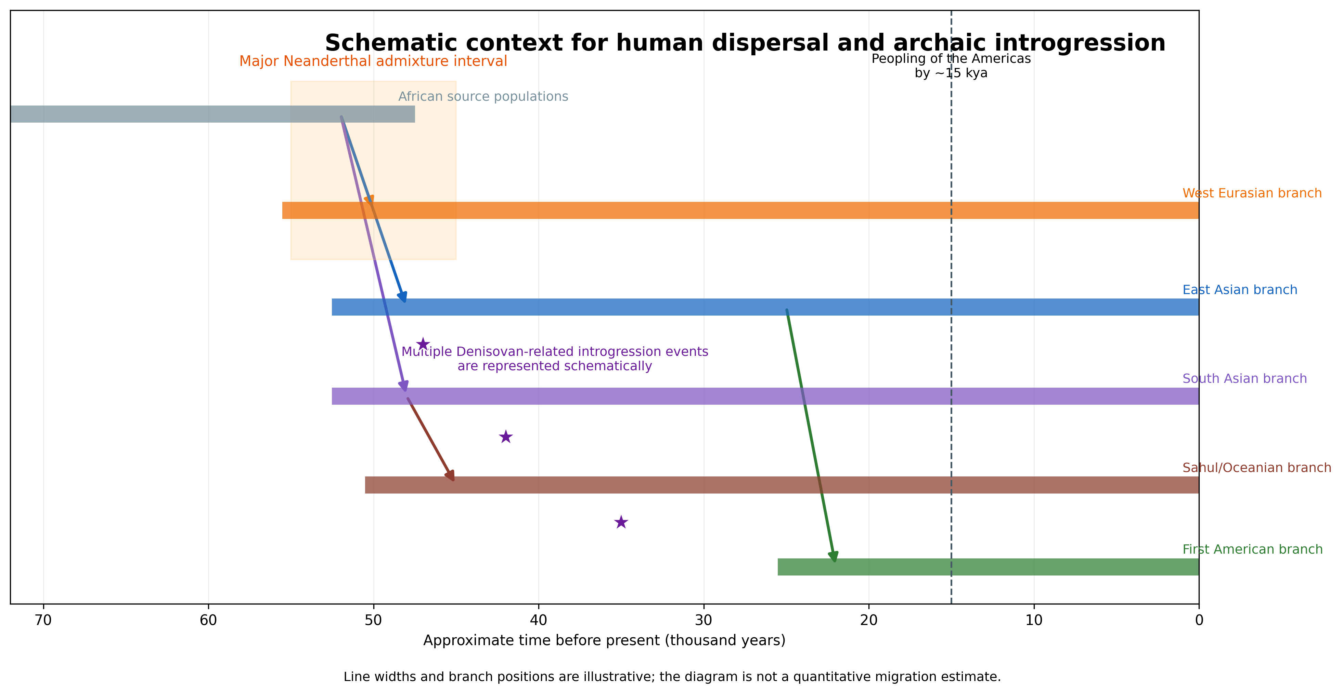
Figure 3
Schematic context for human dispersal and archaic introgression. Line widths and branch positions are illustrative and do not estimate migration magnitude, ancestry proportion, or event timing beyond the labeled broad intervals.

Slide 4
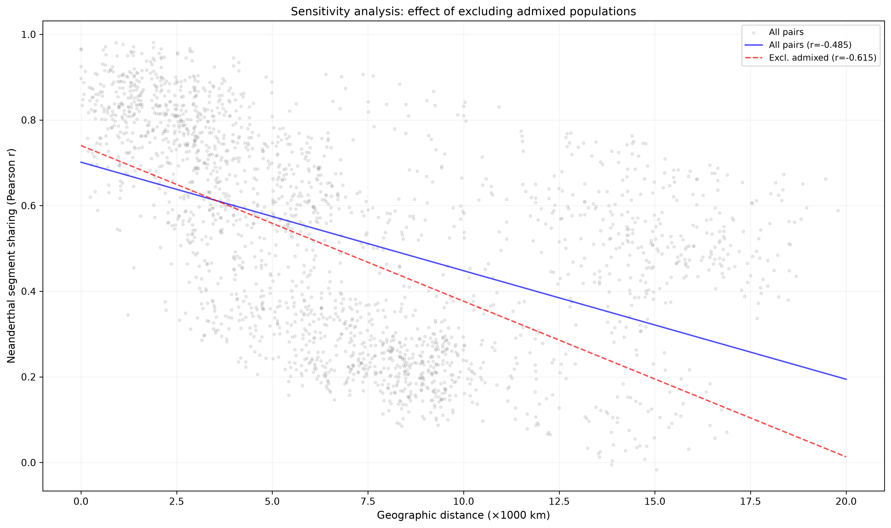
Figure 4
Sensitivity of Neanderthal sharing-distance correlation to exclusion of designated admixed populations. Correlations describe pairwise rows and are accompanied by matrix-level tests in the main analysis.

Slide 5
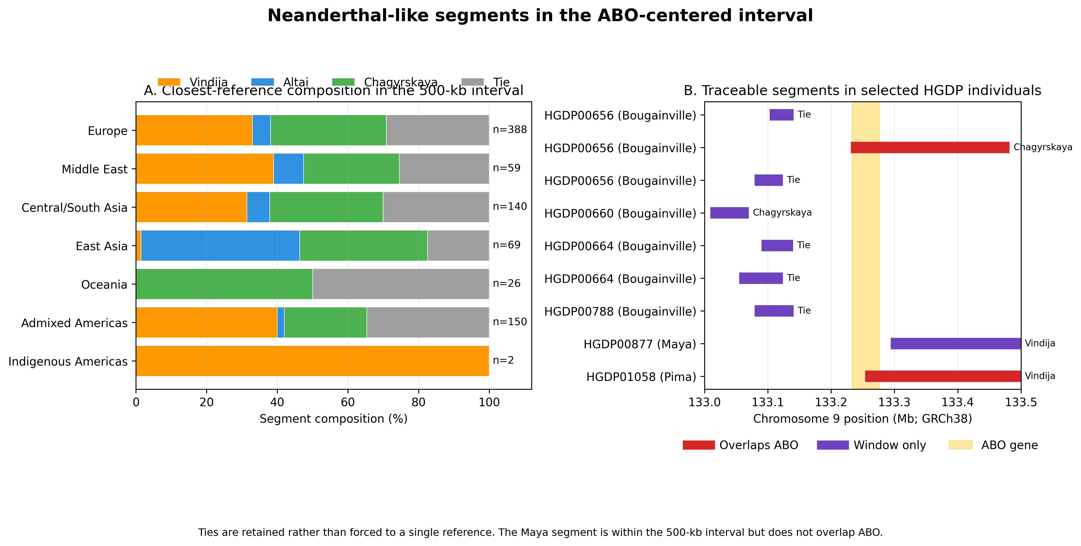
Figure 5
Neanderthal-like segments in the 500-kb ABO-centered interval. (A) Closest-reference composition retains tied maxima. n denotes segments, not individuals. (B) Traceable segments for selected HGDP individuals. The Pima and one Bougainville segment overlap ABO; the Maya segment is within the interval but downstream of the gene.

Slide 6
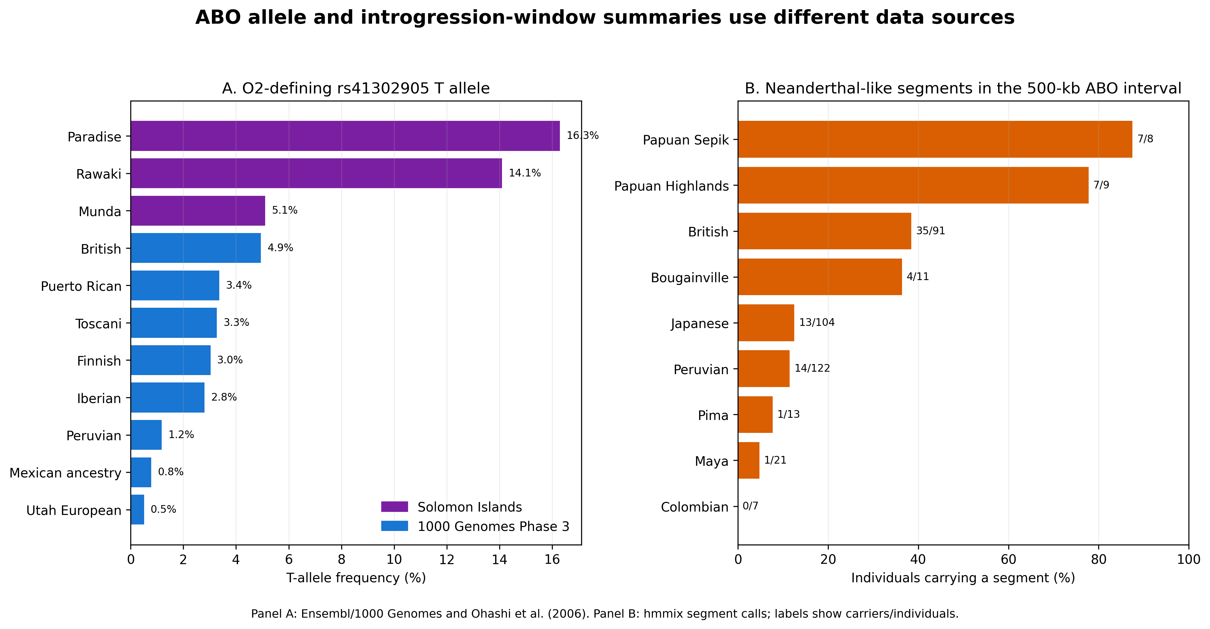
Figure 6
Distinct summaries of the O2-defining allele and ABO-window introgression. (A) rs41302905 T-allele frequencies from Ensembl/1000 Genomes and Ohashi et al. (2006). (B) Frequency of individuals carrying any Neanderthal-like segment in chr9:133.0-133.5 Mb. The panels use different sources and are not an association analysis.

Slide 7
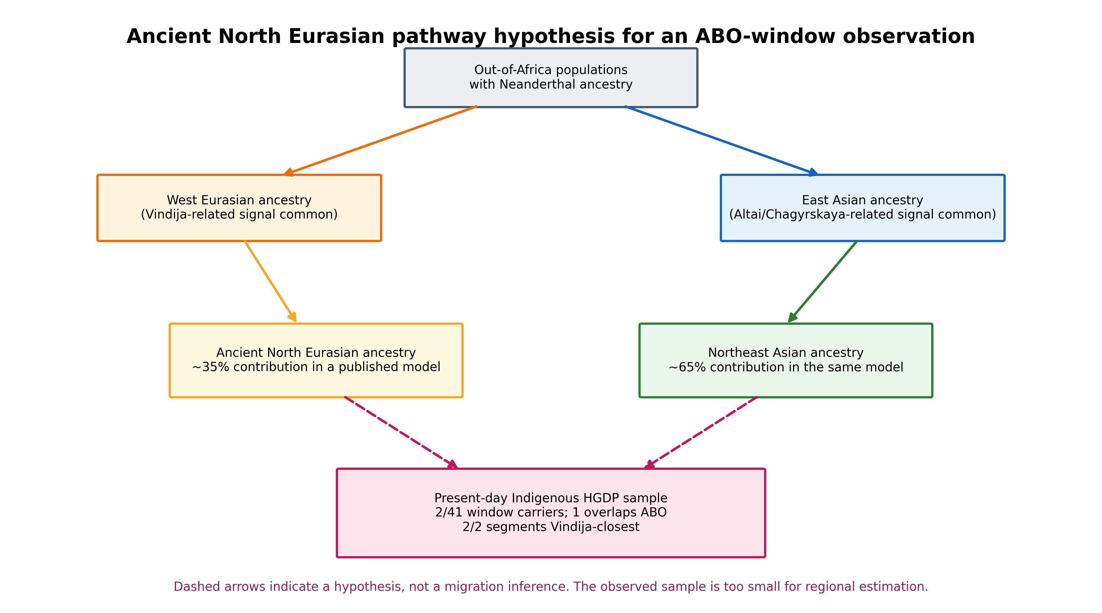
Figure 7
Ancient North Eurasian pathway hypothesis. Dashed arrows connect a published broad ancestry model to the modern ABO-window observation. The diagram is hypothesis-generating and does not infer that either segment followed a particular route.

Slide 8
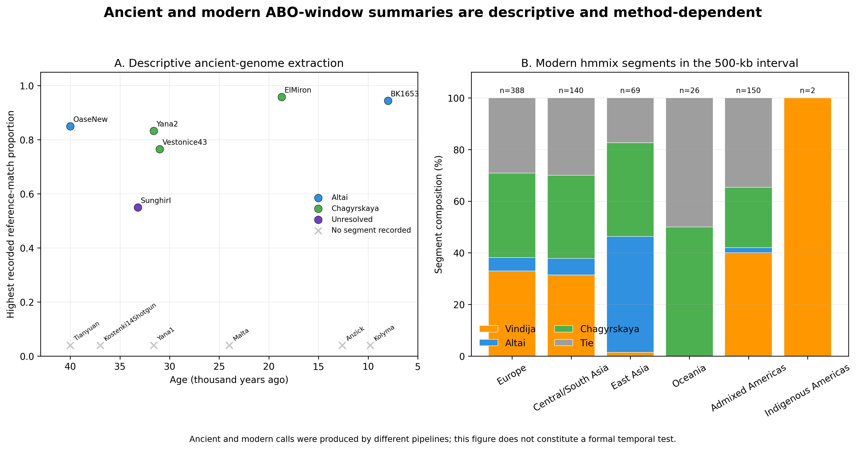
Figure 8
Descriptive ancient and modern ABO-window summaries. Ancient observations were secondarily extracted from public outputs associated with Iasi et al. (2024); modern calls use hmmix. Different pipelines and coverage preclude a formal temporal comparison.

Slide 9
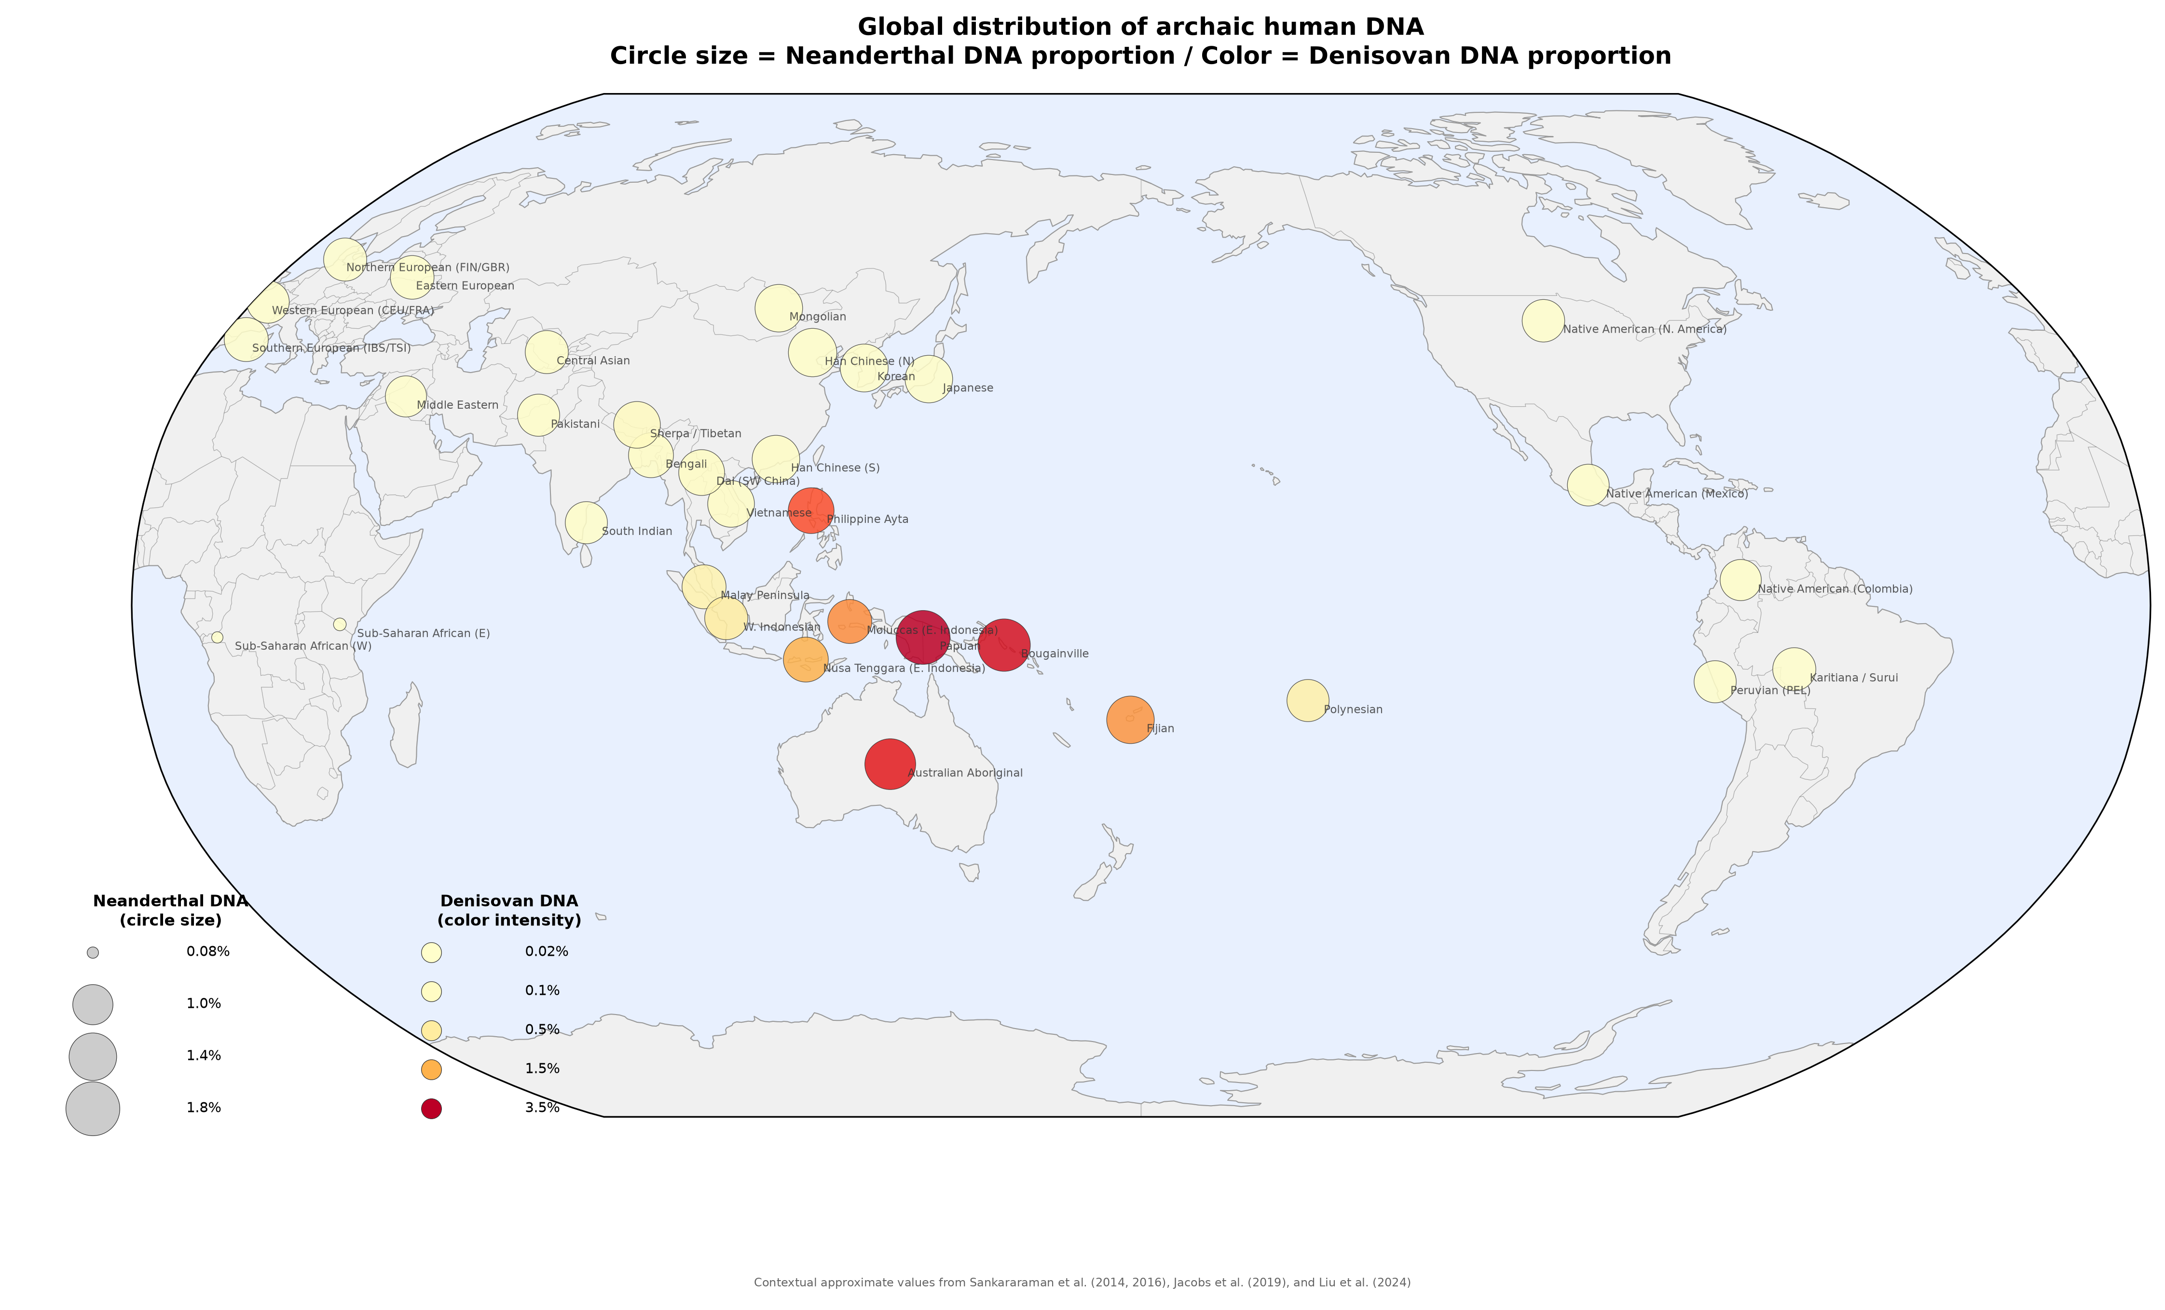
Figure 9
Literature-derived bivariate global context. Circle size represents approximate Neanderthal ancestry and color intensity represents approximate Denisovan ancestry. Source identifiers shown in parentheses are FIN (Finnish), GBR (British), CEU (Utah residents with Northern and Western European ancestry), FRA (French), IBS (Iberian), and TSI (Toscani). Values are contextual approximations from published studies and were not used in the pairwise statistical models.

Slide 10
Table 1. Corrected geographic-distance models and matrix-level tests
Metric | Neanderthal | Denisovan | Interpretation
Populations / unique pairs | 66 / 2,145 | 66 / 2,145 | Same pair set
Raw sharing-distance r | -0.4847 | -0.4656 | Pairwise descriptive correlation
Partial r | -0.3105 | -0.3001 | Controls maximum admixture and same continent
Distance-only R² | 0.2350 | 0.2167 | Uncorrected model
Corrected R² | 0.5100 | 0.4953 | Distance plus two confounders
Non-admixed Mantel r | -0.6157 | -0.5809 | 9,999 label permutations
Mantel p | 0.0001 | 0.0001 | Matrix-level inference
FDR q<0.10 positive outliers | 0 | 0 | Non-admixed pairs
Note. Partial correlations use pairwise rows and should not be interpreted as independent-sample inference. Mantel tests used non-admixed population matrices.

Slide 11
Table 2. Descriptive Neanderthal-reference composition in the 500-kb ABO-centered interval
Group | Segments | Vindija % | Altai % | Chagyrskaya % | Tie % | Strict ABO overlap
Europe | 388 | 33.0 | 5.2 | 32.7 | 29.1 | 56
Middle East | 59 | 39.0 | 8.5 | 27.1 | 25.4 | 8
Central/South Asia | 140 | 31.4 | 6.4 | 32.1 | 30.0 | 31
East Asia | 69 | 1.4 | 44.9 | 36.2 | 17.4 | 12
Oceania | 26 | 0.0 | 0.0 | 50.0 | 50.0 | 1
Admixed Americas | 150 | 40.0 | 2.0 | 23.3 | 34.7 | 20
Indigenous Americas | 2 | 100.0 | 0.0 | 0.0 | 0.0 | 1
Note. Counts are segments, not individuals. Equal maximum similarity counts are reported as ties. The Indigenous American row contains two segments, only one of which overlaps ABO.

