Slide 1
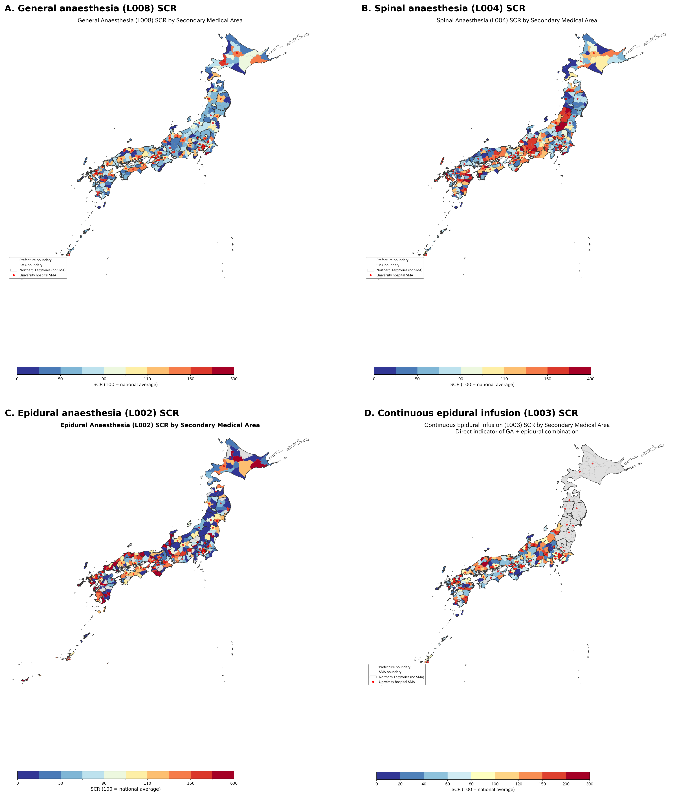
Figure 1. Geographic distribution of anaesthesia standardised claim ratios across 335 secondary medical areas of Japan, fiscal year 2022.
(A) General anaesthesia (L008). (B) Spinal anaesthesia (L004). (C) Epidural anaesthesia as main anaesthetic (L002). (D) Continuous epidural infusion (L003). Choropleth maps shaded by quintile of the standardised claim ratio (national average = 100). Red circles mark secondary medical areas containing at least one university hospital. Areas masked by the data provider owing to low volume are shown in grey.

Slide 2
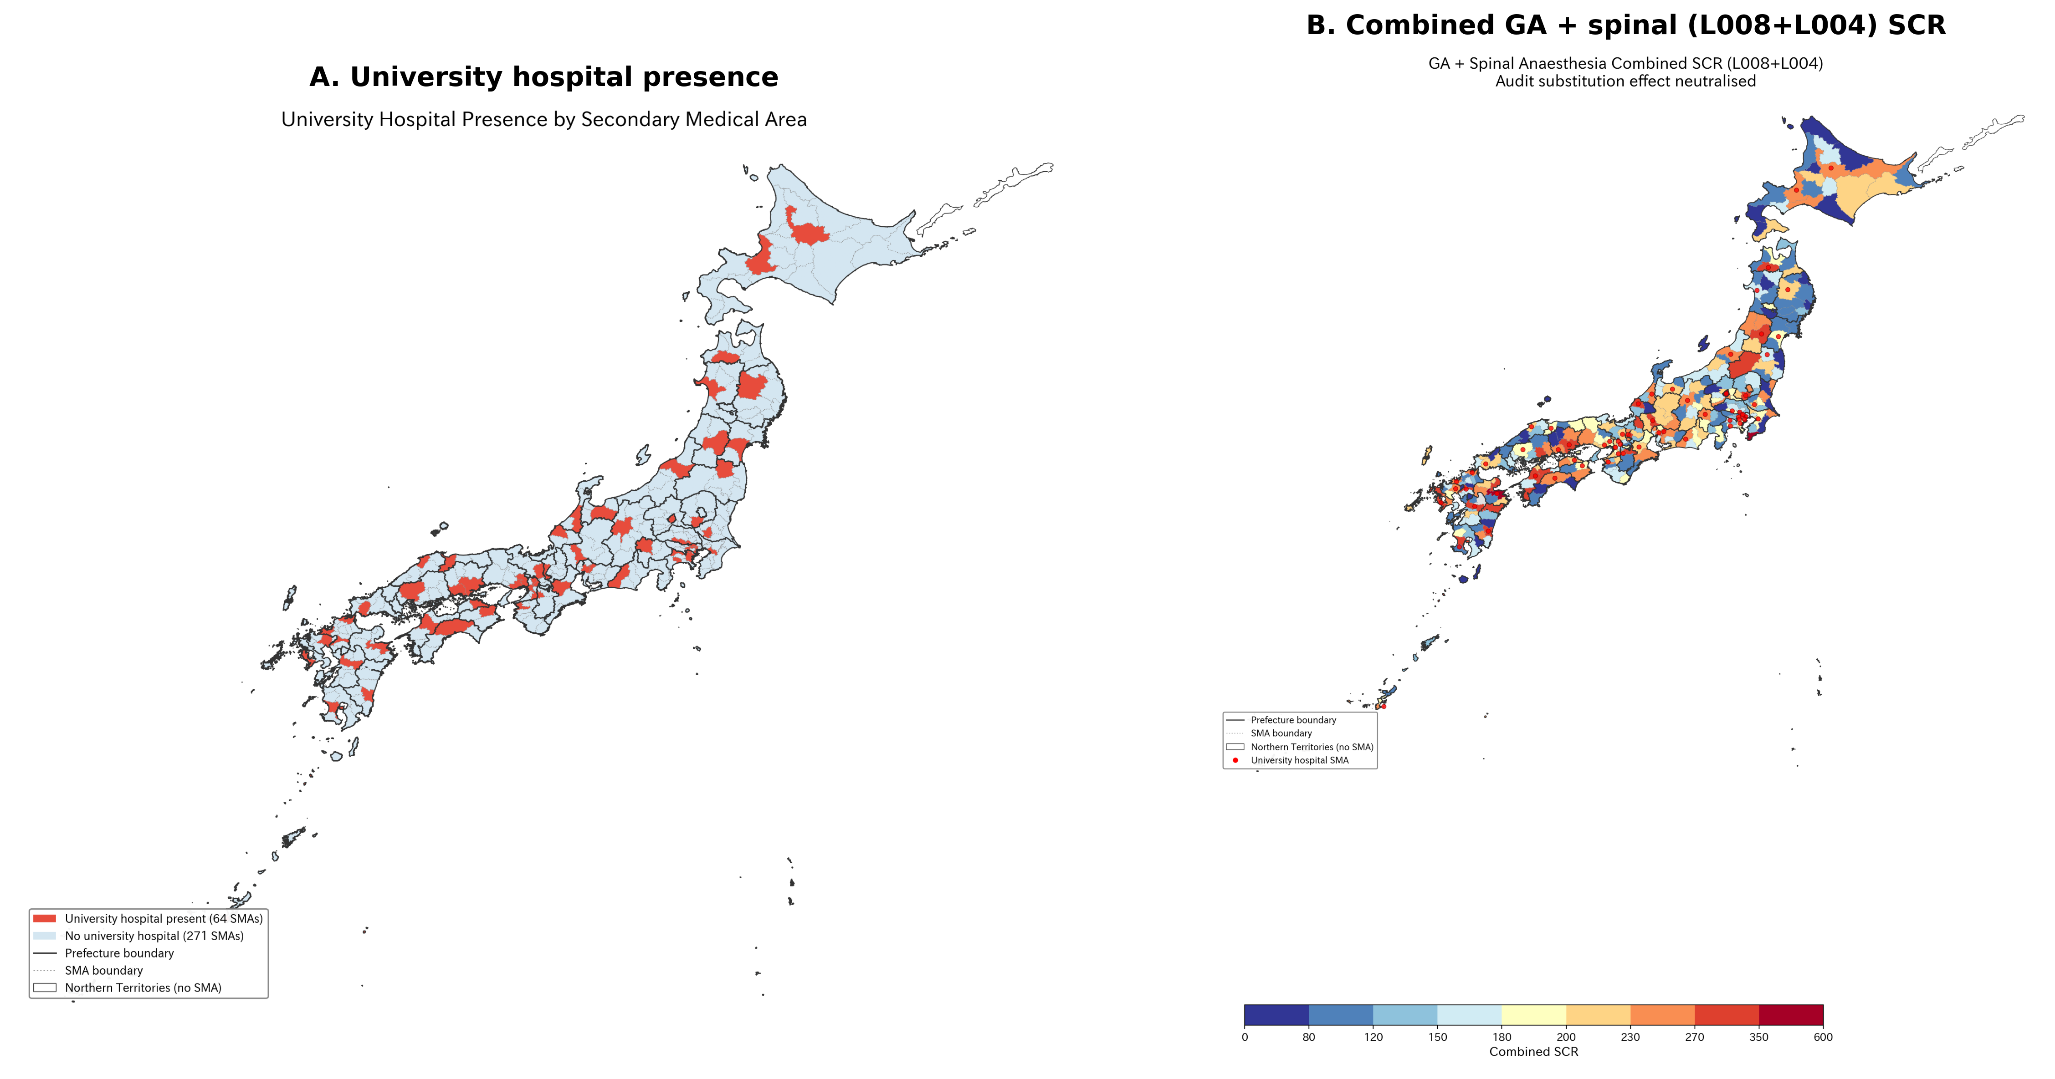
Figure 2. University hospital presence and the standardised claim ratio for general anaesthesia.
(A) Distribution of secondary medical areas containing at least one university hospital (n = 64 of 335). (B) Within-prefecture comparison of mean general anaesthesia ratios between university and non-university areas across all 47 prefectures. The university effect is positive in all 47 of 47 prefectures (mean within-prefecture difference +63.3 points, paired t = 13.28, P < 0.001).

