Slide 1
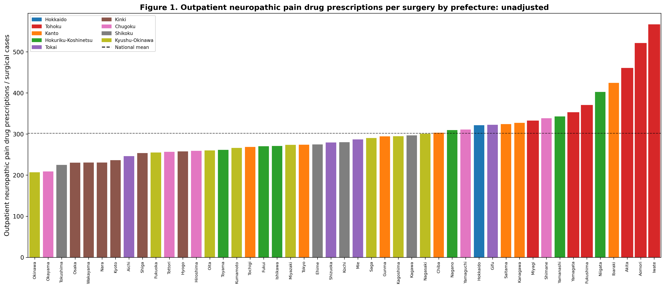
Figure 1
Figure 1. Outpatient neuropathic pain drug prescribing per surgery by prefecture. Bars represent individual prefectures ordered by prescribing index. Bars are coloured by regional block. Dashed line indicates the national mean.

Slide 2
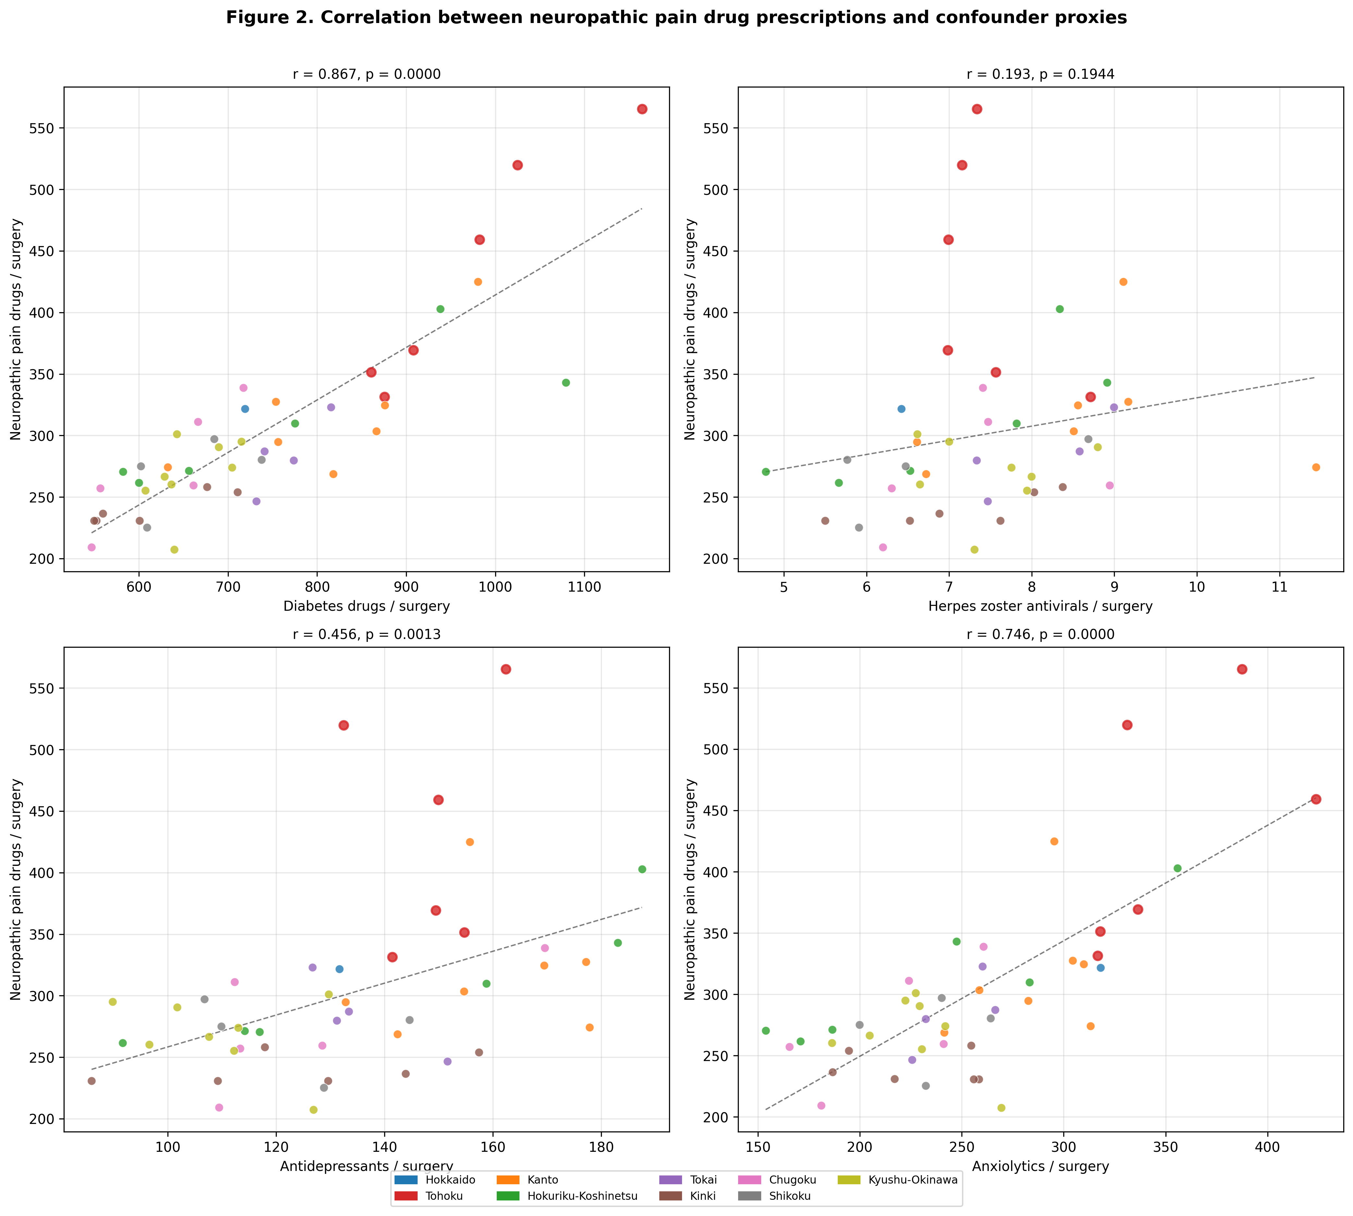
Figure 2
Figure 2. Correlation between neuropathic pain prescribing and confounder disease proxies across 47 prefectures. Each dot represents one prefecture. Diabetes drugs show the strongest correlation (r=0.87).

Slide 3
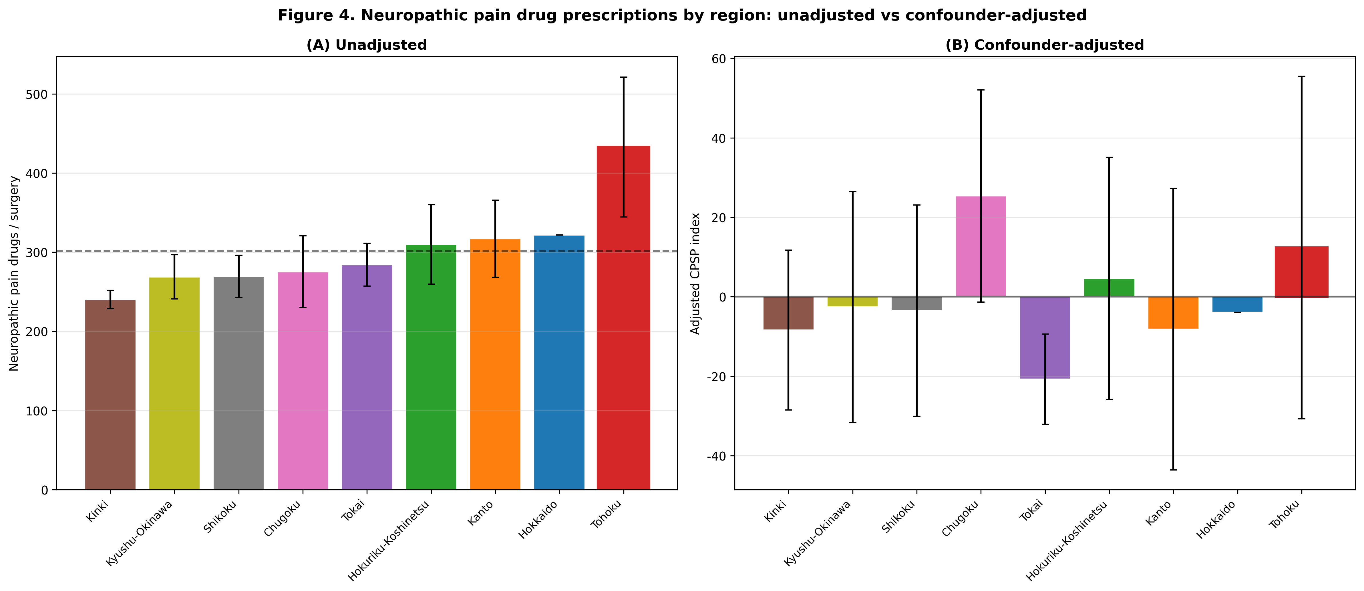
Figure 3
Figure 3. Regional comparison of neuropathic pain prescribing: (a) unadjusted and (b) after adjustment for confounding disease proxies. Error bars indicate SD.

Slide 4
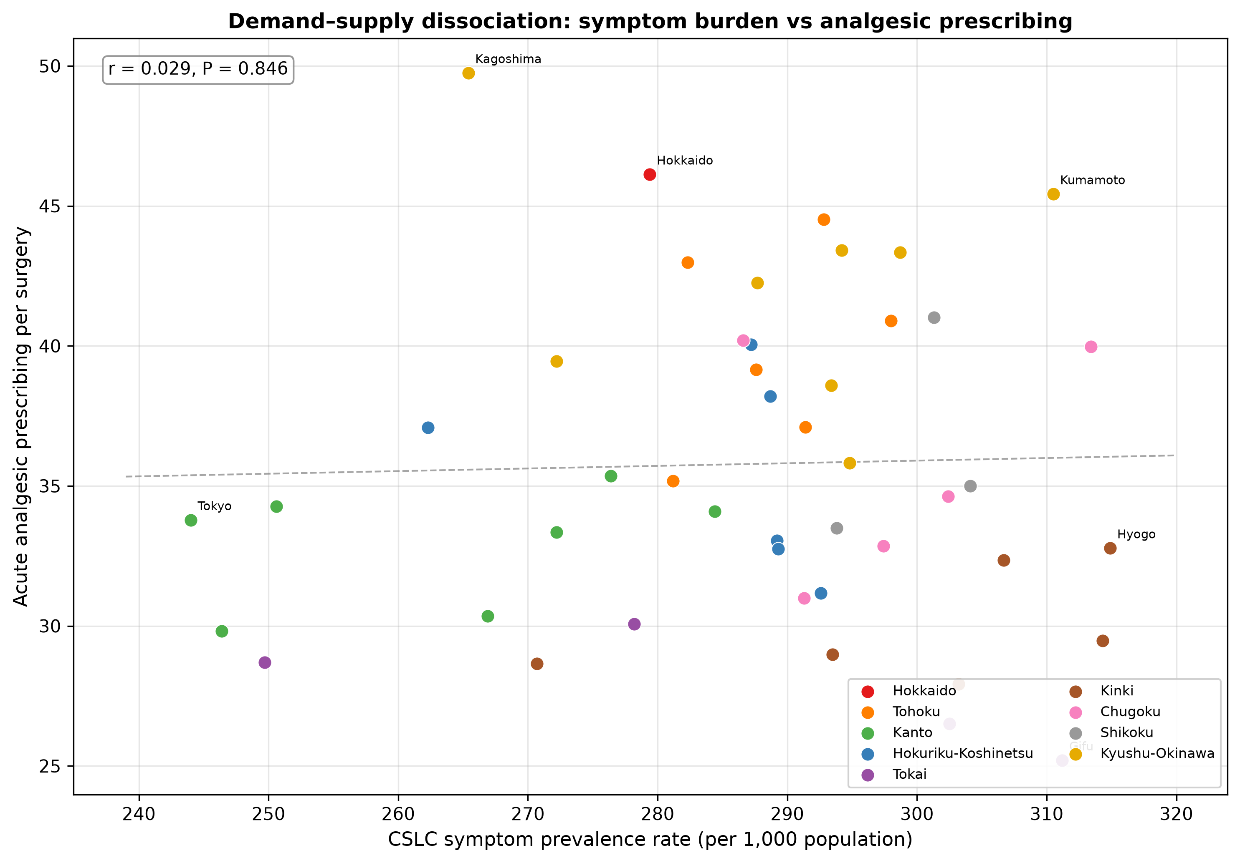
Figure 4
Figure 4. Demand–supply dissociation: CSLC symptom prevalence rate (per 1,000 population) vs acute analgesic prescribing per surgery across 47 prefectures. Each dot represents one prefecture, coloured by regional block. The near-zero correlation (r=0.03, P=0.85) indicates that prescribing variation is dissociated from symptom burden.

