Slide 1
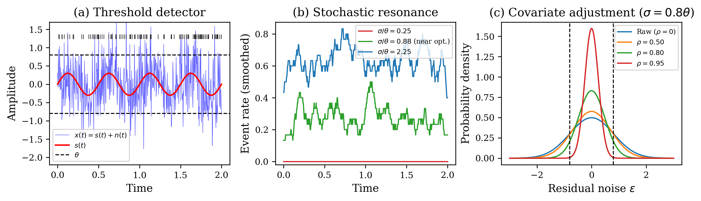
Figure 1
Conceptual schematic of the covariate-adjusted stochastic resonance framework. (a) Threshold-based event detector: a weak periodic signal s(t) embedded in Gaussian noise n(t) triggers events when |x(t)| exceeds threshold θ. (b) Stochastic resonance: event rate modulation is maximized at an intermediate noise level (green), suppressed at too-low noise (red), and washed out at too-high noise (blue). (c) Covariate adjustment narrows the residual noise distribution, effectively shifting the operating point on the SR curve.

Slide 2
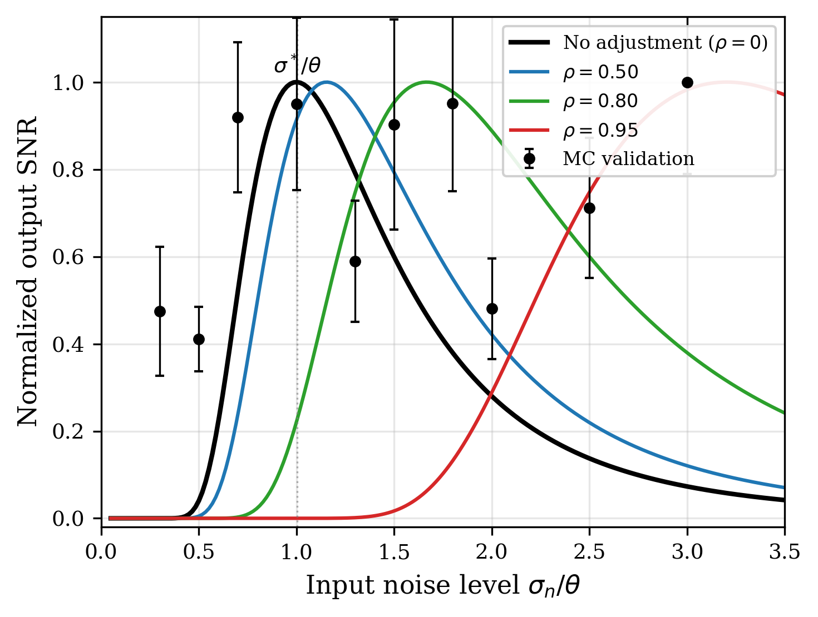
Figure 2
Stochastic resonance curves for a threshold detector (A/θ = 0.3). Solid lines: analytical SNR from two-state theory. Points with error bars: Monte Carlo validation via cross-correlation. Covariate adjustment (ρ > 0) shifts the SR peak to higher input noise levels, meaning the detector tolerates more environmental noise when a good noise model is available.

Slide 3
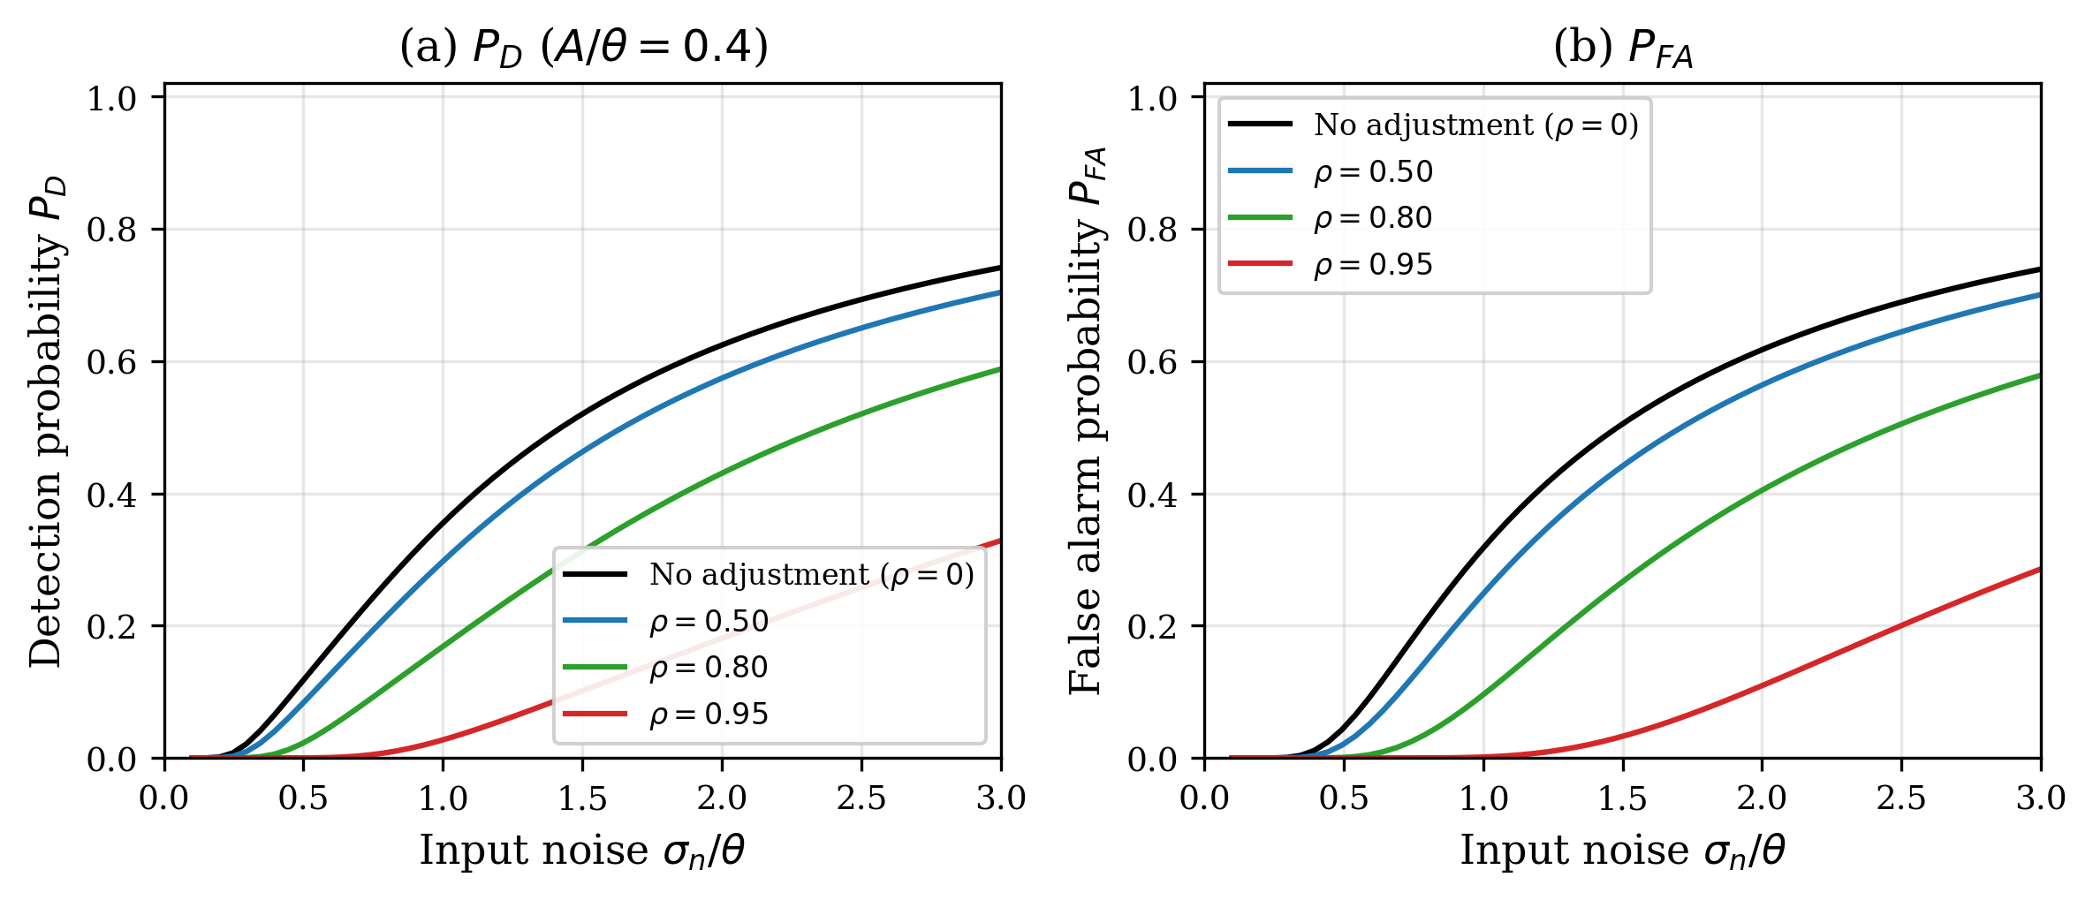
Figure 3
Detection probability P_D and false alarm probability P_FA as functions of input noise level for different covariate model accuracies ρ. Higher ρ suppresses both P_D and P_FA by reducing effective noise; the net effect on detection performance depends on the operating regime.

Slide 4
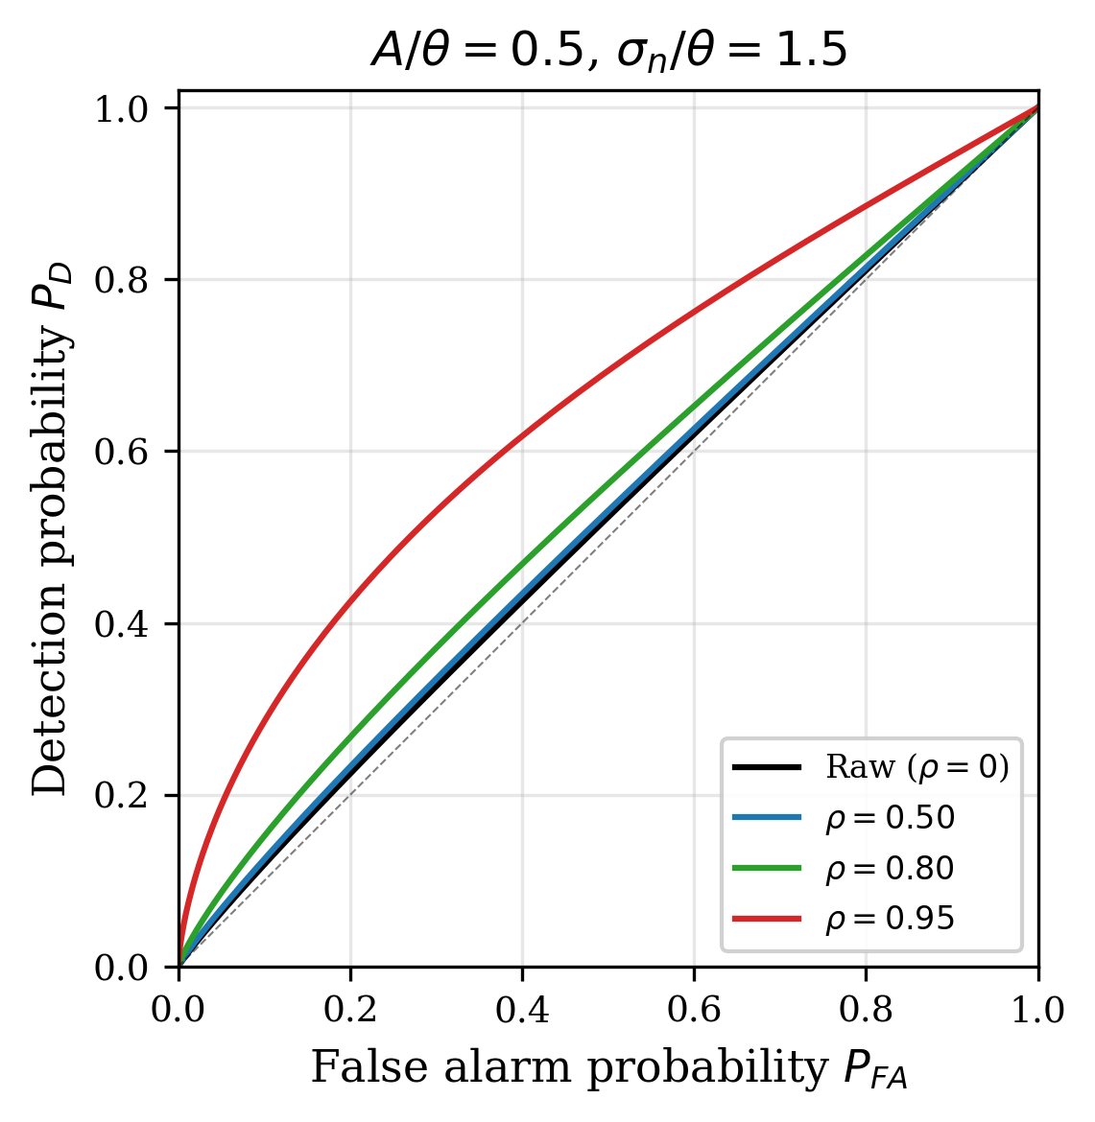
Figure 4
ROC curves at fixed input noise σ_n/θ = 1.5 (excess noise regime) for different covariate adjustment levels. In this regime, higher ρ improves the ROC curve, confirming that covariate adjustment is beneficial when the system operates above the SR optimum.

Slide 5
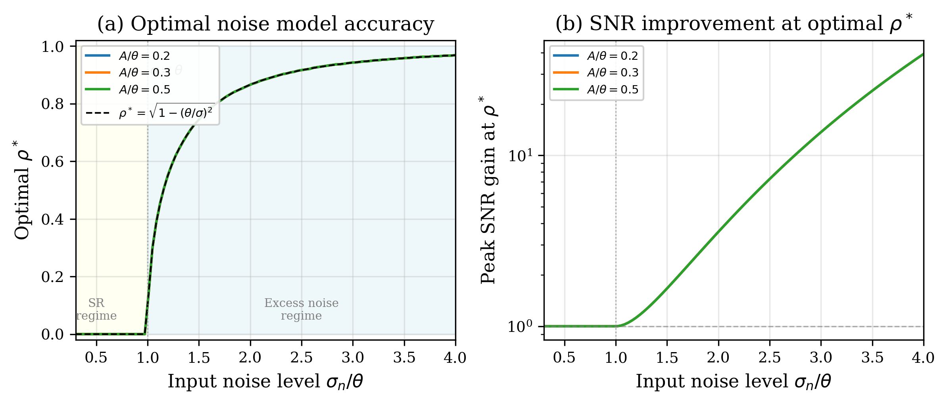
Figure 5
Optimal noise model accuracy ρ* and the corresponding SNR improvement. (a) When σ < θ (SR regime, yellow shading), ρ* = 0: any noise removal degrades performance. When σ > θ (excess noise regime, blue shading), ρ* increases to bring effective noise to the SR optimum. (b) SNR improvement at optimal ρ* grows exponentially with input noise.

Slide 6
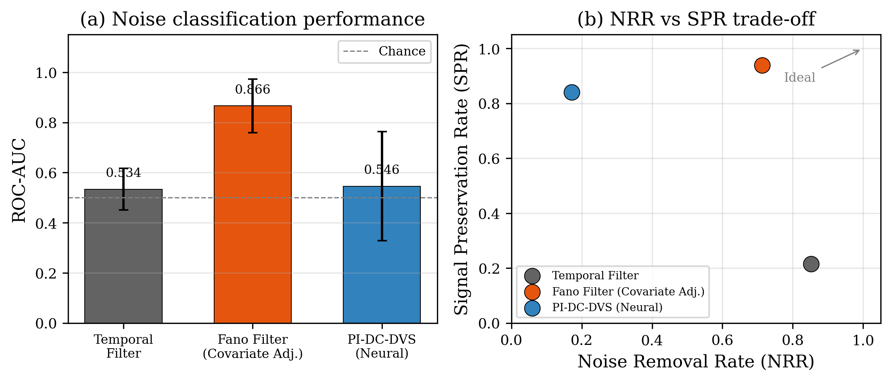
Figure 6
Application to dynamic vision sensor (DVS) astronomical observation. (a) ROC-AUC for noise classification: the Fano filter (covariate adjustment approach) achieves AUC = 0.866, far exceeding temporal filtering and neural methods. (b) NRR vs SPR trade-off: the Fano filter preserves 93.9% of signal events while removing 71.3% of noise.

Slide 7
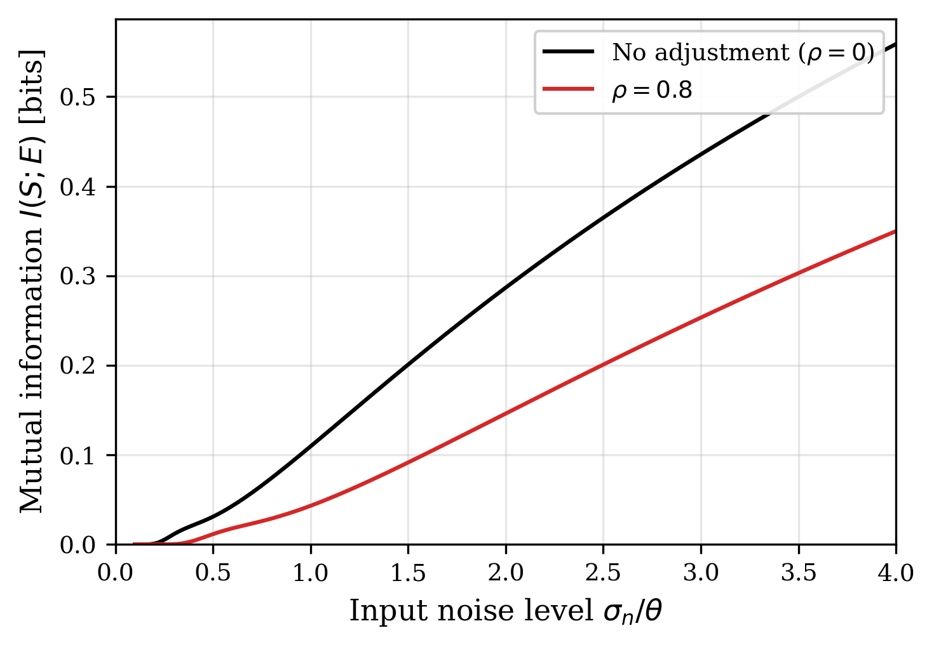
Figure 7
Mutual information I(S; E) between the periodic signal and the event stream as a function of input noise level. Covariate adjustment (ρ = 0.8) shifts the MI peak to higher input noise, consistent with the SR curve analysis.

