Slide 1
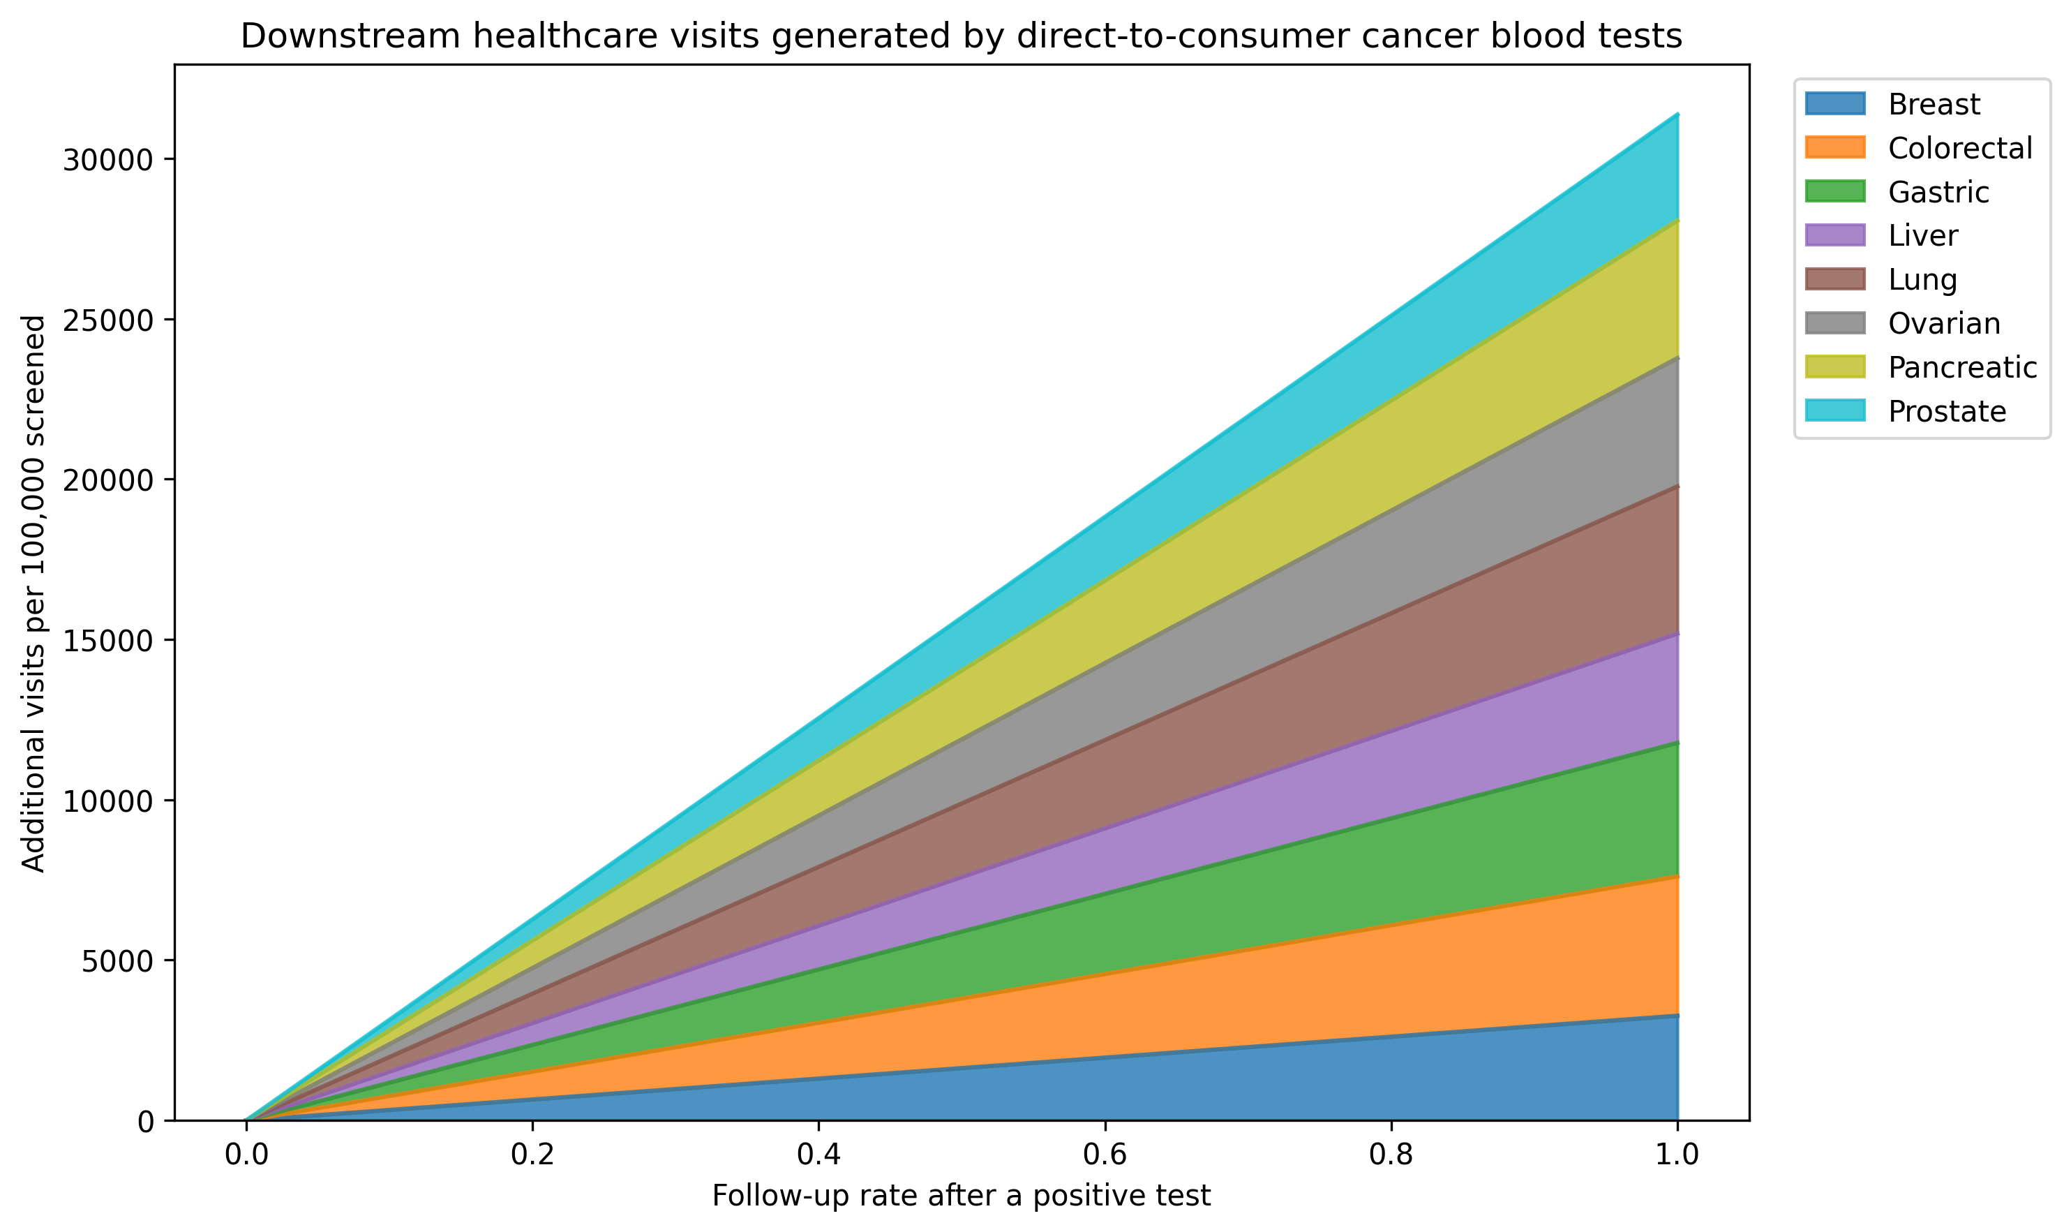
Figure 1. Total downstream visits by follow-up rate

Slide 2
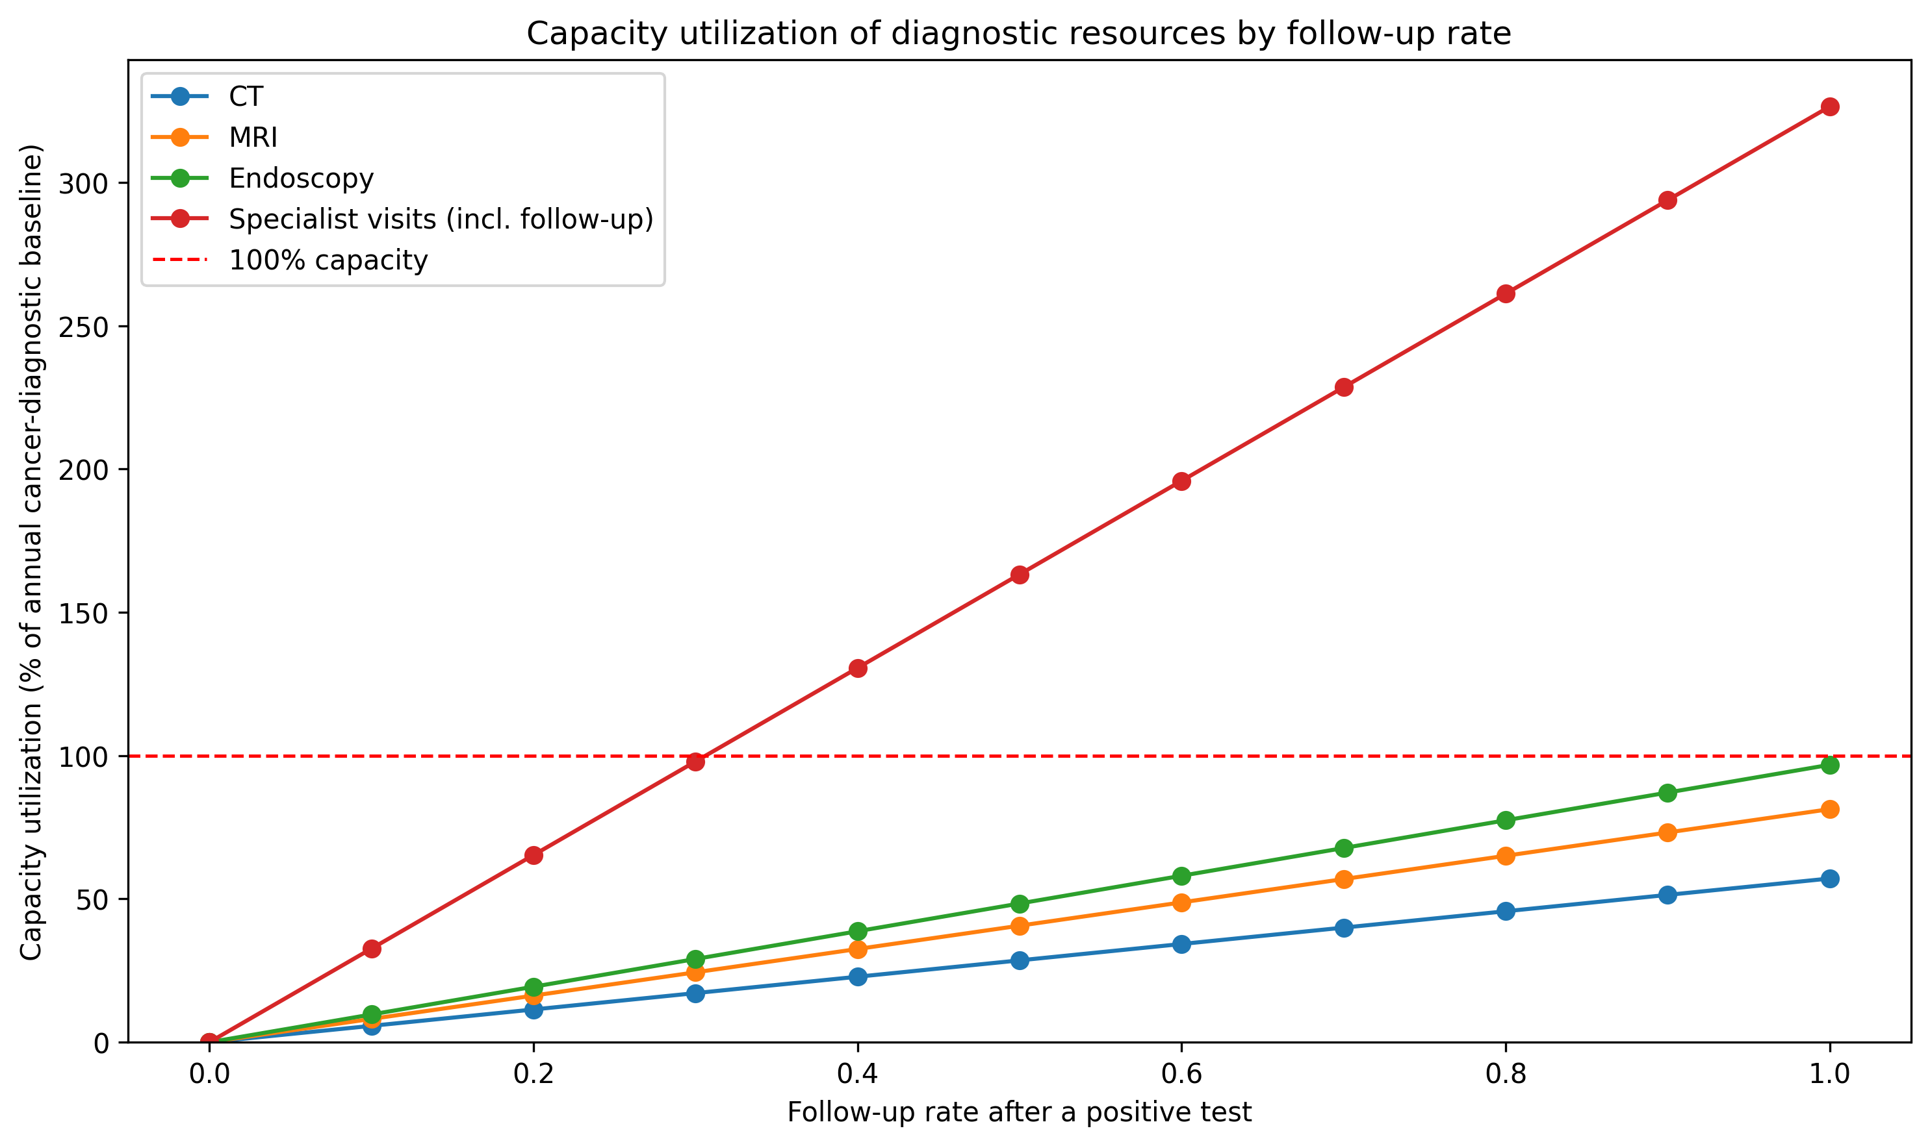
Figure 2. Diagnostic capacity utilisation by follow-up rate

Slide 3
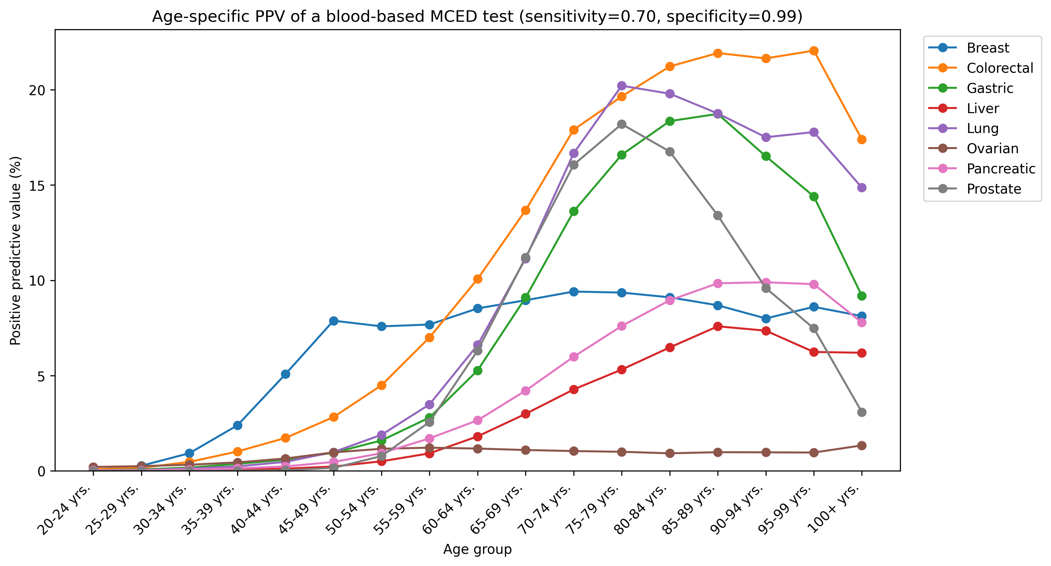
Figure 3. Age-specific PPV by cancer type

Slide 4
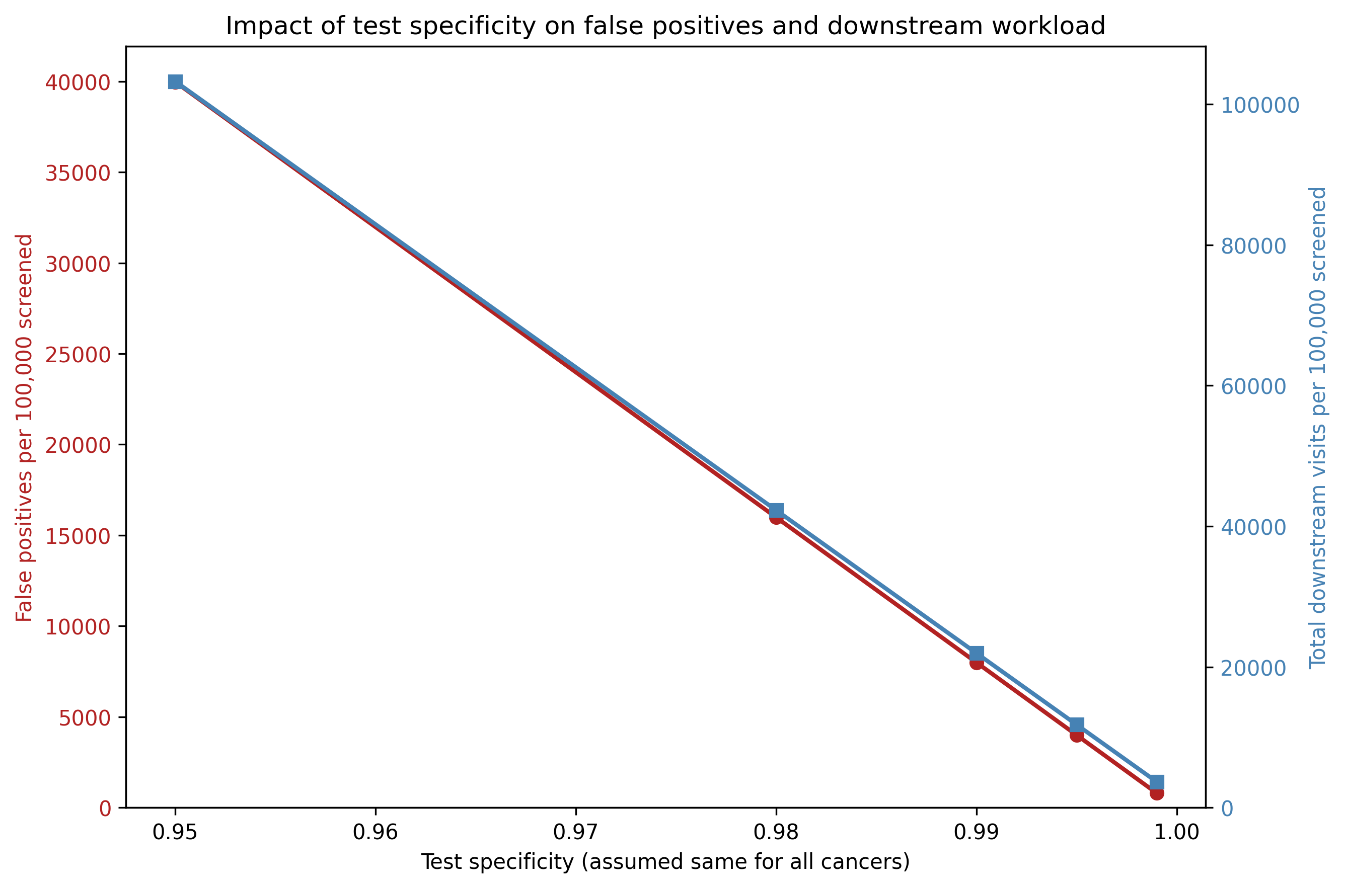
Figure 4. PPV and total positives across specificity values

