Slide 1
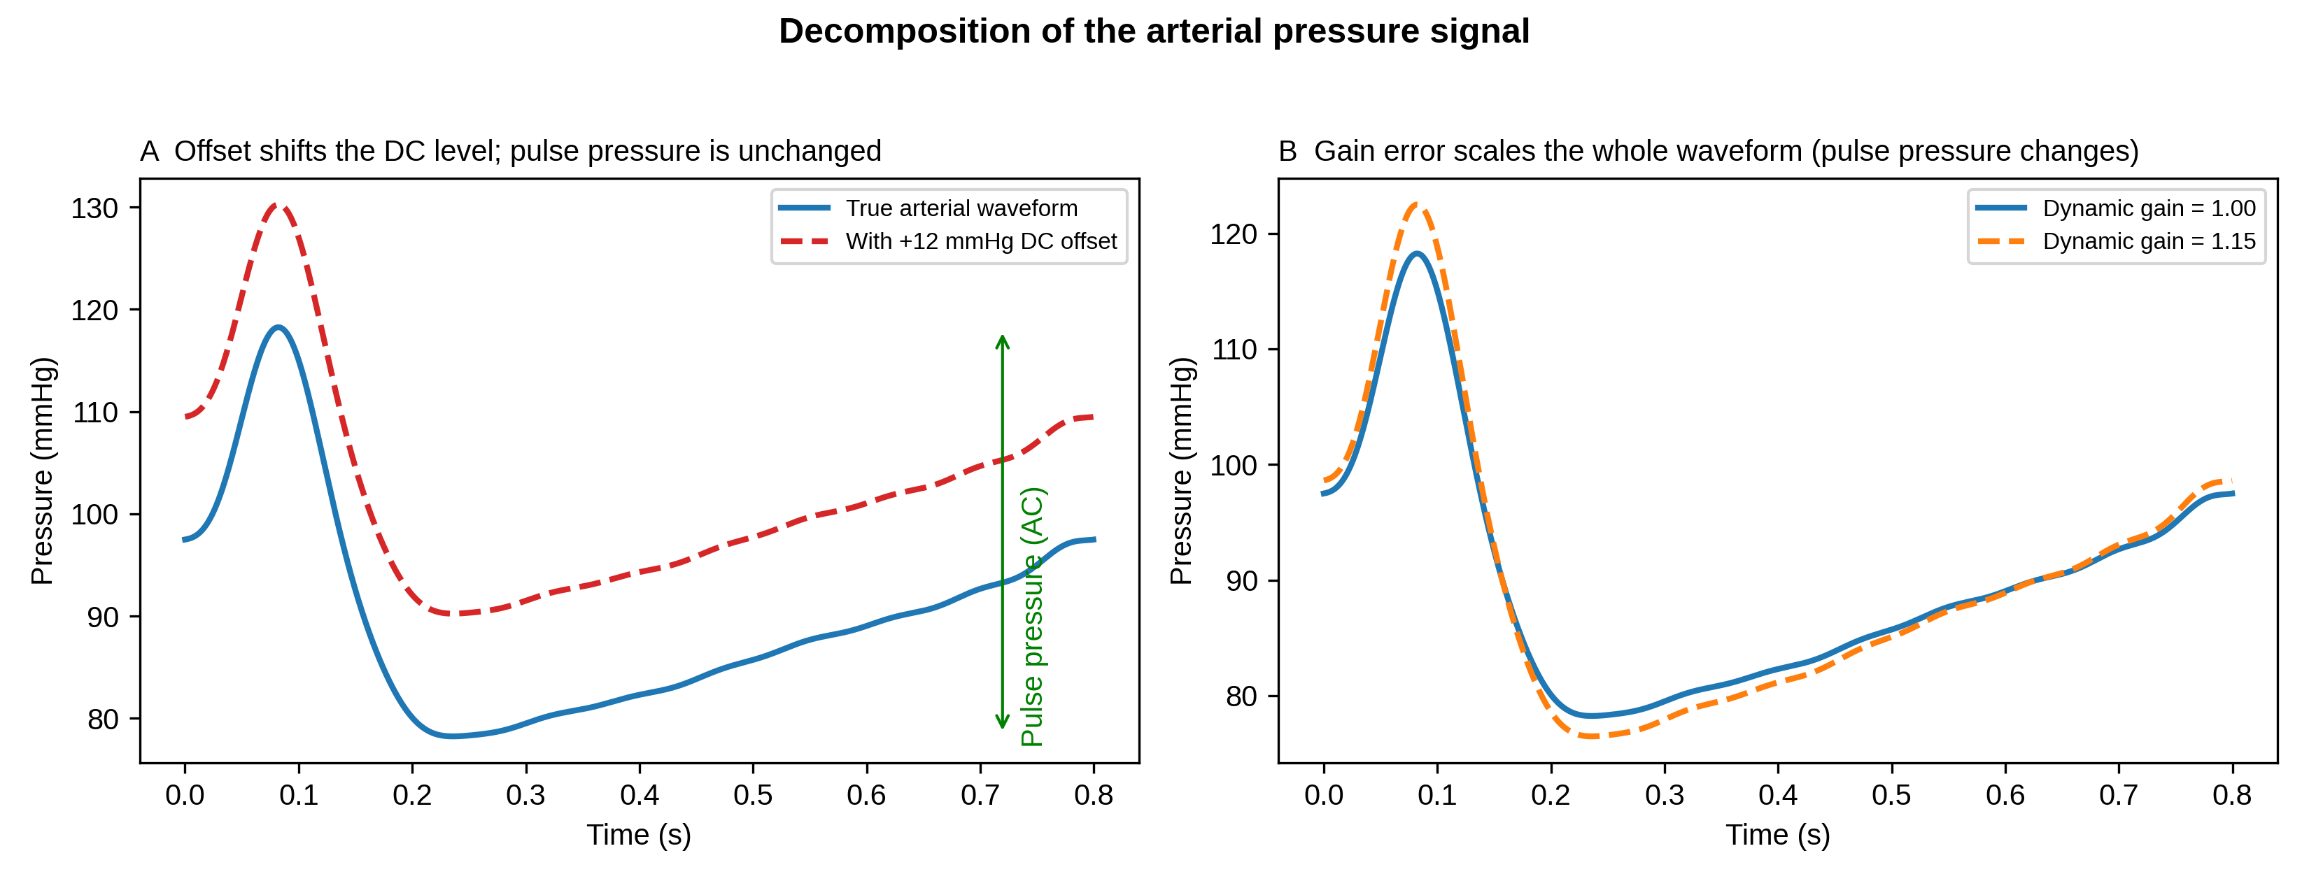
Figure 1. Signal decomposition
A DC offset shifts the arterial pressure baseline but leaves pulse pressure unchanged; a gain error scales the whole waveform and changes pulse pressure. Zeroing corrects the offset but not the gain.

Slide 2
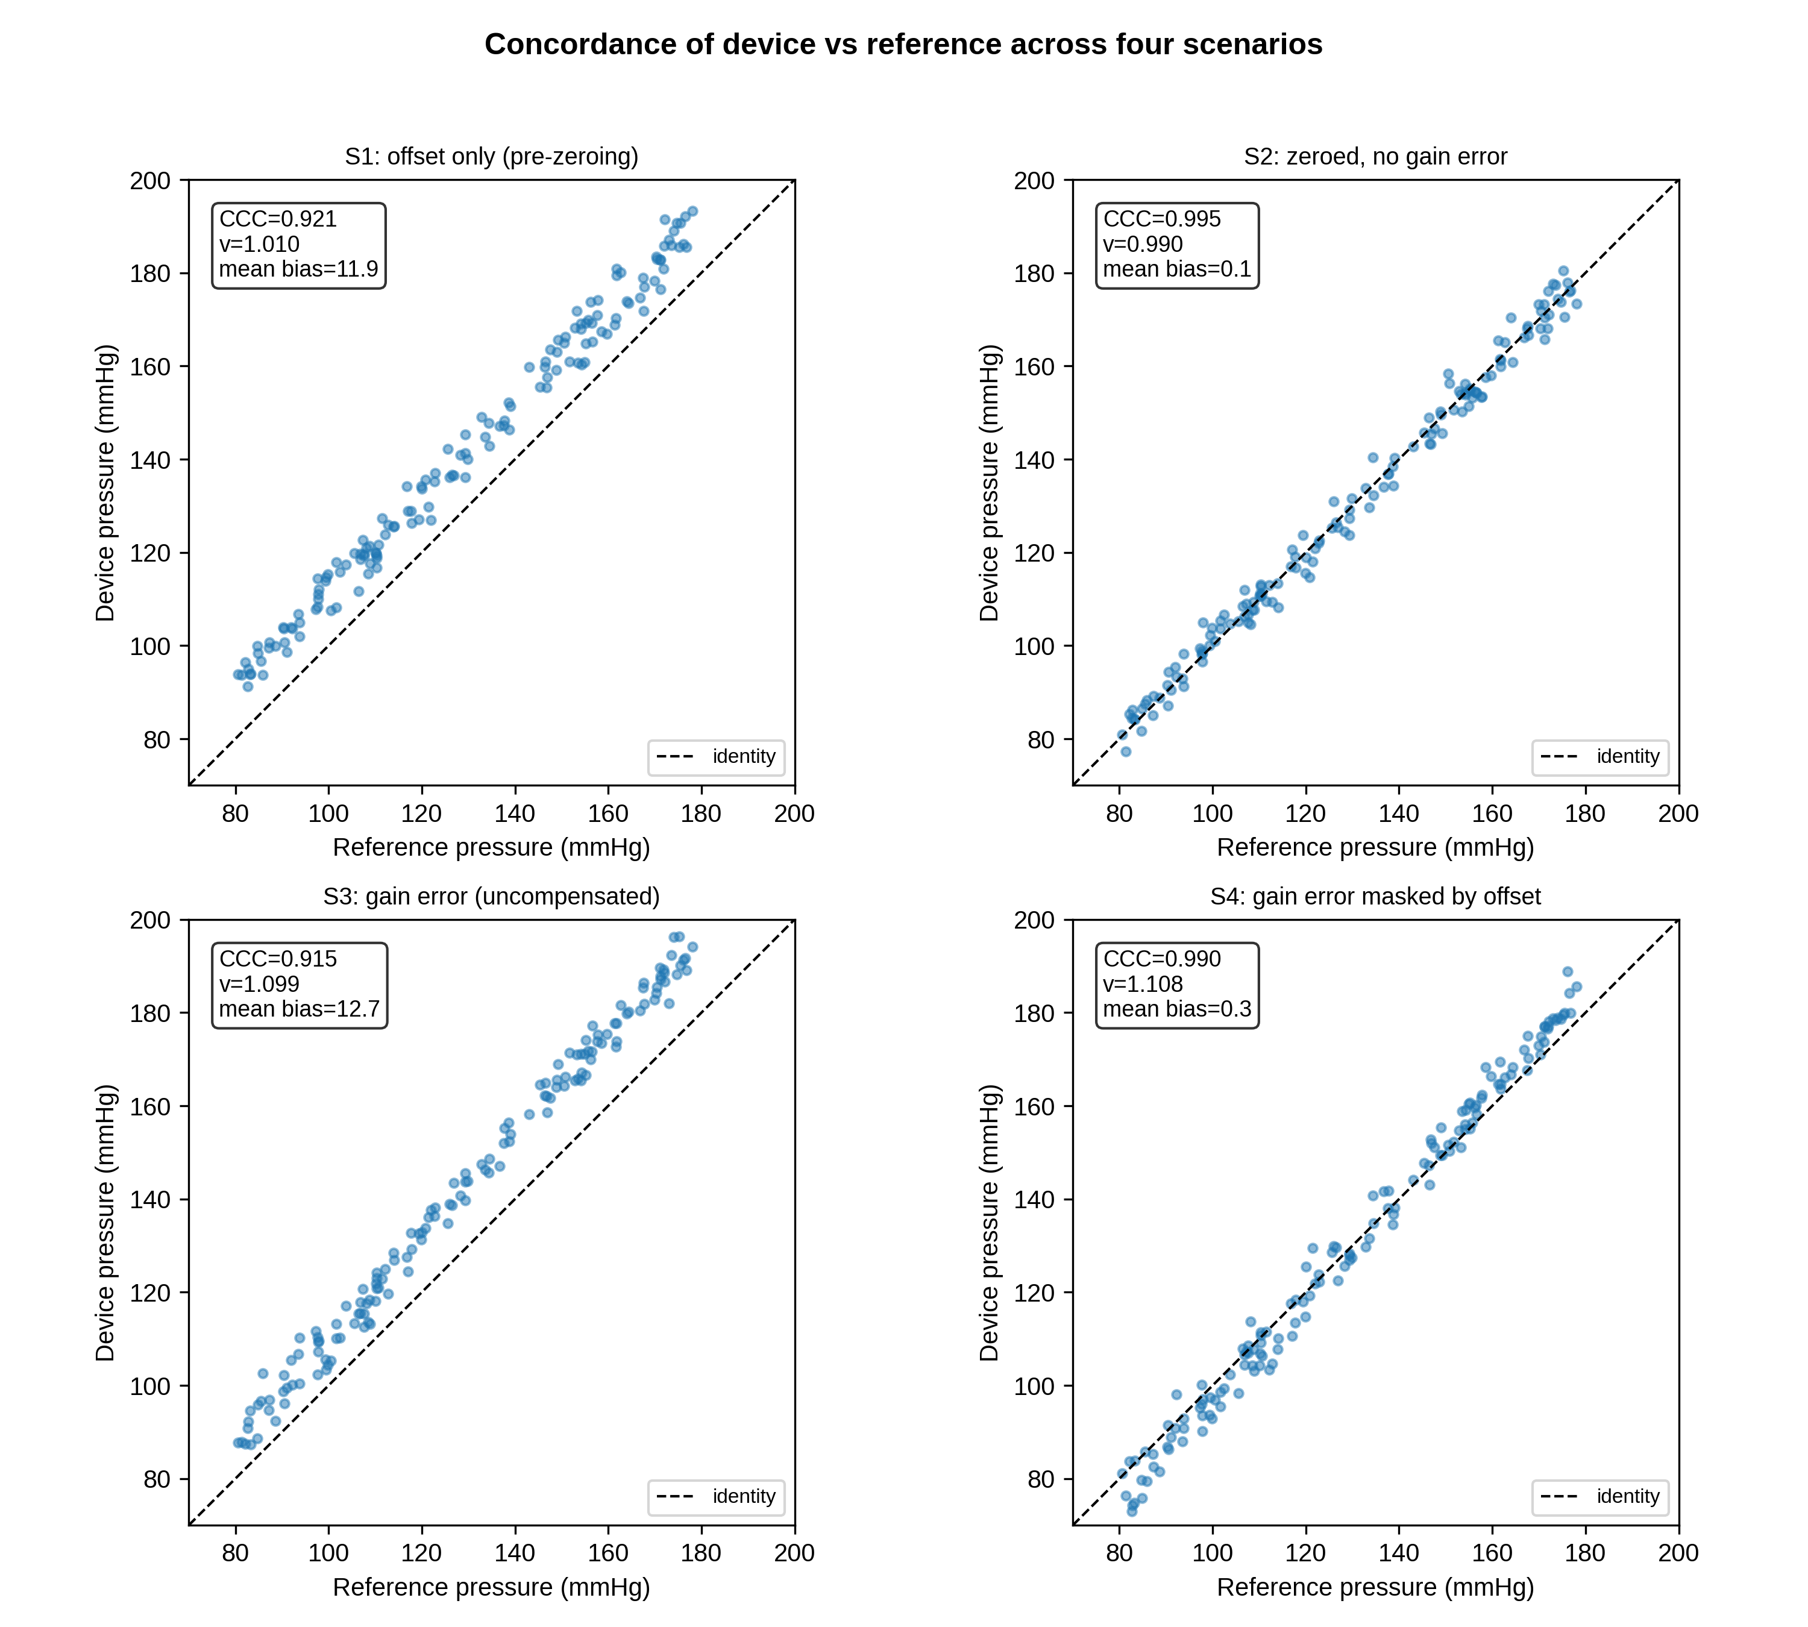
Figure 2. Concordance by scenario
Device-versus-reference concordance for the four static scenarios (dashed line = identity). Each panel shows the CCC, the CCC scale shift v, and the Bland–Altman mean bias. S4 has a near-zero mean bias despite a 10% gain error.

Slide 3
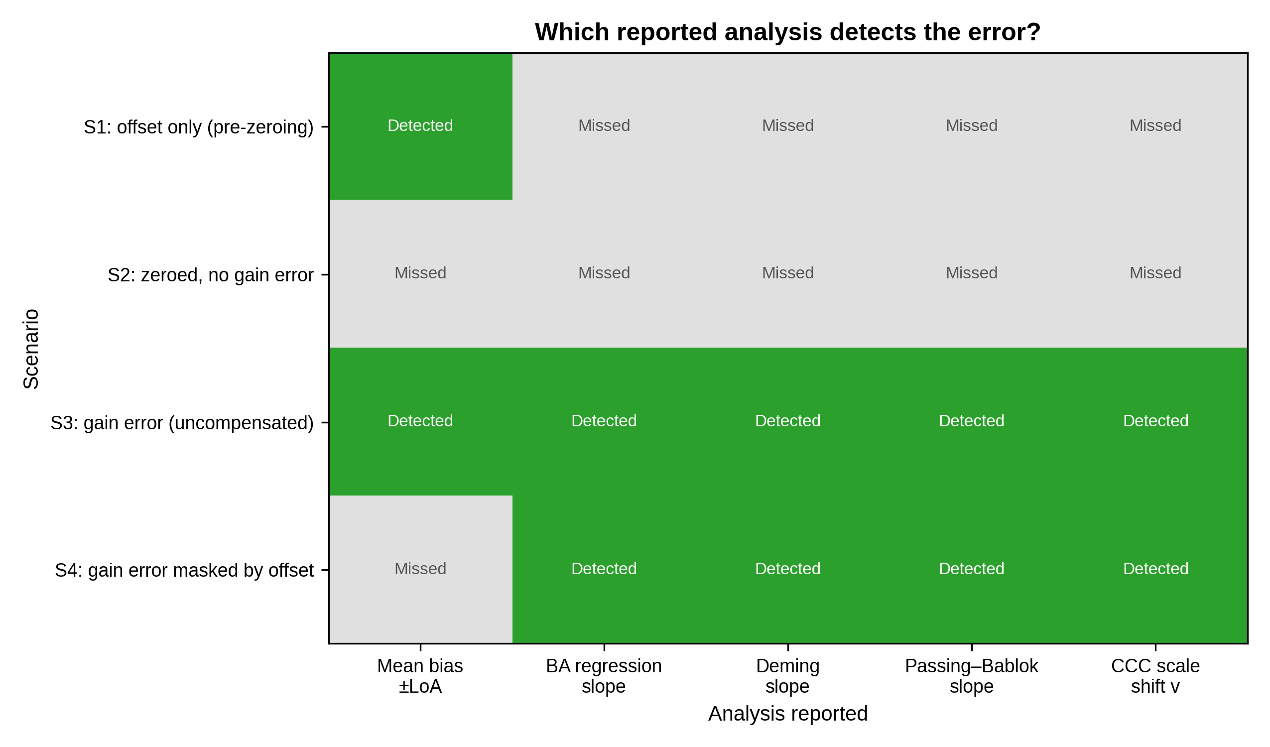
Figure 3. Detection pattern
Which reported analysis detects the error in each scenario (green = detected, grey = missed). In S4 the mean-bias summary misses the gain error that every proportional-bias–aware analysis detects.

Slide 4
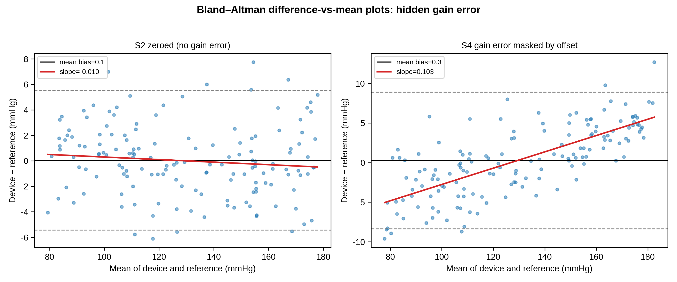
Figure 4. Bland–Altman regression
Difference-versus-mean plots. In S2 the regression slope is flat; in S4 the slope is clearly positive despite a near-zero mean bias, revealing the masked proportional (gain) error.

Slide 5
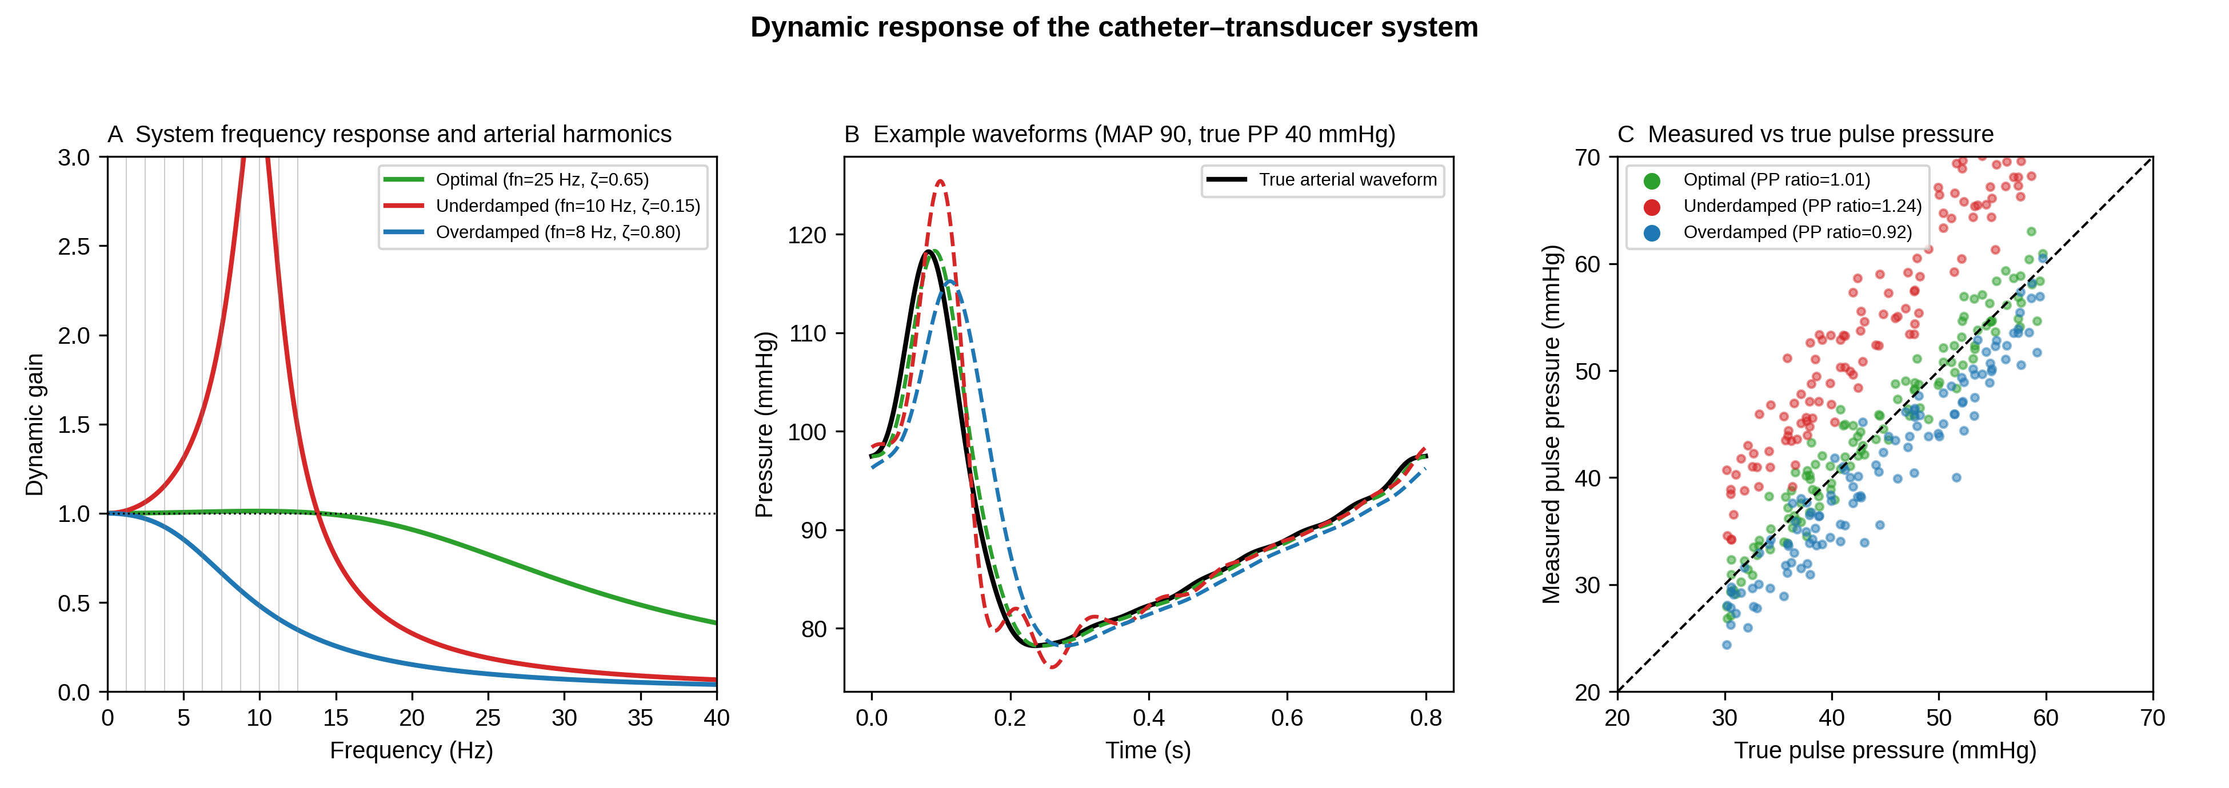
Figure 5. Dynamic response
(A) Frequency response of optimal, under-damped and over-damped systems with arterial harmonics overlaid. (B) Example waveforms. (C) Measured-versus-true pulse pressure and the mean PP ratio for each system.

Slide 6
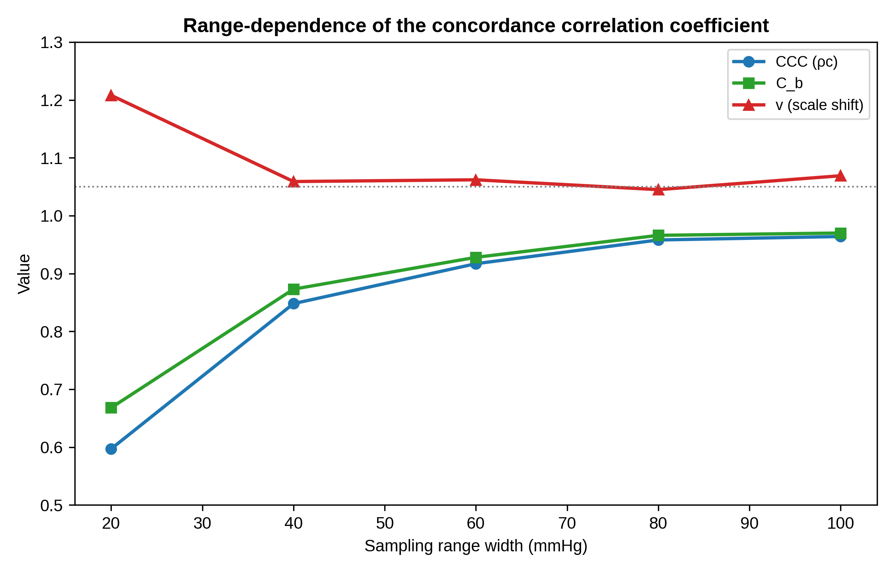
Figure 6. Range-dependence of the CCC
For one fixed device, the CCC and the bias-correction factor C_b increase as the sampled pressure range widens, while the scale shift v stays close to the true gain ratio.

Slide 7
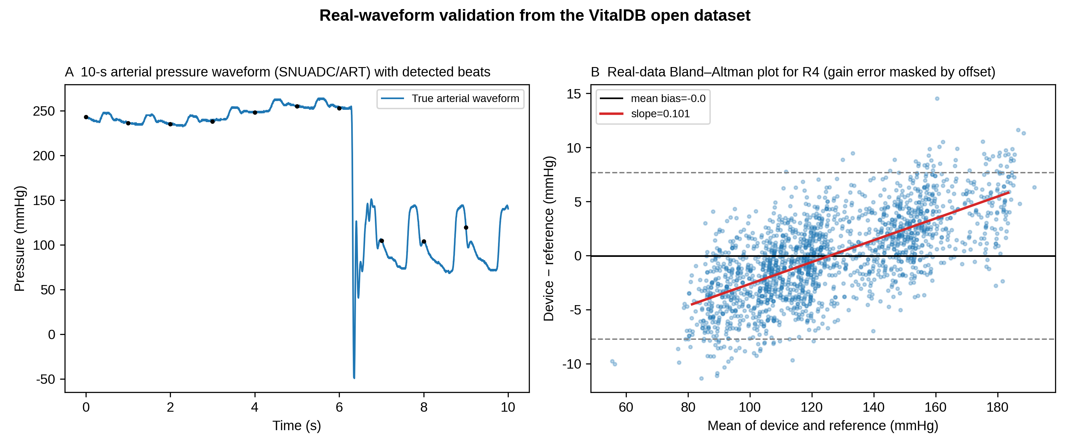
Figure 7. Real-waveform validation
(A) A 10-s segment of the SNUADC/ART waveform from the VitalDB Open Dataset with detected beats. (B) Bland–Altman plot for the gain-masked scenario (R4), showing a near-zero mean bias with a clear proportional bias.

