Slide 1
Impact of medical safety incidents on physician counts and healthcare facility numbers across 12 specialties in Japan: an interrupted time series analysis
Figures and Tables for BMJ Submission
[Author names to be added]

Slide 2
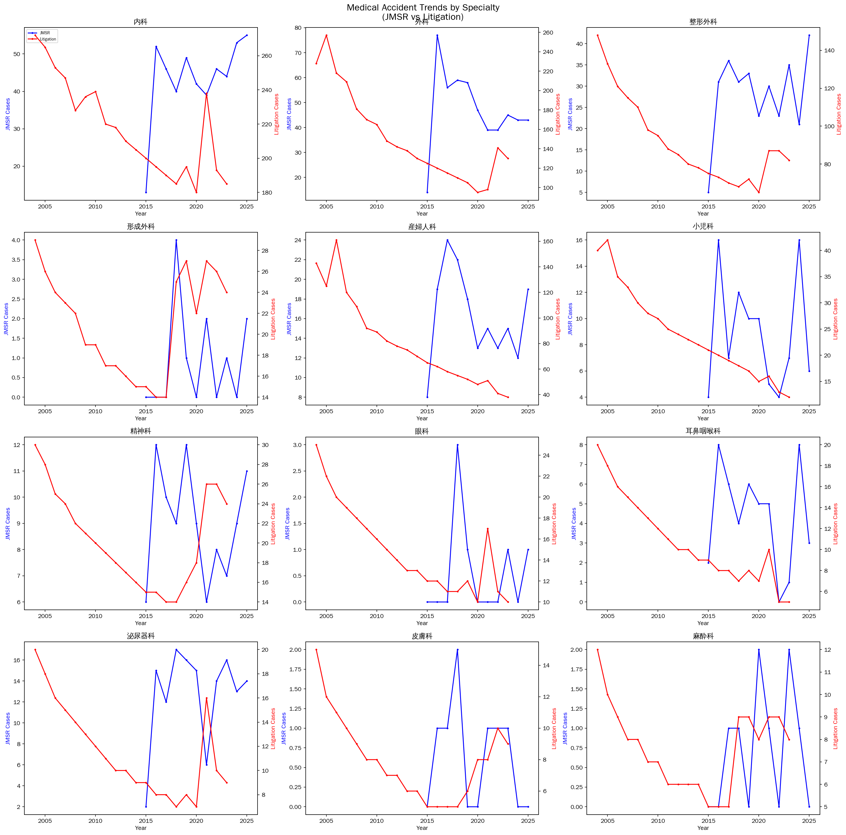
Figure 1. Trends in medical safety incident counts by specialty and definition
Panel A: Mandatory reports to the Japan Medical Safety Research Organisation (JMSR, 2015-2025). Panel B: Medical litigation statistics from the Supreme Court of Japan (2004-2023). Top 5 specialties by incident count highlighted.

Slide 3
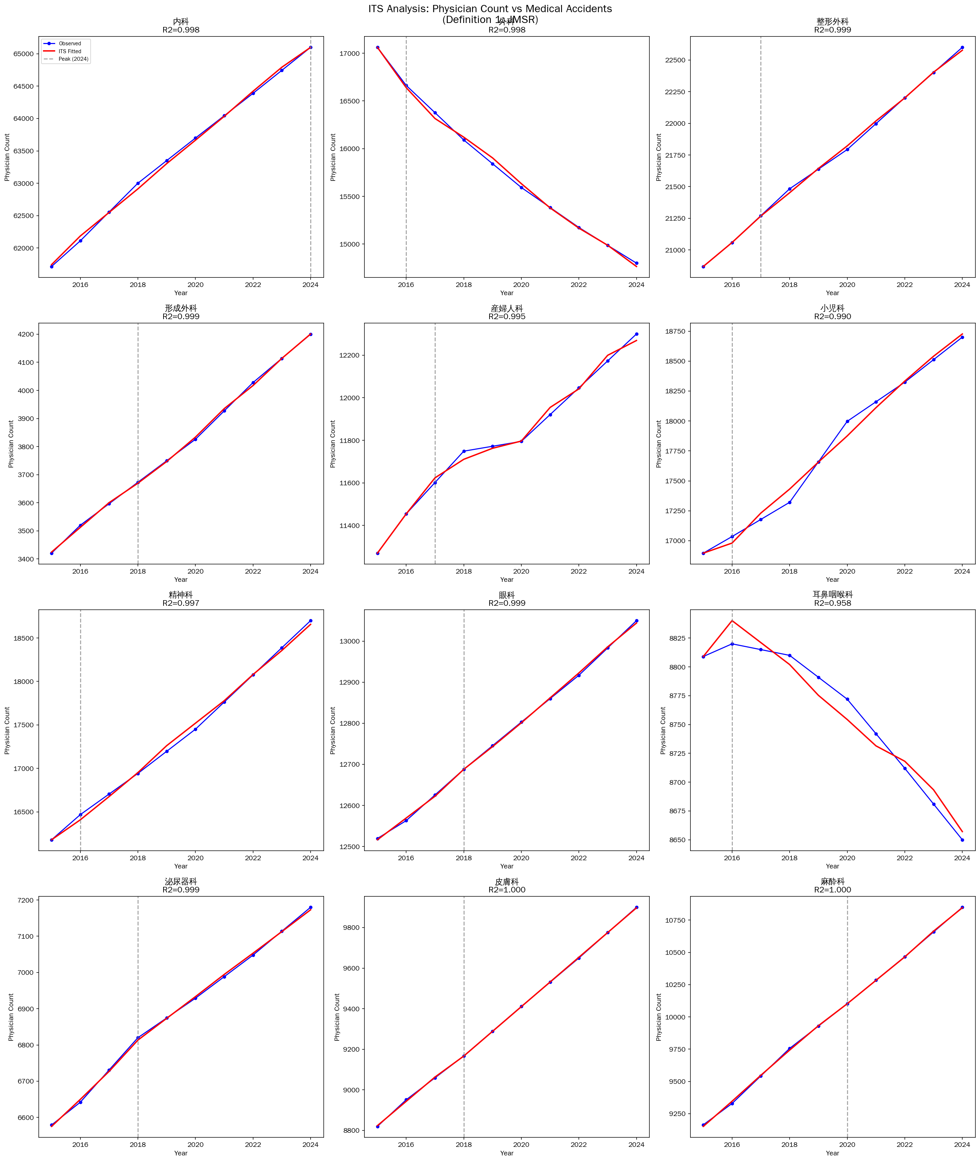
Figure 2. Interrupted time series: physician counts vs JMSR reports
Segmented regression fit lines for 12 core specialties. Vertical dashed lines indicate the intervention year (peak accident reporting year for each specialty).

Slide 4
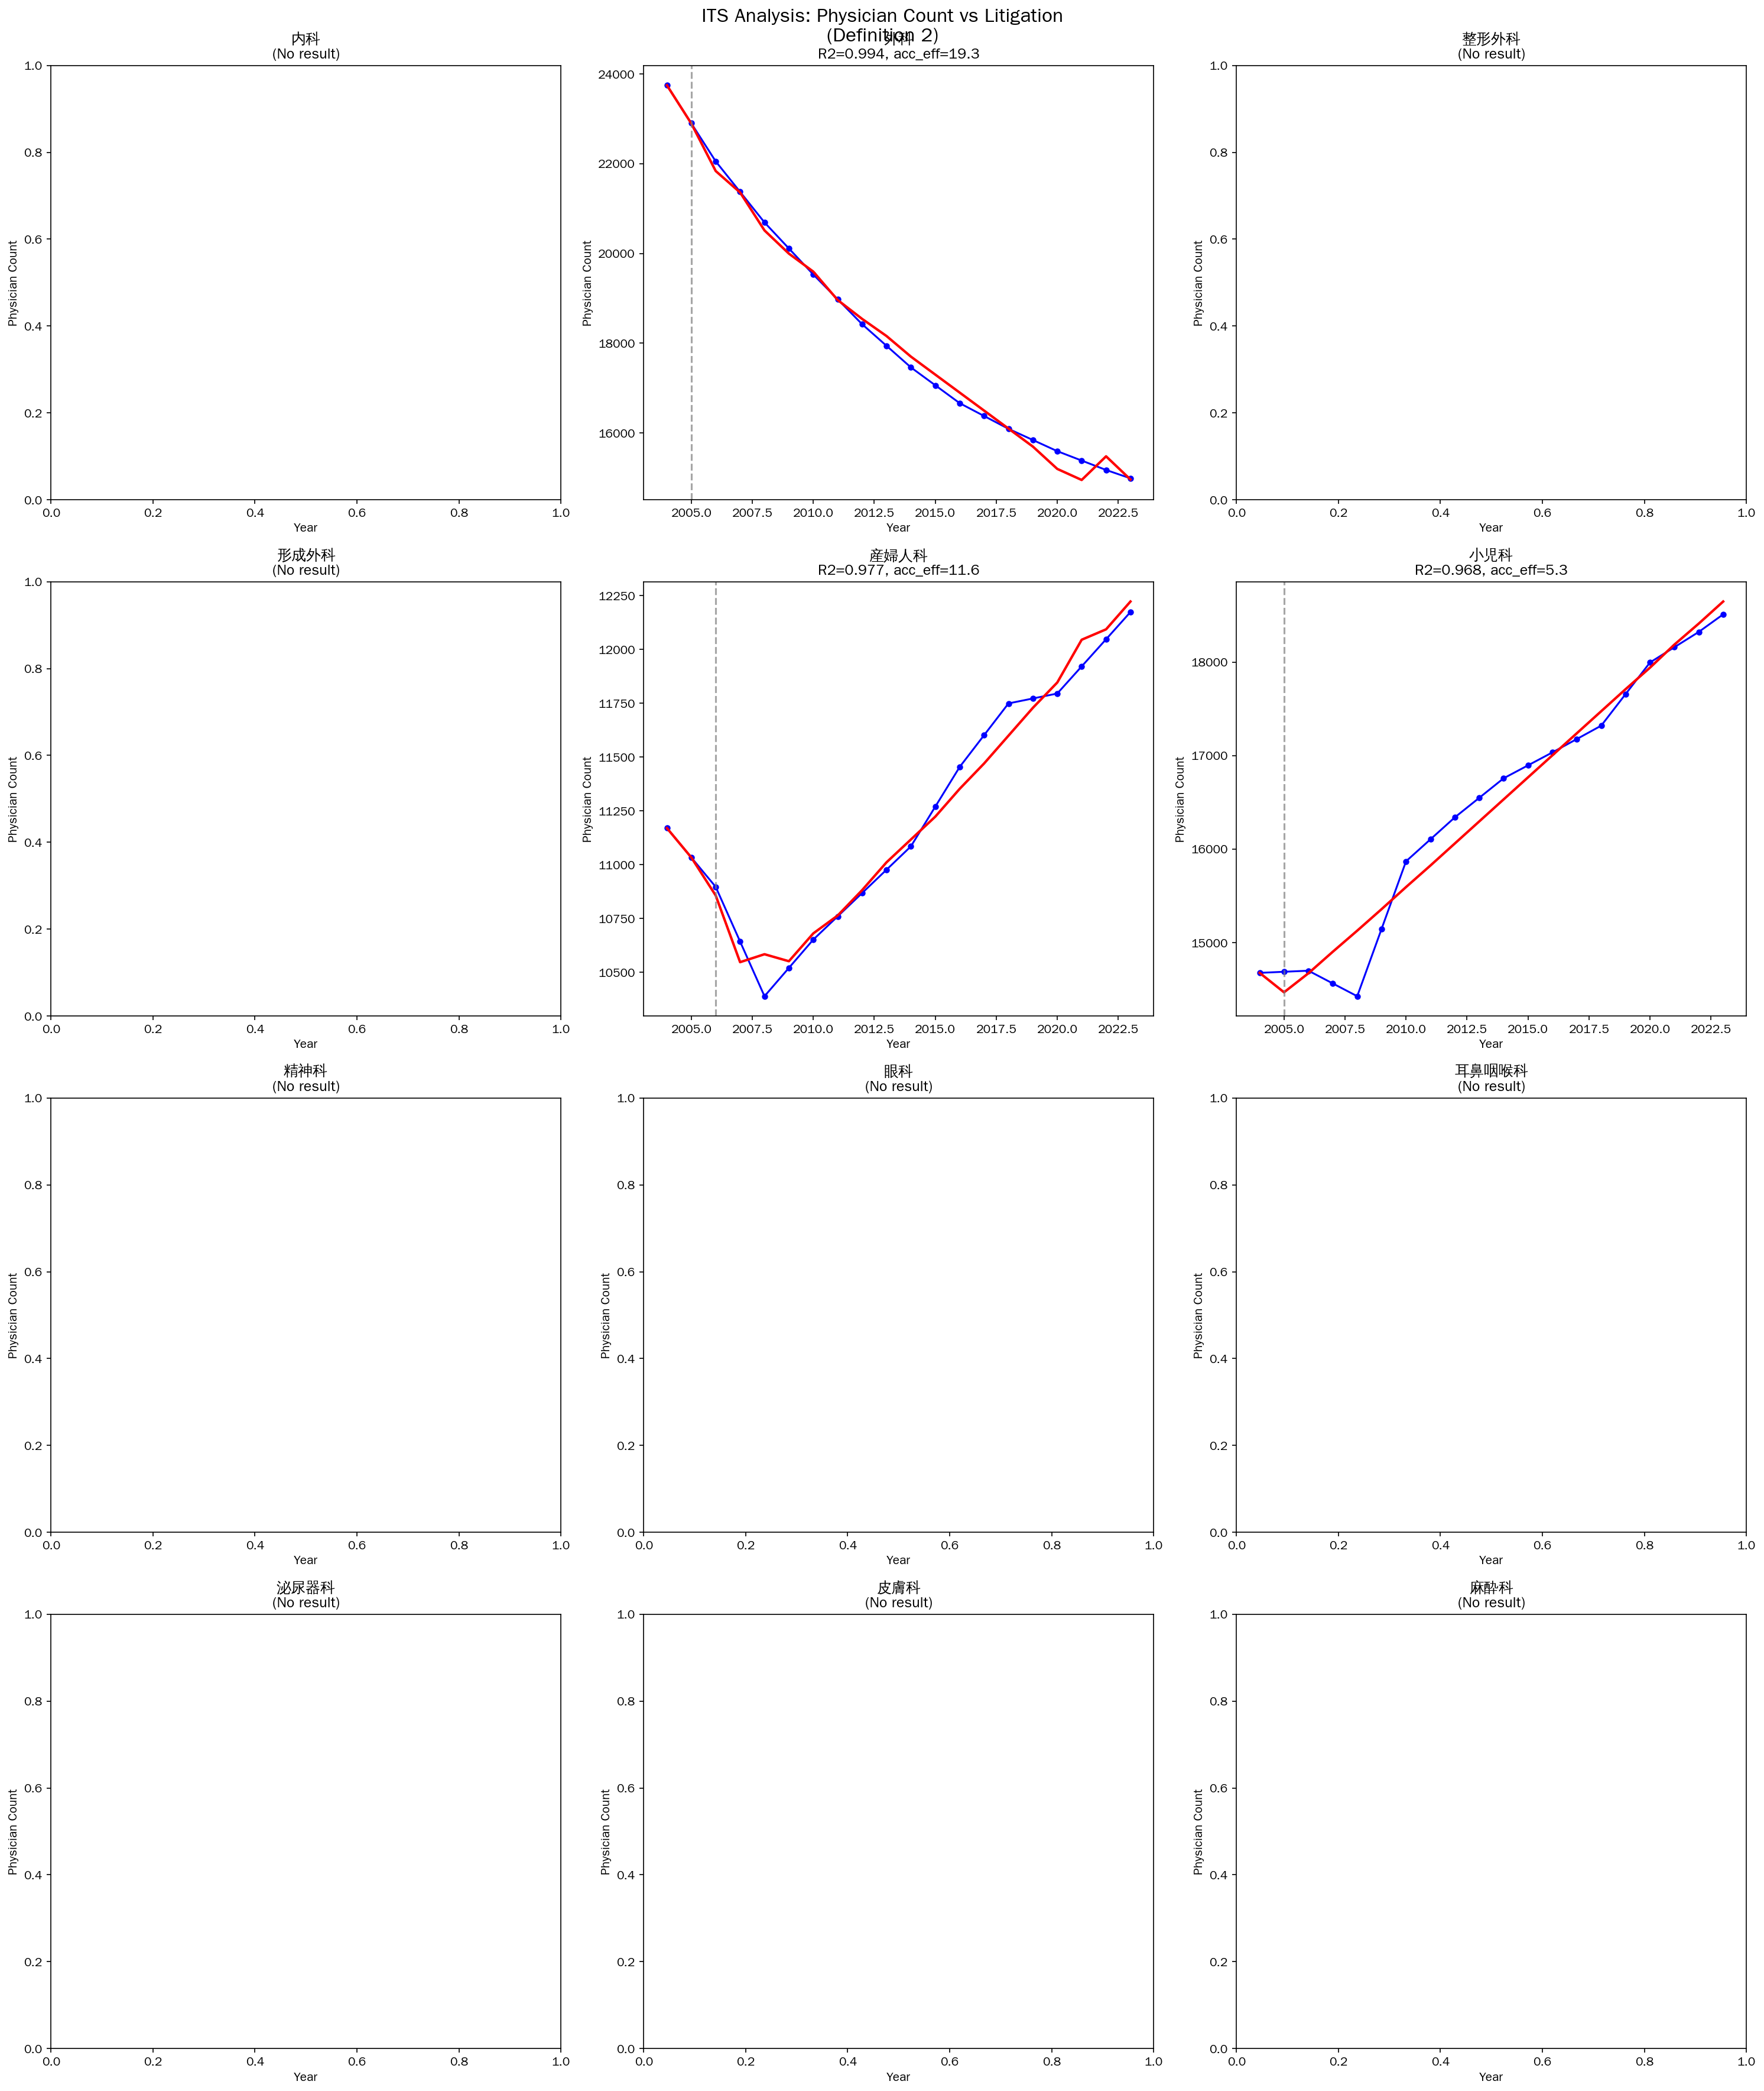
Figure 3. Interrupted time series: physician counts vs litigation statistics
Segmented regression fit lines for 12 core specialties using Supreme Court litigation data (Definition 2). Vertical dashed lines indicate the intervention year.

Slide 5
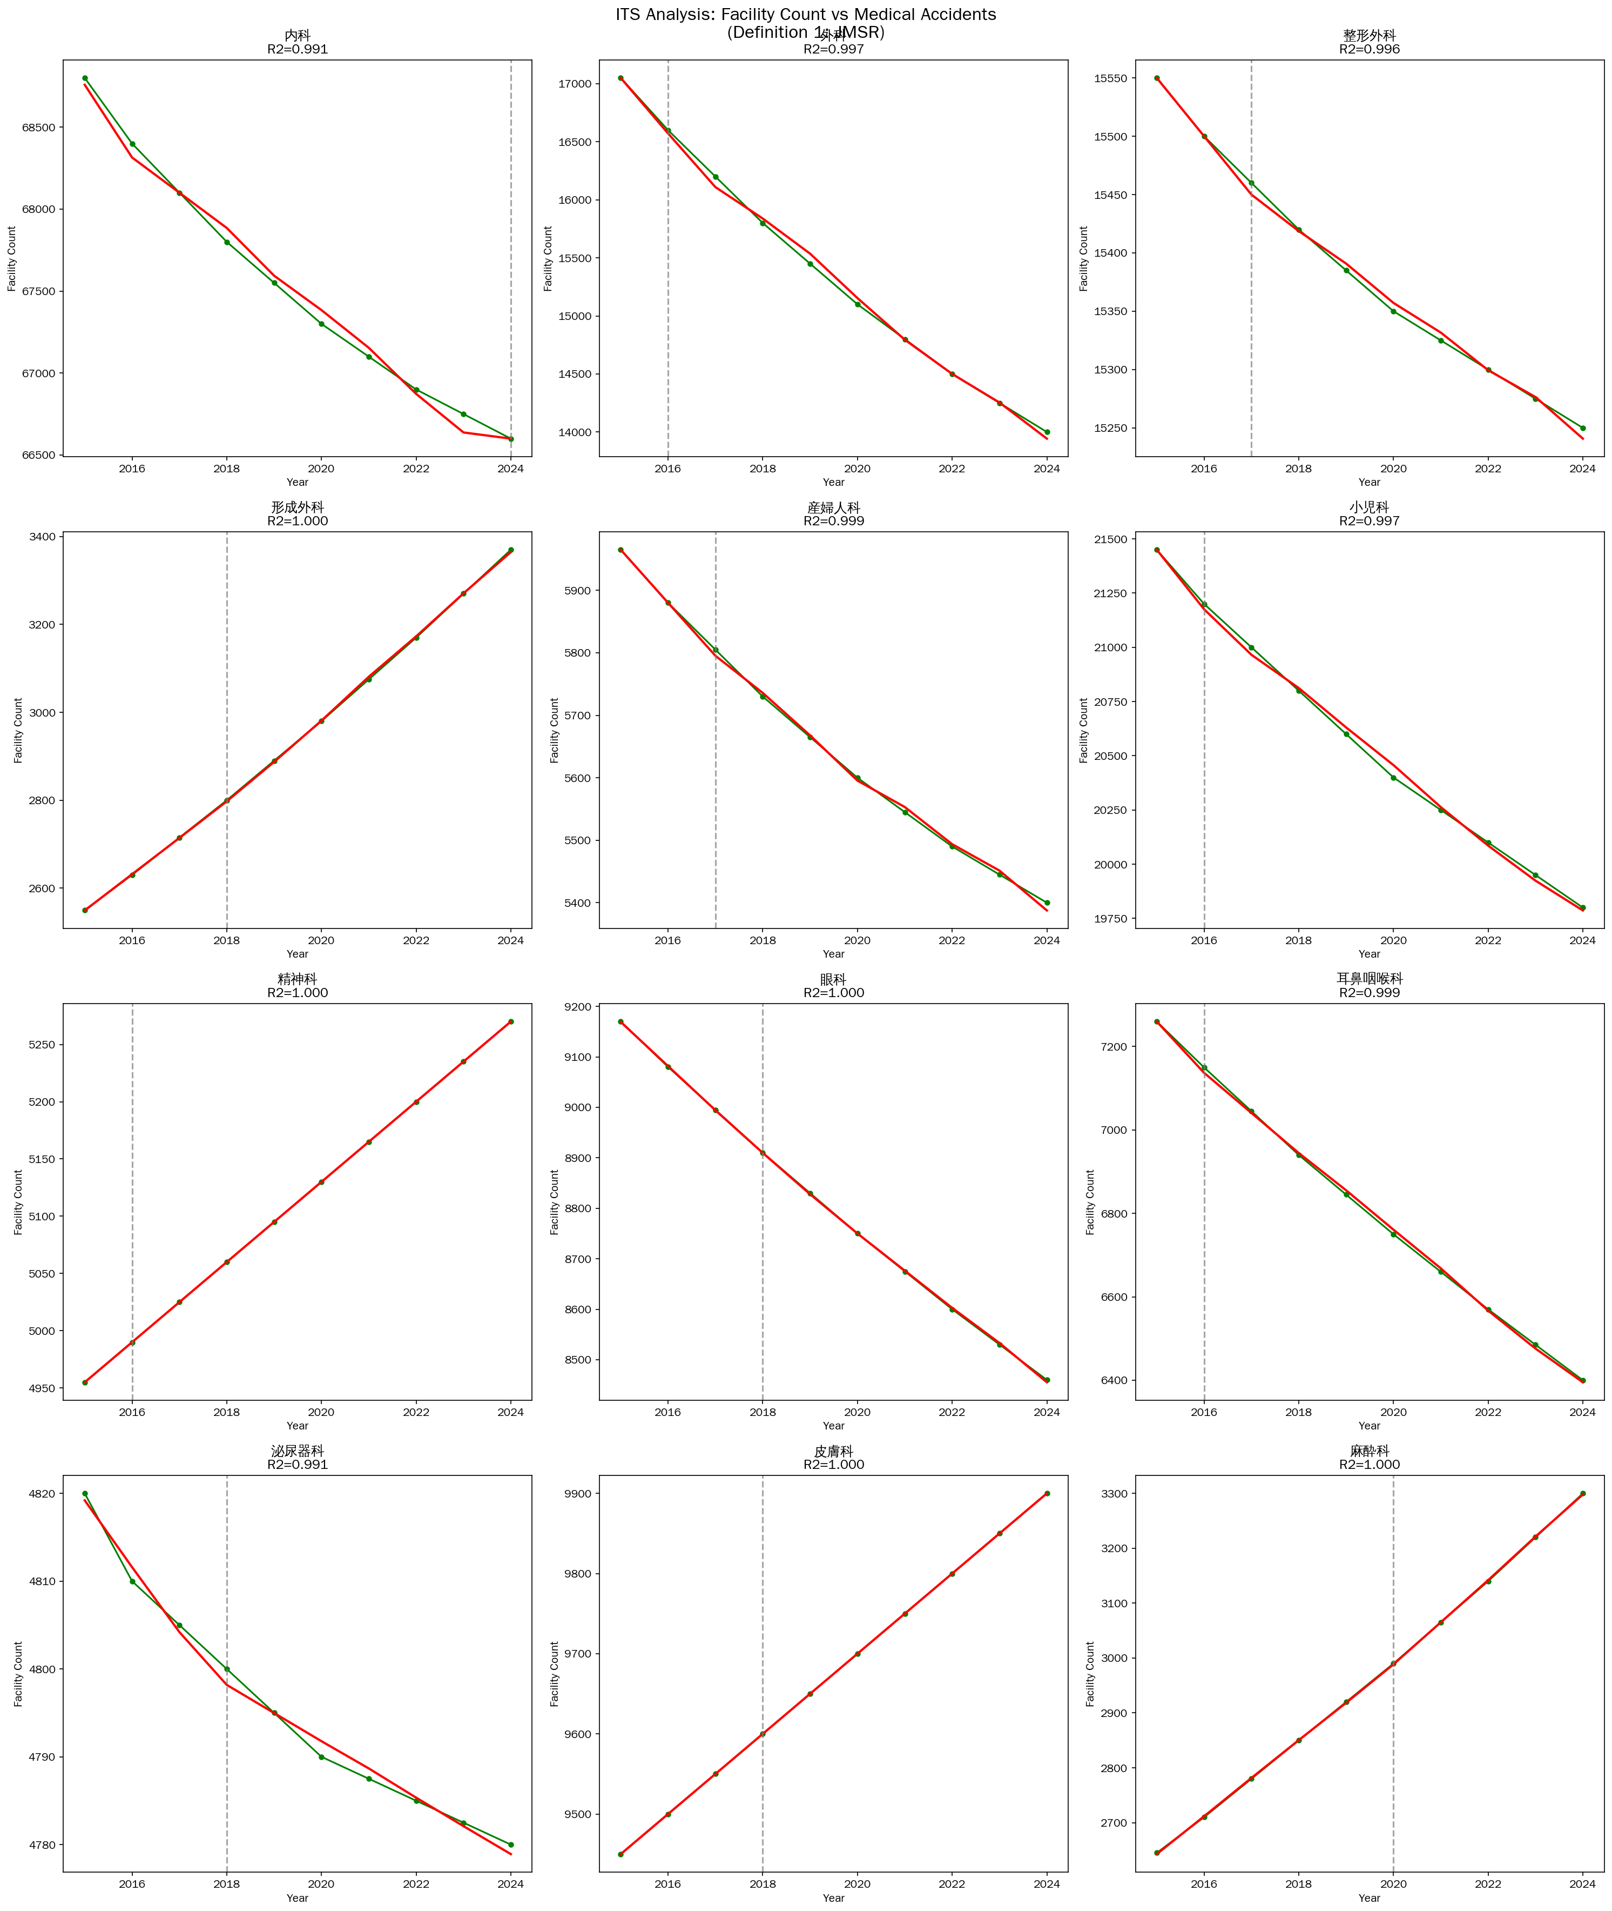
Figure 4. Interrupted time series: facility counts vs JMSR reports
Segmented regression fit lines for healthcare facility counts across 12 core specialties. Vertical dashed lines indicate the intervention year.

Slide 6
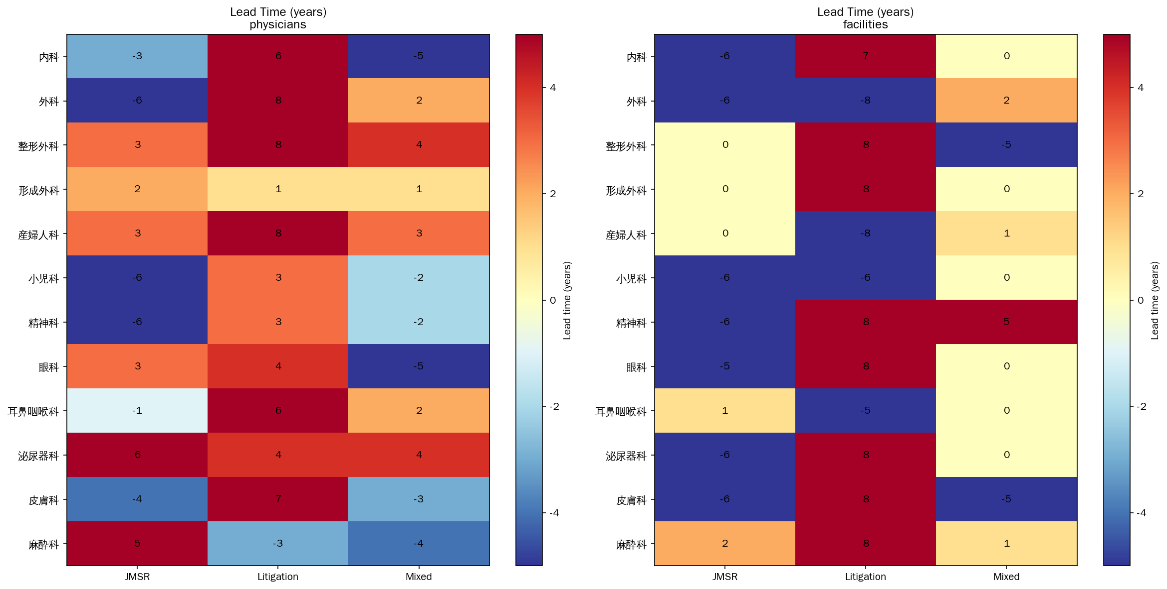
Figure 5. Heatmap of estimated lead times (years) from cross-correlation analysis
Rows: specialties. Columns: accident definition * outcome combinations. Darker colour indicates stronger inverse correlation. Positive lag values indicate accident changes precede outcome changes.

Slide 7
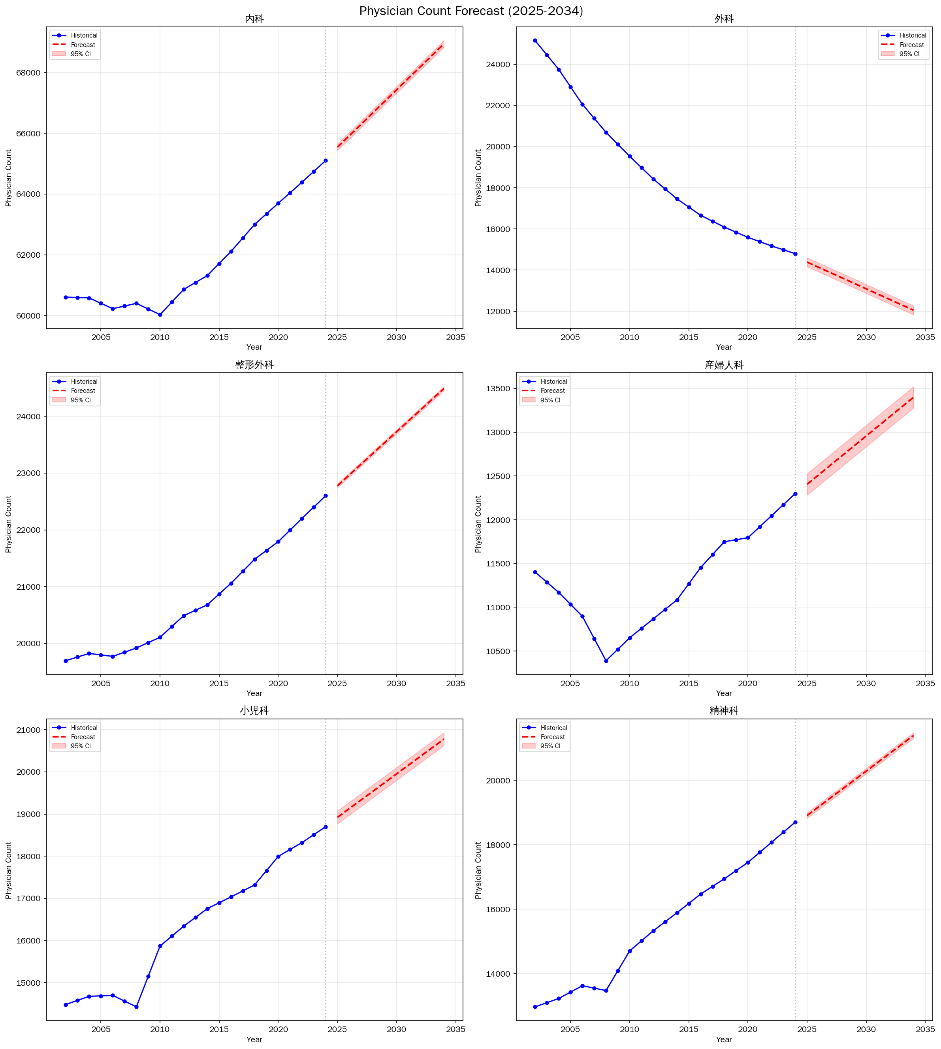
Figure 6. Projected physician counts by specialty (2025-2034)
Linear trend extrapolation based on the most recent 10 years of data, with 95% prediction intervals.

Slide 8
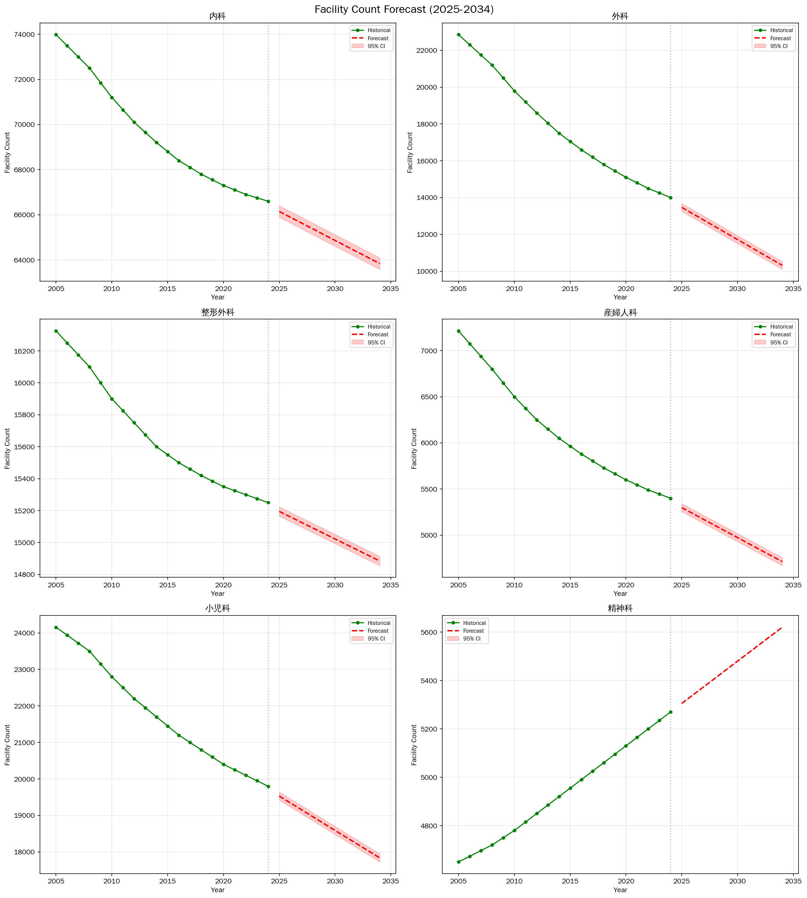
Figure 7. Projected facility counts by specialty (2025-2034)
Linear trend extrapolation based on the most recent 10 years of data, with 95% prediction intervals.

Slide 9
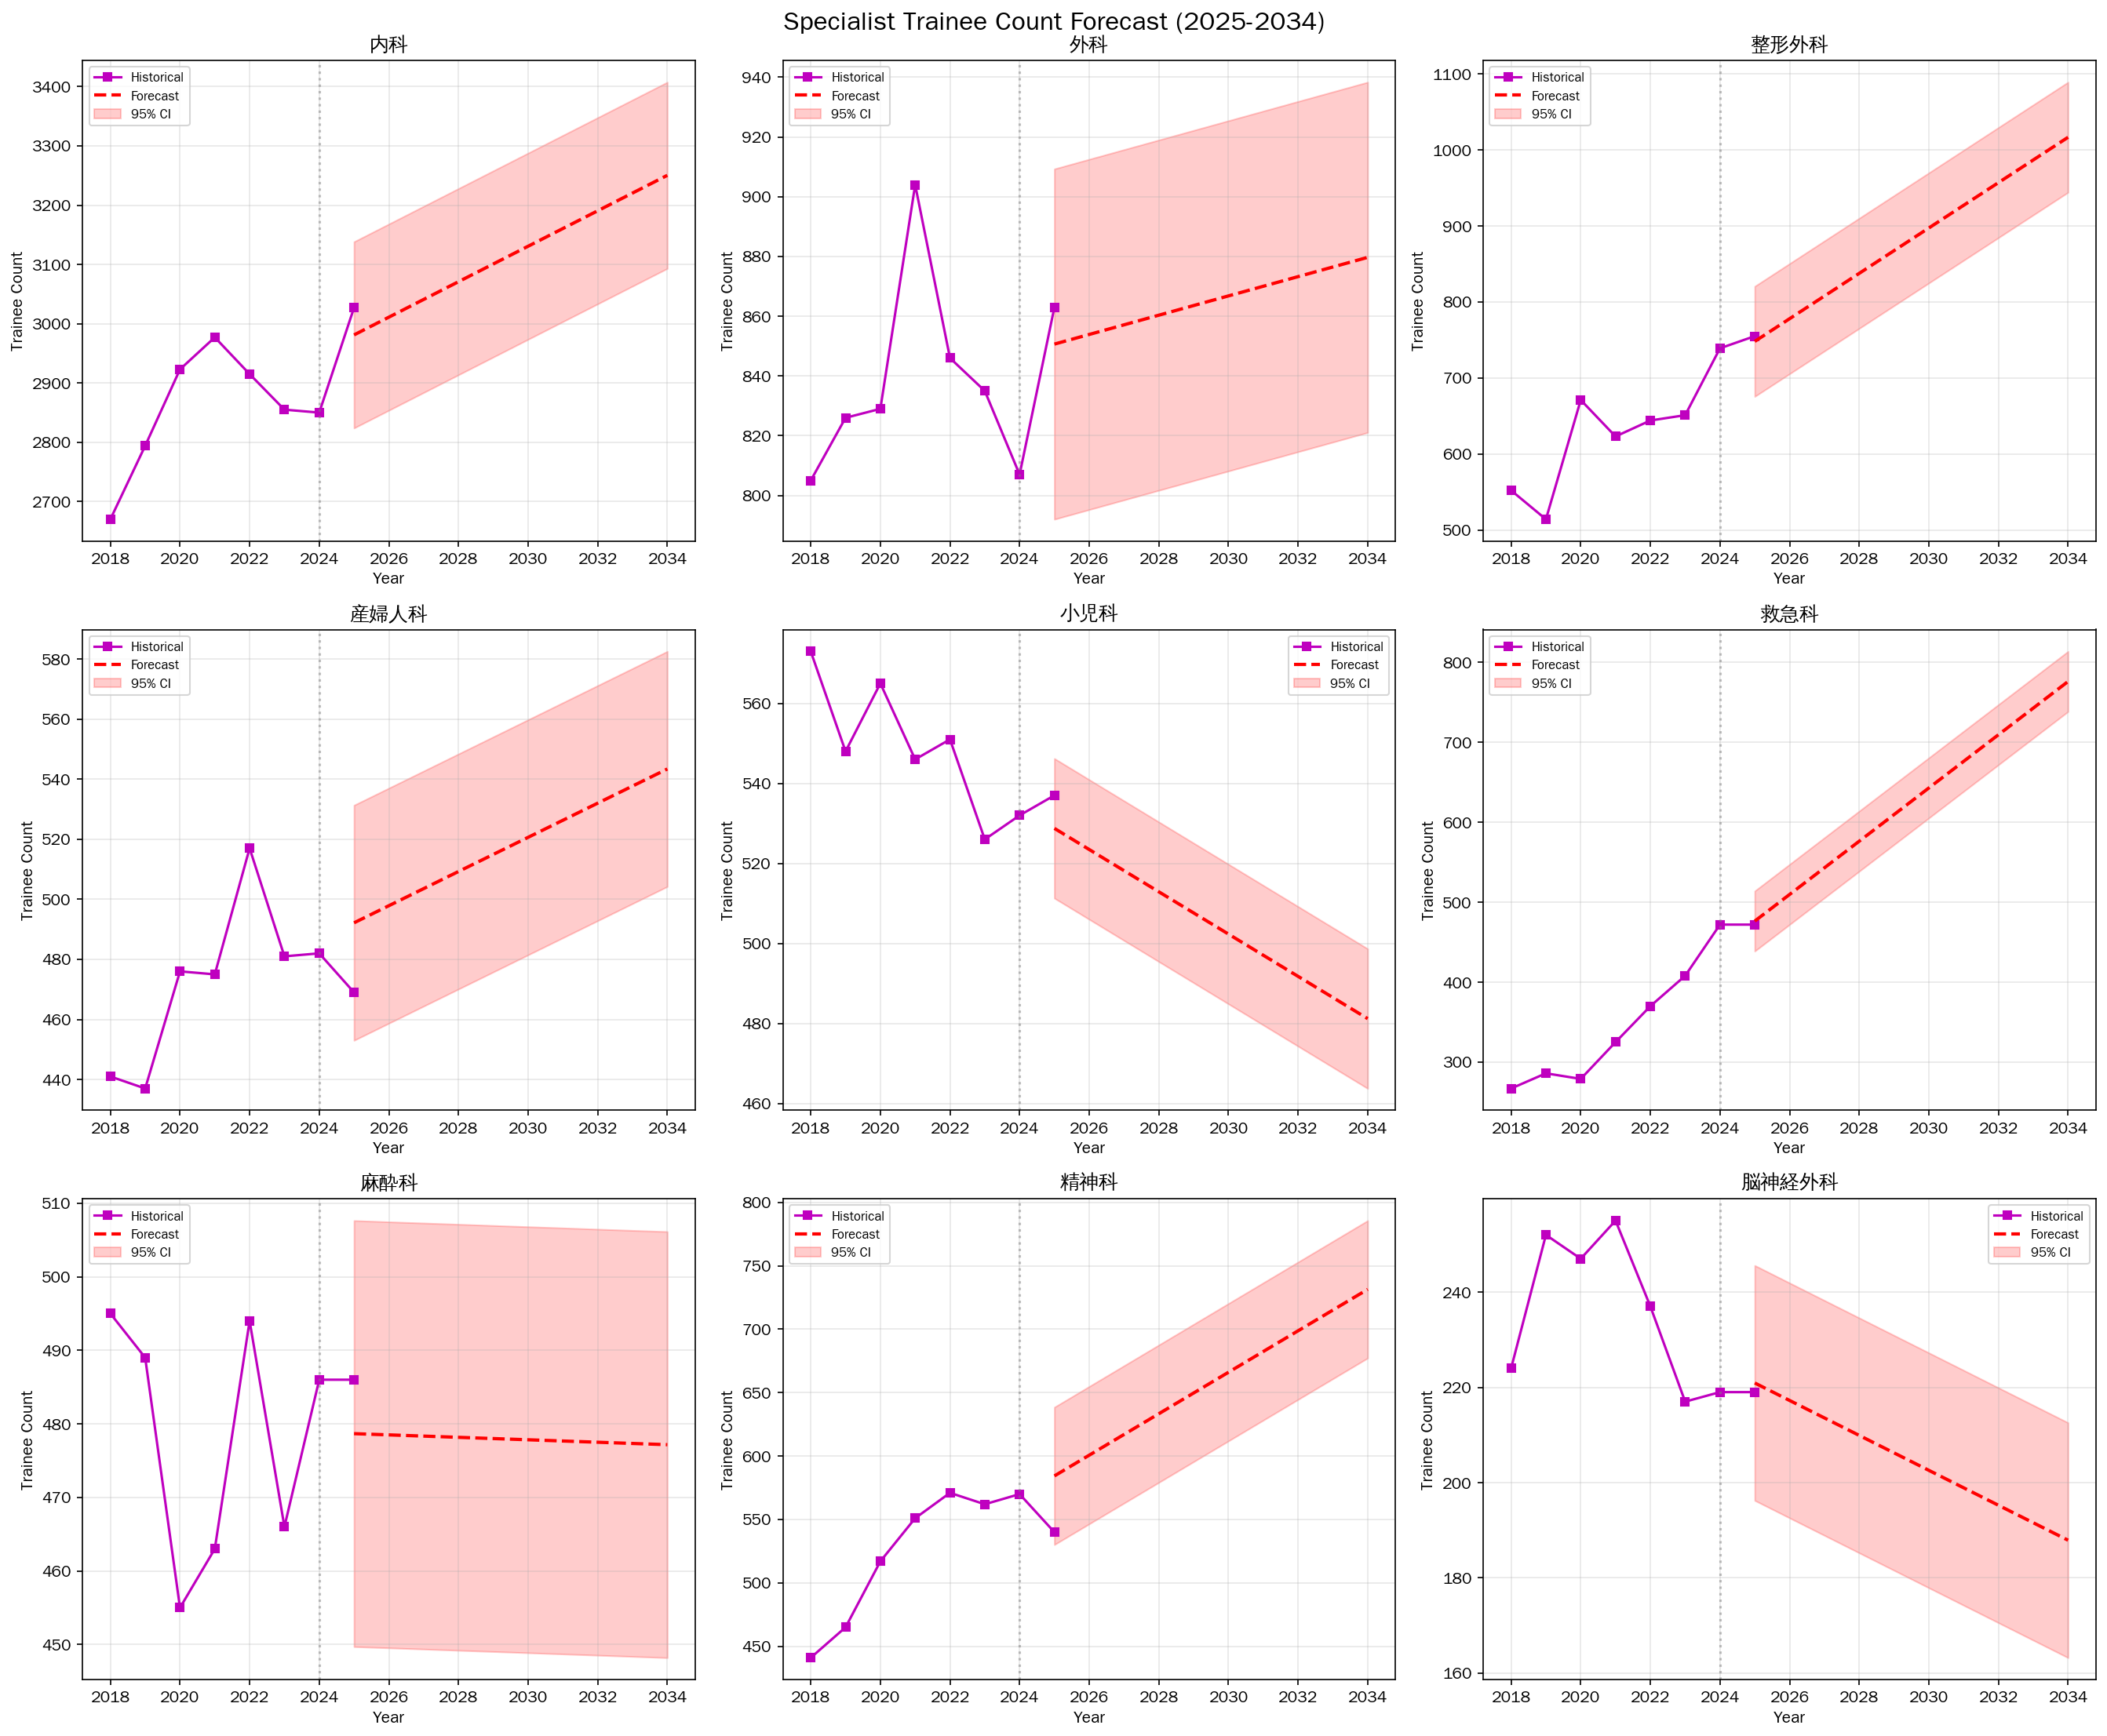
Figure 8. Projected trainee registrations by specialty (2025-2034)
Linear trend extrapolation based on available data (2018-2025), with 95% prediction intervals.

Slide 10
Table 1. Strong inverse cross-correlations (|r| > 0.9) after linear detrending
Specialty | Definition | Outcome | Lag (years) | r
Obstetrics/Gynaecology | JMSR | Physicians | +3 | -0.946
Obstetrics/Gynaecology | Mixed | Physicians | +3 | -0.947
Urology | JMSR | Physicians | +6 | -0.945
Anaesthesiology | Mixed | Physicians | -4 | -0.959
Otorhinolaryngology | Litigation | Physicians | +6 | -0.973
Dermatology | Litigation | Physicians | +7 | -0.988
Orthopaedic Surgery | JMSR (trainees) | Trainees | +4 | -0.909
Otorhinolaryngology | JMSR (trainees) | Trainees | -3 | -0.941
Psychiatry | Litigation | Facilities | +8 | -0.981
Dermatology | Litigation | Facilities | +8 | -0.969
Cross-correlation of linearly detrended accident and outcome series at lags -8 to +8 years. Positive lag = accident change precedes outcome change.

Slide 11
Table 2. Statistically significant (P<0.05) accident effect coefficients from ITS segmented regression
Specialty | Definition | Outcome | R² | Accident effect | P value
General Surgery | Litigation | Physicians | 0.994 | +19.3/case | <0.001
Obstetrics/Gynaecology | JMSR | Physicians | 0.995 | +17.7/report | 0.021
Obstetrics/Gynaecology | Litigation | Physicians | 0.977 | +11.6/case | <0.001
Obstetrics/Gynaecology | JMSR | Facilities | 0.999 | +4.3/report | 0.042
Obstetrics/Gynaecology | Litigation | Facilities | 0.990 | +5.5/case | <0.001
Ophthalmology | JMSR | Facilities | 1.000 | +4.1/report | 0.039
Plastic Surgery | Litigation | Facilities | 0.999 | +4.1/case | 0.005
Note: Positive coefficients reflect shared secular trends between accident counts and outcomes. See Discussion for interpretation.

Slide 12
Table 3. Summary of lead time and window period estimates by outcome
Outcome | Mean lead time (yr) | Median lead time (yr) | Mean window (yr) | Median window (yr)
Physician counts | 1.3 | 2.5 | 4.1 | 4.0
Facility counts | -0.1 | 0.0 | 4.2 | 5.0
Lead time: delay from accident change to outcome change. Window period: duration of effect estimated by AIC-based model selection.

Slide 13
Table 4. Projected annual workforce changes by specialty (2025-2034)
Specialty | Physicians/yr | Facilities/yr | Trainees/yr
General Surgery | -260 | -350 | +3
Obstetrics/Gynaecology | +111 | -65 | +6
Internal Medicine | +378 | -256 | +30
Paediatrics | +206 | -188 | -5
Orthopaedic Surgery | +190 | -34 | +30
Anaesthesiology | +186 | +72 | 0
Otorhinolaryngology | -16 | -97 | -5
Emergency Medicine | — | — | +33
General Practice | — | — | +20
Linear trend extrapolation from the most recent 10 years of available data.

